Slide 1

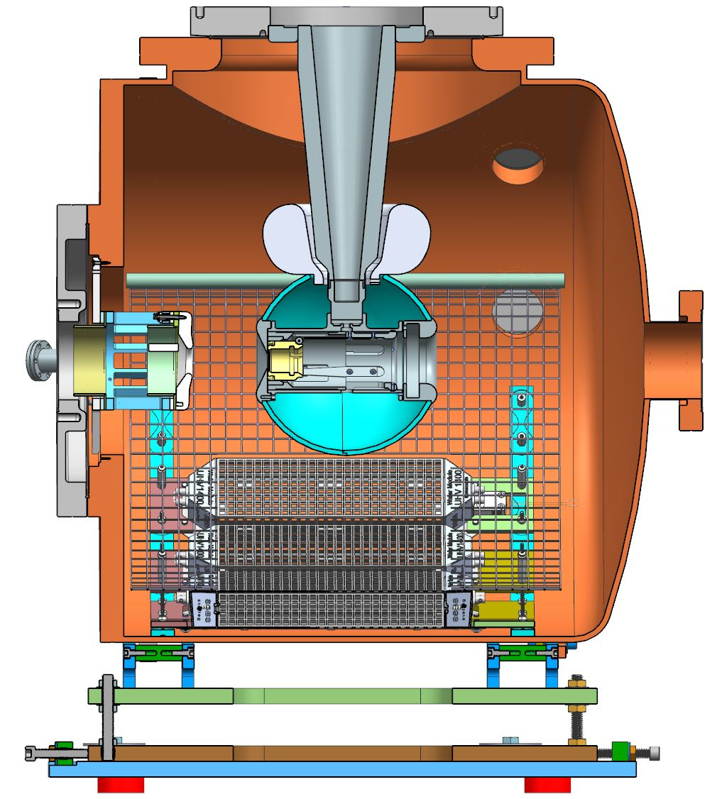
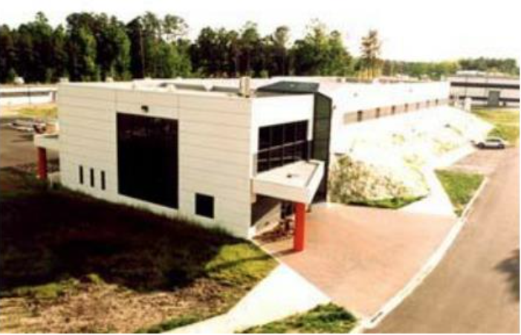
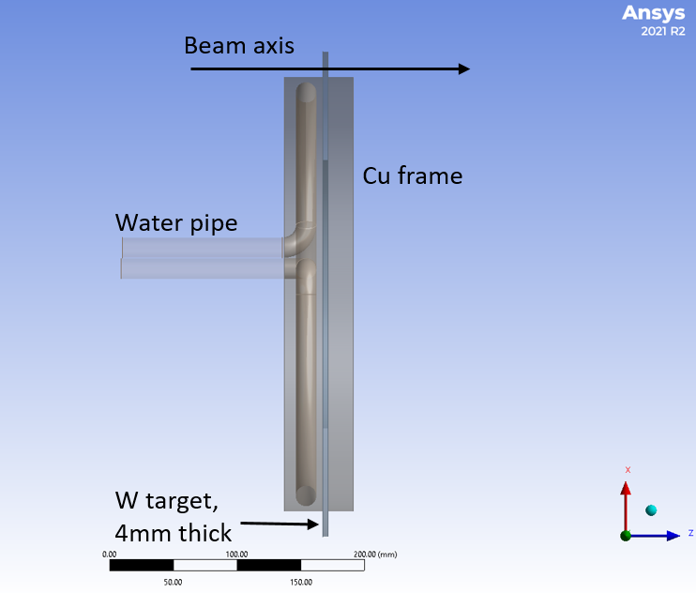
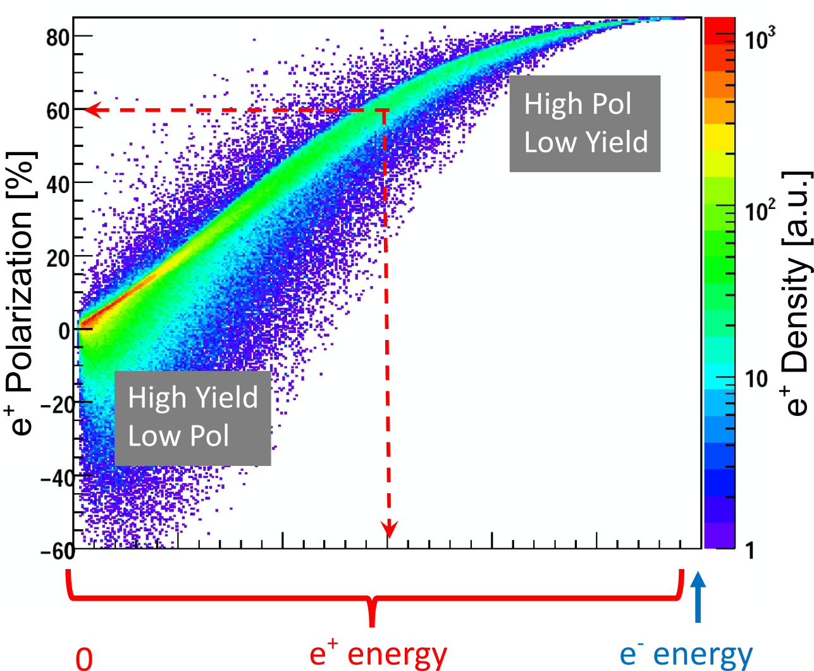
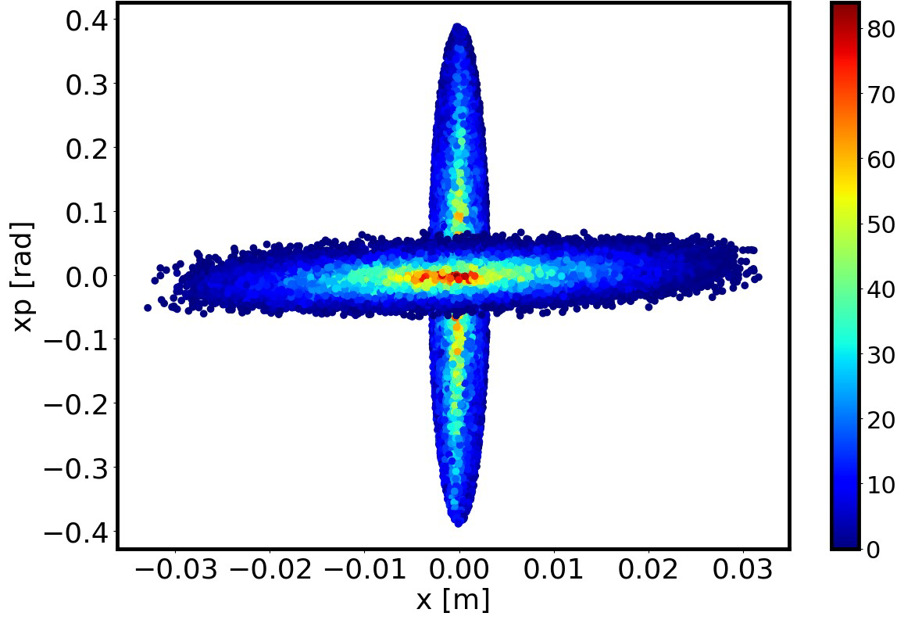
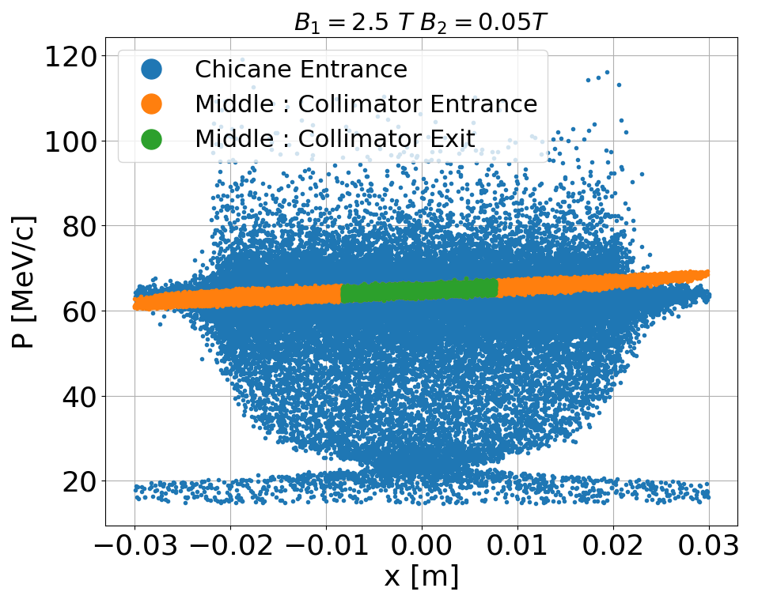
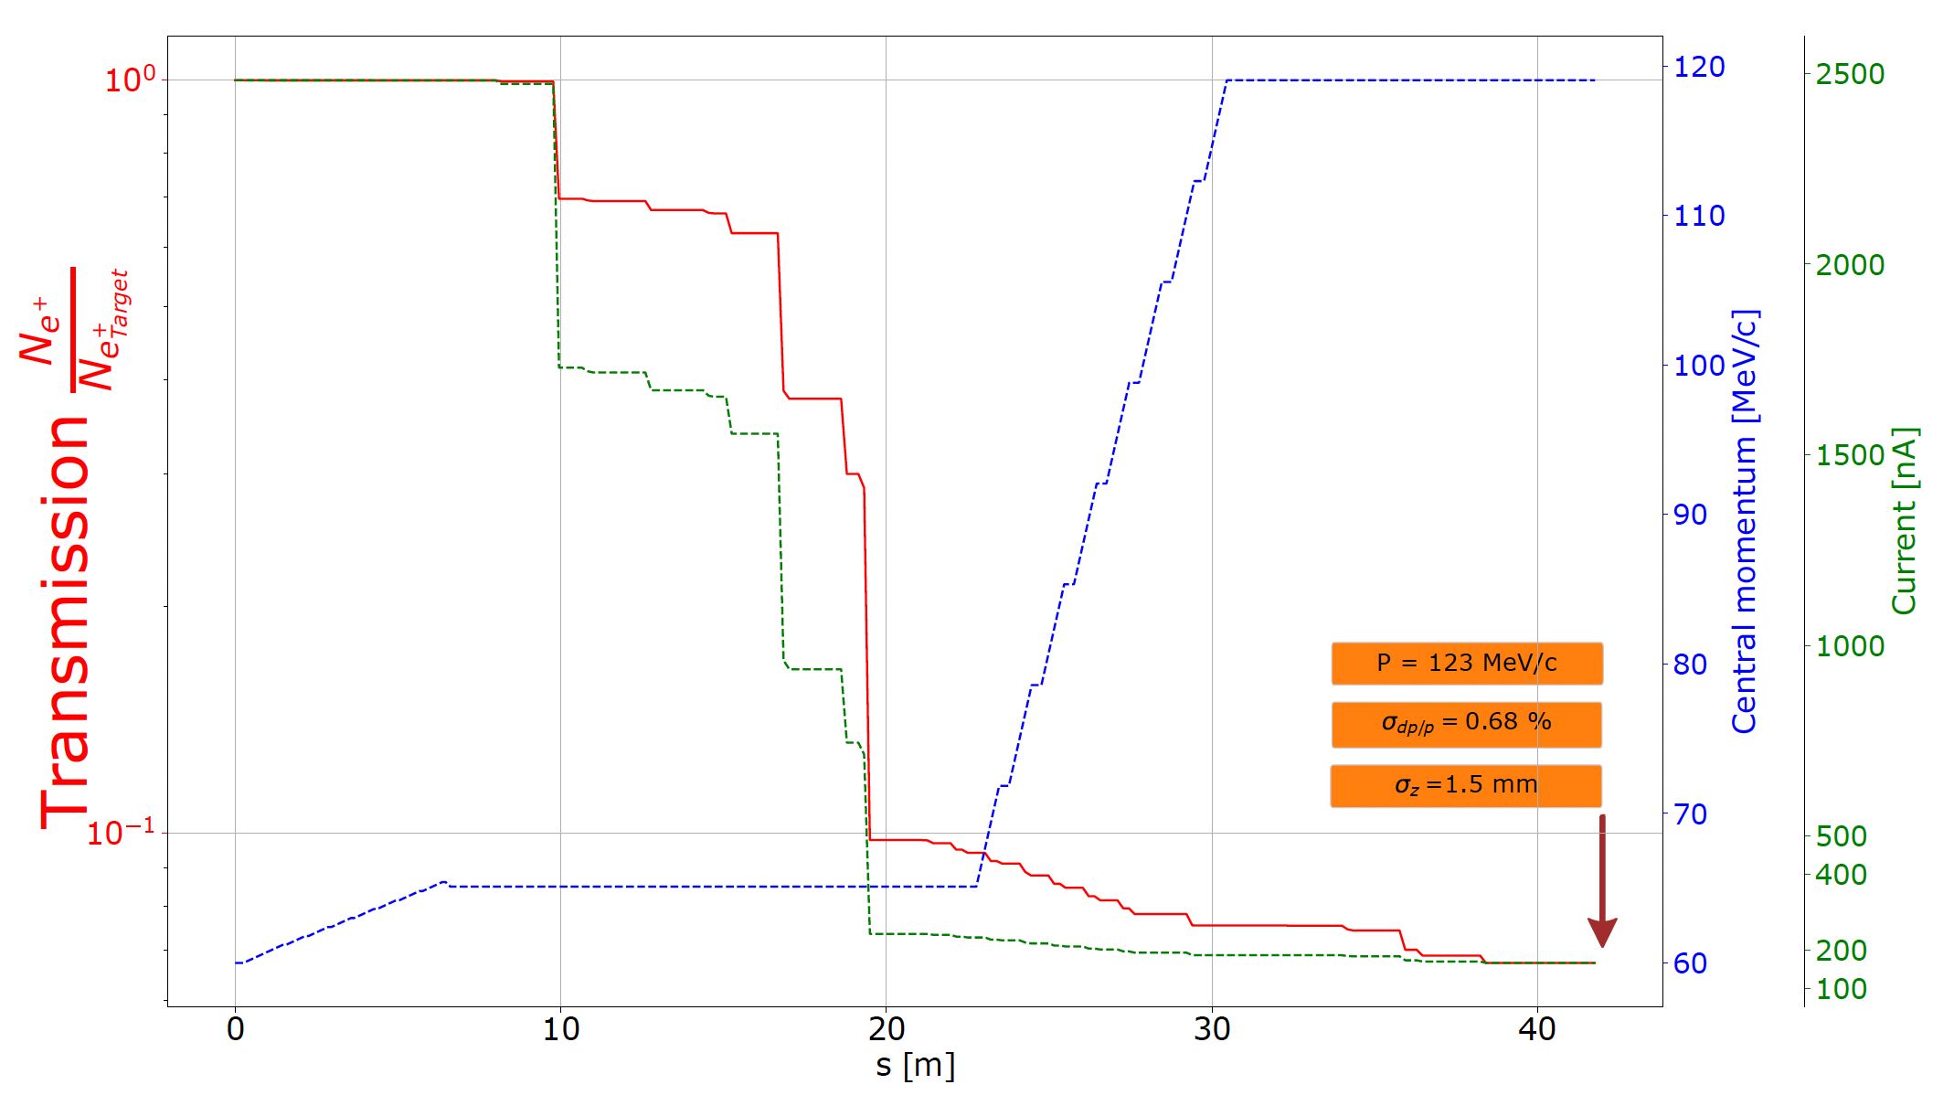
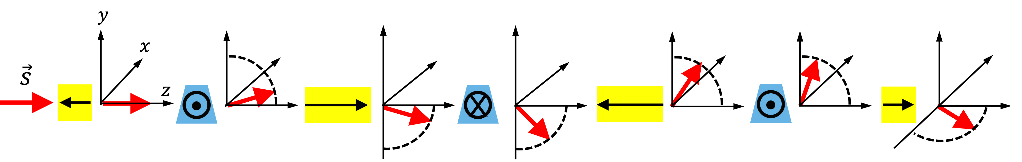
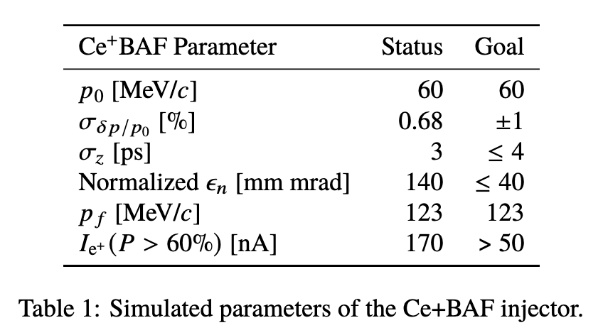
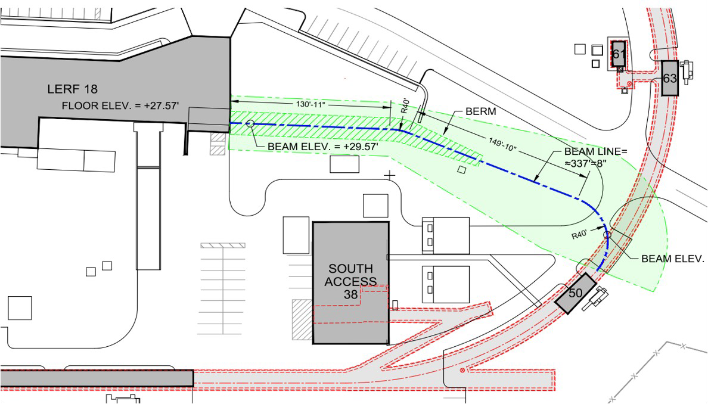
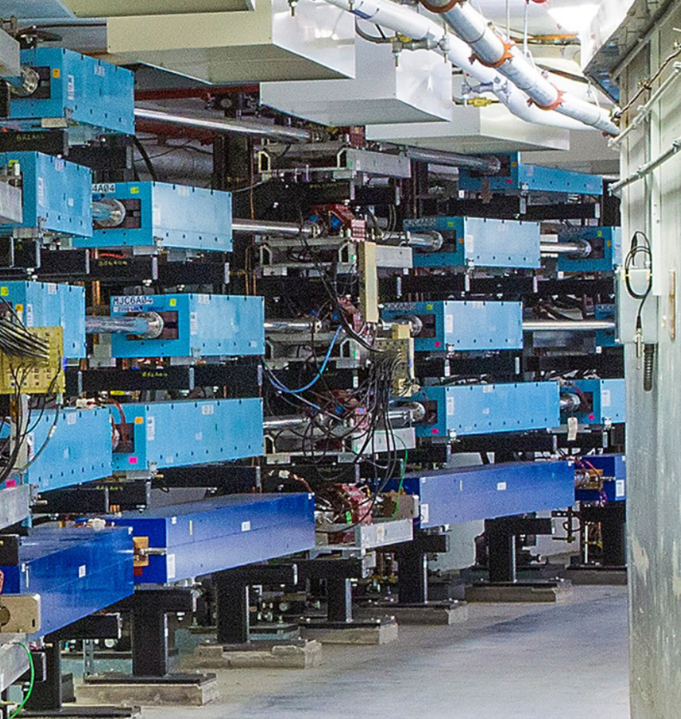
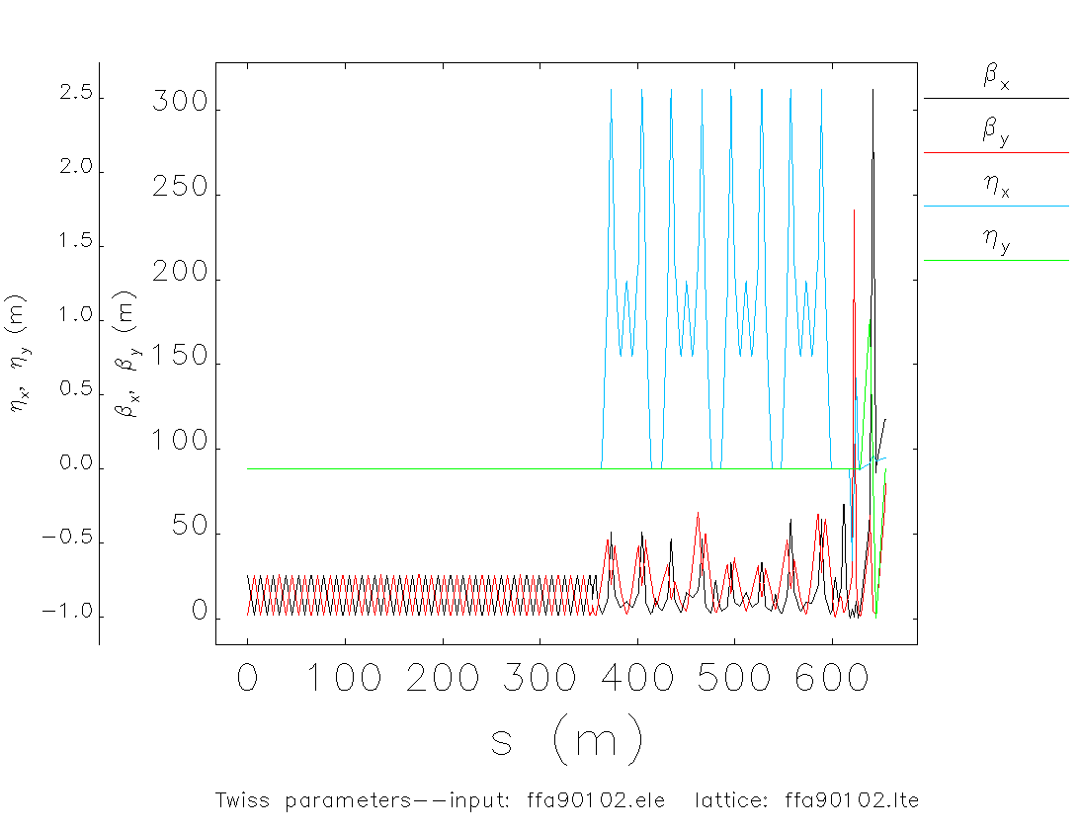
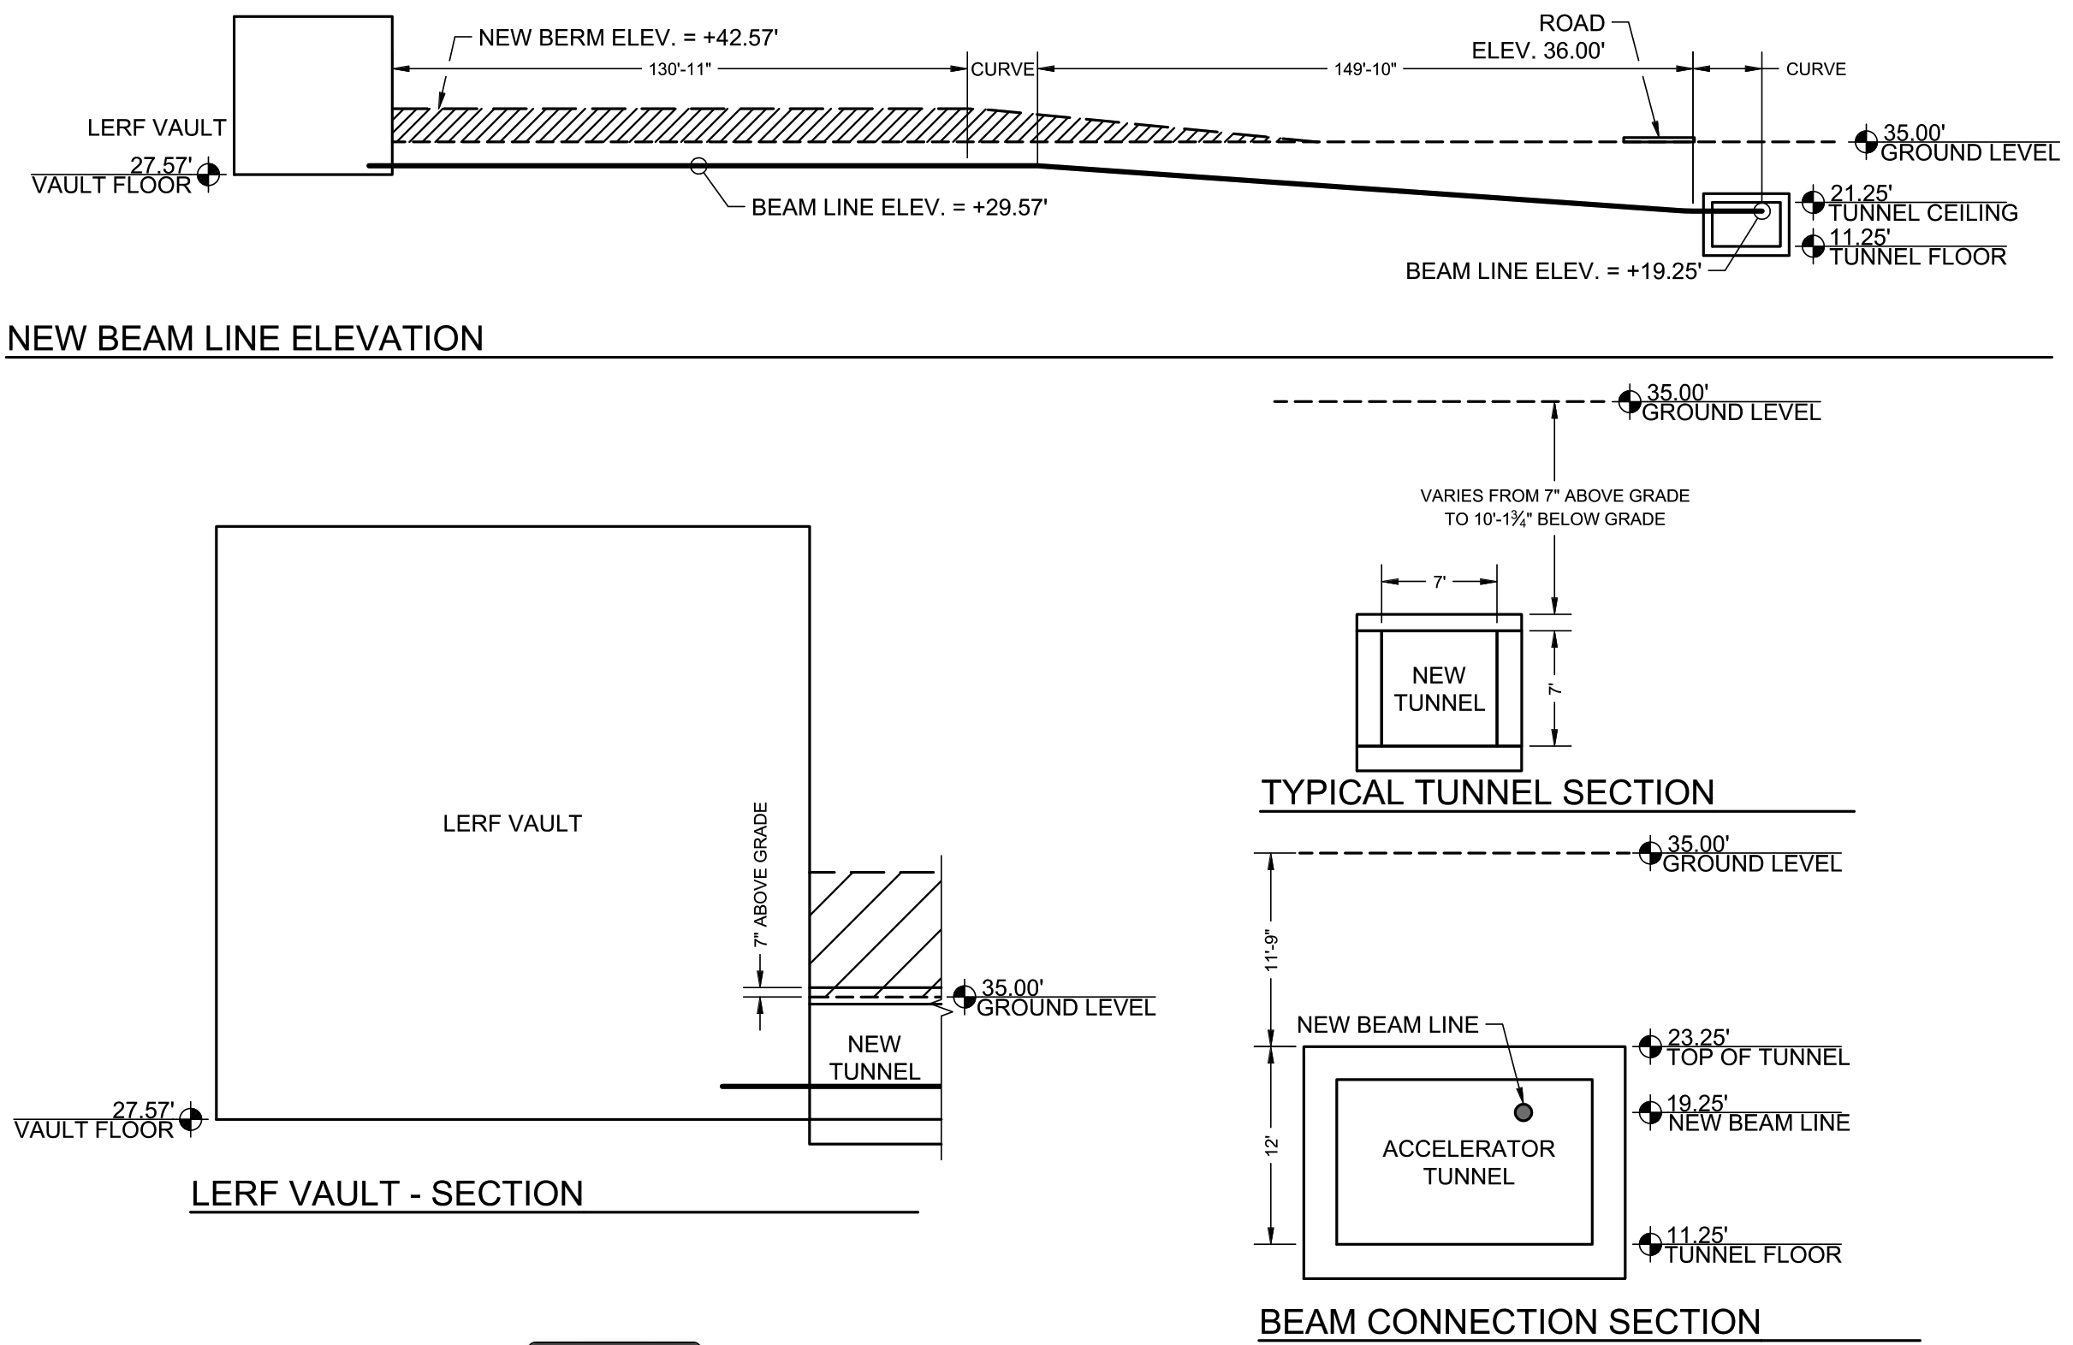


POSITRON BEAMS AT Ce⁺BAF
J. Grames¹, L. Cardman¹, S. Covrig¹, J. Benesch¹, M. Bruker¹, P. Ghoshal¹, S. Gopinath¹, J. Gubeli¹, S. Habet^{1,2}, C. Hernandez-Garcia¹,
A. Hofler¹, R. Kazimi¹, F. Lin³, S. Nagaitsev¹, M. Poelker¹, B. Rimmer¹, Y. Roblin¹, V. Lizarraga-Rubio⁴, A. Seryi¹, M. Spata¹, A. Sy¹,
D. Turner¹, A. Ushakov¹, C.A. Valerio-Lizarraga⁵, E. Voutier²
¹Thomas Jefferson National Accelerator Facility, Newport News, VA 23606, USA, ²Université Paris-Saclay, CNRS/IN2P3/IJCLab, 91405 Orsay, France, ³Oak Ridge National Laboratory, Oak Ridge, TN 37830, USA ⁴Universidad de Guanajuato, 37150 Leon, Gto., México, ⁵Universidad Autónoma de Sinaloa, 80010 Culiacáan, México
Abstract: We present a scheme for the generation of a high polarization positron beam with continuous wave (CW) bunch structure for the Continuous Electron Beam Accelerator Facility (CEBAF) at Jefferson Laboratory (JLab). The positrons are created in a high average power conversion target and collected by a CW capture linac and DC solenoid.
Please visit WEPA035 “Polarized electron injector for positron capability at CEBAF 12 GeV”
What to put here?
Superconducting 10 MV booster and pair of 60 MV cryomodules accelerate milliamp e⁻ >100 MeV
Ultra-high vacuum warm region with Wien and Buncher forms >2 pC bunches for acceleration
350 kV DC high voltage GaAs photogun provides milliamps of e⁻ beam with polarization ~90%
Former FEL re-purposed to build and develop full energy e⁺ source during usual CEBAF operations.
4
3
2
1
High power electron beam is transported through a 180 deg bend into the high power conversion target area
5
120 kW e⁻ beam irradiates water cooled spinning W target, yielding large 6D volume of polarized e⁺
High field >1 T dc solenoid rotates e⁺ phase space through CW NC capture and dp/p defined in momentum collimating chicance
e⁺ of 30-60 MeV are accelerated off-crest in a 90 MV cryomodule to 123 MeV and bunced in a chicane
e⁺ are deflected through vertical chicane with interleved solenoids leaving orbit unchanged & spin precessed in horizontal plane
6
7
8
9
Yu. N. Filatov et al., Eur. Phys. J.C, 81:986 (2021)
Please visit WEPM120 “Conceptual design of a high-power target for positron production at CEBAF”
Please visit MOPM081 “Degrader beamline design at the CEBAF injector for machine acceptance studies”
The LERF provides a CW polarized e⁺ beam with parameters approaching goals for CEBAF injection.
10
Maximum current for positrons will depend on whether or not polarized beam is needed. Initially the goals are >1 uA available for unpolarized positron beams and >50 nA expected for ~60% polarized positrons.
Once the e+ source is ready, civil construction connects the LERF by a new tunnel to CEBAF. The transport line will maintain the e⁺ polarization in plane.
e⁺ beam is transported along the West Arc & injected to North Linac for acceleration to 12 GeV with magnet polarities reversed.
Once in CEBAF the 123 MeV e⁺ beam is transported in a new beam line along the South Linac tunnel
13
12
11
This project is supported by the U.S. Department of Energy, Office of Science, Office of Nuclear Physics under contract DE-AC05-06OR23177; UT-Battelle, LLC, under contract DE-AC05-00OR22725 with the US Department of Energy (DOE); the European Union’s Horizon 2020 research and innovation program under agreement STRONG - 2020 – No. 824093; the Programa de Fomento y Apoyo a Proyectos de Investigación code A1-022, from the Universidad Autónoma de Sinaloa.

