Slide 1
Positron production in North Access Building area
Just an idea, please comment
Reza Kazimi
Nov 2023

Slide 2
The idea:
The basic idea is to add a mA electron gun to the existing injector, as we used to have two at +- 15 degrees. Continue the beam line which now ends at the 123 MeV spectrometer dump around the corner and put the positron converter and the final acceleration stage in the area which was designed to allow a three-point turn for cryo-modules (not under the hatch). Please see the pictures.

Slide 3
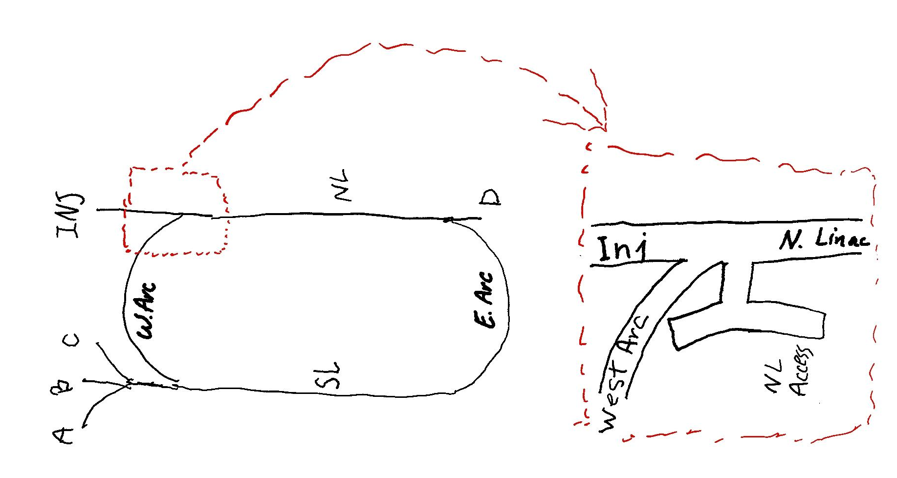
Let’s look at this area:

Slide 4
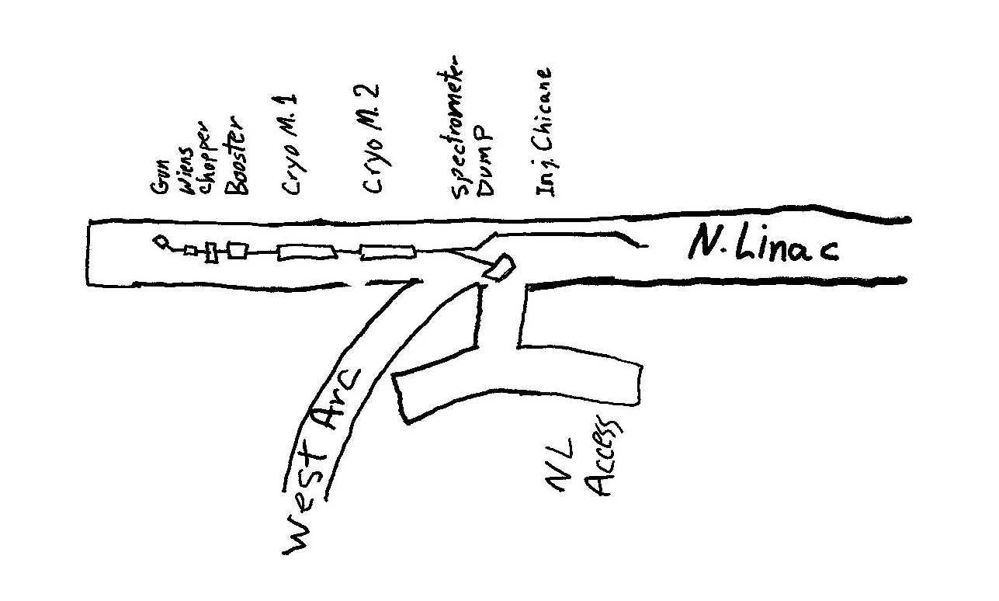
Present Injector Config.

Slide 5
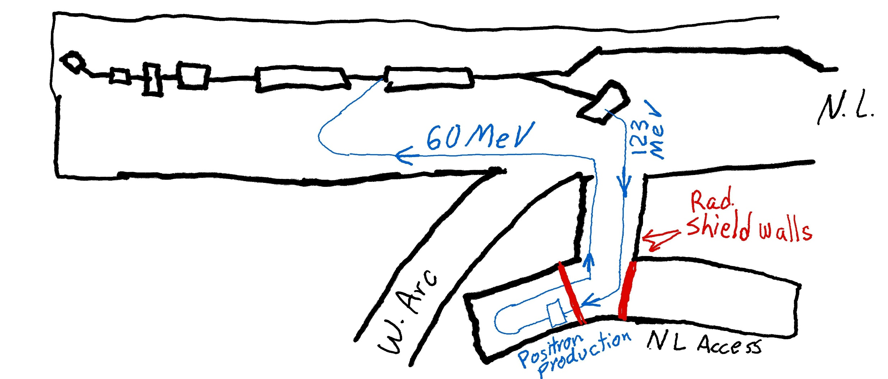
Positron production from 123 MeV electron

Slide 6
Advantages
Minimal change to the existing tunnel. No new tunnel.
Most positron converter and beamlines can be installed before disturbing the main machine.
High radiation area of the positron production can be easily shielded.

Slide 7
Variations
The mA beam could be produced from a second gun before 15 degree bend or a separate parallel beam line joining before the injector booster.
Final positron acceleration through a 60 MeV cryo-module or recirculating back through the second injector cryo-module as shown in the pictures.
Adding FFA injector: There could be acceptable configuration using the same area for higher energy FFA injector.

Slide 8
Some questions for the experts among us
What is the effect of bends, especially 180 degree bend, on energy spread and polarization degradation? (Some estimates and numbers please)
Does it help the final positron polarization if we produce positrons after the 180 bend?

