Slide 1
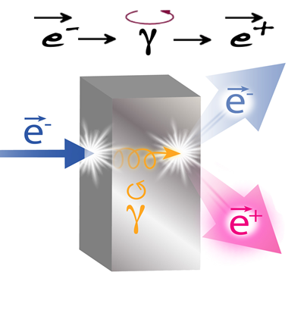
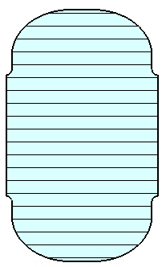
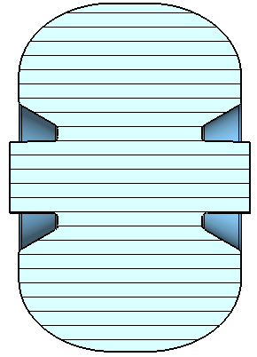
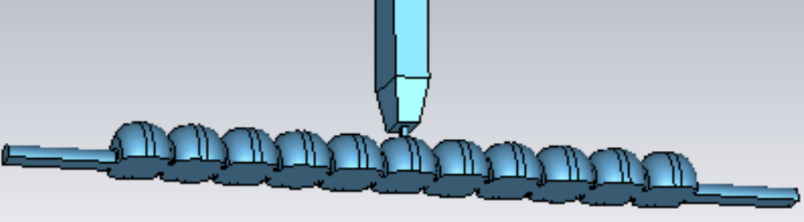
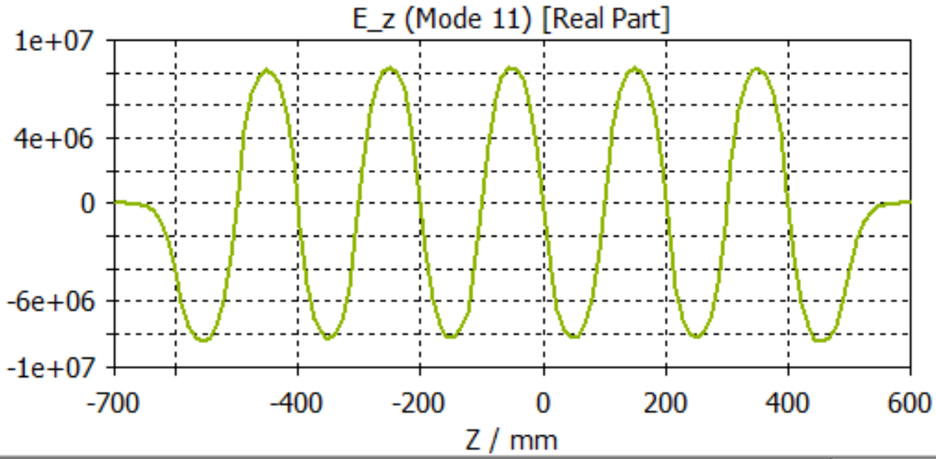
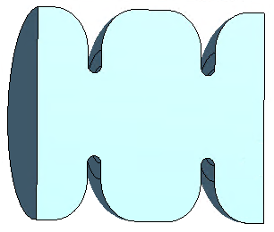
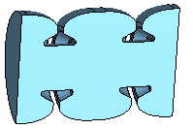
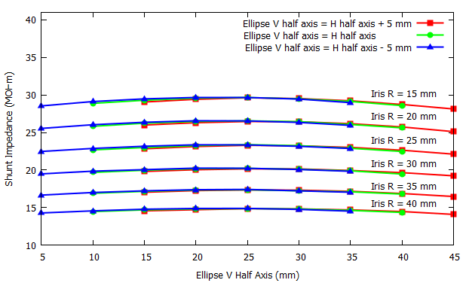
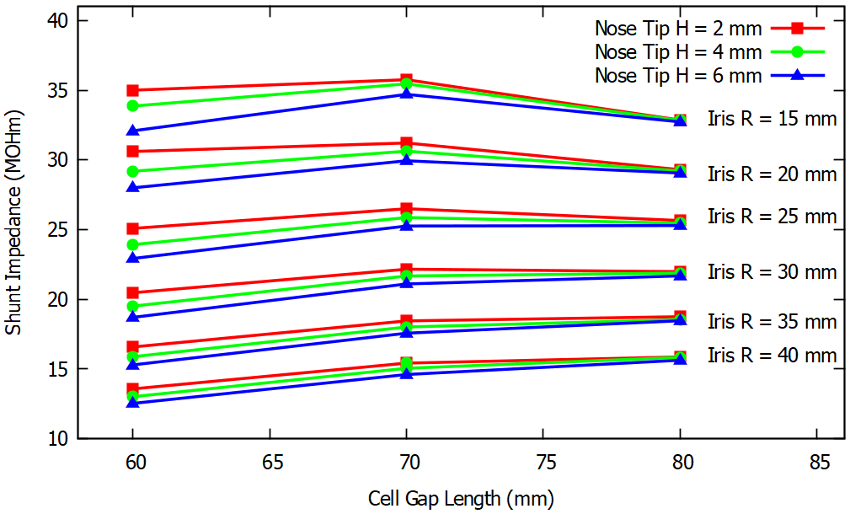
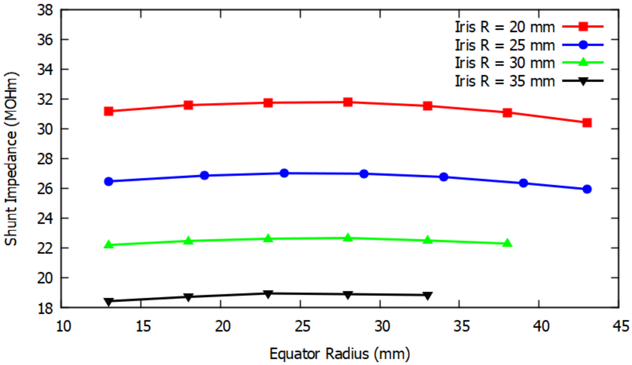
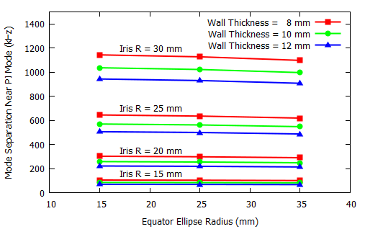
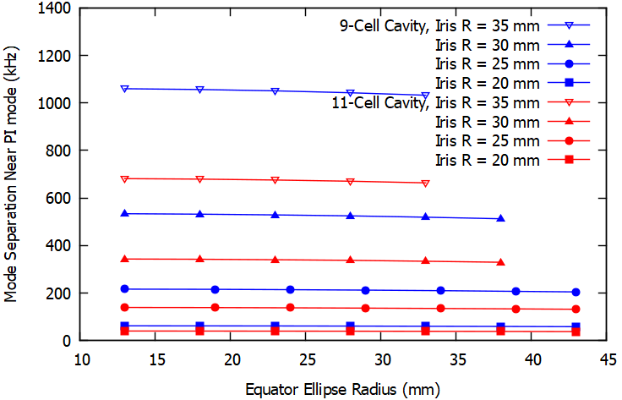
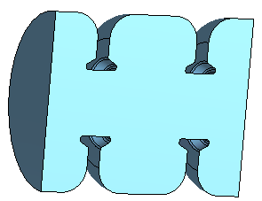
Capture Cavities for the CW Polarized Positron Source Ce⁺BAF
S. Wang, J. Grames, N. Raut, R. Rimmer, Y. Roblin, A. Ushakov, H. Wang
Thomas Jefferson National Accelerator Facility, Newport News, VA 23606, USA
MOPC51
Abstract:
The initial design of the capture cavities for a continuous wave (CW) polarized positron beam for the Continuous Electron Beam Accelerator Facility (CEBAF) up-grade at Jefferson Lab is presented. A chain of standing wave multi-cell copper cavities inside a solenoid channel are selected to capture positrons in CW mode. The cavity shunt impedance is surveyed by tuning the cavity geometry while considering accommodating large phase space distribution positron beams with large beam pipe radius while ensuring a large enough passband mode separation. The RF field wall loss power and maximum wall loss power density are considered in cavity and waveguide design. A range of design parameters are given for larger system optimization when the capture cavities are considered together with thermal calculation and beam dynamics in next phase of work.
Two types of cell shapes are used for the survey for the shunt impedance and mode separation optimization.
Type A, simple iris shape
Type B, nose cone shape
11-cell cavity with tentative FPC, the end cells and center cell are tuned to get leveled electric field on axis.
3-resonantor inner cell structures used for the geometry parameter scanning, shunt impedance and mode separation are shown in figures below.
Shunt impedance, type A cell
Shunt impedance, type B cell
Shunt impedance vs equator radius, type B cell
The most promising cell shape.
Mode separation near π mode, type A cavity
Mode separation near π mode, type B cavity
Summary and Outlook
A parameter survey for two types of standing wave capture cavities has been performed for CW positron source. The result is a continuous trade-off between iris radius (transverse acceptance of the positrons) and gradient (energy acceptance). At small radii the nose-cone cavity is more efficient, at larger radius the simple iris cavity is sufficient. This parameterization can now be used in the capture dynamics simulations and thermal analysis to maximize total acceptance into Ce⁺BAF in the next phase of work.
This work is supported by the U.S. DOE, Office of Science, Office of Nuclear Physics, contract DE-AC05-06OR23177.

