Slide 1
Laser safety training for target lab
Polarized He3 group

Slide 2
Protocols due to COVID-19
The occupancy loading limit for both Room 102A & 202A is 2 people remaining at least 6 feet apart wearing face coverings.
When more than 2 people need to enter the rooms:
All employees beyond 2 must don respirators and cover exhalation valves (if respirator has an exhalation valve) while still maintaining 6 feet social distancing.
If social distancing cannot be maintained during tasks, then all staff within 6 feet of each other must don respirators.
Respirators and respirator training must be obtained from ESH Division.
Respirators must be stored for a minimum of 10 days prior to re-use per ESH provided training.

Slide 3
Operator requirements
The 30-50 watts infrared diode lasers may only be operated by personnel who have:
completed a Laser Safety training course (SAF114O) administrated by DOE
completed and passed an ophthalmological exam
had a safety walkthrough by the Laser Safety Supervisor of the Polarized 3He Target System (Jian-ping Chen)
read this document
been added to the authorized list of Laser Personnel, included as the last page of this LOSP
Jefferson Lab personnel or outside visitors, who have not completed all of above training, are only allowed to enter the laser control area (target lab) under the following conditions:
have permission of the Laser Safety Supervisor of the Polarized 3He target system
be accompanied by a laser authorized personnel
if the laser is operational, with required safety goggles
if any equipment, including the laser, is operational, no touching of equipment due to electrical hazards.

Slide 4
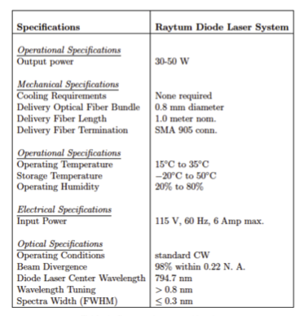
General description
Laser light provided by
795 nm solid state diode lasers from Raytum photonics
30 – 50 Watts power
Main enclosure contains diode, power supplies, fans and control systems
Lasers are
Class IV
The light sent by an optical fiber to the setup
Operate between 15 – 35 deg C
Central wavelength 794.7 nm
Spectral width < 0.3 nm
Fiber diameter 600 microns
Beam divergence ~0.22 N.A.

Slide 5
Hazards associated with Class IV lasers
Eye and skin injuries
Do not view lasers directly with your eyes
795 nm most of the laser light is absorbed in the retina
Could cause blindness and irreversible and severe retinal burns
Could cause skin burns
Surface reactions on skin from photochemical reactions
Mitigation strategy
Proper training
Professional conduct
Optical beam line layout
Adherence to procedures laid out in the LOSP document
Proper selection of laser protective eyewear and clothing, no jewelry, watched portable electronics or clothing that presents a specular reflection hazard

Slide 6
Hazards associated with Class IV lasers..
Potential fire risk
Remove unneeded combustible material
Reduce or properly store flammable material
Capable of producing LGAC (Laser Generated Air Contaminants)
We do not anticipate use of any such material in the laser room

Slide 7
Laser controlled area layout
Crash buttons
Screen that acts as a laser barrier that prevents any light from going out of the room

Slide 8
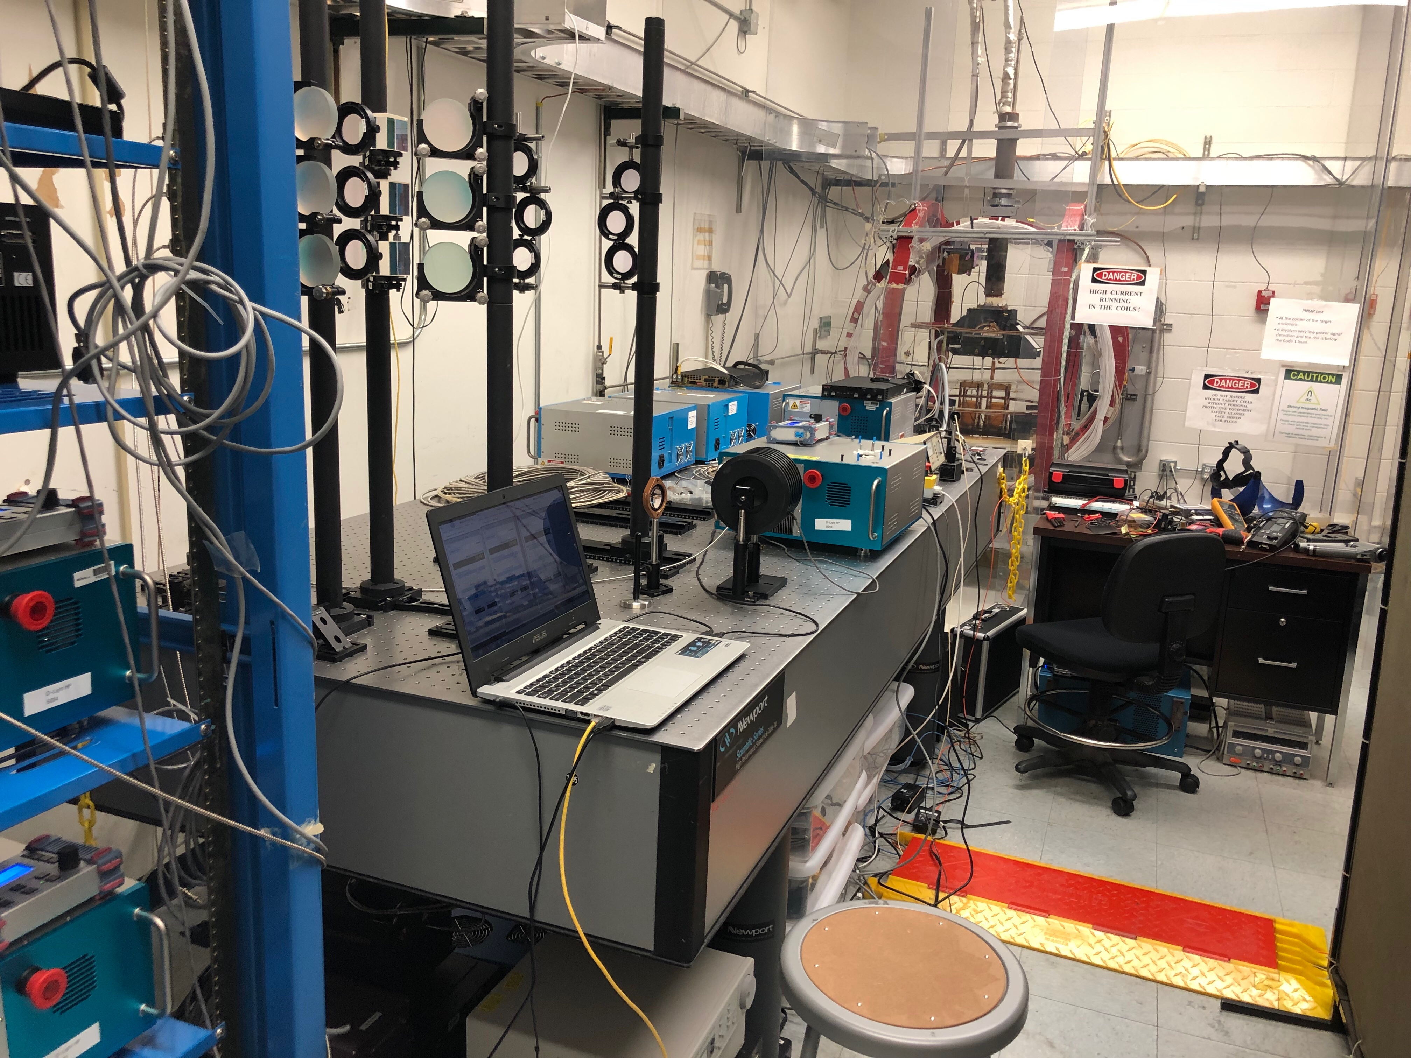
Laser controlled area layout

Slide 9
The optical setup
Up to ten 50 watts
795 nm solid-state diode lasers (four for each pumping direction) located on two racks in the laser room
Two lenses for each laser beam to have it focused at the pumping cell
One beam splitter to split each laser beam to two beams with linear polarization
Two quarter waveplates for each laser beam to transform each beam from linear polarization to right or left circular polarization
Eight dielectric mirrors to redirect each split beam into the pumping cell
Two transparent windows on the oven to allow the combined laser beams to pass through
One pumping cell to absorb all the laser beam power
One mirror and three optical fibers with lenses for spectral-analyzer and for EPR
One spectral-analyzer for monitoring the pumping cell
One ceramic plate serving as beam dump for each pumping direction.

Slide 10
List of Lasers in EEL Target Lab
Laser Name | Power (W)
F224331 | 30 W
F224332 | 30 W
F227767 | 30 W
F224896 | 30 W
Raytum 1314015 | 50 W
Raytum 1314016 | 50 W
The He3 target uses only longitudinal lasers in the target lab

Slide 11
Normal mode of laser operation
At all times, when operating the diode lasers in lasing mode, safety goggles are required. A visible sign indicating the laser is in lasing mode (laser ON) is displayed at the laser rack
Working with the lasers in normal operational mode will require protective eye wear with a minimum optical density (OD) of 5 at wavelength of 795 nm
The general procedures for normal operation of the diode lasers in the target laser room are:
Wear protective eyewear
Enable laser safety interlock box
Switch on AC power
Turn on the control box with a key
Turn laser to Ready and then On.

Slide 12
Alignment mode
Initial alignment will be done with a standard class 3R HeNe laser (class 3R after attenuation, 650 nm) or a laser pointer (class 3R)
Laser safety glasses are NOT required while operating the 3R laser for alignment but do not look directly into the beam or use collecting optics
The final alignment will be done with the diode laser but at a reduced laser power (less than 10 amps, when the laser spot on a card can be clearly seen with IR viewer)

Slide 13
Maintenance mode
Replacement of used or damaged optical components of the setup will be made with the laser off (power switched off and unplugged).
The positions and orientations of the new components will be mechanically surveyed and extensively checked before turning to any procedure needing the laser on.
To inspect an optical fiber which is connected to a laser in the laser room, the following procedure must be followed
turn off laser,
switch off laser power;
remove the key for power and place In lock box;
for the ones do not have a key for power switch, unplug and lockout the power cord at the back of the laser while performing the fiber inspection
disconnect the fiber from the laser
then the fiber can be connected to a fiber inspection scope for inspection

Slide 14
Off-normal and emergency procedure
In case of an emergency, POWER TO THE LASERS SHALL BE SHUT OFF. This can be performed in three ways.
Push the Crash button;
Turn off the control key on the laser power supply;
Pull the plug from the power outlet. In the event of a fire, the users shall leave the laser room and pull the nearest fire alarm.
In case anybody is accidentally exposed to the laser beam (direct or indirect), he or she shall immediately contact the Jefferson Lab medical center (phone: 7539, page: 584-7539). If it is off business hours, please contact local hospital emergency. At the mean time, please inform the laser system supervisor (Jian-ping Chen, phone: 7413, cell:757-218-0722) and the laser safety officer (Paul Collins, phone: 5981).

Slide 15
Implemented laser controls
Several controls have been added as preventive measures to the laser room and to the direct laser area. We will enumerate these controls here
1. The laser control area will have danger signs posted and will have a yellow beacon indicating the presence of Class IV diode lasers. Danger sign will also be posted near the target enclosure area.
2. A controlled access interlock system will limit the entrance to the laser room with a coded number pad. The code is given only to the authorized laser users listed at the end of this LOSP with currently valid training.
3. The laser switches are interlocked to allow an opening of the door to turn off the laser (to stand-by).
4. The main power plug to the laser can be easily pulled. It is plugged into a power strip with an on/off switch which can be easily switched off.
5. Protective safety goggles (minimum OD 5.0 at 795 nm) have to be worn when the laser is operational.
6. All personnel need to fulfill the training requirements as indicated in Section 1 of this document.
7. The LOSP will be posted on the outside door of the laser room to inform personnel about the hazards associated with the setup and the proper procedures. All controls will be inspected every six months and the inspection will be documented.

Slide 16
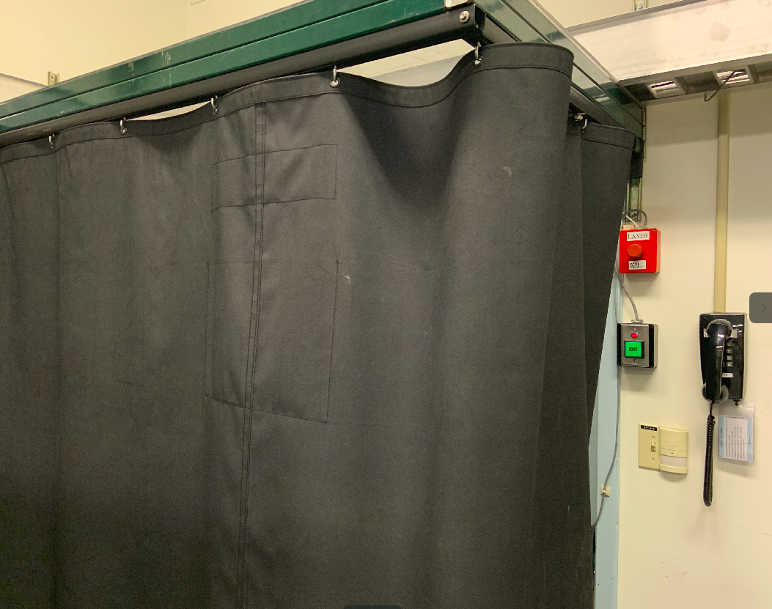
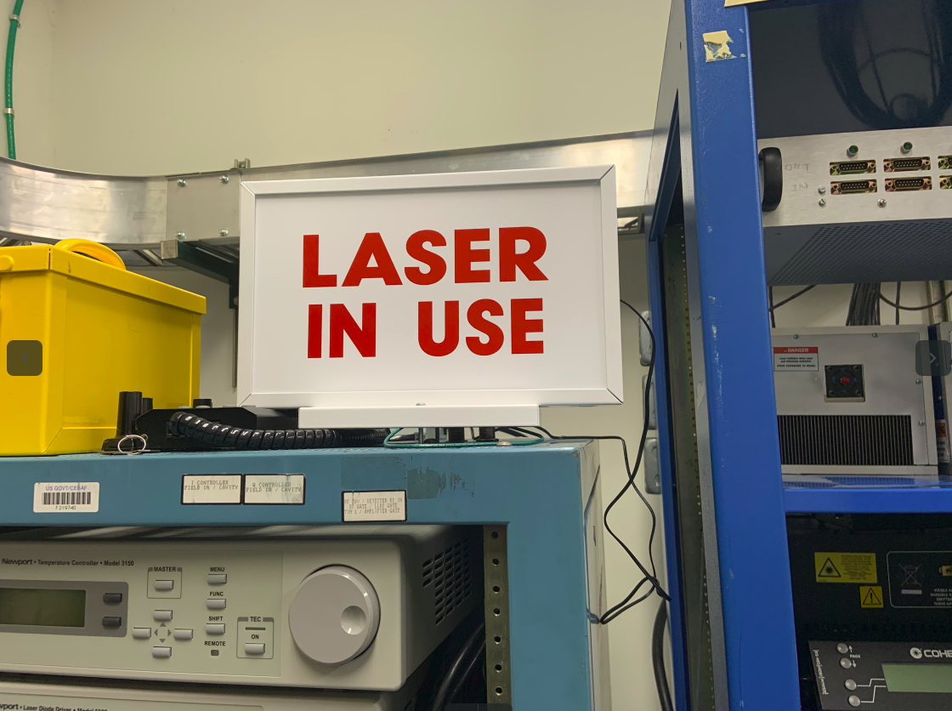
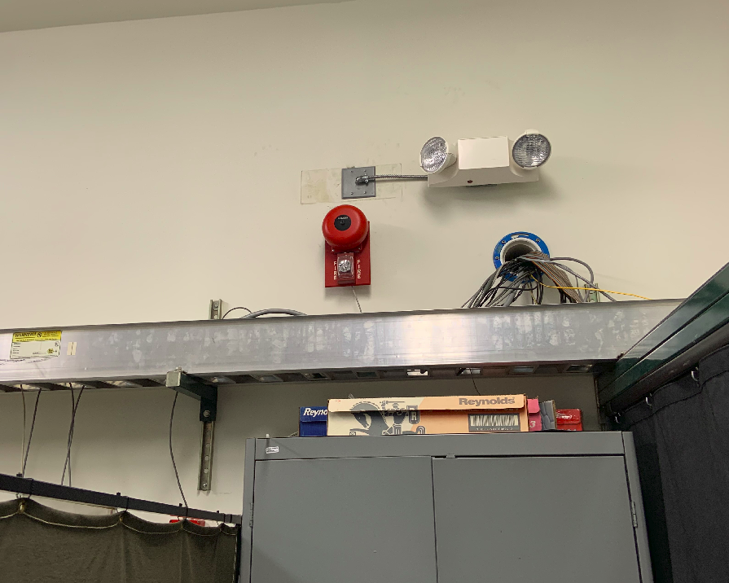
Laser Safety and Warning Sign
Screen near the door serves as a laser barrier
“Laser in Use” warning sign
Moved the safety light emergency test button to a place easy to reach

Slide 17
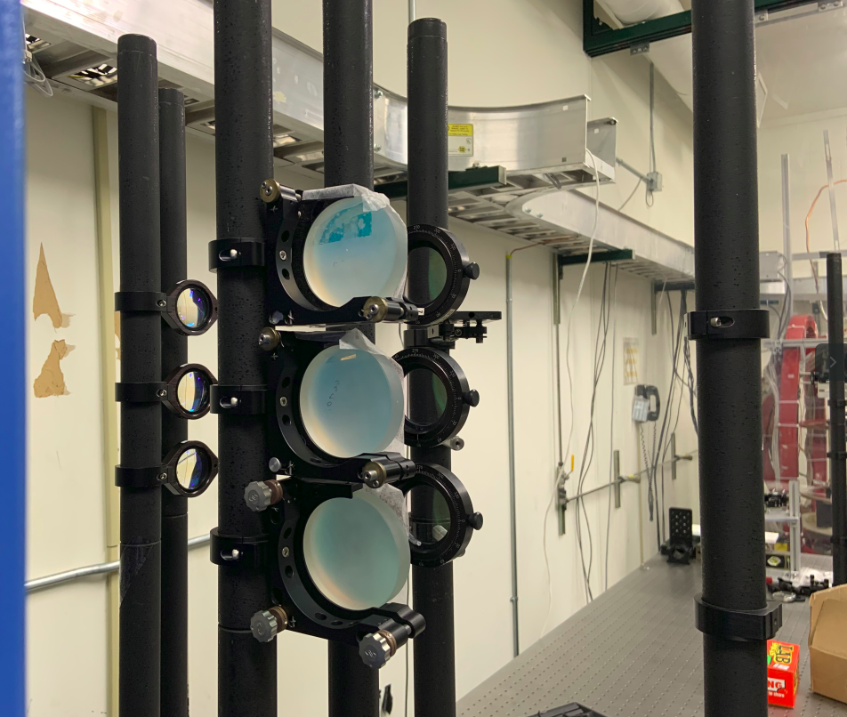
Optics Setup (Still doing laser alignment)

Slide 18
TO DO
Discuss the beam and on-beam hazards associated with the specific laser system
Describe the control measures in place to mitigate the associated hazards
Describe actions if suspected laser exposure
Describe entry procedures including restrictions
Demonstrate knowledge of emergency stop locations
Describe applicable warning signs
Perform pre-use laser eye protection inspection
Perform laser start up procedure
Perform the normal shut-down procedure
Demonstrate the lock, tag and try (LTT) process defined in the LOSP

Slide 19
BACK UP

Slide 20
Target introduction
High density polarized He3 gas at ~10 atm in a target cell along with Rb-K mixture
The target employs a spin-exchange process to polarize the He3
Rubidium vapor is polarized by optical pumping with circularly polarized laser light at 795 nm
The polarization is transferred from Rb to K and eventually to He3 nuclei which will be our effective “neutron target”

Slide 21
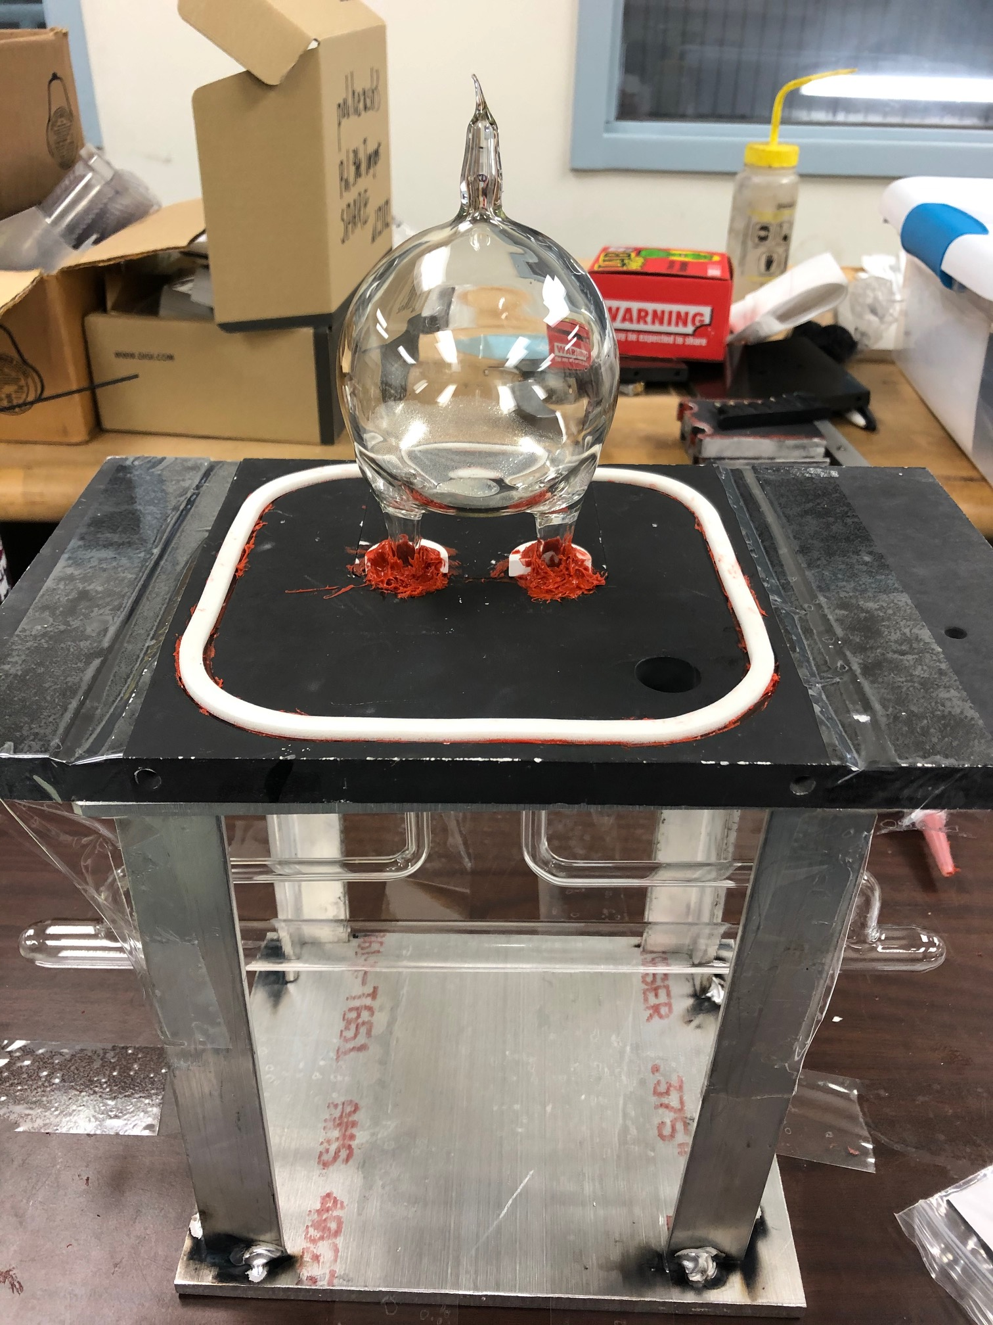
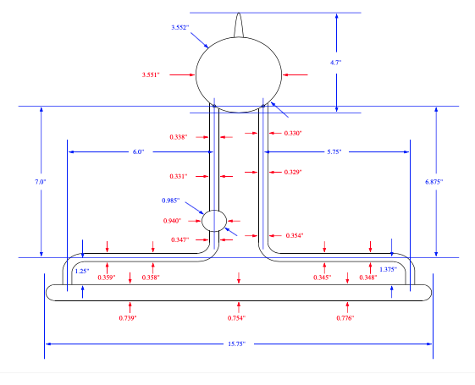
Target cell

Slide 22
Main field Helmholtz coils
Vertical correction coils (to cancel HB field)
Horizontal correction coils (to create gradient)
V_{L}
V_{S}
H_{L}
V_{S}
V_{L}

Slide 23
Target Oven

