Slide 1


Status of the PRad Experiment
(E12-11-106)
Jefferson Lab User Group Meeting 2016
Chao Peng
Duke University
For the PRad Collaboration

Slide 2
Outline
PRad Physics Motivation
Experimental Setup
Current Status
Preliminary analysis

Slide 3
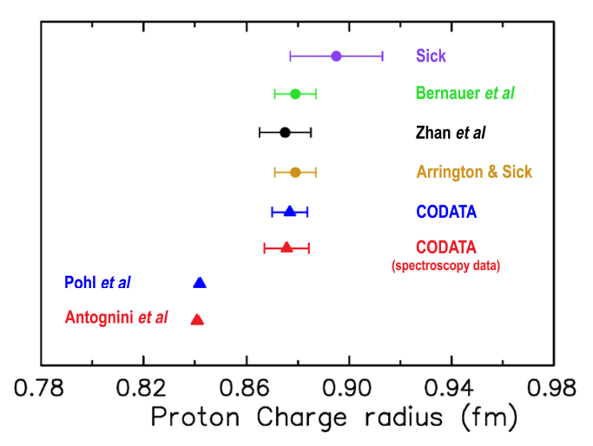
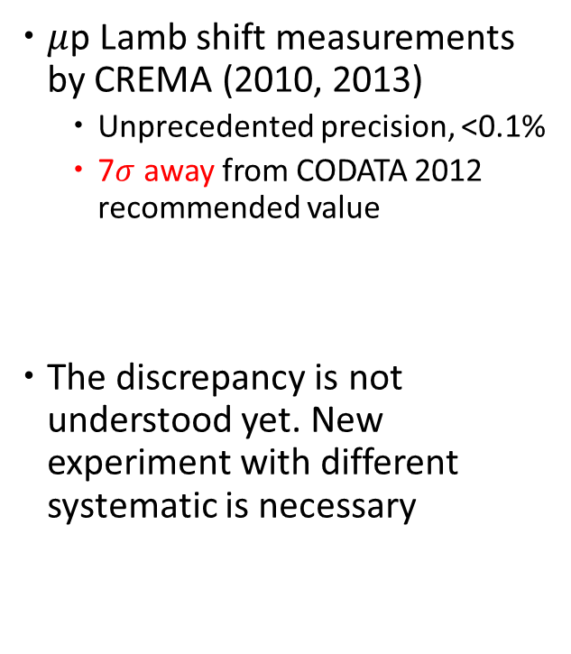
Proton Radius Puzzle
$μ$p Lamb shift measurements by CREMA (2010, 2013)
  Unprecedented precision, <0.1%
  7$σ$ away from CODATA 2012 recommended value
The discrepancy is not understood yet. New experiment with different systematic is necessary

Slide 4
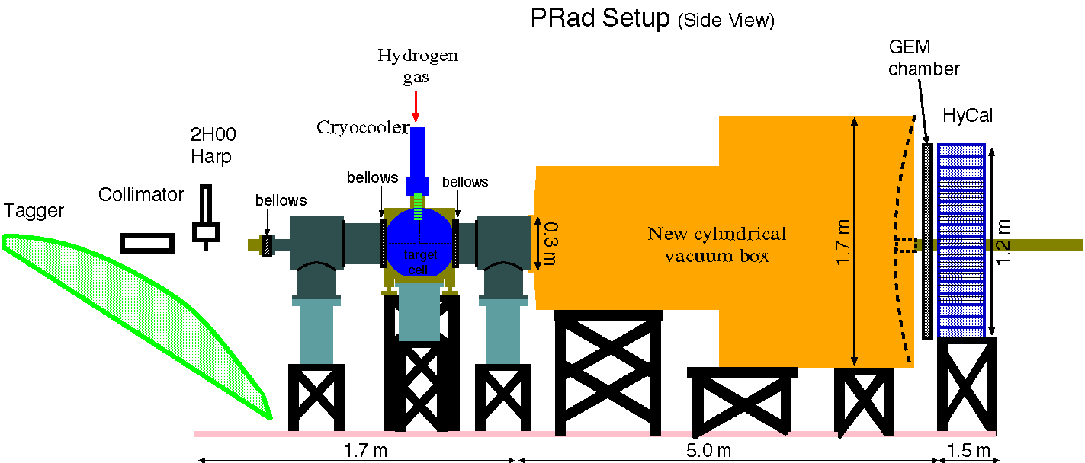
PRad Experiment
  Non-magnetic and calorimetric method with GEM detectors, aiming at an unprecedented low Q² region, Q² = 2×10⁻⁴ – 1×10⁻¹ (GeV/c)² with sub-percent precision
Simultaneous measurement of e-p elastic scat. and Møller processes
Windowless gas flow target

Slide 5
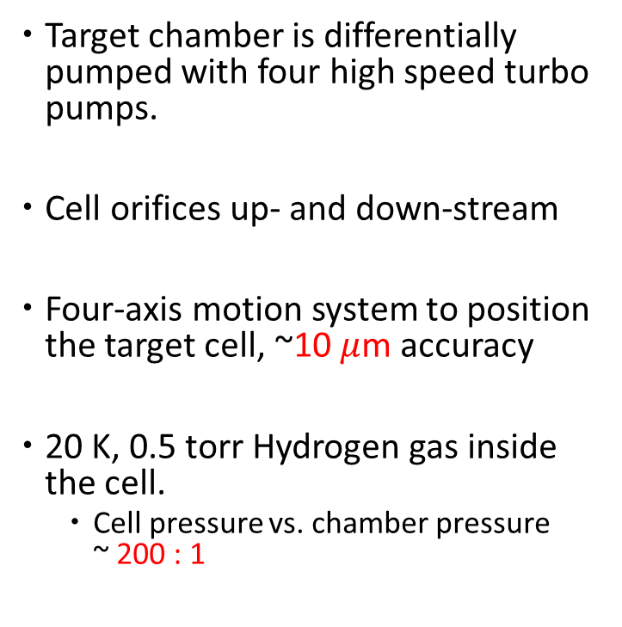
Windowless Gas Flow Target
  Target chamber is differentially pumped with four high speed turbo pumps.
  Cell orifices up- and down-stream
  Four-axis motion system to position the target cell, ~10 $μ$m accuracy
20 K, 0.5 torr Hydrogen gas inside the cell.
  Cell pressure vs. chamber pressure
  ~ 200 : 1
Cell orifice

Slide 6
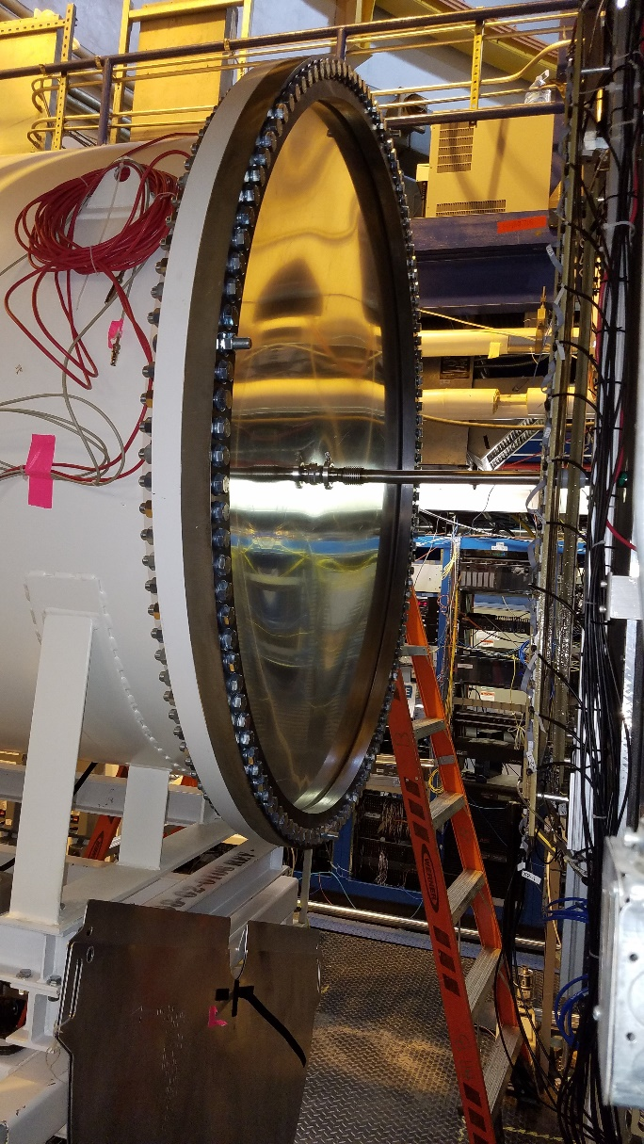
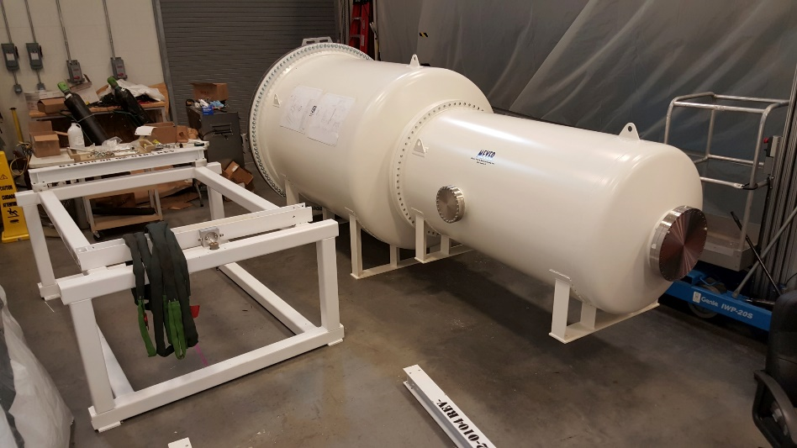
Vacuum Box
  Engineering design done by Duke/JLab
  Installed in May, 2016
  Connect to beam pipe at the end, no material on the beamline

Slide 7
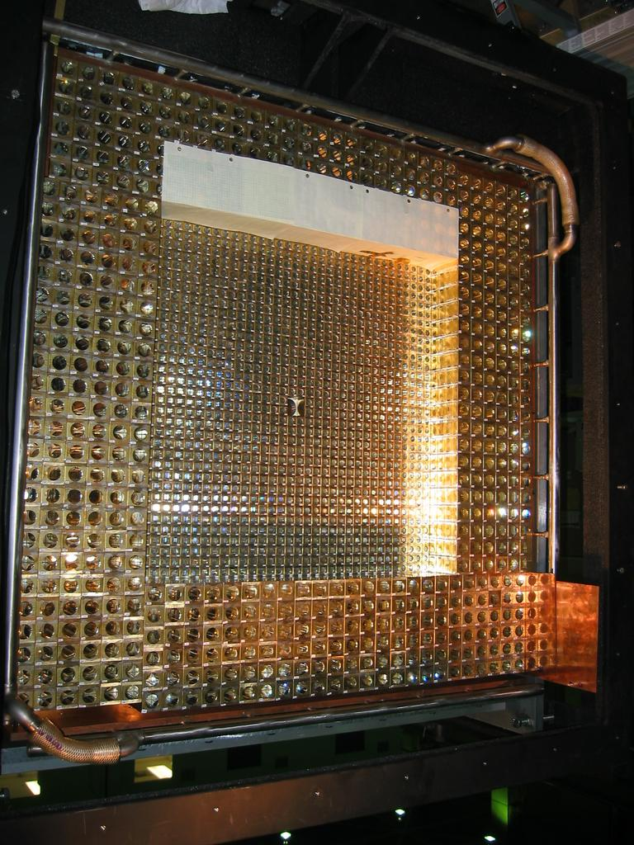

Electromagnetic Calorimeter - HyCal
  Hybrid Calorimeter, combination of PbWO₄ and Pb-Glass modules
  High resolution, high efficiency detector
    $σ_{E}/E=2.6\%/\sqrt{E}$ , $σ_{x,y}/E=2.5 mm/\sqrt{E}$
    ~ 99% efficiency
5.8 m away from target center
(~ 0.5 sr acceptance)

Slide 8
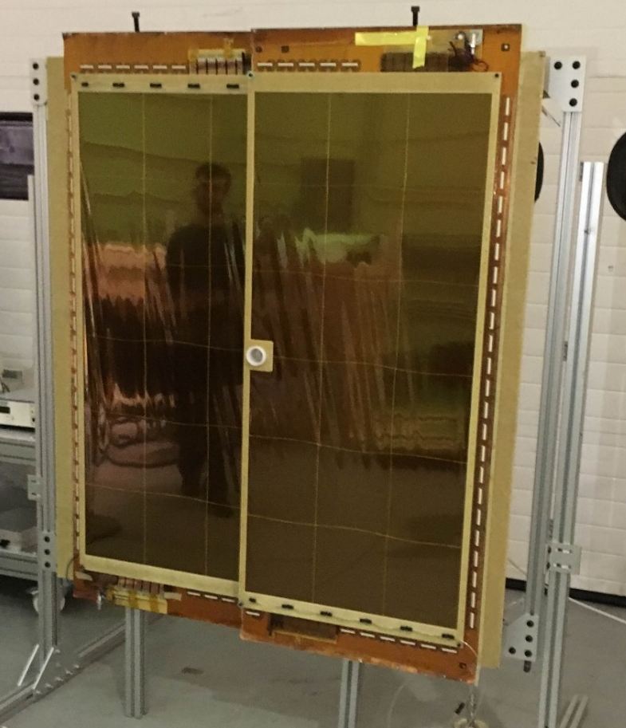
GEM Detectors
  Largest GEM detector ever built in the world. Two chambers to cover the entire region of HyCal
  Two modules overlap in the central part,
  opening for beam pipe
  COMPASS-like strip readout (1.3 m long
  vertical strips, acceptable capacitance
  noise level)
Mounted on HyCal box
105 cm
GEM 1
123 cm
GEM 2
Two modules mounted on the holding frame in PRad GEM configuration before the cosmic run in EEL (March 2016)

Slide 9
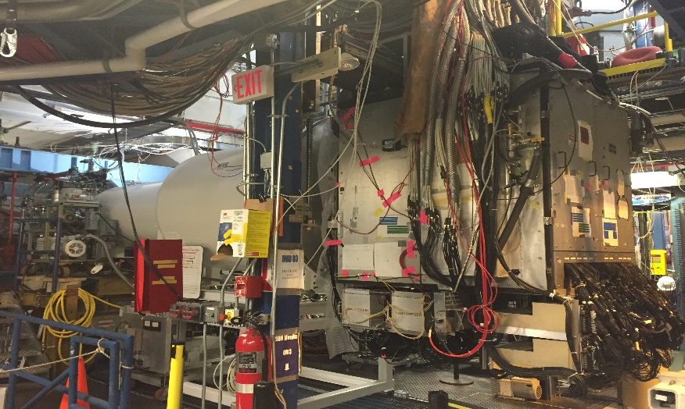
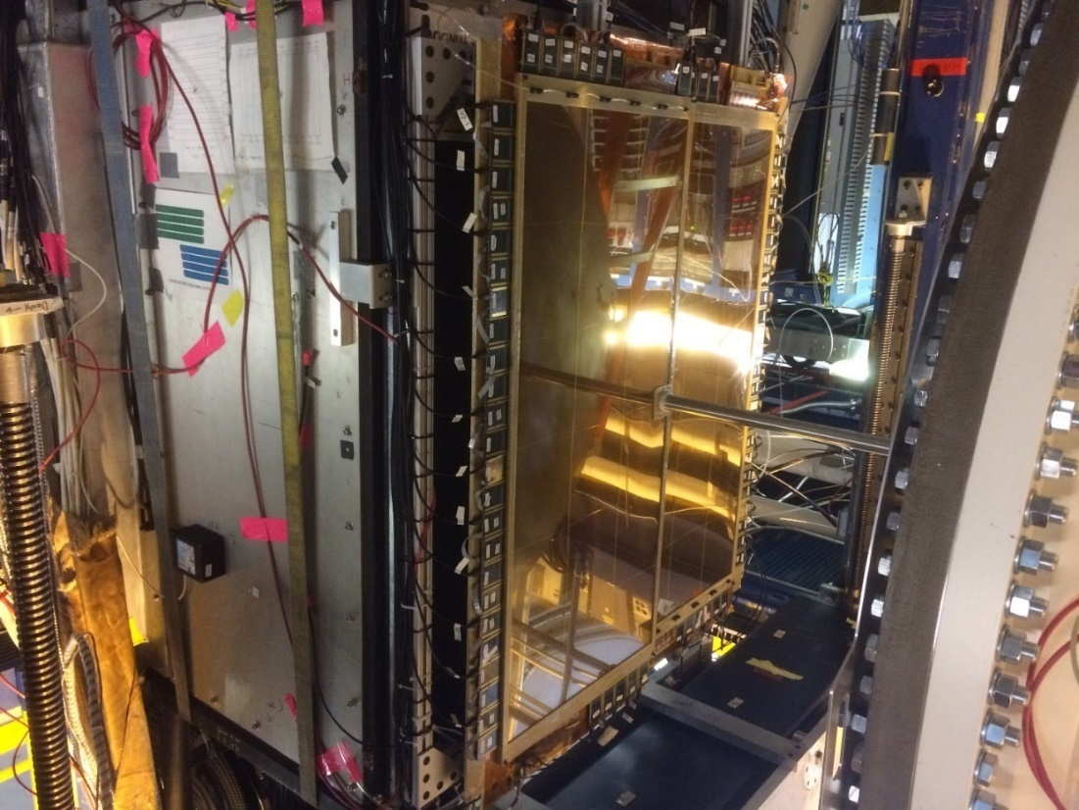
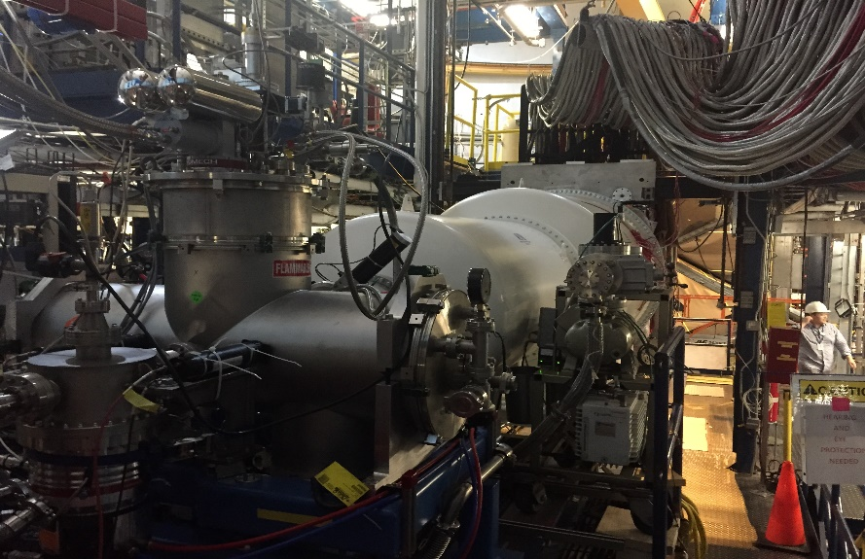
Installation done on May 11, 2016
(Thanks to Hall B Technical Group (D. Tilles and All)
GEM 1
HyCal Box
Vacuum chamber
GEM 2

Slide 10
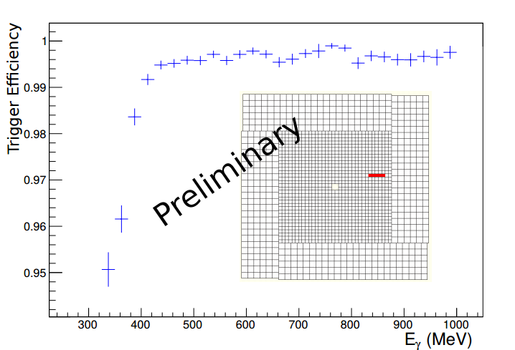
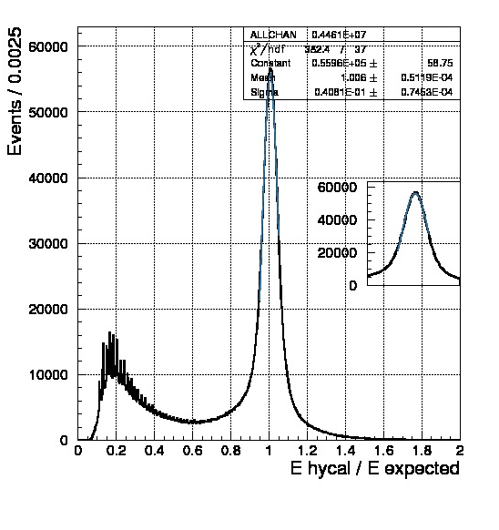
Gain Equalizing and Calibration
  Gain equalizing and calibration
    With tagged photon beam
    data-taking completed (May 25 – May 31)
    Analysis is ongoing
GEM 1
GEM 2

Slide 11
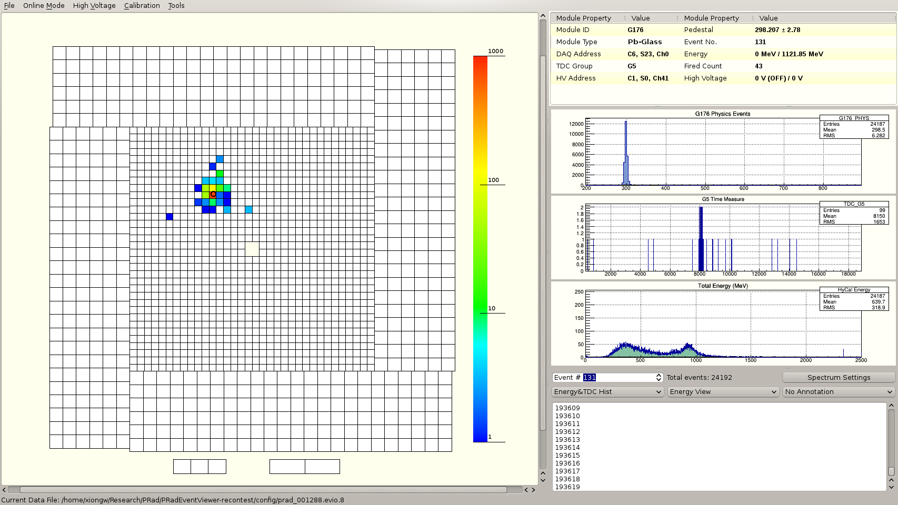
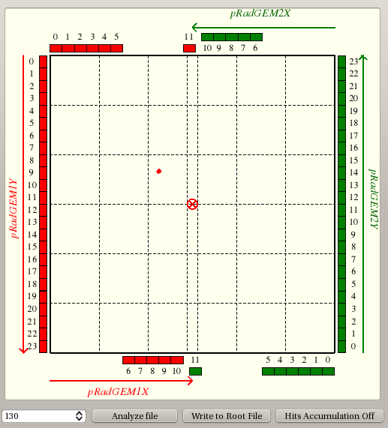
HyCal – GEM Matching
  Online matching, e-p elastic scattering event candidate
GEM 1
GEM 2

Slide 12
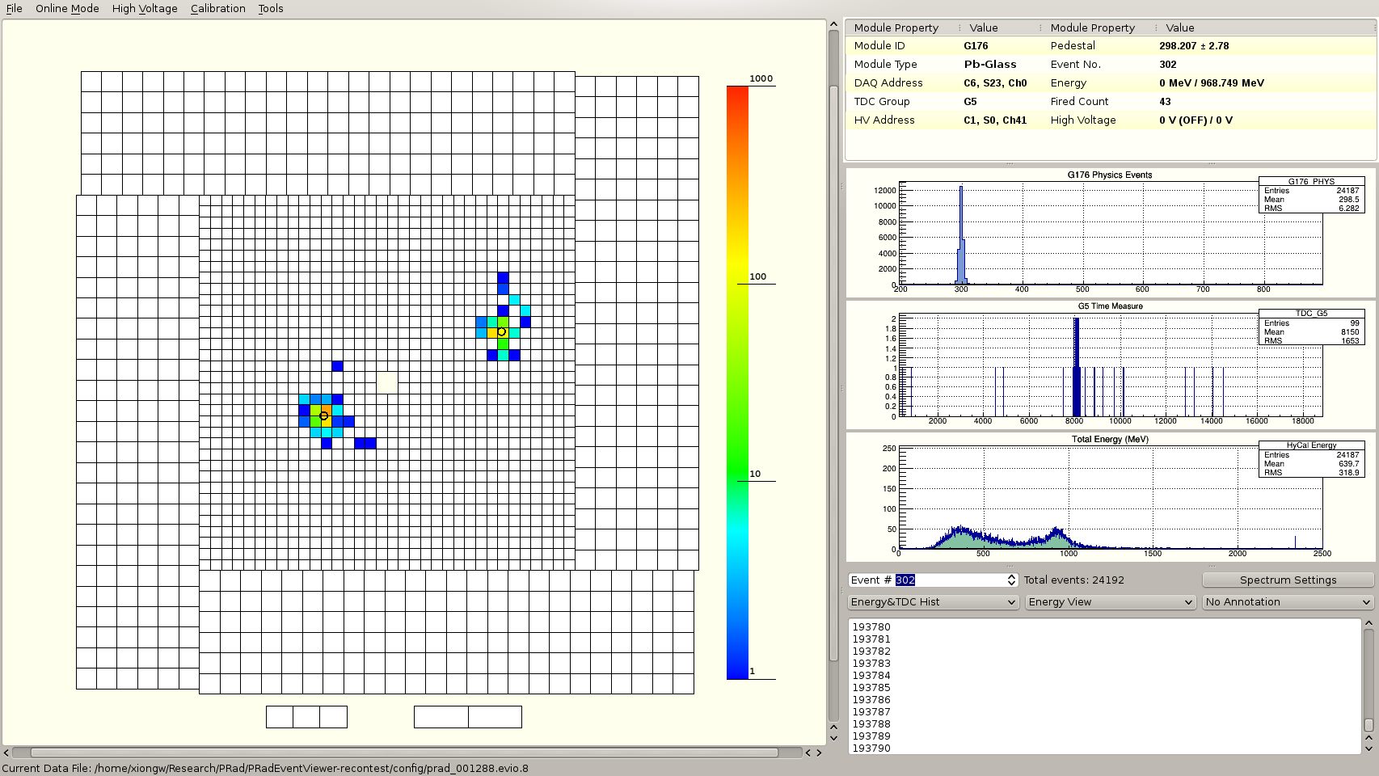
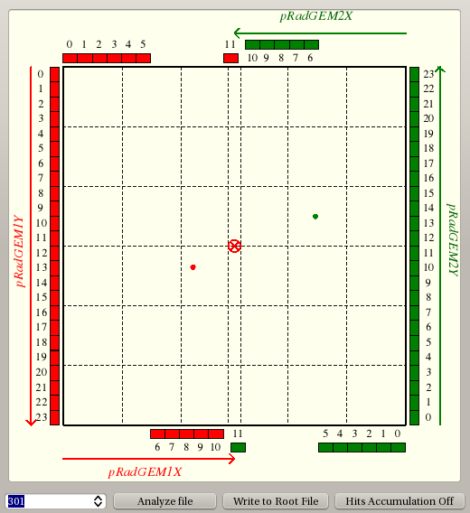
HyCal – GEM Matching
  Online matching, Møller event candidate
GEM 1
GEM 2

Slide 13
Data taking status
  End on June 22, status by June 20
  1.1 GeV data-taking completed
    10 nA/ 15 nA beam current, 400 Mb/s data rate with 86% live time
    600 M production events taken, 50 M events taken with empty target
    24 M events taken with carbon foil target
  2.2 GeV data-taking ongoing
    25 nA/ 60 nA beam current, 320 Mb/s data rate with 89% live time
    450 M production events taken, 15 M events taken with empty target
    Plan on carbon foil target and on background study on June 21 and June 22
GEM 1
GEM 2

Slide 14
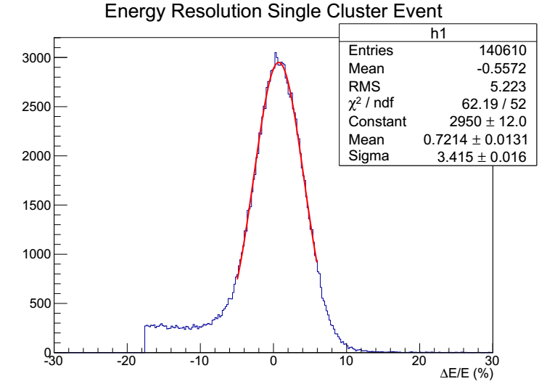
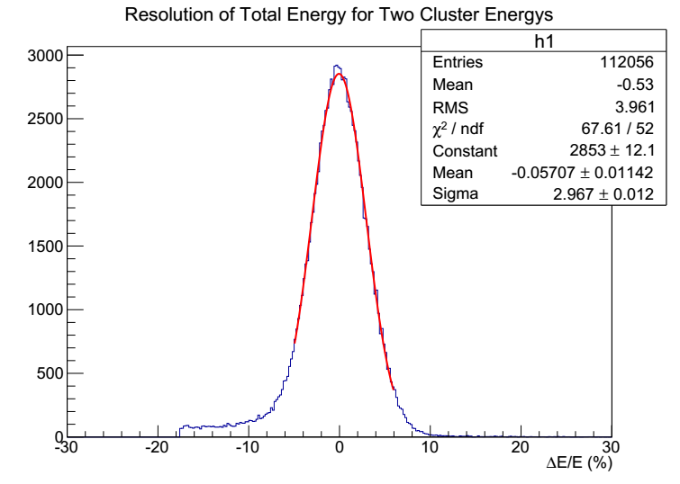
Preliminary analysis
Energy resolution from 1st iteration of calibration
  Single cluster event (e-p elastic scat. candidate) ~ 3.4%
  Total energy of two clusters event (Møller candidate) ~ 3.0%
GEM 1
GEM 2
Preliminary
Preliminary

Slide 15
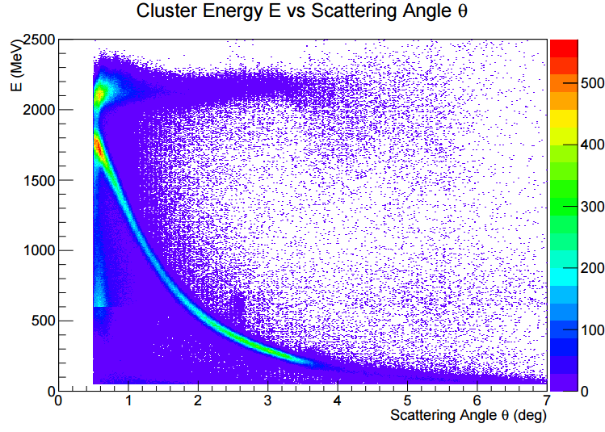
Preliminary analysis
2D-map of cluster energy vs. theta (from latest 2.2 GeV data)
GEM 1
Preliminary
GEM 2

Slide 16
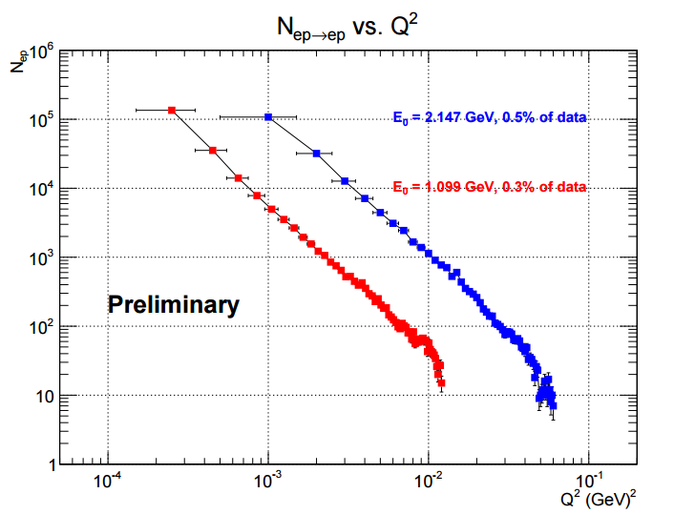
Preliminary analysis
Q² distribution of e-p elastic scattering event candidates
GEM 1
GEM 2

Slide 17
Thank you
Jefferson Lab
  Administration
  Accelerator division
  Hall B leadership, physics, engineering and technical staff
  12 GeV poject team
  Target group
  Data acquisition group and fast electronics group
  Physics division
  Engineering division
  Collaboration
The project is supported by
  U.S. Department of Energy under contract number DE-FG02-03ER41231
  NSF MRI award PHY-1229153
GEM 1
GEM 2

