Slide 1




Data Quality and Analysis Status of PRad Experiment at Jefferson Lab
Weizhi Xiong
Duke University
For the PRad Collaboration
Spokespersons: A. Gasparian(contact person), D. Dutta, M. Khandaker, H. Gao
APS April Meeting 2017
January 28th, 2017

Slide 2


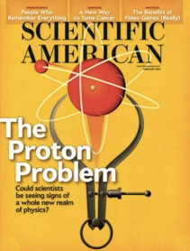
Outline
Proton charge radius puzzle and PRad experiment
PRad experimental apparatus
Data quality and current status
Summary

Slide 3
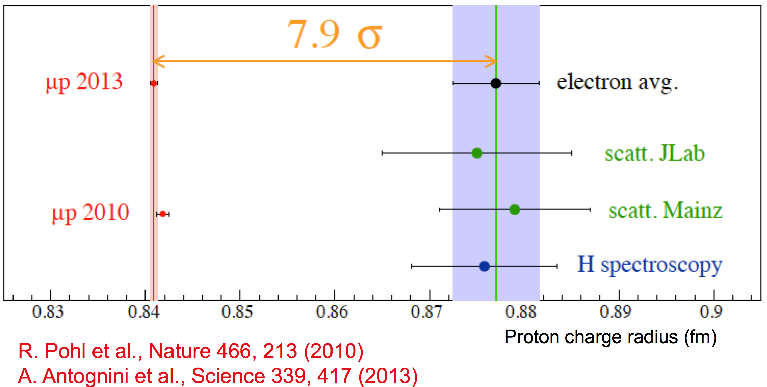
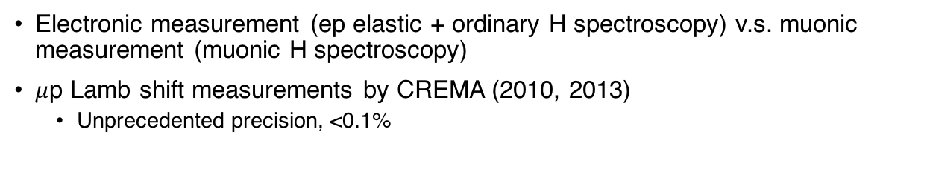
Proton Charge Radius Puzzle
Electronic measurement (ep elastic + ordinary H spectroscopy) v.s. muonic measurement (muonic H spectroscopy)
$μ$p Lamb shift measurements by CREMA (2010, 2013)
  Unprecedented precision, <0.1%

Slide 4
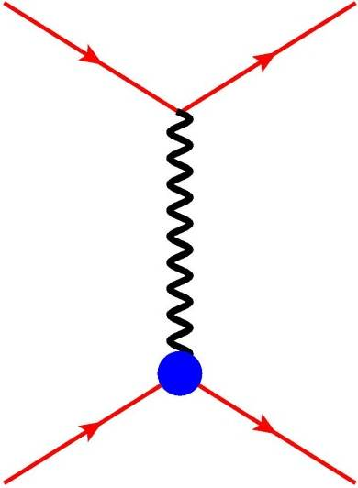


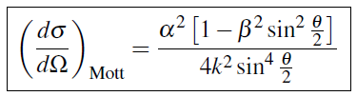

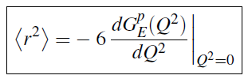
Proton Charge Radius from ep Elastic Scattering
e⁻
e⁻
Elastic ep scattering, in the limit of Born approximation (one photon exchange):
G_{E} ,G_{M}
p
p
Structure-less proton:
Taylor expansion of G_{E} at low Q²
Derivative at low Q² limit
G_{E} and G_{M} can be extracted using Rosenbluth separation
For PRad, cross section dominated by G_{E}

Slide 5
PRad Experiment Overview
PRad goal: Measuring proton charge radius using ep elastic scattering
Unprecedented low Q² (~2x10⁻⁴ GeV²)
  Fill in very low Q² region
Large Q² range in a single setting
  ~2x10⁻⁴ - 6x10⁻² GeV²
Calibrate to the simultaneously measured Møller scattering process
  best known control of systematics
Aims to extract cross section and radius to sub-percentage level

Slide 6
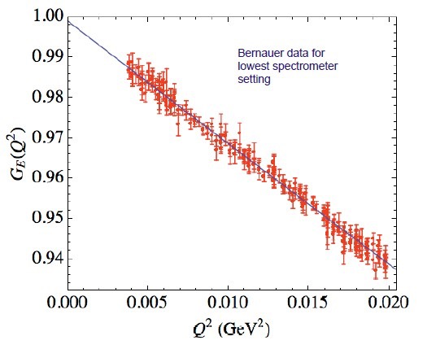
PRad Experiment Overview
PRad goal: Measuring proton charge radius using ep elastic scattering
Unprecedented low Q² (~2x10⁻⁴ GeV²)
  Fill in very low Q² region
Large Q² range in a single setting
  ~2x10⁻⁴ - 6x10⁻² GeV²
Calibrate to the simultaneously measured Møller scattering process
  best known control of systematics
Aims to extract cross section and radius to sub-percentage level
Mainz low Q² data set
Phys. Rev. C 93, 065207, 2016

Slide 7
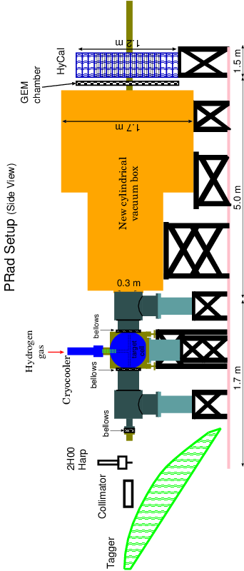
PRad Experimental Apparatus
Data taking in May and June of 2016 in Hall B at Jefferson Lab, with 1.1 and 2.2 GeV electron beams
Over 1.3 billion events taken with hydrogen target

Slide 8
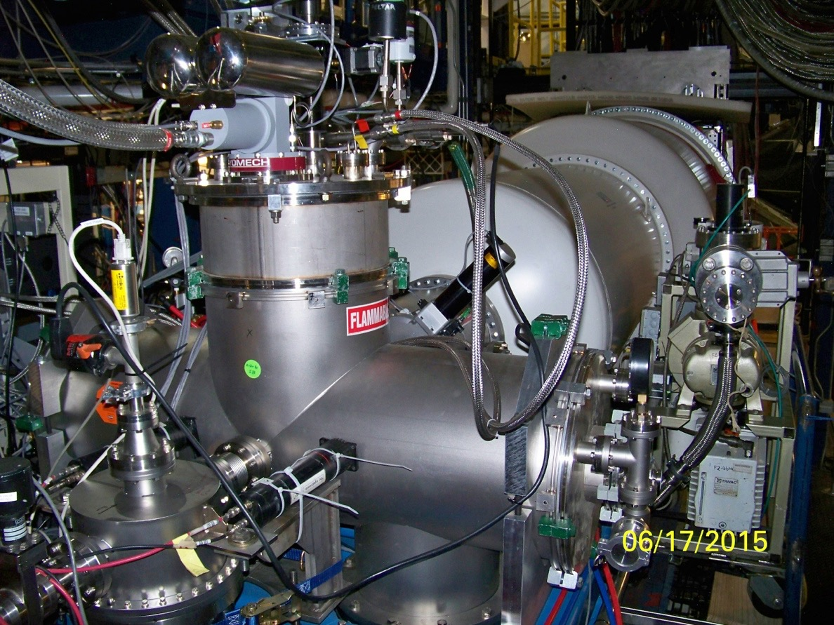
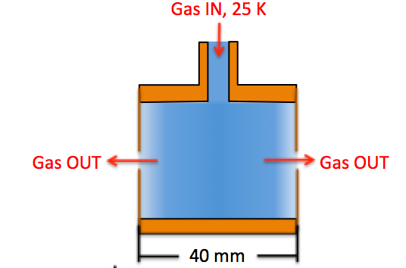
PRad Experimental Apparatus
Electron Beam
8 cm dia x 4 cm long target cell
2mm holes open at front and back kapton foils, allows beam to pass through
Areal density: ~2 x 10¹⁸ H atoms / cm²

Slide 9
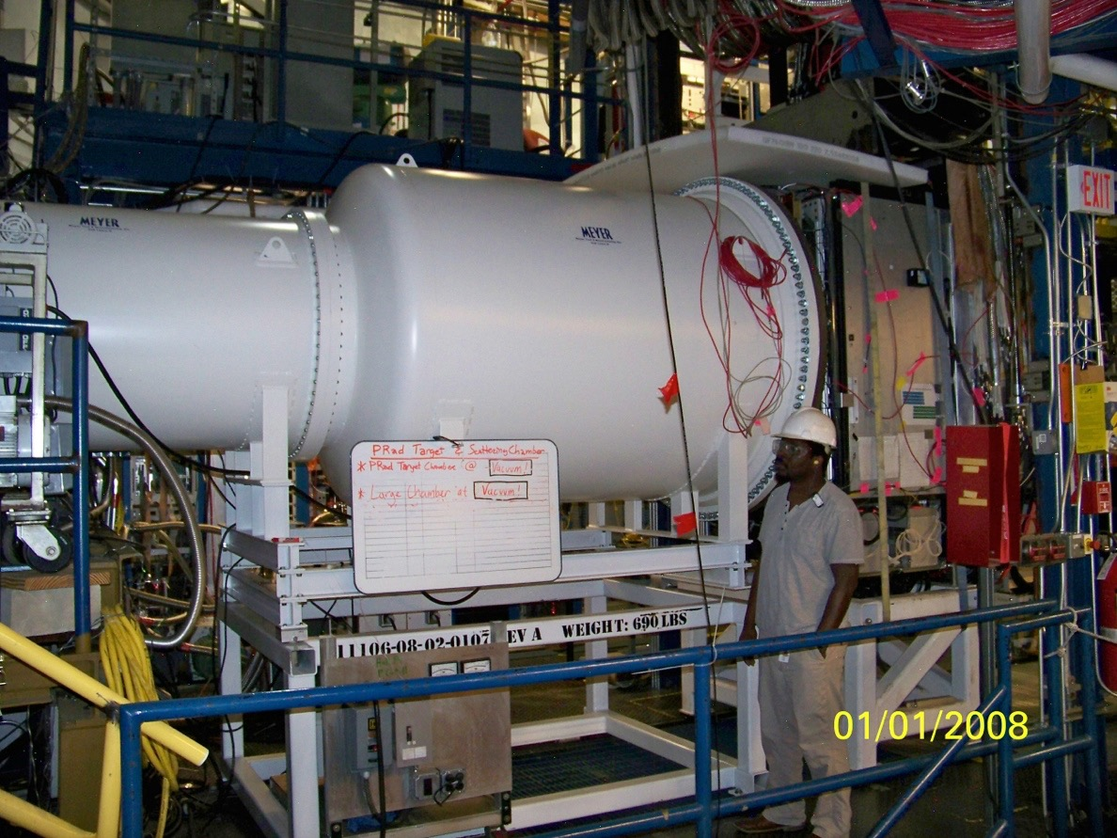
PRad Experimental Apparatus
5m long two stage vacuum box, further remove possible background source
vacuum tank pressure: 0.3 mtorr

Slide 10
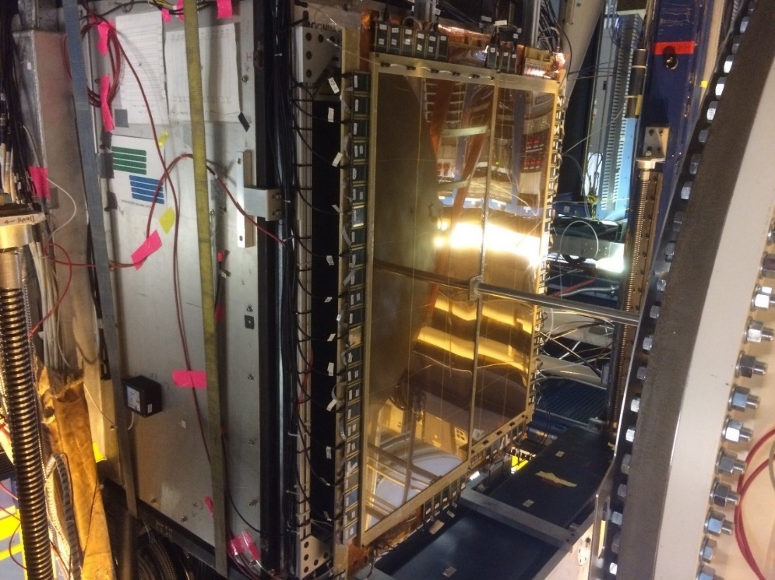
PRad Experimental Apparatus
Two large area GEM detectors
Small overlap region in the middle
Excellent position resolution (~72µm)
Improve position resolution of the setup by > 20 times
Similar improvement for Q² determination at small angle

Slide 11
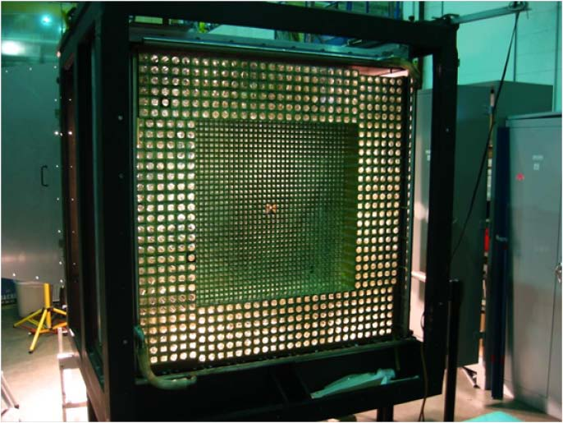
PRad Experimental Apparatus
Hybrid EM calorimeter
  Inner 1156 PWO₄ modules
  Outer 576 lead glass modules
5.8m from the target
Polar angle coverage: ~ 0.6˚ to 7.5˚
Azimuthal angle coverage: 2π
High resolution and efficiency

Slide 12
HyCal Resolution and Efficiency
HyCal energy resolution and trigger efficiency extracted using high energy photon beam from Hall B at Jlab
  > 99.5% trigger efficiency obtained for E_{𝜸} > 500 MeV, for various parts of HyCal
  Energy resolution ~2.6% for PWO₄ part, lead glass part able 2.5 time worse
Preliminary
Preliminary

Slide 13
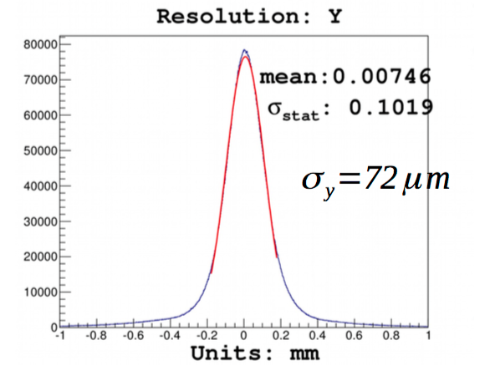
Performance of GEM Detectors
GEM detection efficiency measured in both photon beam calibration (pair production) and production runs (ep and ee)
Using overlap region of GEMs to measure position resolution (~72𝛍m)
Detection efficiency
100
90
80
70
60
Preliminary
Very Preliminary
More details see presentation of X. Bai in session E12

Slide 14
PRad Data Analysis Status
Cluster Energy E’ vs. Scattering Angle 𝜽
(after cluster matching between GEMs and HyCal, and background subtraction)
1.1 GeV
Preliminary
2.2 GeV
Preliminary
HyCal calibration accomplished with tagged photon beam and majority of physics data
  Reached expected energy resolution of 2.6% for PWO₄ modules and 6.2% for lead glass
Obtained preliminary result for HyCal trigger efficiency (>99.5% for E_{𝛄} > 500 MeV)
Detector alignment accomplished, matching of GEMs and HyCal achieved
Obtained GEM position resolution (72𝛍m) and preliminary detection efficiency (~92%)
Analysis for cross section is ongoing

Slide 15
Summary
The Proton Radius Puzzle is still unsolved after six years
The PRad experiment is a unique piece to the puzzle:
  Lowest Q² data set (~2x10⁻⁴ GeV²) has been collected for the first time in ep elastic scattering experiment
  Data in a large Q² range (~2x10⁻⁴ – 6x10⁻² GeV²) have been collected with the same experimental setting
  Large statistics, high quality, rich data has been collected
  Systematic uncertainty well under control by simultaneous measurement of ep elastic and Møller processes
Analysis on the first preliminary result is ongoing
This work was supported in part by NSF-MRI grant PHY-1229153 and US DOE grant DE-FG02-03ER41231

