Slide 1


Latest on the Proton Charge Radius from the PRad Experiment
Haiyan Gao
Duke University and Duke Kunshan University

Slide 2

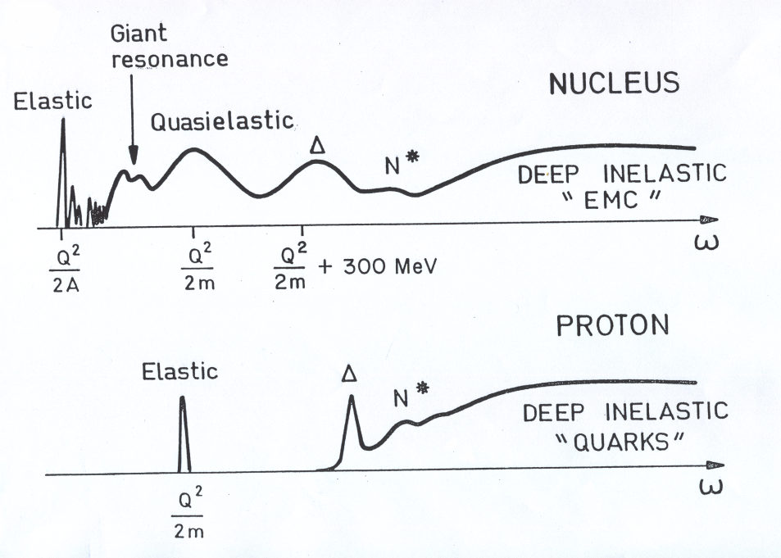
Lepton scattering: powerful microscope!
Clean probe of hadron structure
Electron (lepton) vertex is well-known from QED
One-photon exchange dominates, higher-order
exchange diagrams are suppressed (two-photon physics)
Vary the wave-length of the probe to view deeper inside
Virtual photon 4-momentum
k’
k

Slide 3
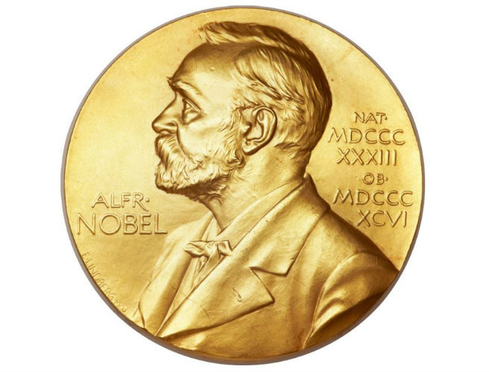
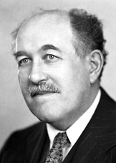
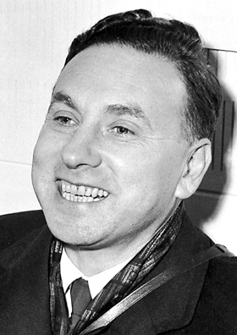
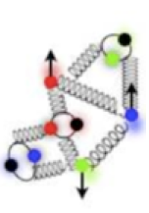
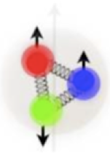
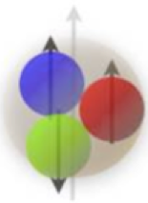
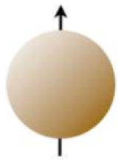
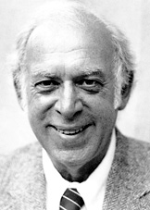
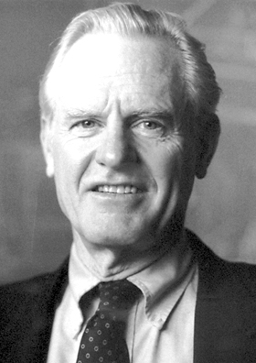
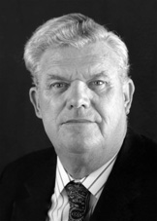
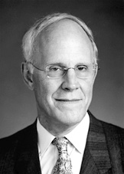


What is inside the proton/neutron?
1933: Proton’s magnetic moment
1960: Elastic e-p scattering
Nobel Prize
In Physics 1943
Nobel Prize
In Physics 1961
Otto Stern
Robert Hofstadter
"for … and for his thereby achieved discoveries concerning the structure of the nucleons"
"for … and for his discovery of the magnetic moment of the proton".
1969: Deep inelastic e-p scattering
1974: QCD Asymptotic Freedom
Nobel Prize in Physics 1990
Nobel Prize in Physics 2004
Jerome I. Friedman,
Henry W. Kendall,
Richard E. Taylor
David J. Gross,
H. David Politzer,
Frank Wilczek
"for their pioneering investigations concerning deep inelastic scattering of electrons on protons …". Jian-Wei Qiu
"for the discovery of asymptotic freedom in the theory of the strong interaction".

Slide 4
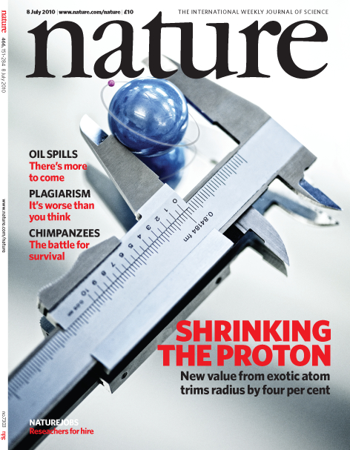
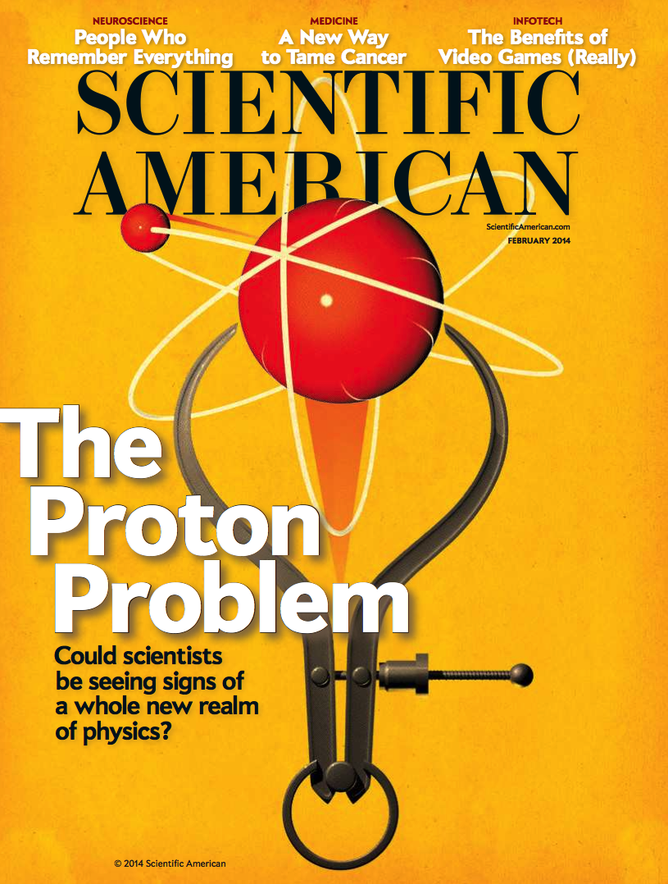
Proton Charge Radius
An important property of the nucleon
  Important for understanding how QCD works
  Challenge to Lattice QCD (exciting new results, Alexandrou et al.)
  An important physics input to the bound state QED calculations, affects muonic H Lamb shift (2S _{1/2} – 2P _{1/2}) by as much as 2%
Electron-proton elastic scattering to determine electric form factor (Nuclear Physics)
Spectroscopy (Atomic physics)
  Hydrogen Lamb shift
  Muonic Hydrogen Lamb shift

Slide 5
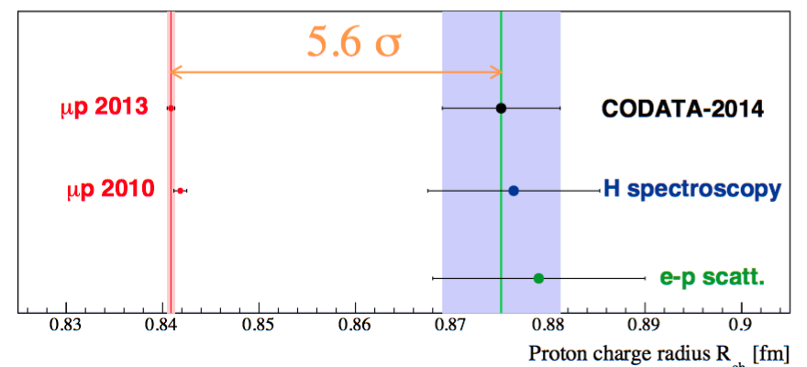
Proton Charge Radius Puzzle
R. Phol
Electron: 0.8751 ± 0.0061 fm
Muon: 0.8409 ± 0.0004 fm
p Lamb shift measurements by CREMA (2010, 2013)
  Unprecedented precision, <0.1%

Slide 6
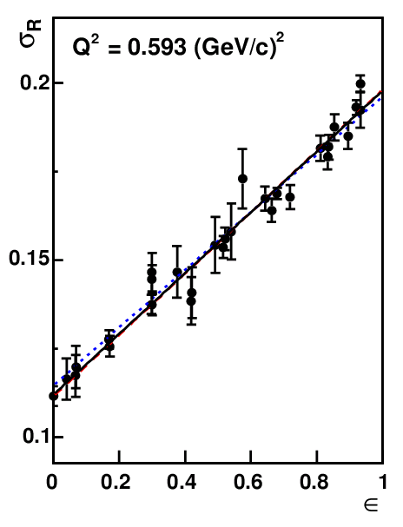
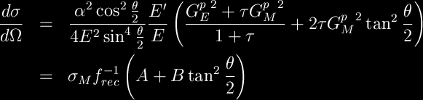

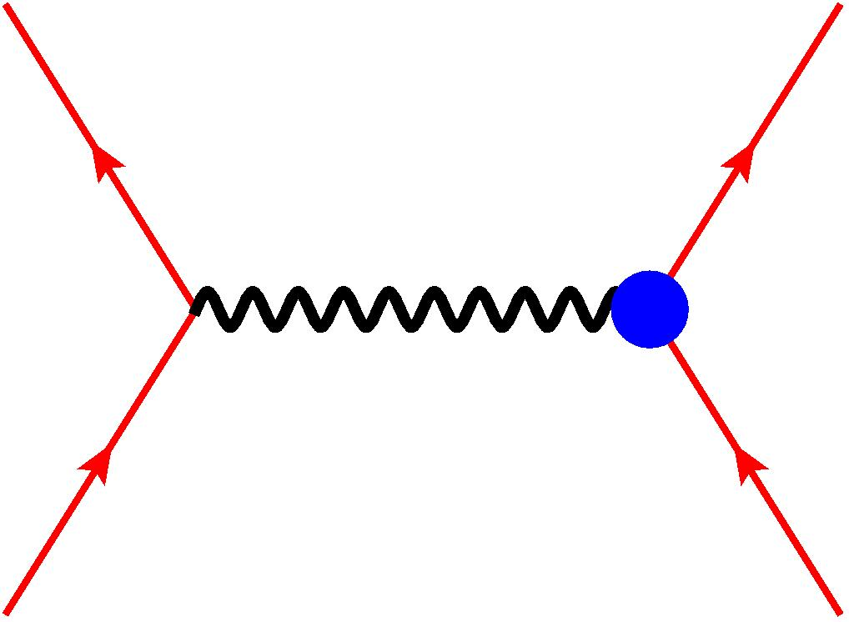
Unpolarized electron-nucleon scattering
(Rosenbluth Separation)
Elastic e-p cross section
At fixed Q², fit dσ/dΩ vs. tan²(θ/2)
  Measurement of absolute cross section
  Dominated by either G_{E} or G_{M}
    Low Q² by G_{E}
    High Q² by G_{M}
  G_{E} or G_{M}

Slide 7
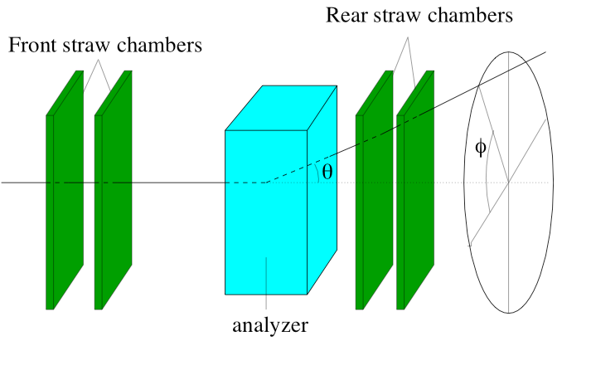

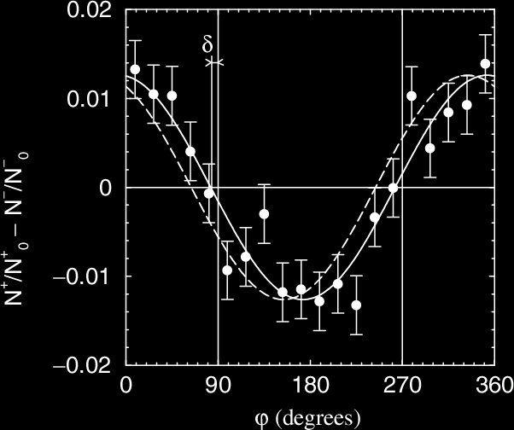
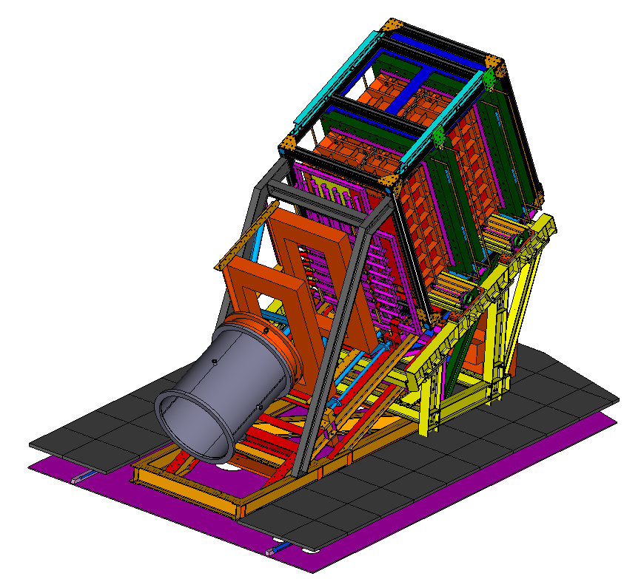
Electron-proton elastic scattering with longitudinally polarized electron beam and recoil proton polarization measurement
Polarization Transfer
Recoil proton polarization
Focal Plane Polarimeter
  recoil proton scatters
  off secondary ¹²C target
  P_{t}, P_{l} measured from
  ϕ distribution
  P_{b}, and analyzing power
  cancel out in ratio
Focal-plane polarimeter

Slide 8
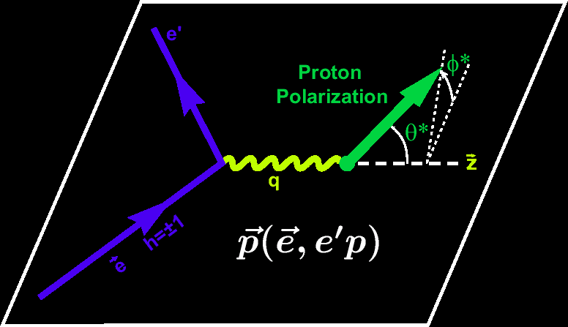
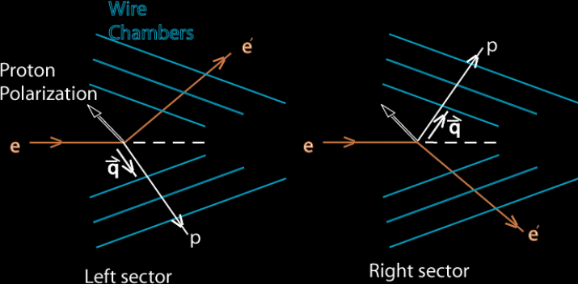
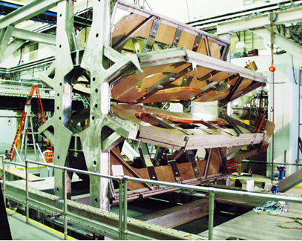

Asymmetry Super-ratio Method
Polarized electron-polarized proton elastic scattering
Polarized beam-target asymmetry
Super-ratio
BLAST pioneered the technique, later also
used in Jlab Hall A experiment

Slide 9
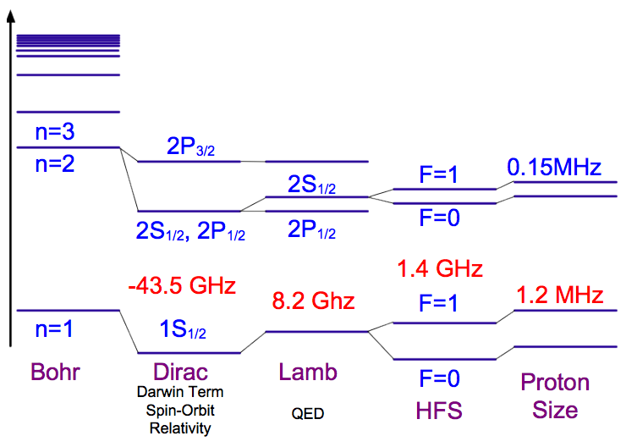
Hydrogen Spectroscopy
The absolute frequency of H energy levels has been measured with an accuracy of 1.4 part in 10¹⁴ via comparison with an atomic cesium fountain clock as a primary frequency standard.
Yields R∞ (the most precisely known constant)
Comparing measurements to QED calculations that include corrections for the finite size of the proton provide an indirect but very precise value of the rms proton charge radius
Proton charge radius effect on the muonic hydrogen Lamb shift is 2%

Slide 10
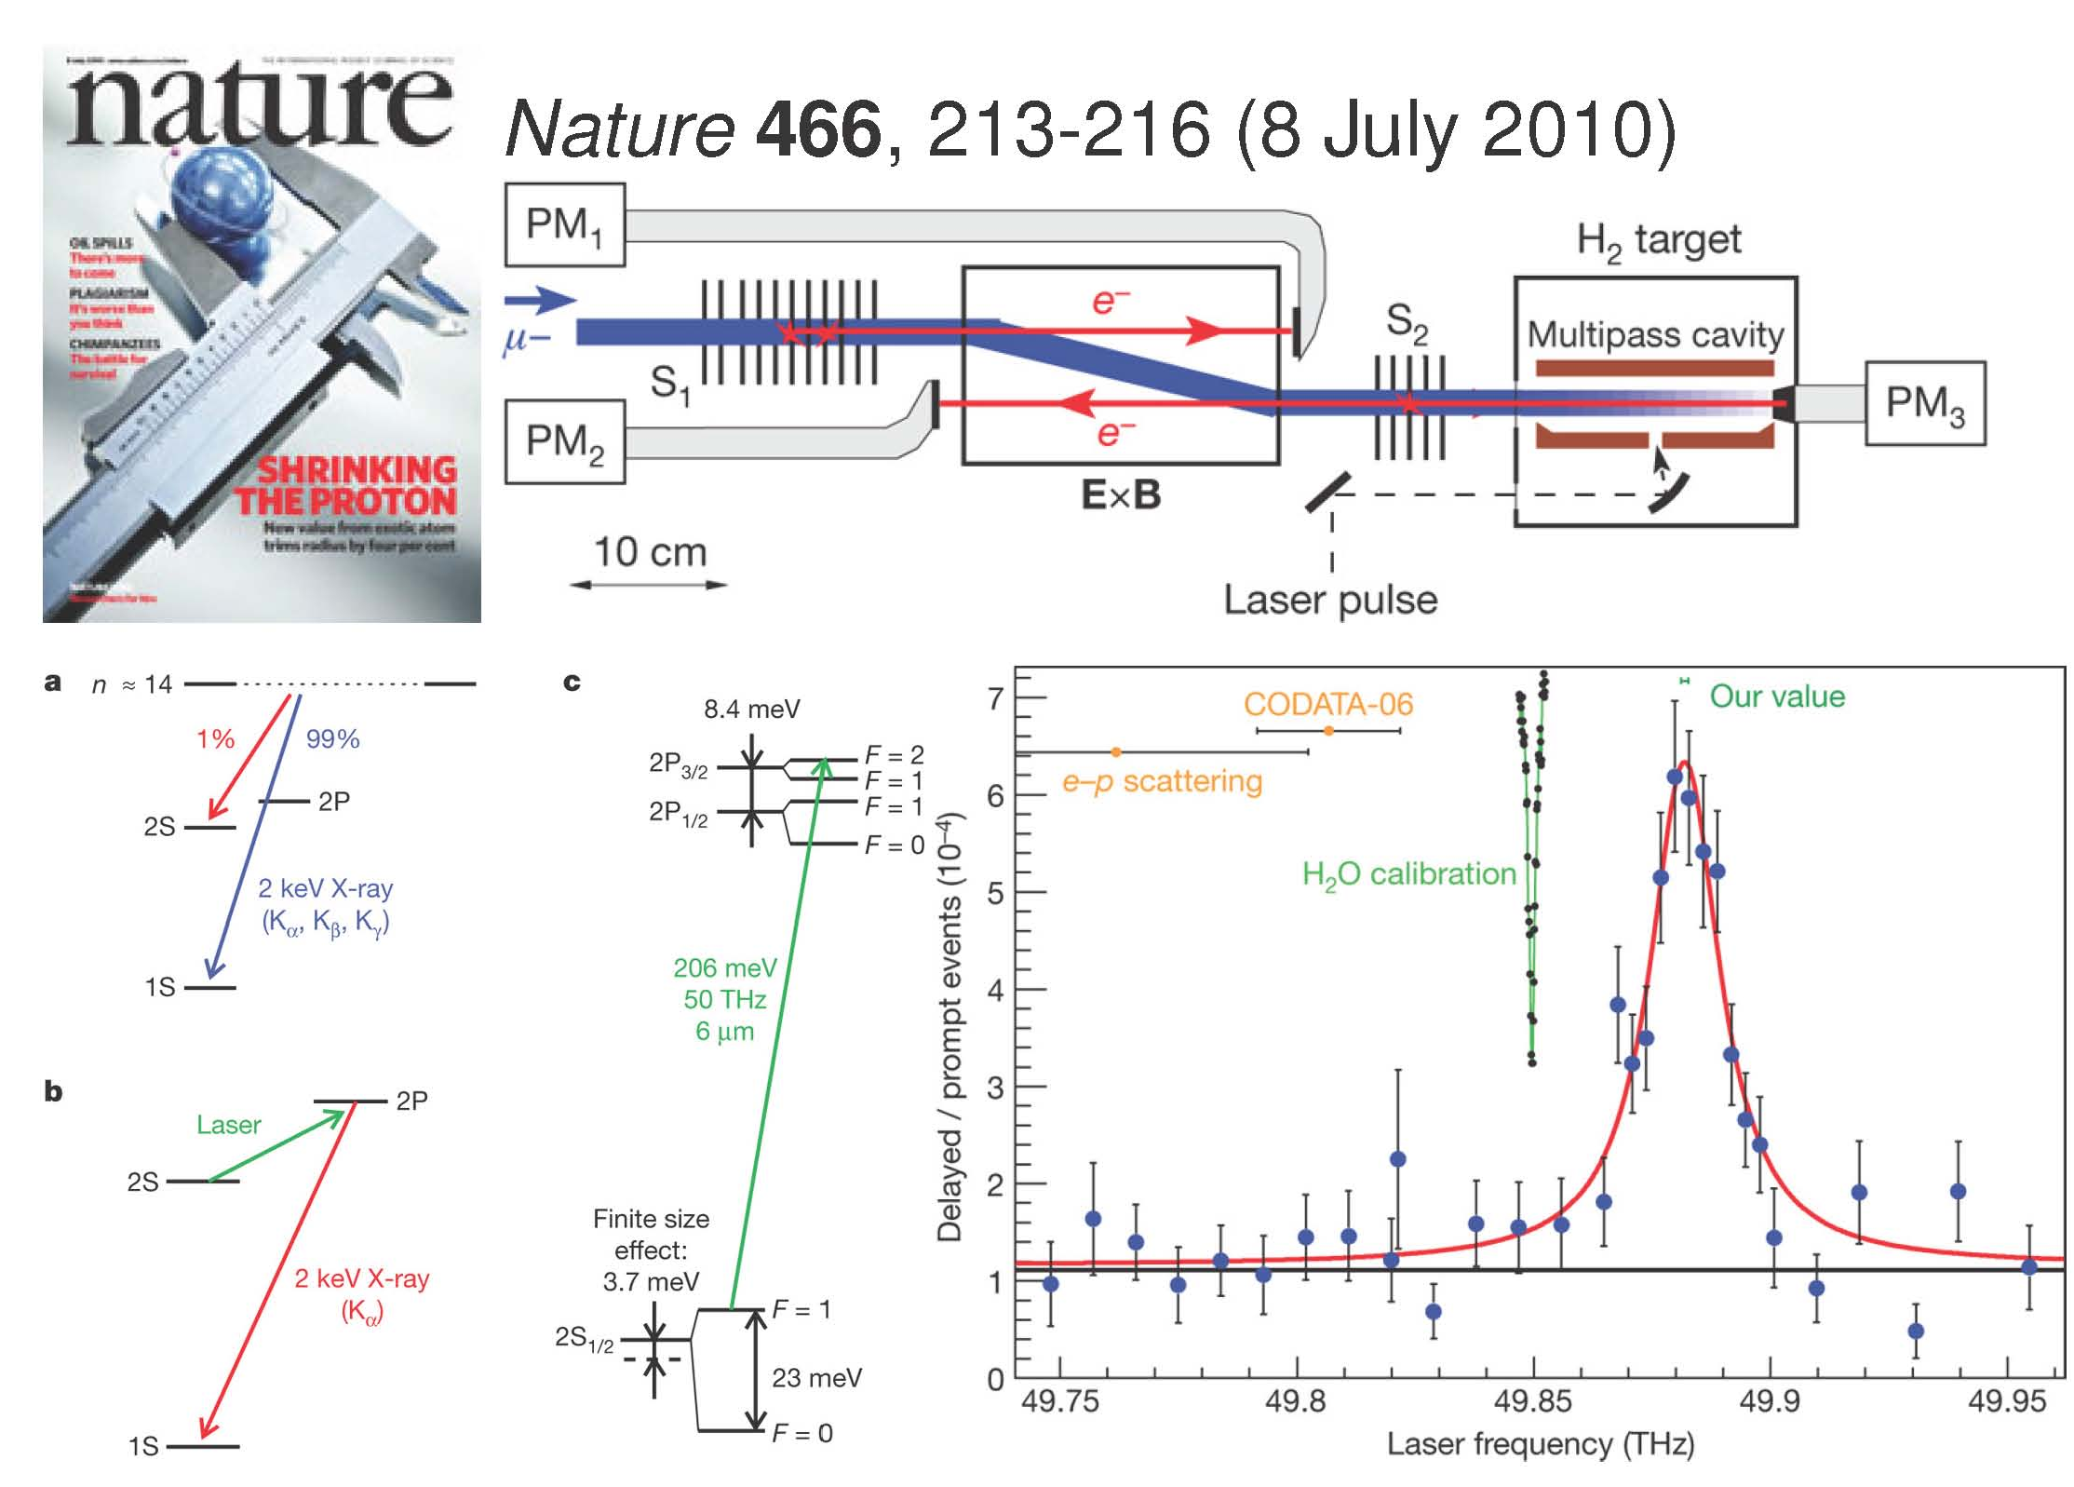
Muonic hydrogen Lamb shift at PSI (2010, 2013)
2010: new value is r_{p} = 0.84184(67) fm

Slide 11
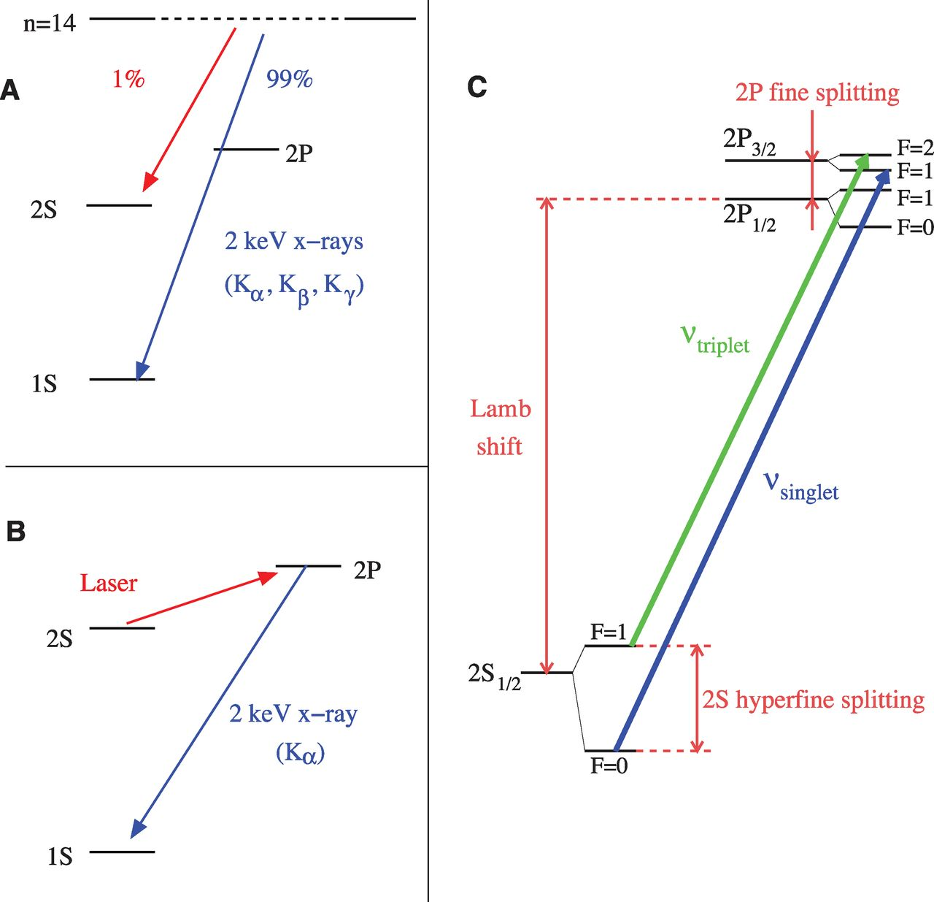
New PSI results reported in Science 2013
2013: r_{p} = 0.84087(39) fm, A. Antognini et al., Science 339, 417 (2013)

Slide 12
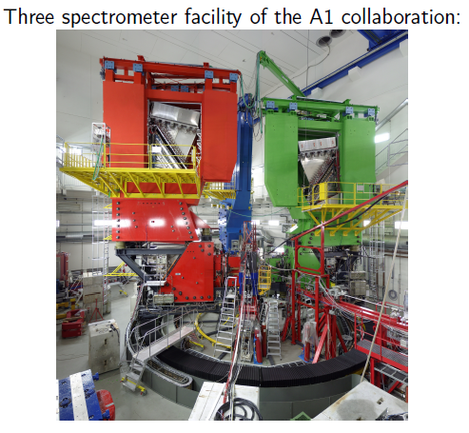
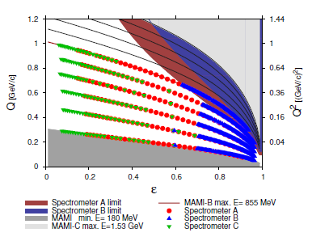
Recent ep Scattering Experiments
Measurements @ Mainz
– Large amount of overlapping data sets
– Statistical error ≤ 0.2%
– Luminosity monitoring with spectrometer
Q² = 0.004 – 1.0 (GeV/c)²
result: r_{p} =0.879(5)_{stat}(4)_{sys}(2)_{mod}(4)_{group}
J. Bernauer, PRL 105,242001, 2010
5-7σ higher than muonic hydrogen result !
(J. Bernauer)

Slide 13
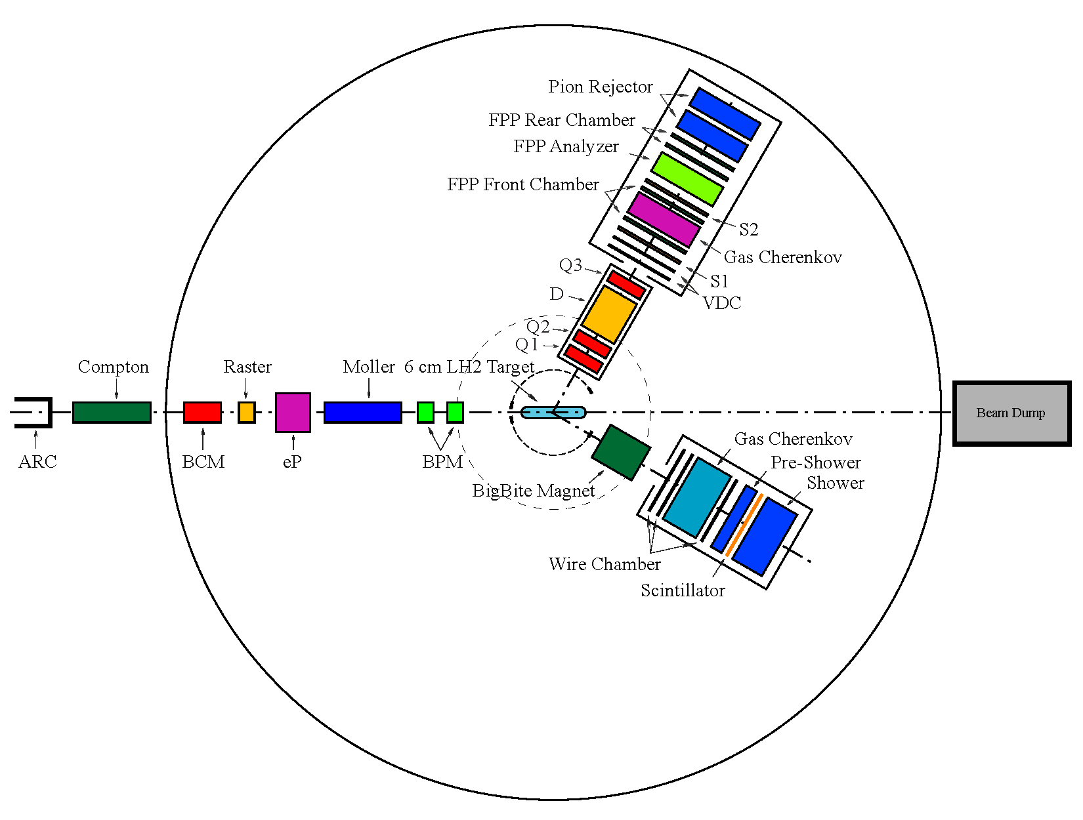
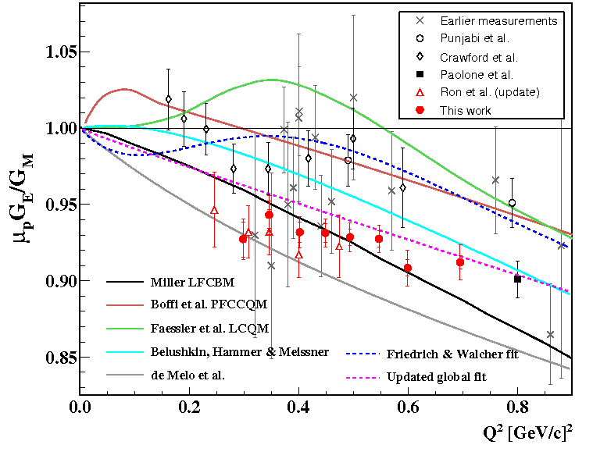
JLab Recoil Proton Polarization Experimental
LHRS
Δp/p0: ± 4.5% ,
out-of-plane: ± 60 mrad
in-plane: ± 30 mrad
ΔΩ: 6.7msr
QQDQ
Dipole bending angle 45º
VDC+FPP
P_{p} : 0.55 ~ 0.93 GeV/c
E_{e}: 1.192GeV
P_{b}: ~83%
BigBite
Non-focusing Dipole
Big acceptance.
  Δp: 200-900MeV
  ΔΩ: 96msr
PS + Scint. + SH
X. Zhan et al. Phys. Lett. B 705 (2011) 59-64
C. Crawford et al. PRL98, 052301 (2007)

Slide 14
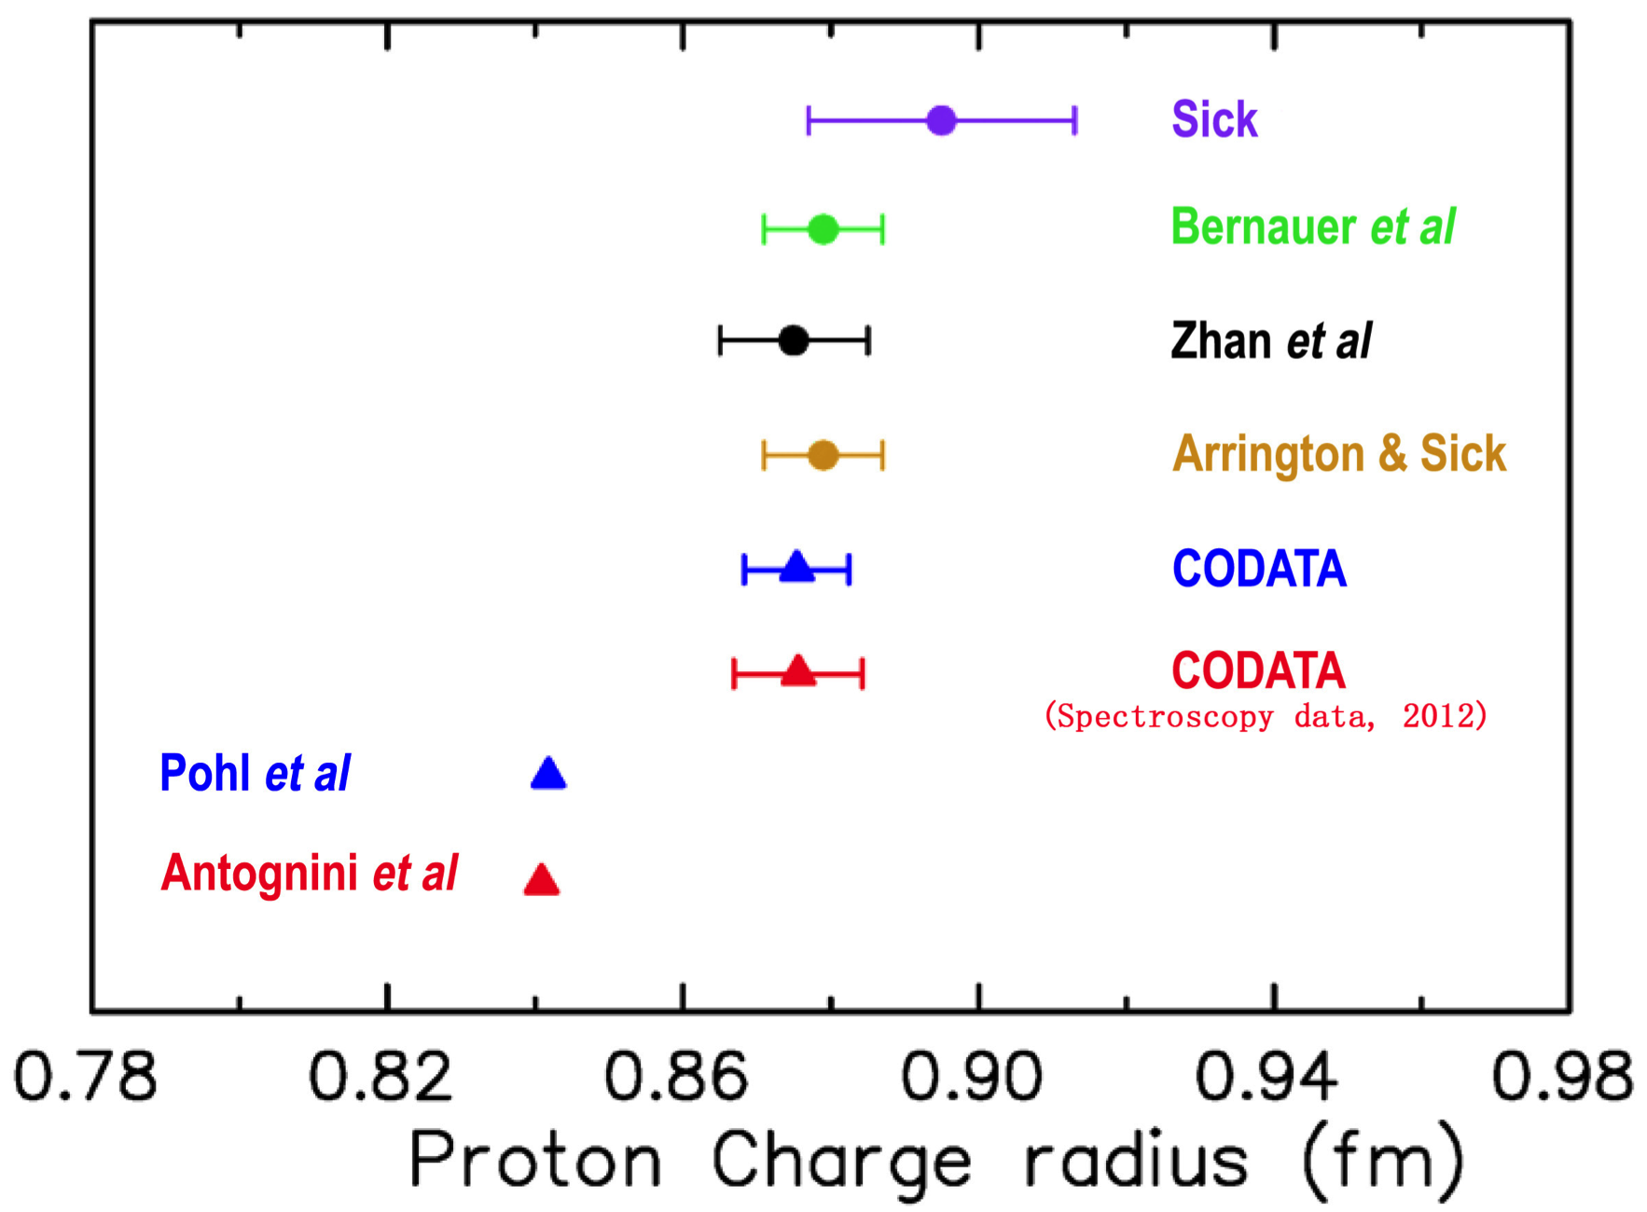
Proton Charge Radius from recent experiments and analyses

Slide 15
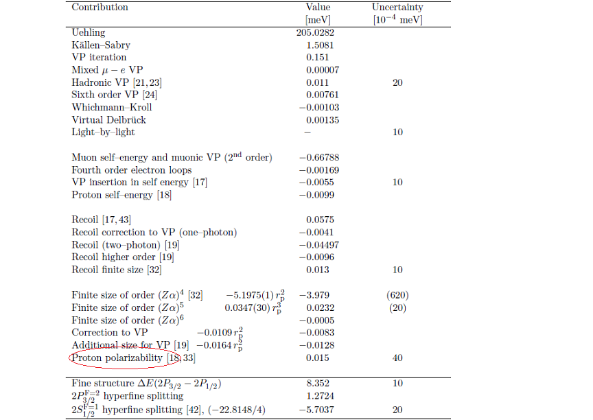
Revisits QED Calculations….
An additional 0.31 meV to
match CODATA value
Evaluation by Jentschura,
Annals Phys. 326, 500 (2011)
Recent summary by
A. Antognini et al., arXiv:1208.2637
Birse and McGovern, arXiv:1206.3030
0.015(4) meV (proton polarizability)
G.A. Miller, arXiv:1209.4667
New experiments at HIGS and
Mainz on proton polarizabilities
J.M. Alarcon, et al. 1312.1219
0.008 meV

Slide 16
Revisits of e-p scattering data (just 2015)
Re-analysis of existing proton form factor data
  D. W. Higinbotham, arXiv:1510.01293: two parameter dipole form fit describes the data at both low Q² and high Q² well, and the result is consistent with PSI value
  K. Griffioen, C. Carson, S. Maddox, arXiv:1509.06676: re-analysis of Mainz data, focusing on the low Q² part with a polynomial form fit.
  M. Horbatsch and E. A. Hessels, arXiv:1509.05644: re-analysis of Mainz data, simple fits (one-parameter model, dipole model, linear model) for low Q2 data, and spline extension to high Q2 data, these fits can all describe data well, but the extracted radius varies from 0.84 ~ 0.89 fm. So current data is not able to resolve the puzzle.
  J. Arrington, arXiv:1506.00873: re-analysis of world data, found the previous scattering results might underestimate the uncertainty.
  Distler, Walcher, and Bernauer, arXiv1511.00479
All these studies emphasize even more the importance of low Q² e-p scattering data
Notes:
Uehling potential

Slide 17
New Physics or what? - Incomplete list
New physics: new particles, Barger et al., Carlson and Rislow; Liu and Miller,….New PV muonic force, Batell et al.; Carlson and Freid; Extra dimension: Dahia and Lemos; Quantum gravity at the Fermi scale R. Onofrio;…….
Contributions to the muonic H Lamb shift: Carlson and Vanderhaeghen,; Jentschura, Borie, Carroll et al, Hill and Paz, Birse and McGovern, G.A. Miller, J.M. Alarcon, Ji, Peset and Pineda….
Higher moments of the charge distribution and Zemach radii, Distler, Bernauer and Walcher,…..
J.A. Arrington, G. Lee, J. R. Arrington, R. J. Hill discuss systematics in extraction from ep data, no resolution on discrepancy
Donnelly, Milner and Hasell discuss interpretation of ep data,………
Discrepancy explained by some but others disagree
Dispersion relations: Lorentz et al.
Frame transformation: D. Robson
New experiments: Mainz (e-d, ISR), JLab (PRad), PSI (Lamb shift, and MUSE), H Lamb shift
Notes:
Uehling potential

Slide 18
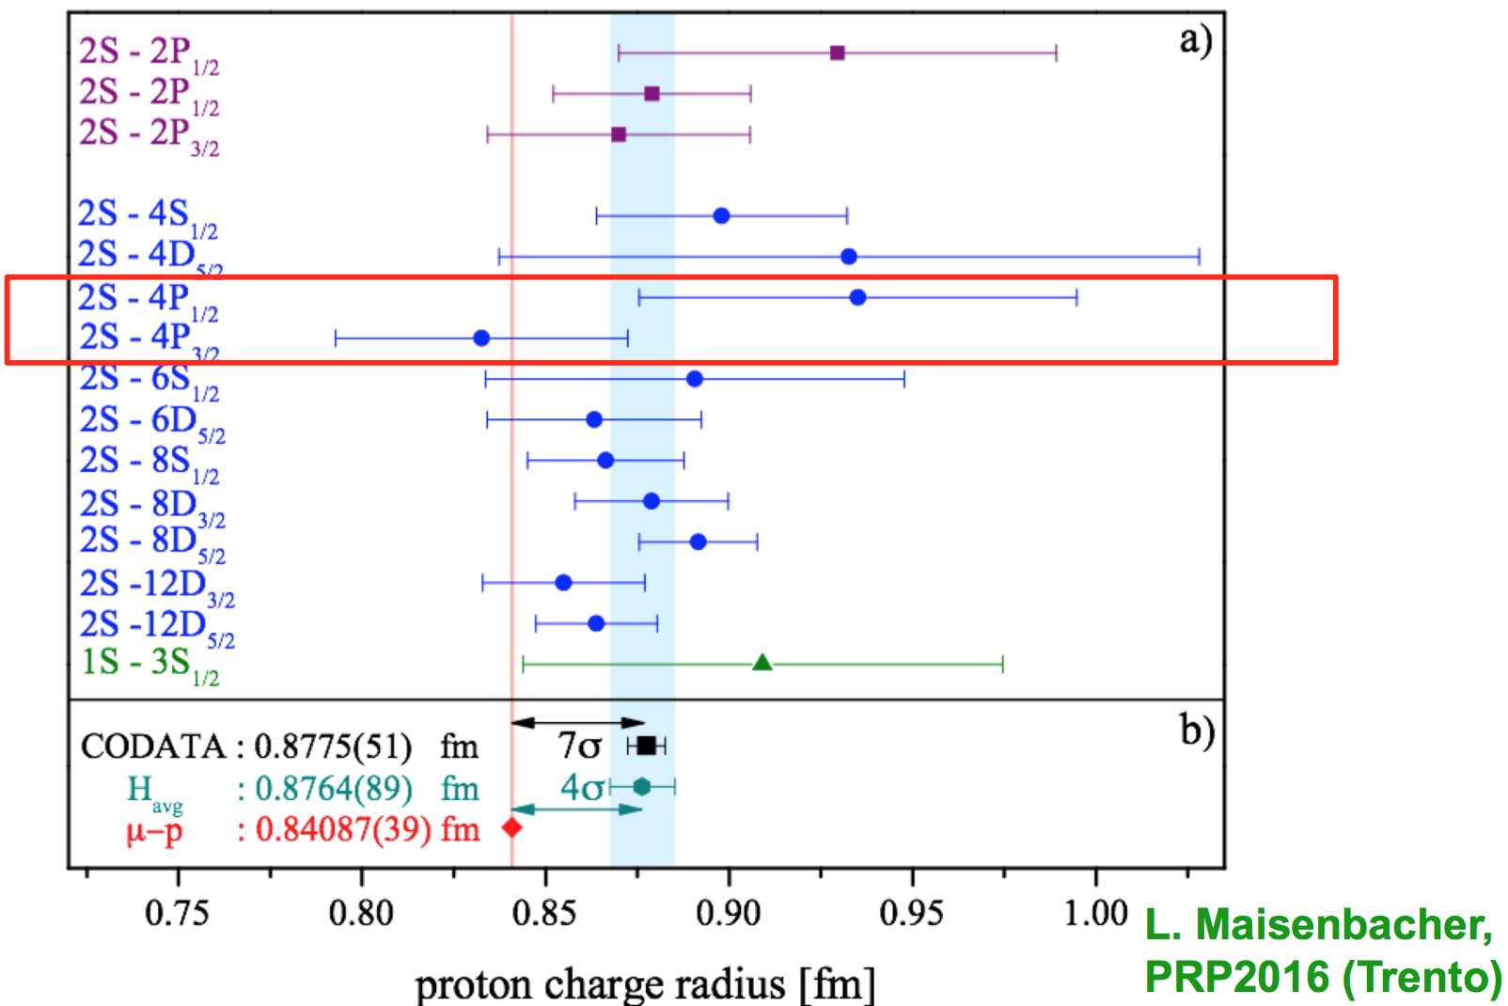
The Proton Radius Puzzle (June 2016)
M. Kohl
New, preliminary value for r_{p} was reported in PRP-2016 Workshop (Trento, Italy) from ordinary hydrogen
Consistent with the muonic-hydrogen result !
Is the Puzzle solved? No, new measurements are needed (spectroscopy, ep-scattering)

Slide 19
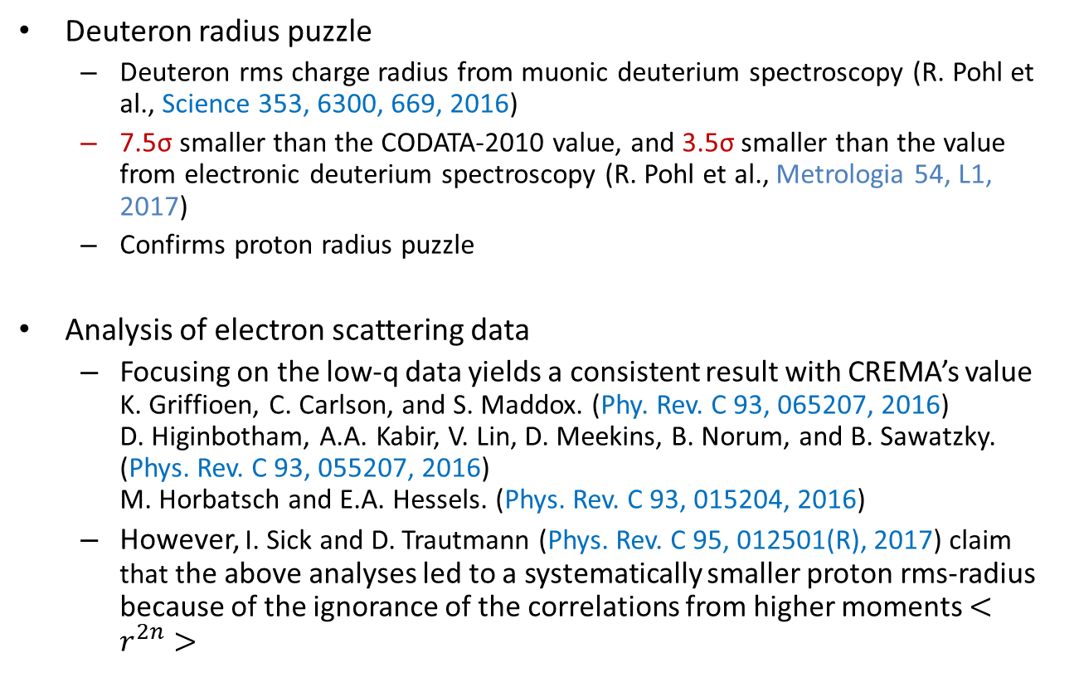
Update on proton radius puzzle

Slide 20
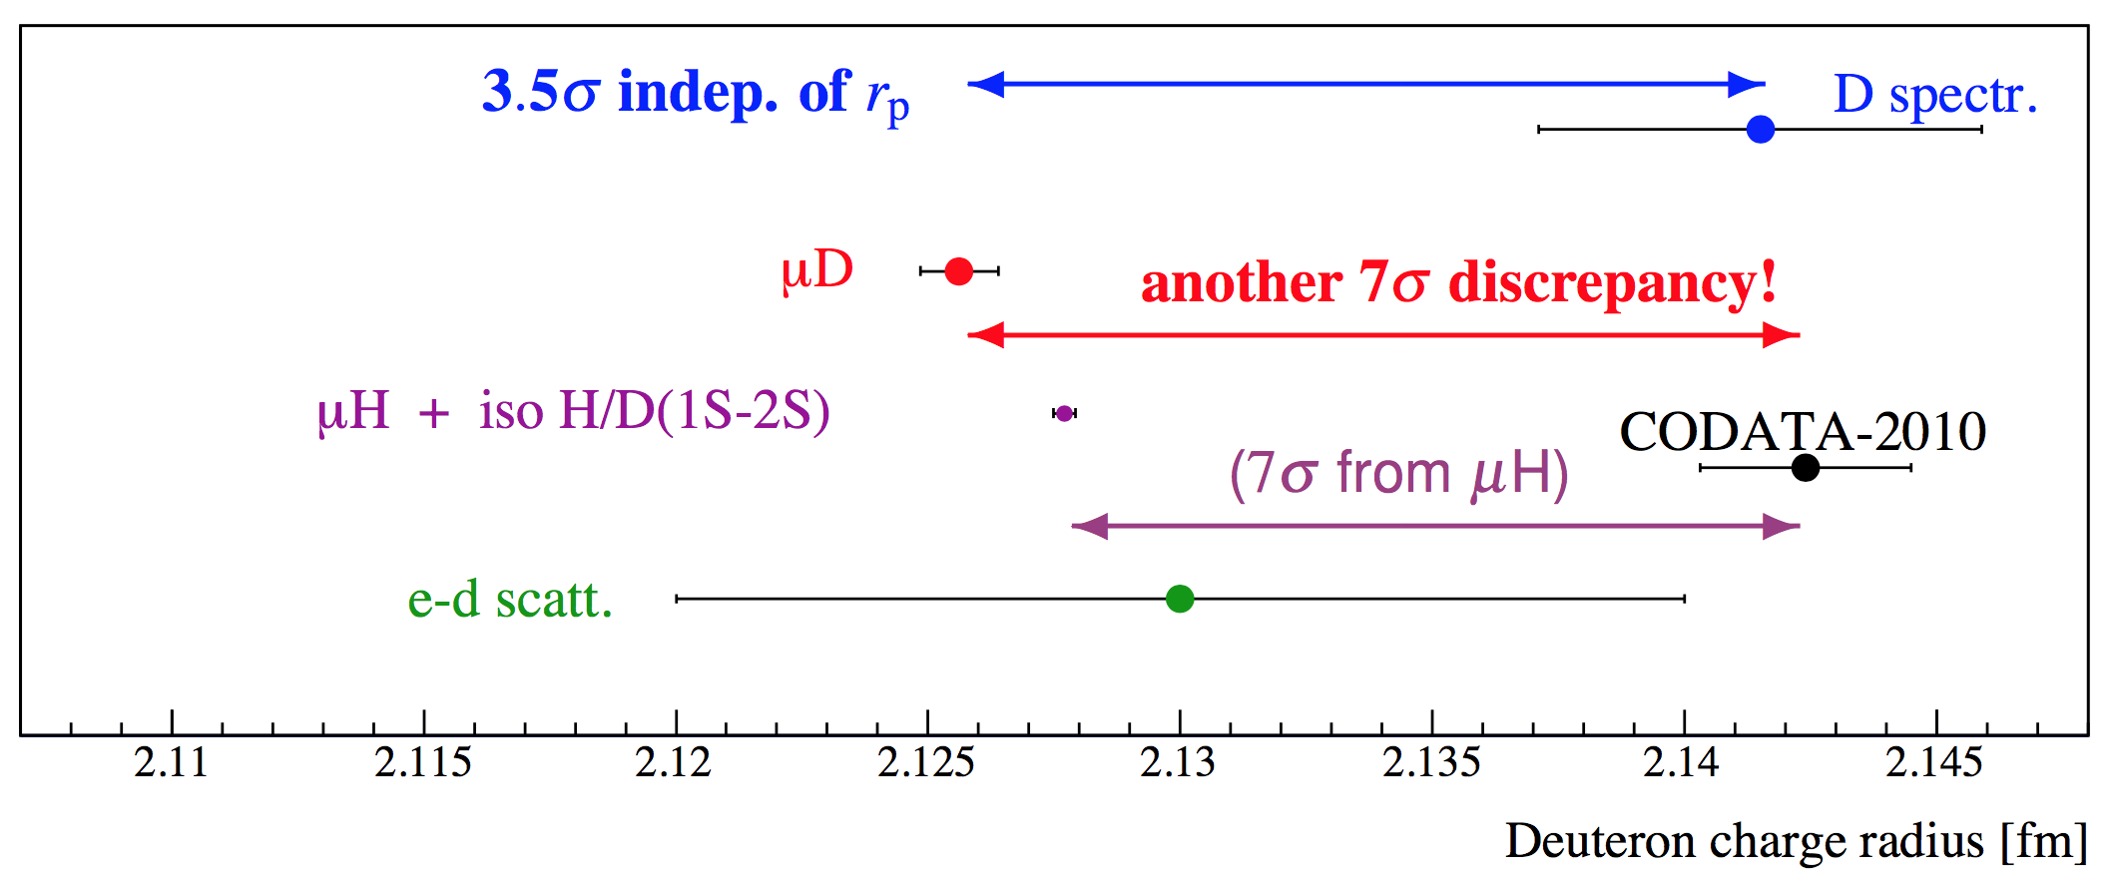
Deuteron Charge Radius?
“Proton Charge Radius Puzzle” is still unsolved after seven years.
There is a newly developing “Deuteron Charge Radius Puzzle”
H/D isotope shift: r_{d}² – r_{p}² = 3.82007(65) fm2
Muonic deuterium: r_{d} = 2.12562(13)_{exp}(77)_{theory} fm
Electronic deuterium: r_{d} = 2.14150(450) fm
Calls for new independent experiments with possible highest accuracy!
New ed- cross sections at low Q² will be a critical input to reduce theory error in r_{d} extracted from μD spectroscopy.
(R. Pohl, 2017)

Slide 21
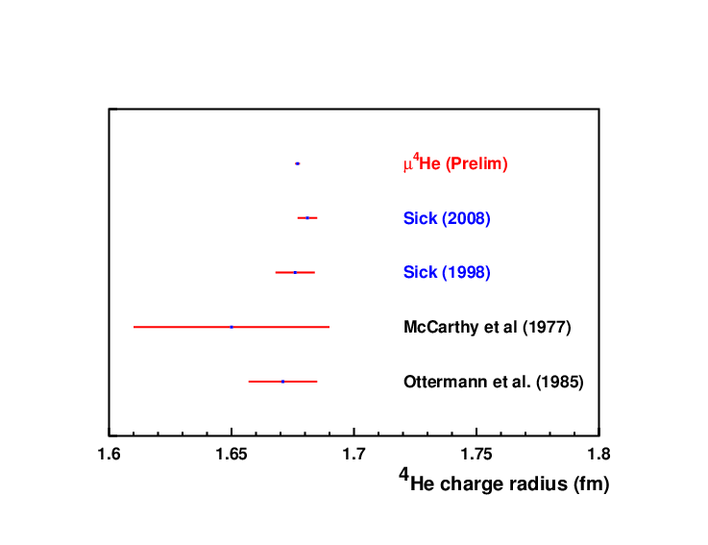
Charge Radius of Helium Nuclei
Helium
Electron scattering consistent with μ-spectroscopy

Slide 22
PRad Experimental Setup in Hall B at JLab
High resolution, large acceptance, hybrid HyCal calorimeter (PbWO₄ and Pb-Glass)
Windowless H₂ gas flow target
Simultaneous detection of elastic and Moller electrons
Q² range of 2x10⁻⁴ – 0.14 GeV²
XY – veto counters replaced by GEM detector
Vacuum chamber
Spokespersons: D. Dutta, H. Gao, A. Gasparian, M. Khandaker
Sub 1% measurements:
(1) ep elastic scattering at Jlab (PRad)
(2) μp elastic scattering at PSI - 16 U.S. institutions! (MUSE)
(3) ISR experiments at Mainz
Ongoing H spectroscopy experiments

Slide 23
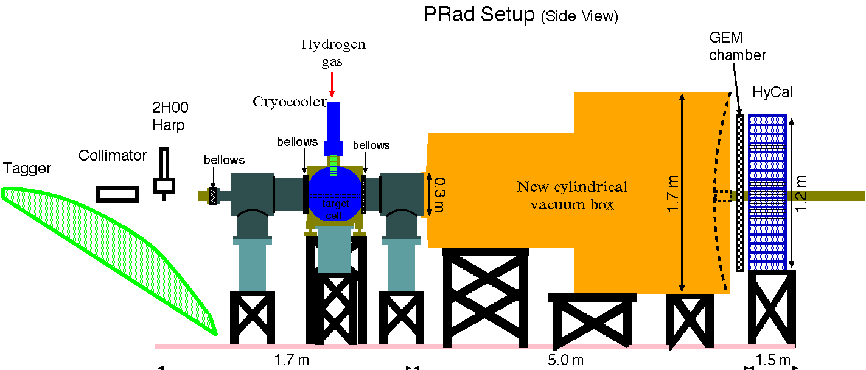
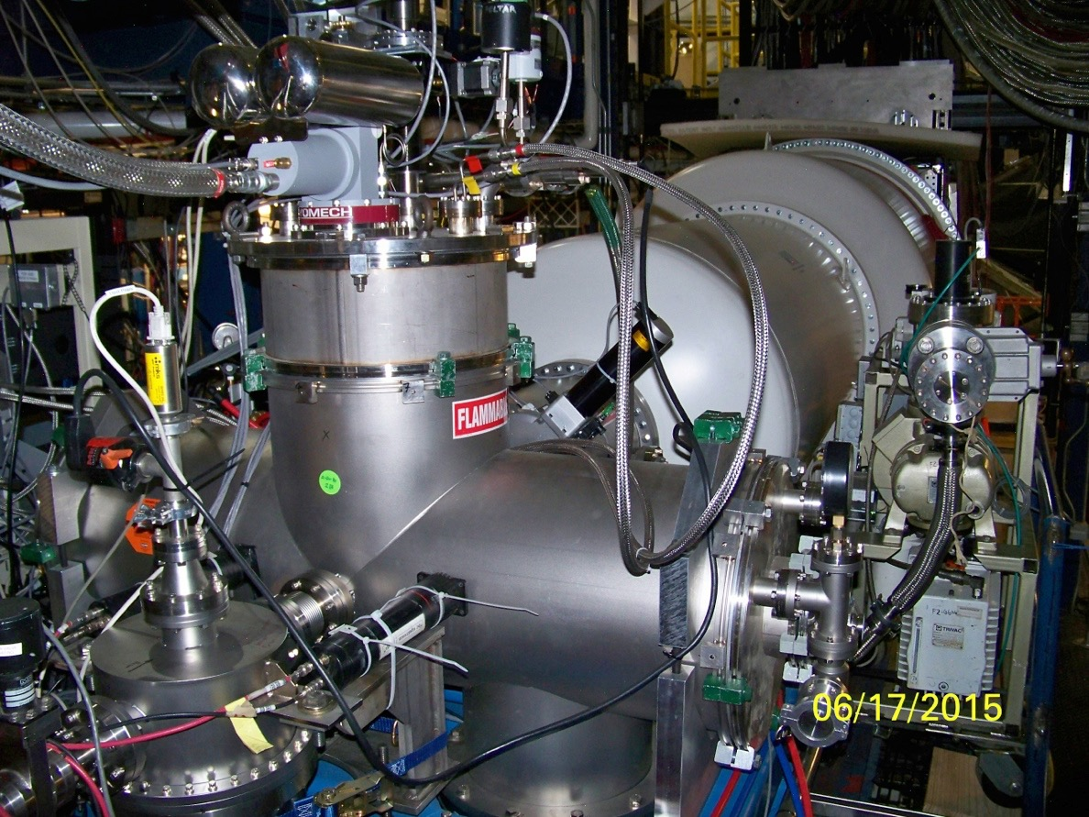
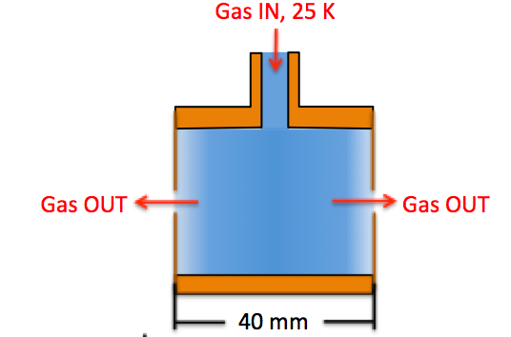
PRad Experimental Apparatus
Electron beam
Electron Beam
8 cm dia x 4 cm long target cell
2 mm holes open at front and back kapton foils, allows beam to pass through
Target thickness: ~2 x 10¹⁸ H atoms / cm²

Slide 24
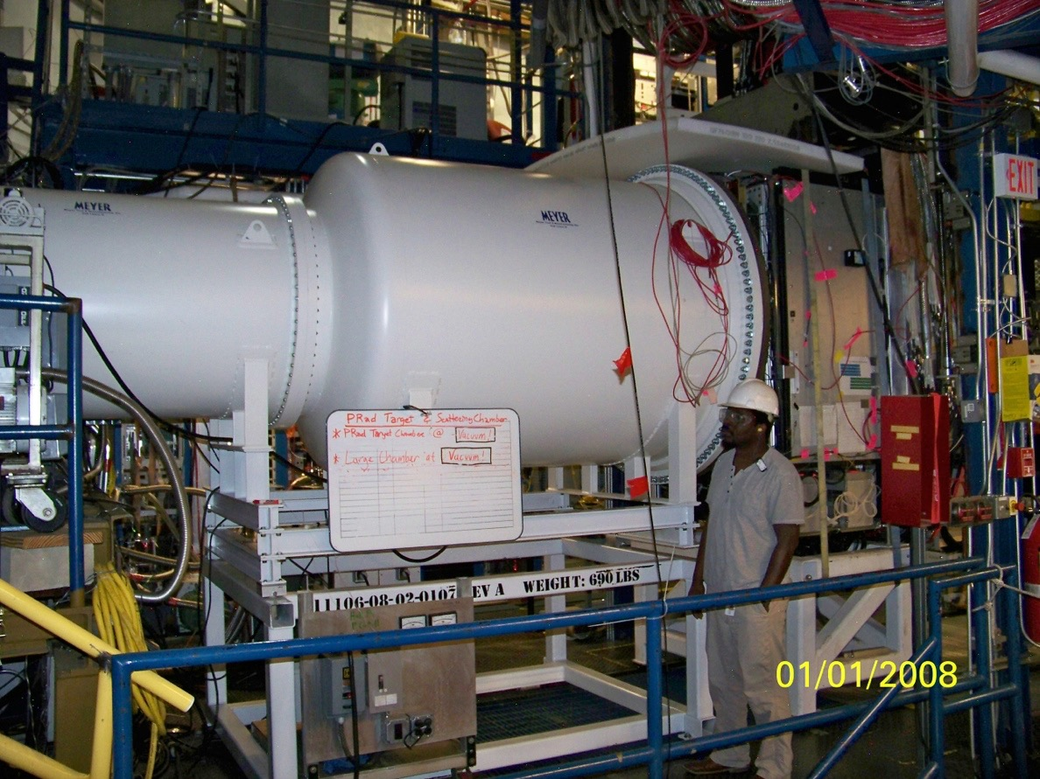
PRad Experimental Apparatus
5 m long two stage vacuum chamber, further remove possible background source
vacuum tank pressure: 0.3 mTorr

Slide 25
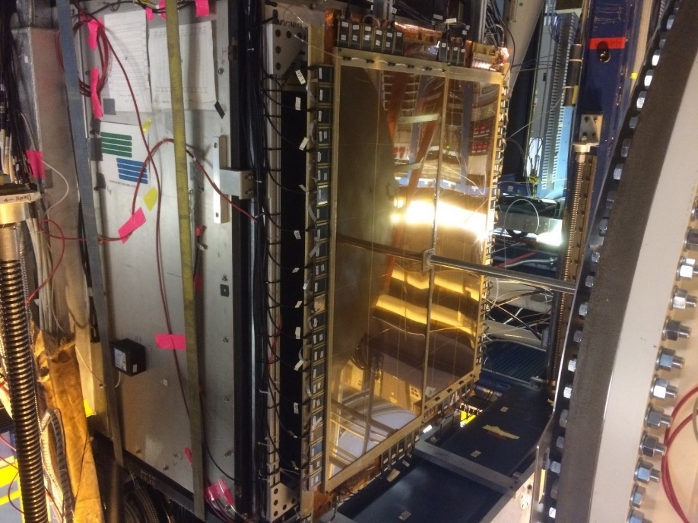
PRad Experimental Apparatus
Two large area GEM detectors
Small overlap region in the middle
Excellent position resolution (72 µm)
Improve position resolution of the setup by > 20 times
Similar improvement for Q² determination at small angle
More details see presentation of X. Bai in session E12

Slide 26
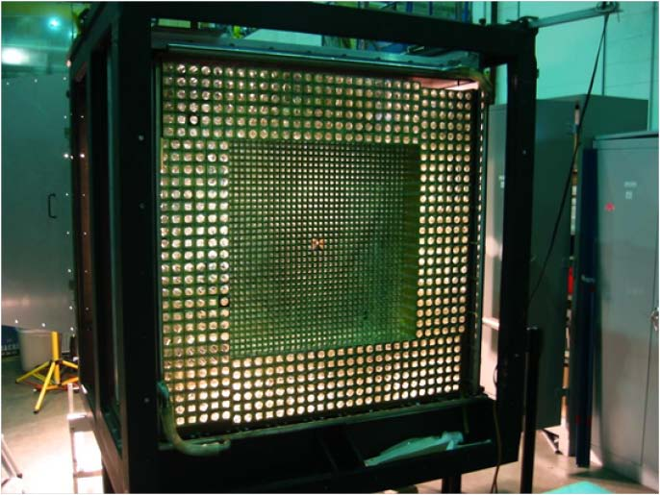
PRad Experimental Apparatus
Hybrid EM calorimeter (HyCal)
  Inner 1156 PWO₄ modules
  Outer 576 lead glass modules
5.8 m from the target
Scattering angle coverage: ~ 0.6˚ to 7.5˚
Full azimuthal angle coverage
High resolution and efficiency

Slide 27
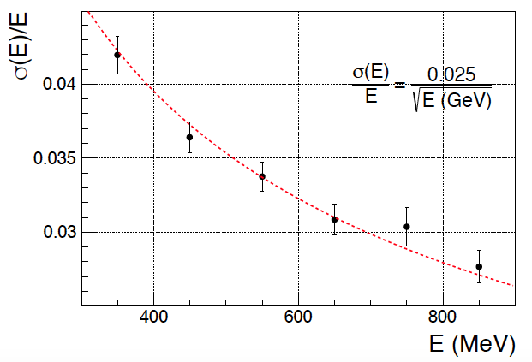
HyCal Resolution and Efficiency
HyCal energy resolution and trigger efficiency extracted using high energy photon beam from Hall B at Jlab
  > 99.5% trigger efficiency obtained for E_{𝜸} > 500 MeV, for various parts of HyCal
  Energy resolution ~2.5% for PWO₄ part, lead glass part about 2.5 time worse
Plots courtesy of M. Levillain

Slide 28
Performance of GEM Detectors
GEM detection efficiency measured in both photon beam calibration (pair production) and production runs (ep and ee)
Using overlap region of GEMs to measure position resolution (72 𝛍m)
GEM Efficiency in Active Area
Position Resolution
Plots courtesy of X. Bai

Slide 29
Preliminary Results:

Slide 30
Preliminary Elastic ep Cross Section
Plots show the extracted differential cross section v.s. scattering angle and Q², with 2.2 GeV data in 0.7 ~ 3.5 deg range (very preliminary)
Statistical error at this stage: ~0.2% per point
Systematic errors are conservatively assigned at ~2% at current stage (shown as shadow area)

Slide 31
PRad Analysis Status: Event Selection Quality
Control of background in the PRad experiment.
Consistency of two practically independent
measurements (within the ~ 0.2% statistical
errors)demonstrates that we
control the background, and
PRad will reach its goal of sub-percent
extraction of the Proton Radius!!!
Double ratio of (ep/ee) from experiment and from theory
for both 1.1 GeV and 2.2 GeV

Slide 32
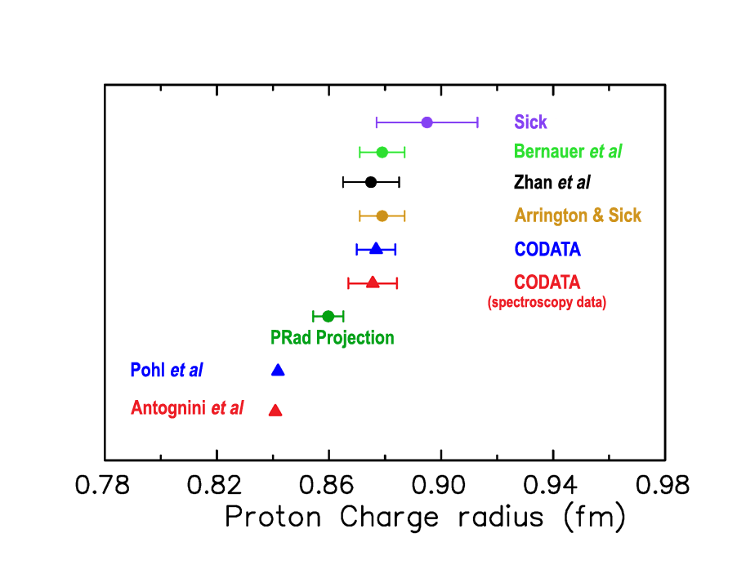
PRad Projected Result with world data

Slide 33
Summary and outlook
After several years, the proton charge radius remains puzzling, and perhaps also the deuteron charge radius
PRad experiment had a successful data taking in May/June 2016
PRad collaboration is making good progress in data analysis and preliminary cross section results (partial data) announced in June 2017
Preliminary radius result is anticipated in the fall 2017 –Stay tuned!
Acknowledgement: the SoLID collaboration, and the PRad Collaboration (supported in part by U.S. Department of Energy under contract number DE-FG02-03ER41231, NSF MRI PHY-1229153)

