Slide 1


The Proposed Deuteron Charge Radius Experiment (DRad) at Jefferson Lab
Jingyi Zhou
Duke University
For the DRad Collaboration
86th Annual Meeting of the APS Southeastern Section

Slide 2
Outline
Introduction and the deuteron charge radius puzzle
Experimental apparatus
Event selection and PID
Preliminary uncertainty estimation
Summary

Slide 3
Introduction
Deuteron: the simplest nuclear system in nature
Except for the “Proton Charge Radius Puzzle”, there is also a “Deuteron Charge Radius Puzzle”
A possible third observation in addition to the (i) muon g-2 factor and the (ii) proton radius puzzle which is related to a possible violation of electron-muon universality

Slide 4
Introduction
Three major methods:
Laser spectroscopy; 2. Isotope shift; 3. Electron scattering
R. Pohl 2017
Calls for new independent experiments with highest possible accuracy!
Notes:
High precision muonic deuterium spectroscopic measurements found a significantly smaller (7$σ$) deuteron charge radius compared to the CODATA recommended value, creating the “deuteron charge radius puzzle".

Slide 5
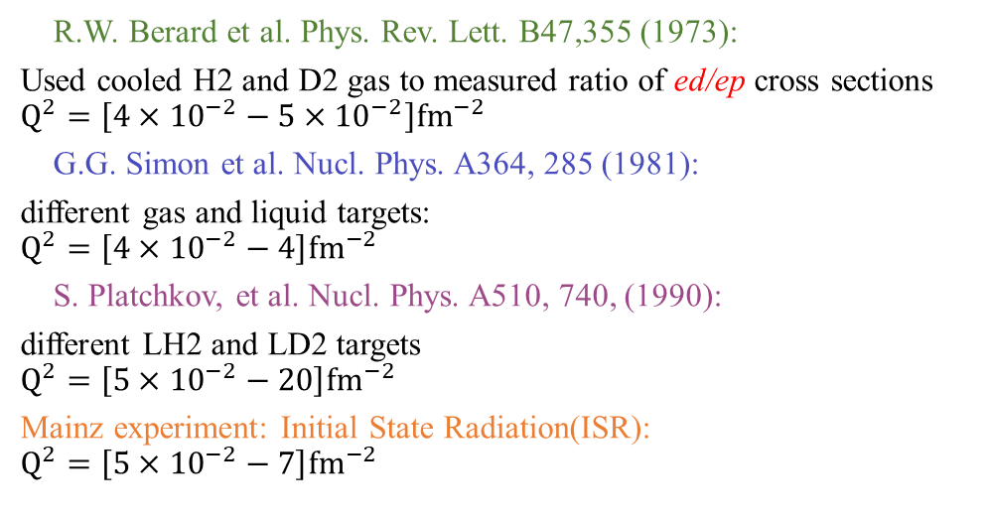
Previous e-d scattering Experiments at Low $Q^{2}$ Range
Three experiments had been used for the modern extraction of deuteron charge radius from e-d scattering:
R.W. Berard et al. Phys. Rev. Lett. B47,355 (1973):
Used cooled H2 and D2 gas to measured ratio of ed/ep cross sections
$$Q^{2}=\left[4×{10}^{−2}−5×{10}^{−2}\right]{fm}^{−2}$$
G.G. Simon et al. Nucl. Phys. A364, 285 (1981):
different gas and liquid targets:
$$Q^{2}=\left[4×{10}^{−2}−4\right]{fm}^{−2}$$
S. Platchkov, et al. Nucl. Phys. A510, 740, (1990):
different LH2 and LD2 targets
$$Q^{2}=\left[5×{10}^{−2}−20\right]{fm}^{−2}$$
Mainz experiment: Initial State Radiation(ISR):
$$Q^{2}=\left[5×{10}^{−2}−7\right]{fm}^{−2}$$
Mainz
Previous experiments used:
magnetic spectrometer method;
different types of targets;
normalized e-d to e-p cross sections.
I. Sick and D. Trautmann, NPA 637, 559 (1998)
We propose a new independent method to measure e-d elastic cross sections with high accuracy.

Slide 6
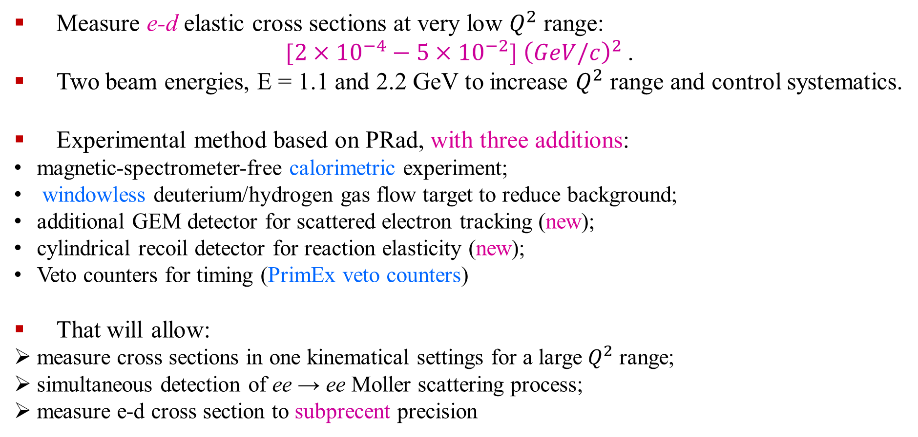
The highlight of DRad experiment setup
Measure e-d elastic cross sections at very low $Q^{2}$ range:
[$2×{10}^{−4}−5×{10}^{−2}$] ${\left(GeV/c\right)}^{2}$.
Two beam energies, E = 1.1 and 2.2 GeV to increase $Q^{2}$ range and control systematics.
Experimental method based on PRad, with three additions:
magnetic-spectrometer-free calorimetric experiment;
windowless deuterium/hydrogen gas flow target to reduce background;
additional GEM detector for scattered electron tracking (new);
cylindrical recoil detector for reaction elasticity (new);
Veto counters for timing (PrimEx veto counters)
That will allow:
measure cross sections in one kinematical settings for a large $Q^{2}$ range;
simultaneous detection of ee → ee Moller scattering process;
measure e-d cross section to subprecent precision

Slide 7
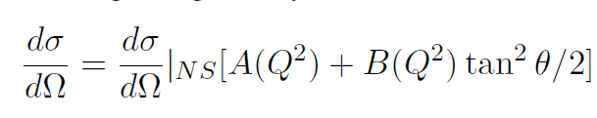
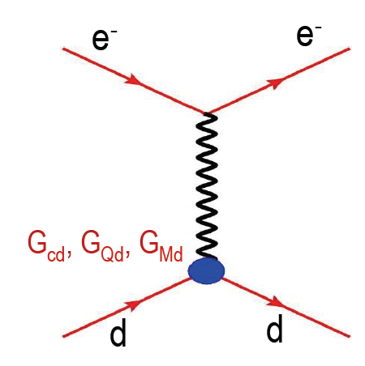
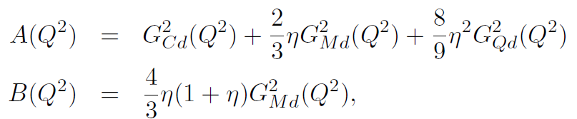
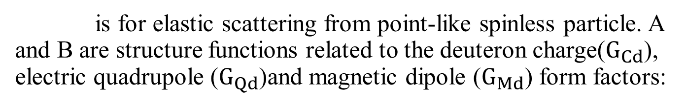
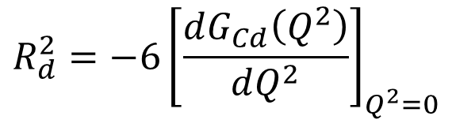
The extraction of Deuteron Charge Radius
In the Born approximation, the cross section for e-d elastic scattering:
is for elastic scattering from point-like spinless particle. A and B are structure functions related to the deuteron charge($G_{Cd}$), electric quadrupole ($G_{Qd}$)and magnetic dipole ($G_{Md}$) form factors:
At low $Q^{2}$, the rms charge radius can be obtained from the slope of the charge form factor $G_{Cd}$:
$$R_{d}^{2}=−6{\left[\frac{dG_{Cd}\left(Q^{2}\right)}{dQ^{2}}\right]}_{Q^{2}=0}$$

Slide 8
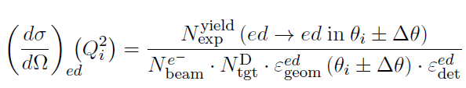
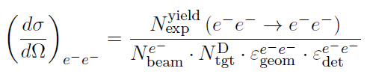
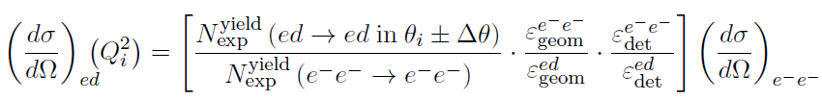
Extraction of ed Elastic Scattering Cross Section
To reduce the systematic uncertainty, the ed cross section will be normalized to the Møller cross section:
Luminosity cancelled by taking ed/ee ratio
Method 1: bin by bin method – taking ed/ee counts from the same angular bin
Method 2: integrated Moller method – integrate Møller in a fixed angular range and use it as common normalization for all angular bins
  Cancel part of the efficiency and acceptance
  May introduce Q² dependent uncertainty from Moller
  Limited converge due to double arm Moller acceptance
  Moller uncertainty only affects normalization
  Need correction for GEM efficiency
Notes:
methods of Forming ep/ee ratio

Slide 9
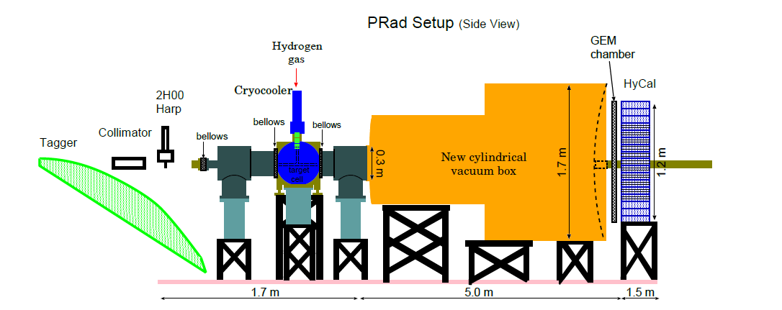
PRad experimental appratus
@HallB JLab
Electron Beam

Slide 10
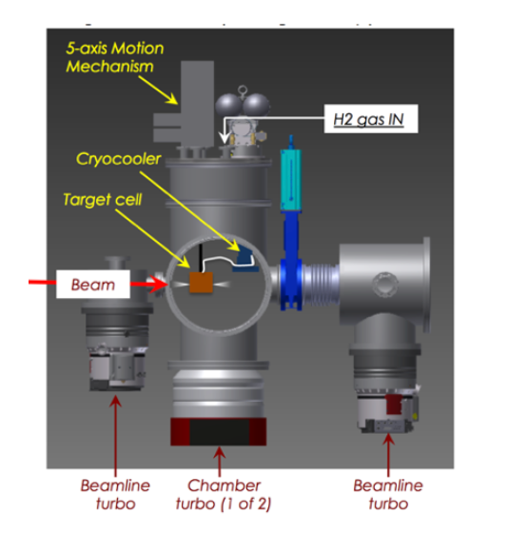
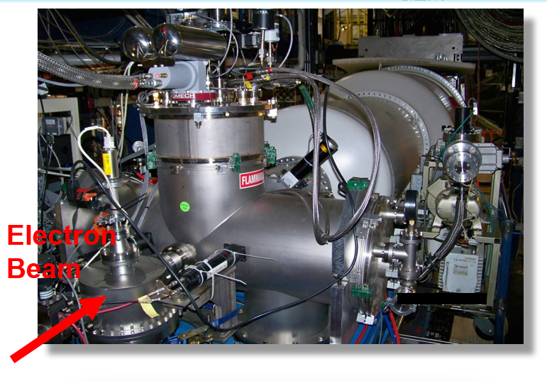
PRad experimental appratus
Windowless gas flow target
Electron Beam
8 cm diam x 4 cm long target cell
4 mm diam holes open at front and back kapton foils, allows beam to pass through
Target thickness: ~2 x 10¹⁸ H atoms / cm²
remove major background source

Slide 11
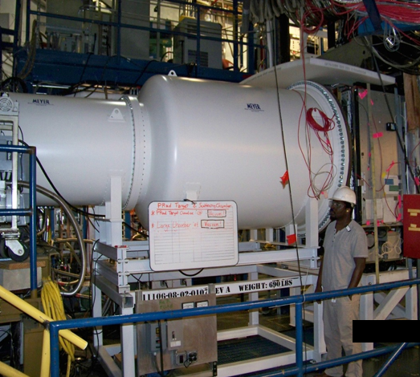
PRad experimental appratus
Vacuum chamber
Electron Beam
5 m long two stage vacuum chamber, further remove possible background source from the electron multiple scattering
vacuum chamber pressure: 0.3 mTorr

Slide 12
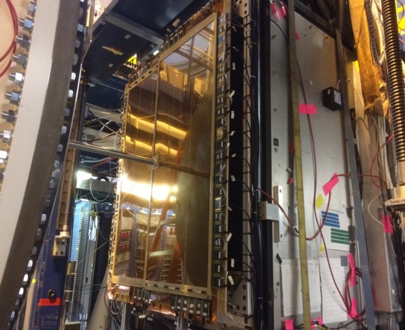
PRad experimental appratus
Gas Electron Multiplier (GEM)
Electron Beam
Two large area GEM chambers
Small overlap region in the middle
Excellent position resolution (72 µm)

Slide 13
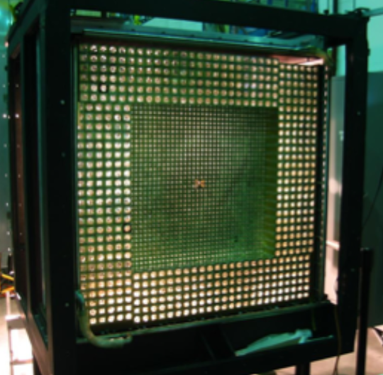
PRad experimental appratus
Hybrid Calorimeter (HyCal)
Hybrid EM calorimeter (HyCal)
High resolution and efficiency
5.8 m from the target
  Inner 1156 PbWO₄ modules
  Outer 576 lead-glass modules
Scattering angle coverage:
~ 0.6˚ to 7.5˚
Full azimuthal angle coverage
Electron Beam

Slide 14
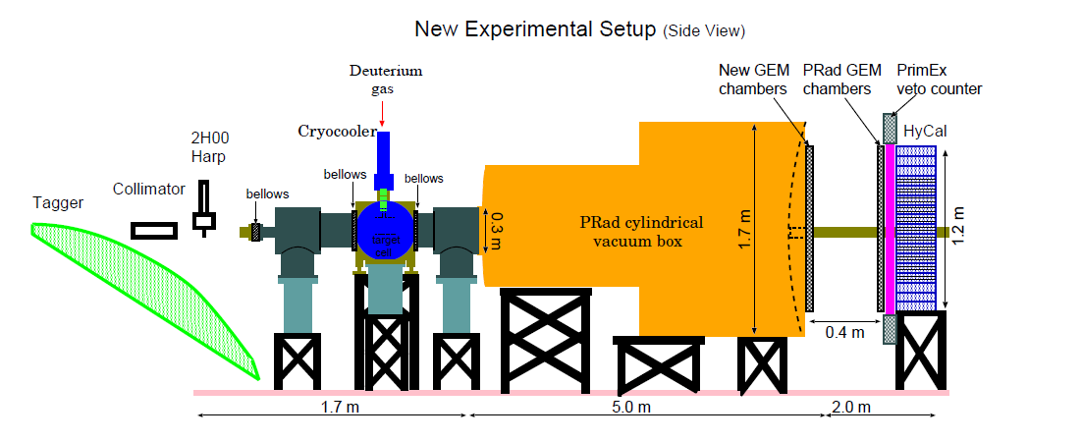
Proposed DRad experiment setup
The PRad experiment successfully extracted the radius with precision from subpercent cross section measurement. Based on PRad experiment setup, three additions:
Additional GEM detector for scattered electron tracking (new)
Cylindrical recoil detector for reaction elasticity (new)
Veto counters for timing (PrimEx veto counters)

Slide 15
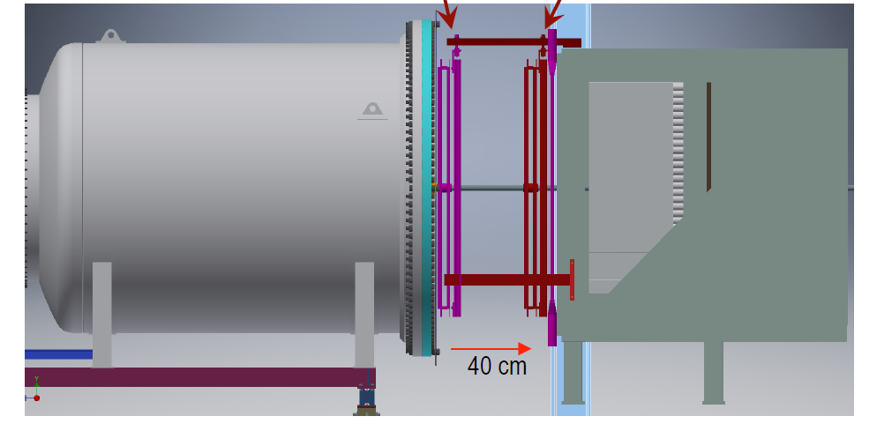
New GEM
PRad GEM
Based on PRad GEM detector:
• The new GEM is located at 40 cm distance upstream from the PRad GEM
• Half material (0.25% r.l. vs. 0.5% r.l.)
• Will provide tracking for the scattered electrons
• Better control of beam line background from the upstream collimator, especially at very small angles (electron scattering angle less than 1 deg)

Slide 16
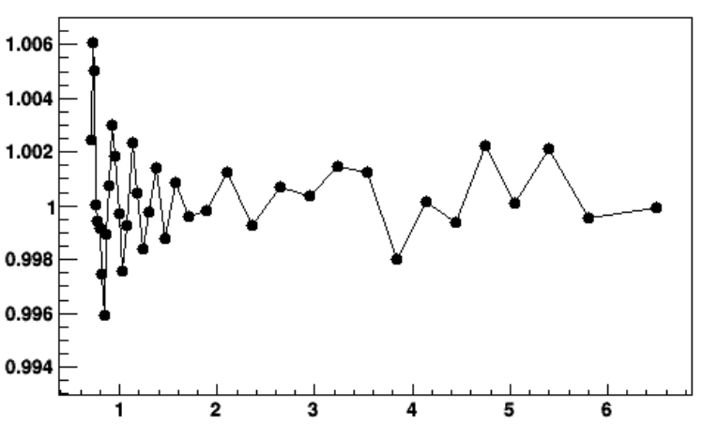
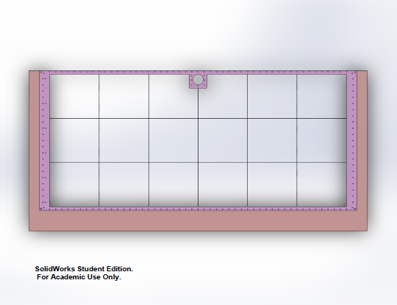
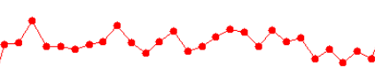
The improvement after adding the second GEM
PRad GEM efficiency calibrated by HyCal, the precision limited by HyCal finite resolution
The precision greatly improved if calibrated by a second GEM
Integrated Moller method applicable for full angular range with high precision GEM efficiency measurement.
Uncertainty of GEM efficiency correction
Spacers (width:~1.5 mm)
Fluctuation Ratio
Calibrated by HyCal from PRad data
Calibrated by second GEM from simulation
Electron scattering angle (deg)
Notes:
To prevent GEM foils from direct contact with each other, multiple dielectric spacers were placed in between them. These spacers can cause an uncertainty on GEM efficiency.

Slide 17
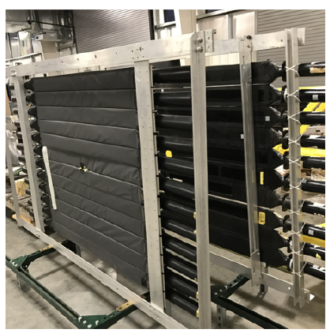
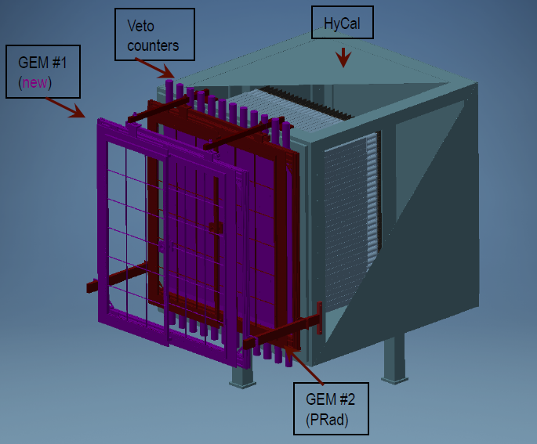
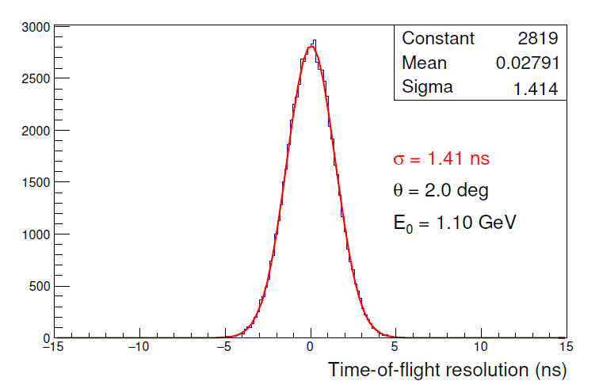
Veto Scintillators
The major background for the e-d elastic scattering is the e-d inelastic breakup process:
e+d → e+p+n
Measure the time-of-flight difference between the recoil detector and the HyCal Calorimeter for particle identification between deuteron and proton from the deuteron inelastic process.
Veto Counter
HyCal
New GEM
PRad GEM

Slide 18
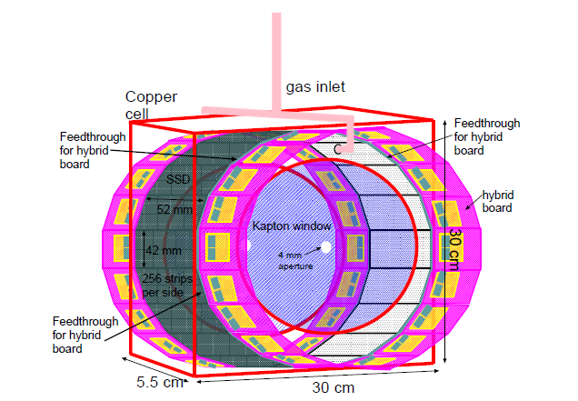
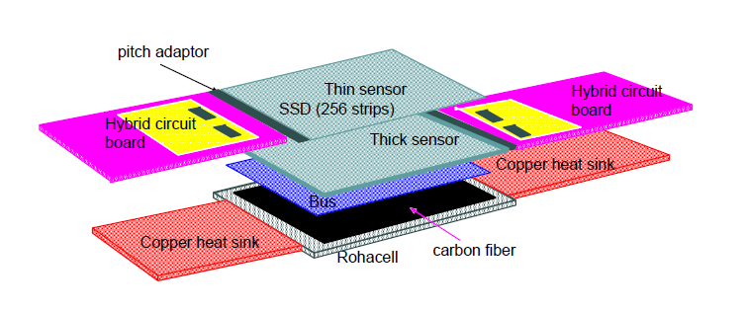
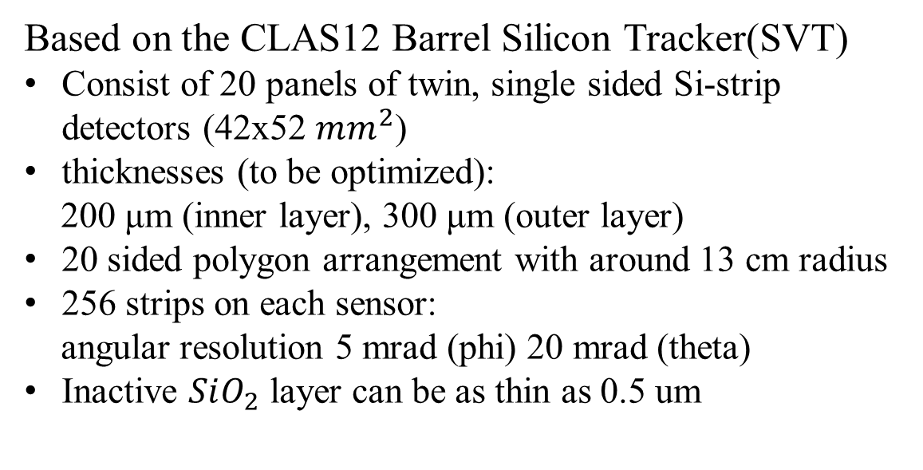
Si-strip Cylindrical Recoil Detector
Detect recoil particles, provide two major information:
Timing
Azimuthal angle
Based on the CLAS12 Barrel Silicon Tracker(SVT)
Consist of 20 panels of twin, single sided Si-strip detectors (42x52 $mm^{2}$)
thicknesses (to be optimized):
200 μm (inner layer), 300 μm (outer layer)
20 sided polygon arrangement with around 13 cm radius
256 strips on each sensor:
angular resolution 5 mrad (phi) 20 mrad (theta)
Inactive $SiO_{2}$ layer can be as thin as 0.5 um
Single pair of Si-strip detectors

Slide 19
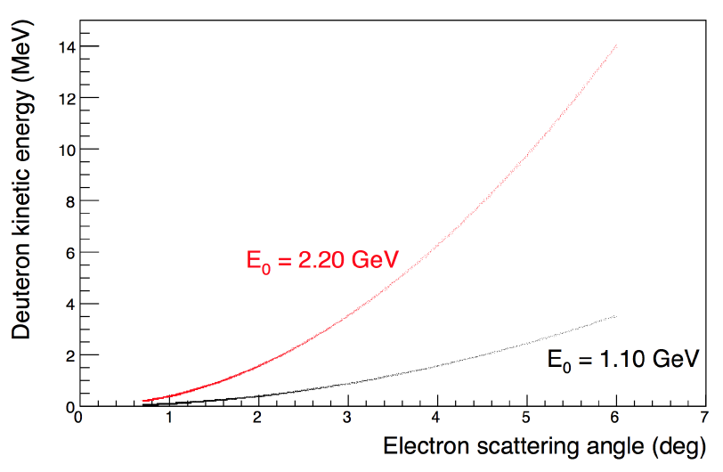
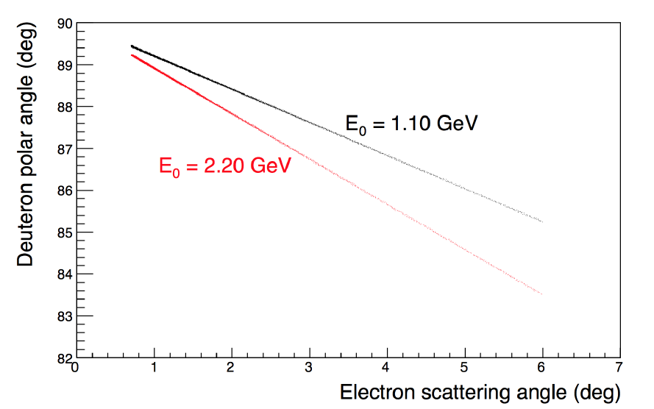
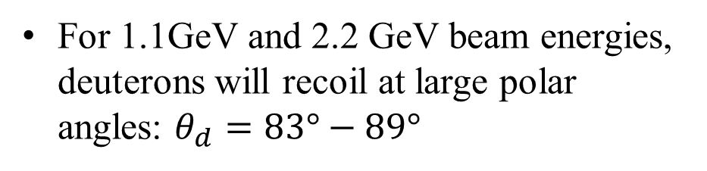

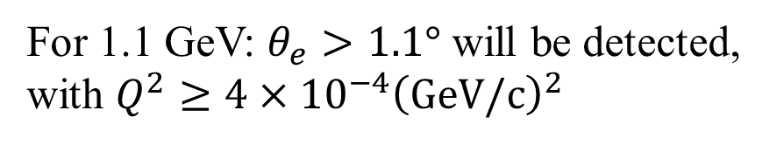
Kinematics and $Q^{2}$ Coverage
Full GEANT4 simulation code has been developed, including all detectors.
For 1.1GeV and 2.2 GeV beam energies, deuterons will recoil at large polar angles: $θ_{d}=83°−89°$
For 1.1 GeV: $θ_{e}>1.1°$ will be detected, with $Q^{2}≥4×{10}^{−4}{\left(GeV/c\right)}^{2}$

Slide 20
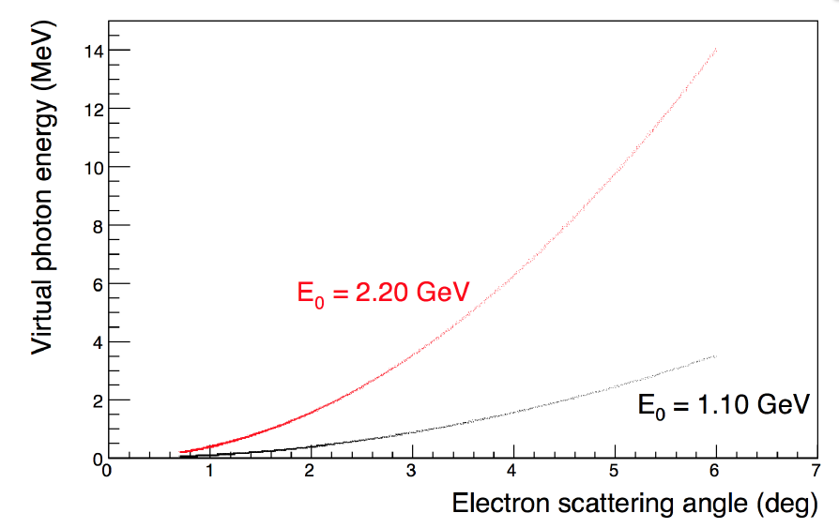
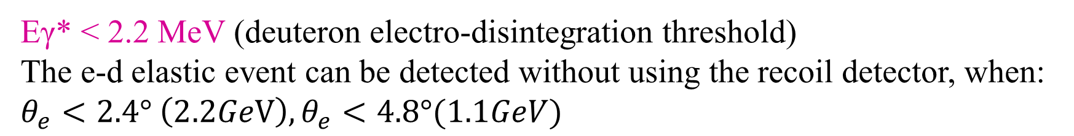
PID for recoil particles
To select the deuterons from the proton background, we will use the following information:
Deuteron breakup threshold
Energy deposition in the Recoil Detector
Time of flight and co-planarity
Eγ* < 2.2 MeV (deuteron electro-disintegration threshold)
The e-d elastic event can be detected without using the recoil detector, when:
$θ_{e}<2.4° \left(2.2GeV\right), θ_{e}<4.8°(1.1GeV)$

Slide 21
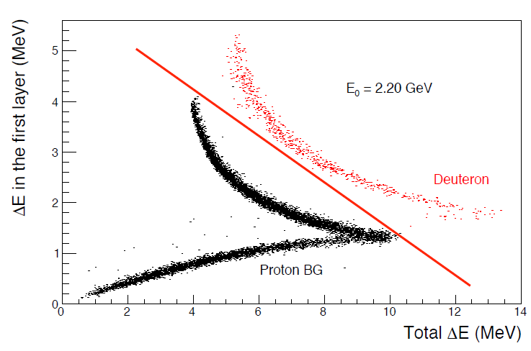
PID for recoil particles
Complete simulation of deuteron electro-disintegration process, including Fermi-motion and realistic models is developed. (QUEEG Monte Carlo event generator for CLAS6)
1. dE/dx vs. ΔE
For 2.2 GeV, a 2D cut alone on dE in the first layer vs. total dE in the Si-strip detectors is very effective for PID

Slide 22
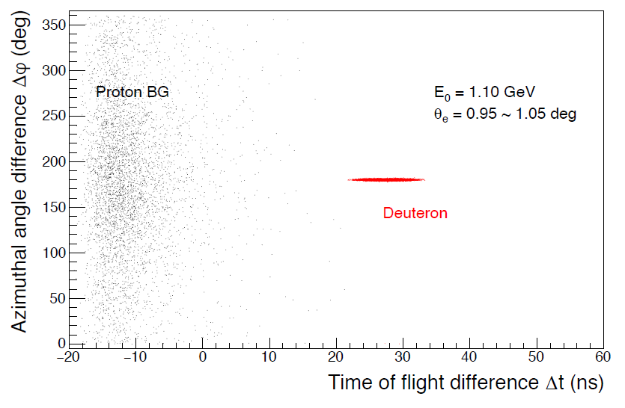
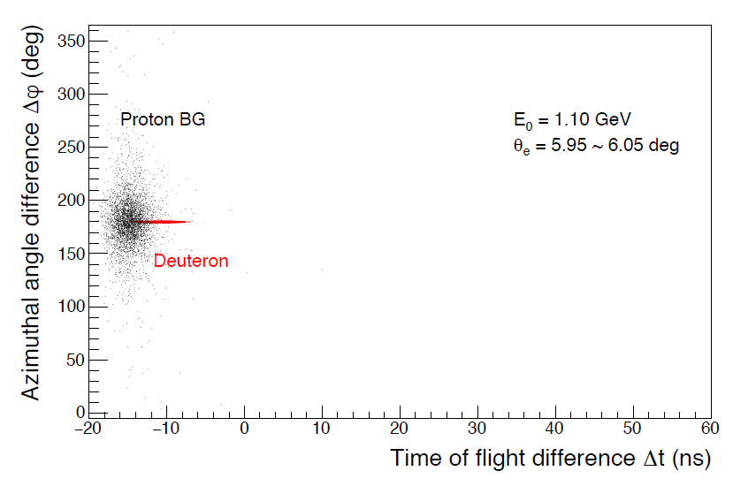
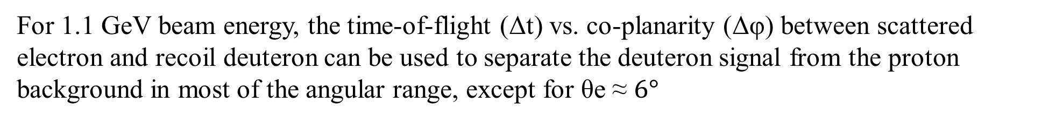
PID for recoil particles
2. time-of-flight (Δt) vs. co-planarity (Δφ) :
For 1.1 GeV beam energy, the time-of-flight (Δt) vs. co-planarity (Δφ) between scattered electron and recoil deuteron can be used to separate the deuteron signal from the proton background in most of the angular range, except for θe ≈ $6°$

Slide 23
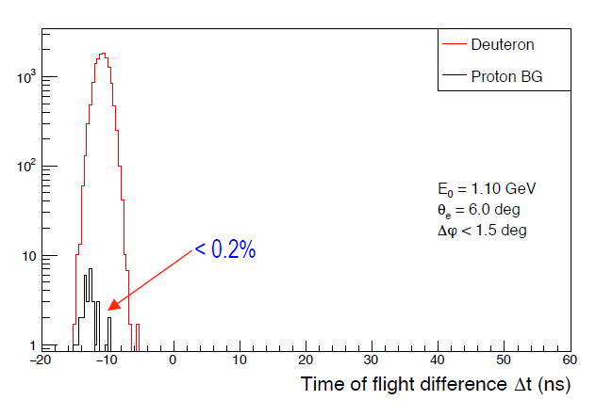
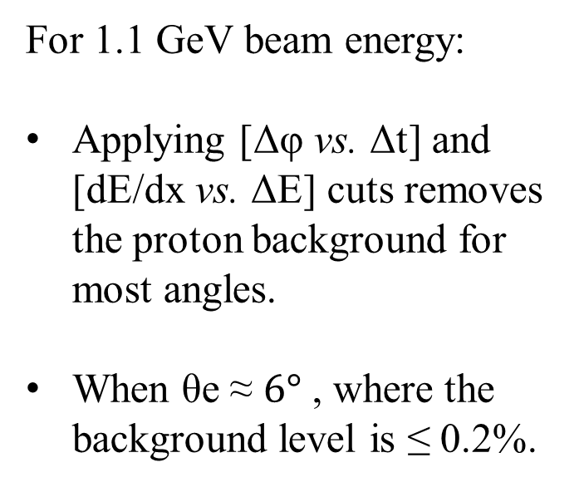
PID for recoil particles
2. time-of-flight (Δt) vs. co-planarity (Δφ) between scattered electron and recoil deuteron:
For 1.1 GeV beam energy:
Applying [Δφ vs. Δt] and [dE/dx vs. ΔE] cuts removes the proton background for most angles.
When θe ≈ $6°$ , where the background level is ≤ 0.2%.

Slide 24
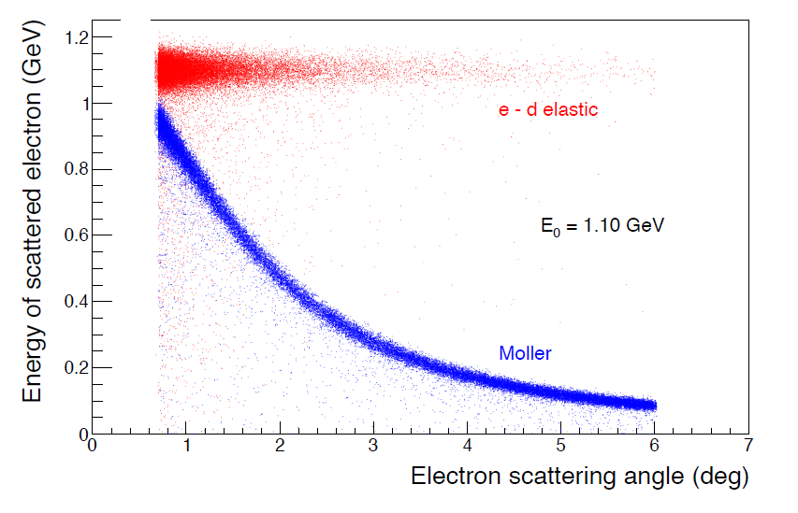
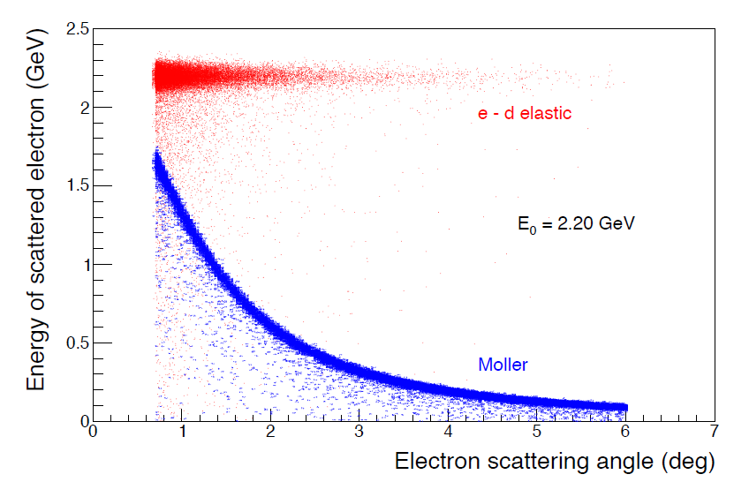
Moller event selection
Compared to PRad, the Moller event selection method is the same:
e-d elastic process and the Møller process can be separated by a 2D cut.

Slide 25
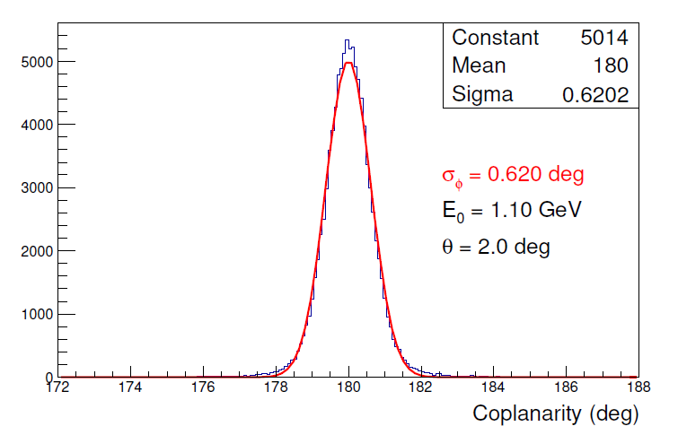
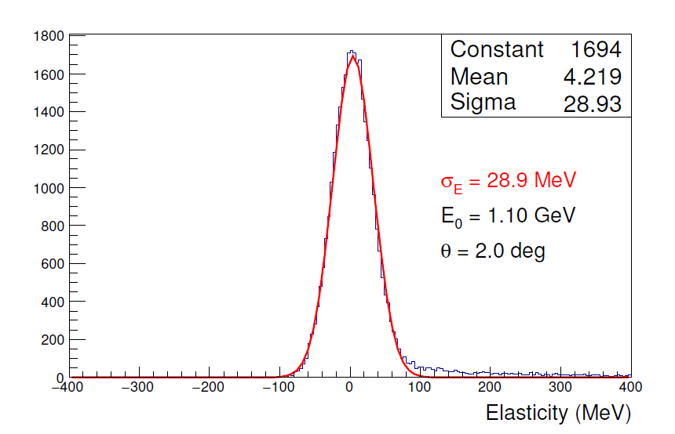

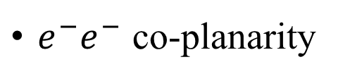
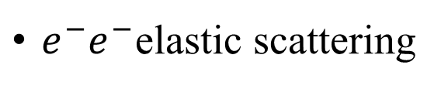
Moller event selection
$e^{−}e^{−}$ co-planarity
$e^{−}e^{−}$elastic scattering
$$φ_{e1}−φ_{e2}=π$$
$$Elasticity=E_{o}−{(E}_{e1}+E_{e2})$$
The two GEMs can provide an excellent resolution in the co-planarity.
The Hycal can provide a high resolution to select the elastic events.
Notes:
The co-planarity of two scattered electrons (ignoring the radiative effects) ($φ_{e1}−φ_{e2}=π$) is another important criterion for the Møller event selection process.

Slide 26
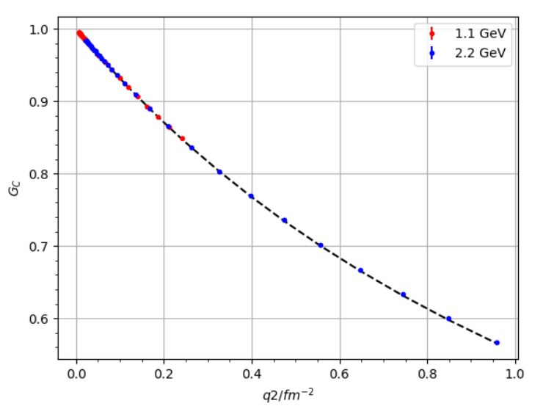
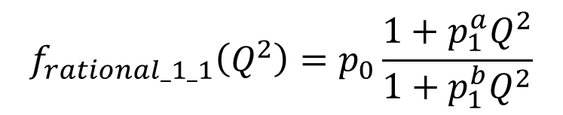

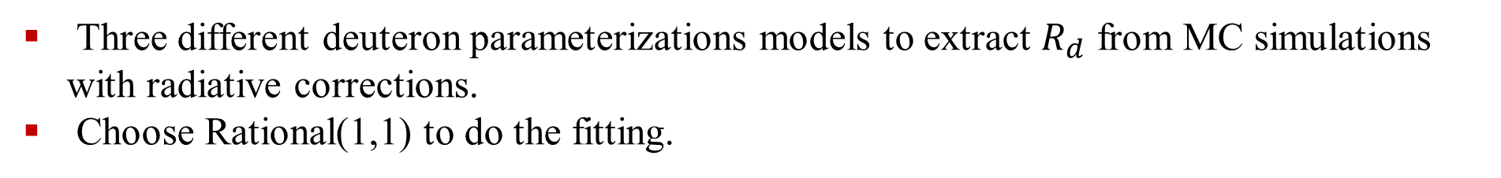

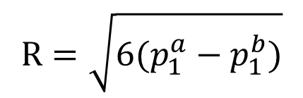
Extraction of Deuteron Charge Radius
$$Simulation\left\langle R\right\rangle =2.094 fm$$
Rational(1,1) function
$$Fit\left\langle R\right\rangle =2.091 ±0.0023fm$$
$$f_{rational_1_1}\left(Q^{2}\right)=p_{0}\frac{1+p_{1}^{a}Q^{2}}{1+p_{1}^{b}Q^{2}}$$
$$R=\sqrt{6(p_{1}^{a}−p_{1}^{b})}$$
Three different deuteron parameterizations models to extract $R_{d}$ from MC simulations with radiative corrections.
Choose Rational(1,1) to do the fitting.

Slide 27
Systematic uncertainties from
1. Event selection (elasticity cuts, co-planarity cuts…)
2. Radiative correction
3. Detector efficiencies (GEM, HyCal, Recoil Detector…)
4. Beam-line background (Halo hitting collimator, residual gas…)
5. HyCal energy calibration
6. Detector position
7. Beam energy
8. Inelastic contributions
9. Assumed magnetic and quadrupole form factors during the GC extraction
10. The choice of the fitter
11. Detector acceptance
…

Slide 28
Uncertainty budget of the radius
The uncertainty in this proposed experiment is expected to be 0.25%

Slide 29
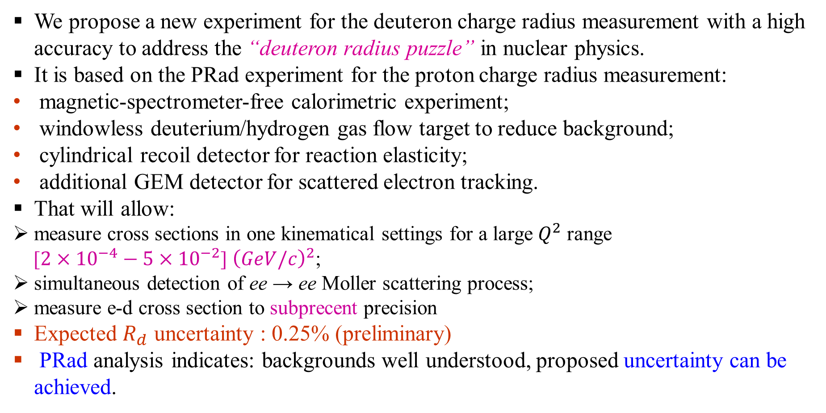
Summary
We propose a new experiment for the deuteron charge radius measurement with a high accuracy to address the “deuteron radius puzzle” in nuclear physics.
It is based on the PRad experiment for the proton charge radius measurement:
magnetic-spectrometer-free calorimetric experiment;
windowless deuterium/hydrogen gas flow target to reduce background;
cylindrical recoil detector for reaction elasticity;
additional GEM detector for scattered electron tracking.
That will allow:
measure cross sections in one kinematical settings for a large $Q^{2}$ range
[$2×{10}^{−4}−5×{10}^{−2}$] ${\left(GeV/c\right)}^{2}$;
simultaneous detection of ee → ee Moller scattering process;
measure e-d cross section to subprecent precision
Expected $R_{d}$ uncertainty : 0.25% (preliminary)
PRad analysis indicates: backgrounds well understood, proposed uncertainty can be achieved.

Slide 30
Back up

Slide 31



Moller Selection Method
Single-arm Moller method: one Moller e- is in the same Q2 range
Double-arm Moller method: require the two Moller $e^{−}$ to be detected at the same time, the angular coverage is limites by the acceptance of HyCal

Slide 32



Calibration of the Recoil Detector
The kinematics of e-p is very similar to the e-d elastic process
Both detection efficiency $ε_{det}^{ed}$ and geometrical acceptance $ε_{geom}^{ ed}$ of the recoil detector will be measured during special runs with hydrogen gas

