Slide 1
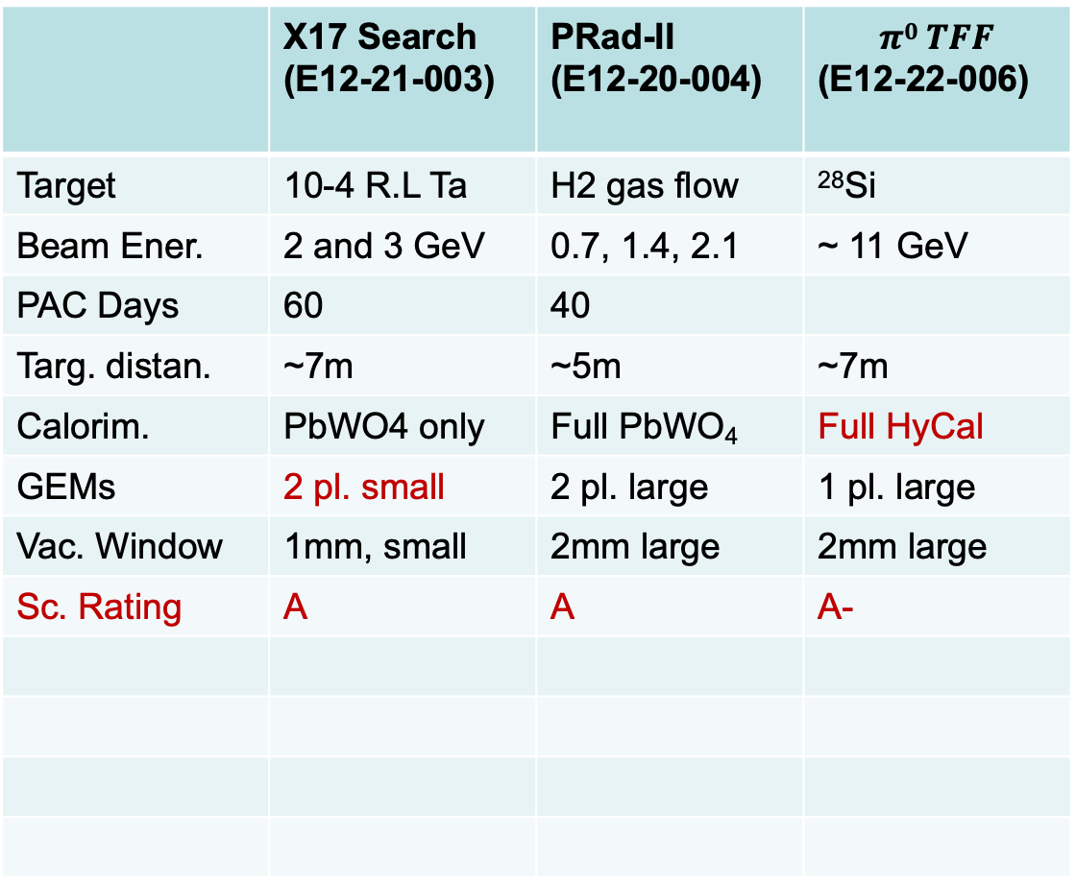
Slide for Group Discussion
 | X17 Search (E12-21-003) | PRad-II (E12-20-004) | $$π0 TFF$$ (E12-22-006)
Target | 10-4 R.L Ta | H2 gas flow | ²⁸Si
Beam Ener. | 2 and 3 GeV | 0.7, 1.4, 2.1 | ~ 11 GeV
PAC Days | 60 | 40
Targ. distan. | ~7m | ~5m | ~7m
Calorim. | PbWO4 only | Full PbWO₄ | Full HyCal
GEMs | 2 pl. small | 2 pl. large | 1 pl. large
Vac. Window | 1mm, small | 2mm large | 2mm large
Sc. Rating | A | A | A-

