Slide 1
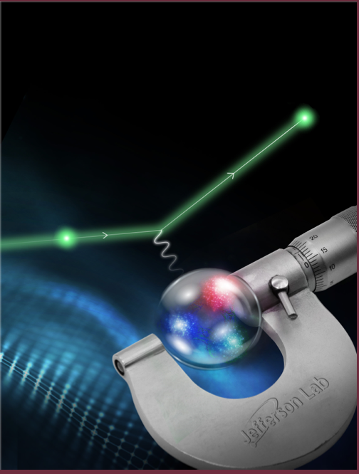

The PRad Experiments at Jefferson Lab
(PRad, PRad-II, DRad, and more)
A. Gasparian
NC A&T State University, NC USA
for the PRad collaboration
Outline
  the PRad approach for new ep-experiments
  PRad experiment and the results
  new approved experiment, PRad-II
  new proposal, DRad
  Summary and outlook

Slide 2
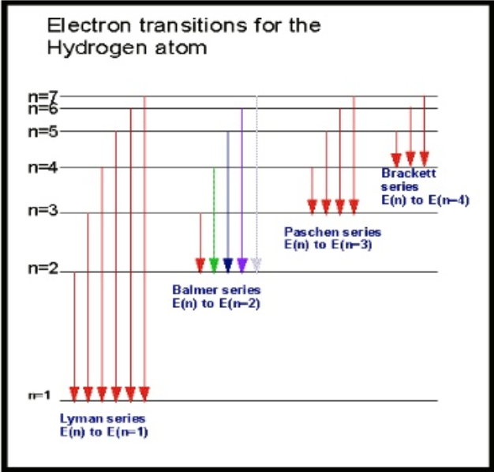
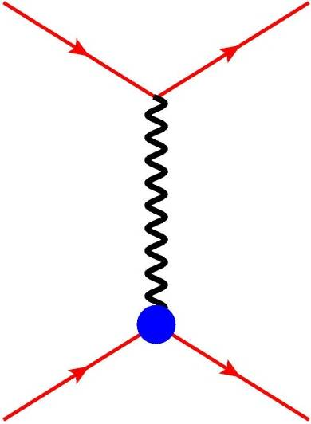

Proton Charge Radius
One of the most fundamental quantities in physics:
atomic physics:
  precision atomic spectroscopy (QED, Lamb shifts, Rydberg constant R∞);
  r_{p} is strongly correlated to R∞
nuclear physics:
  QCD, test of nuclear/particle models
connects atomic and subatomic physics.
Methods to measure the Proton rms charge radius (r_{p}):
Hydrogen spectroscopy (lepton-proton bound state, Atomic Physics):
  ordinary hydrogen
  muonic hydrogen
Lepton-proton elastic scattering (Nuclear Physics):
  ep- scattering (like MAMI, PRad, ULQ2, …)
  μp- scattering (like MUSE, AMBER, …)
e⁻ $,μ$
e⁻ $,μ$
G_{E} ,G_{M}
p
p

Slide 3


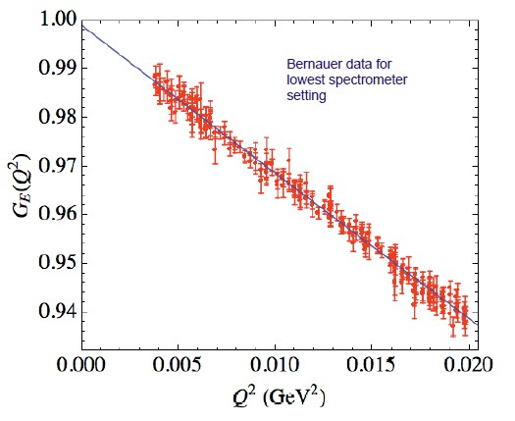
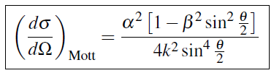

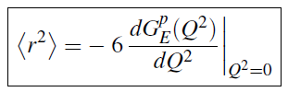

Proton Radius from ep→ep Scattering Experiments
In the limit of first Born approximation the elastic ep scattering
(one photon exchange):
e⁻
e⁻
$γ∗$
p
G_{E} ,G_{M}
p
Structureless proton:
G_{E} and G_{M} can be extracted using Rosenbluth separation
for extremely low Q², the cross section is dominated by G_{E}
Taylor expansion of G_{E} at low Q²
derivative at Q² = 0:
Mainz low Q² data set
Phys. Rev. C 93, 065207, 2016
definition of the proton rms charge radius

Slide 4
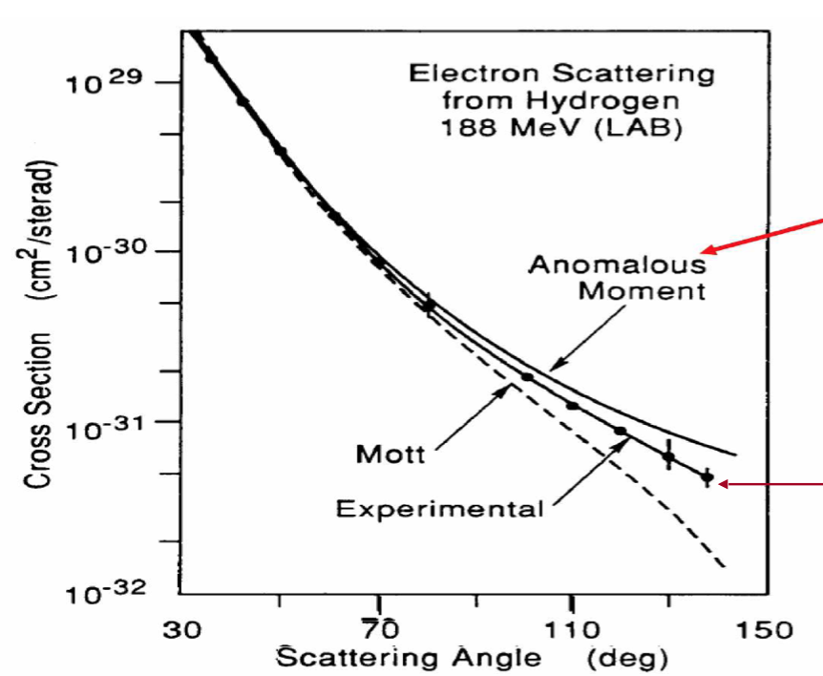
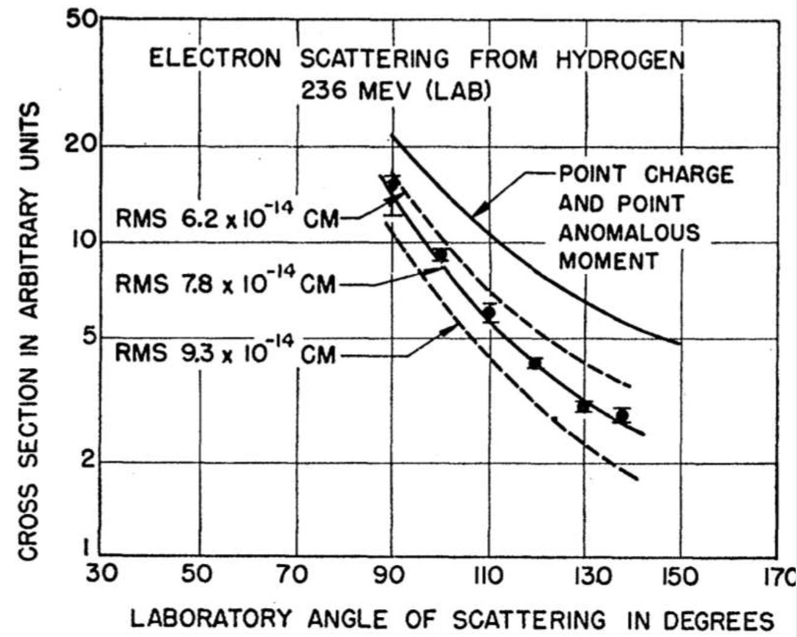
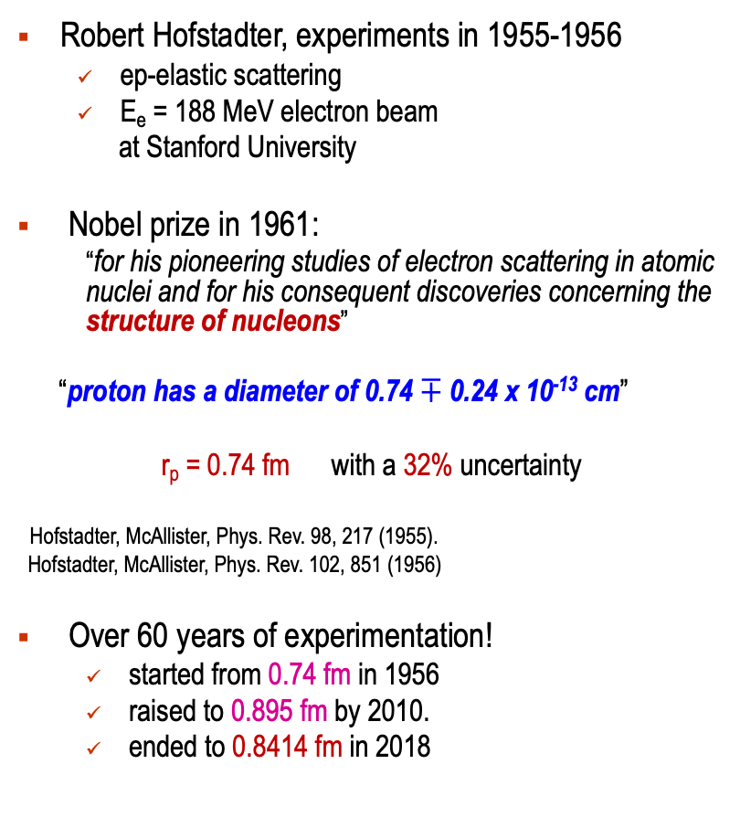
First Measurement of the Proton Radius
Robert Hofstadter, experiments in 1955-1956
  ep-elastic scattering
  E_{e} = 188 MeV electron beam
  at Stanford University
Nobel prize in 1961:
  “for his pioneering studies of electron scattering in atomic nuclei and for his consequent discoveries concerning the structure of nucleons”
“proton has a diameter of 0.74 $∓$ 0.24 x 10⁻¹³ cm”
r_{p} = 0.74 fm with a 32% uncertainty
Hofstadter, McAllister, Phys. Rev. 98, 217 (1955).
Hofstadter, McAllister, Phys. Rev. 102, 851 (1956)
Over 60 years of experimentation!
  started from 0.74 fm in 1956
  raised to 0.895 fm by 2010.
  ended to 0.8414 fm in 2018

Slide 5

The Proton Radius Puzzle before the PRad Experiment (2016)
New York Times
Regular hydrogen average (CODATA): 0.8751 ± 0.0061 fm
Muonic hydrogen (CREMA coll. 2013): 0.8409 ± 0.0004 fm
  Muonic hydrogen (CREMA coll. 2010): 0.84184 ± 0.00067 fm

Slide 6
Possible Resolutions to the Proton Radius Puzzle
Some initial open questions about QED calculations:
  additional corrections to muonic-hydrogen. Not found
  missing contributions to electronic-hydrogen. Not found
  higher moments in electric form factor; Not significant
  …
Is the ep-interaction the same as μp-interaction (the lepton universality principle)?
New Physics (forces) beyond the Standard Model? Not found yet
  many models, discussions, suggestions …
Potential solutions:
  need new high precision, high accuracy experiments:
      ep-scattering experiments:
        reaching extremely low Q² range (10⁻⁴ Gev/c²)
        possibly with new independent methods PRad at JLab
        measure absolute cross sections in ONE experimental setting!
        MUSE at PSI, ISR at Mainz, ULQ² in Japan, AMBER at CERN …
      ordinary hydrogen spectroscopy experiments:
        York University in Canada, LKB in Paris, France, CREMA in Germany …

Slide 7
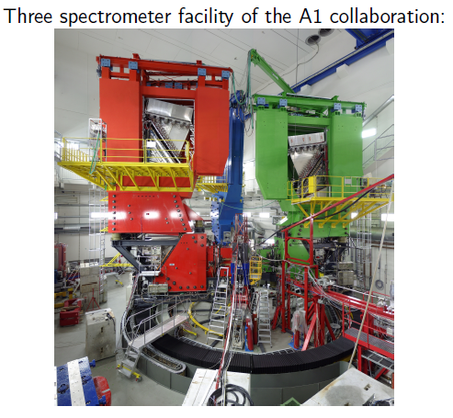
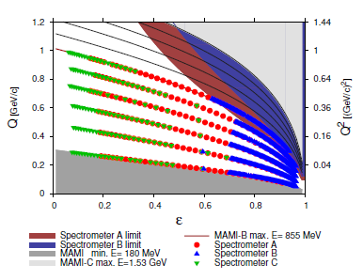
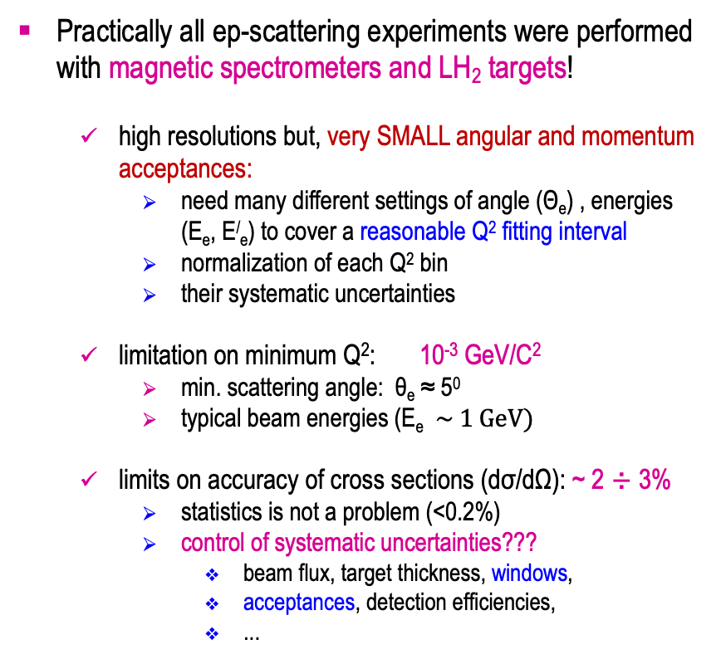
Planning a New ep→ep Scattering Experiment
Practically all ep-scattering experiments were performed with magnetic spectrometers and LH₂ targets!
  high resolutions but, very SMALL angular and momentum acceptances:
    need many different settings of angle (Θ_{e}) , energies (E_{e}, E/_{e}) to cover a reasonable Q² fitting interval
    normalization of each Q² bin
    their systematic uncertainties
  limitation on minimum Q²: 10⁻³ GeV/C²
    min. scattering angle: θ_{e} ≈ 5⁰
    typical beam energies (E_{e} $\sim 1 GeV)$
  limits on accuracy of cross sections (dσ/dΩ): ~ 2 ÷ 3%
    statistics is not a problem (<0.2%)
    control of systematic uncertainties???
      beam flux, target thickness, windows,
      acceptances, detection efficiencies,
      ...

Slide 8
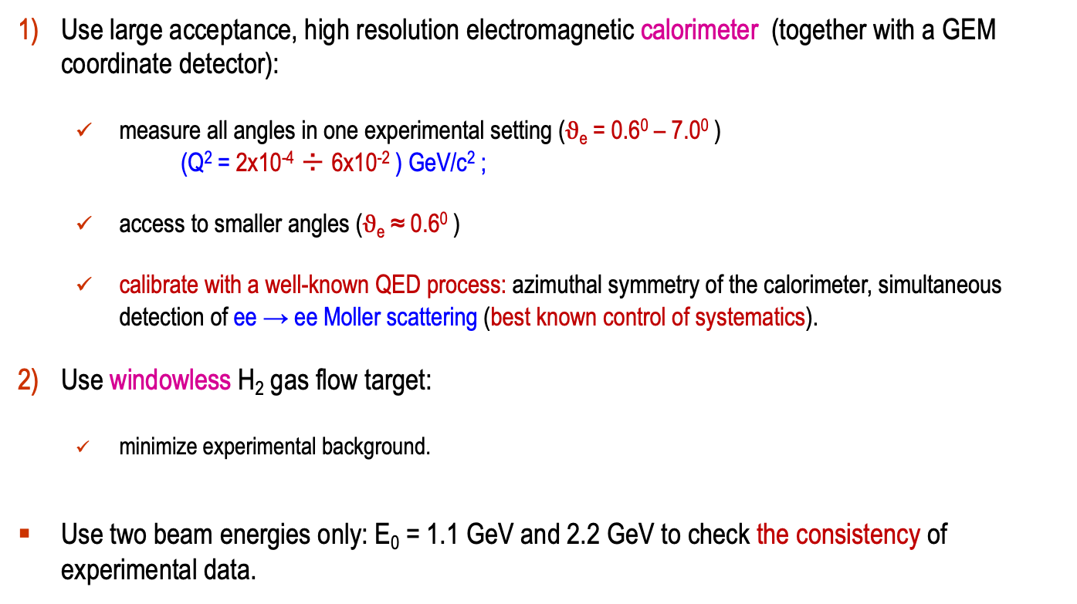
The PRad Experimental Approach
Use large acceptance, high resolution electromagnetic calorimeter (together with a GEM coordinate detector):
  measure all angles in one experimental setting ($ϑ$_{e} = 0.6⁰ – 7.0⁰ )
  (Q² = 2x10⁻⁴ ÷ 6x10⁻² ) GeV/c² ;
  access to smaller angles ($ϑ$_{e} ≈ 0.6⁰ )
  calibrate with a well-known QED process: azimuthal symmetry of the calorimeter, simultaneous detection of ee → ee Moller scattering (best known control of systematics).
Use windowless H₂ gas flow target:
  minimize experimental background.
Use two beam energies only: E₀ = 1.1 GeV and 2.2 GeV to check the consistency of experimental data.

Slide 9
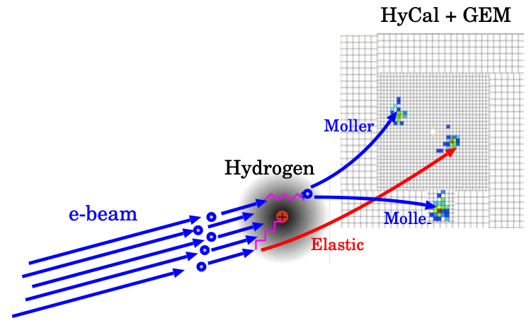
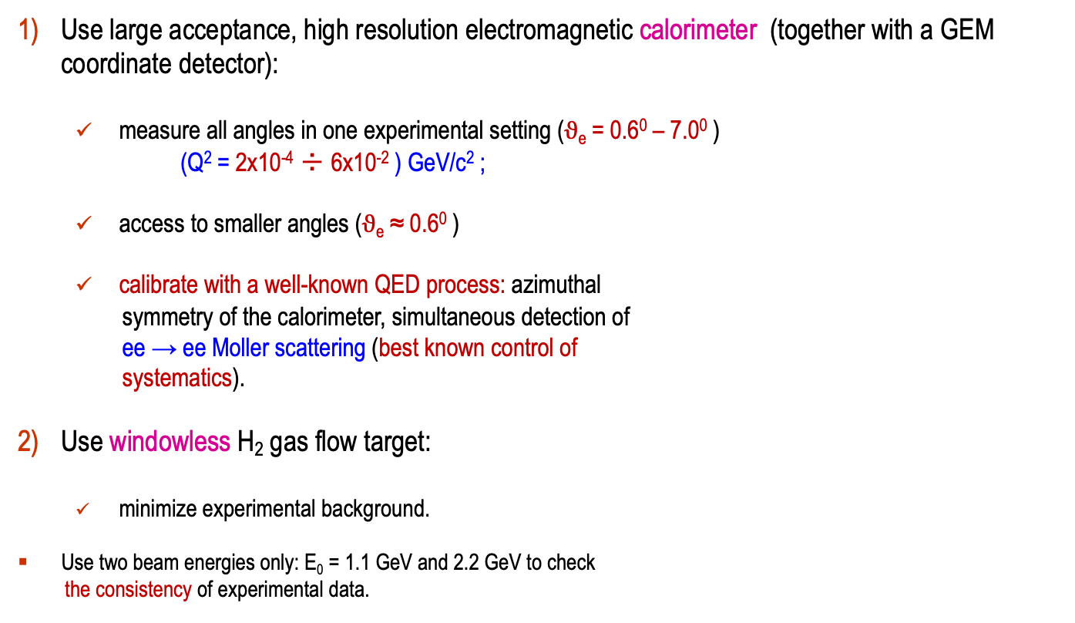
The PRad Experimental Approach
Use large acceptance, high resolution electromagnetic calorimeter (together with a GEM coordinate detector):
  measure all angles in one experimental setting ($ϑ$_{e} = 0.6⁰ – 7.0⁰ )
  (Q² = 2x10⁻⁴ ÷ 6x10⁻² ) GeV/c² ;
  access to smaller angles ($ϑ$_{e} ≈ 0.6⁰ )
  calibrate with a well-known QED process: azimuthal
  symmetry of the calorimeter, simultaneous detection of
  ee → ee Moller scattering (best known control of
  systematics).
Use windowless H₂ gas flow target:
  minimize experimental background.
Use two beam energies only: E₀ = 1.1 GeV and 2.2 GeV to check
the consistency of experimental data.

Slide 10
PRad Experiment Timeline
Initial proposal development: 2011-12
Approved by JLab PAC39: 2012
Funding proposal for windowless H₂ gas flow 2012
target (NSF MRI #PHY-1229153)
Development, construction of the target: 2012 – 15
Funding proposals for the GEM detectors: 2013
(DOE awards)
Development, construction of the GEM detectors: 2013-15
Beam line installation, commissioning,
data taking in Hall B at JLab: January /June 2016
Data analysis 2016 – 2019
Preliminary results released Summer 2018 (Mainz workshop)
Publication in November, 2019
Nature, 575, 145–150 (2019)

Slide 11
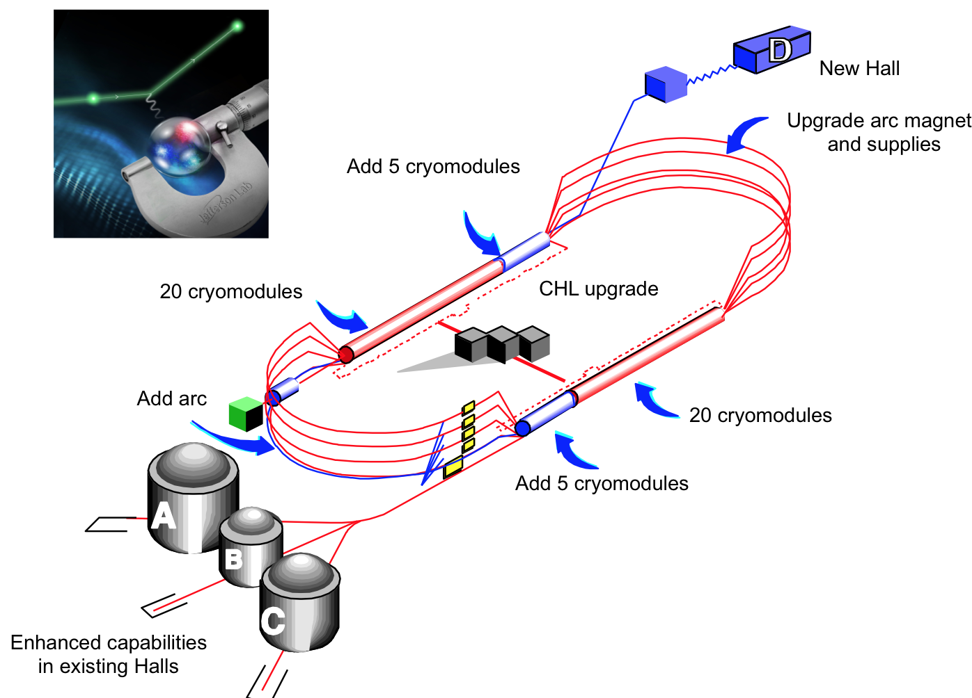
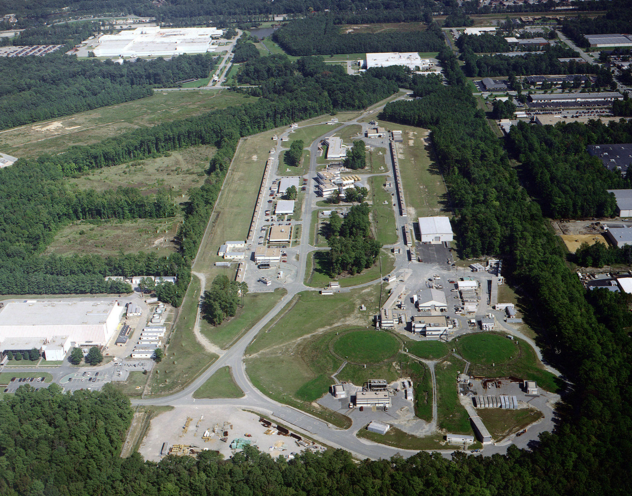
PRad Experiment Performed in Hall B at Jefferson Lab
PRad was performed in Hall B at JLab
in January – June of 2016

Slide 12
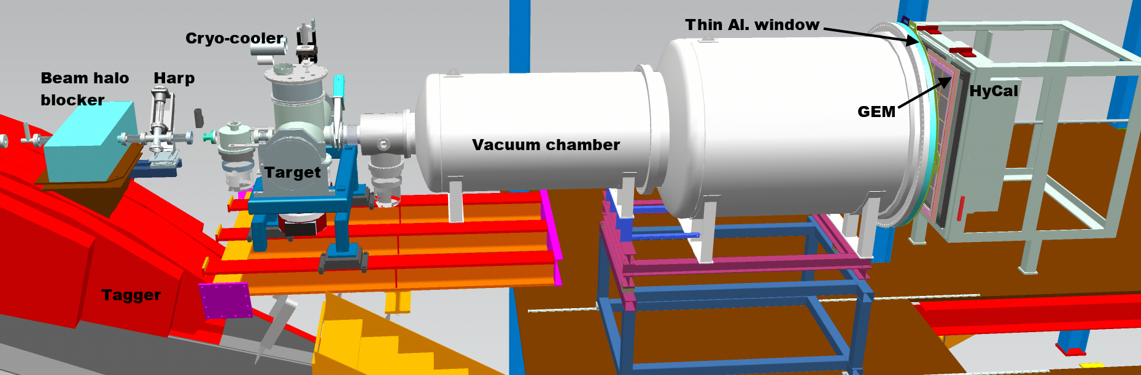
PRad Experimental Setup in Hall B at JLab (schematics)
Main detector elements:
  windowless H₂ gas flow target
  PrimEx HyCal calorimeter
  vacuum box with one thin window at HyCal end
  X,Y – GEM detectors on front of HyCal
Beam line equipment:
  standard beam line elements (0.1 – 50 nA)
  photon tagger for HyCal calibration
  collimator box (6.4 mm collimator for photon beam, 12.7 mm for e⁻ beam halo “cleanup”)
  Harp 2H00 l
e - beam

Slide 13
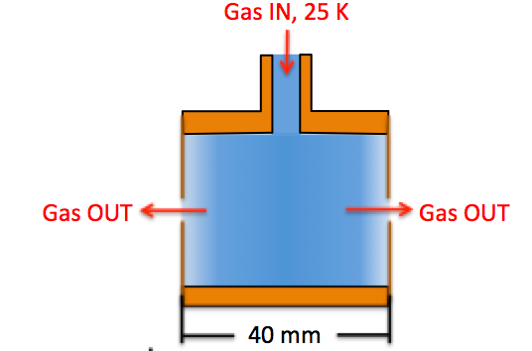
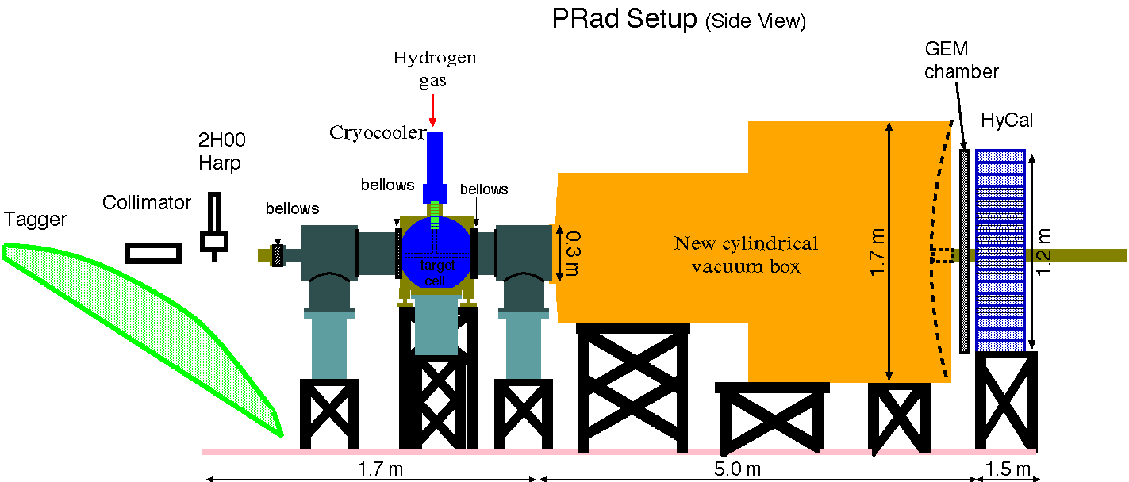
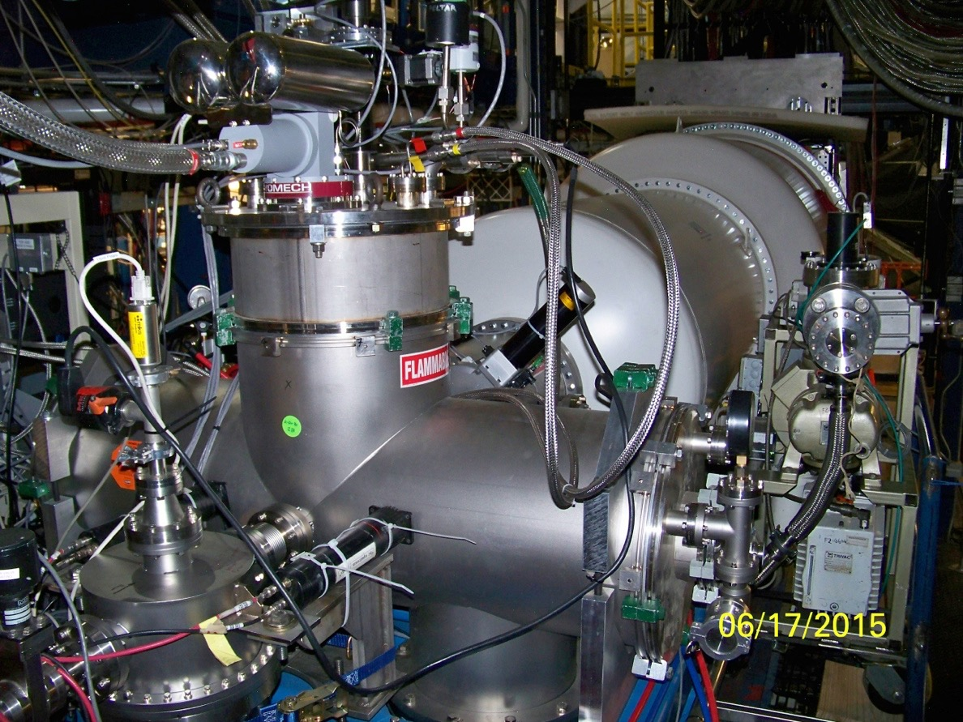
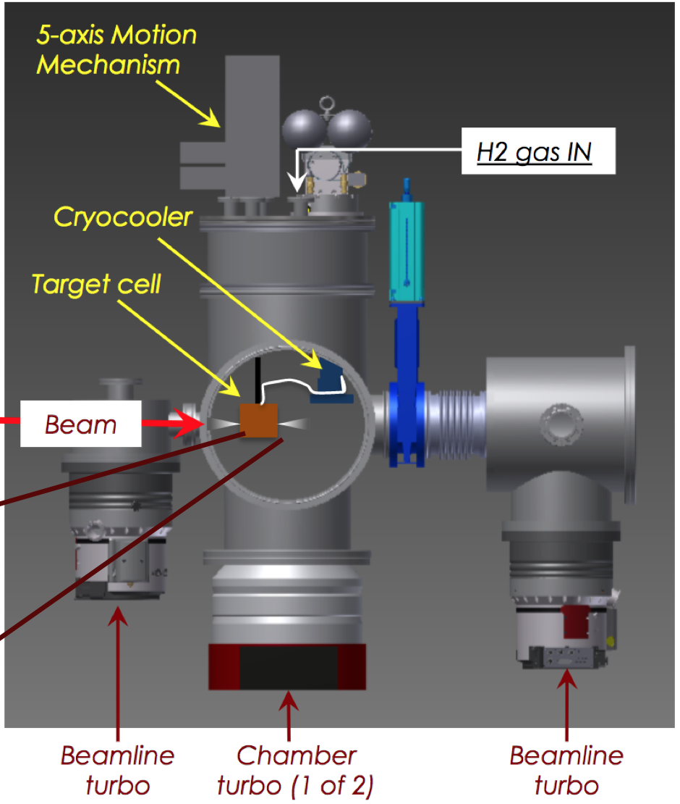
Windowless Hydrogen Gas Flow Target
e-beam
Electron Beam
New Cylindrical Vacuum Chamber
Electron beam
8 cm diam. X 4 cm long target cell
2 mm holes open at front and back of kapton foils for the beam passage
areal density: 1.8x10⁺¹⁸ H atoms/cm²
  cell pressure: 471 mTorr
  chamber pressure: 2.34 mTorr: cell vs. chamber pressures: 200:1
  vacuum tank pressure 0.3 mTorr: cell vs. vacuum tank pressures: 1000:1
  at temperature: 19.5 K

Slide 14
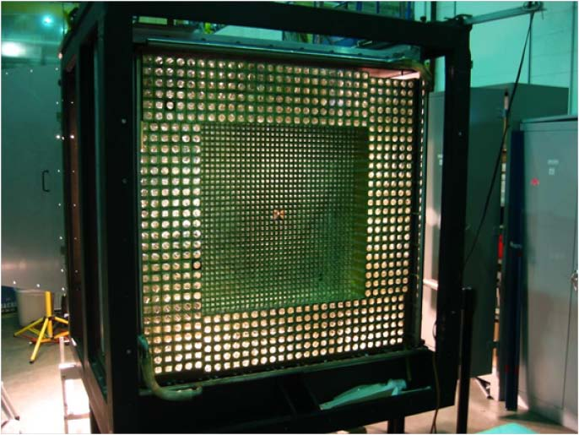
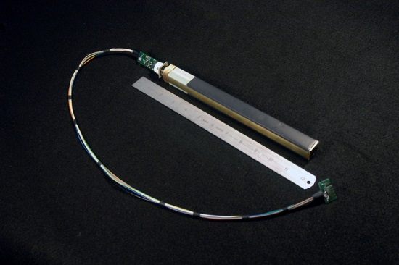
PRad Experimental Apparatus: HyCal El. Mag. Calorimeter
hybrid EM calorimeter (HyCal)
  inner 1156 PbWO₄ modules.
  outer 576 lead glass modules.
5.8 m from the target.
scattering angle coverage: ~ 0.6˚ to 7.5˚
full azimuthal angle coverage
high resolution and efficiency
  2.5% at 1 GeV for crystal part
  6.1% at 1 GeV for lead glass part
energy calibration done with tagged photons
e-beam
New Cylindrical Vacuum Chamber
Electron beam

Slide 15
Data Analysis: ep-inelastic Contribution
Using Christy 2018 empirical fit* to study inelastic ep contribution
Good agreement between data and simulation
Negligible for the PbWO₄ region (<3.5º)
Less than 0.2%(2.0%) for 1.1GeV(2.2GeV) in the Lead glass region
PbWO₄ region
Lead glass region
* M. E. Christy and P. E. Bosted, PRC 81, 055213 (2010)

Slide 16

Extracted ep→ep Elastic Differential Cross Sections
Extracted differential cross sections vs. Q², with 1.1 and 2.2 GeV data.
Statistical uncertainty: ~0.2% for 1.1 GeV and ~0.15% for 2.2 GeV per point.
Systematic uncertainties: 0.3% - 0.5% for 1.1 GeV and 0.3 – 1.1% for 2.2 GeV per point.
33 data points from 1.1 GeV data set
38 data points from 2.2 GeV data set

Slide 17
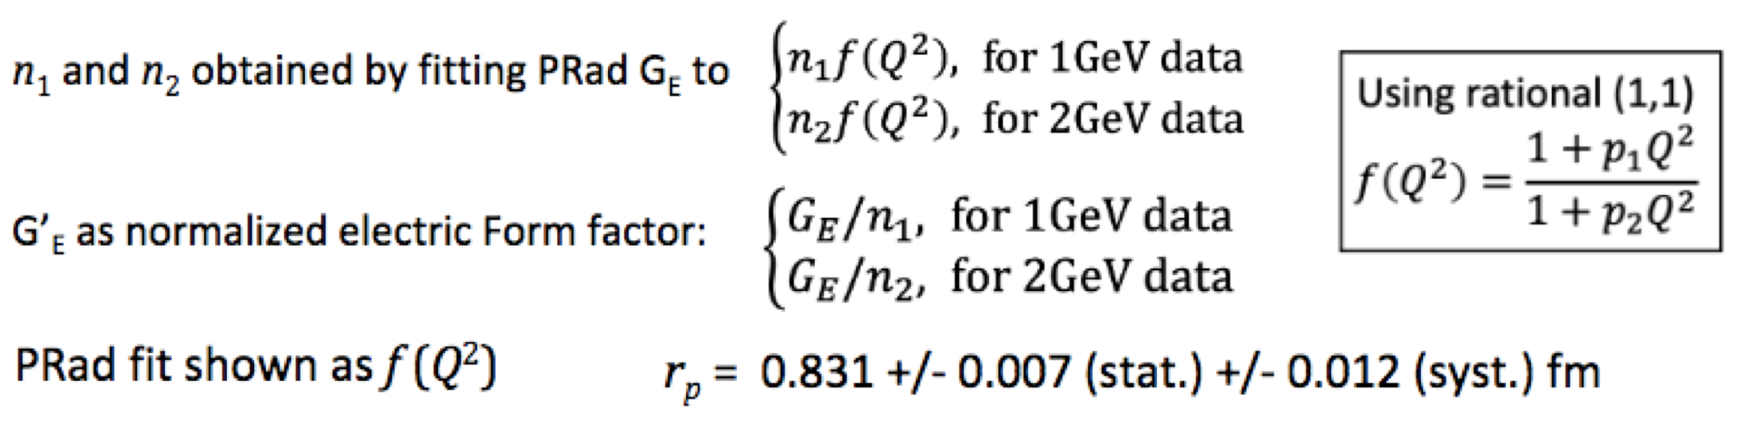
Extracted Charge Form Factor (fit to extract the Proton Radius)
PRad final result: R_{p} = 0.831 ± 0.007 (stat.) ± 0.012 (syst.) fm

Slide 18
The Proton Radius Puzzle before the PRad Publication
Regular hydrogen average (CODATA): 0.8751 ± 0.0061 fm
Muonic hydrogen (CREMA coll. 2013, PSI): 0.8409 ± 0.0004 fm
  Regular H-spectr. (2S ➔ 4P, Garching, PSI): 0.8335 ± 0.0095 fm
  Regular H-spectr. (1S ➔ 3S, LKB, Paris): 0.877 ± 0.013 fm
  Regular H-spectr. (2S_{1/2} ➔ 2P_{1/2} , York Un. Canada) 0.833 ± 0.010 fm

Slide 19
The PRad Final Result on the Radius
PRad final result: R_{p} = 0.831 ± 0.007 (stat.) ± 0.012 (syst.) fm
published in: Nature 575, 145–150 (2019)

Slide 20
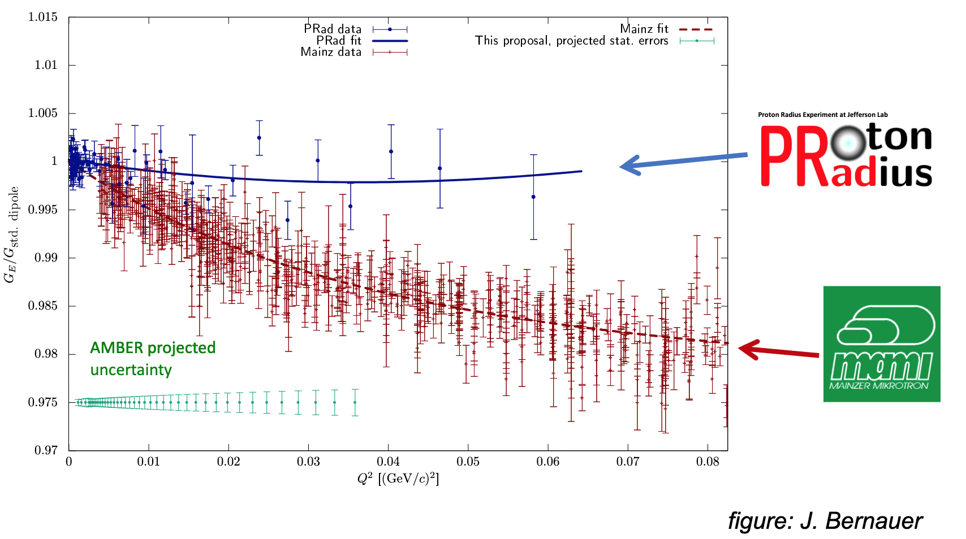
What is Next? Or the Current Open Questions
The “Puzzle” is still not fully resolved!
There is certain discrepancy between the very recent FF measurements.

Slide 21
Data Analysis: ep-inelastic Contribution
Using Christy 2018 empirical fit* to study inelastic ep contribution
Good agreement between data and simulation
Negligible for the PbWO₄ region (<3.5º)
Less than 0.2%(2.0%) for 1.1GeV(2.2GeV) in the Lead glass region
PbWO₄ region
Lead glass region
* M. E. Christy and P. E. Bosted, PRC 81, 055213 (2010)

Slide 22
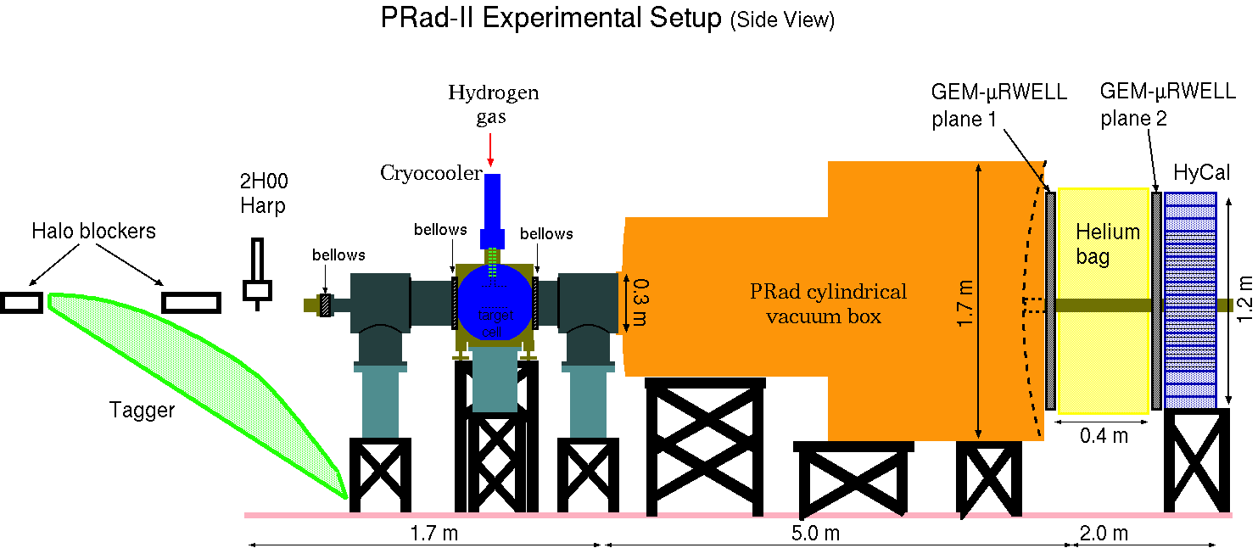
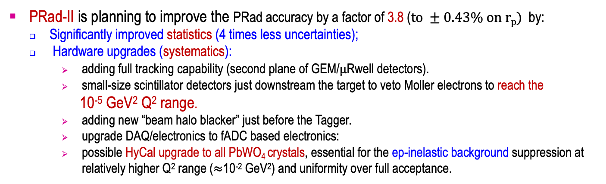
Planed New Experiment: PRad-II at JLab (E12-20-004)
PRad-II is planning to improve the PRad accuracy by a factor of 3.8 ($to ±0.43\% on rp)$ by:
Significantly improved statistics (4 times less uncertainties);
Hardware upgrades (systematics):
  adding full tracking capability (second plane of GEM/$μ$Rwell detectors).
  small-size scintillator detectors just downstream the target to veto Moller electrons to reach the
  10⁻⁵ GeV² Q² range.
  adding new “beam halo blacker” just before the Tagger.
  upgrade DAQ/electronics to fADC based electronics:
  possible HyCal upgrade to all PbWO₄ crystals, essential for the ep-inelastic background suppression at relatively higher Q² range ($≈$10⁻² GeV²) and uniformity over full acceptance.

Slide 23
PRad-II: Projected Result
Approved by JLab’s PAC-48 in August, 2020
Projected total uncertainty on radius: 0.43%

Slide 24
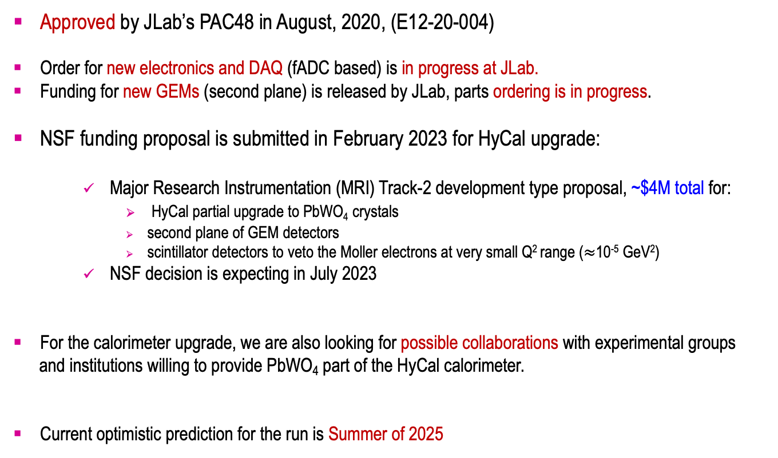
PRad-II: Current Status
Approved by JLab’s PAC48 in August, 2020, (E12-20-004)
Order for new electronics and DAQ (fADC based) is in progress at JLab.
Funding for new GEMs (second plane) is released by JLab, parts ordering is in progress.
NSF funding proposal is submitted in February 2023 for HyCal upgrade:
  Major Research Instrumentation (MRI) Track-2 development type proposal, ~$4M total for:
    HyCal partial upgrade to PbWO₄ crystals
    second plane of GEM detectors
    scintillator detectors to veto the Moller electrons at very small Q² range ($≈$10⁻⁵ GeV²)
  NSF decision is expecting in July 2023
For the calorimeter upgrade, we are also looking for possible collaborations with experimental groups
and institutions willing to provide PbWO₄ part of the HyCal calorimeter.
Current optimistic prediction for the run is Summer of 2025

Slide 25
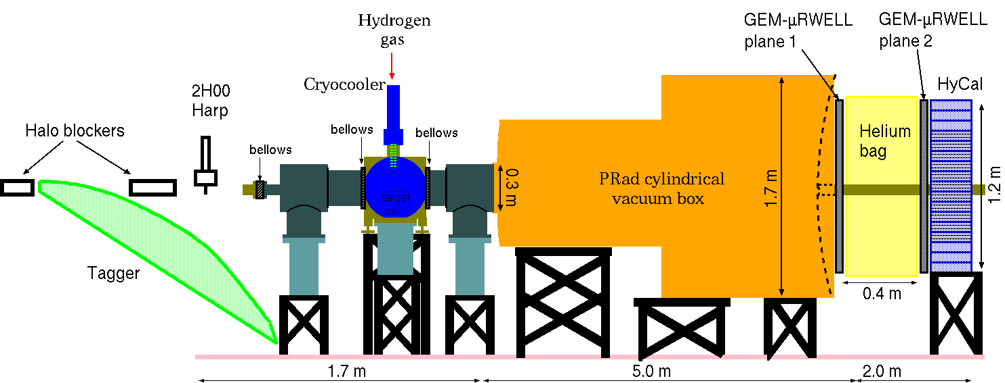
DRad: New Proposal for Deuteron Charge Radius (PR12-23-011)
Use (PRad-II setup) + (cylindrical recoil detector) for the control of reaction elasticity
Electron beam energy: 1.1 GeV and 2.2 GeV
Q² range: 2x10⁻⁴ – 5x10⁻² GeV²
Simultaneous detection of scattered elastic and Moller electrons (control of systematics)

Slide 26
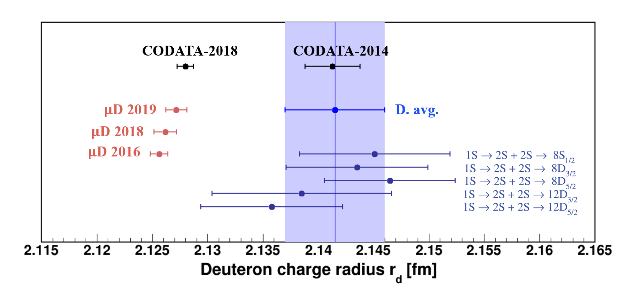
The Deuteron Radius Puzzle (spectroscopy results)
$\sim$ 6 $σ$ discrepancy between R_{d} from ordinary and muonic spectroscopy results.

Slide 27
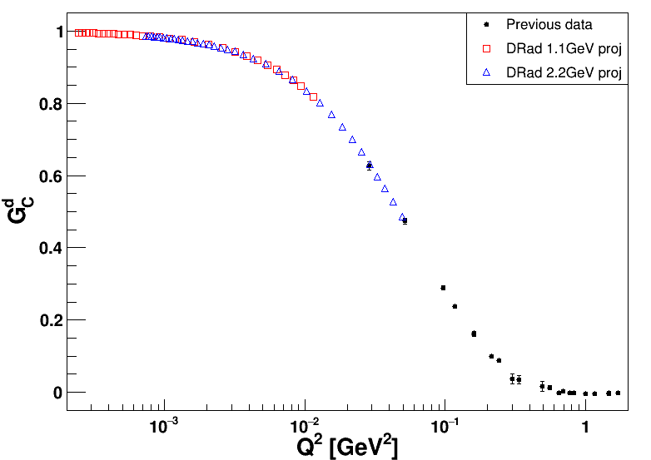
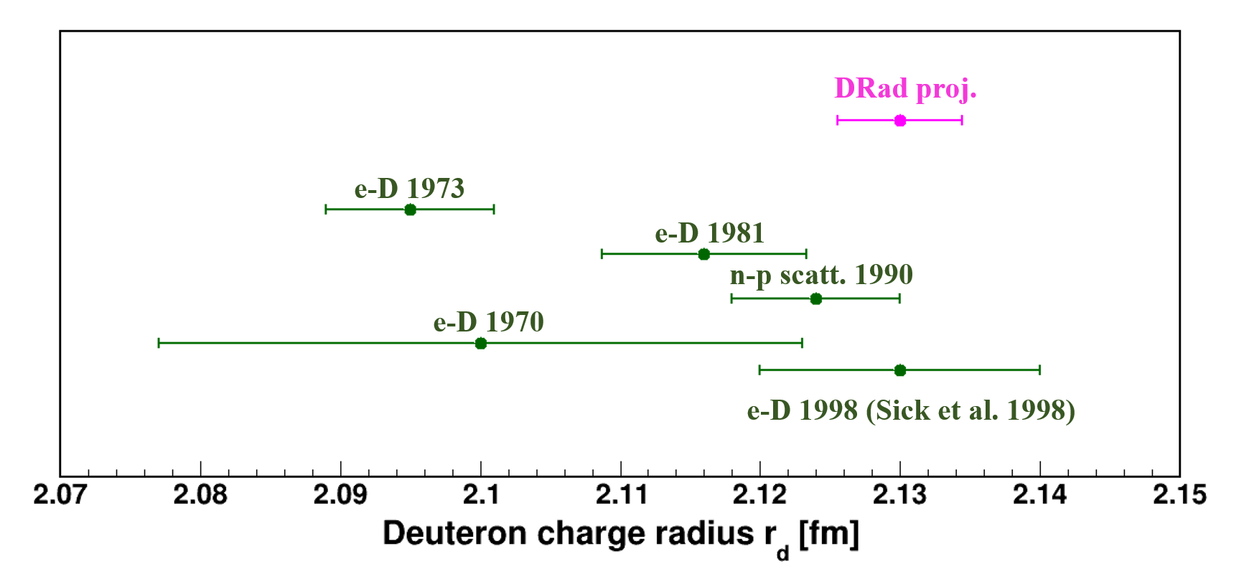
Expected Results
Submitted to JLab PAC51 for July 2023 meeting
Expected total uncertainty on Rd: 0.21%

Slide 28
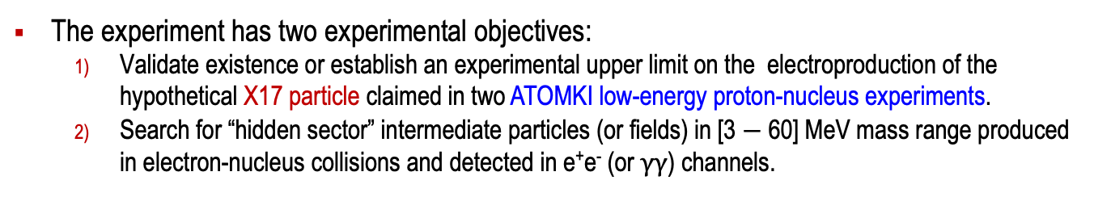
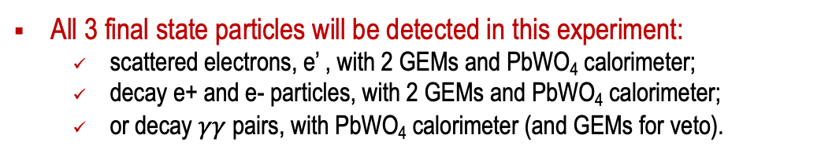
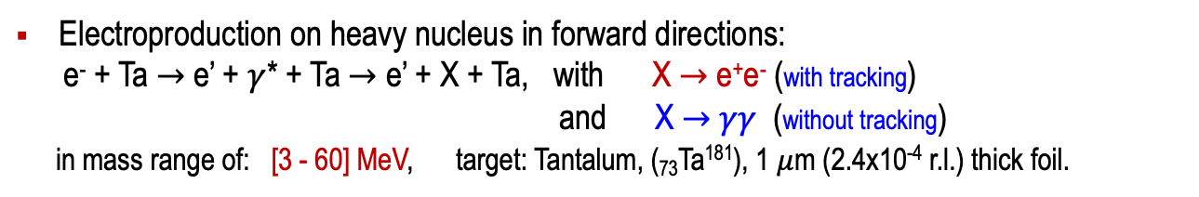
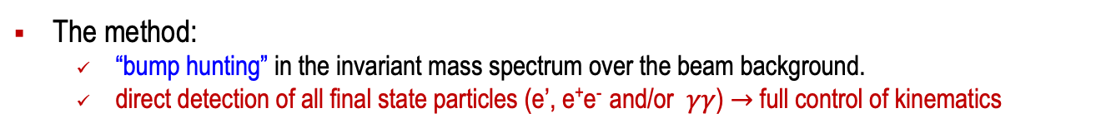
Search for Hidden Sector New Particles in the 3 - 60 MeV Mass Range
(JLab Experiment E12-21-003)
The experiment has two experimental objectives:
  Validate existence or establish an experimental upper limit on the electroproduction of the hypothetical X17 particle claimed in two ATOMKI low-energy proton-nucleus experiments.
  Search for “hidden sector” intermediate particles (or fields) in [3 $−$ 60] MeV mass range produced in electron-nucleus collisions and detected in e⁺e⁻ (or $γγ$) channels.
The method:
  “bump hunting” in the invariant mass spectrum over the beam background.
  direct detection of all final state particles (e’, e⁺e⁻ and/or $γγ$) $→$ full control of kinematics
Electroproduction on heavy nucleus in forward directions:
e⁻ + Ta $→$ e’ + $γ$* + Ta $→$ e’ + X + Ta, with X $→$ e⁺e⁻ (with tracking)
and X $→$ $γγ$ (without tracking)
in mass range of: [3 - 60] MeV, target: Tantalum, (₇₃Ta¹⁸¹), 1 $μ$m (2.4x10⁻⁴ r.l.) thick foil.
All 3 final state particles will be detected in this experiment:
  scattered electrons, e’ , with 2 GEMs and PbWO₄ calorimeter;
  decay e+ and e- particles, with 2 GEMs and PbWO₄ calorimeter;
  or decay $γγ$ pairs, with PbWO₄ calorimeter (and GEMs for veto).
Expected run: Summer 2025

Slide 29
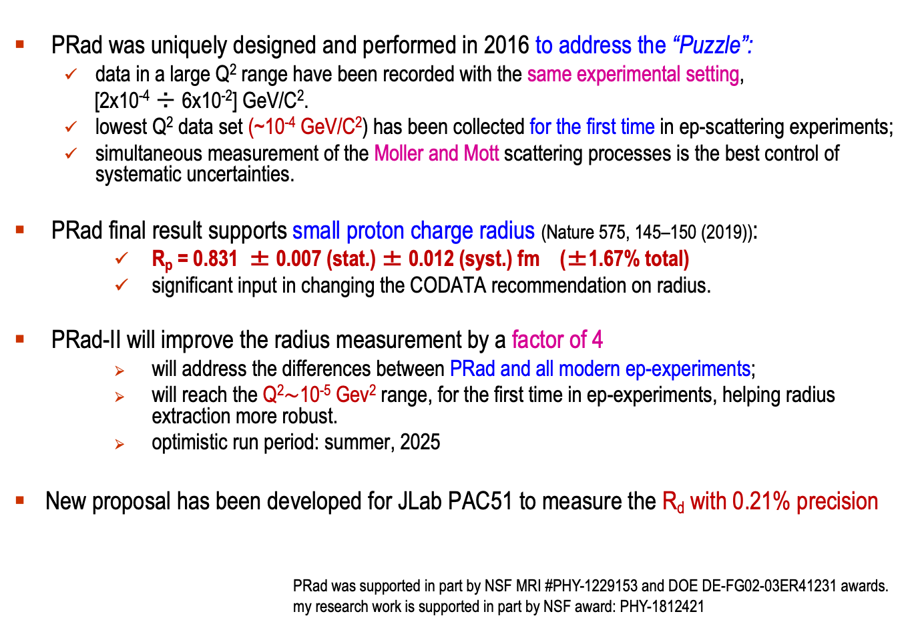
Summary and outlook
PRad was uniquely designed and performed in 2016 to address the “Puzzle”:
  data in a large Q² range have been recorded with the same experimental setting,
  [2x10⁻⁴ ÷ 6x10⁻²] GeV/C².
  lowest Q² data set (~10⁻⁴ GeV/C²) has been collected for the first time in ep-scattering experiments;
  simultaneous measurement of the Moller and Mott scattering processes is the best control of systematic uncertainties.
PRad final result supports small proton charge radius (Nature 575, 145–150 (2019)):
    R_{p} = 0.831 ± 0.007 (stat.) ± 0.012 (syst.) fm (±1.67% total)
    significant input in changing the CODATA recommendation on radius.
PRad-II will improve the radius measurement by a factor of 4
    will address the differences between PRad and all modern ep-experiments;
    will reach the Q²$\sim$10⁻⁵ Gev² range, for the first time in ep-experiments, helping radius extraction more robust.
    optimistic run period: summer, 2025
New proposal has been developed for JLab PAC51 to measure the R_{d} with 0.21% precision
PRad was supported in part by NSF MRI #PHY-1229153 and DOE DE-FG02-03ER41231 awards.
my research work is supported in part by NSF award: PHY-1812421

Slide 30
Thank you!

Slide 31
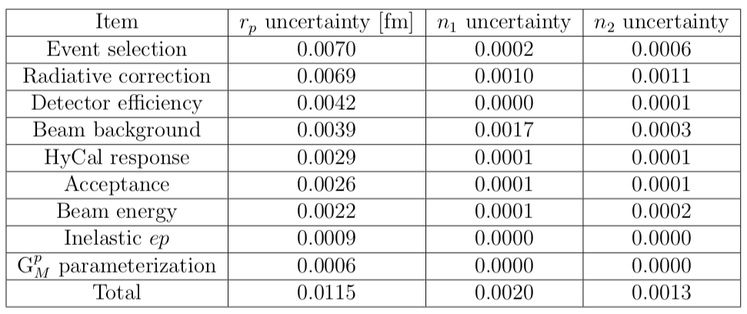
PRad Systematic Uncertainties

Slide 32
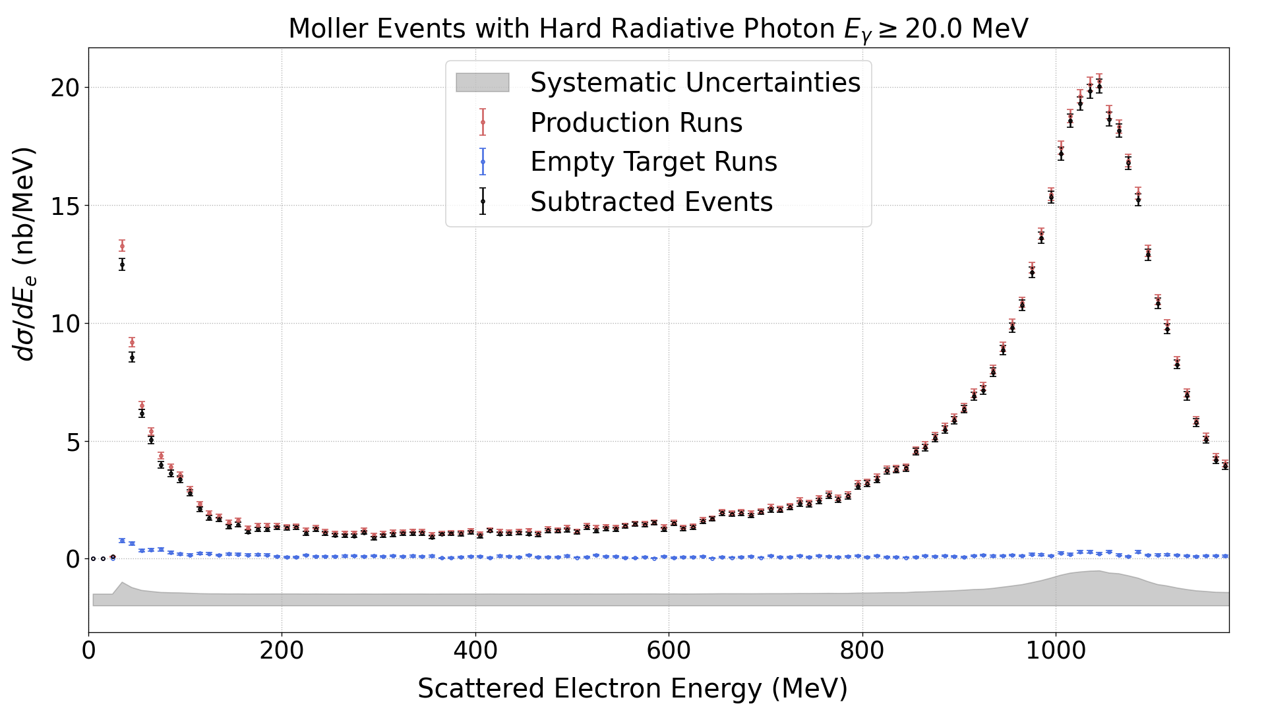
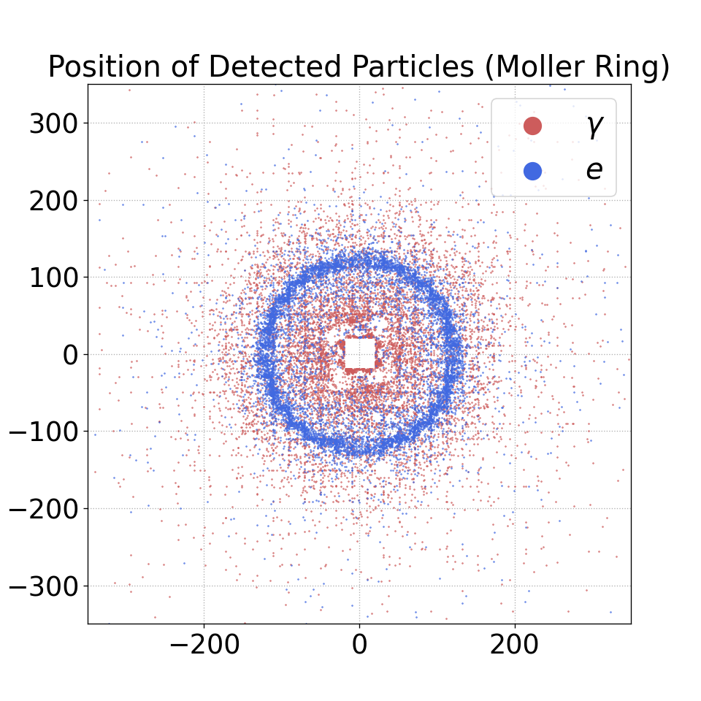
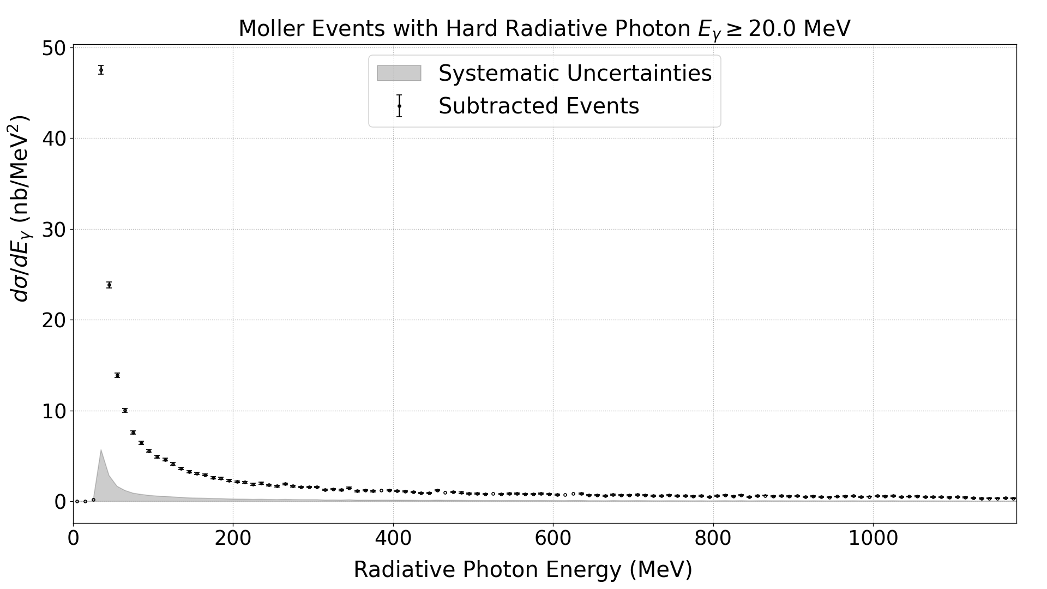
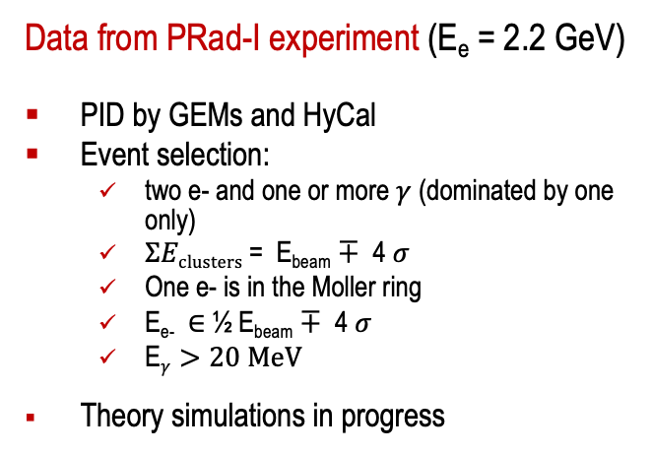
Radiative Tail Measurement from Moller
Data from PRad-I experiment (E_{e} = 2.2 GeV)
PID by GEMs and HyCal
Event selection:
  two e- and one or more $γ$ (dominated by one only)
  $ΣEclusters$= E_{beam} $∓$ 4 $σ$
  One e- is in the Moller ring
  E_{e-} $∈$½ E_{beam} $∓$ 4 $σ$
  E$γ>20 MeV$
Theory simulations in progress
Preliminary
Electron Energy Spectrum
Preliminary
Radiative Photon Energy Spectrum

Slide 33
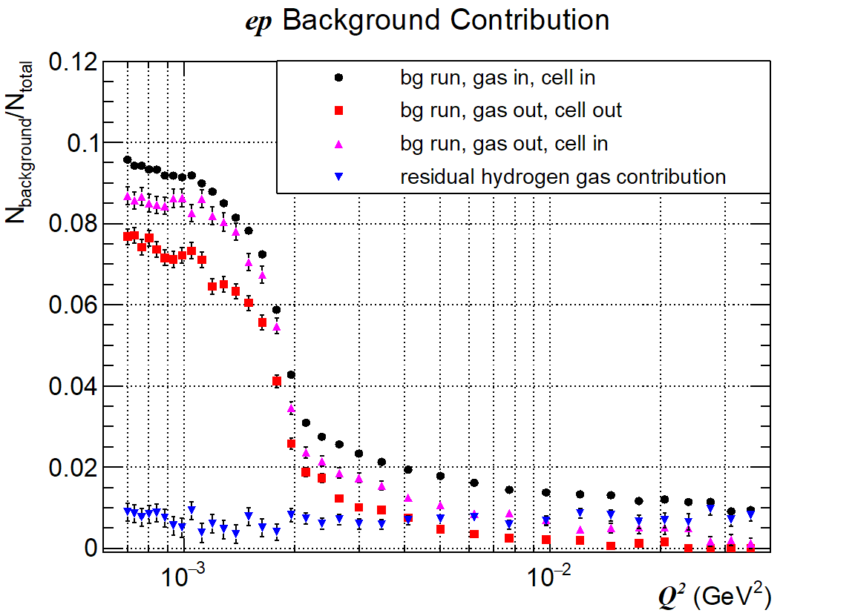
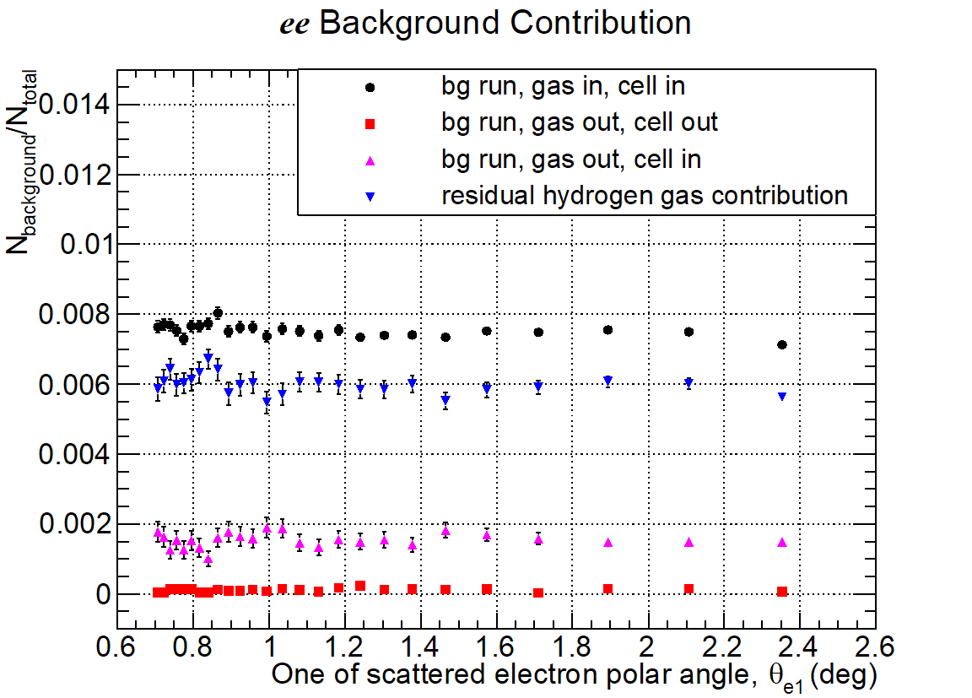
Data Analysis: Beam Background Subtraction
ep background rate ~ 10% at forward angles (<1.3⁰, dominated by upstream “collimator”),
less than 2% otherwise.
ee background rate ~ 0.8% at all angles .
2.2 GeV data
2.2 GeV data

Slide 34
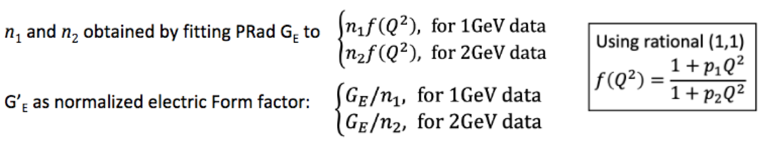
Extracted Proton Electric Form Factor, G_{E} vs. Q²
33 data points from 1.1 GeV data set
38 data points from 2.2 GeV data set
n₁ = 1.0002 +/- 0.0002(stat.) +/- 0.0020 (syst.), n₂ = 0.9983 +/- 0.0002(stat.) +/- 0.0013 (syst.)

Slide 35
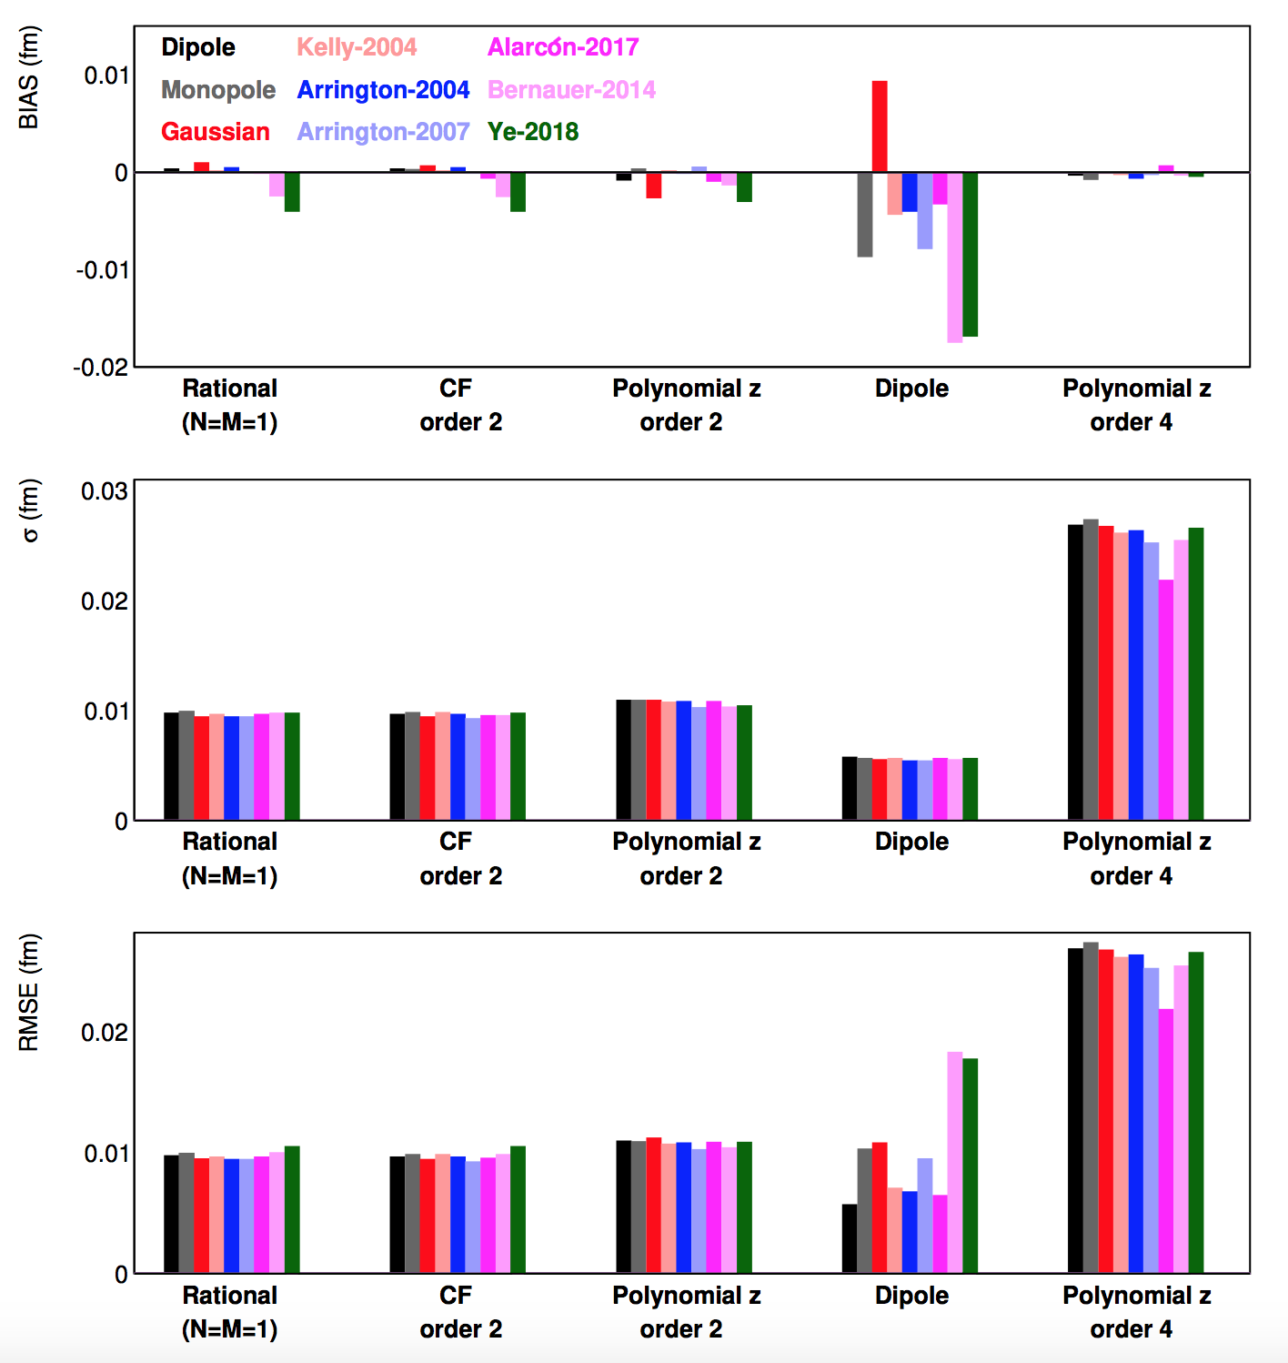
Recent Developments in Fitting Procedures
The input form factors (with known r_{p}) are used to generate pseudo data using PRad kinematic range and uncertainties.
All combinations of input functions and fit functions can then be tested repeatedly against regenerated pseudo data.
Since the input radius is known, this allowed to find fitting functions that are robust for proton radius extractions in an objective fashion.
The following fitters:
  two-parameter rational function
  two-parameter continued fraction
  second-order polynomial expansion of z
are identified as robust fitters with small uncertainties
RMSE = sqrt(bias² + σ²)
X. Yan, et al.
“Robust extraction of the proton charge radius from electron-proton scattering data”, PRC 98, 2, 025204, 2018

Slide 36
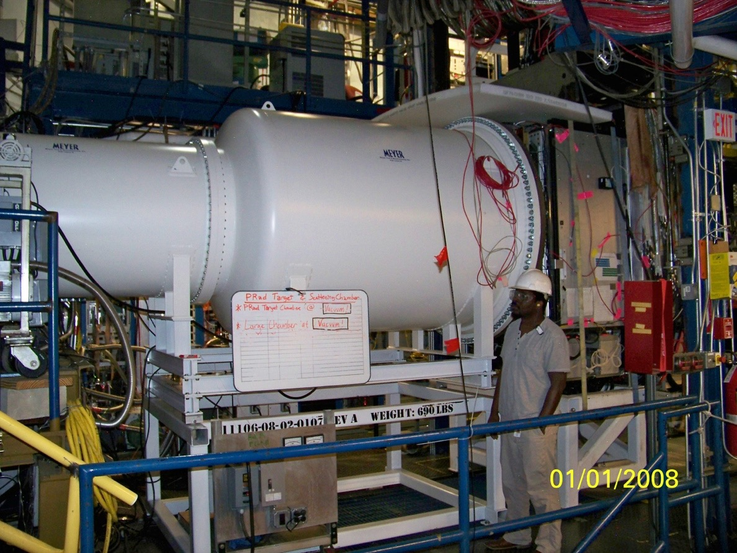
PRad Experimental Apparatus: Vacuum Chamber
New Cylindrical Vacuum Chamber
Electron beam
5 m long two stages vacuum chamber,
1.7 m diameter, 2 mm Al vacuum window
vacuum chamber pressure: 0.3 mTorr

Slide 37
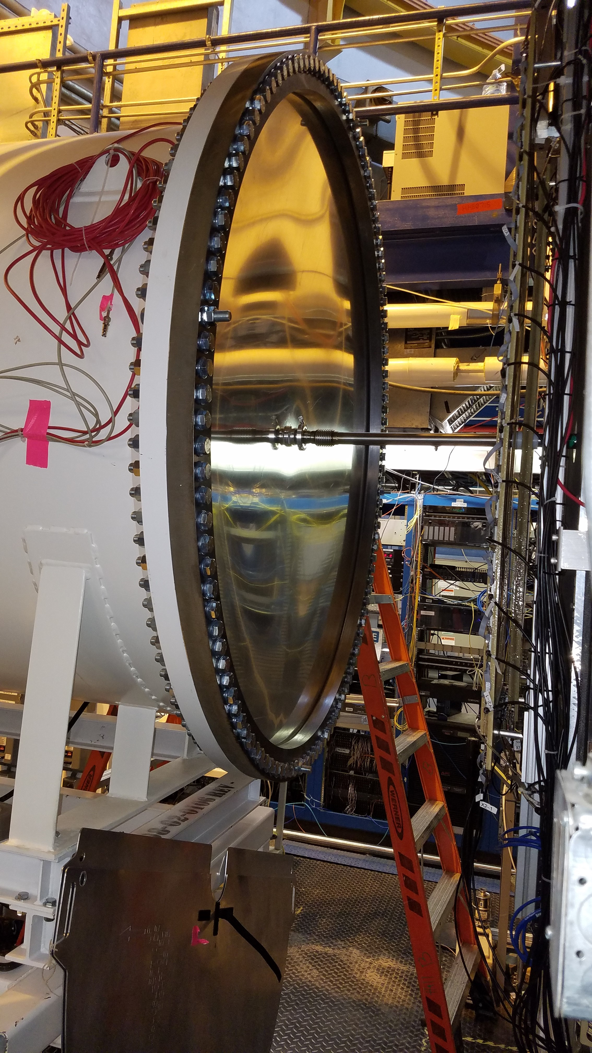
PRad Experimental Apparatus: Vacuum Chamber and Window
2-stage vacuum box in Hall B beam line
1.7 m diameter, 2 mm Al vacuum window

Slide 38
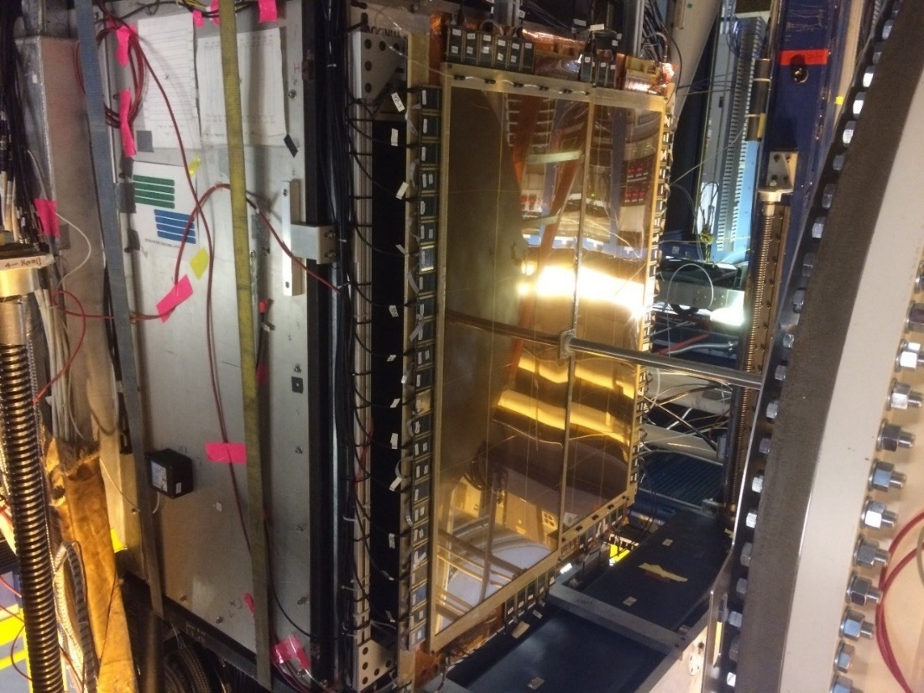
PRad Experimental Apparatus: GEM Coordinate Detectors
Two large area GEM detectors
Small overlap region in the middle
Excellent position resolution (72 µm)
Improve position resolution of the setup by > 20 times
Large improvements in Q² determination
New Cylindrical Vacuum Chamber
Electron beam

Slide 39

Data Analysis: Empty Target Runs for Background Subtraction
ep background rate ~ 10% at forward angle (<1.1 deg, dominated by upstream beam halo blocker),
less than 2% otherwise
ee background rate ~ 0.8% at all angles
(a)
(b)
2.2 GeV ep data
(c)
(d)
Residual hydrogen gas: hydrogen gas filled during background runs

Slide 40


Data Analysis: Event Selection
Experimental data was taken with two beam energies:
  1.1 GeV (604 M events)
  2.2 GeV (756 M events)
For all events, require hit matching between GEMs and HyCal
For ep and ee events, apply angle dependent energy cut based on kinematics:
  cut size depend on local detector resolution
For ee, if requiring double-arm events, apply additional cuts:
  elasticity
  co-planarity
  vertex z (kinematics)
2.2 GeV

Slide 41
What is Next? Or the Current Open Questions
The “Puzzle” is still not fully resolved
There is certain discrepancy between the very recent FF measurements

Slide 42

Radiative Corrections for DRad
The complete elastic e-d NLO cross section including the lowest order radiative corrections beyond the ultrarelativistic limit has been calculated
Based on the ansatz in the PRad RC calculation and used the Bardin-Shumeiko infrared divergence cancellation method (I. Akushevich et al. Eur. Phys. J. A 51.1(2015), p. 1. DOI: 10.1140/epja/i2015-15001-8)
A generator is developed and the total correction to the elastic e-d Born cross section in the DRad kinematics is calculated
The uncertainty of the NLO calculation is estimated, taking into account higher-order contributions, calculation assumptions, and differences between various recipes
The paper is to be submitted to arXiv and European Physical Journal A

Slide 43

PRad Collaboration
A part of the PRad collaboration
in December, 2019 at JLab
Currently 14 collaborating universities and institutions:
Jefferson Laboratory, NC A&T State University,
Duke University, Idaho State University,
Mississippi State University, Norfolk State University,
University of Virginia, Argonne National Laboratory,
University of North Carolina at Wilmington, Hampton University,
College of William & Mary, Tsinghua University, China,
Old Dominion University, ITEP Moscow, Russia.
Graduate students:
Chao Peng (Duke), Weizhi Xiong (Duke),
Xinzhan Bai (UVa), Li Ye (MSU)
Postdocs:
Chao Gu (Duke), Xuefei Yan (Duke), Mehdi Meziane
(Duke), Zhihong Ye (Duke), Tyler Hague (NC A&T SU),
Maxime Lavilain (NC A&T), Krishna Adhikari (MSU),
Latif-ul Kabir (MSU), Chandra Akondi (NC A&T)

