Slide 1
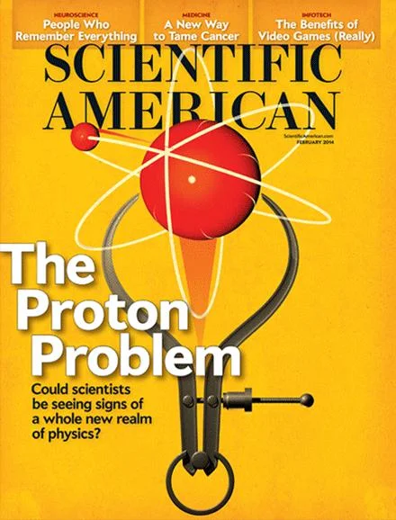
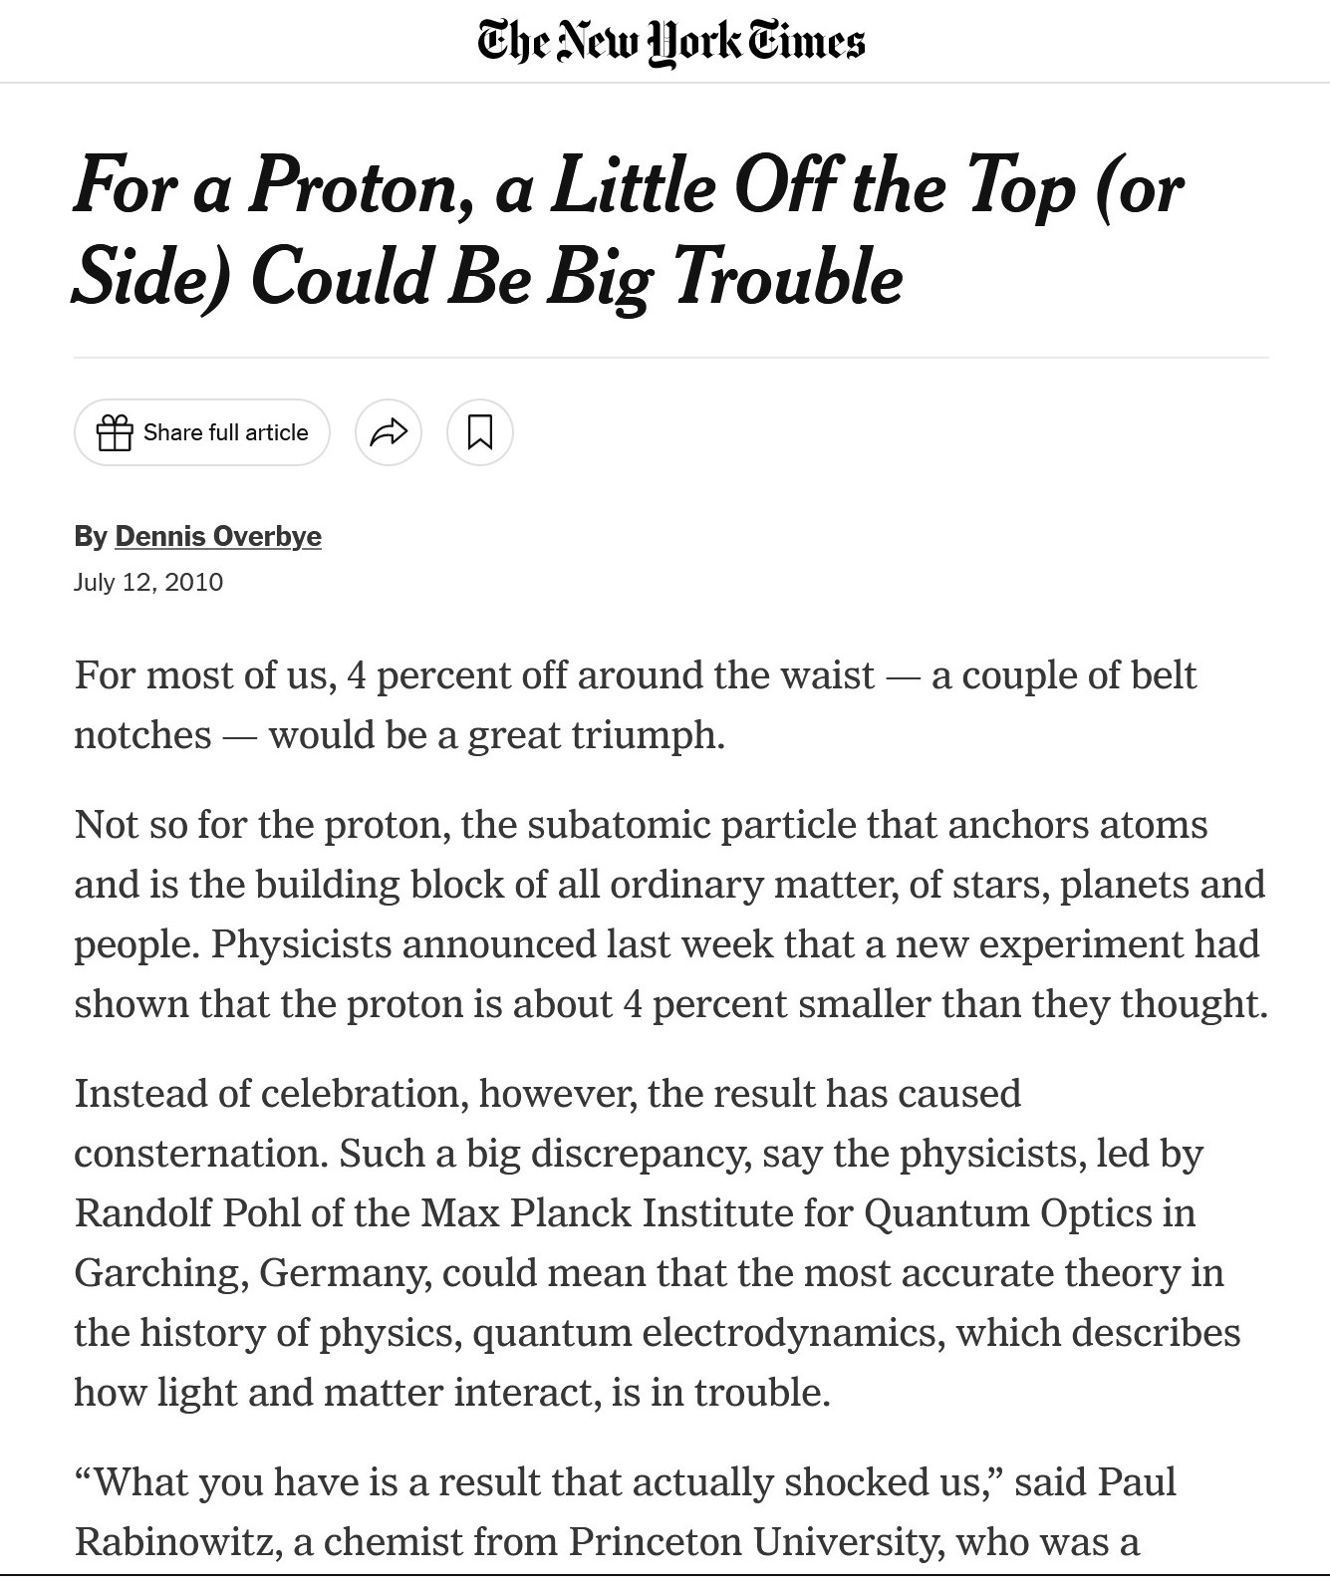
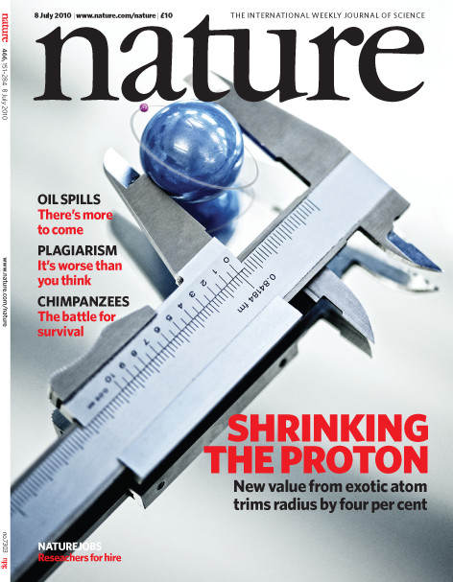
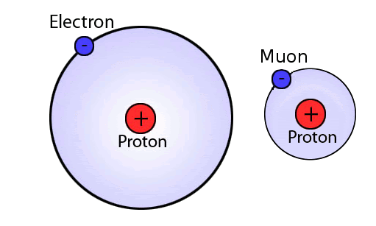
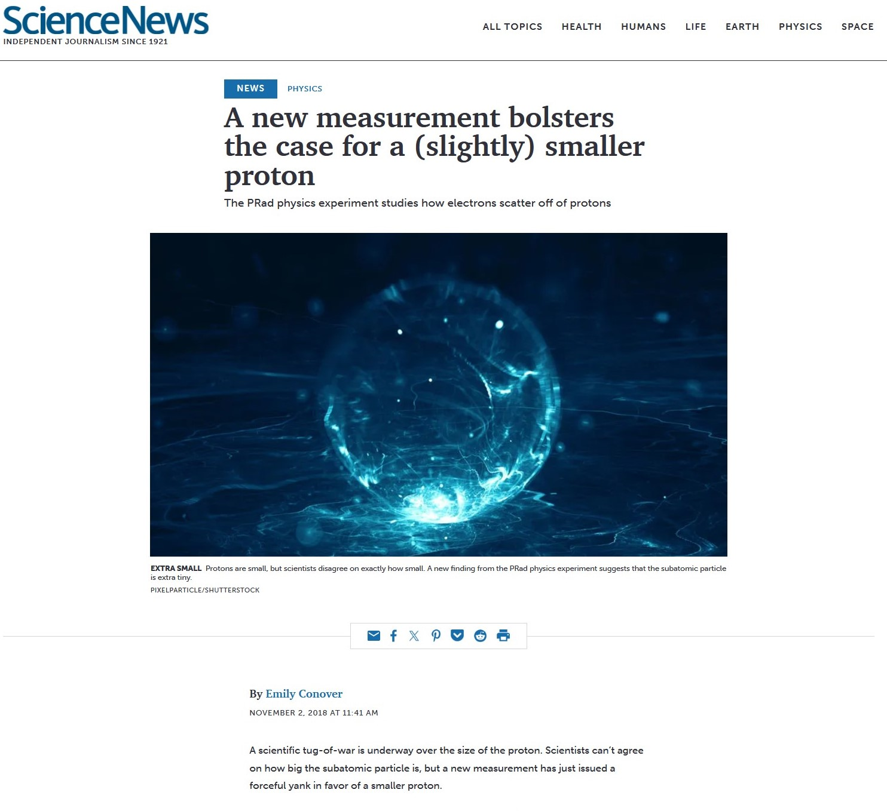
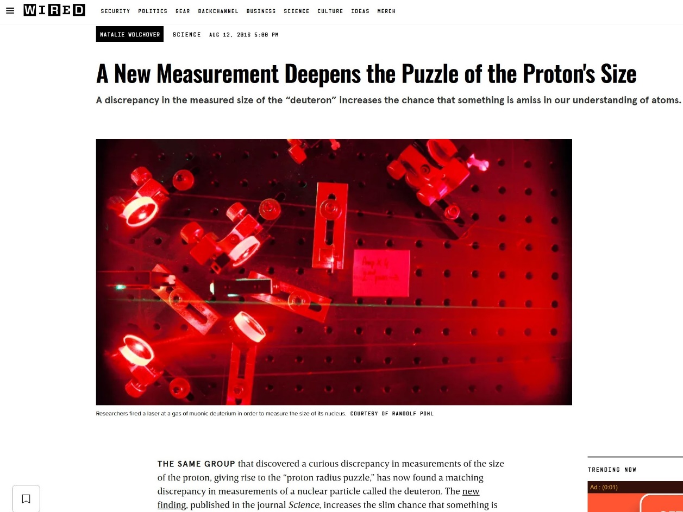
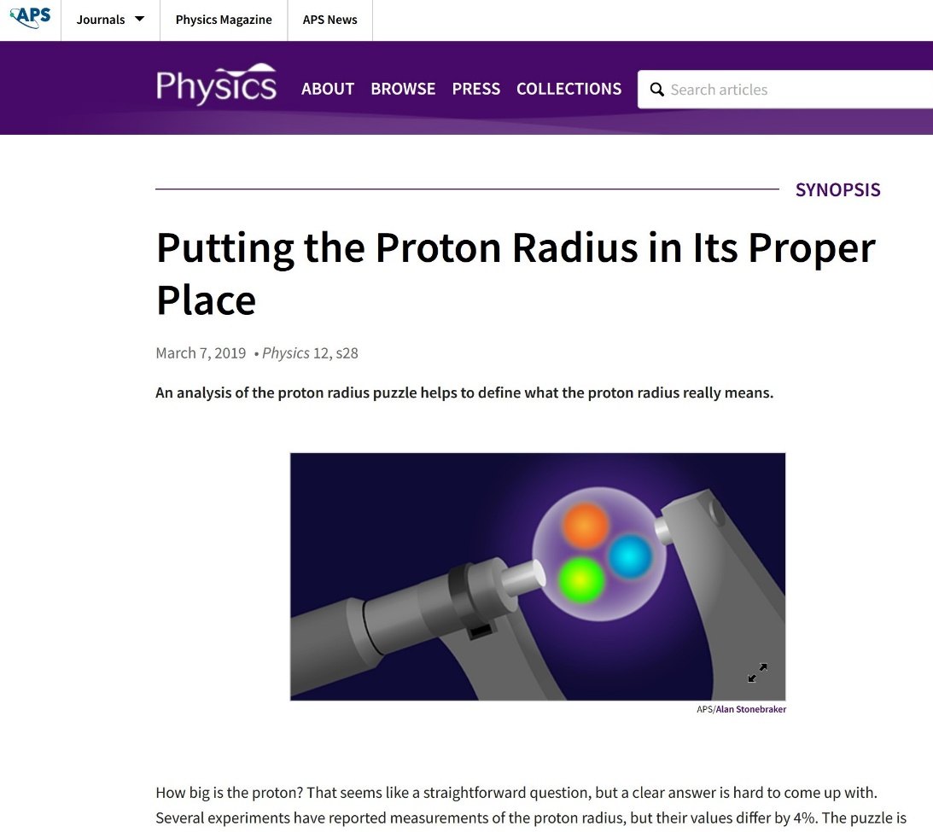
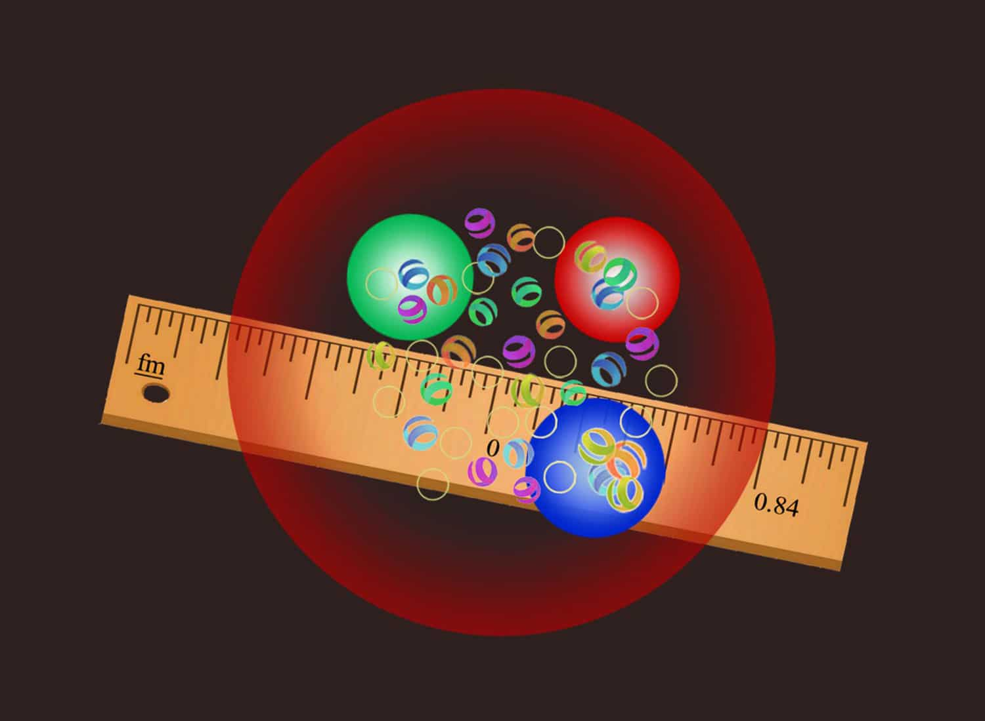
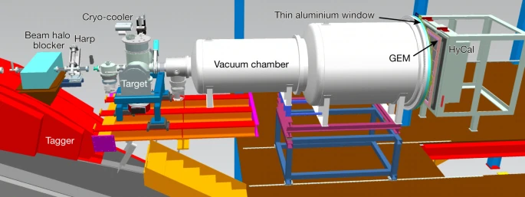
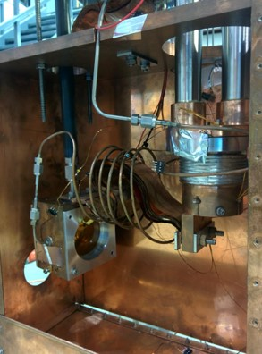
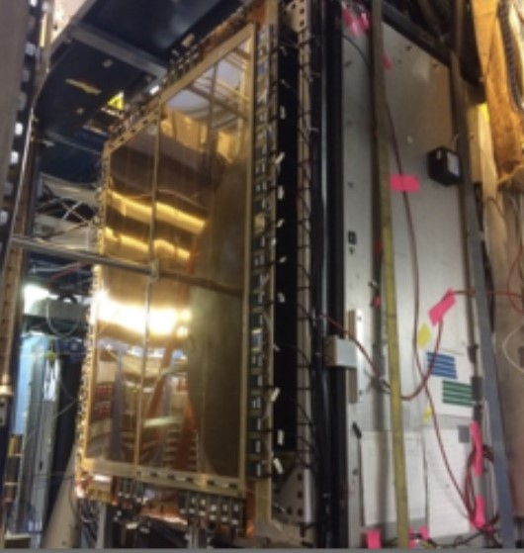
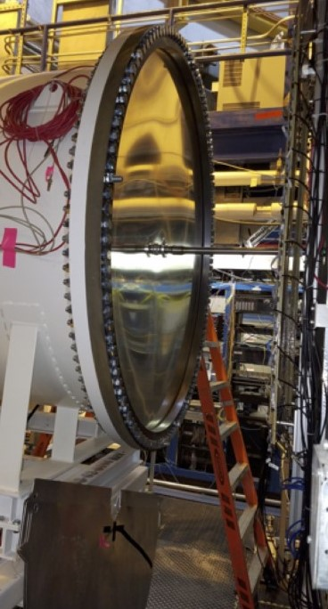
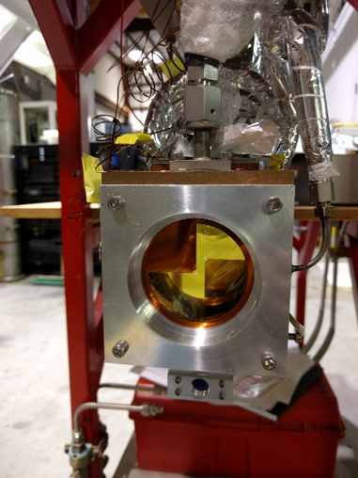
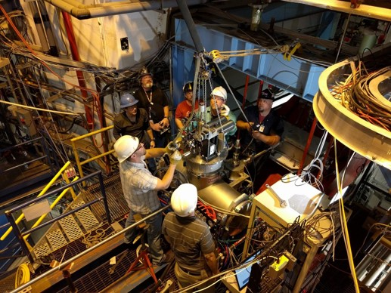
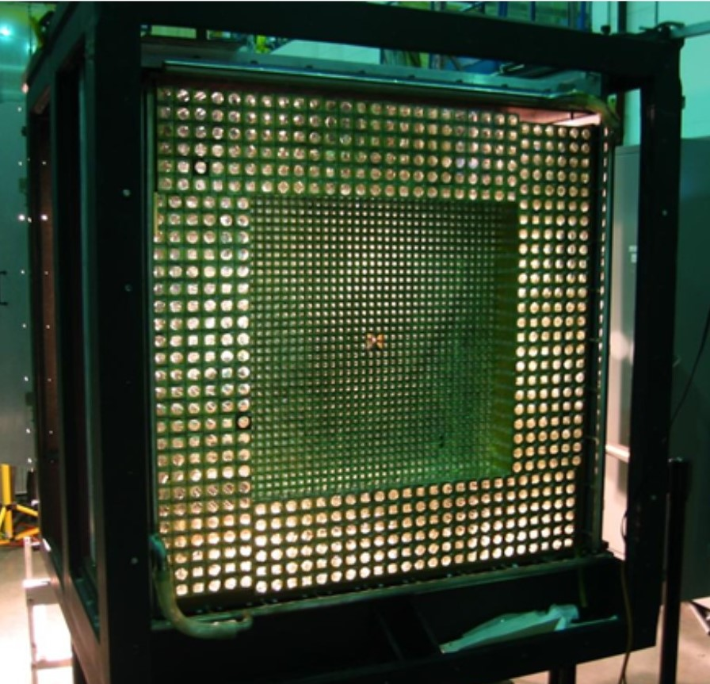
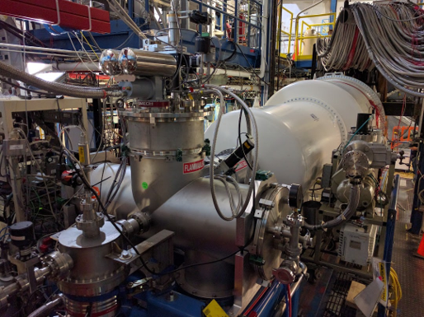
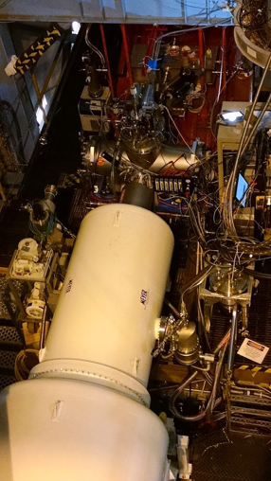
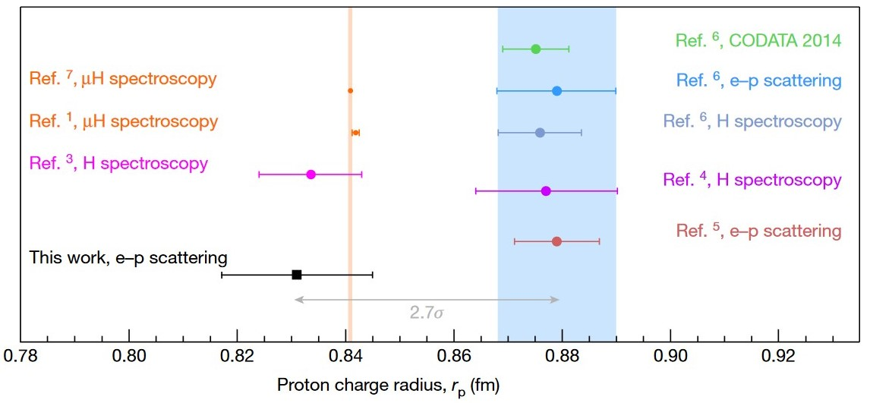
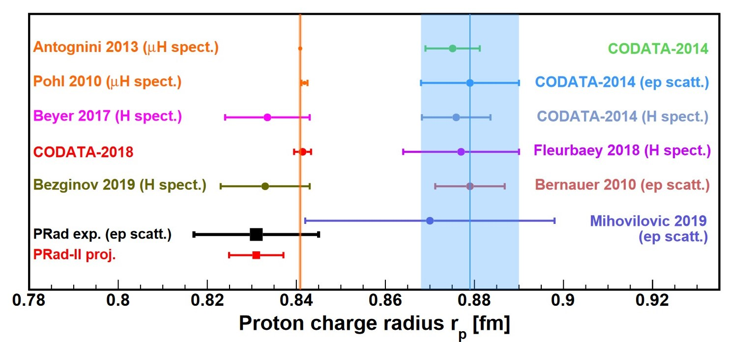
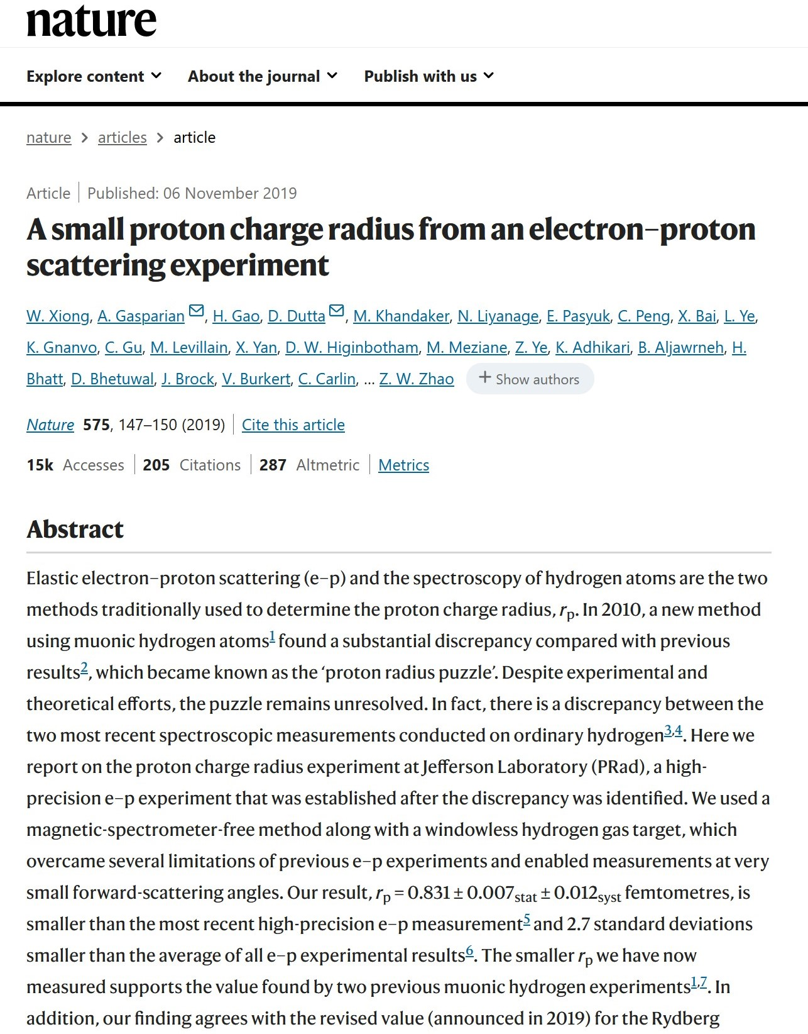
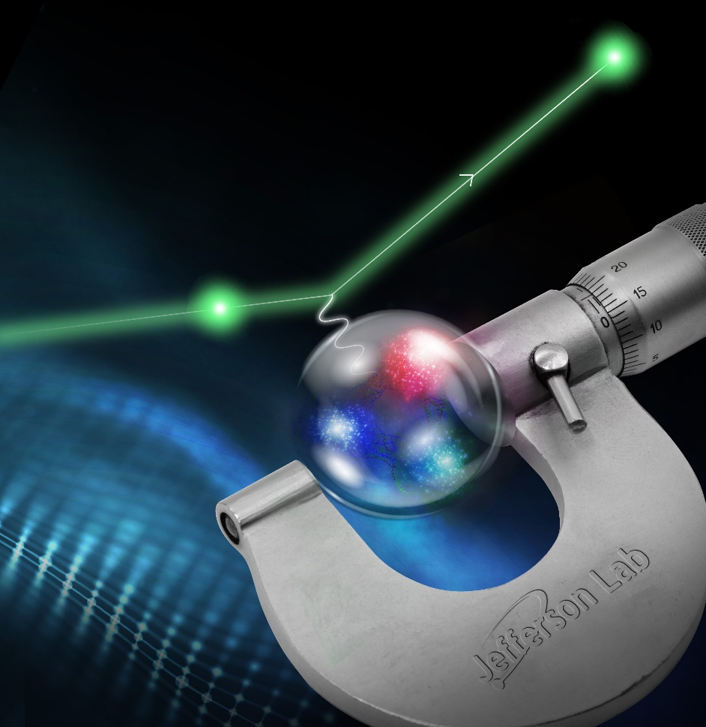
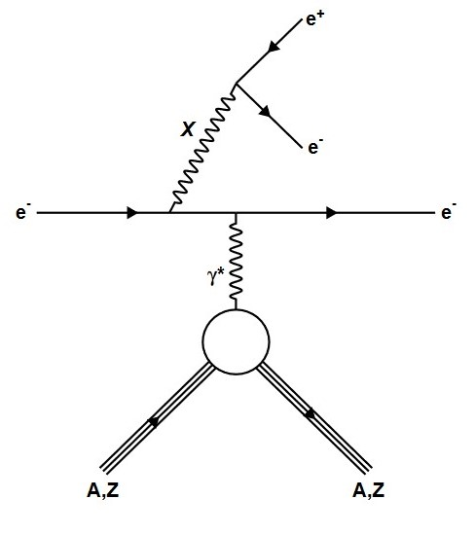
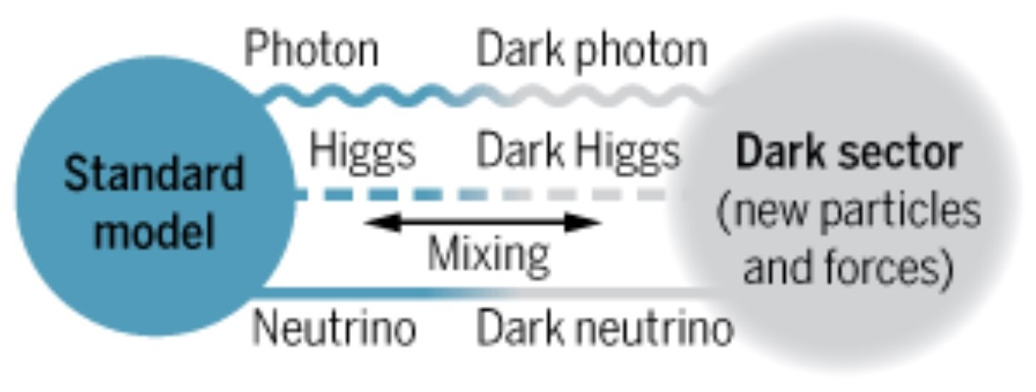
The Proton Radius (PRad) Experiment
Thomas Jefferson National Accelerator Facility
The Proton Radius Puzzle
In 2010, an experiment found the proton radius from measuring the energy levels of muonic hydrogen and found a value lower than any other measurement of the proton radius from normal hydrogen. This measurement had only a 1 in 100 billion chance to be a random chance.
$$M_{μ}≈205M_{e}$$
*Not to scale*
The Novel PRad Experiment at JLab
To solve this puzzle a new high precision electron scattering experiment on hydrogen was performed in Hall B at JLab. It used a completely unique target design along with covering a large angular range using a magnetic spectrometer free electromagnetic calorimeter.
*Target pictures contributed by the JLab Target Group*
JLab Electron Scattering Results
Future Experiments
Results from 2019 Nature article
Three more experiments utilizing the PRad apparatus are on the way here at JLab.
PRad II:
After the original PRad experiment found such novel results and is giving answers pointing in the direction of the true size of the proton, there is an approved experiment to repeat this measurement with many improvements. This new measurement will use more beam time, with better position information, with a better understanding of and ability to control any uncertainties, and some new electronics. This is expected to be the highest precision measurement of the proton radius using the electron scattering method.
PRad-II Projected Results
Direct Detection Search for Dark Matter:
A search for “Dark Light”, or a dark matter equivalent of a photon called A’ or X. This search will cover sweep over a mass region from 3-60 MeV and make use of the highly precise central crystal region of HyCal. This will be able to cover the entire phase space region of a potential 17 MeV particle (X17) that has been observed in other experiments in recent years. The target will be a thin Tantalum sheet. PRad’s magnet-less setup is perfect for high precision measurements of small likelihood processes like Dark Matter interactions.
The smaller proton radius was confirmed with the new measurement by the PRad group. This suggested that some new force was not the cause of the puzzle. This has now been corroborated by 2 of 3 energy level measurements in recent years.
$π^{0}$ TFF:
Using higher energy beams with the PRad setup a new experiment will make a high precision measurement of how the $π^{0}$ particle decays into 2-gamma rays.

