Slide 1
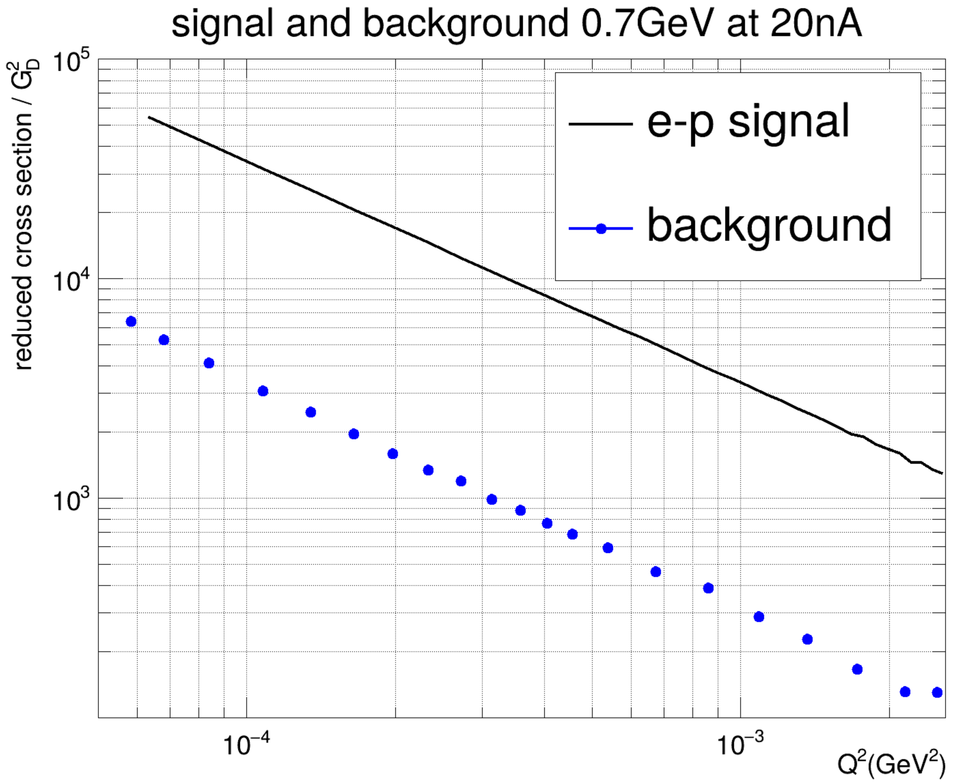
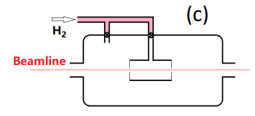
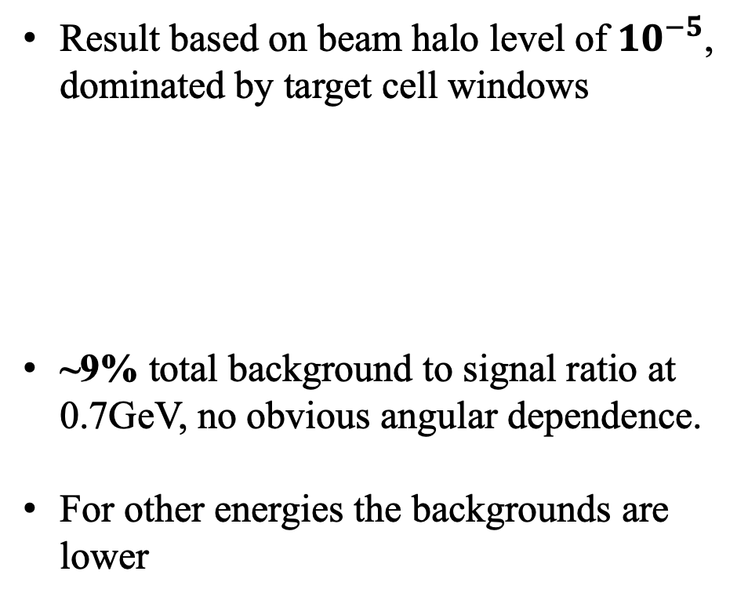
ERR – PRad-Ⅱ Recommendation #2
Recommendation:
A plot of reduced cross section vs Q² showing signal events and expected background events would help everyone see the potential for the background correction to introduce systematic errors into the radius determination.
Result based on beam halo level of ${10}^{−5}$, dominated by target cell windows
~9% total background to signal ratio at 0.7GeV, no obvious angular dependence.
For other energies the backgrounds are lower
error bar is smaller than marker

Slide 2
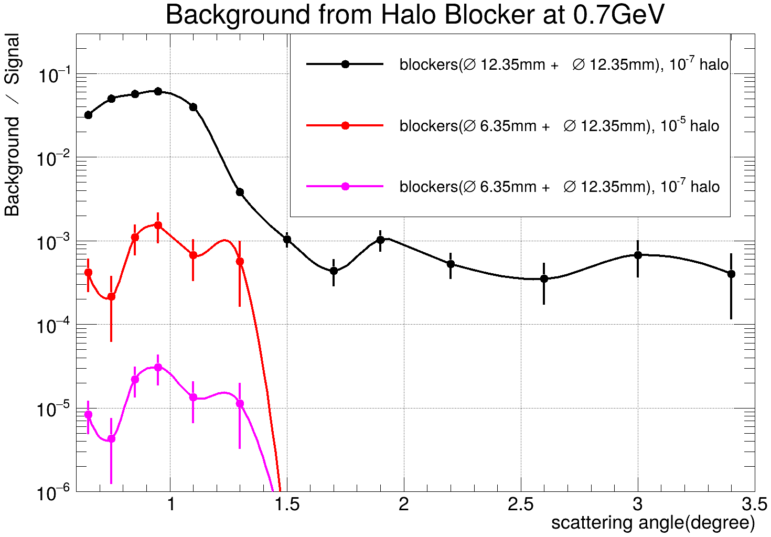
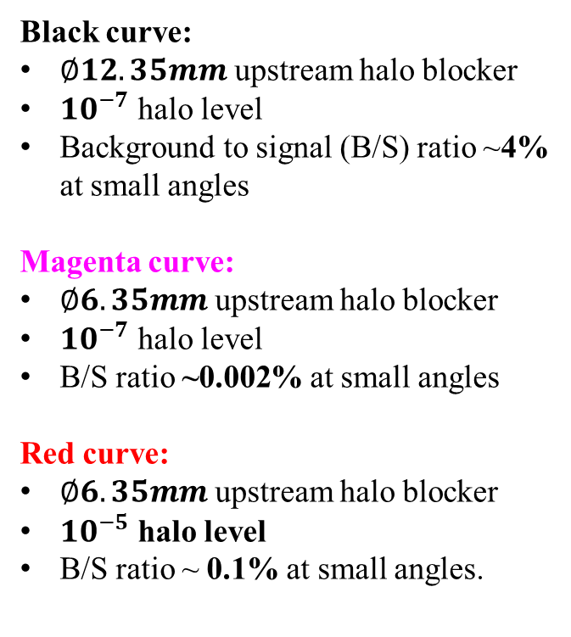
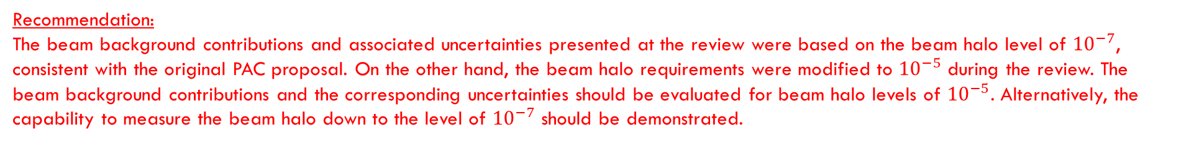
ERR – PRad-Ⅱ Recommendation #4
Recommendation:
The beam background contributions and associated uncertainties presented at the review were based on the beam halo level of ${10}^{−7}$, consistent with the original PAC proposal. On the other hand, the beam halo requirements were modified to ${10}^{−5}$ during the review. The beam background contributions and the corresponding uncertainties should be evaluated for beam halo levels of ${10}^{−5}$. Alternatively, the capability to measure the beam halo down to the level of ${10}^{−7}$ should be demonstrated.
Black curve:
$∅12.35mm$ upstream halo blocker
${10}^{−7}$ halo level
Background to signal (B/S) ratio ~4% at small angles
Magenta curve:
$∅6.35mm$ upstream halo blocker
${10}^{−7}$ halo level
B/S ratio ~0.002% at small angles
Red curve:
$∅6.35mm$ upstream halo blocker
${10}^{−5}$ halo level
B/S ratio ~ 0.1% at small angles.
Downstream blocker
Upstream blocker

Slide 3
Backup

Slide 4
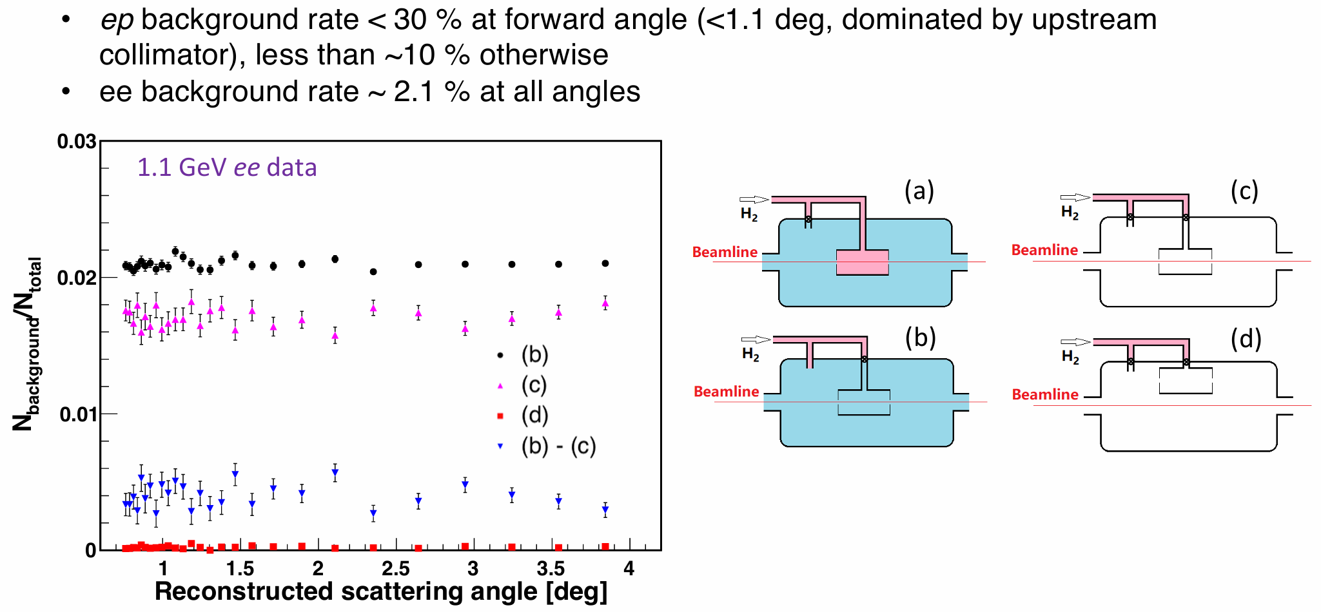

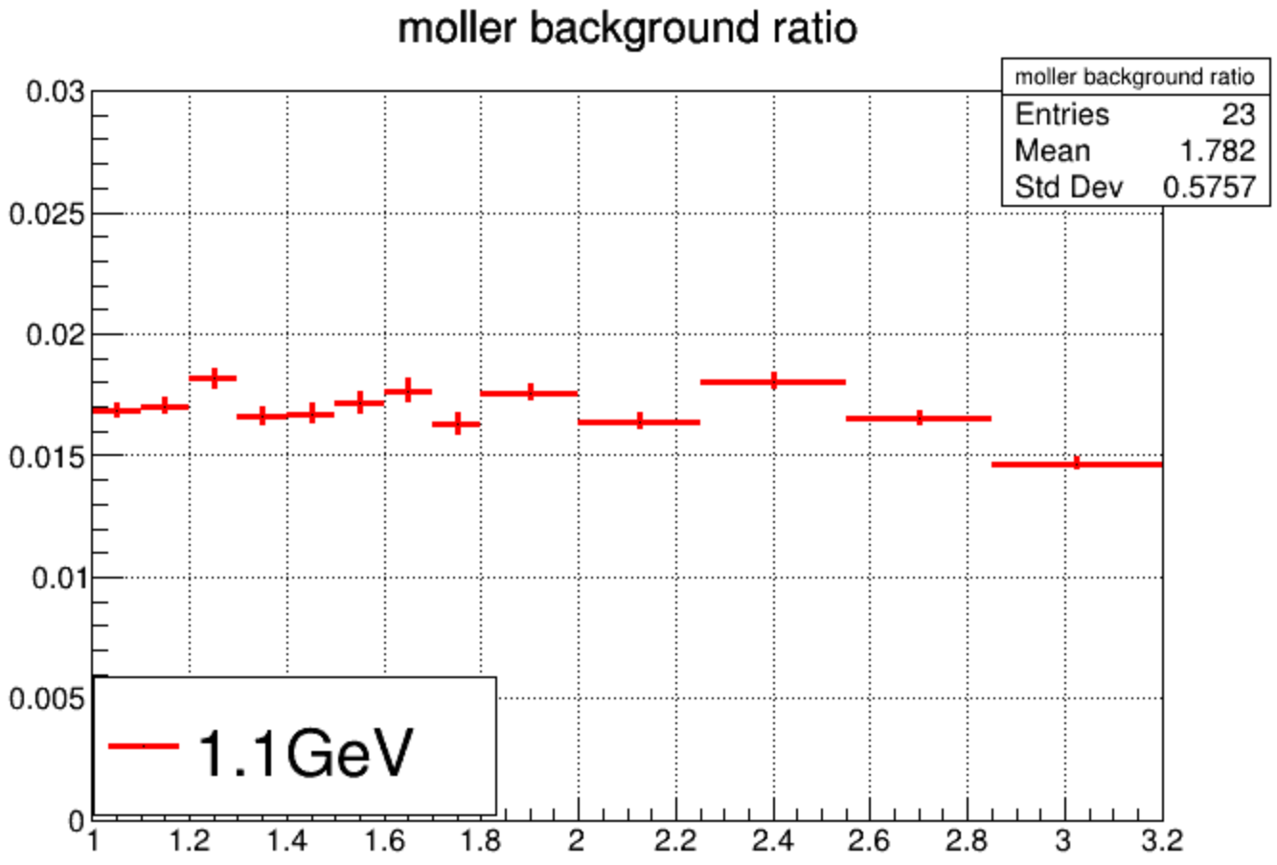
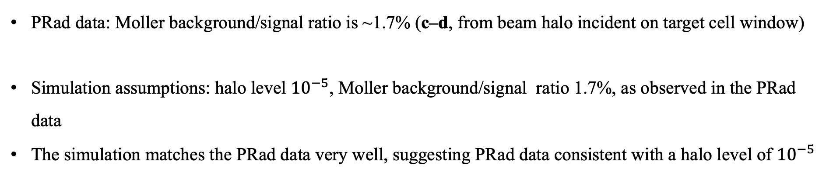
PRad data: Moller background/signal ratio is ~1.7% (c–d, from beam halo incident on target cell window)
Simulation assumptions: halo level ${10}^{−5}$, Moller background/signal ratio 1.7%, as observed in the PRad data
The simulation matches the PRad data very well, suggesting PRad data consistent with a halo level of ${10}^{−5}$
Scattering angle (deg)

Slide 5
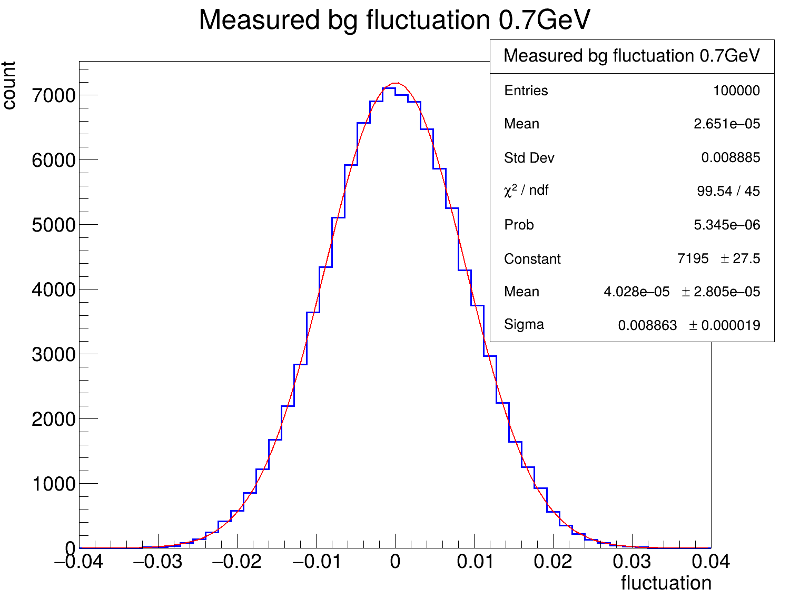
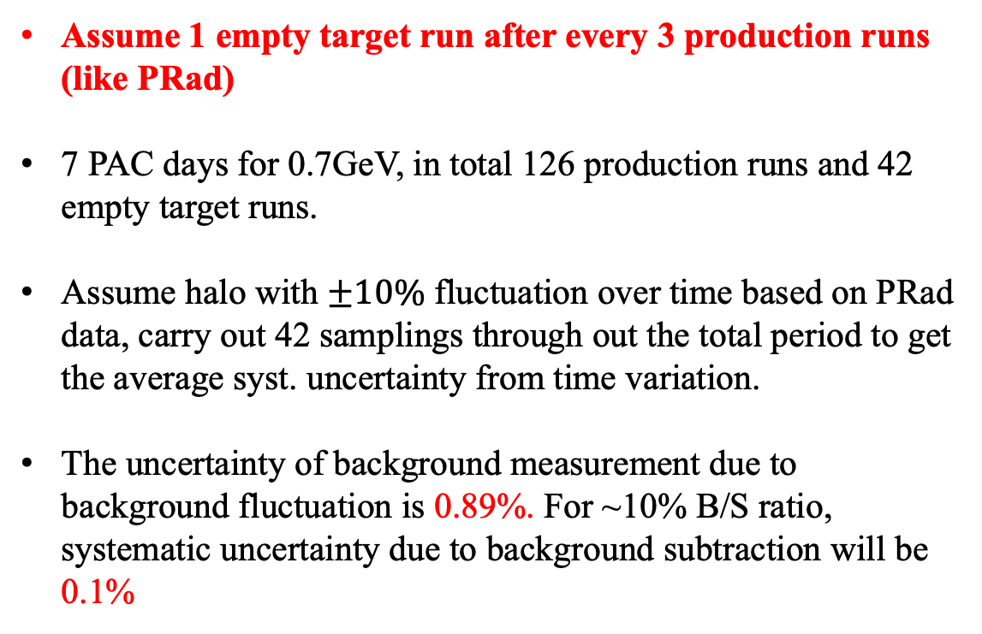


Halo Background Subtraction Uncertainty
42 samplings for 42 empty runs
Assume 1 empty target run after every 3 production runs (like PRad)
7 PAC days for 0.7GeV, in total 126 production runs and 42 empty target runs.
Assume halo with $±10\%$ fluctuation over time based on PRad data, carry out 42 samplings through out the total period to get the average syst. uncertainty from time variation.
The uncertainty of background measurement due to background fluctuation is 0.89%. For ~10% B/S ratio, systematic uncertainty due to background subtraction will be 0.1%
……
$$−10\%$$
Background fluctuation over time
$$10\%$$
Background measurement uncertainty

Slide 6
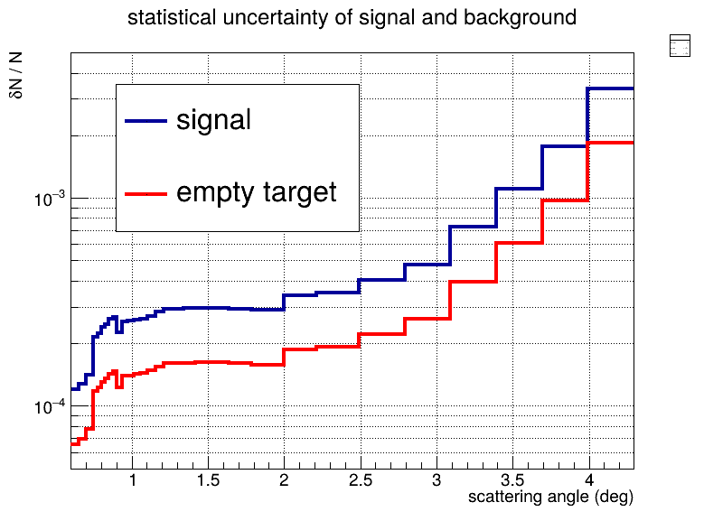
Halo Background Subtraction Uncertainty
0.35%
1 empty target run after every 3 production runs
Assume 10% B/S ratio in each bin
The projected systematic uncertainty of subtraction due to background statistics ~ 0.1%
0.15%
0.03%
0.013%
0.014%
0.006%

