Slide 1
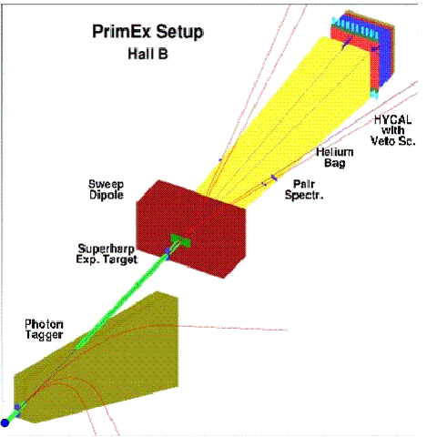

Slide 2
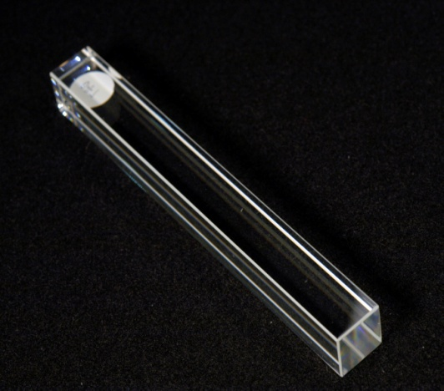
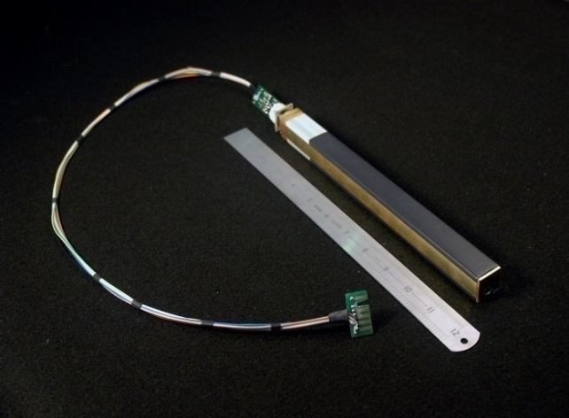
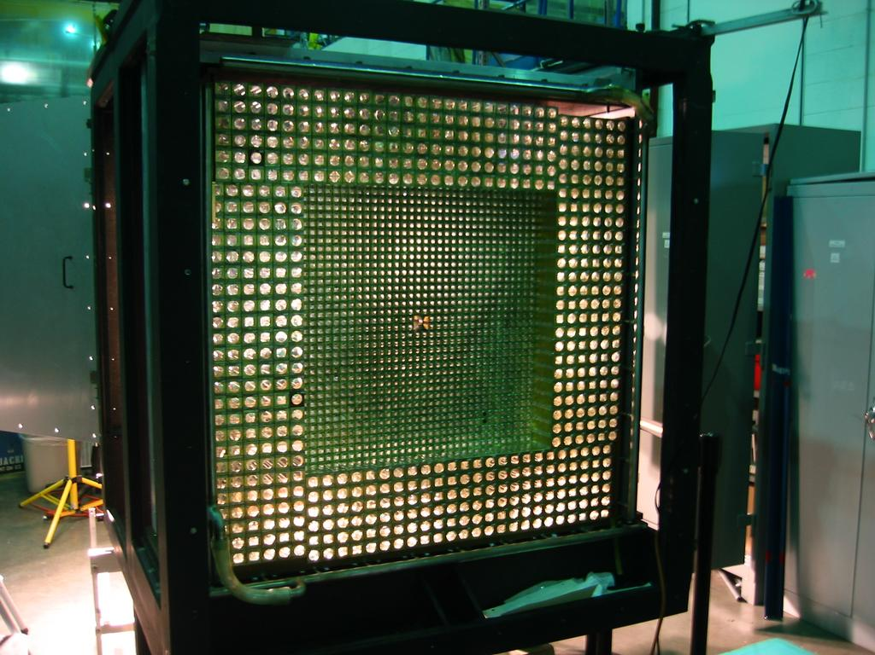
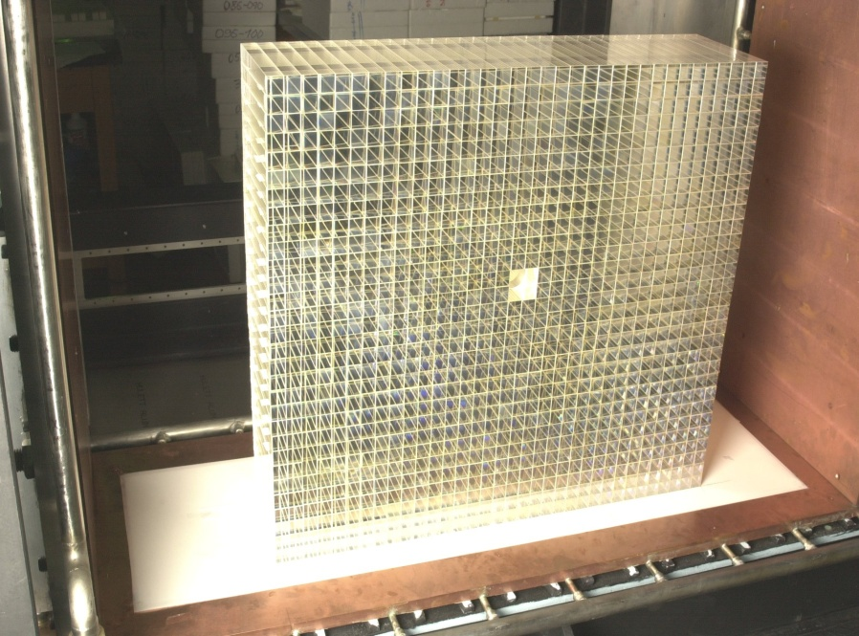
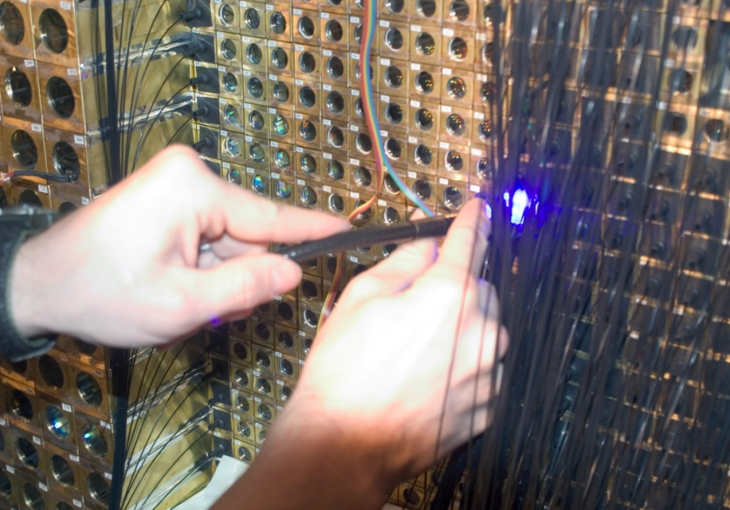

Slide 3
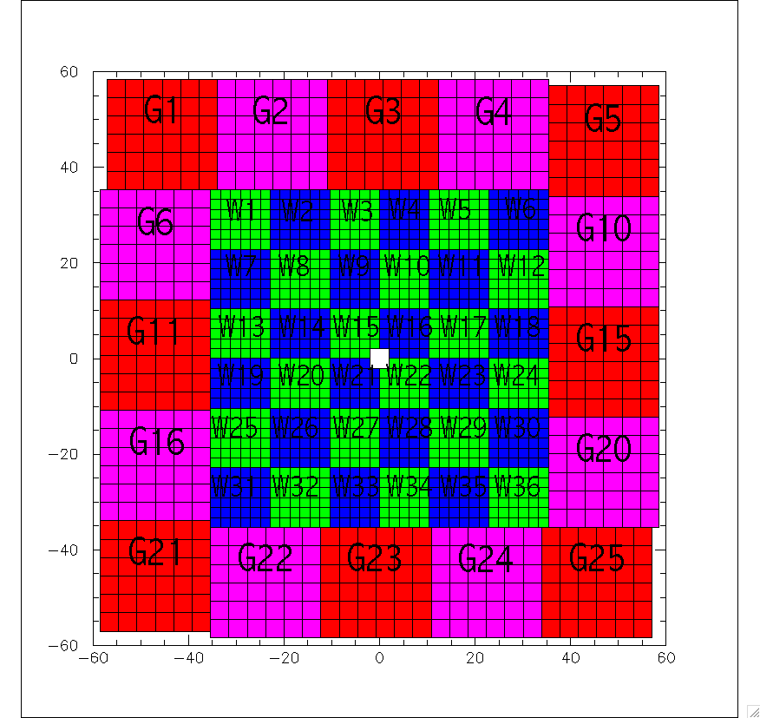
Each dynode output goes to one of 36
Inputs of the UVA120A Sum module.
Two linear output signals from
UVA120A go to “electronics area”
One of them used for further summation,
The second one was not used in the
PrimEx-1 configuration.
Version #1
Use the second signal (cable) for the timing;
Needs
61 Discriminator channels;
61 channels TDC.

Slide 4
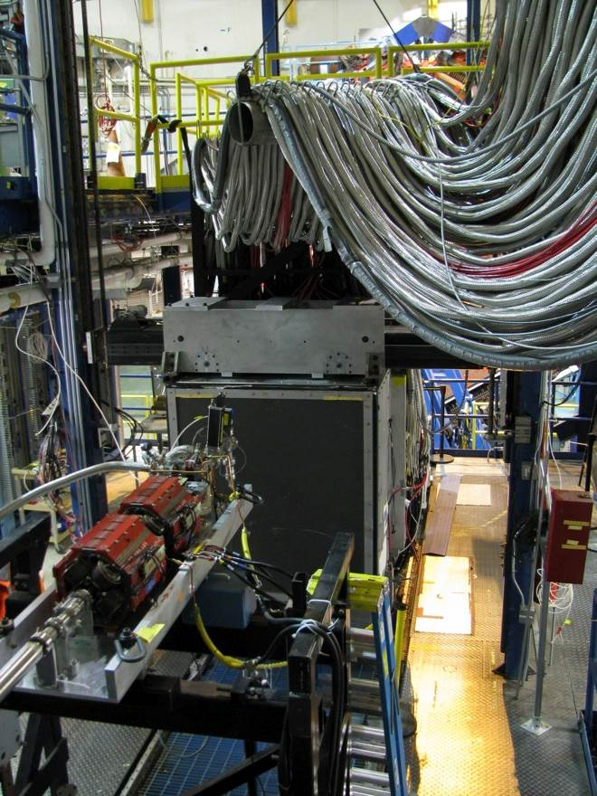

Slide 5
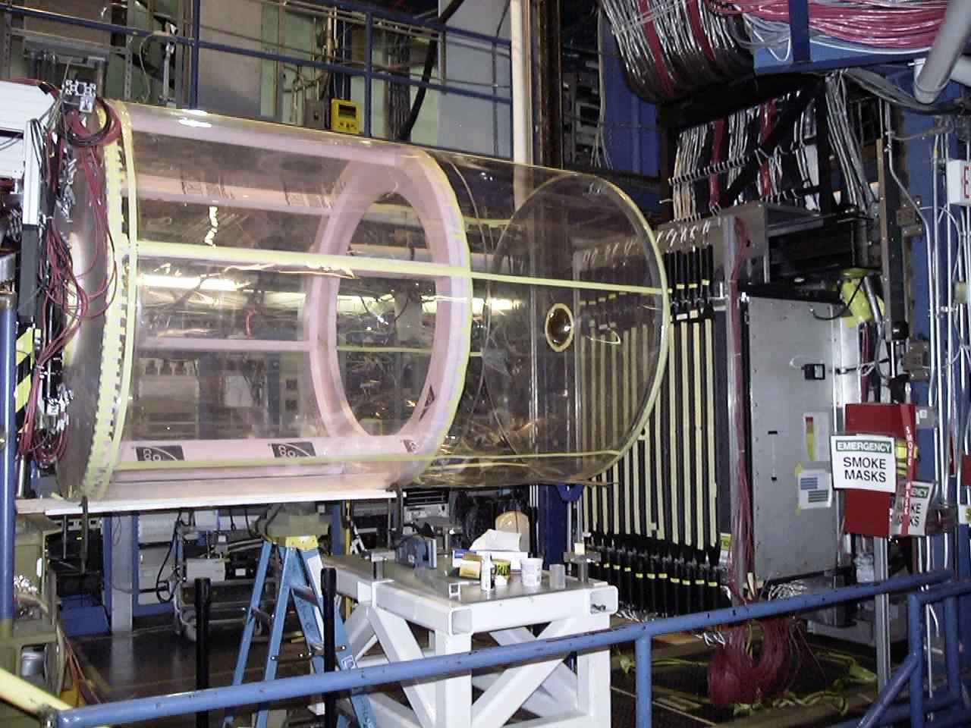
HyCal and Veto Counters in Hall B Beam Line
Installed in 2004
for PrimEx-I experiment
about 7.5 m from targets
He-bag
at 1atm
Beam side view
Veto counters
HyCal

Slide 6
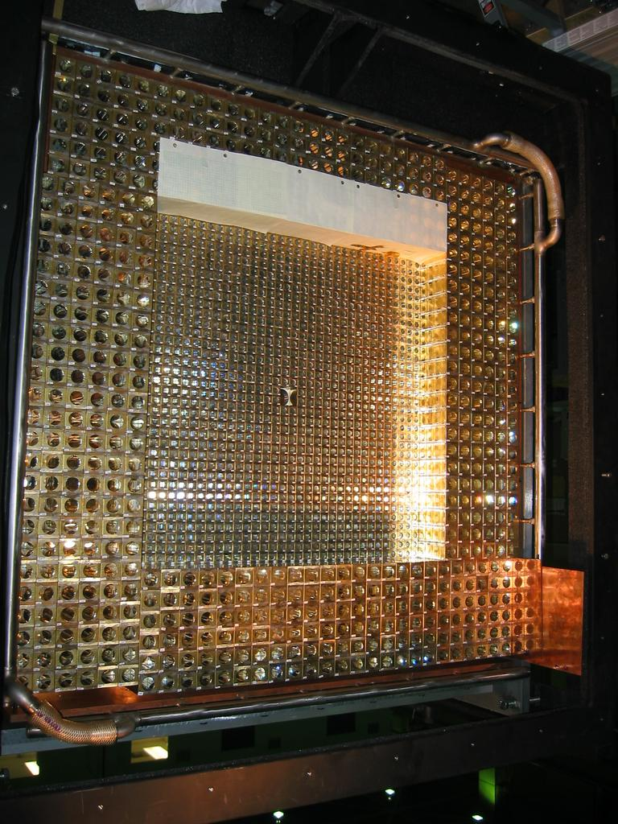
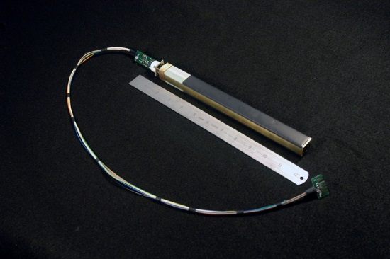
PrimEx Hybrid EM Calorimeter (HyCal)
Combination of PbWO₄ and Pb-glass detectors (118x118 cm²)
PbWO₄ crystals resolution
Pb-glass budget
  34 x 34 matrix of 2.05 x 2.05 x 18 cm³ PbWO₄ shower detectors
  (1152 PbWO₄ detectors)
  576 Pb-glass shower detectors (3.82x3.82x45.0 cm³)
  2 x 2 PbWO₄ modules removed in middle for beam passage
  ≈7.5 m from target
Good energy and position resolutions:
  σ_{E} / E = 2.6% / √E
  σ_{xy} / E = 2.7 mm/ √ E
Good photon detection efficiency (≈100%)
Served in 3 precision experiments!
front view, before Light Monitoring System assembly
Single PbWO₄ detector

Slide 7
Electromagnetic Calorimeter (HyCal)
(Energy Resolutions)

Slide 8
Electromagnetic Calorimeter (HyCal)
(Coordinate Resolution for PbWO4)

Slide 9
Electromagnetic Calorimeter (HyCal)
(Resolutions in Transition Region)

Slide 10
HyCal and Veto Counters in Hall B Beam Line
Installed in 2004
for PrimEx-I experiment
about 7.5 m from targets

Slide 11
Energy resolution
Position resolution
Good photon detection efficiency
@ 0.1 – 5 GeV;
Large geometrical acceptance
HyCal
only
HyCal with kinematical
constraint

Slide 12
HyCal Upgrade (full PbWO₄ crystals)
Existing inner part:
34 x 34 =1156 PbWO4 crystal modules
Size: 68 x 68 cm² area
New PbWO4 modules needed:
~ 576 x 4 = 2,304 PbWO₄ modules
Total estimated cost: $3.4 M
Item | quantity | Cost/unit ($) | Cost for item ($)
PbWO4crystals | 2310 | $1000. | 2,310,000
PMT (R1425) | 2310 | $300. | 693,000
HVD | 2310 | $100. | 231,000
Assembly materials | 2310 | $50. | 115,500
TOTAL |  |  | 3,349,500

Slide 13

PbWO₄ Module Development
HVD
G10 PMT housing
with R4125HA tube
VM-2000 and Tedlar
wrapping (38.1 micrometer)
25 micrometer brass strips
Readout cable

Slide 14
HyCal Temperature Stabilization
Gain vs. temperature: ~ 2% per degrees @ 18 degrees

Slide 15
Beam Tests: PbWO₄ Energy Resolution
Prototype Tests
HYCAL Beam Test
3 x 3
1 x 1
6 x 6 crystals
σ_{E}/E = 1.3 %

Slide 16
Beam Tests: PbWO₄ Position Resolution
Prototype Tests
HYCAL Beam Test
σ_{x} = 1.3 mm

Slide 17
HYCAL: Transition Region

Slide 18
PbWO₄ Detector Response vs. Dose Rate

