Slide 1
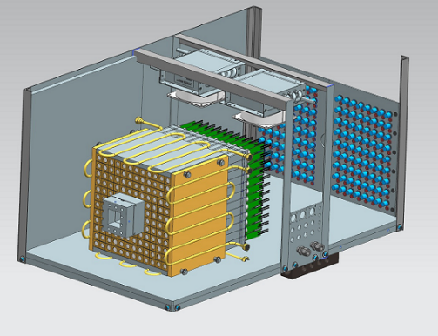
PrimEx-η Experiment in Hall D
A. Gasparian, L. Gan, I. Larin, A. Somov
on behalf of the PrimEx groups
August 4, 2021

Slide 2
The Primakoff Method
The goal of the PrimEx η experiment in Hall D is
to measure the width of Γ(η → γγ) using Primakoff
process (with the precision better than 4 %)
- use low A targets LH₂ and LHe₄
- the experiment complements the Primakoff program
at Jefferson Lab
η
ρ,ω
Extract decay width Γ(η→γγ) from the measured cross section dσ/dΩ
The measurements will be used to:
extract the quark mass ratio
extract (η - η′) mixing angle
significantly improve all η decay widths in PDG

Slide 3
PrimEx-η Experiment
LH₂ target | 40 days
LHe₄ | 30 days
Empty target | 6 days
Setup, Calibration | 3 days
Total | 79 days
Approved by PAC
(beam energy 10.5 – 11.7 GeV )
Time | Beam energy | Calendar Days | PAC days
Phase I
02/21 – 03/05 03/08 – 04/15 | 11.61 GeV 11.17 GeV | 15 38 | 8 16
Total |  | 53 | 24
Efficiency 0.45
no FOM
corrections
Time | Beam energy | Calendar Days
Phase II
08/20/2021 - 10/14/2021 | 10.1 GeV | 56
Continue to take data using liquid ⁴He target

Slide 4
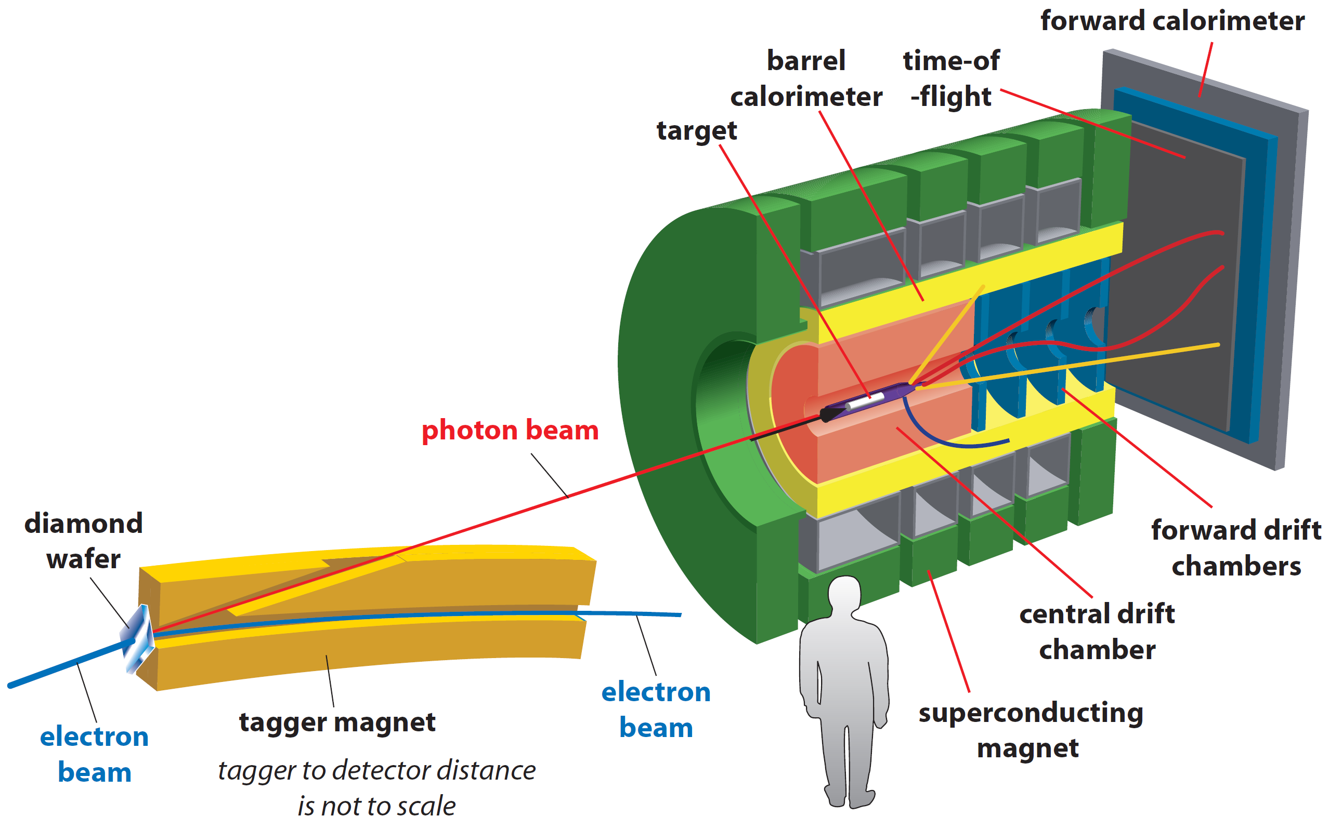
PrimEx-η Experiment
New liquid He and Be targets
New Compton Calorimeter
Use Compton events for:
- absolute luminosity normalization
(Be target)
- stability monitoring
(He target)
Solenoid field switched off
(ON for some runs)
Beam energy range if interest
9 GeV – 11.2 GeV
Collected 30 % of the total statistics
in Spring 2019 using LHe target
Compton
calorimeter

Slide 5
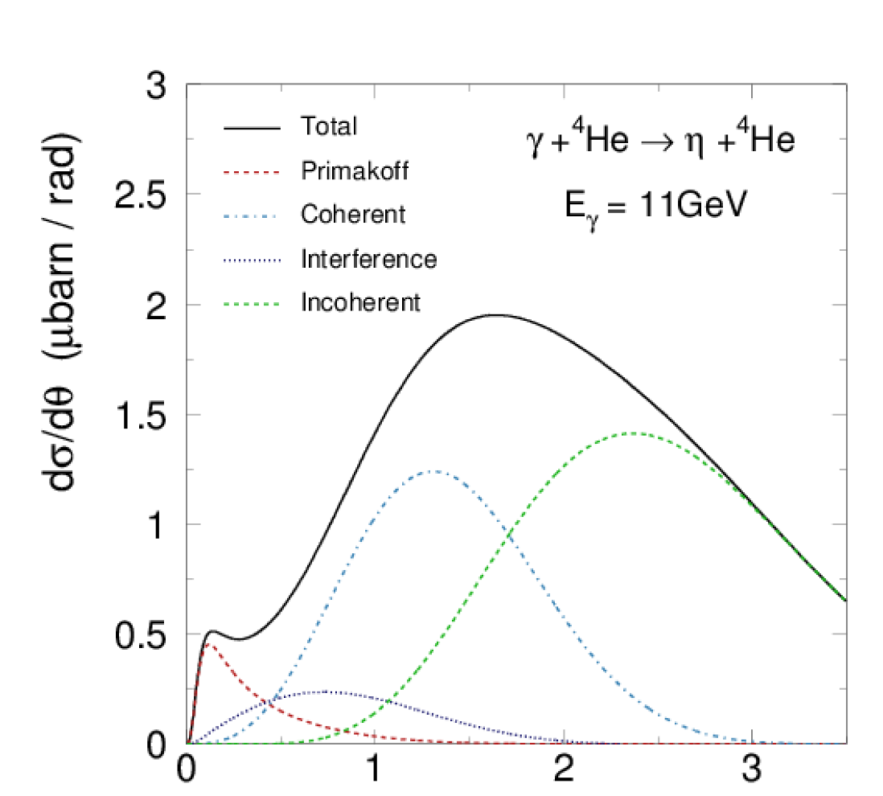
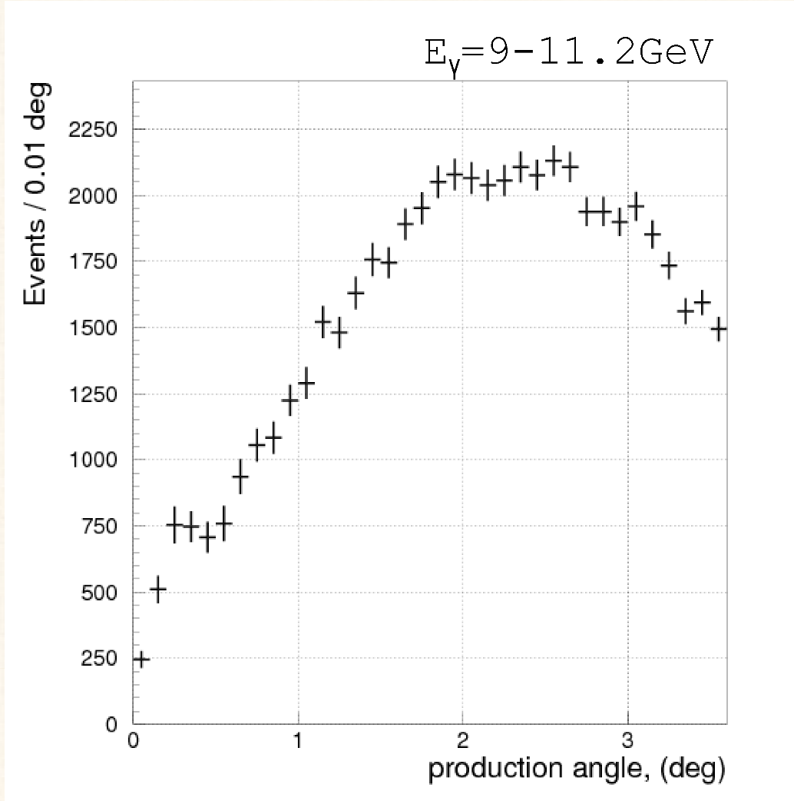
η → γγ Angular Distribution
Preliminary
MC predictions
He target, Spring 2019
Primakoff region
(empty target BG
not subtracted)
production angle (deg)
production angle (deg)
30 % of the total statistics
E_{γ} = 9 – 11.2 GeV

Slide 6
Run Conditions
Run conditions are similar to that in Spring 2019
(the solenoid magnet will be switched ON for some part of the run)
Beam energy: 10.1 GeV
Radiators:
10⁻⁴ R.L. Aluminum for production runs
2⋅ 10⁻⁵ R.L. for TAC runs and CCAL calibration
Primary collimator: 5 mm
Beam current: 200 nA for production runs
50 nA and 100 nA for calibration runs with the CDC / FDC
< 2-5 nA TAC run, CCAL calibration
PS converter: 750 μm
Targets: liquid He₄ , Be

Slide 7
Run Plan
https://halldweb.jlab.org/wiki/index.php/Eta_Decay_Width_Measurements_via_Primakoff_Effect
 | Time (shifts) | Beam Intensity (nA) | Radiator (X₀) | CCAL position | TAC position | Solenoid field | CDC/FDC
No target
Establish typical tagged photon beam |  |  |  | retracted | retracted | off
Harp scans for the electron Beam (and PS) | 1 | 10-100 | retracted (10⁻⁴) | retracted | retracted
Initial detector check out | 1 | 10-100 | 10⁻⁴ | inserted | retracted
Equalize CCAL gains (calibrate CCAL) | 4 | ~2 nA | 2⋅10⁻⁵ | Snake scan | inserted
TAC run | 1 | ~2 nA | 2⋅10⁻⁵ | inserted | inserted
Install Be target mount, install ST, align | 2
Trigger and DAQ study for physics | 2 | 10-100 | 10⁻⁴ | inserted | retracted
Take data for the detector calibration (raw mode for ADCs) Take data for FCAL gain equalization and calibration | 2 | 10-100 | 10⁻⁴ | inserted | retracted
FCAL HV tuning | 1
Data production
Compton run at low beam intensity (Be target) | 2 2 | 50 100 | 10⁻⁴ | inserted | retracted |  | on
Compton run at the nominal beam intensity | 7 | 200 | 10⁻⁴ | inserted | retracted
Remove Be target | 2
Run with empty target | 3 | 200 | 10⁻⁴ | inserted | retracted
Calibration
at small beam
current
Production
on Be target

Slide 8
Run Plan
Install LH4 target mount, install ST, align
Run with empty target | 3 | 200 | 10⁻⁴ | inserted | retracted
Fill the target
Production run at the nominal Luminosity | 4 | 200 | 10⁻⁴ | inserted | retracted
Production run at small Luminosity | 2 2 | 50 100 | 10⁻⁴ | inserted | retracted
 | Time shifts | Beam current (nA) | Radiator (X₀) | CCAL position | TAC position | Solenoid field | CDC/FDC
Alternate production runs with the empty target runs 70 % / 30 % | run for 2 weeks | 200 | 10⁻⁴ | same | same | off | off
Production
on He target

Slide 9
Special Requirements
During calibration of CCAL, the detector will be moved to
the photon beam. The electron beam current should be < 5 nA
(the thinnest amorphous radiator, 2 10-5 XO will be used)
The CCAL calibration and TAC run will be performed in the beginning of
the experiment
The calibration at small beam current had been successfully used in Hall D
before
- have to make sure that the beam quality is good, i.e., no
significant bleed through

