Slide 1
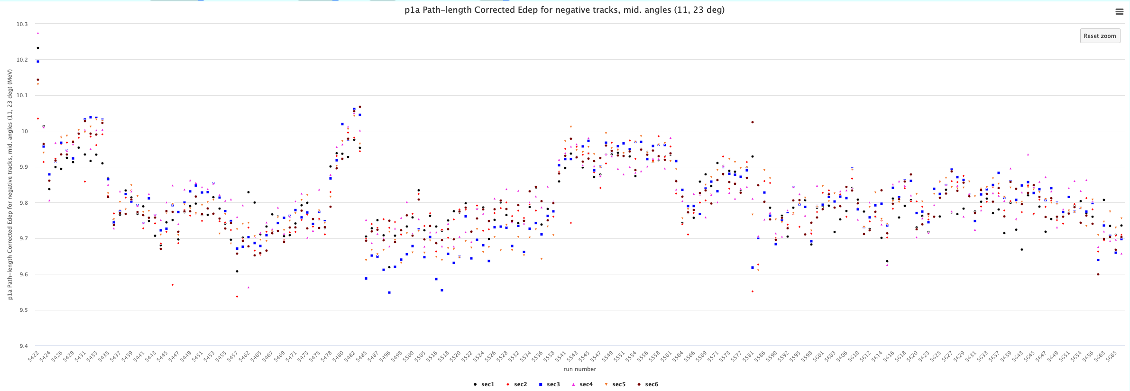
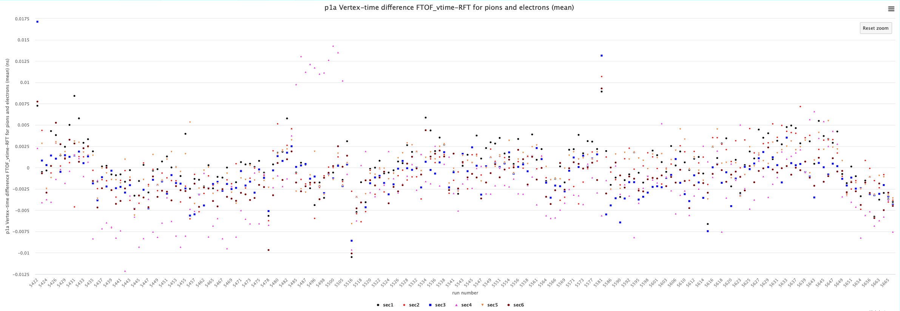
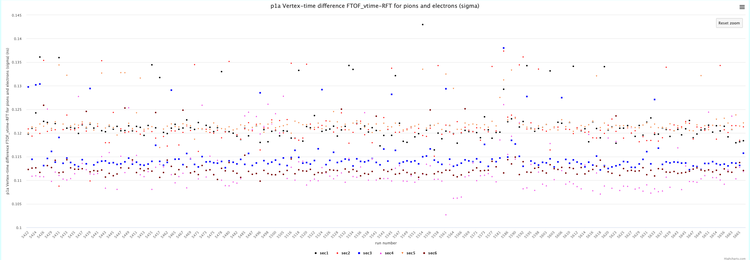
FTOF P1a Calibrations – RG-A fall 2018
v2.2.10

Slide 2
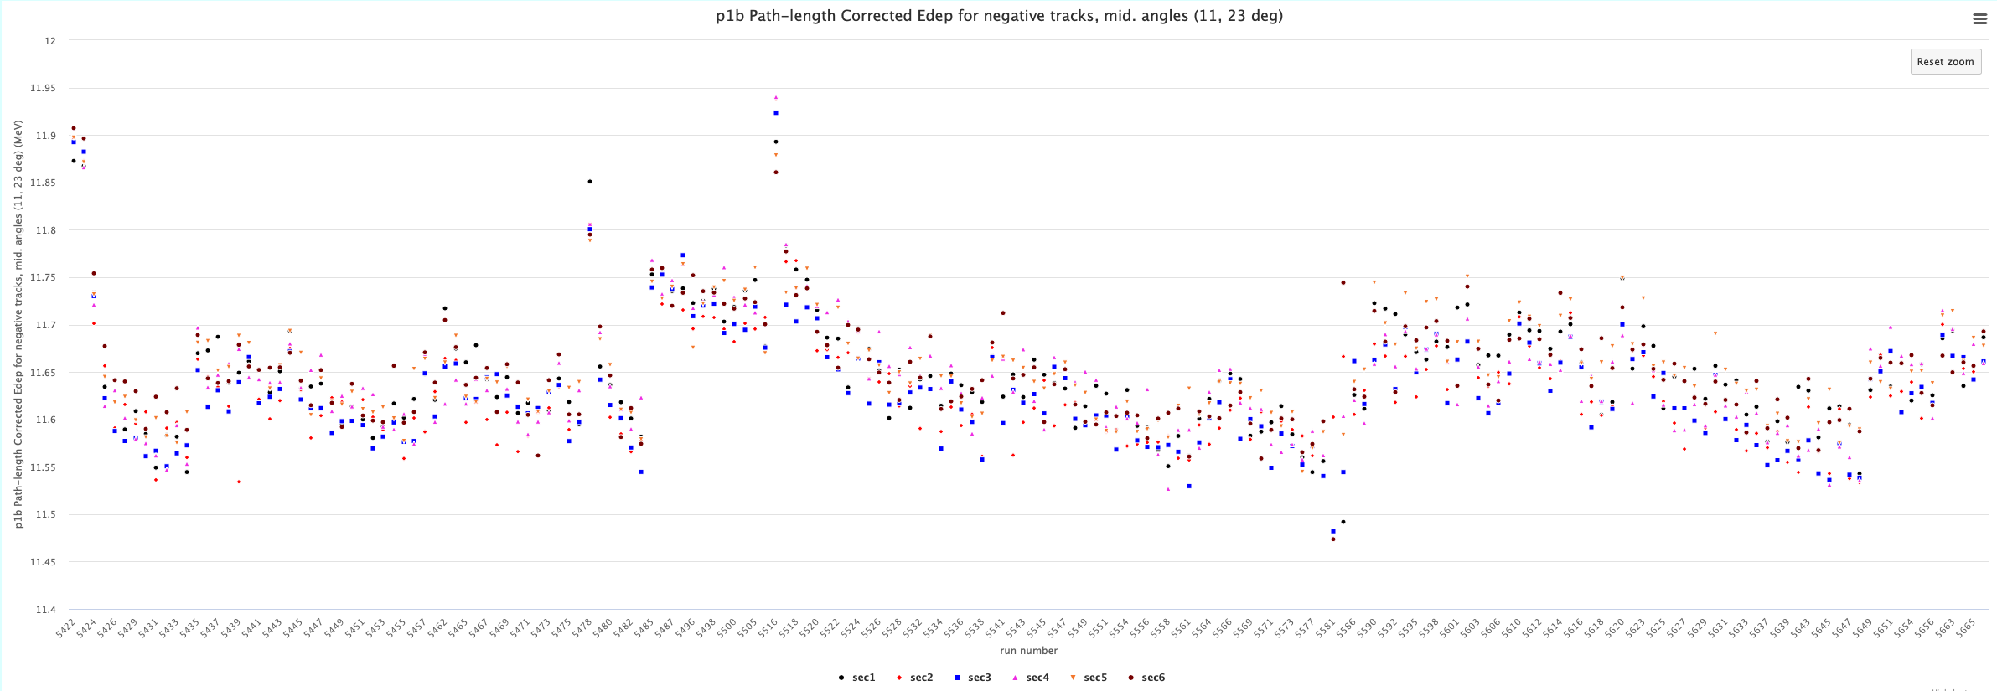
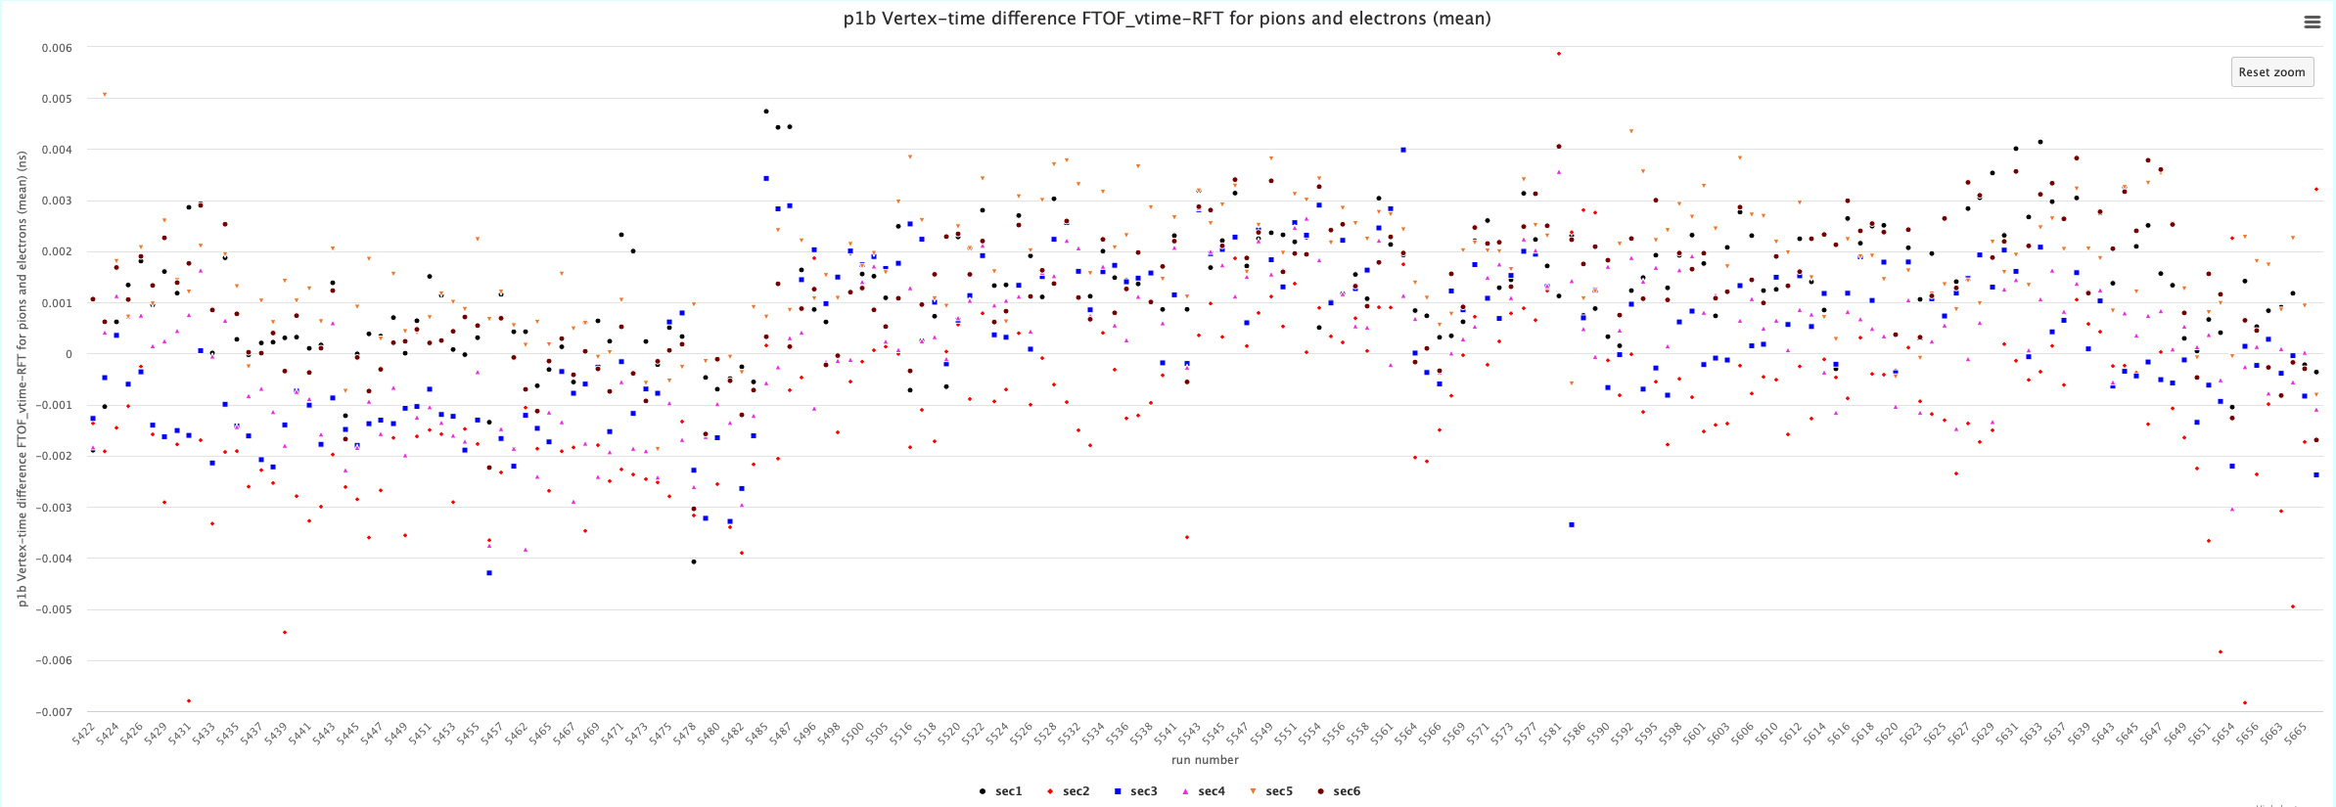
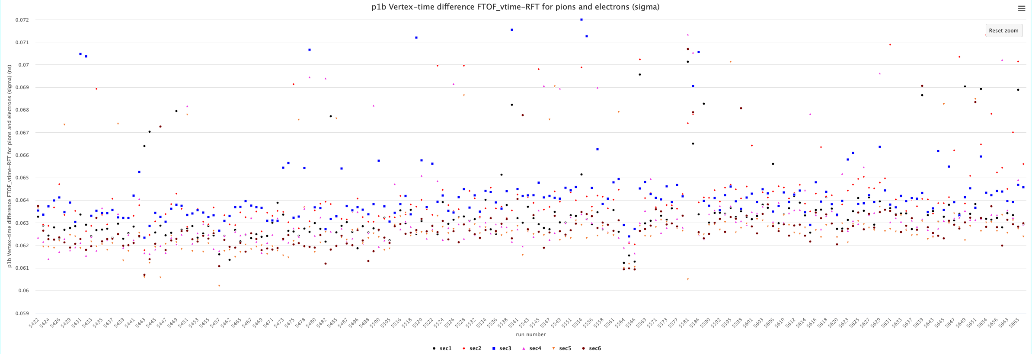
FTOF P1b Calibrations – RG-A fall 2018

Slide 3
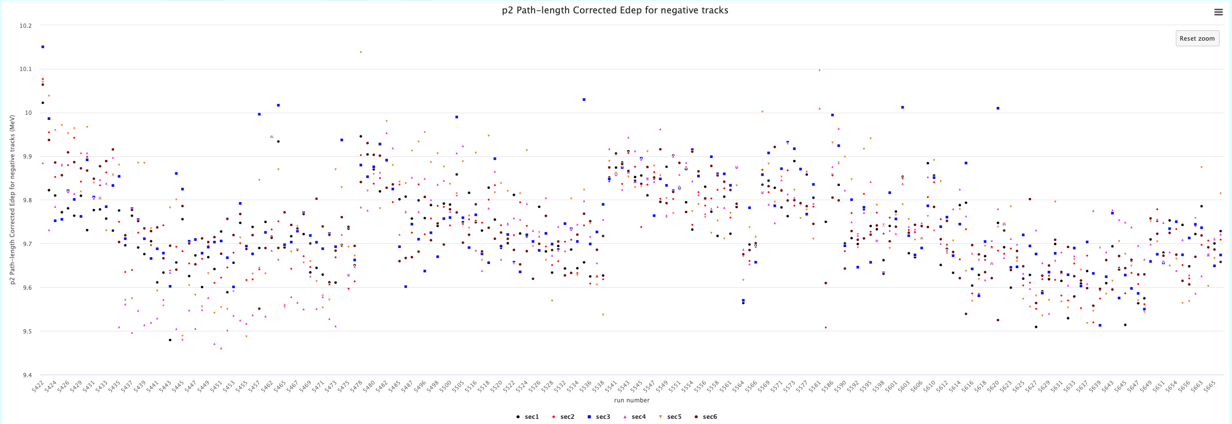
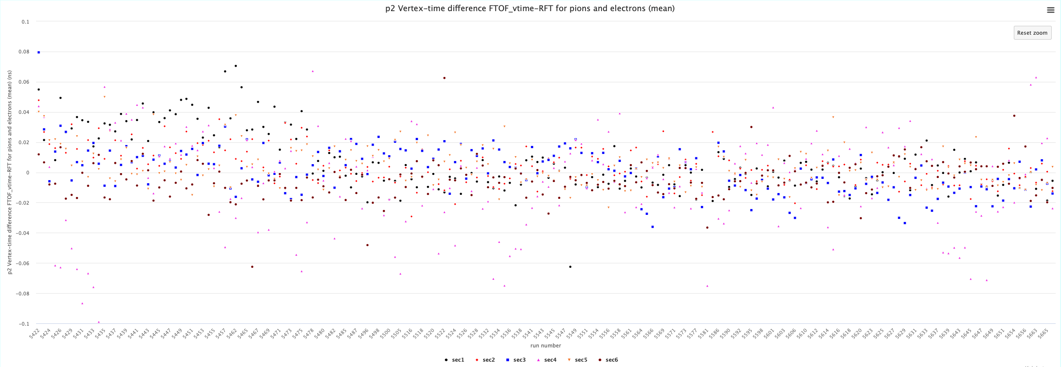
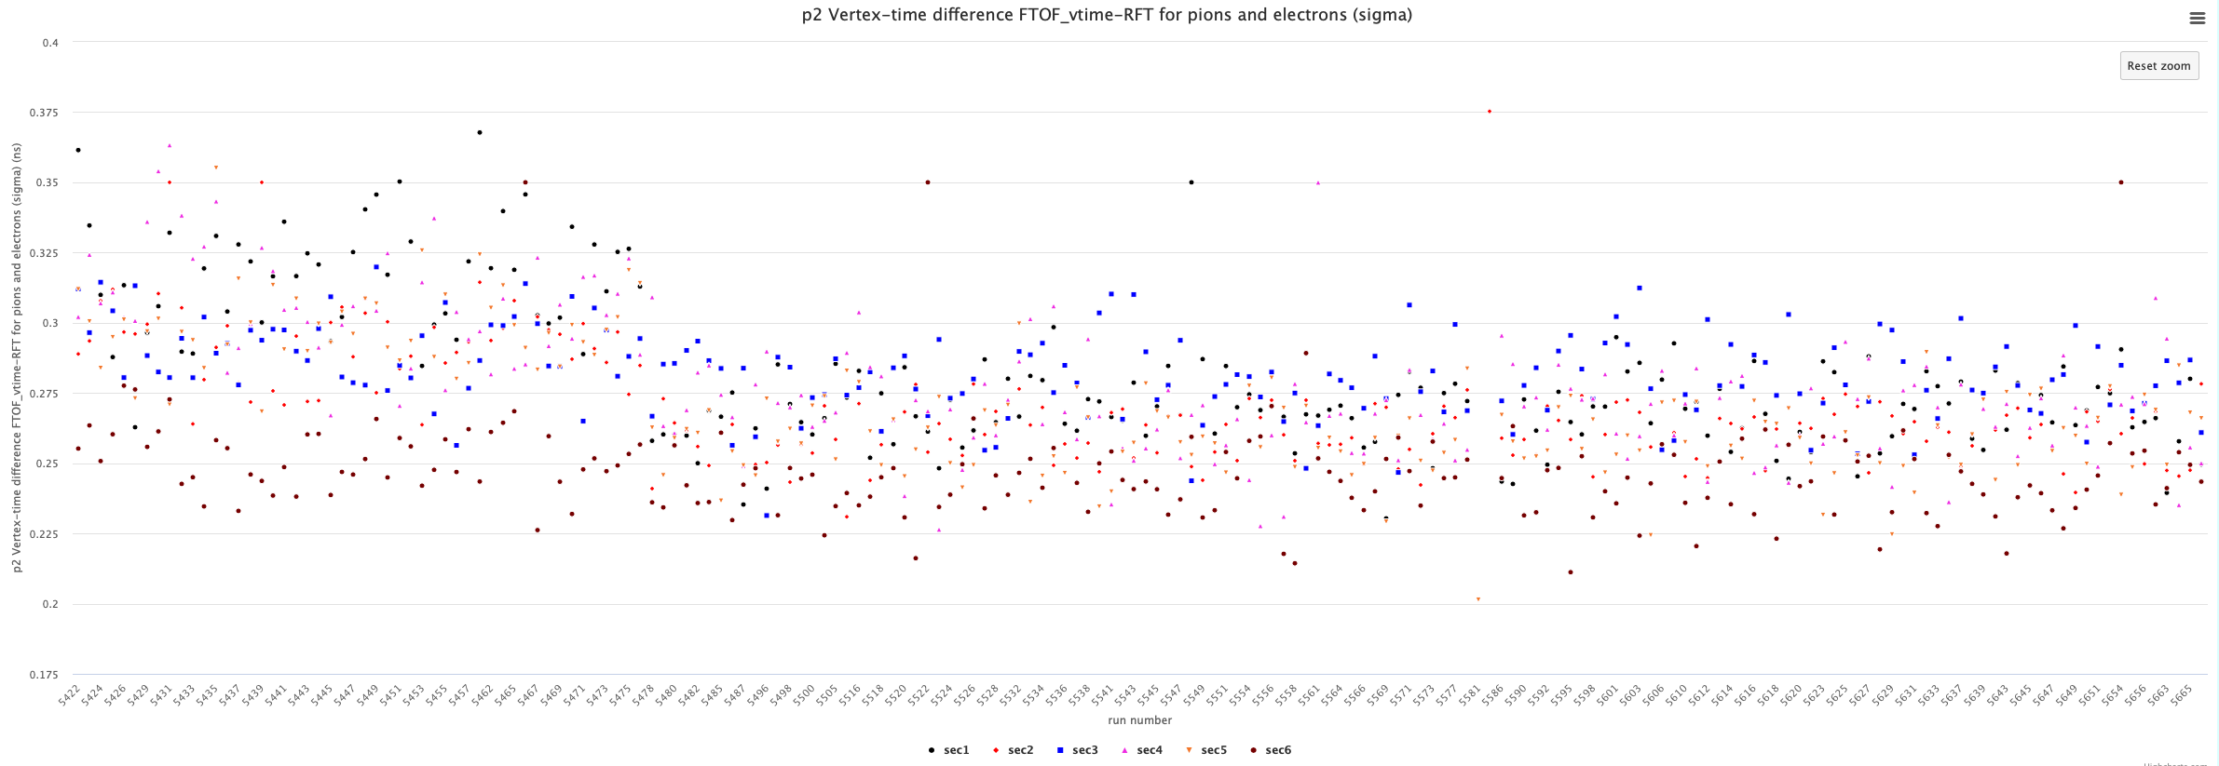
FTOF P2 Calibrations – RG-A fall 2018

Slide 4
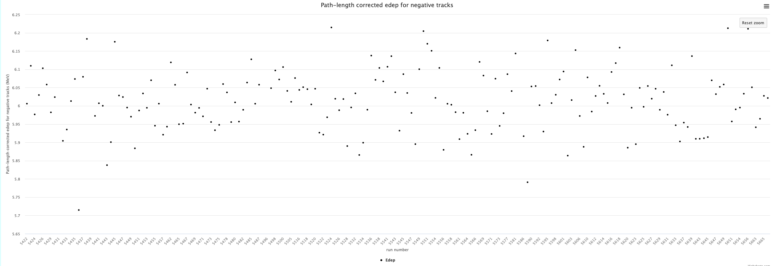
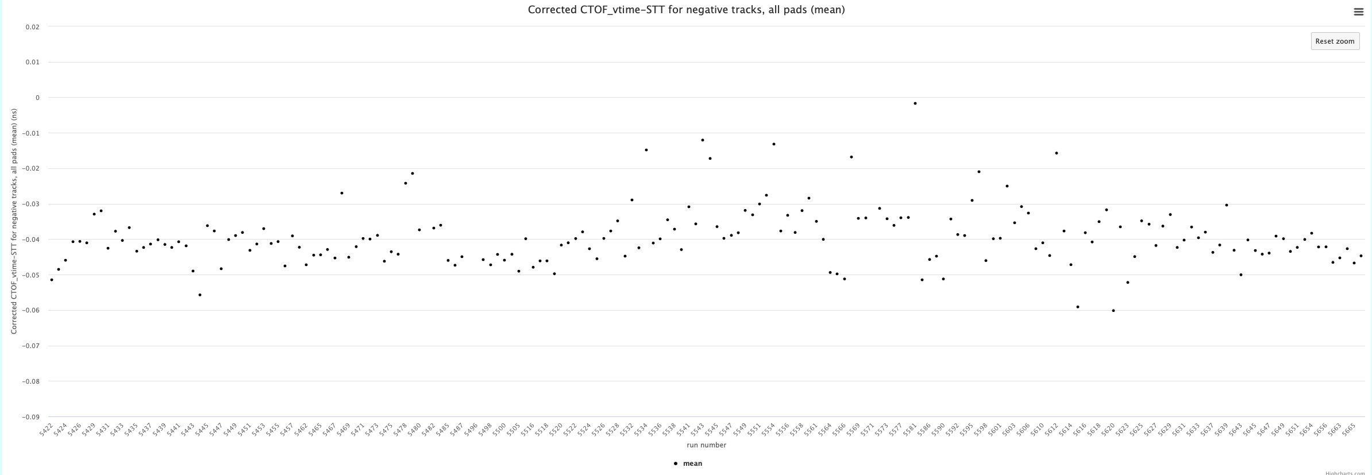
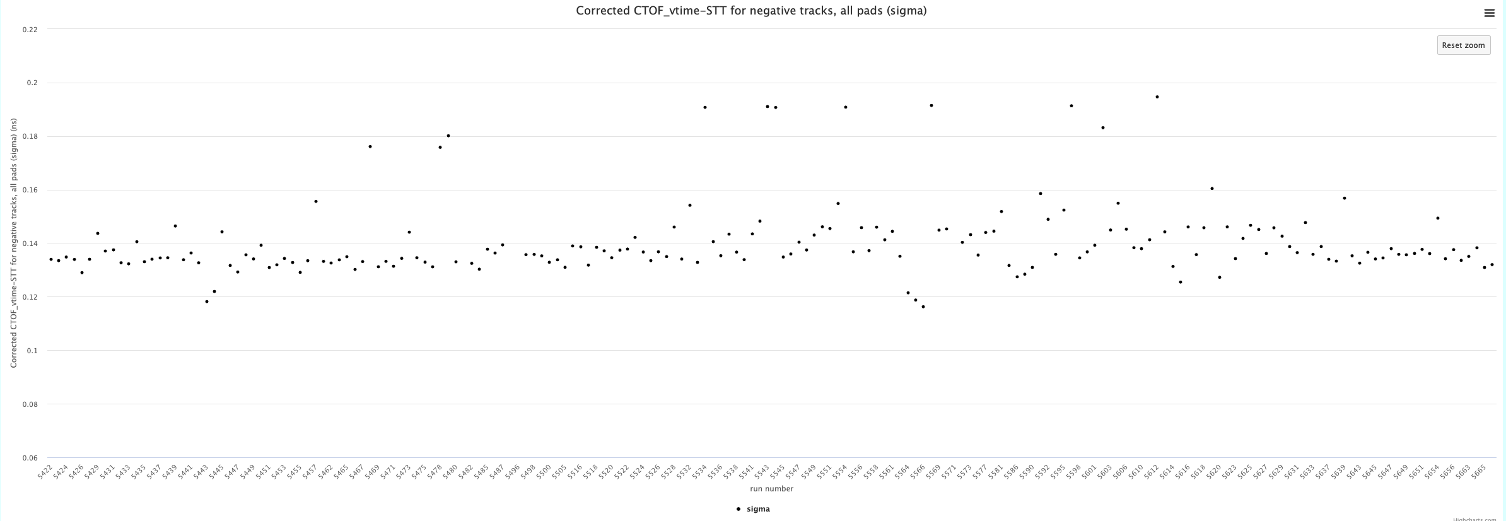
CTOF Calibrations – RG-A fall 2018

Slide 5
RG-A fall 2018 (outbending) – Fourth Pass-0
FTOF acceptable throughout the run range
CTOF:
vertex time mean shifted to -40 ps – verified to be artifact in timelines
Acceptable throughout the run range

