Slide 1
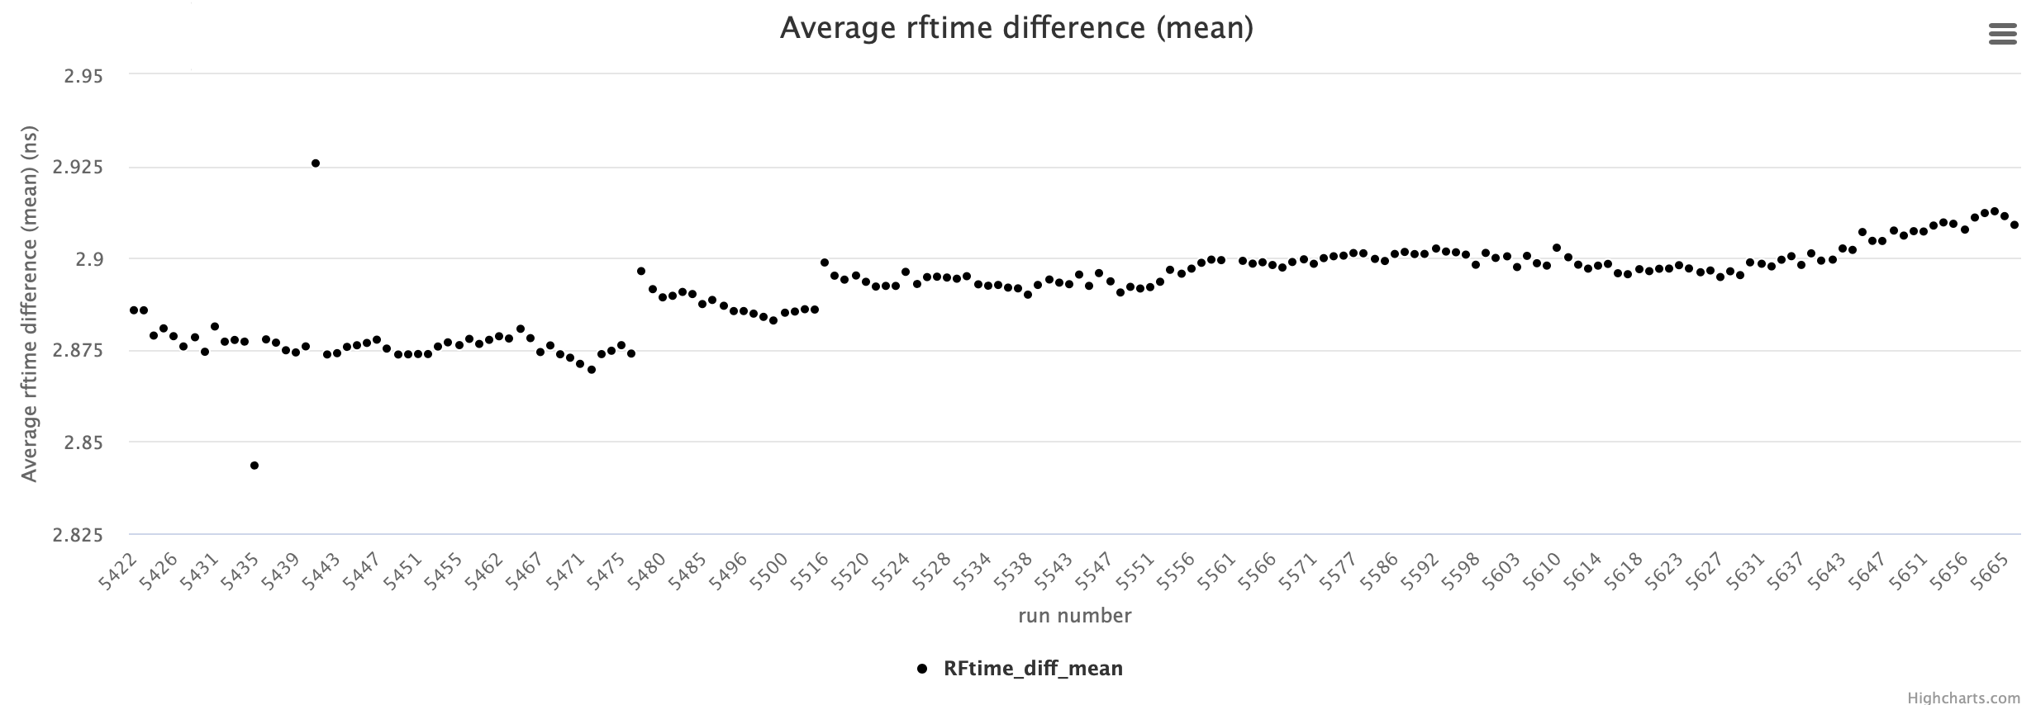
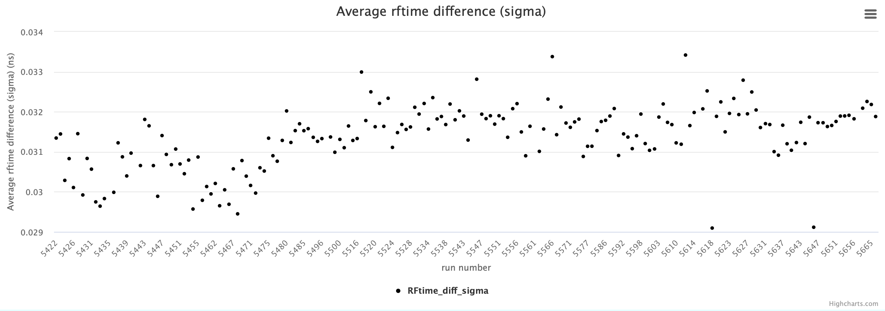
RF signal integrity and resolution
Use RF1-RF2
Variations of the mean in the range of tens of picoseconds, addressed by run-by-run calibrations of the offsets
Sigma stable at 30 ps
Only one problematic run 5561 due to RF2
Other outliers are failed fits (5435 and 5441)

Slide 2
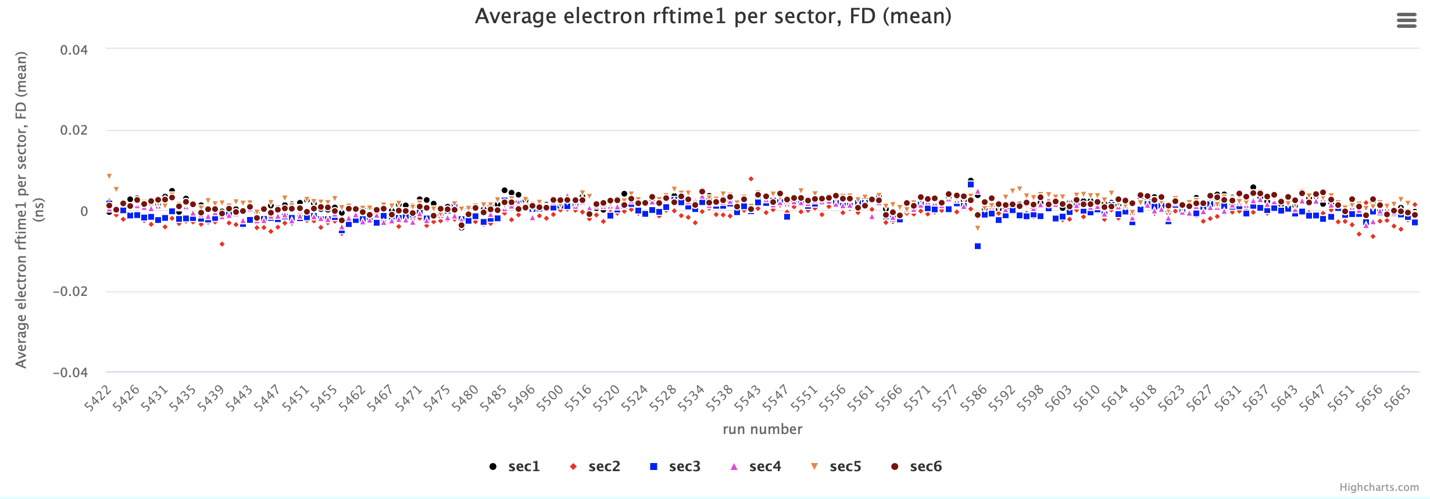
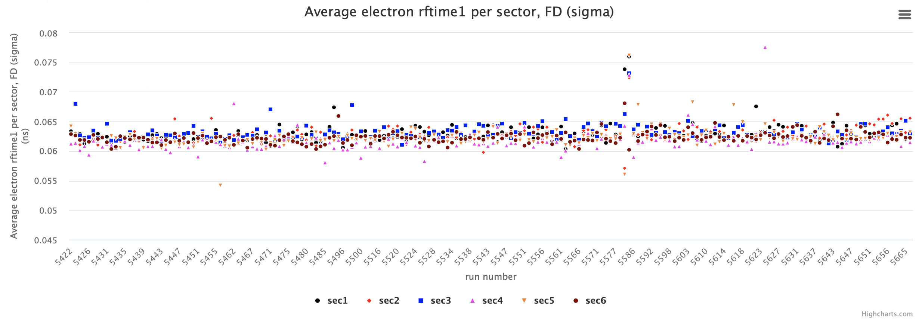
RF offsets
Variations of the mean <5 ps after run-by-run calibration
Sigma stable at ~62 ps
Only outliers are low statistics runs where fits may not be optimal

Slide 3
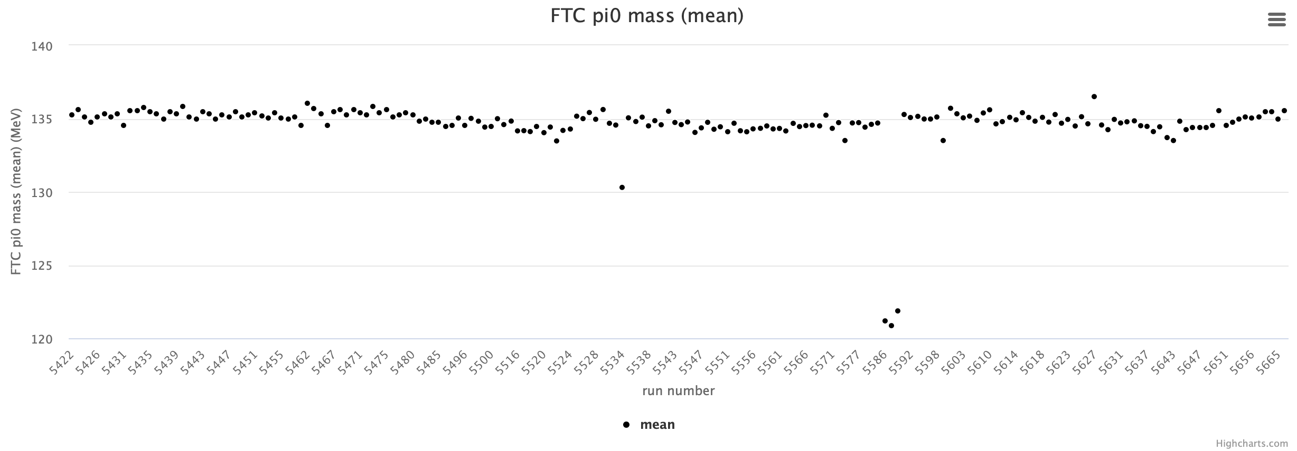
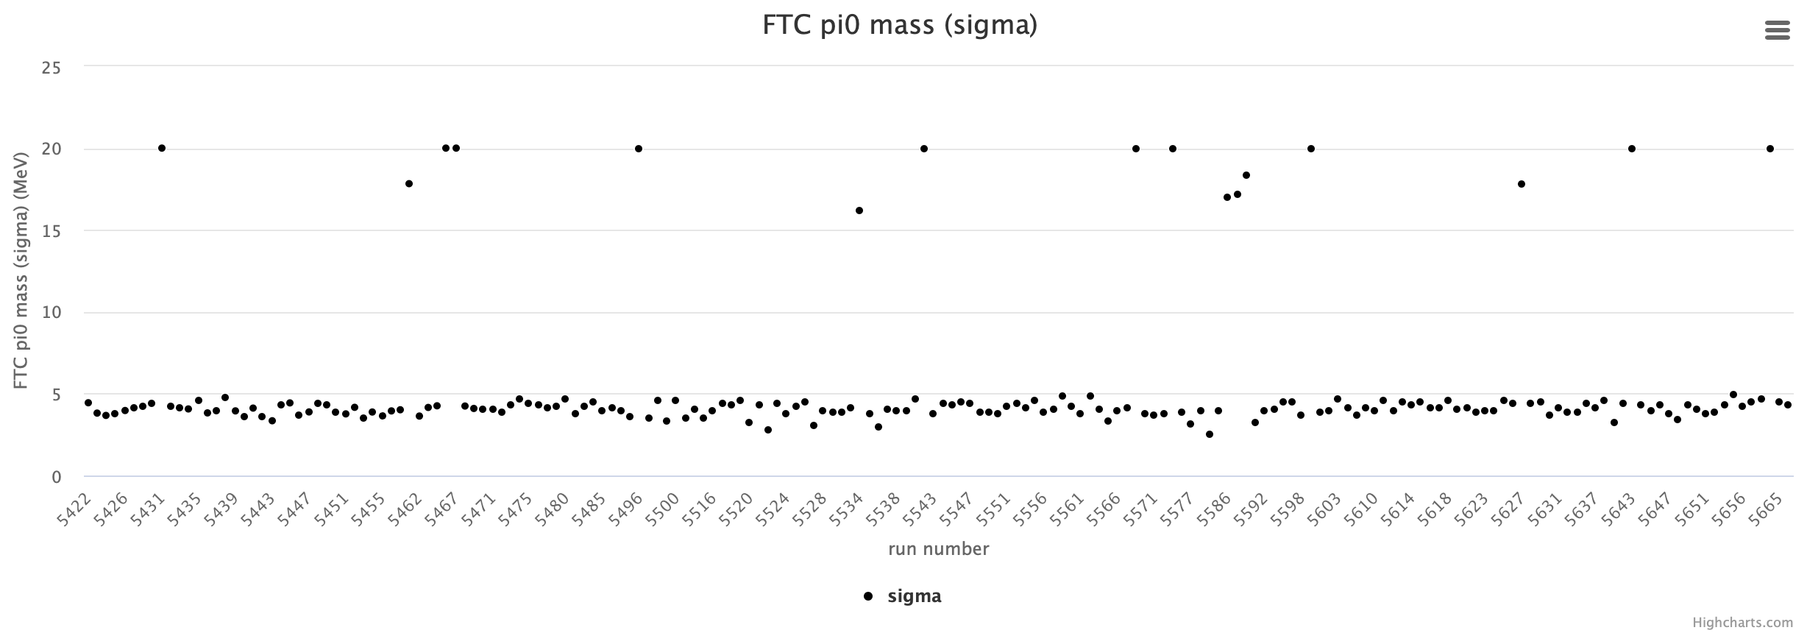
FTCal energy
Pi0 mass spectrum mean stable within 1 MeV
Resolution also stable at ~4 MeV
Only problematic runs with double peak distribution 586-5591(empty target)
Other outliers are failed fits

Slide 4
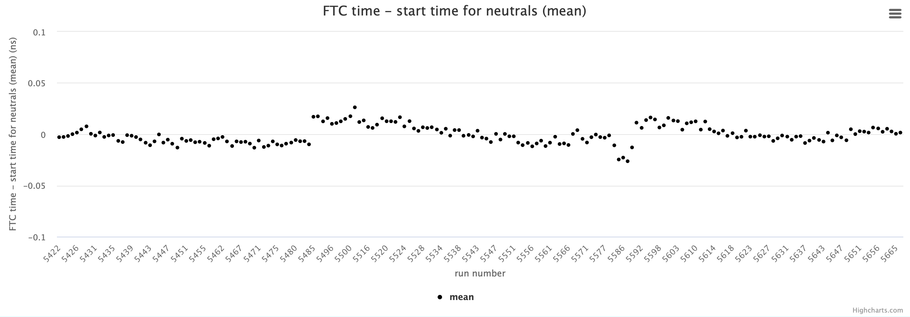
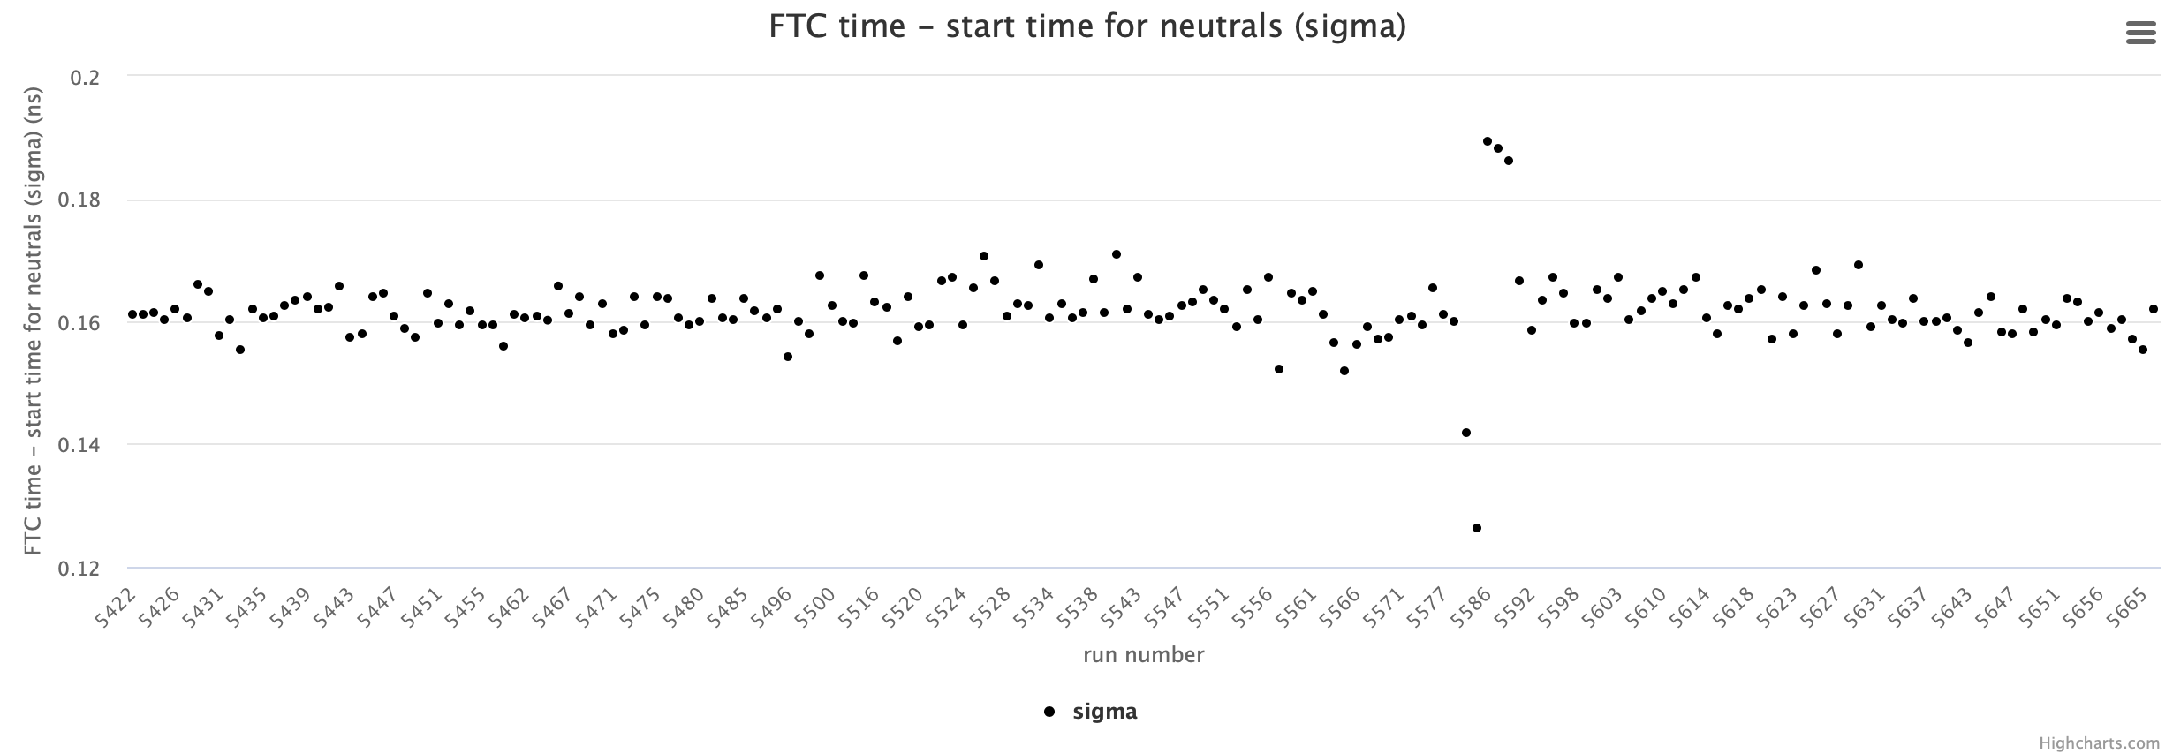
FTCal time
Use neutrals time vs. FD electron start time as in calibration
Means stable within +/-20 ps
Resolution also stable at ~160 ps
Only problematic runs with double peak distribution 5586-5591 (empty target) and very low statistics runs (5581-5584) due to limited fit accuracy

Slide 5
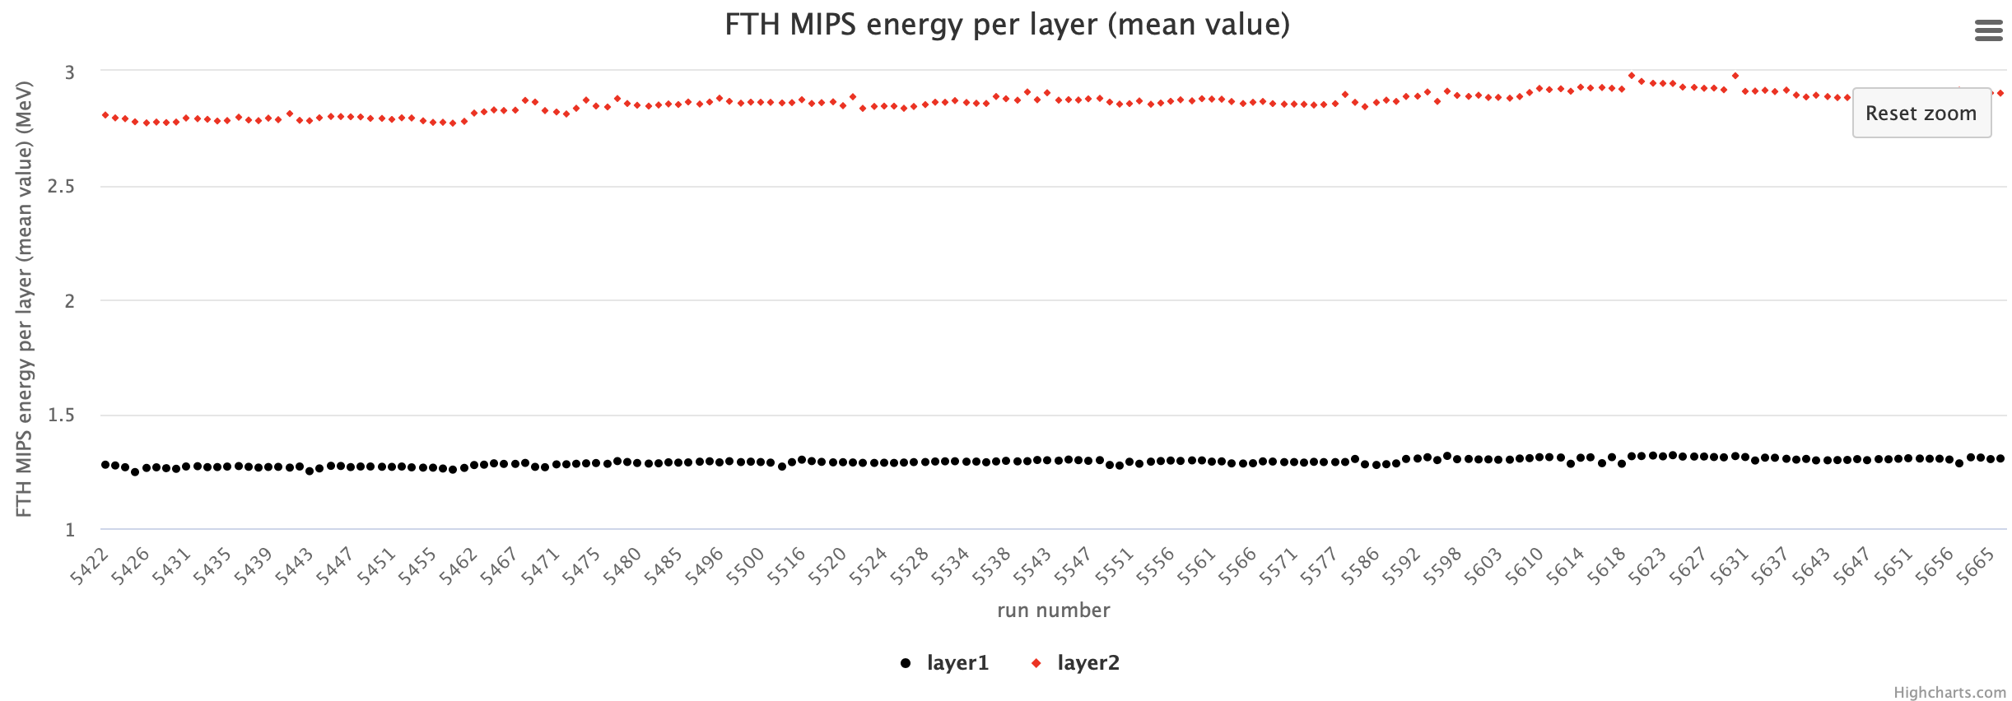
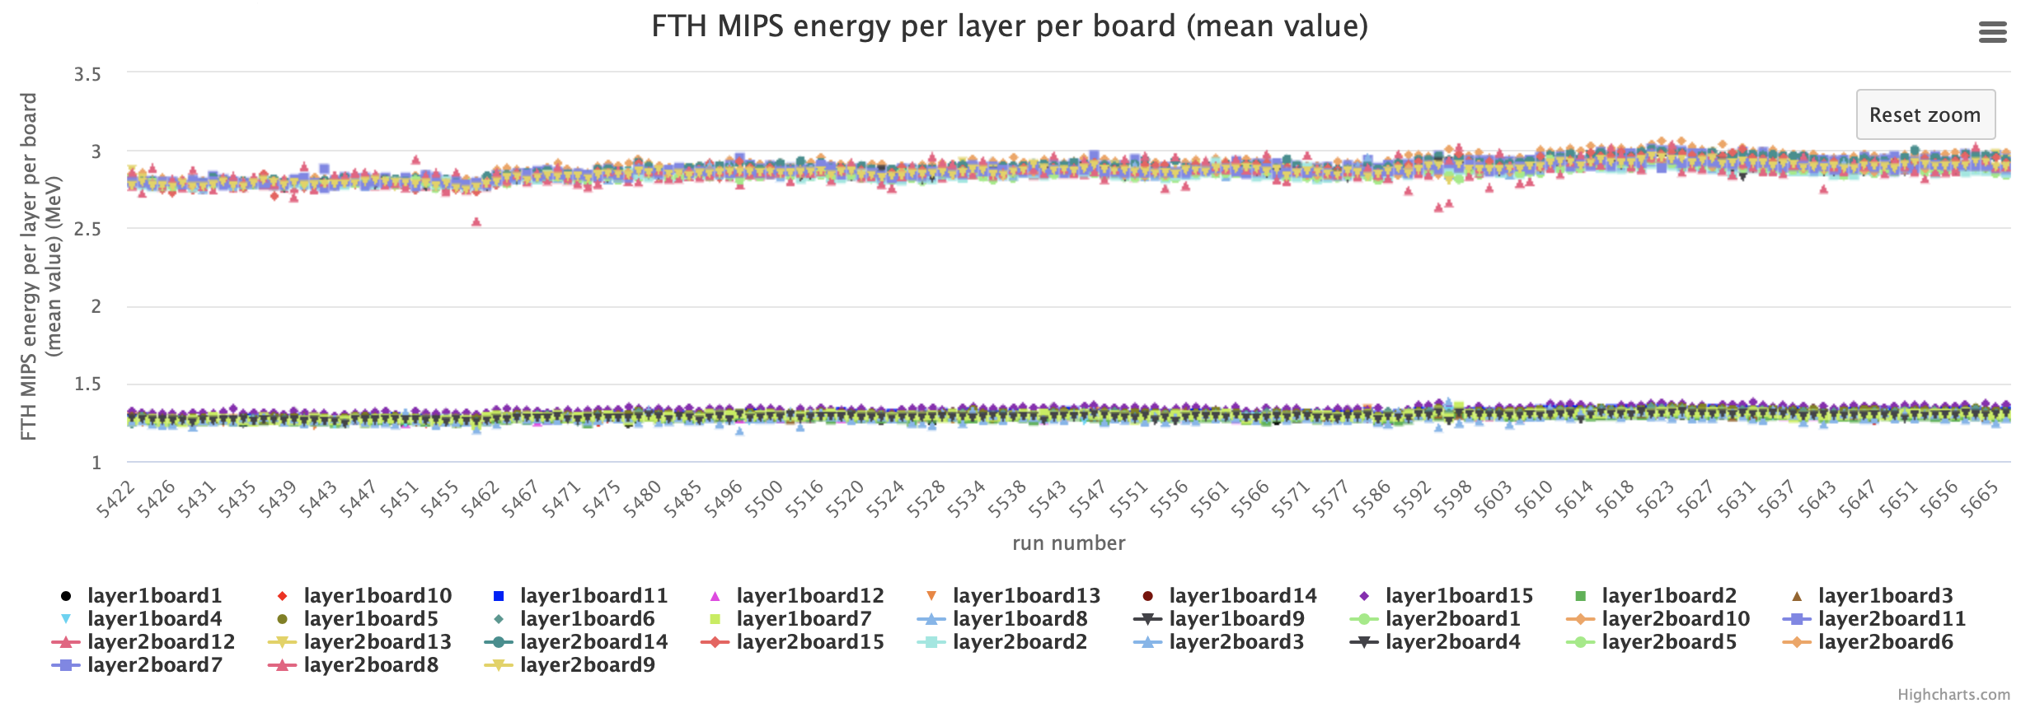
FTHodo gain matching
Very stable gains (to be compared with thresholds of 0.15 MeV)

Slide 6
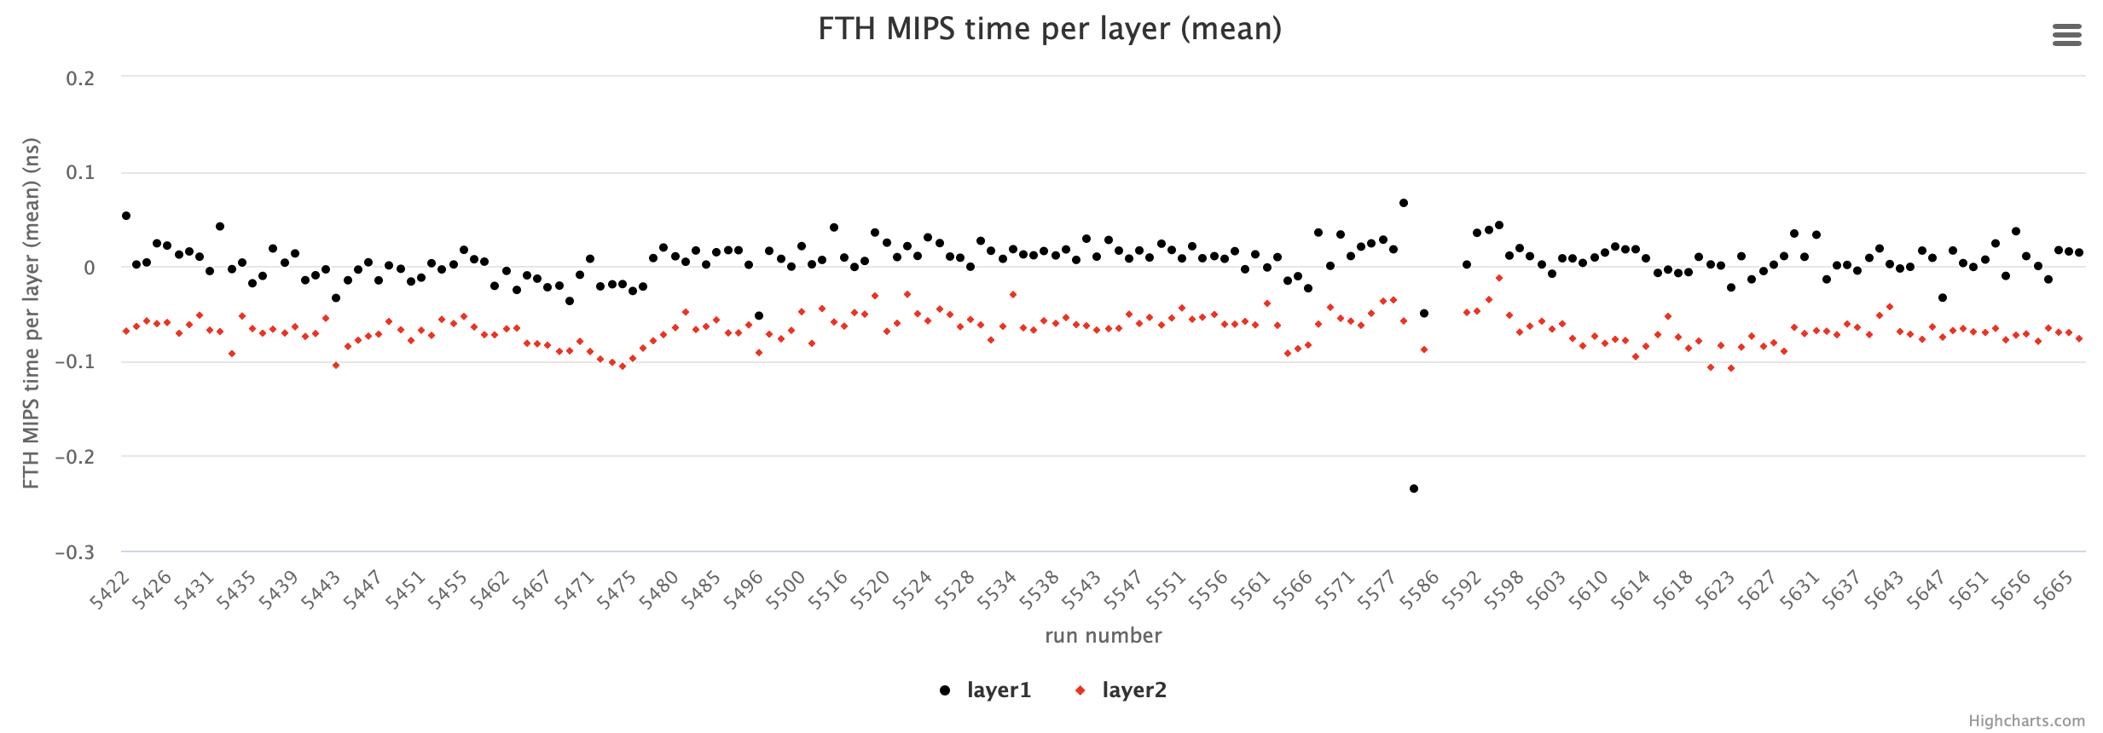
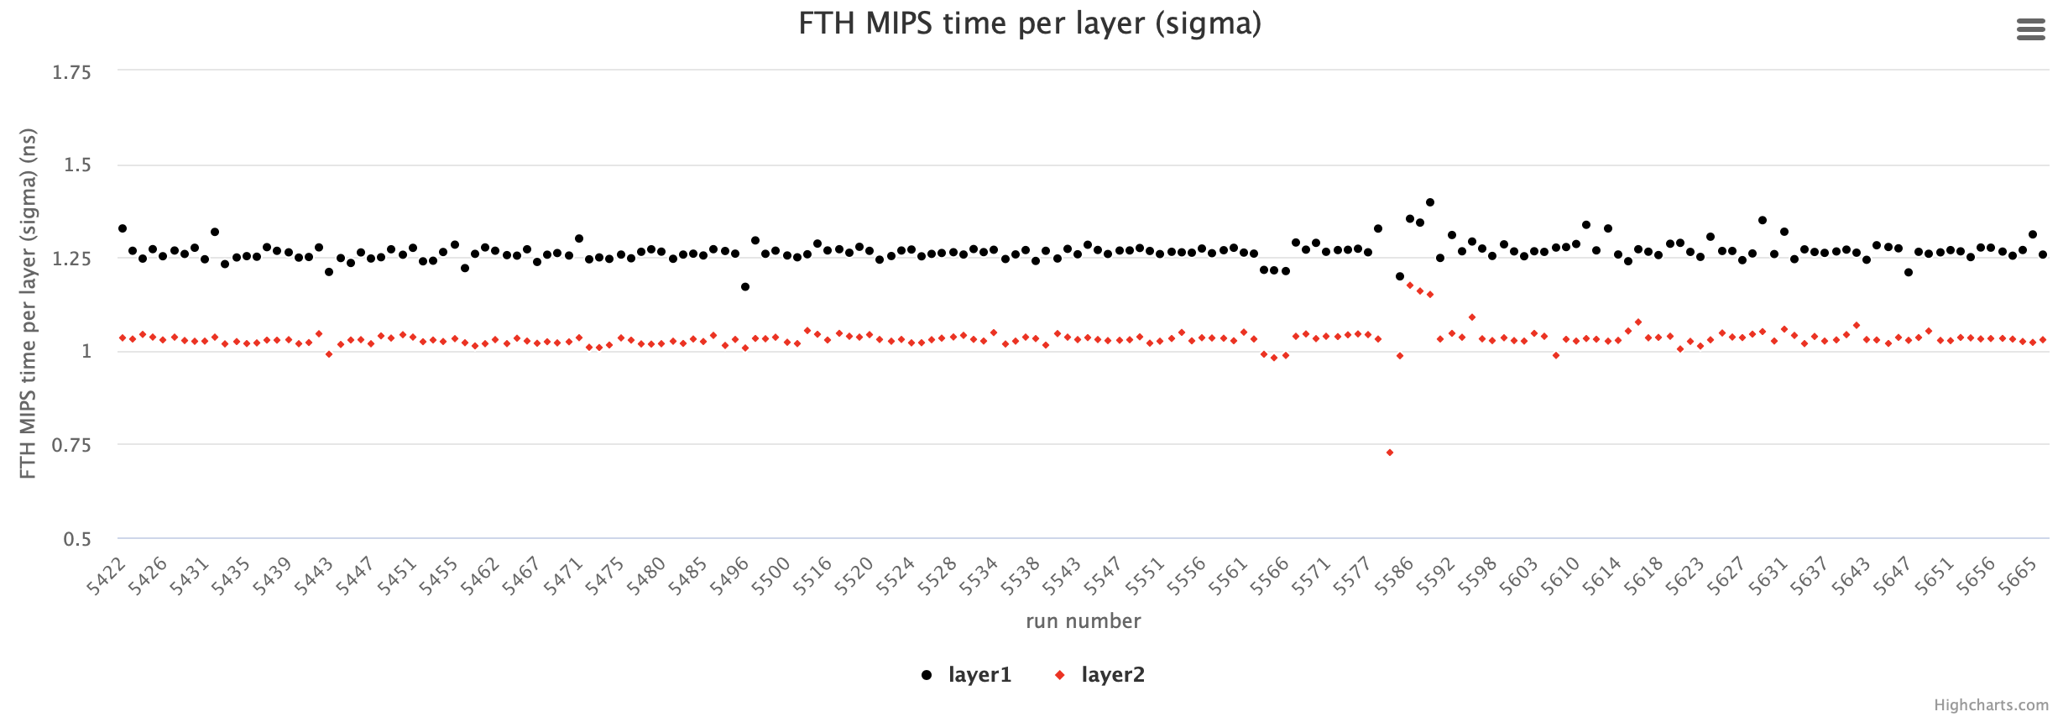
FTHodo time
Very stable means and sigmas compared to the expected resolution of the order of 1 ns
Only outliers are runs with very low statistics

