Slide 1
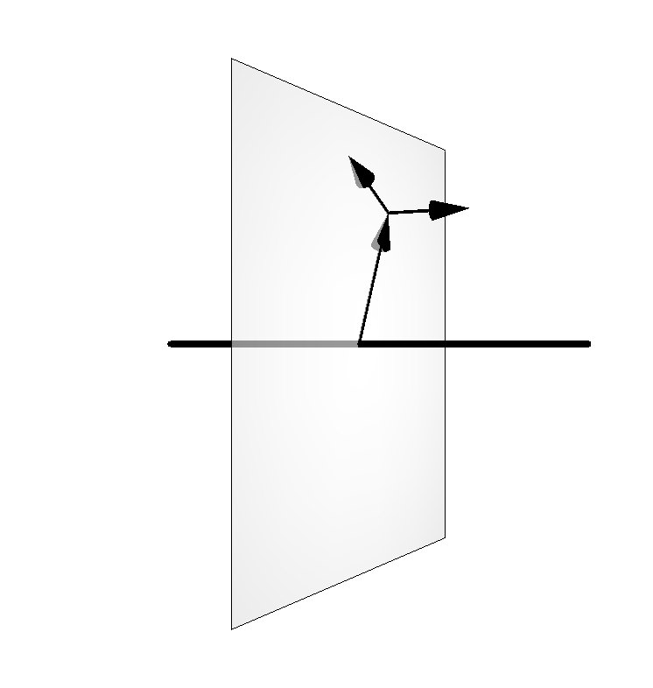
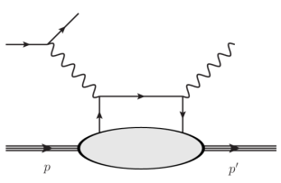
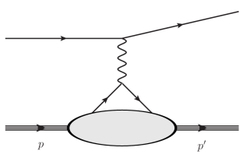
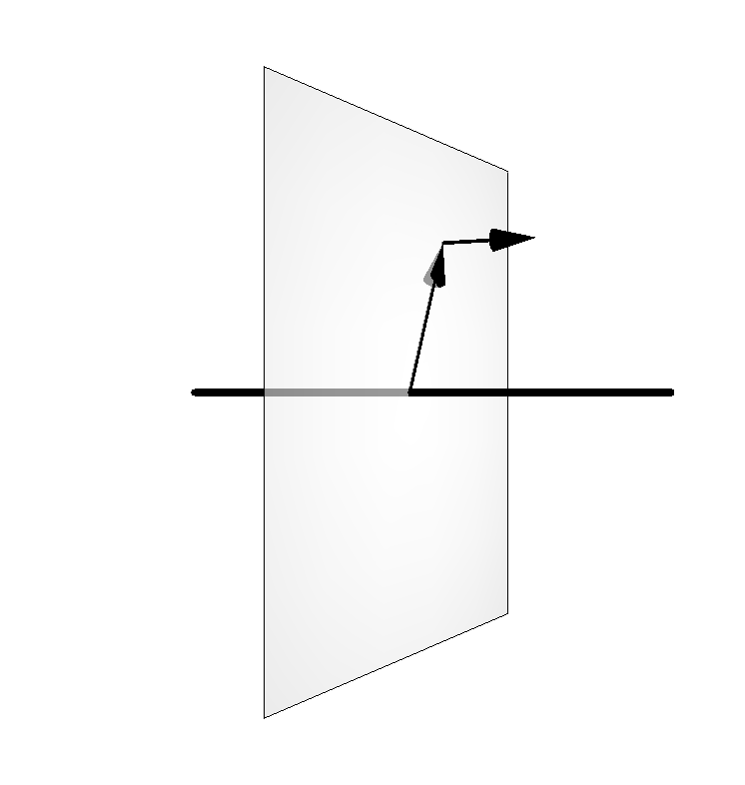
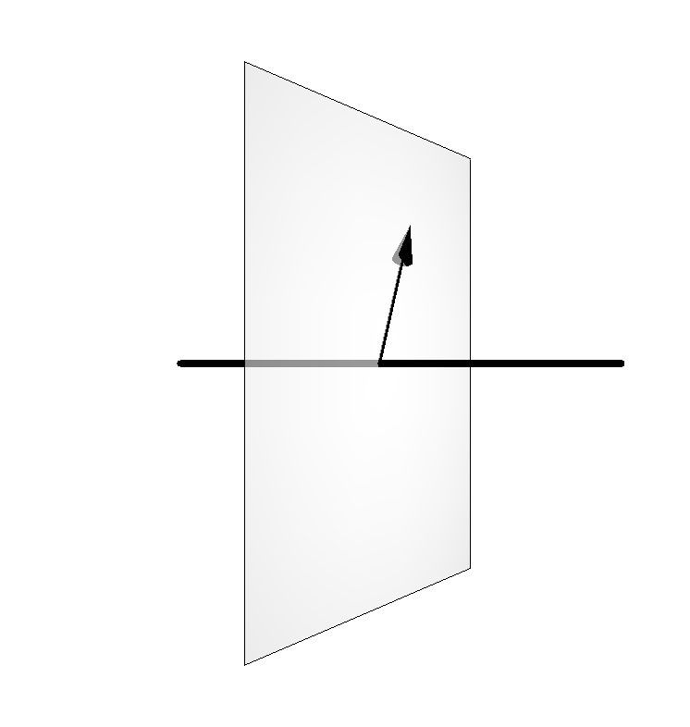
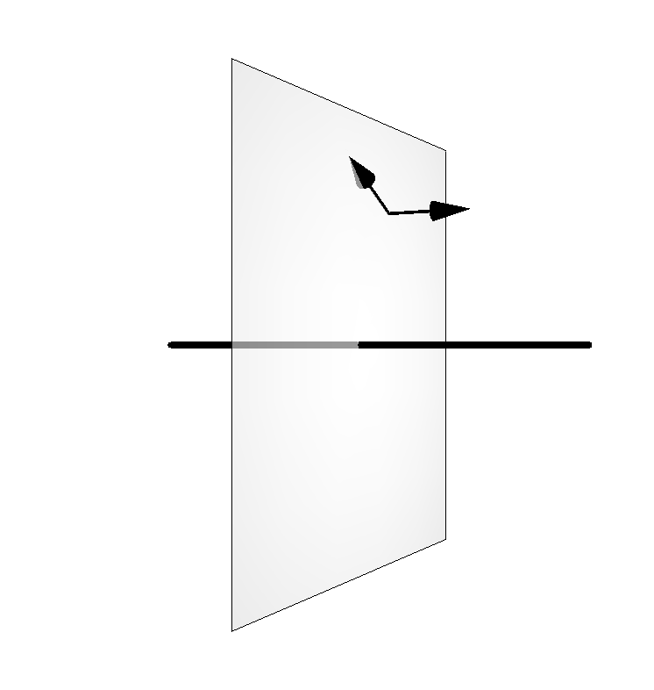
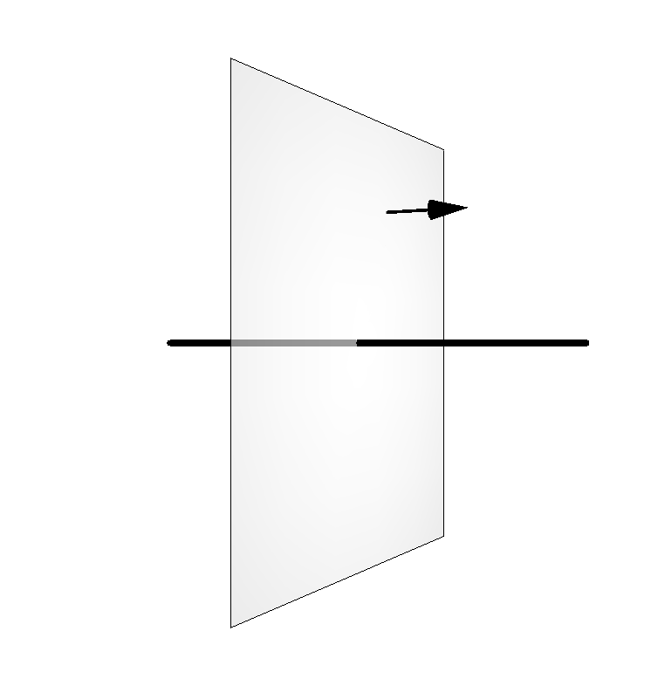
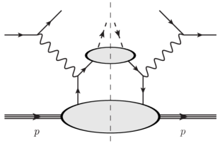
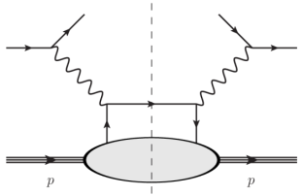
Longitudinal momentum
Multi-dimensional mapping of the nucleon
Transverse momentum
Impact parameter
Elastic Scattering
DVCS
GPDs
FFs
GTMDs
A complete picture of nucleon structure requires the measurement of all these distributions
TMDs
PDFs
SIDIS
DIS
4

Slide 2
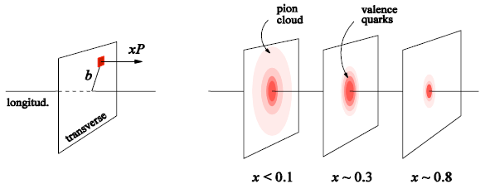
Deeply Virtual Compton Scattering and quark GPDs
e’
Q²= - (k-k’)²
x_{B} = Q²/2Mν n=E_{e}-E_{e’}
x+ξ, x-ξ long. mom. fract.
t = Δ² = (p-p’)²
x ≅ x_{B}/(2-x_{B})
e
t
γ
γ*
(Q²)
factorization
x+ξ
x-ξ
At leading order QCD, twist 2, chiral-even (quark helicity is conserved), quark sector
→ 4 GPDs for each quark flavor
~
~
H, H, E, E (x,ξ,t)
N(p)
N(p’)
Quark angular momentum (Ji’s sum rule)
z
x
X. Ji, Phy.Rev.Lett.78,610(1997)
Nucleon tomography
M. Burkardt, PRD 62, 71503 (2000)
Notes:
The channel more directly interpretable in the terms of GPDs is DVCS, which is the electroproduction of a real photon on a quark of the nucleon. You see it here represented by the « handbag » diagram, which shows the virtual photon that interacts with one of the quarks of the nucleon, which propagates and then radiates a real photon, before « going back » in the nucleon. The handbag implies the factorization of this reaction in two parts: the top one, describing the virtual-photon/quark interaction, which is calculable in perturbative QCD; and the bottom one, which describes the partonic structure of the nucleon, and is encoded in the generalized parton distributions. The handbag factorization holds in the so-called Bjorken regime, which requires to be at high Q2 with respect to the momentum transfered to the proton (t).
At leading order and twist in QCD, considering only quark-helicity conserving quantities and the quark sector, there are 4 GPDs, H, Htidle, E, Etilde, and they depend on three variables: x, the momentum fraction carried by the struck quark, csi, the difference of the quark momentum between initial and final state (which is linked to the Bjorken variable xB) and t, the momentum transfered to the proton. There are 4 GPDs to describe different combinations of nucleon spin with respect to the quark’s helicity.

Slide 3
DVCS on proton and neutron with polarized target
DVCS allows access to 4 complex GPDs-related quantities: Compton Form Factors CFF(ξ,t)
Unpolarized beam, longitudinal target:
~
Proton
Neutron
~
~
Im{H_{p}, H_{p}}
Δσ_{UL} ~ sinφIm{F₁H+ξ(F₁+F₂)(H + x_{B}/2E) –ξkF₂ E+…}
Im{H_{n}, E_{n}}
Polarized beam, longitudinal target:
~
~
Re{H_{p}, H_{p}}
ξ= x_{B}/(2-x_{B})
k=-t/4M²
Δσ_{LL} ~ (A+Bcosφ)Re{F₁H+ξ(F₁+F₂)(H + x_{B}/2E)…}
Re{H_{n}, E_{n}}
Proton and neutron GPDs (and CFFs) are linear combinations of quark GPDs
A combined analysis of DVCS observables for proton and neutron targets is necessary to perform the flavor separation of the CFFs

