Slide 1
Possible parasitic measurement during Fall GMp run
February 24th 2016
Alexandre Camsonne

Slide 2
DVCS setup
Stand has range from 10 to 16 degrees
Z position from 1.5 m to 5.5 m
Carrier about 2 m x 1m
208 channels of RG 213 signal going in HRS
208 HV channels
DVCS electronics in spectrometer
  1 GHz waveform sampling 128 ns depth
  Calorimeter trigger

Slide 3
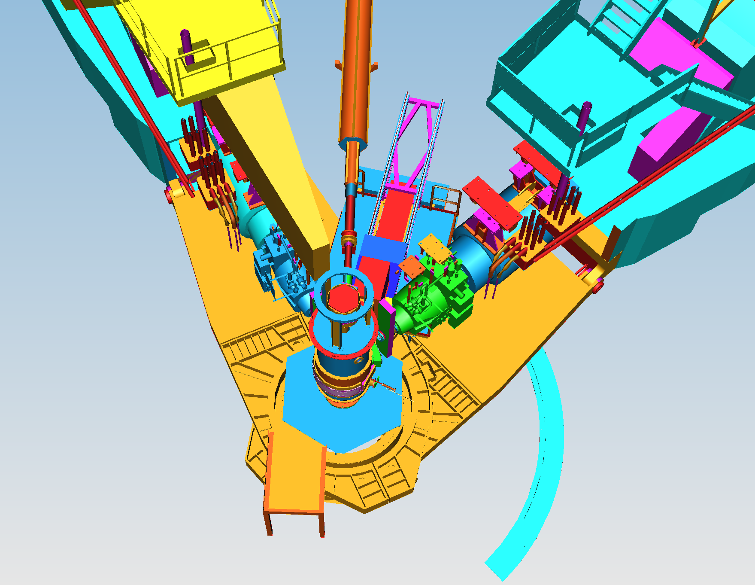
DVCS setup

Slide 4
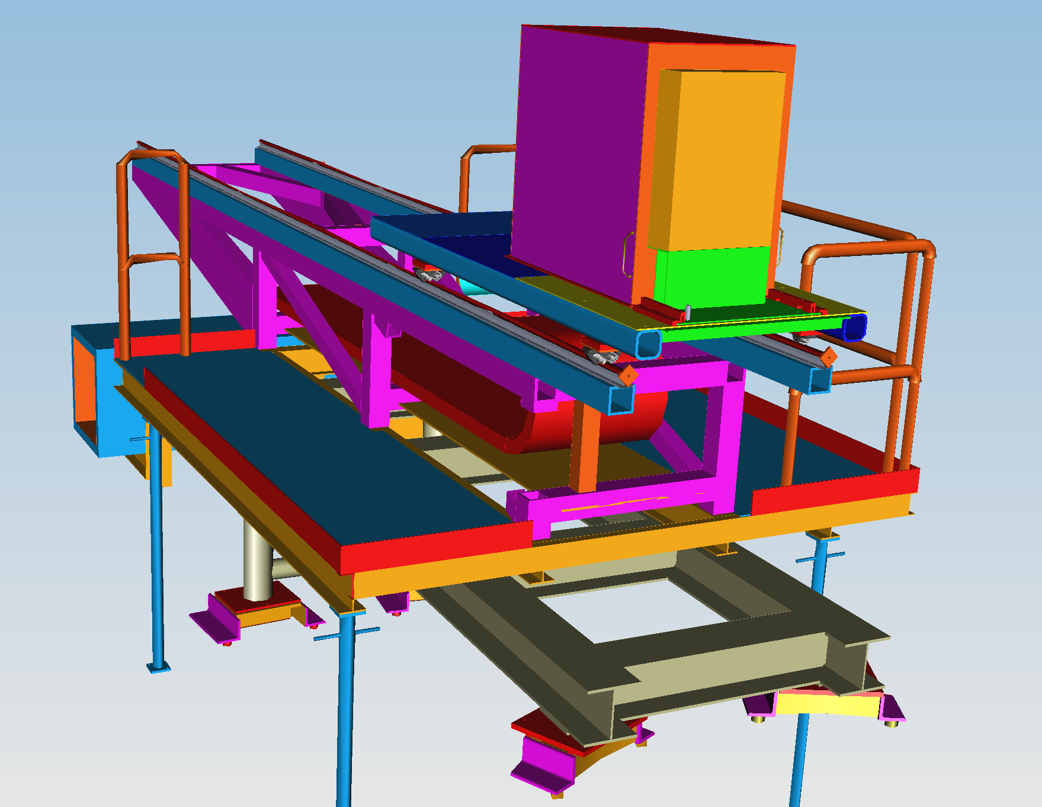
DVCS arm

Slide 5
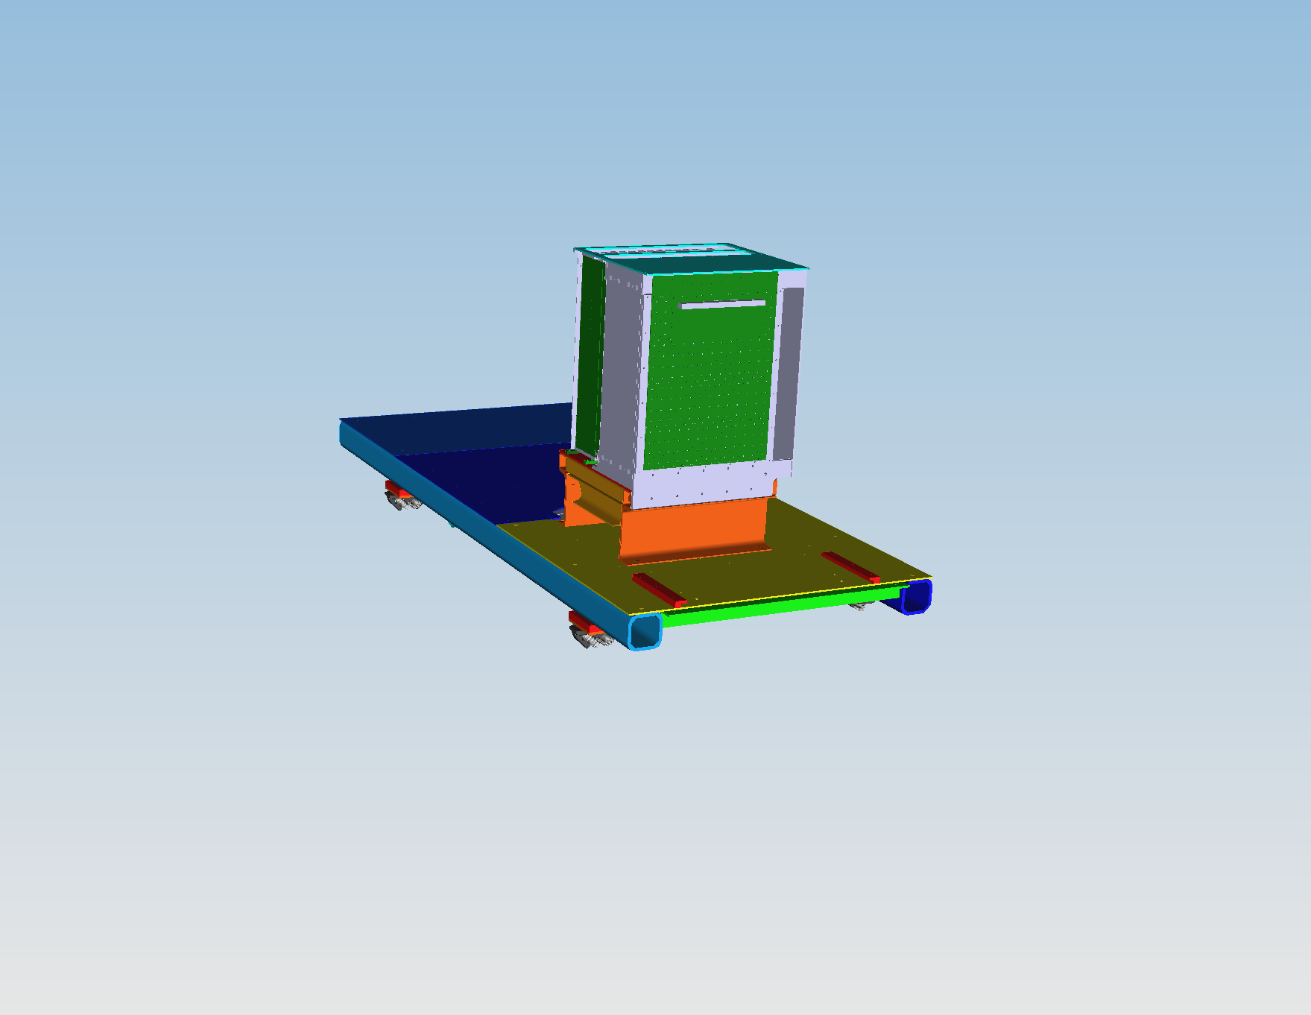
DVCS calorimeter box and carriage

Slide 6
GMp experiment
Need high current up to 60 uA
Two single arms DAQ
Left HRS
Right HRS : limite to about 42 degrees because of DVCS stand
DVCS requested to run at under 25 uA when calorimeter is in place, can run high current when DVCS calorimeter is unstacked
Most likely extended to Fall

Slide 7
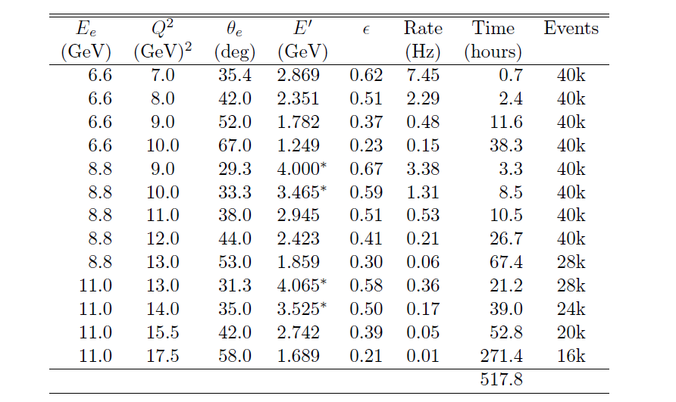
GMp kinematics
0.7+2.4+3.3+8.5+10.5+26.7+21.2+39 =112.3 hours = 5 PAC days = 10 days

Slide 8
Dedicated GMp run
When DVCS is done, unstack calorimeter
Most likely stand stays in place to save installation time
GMp uses Left HRS for small angle measurement
Most like Right HRS at smallest angle and DVCS stand at smallest angle 10 degrees

Slide 9
Electron Calorimeter irration test
10 degrees, current up to 60 uA
Can reuse DVCS cables 208 channels and stack lead glass, need PMTs support
Could reuse DVCS box, but not heat curing
C200 ready next fall ?

Slide 10
GEM tests
One plane or more in front of calorimeter
Large or small GEM in front of HRS on sieve hold
MPD in VME64X crate in spectrometer
Test CODA integration, rate capability, DAQ capability, position resolution in high background, radiation hardness

Slide 11
GRINCH prototype test
PID for GEM and ECAL
Test rate capability and VETROC

Slide 12
HCAL
Can be place in place of ECAL
Or could look for coincidence with ECAL or HRS
Can install FADC crate in LHRS for trigger testing

Slide 13
DAQ options
Use DVCS DAQ
  Good to look at accidental and background rate
Use SBS DAQ
  Good to test full scheme in realistic conditions
  More involved in terms of installation

Slide 14
Drawback
Only small angle available 10 to 16 degrees limited by RHRS
No magnet : background and irradiation will be significantly higher

Slide 15
Conclusion
Opportunity to take data in high background environment
  Test detector capabilities
  Benchmark Montecarlo
Could test several detector components
Could need significant effort depending how involved in the setup

