Slide 1
SNS PPU COVID-19 Procurement Strategy
Ed Daly, STL Katherine Wilson, CAM
Mitch Laney, Strategic Acquisitions Group
Jennifer Logan, CFO
9 APR 2020

Slide 2
Outline
Introduction
Concerns
Procurement Accommodation Considerations
Four Options
Summary
SNS PPU Cryomodule 5 ton, 24’ long

Slide 3
Introduction
Lab Director has stated that on-site activity should be minimized during MEDCON6
SNS PPU has been identified as non-essential by JLab management so virtually all on-site work has been stopped until further notice
~$9M in procurements for PPU are in progress with 85% awarded to vendors
A large portion of the components ($2.7M) planned for shipment from vendors to JLab in the next three to six months
Receipt, inspection and acceptance of complex hardware
involves many groups across the laboratory

Slide 4
Concerns
SNS PPU has a number of parts due for delivery to JLab in the near future.
Direction is that only critical items should be received
－PPU is not considered mission-critical at JLab
Due to MEDCON-6 status, we have been told receiving at JLab
is limited:
－Limited personnel onsite and must adhere to distance/PPE rules
－Limited forklift availability to receive larger items (vacuum vessel, space frame, cavities, helium vessels, etc)
－Limited SRF inventory staff to store parts in secure area or enter items into Primes inventory database for tracking
－No QC technicians available for inspections
Receipt at JLab means warranty period would begin, though inspection and assembly schedule are delayed

Slide 5
Procurement Accommodation - Some Considerations
Appropriate level of staff activity at JLab during MEDCON6
Some PPU parts received while JLab is closed
Complex receipt/inspection activities on hold
Current contractual obligations with planned deliveries
－Some vendors are still operating
Vendors hold shipments until the lab re-opens
Warranty period - impacted if parts are held at vendor?
Storage charges for holding hardware
Large number of deliveries to JLab when the lab re-opens
Vendor solvency / Economic issues
Other JLab projects or groups with similar issues & challenges

Slide 6
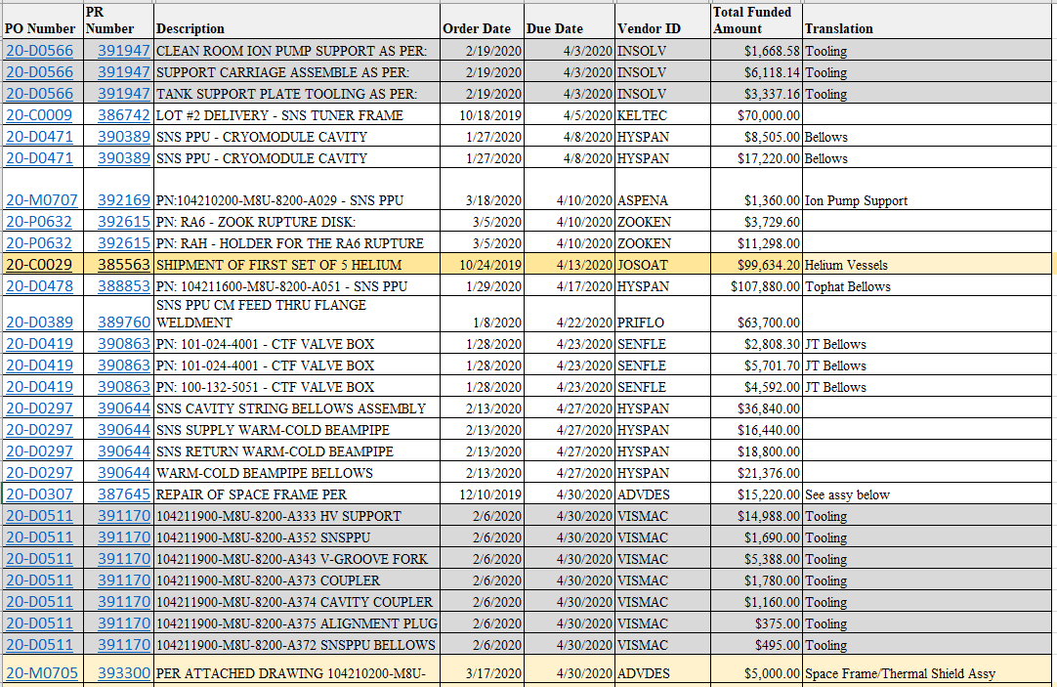
Planned Deliveries : April thru September ($2.76M)
Key Items requiring SRF support
5 Helium Vessels requiring dimensional and visual inspection (100 lbs each)
Various bellows requiring dimensional, visual and sensitive helium leak check
Ultra-high vacuum beampipes requiring dimensional, visual and sensitive helium leak check
Complex items require special handling during receipt
List of planned mat’l deliveries for April 2020 - $547K
Month | Total Open Amount | Simple Items | Complex Items
April | $547,105 | $442,470 | $104,634
May | $539,017 | $152,443 | $386,574
June | $302,411 | $64,455 | $237,956
July | $610,776 | $264,880 | $345,896
August | $312,314 | $0 | $312,314
September | $444,364 | $236,790 | $207,574
Totals | $2,755,987 | $1,161,038 | $1,594,949

Slide 7
Some Components Requiring SRF Support at Receiving
Helium Vessel Assembly (April)
Large components are handled by SRF staff in coordination with S/R
－Helium Vessels (due in April)
－Thermal Shields (April/May)
－Space Frame (due in June)
－End Cans (due June)
Some are stored at an offsite warehouse (“Blue Crab”)
Inspection activities routinely include:
－Dimensional/Visual Inspection
－Sensitive Helium Leak Check
－Pressure Testing
－Cold Shocking
Requires up to 5 different skill sets
Thermal Shield Assembly
(May)
Cryogenic Return End
Can Assembly (June)

Slide 8
Options Considered
Option | Benefits | Risks
1) Take delivery at JLab and perform incoming inspection as originally scheduled for all SNS PPU equipment | Maintains project schedule Maintains positive relationship with suppliers Adheres to JSA vendor payment processes and financial controls Warranty period remains intact Adheres to standard receipt/inspection/payment process | SRF staff would have to come on site and work together to receive and inspect Some inspection tasks can’t be performed without violating social distancing Require use of PPE and social distancing to complete complex inspections
2) Take Delivery at JLab and make payment to vendor, but delay inspection until after JLab is back to normal operations. | Mitigates project schedule delays Maintains positive relationship with suppliers JLab maintains the right to inspect equipment at a later date Adheres to JSA vendor payment processes and financial controls Avoids storage/maintenance costs at vendor’s facility | SRF staff would have to come on site and work together to receive complex equipment Requires use of PPE and social distancing to complete receipt Warranty period may start before inspection – negotiate with vendor Does not adhere to standard receipt/inspection/payment process
3) Take Delivery at Subcontractor’s site and make payment to vendor without receiving or inspection. | Could maintain project schedule (production continues) Maintains positive relationship with suppliers No JSA staff exposure because no on-site receiving or inspection | Could delay project schedule (for shipping equipment after JLab reopens) Does not adhere to standard receipt/inspection/payment process Waives Lab financial controls associated with vendor payment; exposes JLab to risk of fraud or improper payment in the amount of up to ~$1.4M of equipment over 3 months. Warranty period may start before inspection – negotiate with vendor Potential damage to equipment at subcontractor’s site or in shipping (after payment) – JLab could be legally responsible. Could incur storage/maintenance costs at vendor’s facility.
4) Hold delivery at vendor until after JLab is back to normal operations. | Adheres to JSA vendor payment processes and financial controls. No JSA staff exposure because no on-site receiving or inspection. Warranty period remains intact; would not begin until receipt of equipment at JLab. | Impact to project schedule Potential loss of positive supplier relationship Potential cost growth and contract claims; need to quantify by engaging suppliers Warranty period may start before inspection – negotiate with vendor Possible request for equitable adjustment or storage fees via re-negotiation of contract

Slide 9
Summary
Recommend option 2 for simple items and critical path complex items – receive into inventory and store components with limited staff involved
Recommend option 4 for non-critical path complex items – evaluate and update project schedule as part of recovery efforts due to COVID-19 impacts

Slide 10
Back Up

Slide 11
Payment – Option 2
Have the subcontractor ship the equipment upon completion without SOTR Inspection:
Get in writing that the vendor will honor all terms and conditions as previously negotiated with regard to delivery to the site after notification to release based on a prioritization schedule by JLab PPU Project Personnel.
Obtain a certificate of conformance, any certifications, and pictures of the equipment to certify completion.
4. Procurement and SOTR will communicate with S and R the details of equipment to be received and Procurement will arrange shipping with subcontractor to have equipment received on a Friday per facilities direction.
5. If the subcontractor complies with item 2 and 3, a payment will be made to the subcontractor in full. In addition the subcontractor will agree to start the warranty period after receipt.
6. Any issues would be handled under the warranty clause or under the Certificate of Conformance clause.
This will keep the small businesses moving with people employed to complete the requirement and also allow for maintenance of the PPU schedule. Further, JLab will have the equipment on site.
Note: Any payments made under either scenario will be maintained in a tracker sheet to assist S and R with any check in of equipment after JLab opens.

Slide 12
Payment – Option 3
Have the subcontractor hold the equipment at their facility once completed.
Get in writing that the vendor will honor all terms and conditions as previously negotiated with regard to delivery to the site after notification to release based on a prioritization schedule by JLab PPU Project Personnel.
Get certification from the subcontractor that while equipment is being stored at their facility that the equipment is still under their control and risk and they take full responsibility for the equipment for loss etc and that their facility is bonded against loss.
Obtain a certificate of conformance, any certifications, and pictures of the equipment to
certify completion.
If the subcontractor complies with item 2, 3, and 4 a payment will be made to the subcontractor in full less 5 to 10%, and the balance will be paid upon receipt. In addition the subcontractor will agree to start the warranty period after receipt.
Any issues would be handled under the warranty clause or under the Certificate of Conformance clause.
This will keep the small businesses moving with people employed to complete the requirement and also allow for maintenance of the PPU schedule.
Note: Any payments made under either scenario will be maintained in a tracker sheet to
assist S and R with any check in of equipment after JLab opens.

