Slide 1
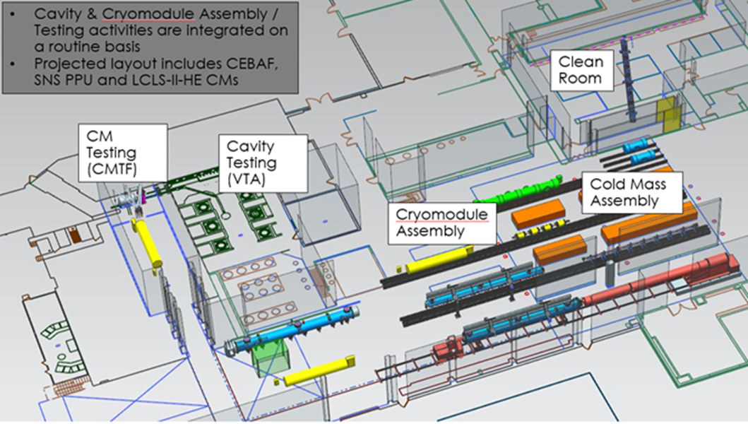
SRF Operations Restart
What we’re preparing for
How we’re preparing
What might things look like when we return
SRF Ops (Phil, Ed, John, Kirk, Mike, Katherine, Naeem, Anne and Tony)

Slide 2
What we’re preparing for
Not been any official process for returning to operations, but it’s coming
“Nonetheless, we must be deliberate while preparing for an orderly and safe return, when the conditions permit. And to this end, we are starting development of a Restart Plan which will layout the sequence of activities and responsibilities necessary to resume operations across the laboratory. We expect to be able to circulate this plan in the next few weeks. The Restart Plan will provide a framework, recognizing the details will be dictated by health conditions across our region, DOE direction, and program objectives.” M. Maier MEDCON 6 Update: Looking Ahead (msg.15)
Accelerator Division and SRF Ops have been preparing restart plans
  Likely the Lab will back out of Medcon 6 into Medcon 5
  Medcon 5 will impose several conditions, such as social distancing and the use of PPE
  Working conditions under Medcon 5 will slow us down in all work centers, some activities more than others
    Social distancing, use of PPE, work force population will be lower and some key personnel will need to work remotely

Slide 3
What we’re preparing for
It has been stated that only critical activities will be restarted
We’re told the Lab will bring CEBAF back and do ~ 6 weeks of physics
SRF Operations was previously deemed critical for supporting CEBAF operations, LCLS II and Energy Reach projects
Priorities for work while on MEDCON5:
CEBAF operation support
====== work listed below this line may slow down ====
CEBAF Energy plan, Summer SAD preparations, LCLS-II
= work closer than 6ft with heavy use of PPE that will significantly slow down==
LCLS-II U-tubes – as an example
====== work listed below this line will not be done under MEDCON5 =======
SNS PPU, LCLS-HE R&D, UITF support, LDRD, ECA, Stewardship awards, Nb3Sn R&D, Other WFO (US-Japan, etc.)
We (SRF) anticipate the Lab will want to increase the authorized work list to include PPU and SRF R&D projects
We’re preparing to resume all activities to bring CEBAF back online, supporting CEBAF during operation, perform some level of ALL cryomodule projects and some level of R&D projects

Slide 4
How we are preparing
Taking the approach to segregate our restart efforts into two primary activities
  Define plans to bring all SRF work centers back into operation
  Determine the feasibility of performing processing and assembly activities as they apply to the work which may be authorized under Medcon 5
    What can be done and how (through social distancing and use of PPE)
SRF Work Centers Operations
We’ve been told all OSP/TOSP will need to be revised and reapproved and that all relevant staff will need to be retrained
  New administrative controls to meet Medcon 5 conditions
All systems and equipment will need to be inspected and readiness verified before restart

Slide 5
Work Center Restart Plans
Phil Denny is leading
Similar to commissioning all work centers when transitioned into the new Test Lab Annex (TLA)
Ensure all work control and authorization documents are revised, approved and staff has been trained
  Evidence to show completion and compliance
Develop and conduct some level of functional acceptance test (FAT) on all systems and equipment
  Evidence to show completion and compliance
All work center leads and supervisors are or will be revising all the necessary work documents and developing FATs.
Leads and supervisors will retrain staff and work with Phil’s team to complete FATs
Once completed, AD approval is needed to begin operations

Slide 6
Defining what’s feasible and how to perform task
Tony is facilitating…
SME, Supervisors and CAMs are leading and working together to define what is feasible and how it can be accomplished
Mapping out what task and activities there are for each mainstream project (LCLS II, ER and PPU) that are likely needing to be done while under Medcon 5
Determining what level of activities can be accomplished in Medcon 5
  Three main buckets
    Those that social distancing and PPE rules do not apply to
    Those that can be accomplished through social distancing
    Those that require the use of PPE
      Determine the amount or rate of use of PPE
PPE requirements include N95 mask, Tyvek suits and gloves

Slide 7
Defining what’s feasible and how to perform task
Major hurdle in performing clean room assemblies
Most multi-cell cavity work and strings require the use of PPE
  We can't use the required N95 mask in our clean room operations due to the cleanliness requirements and concerns for resulting quality issues affecting the performance our deliverables to internal and external customers
  Our current clean room mask or not approved as alternates to N95 mask
  A possible IS0 6 N95 mask has been found, it would need to be evaluated but is currently unavailable
  SRF cryomodule and cavity assembly operations can not continue under Medcon 5 under the current constraints.
We need to determine how to perform clean room assemblies and get approval
  Safety, Quality, Schedule

Slide 8

Summary
Although not yet official guidance on restart plans, most Divisions including Accelerator are developing restart plans with Medcon 5 constraints
We think our Medcon 5 activities will include all activities to bring CEBAF back online, supporting CEBAF during operation, perform some level of ALL cryomodule projects and some level of R&D projects
First phase for SRF Operations will be to bring all work centers back into operation
  Concerns with the level of work control documents that need to be revised, reviewed and approved
  Intent is to get these done before we return to work
Second phase will be to ramp into authorized activities starting with getting CEBAF back online and doing physics
Test Lab activities may be gated by approval to perform clean room assemblies which means resolving the PPE dilemma
Safety, then Quality, then Schedule – slow downs are anticipated

