Slide 1
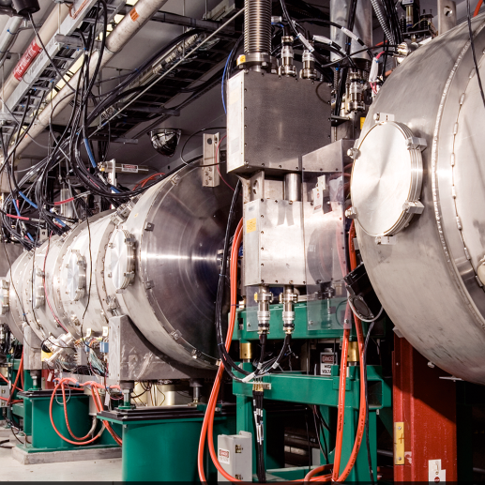
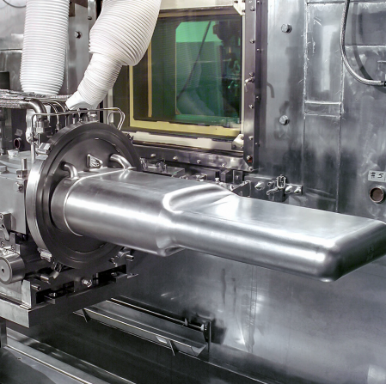
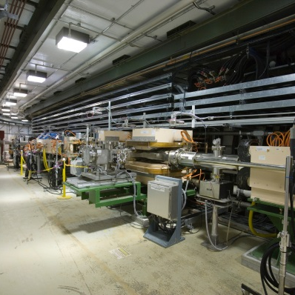

CD-2/3 Director’s Review of the
Proton Power Upgrade Project
Closeout Report
Mark Reichanadter, Committee Chair
June 2–4, 2020

Slide 2
PPU CD-2/3 Director’s Review – Committee

Slide 3
PPU CD-2/3 Director’s Review – Charge Questions & Assignments
Scope/Design Maturity: Is the project scope definition sufficiently mature to establish a performance baseline and a CD-3 approval decision? Do the KPPs adequately define the performance baseline? Are system specifications, designs, and interfaces sufficiently mature to support CD-2 and CD-3 approval?
SC1, SC2, SC3, SC4, SC5, SC6, SC8
Cost & Schedule: Are the cost and schedule estimates of sufficient quality to establish a baseline and to support the start of construction? Is there adequate cost and schedule contingency? Are the financial systems and staff prepared to properly collect and report project earned value? Are the cost and schedule risks presented by COVID-19 adequately addressed?
SC7 (with technical input on drill-downs)
Technical: Is the technical progress to date sufficient to support the planned procurements and installation? Are project risks sufficiently identified and managed?
SC1, SC2, SC3, SC4, SC5, SC6, SC8
Management: Is the project being managed for successful execution? Is the project leadership team fully staffed with people who have sufficient expertise and experience to successfully execute the project and progress to CD-4?
SC6 (with input from all subcommittees)
ESH&Q: Are Environment Safety Health & Quality Assurance requirements and plans being properly addressed? Is the project proposing adequate COVID-19 protection and safety measures for project work going forward?
SC8 (with input from all subcommittees)
Recommendations: Have past review recommendations been appropriately addressed?
SC1, SC2, SC3, SC4, SC5, SC6, SC7, SC8

Slide 4
SC1 – Superconducting Linac
T. Xu (MSU), A. Rowe (FNAL)
Findings
  The SCL upgrade scope consists of 7 High Beta (HB) cryomodules with insulating and beamline vacuum systems, RF coupler water cooling, cryogenic components, cryogenics and instrumentation controls, and integration efforts. CD-3a approval for long lead procurement of cavities and RF couplers was received in 2018. All contracts were awarded and expected to be complete by Dec 2020.
  Final design report is in draft and 90% complete. ALL PPU SCL is at or near final design.
  CD-3b approval for long lead procurements for the cryomodule production was received in September 2019. This scope included all scope for the JLab procurement contracts.
  Installation and commissioning are planned in three stages and coordinated with current machine operation outages. The installation strategy is 2-3-2 for the 7 new cryomodules. The threshold KPP for linac 1.25 GeV will be demonstrated in the second stage.
  Current COVID19 impact to the SCL schedule and costs appear to be minor. JLab team is able to move the procurements toward completion working remotely. 63 major procurements are included with 19 already completed.

Slide 5
SC1 – Superconducting Linac
T. Xu (MSU), A. Rowe (FNAL)
Findings (continued)
  SCL systems costs are tracking very closely with estimates presented at CD-3b for both LLPs and ETC – $20.9M vs. $20.4M due to vendor contracts and quotations.
  Vendor quotations and contracts have narrowed remaining uncertainty in ETC. CD3b – 92% vendor estimates, 5% quotation. Current: 81% contracts, 14% vendor quotation, Vendor estimate 3%.
  The SCL schedule is tracking as planned.
  There is no upgrade or replacement of the existing LINAC as part of the PPU scope.
  LINAC energy ramping strategy follows installation of the new HB CMs at each shutdown. 1.1 GeV is the next planned beam energy demonstration.
  Cryomodule/gradient performance in the tunnel has a 3 HB-cavity planned operational margin after plasma processing is completed on the MB cryomodules.
  FMEAs, where deemed applicable, are included as part of the procurement documentation. No system-wide FMEA is planned.
  Operational Readiness Clearance reviews are not required to install and operate for CMs. Acceptance testing is sufficient.

Slide 6
SC1 – Superconducting Linac
T. Xu (MSU), A. Rowe (FNAL)
Findings (continued)
  Cavities and Fundamental Power Couplers (FPC)
    The SRF cavity performance requirements for Q₀ and E_{acc} are conservative and demonstrated using reference cavities from vendor.
    The PPU cavities have improved designs which were the result of lessons-learned from the original SNA cavity design. (no HOMs, no piezos, end-group modification, end group RRR material)
    COVID-19 schedule impacts have not yet been realized, but is still possible with some minor vendor schedule uncertainty remaining. Cavity COVID-19 technical and schedule risk mitigated with DESY consultant hired to monitor progress.
    Initial RF coupler QC issues have been resolved. All inner conductors have been accepted without issue.

Slide 7
SC1 – Superconducting Linac
T. Xu (MSU), A. Rowe (FNAL)
Findings (continued)
  Cryomodule Design and Fabrication
    PPU cryomodule design is based on SNS spare HB cryomodule and incorporated lessons learned and feedback over 10 years’ operation experience of current SNS cryomodules.
    Final Design Review for PPU CM was held in June 2019 and a Production Readiness Review in Feb 2020.
    Monthly JLab schedule reporting to SNS is performed and includes a ‘flat file’ that is incorporated into P6 at SNS. Summary activities and key milestones are tracked and reported.
    Original SNS cryomodule transportation fixtures were modified to minimize shipment risk. No transportation-caused incidents occurred during the original SNS cryomodule shipment. New analysis and transportation studies have either been done or are planned.
    Staffing gaps are identified. All positions are approved and posted.
    JLab planned production schedule enables flexibility in downstream CM delivery schedule.

Slide 8
SC1 – Superconducting Linac
T. Xu (MSU), A. Rowe (FNAL)
Findings (continued)
  Cryogenics
    No new design elements are required for PPU.
    Cryogenic shield capacity can increase from 8.3 kW to 10 kW by implementing a new nozzle of the first turbine string. This nozzle is already delivered.
    2K pump down sequence development has this highest risk score (medium risk score) in the SCL scope.
    All designs are at final design maturity.
  Utility Systems
    A dedicated insulating vacuum system for cryomodule is included in PPU scope. IVS design concept is based on the successful upgrade of vacuum systems for the DTL and CCL.
    Vacuum configuration is improved from the original LINAC.
    All designs are at final design maturity.

Slide 9
SC1 – Superconducting Linac
T. Xu (MSU), A. Rowe (FNAL)
Findings (continued)
  SCL System Integration
    Cryomodule acceptance testing occurs in two primary phases: 2K testing at JLab and 2K + RF testing at SNS. Acceptance criteria, except HPRF, is tested in both locations.
    SCL Integration scope is at final design maturity.
    Non-conformance management at SNS and at JLab are similar. The interface between the two systems, in particular with who owns the decision to resolve major NCs, is handled through direct communication between the two teams. See comment and recommendation.
  SCL Controls
    The upgraded MPS is capable to shut off beam in 6-7 µs to protect SCL cavity degradation from errant beam.
    New cryogenics controls will be tested an operated in the test cave using operational funds. This early testing enables changes to be implemented prior to CM tunnel operations.
    Technical review of SCL controls scope is handled as a sub-section of the overall SCL FDR.
    No larger integrated controls review is deemed necessary due to the incremental nature of the changes.

Slide 10
SC1 – Superconducting Linac
T. Xu (MSU), A. Rowe (FNAL)
Comments
  The partnership with JLab is essential to the success of the CM scope. The ICD, SOW and ACL are well defined. Consider a decision/responsibility matrix on Non-conformance resolution. See recommendation.
  A lessons-learned document from the original SNS CM production at JLab was shared that covered many technical improvements that can continue to be used as reference and expanded for future CM design and production.
  Current COVID-19 impact to SCL scope appears minor since project is mainly at the procurement stage. Additional work safeguards are required when Jlab goes back to work. The impact on return-to-work efficiency needs to be monitored closely.

Slide 11
SC1 – Superconducting Linac
T. Xu (MSU), A. Rowe (FNAL)
Comments (continued)
  Cavities and Fundamental Power Couplers (FPC)
    Reference cavities were used to qualify vendor processing work flow. VTA results at SNS of two reference cavities exceed PPU requirements. The first batch of 5 cavities is expected deliver August 2020, which is one month later than expected. Vendor made PPU cavities the highest priority to recover the production schedule. Continued close monitoring is required to recover production schedule since the first cavity delivery is on the critical path.
    30 sets of FPC parts have been received at SNS. 12 FPCs have been assembled and conditioned with 6 sets shipped to JLab. One FPC inner conductor was damaged during conditioning due to insufficient instrumentation protection and a wrong rf component was installed. Configuration control should be reinforced. An integrated PPU cavity and FPC in horizontal test apparatus should be considered to fully vet the PPU FPC design.

Slide 12
SC1 – Superconducting Linac
T. Xu (MSU), A. Rowe (FNAL)
Comments (continued)
  Cryomodule Design and Fabrication
    PPU cryomodule will use a slightly modified shipping fixture design from one used for the current SNS cryomodules. A shipping test is added to SCL scope to test shock and vibration response using a dummy cryomodule. Committee commends the change to reduce the technical risk and incorporate the lessons-learned from the LCLS II project.
    JLab cryomodule production schedule supports PPU installation schedule with adequate float. Five PPU cryomodules are scheduled to be delivered before August 2022, the first outage for installation at SNS. There is no first article in the production schedule to allow feedback to production modules. cold high-power RF testing of the first CM should be a high priority and be performed as soon as possible to validate design changes and mitigate potential technical risk.
    JLab expects to work on SNS PPU production, LCLS II HE production and JLab cryomodule refurbishment in parallel. Coordination and resource allocation can be challenging. Adding an additional 13 staff is planned. JLab should hire staff at the required pace to ensure staffing are filled at the time required, especially for skilled positions. A fixed dedicated core crew for PPU should be considered.

Slide 13
SC1 – Superconducting Linac
T. Xu (MSU), A. Rowe (FNAL)
Comments (continued)
  Cryogenics
    No new hardware is required for cryogenic system for PPU. 2K pump down will need be developed for each stage of commissioning. Team may consider exploring the possibility to install current spare HB cryomodule in slot 32 before PPU modules are available may help develop pump down sequence before PPU cryomodule if other supporting system is available.
  SCL System Integration
    Last stage of cryomodule installation and cold test is on critical path of the project, while most cryomodule assembly activities are on near critical path. Team may consider to install more cryomodules in the second outage to take advantage of early delivery of cryomodules from JLab.
    A spare MB cryomodule has been completed and installed in the LINAC in Feb 2020. This allows MB cryomodules to be removed from tunnel for maintenance repair. Plasma processing selective MB cryomodules in test cave instead of all in tunnel has been proposed. Committee commends the change. However, this will increase the activities in the test cave and may cause schedule conflict with testing the PPU cryomodule.

Slide 14
SC1 – Superconducting Linac
T. Xu (MSU), A. Rowe (FNAL)
Comments (continued)
  Utility Systems
    Include the downstream valve configuration in the cryomodule vacuum diagram slide.
  SCL Controls
    Controls interface specification documents to other systems should be carefully reviewed for uniformity and consistency.
    Protecting staffing resources for PPU controls work is important to ensure progress during cryomodule integration and testing.
  Presentations
    Prior to IPR, improve breakout slides for uniformity in format, quantities of deliverables, graphic captions, etc.

Slide 15
SC1 – Superconducting Linac
T. Xu (MSU), A. Rowe (FNAL)
Recommendation
  Develop and align non-conformance record and resolution strategy with formal NCR process recommended in SC8. Lines of authority and communication should be defined.

Slide 16
SC1 – Superconducting Linac
T. Xu (MSU), A. Rowe (FNAL)
Response to Charge Questions
  Scope/Design Maturity: Is the project scope definition sufficiently mature to establish a performance baseline and a CD-3 approval decision? Yes. Do the KPPs adequately define the performance baseline? Yes. Are system specifications, designs, and interfaces sufficiently mature to support CD-2 and CD-3 approval? Yes.
  Technical: Is the technical progress to date sufficient to support the planned procurements and installation? Yes. Are project risks sufficiently identified and managed? Yes.
  Recommendations: Have past review recommendations been appropriately addressed? Yes.

Slide 17
SC2 – Radio-Frequency Systems
C. Hovater (TJNAF), C. Burkhart (SLAC)
Findings
  The SCL RF System upgrade to support PPU
    Five new HPRF transmitter systems to support the seven new cryomodules.
    28 new SCL HPRF stations rated at 700kW peak. The new SCL klystrons stations are compatible with existing SCL klystrons.
    28 new LLRF systems, based on legacy SNS design, but redesigned on a μTCA platform
    3 new modulators (AT-HVCM) and power supplies (transformer & SCR controller).
  The NCL RF System upgrade to support PPU
    The RFQ and DTL modulators are being upgraded to a single design (AT-HVCM) that supports PPU.
    New 3 MW klystrons are being purchased for DTL3-5.
  New mechanical and electrical utilities are being added to support the additional 28 RF systems and the 3 MW upgrade to DTL3-5.
  Primary KPPs for the RF system are to support operation at 1.3 GeV beam energy and 2 MW beam power.
  DTL3-5 circulators have been studied and have the capacity to protect the new 3 MW klystrons.

Slide 18
SC2 – Radio-Frequency Systems
C. Hovater (TJNAF), C. Burkhart (SLAC)
Findings (continued)
  Vendor has delayed the 3 MW klystron delivery to March of 2021 because of COVID-19 and an internal cyber security issue.
  The new 700 kW circulators have been awarded to a new vendor.
  The new LLRF system underwent a “witness” test next to an existing LLRF system.
  The LLRF team is collaborating with LBNL on the field control firmware.
  All RF System FDRs have been completed except for LLRF and RFQ-DTL HVCM upgrade.
  There are no high risks associated with the RF system.
  For the CD-3b activities, the RF system SPI and CPI is on track with no outliers.

Slide 19
SC2 – Radio-Frequency Systems
C. Hovater (TJNAF), C. Burkhart (SLAC)
Comments
  The RF team’s presentations were insightful and contained all the information to make an informed evaluation of the RF system.
  The RF team has staffed up appropriately to execute the project.
  The 3 MW klystrons for DTL3-5 are a new design, this procurement needs to be closely monitored.
  The RF system can make the 1.3 GeV KPP with out the 3 MW power increase to DTL3-5, although availability would be greatly decreased.
  Previous review recommendations have all been addressed and closed.
  RF System documentation is at the level one would expect at this stage of the project.
  RF system is at the 90% design complete level (still need to complete LLRF and RFQ-DTL HVCM FDRs).
  Circulator procurement needs to be closely monitored, with additional vendor communication, and potentially with additional tests.
  .

Slide 20
SC2 – Radio-Frequency Systems
C. Hovater (TJNAF), C. Burkhart (SLAC)
Comments (continued)
  RF system KPP is not just the 1.3 GeV energy specification, beam current should also be considered.
  2-3-2 Installation schedule does not appear to be an issue at this time.
  COVID-19 Impacts: With the mitigations for COVID-19 held at the Project-level, system leads are not managing these risks and anticipating their impacts. The project may not have a clear understanding of the impact at the L3 level, (e.g., vendor impacts).
  Consider using a consistent slide “template” (formatting, outline, …etc.), especially within a subcommittee. This will better communicate your message (easier to find pertinent information).
  Consider adding CPI/SPI numbers to talks for CD-3b activities.
  Break-out cost into labor and M&S.
  Consider adding a “percent complete” be added to system-level talks to provide a quantitative measure of progress.
  Add the DOE-approved milestone date for the two uncompleted FDR’s to the presentations.

Slide 21
SC2 – Radio-Frequency Systems
C. Hovater (TJNAF), C. Burkhart (SLAC)
Recommendation
  Consider testing the new LLRF system in 23D with beam before the LLRF FDR. Full system functionality is not necessary, but the system must demonstrate that the system meets the field control specification for typical SNS RF/Beam operation with basic software functions and EPICS interface.

Slide 22
SC2 – Radio-Frequency Systems
C. Hovater (TJNAF), C. Burkhart (SLAC)
Response to Charge Questions
Scope/Design Maturity: Is the project scope definition sufficiently mature to establish a performance baseline and a CD-3 approval decision? Yes. Do the KPPs adequately define the performance baseline? Yes. Are system specifications, designs, and interfaces sufficiently mature to support CD-2 and CD-3 approval? Yes.
Technical: Is the technical progress to date sufficient to support the planned procurements and installation? Yes, conditional on the LLRF demonstration on the linac. Are project risks sufficiently identified and managed? Yes.
Recommendations: Have past review recommendations been appropriately addressed? Yes.

Slide 23
SC3 – Ring Systems
D. Raparia (BNL), N. Tsoupas (BNL)
Findings
  PPU scope: 1.3 GeV and 2.8 MW capable ring system.
  About 90% over all ring system design is complete.
  PDR for beam power limit system (BPLS) and primary & secondary foil changer still need to be complete (September 2020).
  Ring system FDR is scheduled for September 18-24, 2020.
  Chicane magnet design by FNAL is complete and 3D ORBIT tracking finished for all three ion spices namely H⁻, H⁺, and H⁰.
  Injection dump magnet design and 3D tracking finish for for all ions including chicane magnets.
  Injection dump imaging system design is mature. FDR schedule prior to CD2/3 IPR.
  Engineering review for injection dump power rating complete, dump power limit remain 150 kW, the estimated power for waist beam to dump about 100 kW in case of 2.8 MW beam operation.

Slide 24
SC3 – Ring Systems
D. Raparia (BNL), N. Tsoupas (BNL)
Findings (continued)
  A new quadrupole will be added to injection dump line to provide more flexible optics.
  SNS injection foil failure limit is more than 5MW, based on the operational data and bench test.
  Investigation of shims for Lambertson magnet is being carried out by FNAL for removing beam coupling due to the rotation of the Lambertson magnet.
  Upgraded extraction kicker test unit was tested up 46 kV.
  Operational data indicates there are no issues for e-p instability up to 29uC @ 0.97GeV. (2.3 MW equivalent at 1.3 GeV)of accumulated charge in the ring.
  Ring utility systems are well defined and in a mature design state.
  Ring control system are ready for CD-2 (only BPLS is at PDR ).
  Beam power limit system is first digital credited control at SNS to limit the beam power to FTS to 2MW-s.

Slide 25
SC3 – Ring Systems
D. Raparia (BNL), N. Tsoupas (BNL)
Comments (continued)
  The PPU Ring scope requirements were clearly defined as presented to the committee.
  Most of the systems design are ready for the CD2/3, except for beam power limiting system, primary & secondary injection foil, injection area vacuum chamber design which are still at the preliminary design state.
  It is good news that injection foil failure limit is more than 5 MW of beam power and e-p is not an issue up to 29 μC @ 0,97 GeV (2.3 MW equivalent at 1.3 GeV) as shown by beam test at SNS.
  The idea of a single magnet design that functions for both chicane-2 and chicane-3 is an excellent idea thereby saving design and fab costs. Design was verified with 3D ORBIT tracking.
  Injector kickers design appears to be very robust with plenty of headroom and no thermal (reliability) issues.
  Though the vacuum chambers have complicated geometries, the team seems to have a good handle on potential manufacturing issues and the schedule reflects adequate time for completion.

Slide 26
SC3 – Ring Systems
D. Raparia (BNL), N. Tsoupas (BNL)
Comments (continued)
  The new quadrupole and beam imaging system in the Injection dump line will ensure better control of the beam(s) size and location at the dump.
  To remove the x-y coupling in beam, shims in the Lambertson magnet are being investigated by FNAL. The backup solutions can be four skew quads in the RTBT (included in the risk register) or restoring the rotation of the Lambertson magnet and introducing a vertical dipole after the septum magnet.
  The 20% increase of the Lambertson septum field may cause some change in the field inside the pipe of the circulating beam. The field change and the multipoles have to be calculated to investigate whether a correction to the circulating beam is needed.
  Upgraded extraction Kickers were successfully tested up to 46 kV on the test bench . This is more cost effective and could improve the overall reliability of the extraction kicker system.

Slide 27
SC3 – Ring Systems
D. Raparia (BNL), N. Tsoupas (BNL)
Comments (continued)
  The HVAC upgrade should provide a more conducive work environment for support personnel and environmental balance in the building. However, we believe that the addition of the two AC units in the PFN room of the Ring Service Building will likely lead to improved reliability of the PFN systems.
  The fault tolerant logic 2 out of 3 in the BPLS design, will prevent nuisance trips and make the overall system more robust and schedule reflects adequate time for completion.
  Presented risks for each subsystem and installation appear reasonable.
  Schedule also appears reasonable and does not present any issues at this time.
  COVID-19 concerns were not included in the presentation but discussed during breaks. This risk does not have any impact yet, but there could be issues with international vendor because of travel for acceptance tests.

Slide 28
SC3 – Ring Systems
D. Raparia (BNL), N. Tsoupas (BNL)
Recommendations
  None.

Slide 29
SC3 – Ring Systems
D. Raparia (BNL), N. Tsoupas (BNL)
Response to Charge Questions
  Scope/Design Maturity: Is the project scope definition sufficiently mature to establish a performance baseline and a CD-3 approval decision? Mostly yes. FDR for the ring systems is schedule in September 2020 and few subsystems are still at preliminary design state. Do the KPPs adequately define the performance baseline? Yes. Are system specifications, designs, and interfaces sufficiently mature to support CD-2 and CD-3 approval? Yes.
  Technical: Is the technical progress to date sufficient to support the planned procurements and installation? Yes. Are project risks sufficiently identified and managed? Yes.
  Recommendations: Have past review recommendations been appropriately addressed? Yes.

Slide 30
SC4 – Conventional Facilities
J. Stellern (ORNL)
Findings
  The CF team is experienced and fully staffed.
  The project scope for Conventional Facilities (CF) is well defined and the designs are complete.
  The CF schedule is fully developed and incorporated into the overall project schedule.
  The CF estimate is complete and has been updated based on the high bid experience with the construction bids and award for the Klystron Gallery Building Modification scope.
  CF risks are included in the project risk matrix and regularly reviewed.
  All previous review recommendations have been addressed.

Slide 31
SC4 – Conventional Facilities
J. Stellern (ORNL)
Comments
  The CF team is very experienced and capable. The task leader and project manager have been with SNS since the initial SNS construction. The matrixed support staff is from SNS and the ORNL main campus.
  The project scope for the Klystron Gallery Building Modifications, the Controls and Tunnel Stub are well defined.
  The designs for the CF scope were well coordinated, completed and externally reviewed.
  The PPU required the design A-E to coordinate the Tunnel Stub design and estimate with the construction manager Barton Mallow. This was a good practice to ensure constructability of the design, minimize construction schedule and to define any work that could be done outside the outage window.
  The CD-3b scope for the Klystron Gallery Building Modifications was closely coordinated with the technical equipment installation team and has been awarded and is under construction. The construction contractor is working well with PPU and no safety issues have occurred.

Slide 32
SC4 – Conventional Facilities
J. Stellern (ORNL)
Comments (continued)
  The technical equipment installation team is observing the klystron building construction work to ensure the prescribed locations for technical equipment are maintained.
  The presentation of the Klystron Gallery Installation Plans was well done. The possibility exists for the construction contractor and the technical installation staff to be working together in the same area due to the schedule. This happened during the first SNS construction so the team knows how to handle it but it should be addressed in the presentation.
  The Controls scope was designed by the SNS controls group, who will also perform installation and commissioning. This group has extensive experience at SNS and the PPU controls will be the same type as they have currently at SNS.
  The award for the Klystron Gallery Building Modifications was significantly higher than the original estimates. An evaluation was made to determine unusual factors impacting the bid prices. These factors were used to adjust the estimate for the remaining fixed price construction package for the Tunnel Stub. The estimate for the Tunnel Stub was significantly increased and appears adequate.

Slide 33
SC4 – Conventional Facilities
J. Stellern (ORNL)
Comments (continued)
  The challenge of the Tunnel Stub construction procurement should not be underestimated. This is a critical construction task that must be completed during the 6 month long outage. A well qualified construction contractor with large excavation and concrete experience is critical. The local contractors typically used for smaller ORNL buildings could quickly run into problems that could result in schedule delays and impact the outage schedule. The large qualified contractors that are needed for this work would normally not bid on this contract due to the small contract dollar amount. PPU does not currently have a planned approach to address this issue. Although the procurement process will not start until 2022, a well thought out approach needs to be presented at the CD-2/3 IPR. The approach could include placing the STS construction manager on the bid list. However, this is not the final answer since the funding profile and schedule for STS is unknown. A working session with PPU, ORNL/SNS procurement and STS would help in developing a plan.

Slide 34
SC4 – Conventional Facilities
J. Stellern (ORNL)
Recommendation
  Develop a procurement approach, prior to the CD 2/3 IPR, to award the Tunnel Stub contract to a qualified construction contractor capable of meeting the required schedule for construction completion during the long outage.

Slide 35
SC4 – Conventional Facilities
J. Stellern (ORNL)
Response to Charge Questions
Scope/Design Maturity: Is the project scope definition sufficiently mature to establish a performance baseline and a CD-3 approval decision? Do the KPPs adequately define the performance baseline? Are system specifications, designs, and interfaces sufficiently mature to support CD-2 and CD-3 approval? Yes.
Technical: Is the technical progress to date sufficient to support the planned procurements and installation? Yes. Are project risks sufficiently identified and managed? Yes.
Recommendations: Have past review recommendations been appropriately addressed? Yes.

Slide 36
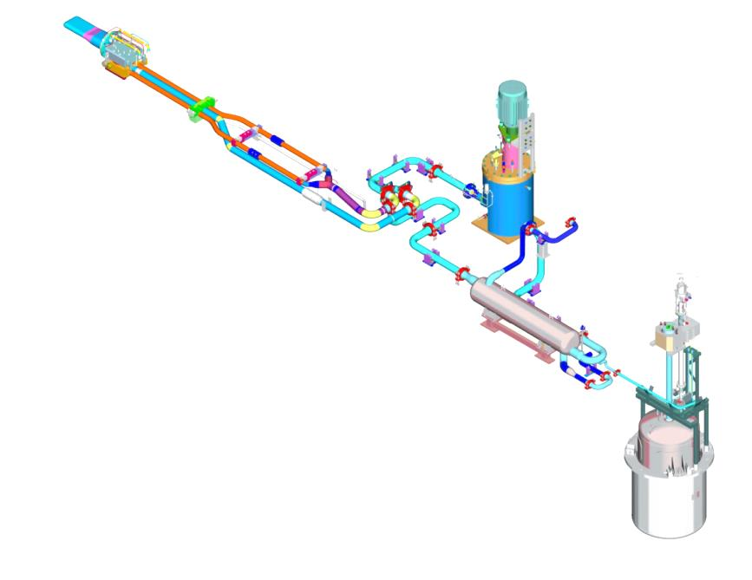
SC5 – First Target Station and Target R&D
J. Busby (ORNL), P. Ferguson (ORNL)
Findings
  The First Target Station and Target R&D includes the target and mercury process loop, as well as the cryomoderator system upgrades.
  Target mercury vessel and water-cooled shroud designs have gone through considerable engineering effort, incorporating operational experience, R&D, state-of-the-art analysis for heating / flow / temperature / stress / fatigue.
    Final Design Review will be June 23-24
    By the July IPR, targets will be ready for fabrication
  Meeting challenges associated with high-flow gas injection is essential for the target to meet power and lifetime goals.
  This is a complex engineering system that must include process systems, gas injection, off-gas, controls and safety.
  Design progress in these areas is better than preliminary design maturity.
Supply Pipes (3)
Hg Pump Motor
Target
Hg Pump Tank
Return Pipe (1)
Transfer Valve
Heat Exchanger
Mercury Storage Tank
SNS Mercury Process Loop
20+ ton of mercury; life of facility
Removes heat ≈ 60% of beam power
Hot off gases are vented

Slide 37
SC5 – First Target Station and Target R&D
J. Busby (ORNL), P. Ferguson (ORNL)
Comments
  The technical presentations were detailed and informative. There was also clear evidence that interfaces between subsystems were an area of focus, which is essential in a complex engineering project.
  There have been no significant impacts due to COVID-19 on either the ongoing research or the supply chain for the first target station activities. PPU team staff have worked diligently to minimize impact on design, reviews, and experiments.
  Actions for the long-term integrity and performance of SNS FTS are being developed to enable a 60-year life as part of normal SNS operations. These actions also support confidence in PPU success and long-term reliability. For example, on the long-term integrity of the mercury loop, protocols for periodic sampling of the mercury coolant are being developed, which is positive.
  Lessons learned are being applied across the board for this system. This is an asset and should be more clearly highlighted. We suggest including a slide or two with very specific examples of lessons-learned that have been applied to further demonstrate the maturity of the design and the reduction of risk.

Slide 38
SC5 – First Target Station and Target R&D
J. Busby (ORNL), P. Ferguson (ORNL)
Comments
  The PPU team should continue to look to other areas for best practices. For example, confirmation of EB welding of the target was mentioned as a challenging aspect of fabrication acceptance. The HFIR has recently worked to adopt new techniques for their reactor cores. That experience could be considered to further support target acceptance.
  Recent experience with gas-injection in targets (e.g. target 24), prototype testing with swirl bubblers, and mod/sim analysis of stress in the new design indicate improved resistance to cavitation damage erosion and improved reliability. These measures (stress, target cycles, etc.) could provide Alternative KPPs for target performance and acceptance more consistent with project transition to operations.

Slide 39
SC5 – First Target Station and Target R&D
J. Busby (ORNL), P. Ferguson (ORNL)
Recommendation
  Consider alternate methods for providing target acceptance such as measurements of stress reduction, reaching a specific number of target stress cycles, etc., more consistent with timely project completion.

Slide 40
SC5 – First Target Station and Target R&D
J. Busby (ORNL), P. Ferguson (ORNL)
Response to Charge Questions
Scope/Design Maturity: Is the project Scope/Design Maturity: Is the project scope definition sufficiently mature to establish a performance baseline and a CD-3 approval decision? Yes. Do the KPPs adequately define the performance baseline? Mostly, although the Operational KPP as defined, (and discussed further in SC6), create significant challenges to the target system and should be evaluated. However, the team is making solid progress towards meeting the requirements as they are defined. Are system specifications, designs, and interfaces sufficiently mature to support CD-2 and CD-3 approval? Yes, while a few specific subsystems have the final design review are scheduled after the CD2/3 review, we found that the systems designs, interfaces, and fabrication processes are all sufficiently mature to support CD-2 and CD-3 approval.

Slide 41
SC5 – First Target Station and Target R&D
J. Busby (ORNL), P. Ferguson (ORNL)
Response to Charge Questions (continued)
Technical: Is the technical progress to date sufficient to support the planned procurements and installation? Yes. Are project risks sufficiently identified and managed? Maybe, there are indeed project risks with the target and the target is on the critical path for the larger program. These have been identified and are being managed. The probability and impact should be scrubbed. Lessons-learned and best practices are being applied.
Recommendations: Have past review recommendations been appropriately addressed? Yes. Further, lessons learned from past campaigns with new target designs have been applied to this effort. Operational experience and off-normal conditions during first 10-years of the target station have been incorporated into the PPU designs and planning. Concepts and successes from other facilities such as JPARC have also been incorporated.

Slide 42
SC8 – ESH&Q
F. Casella (ORNL)
Findings
  ESH&Q function is fully staffed both with dedicated and matrixed personnel as well as experienced leadership.
  The Final Environmental Impact Statement from April 1999 remains current; NEPA determination is complete.
  Environmental Compliance Strategy has been prepared.
  SNS is fully compliant with Federal/State Environmental Regulations, according to:
    TDEC Air Pollution Control Division Title V Facility Air Permit inspection, October 24, 2019
    TDEC RCRA inspections April 10-11, 2018; February 11, 2019; and March 11-12, 2020 (with US EPA)
  Hazard Analysis Report has been completed, credited controls for 3 USIs are adequately planned or now in effect.
  Integrated Safety Management Plan has been implemented.

Slide 43
SC8 – ESH&Q
F. Casella (ORNL)
Findings (continued)
  Industrial Health and Safety program is adequately staffed with very tight contractor oversight
    AMS Guided Procurement System (GPS) provides guidance on ESH&Q requirements/issues
    Technical Project Officer (TPO) provides oversight
    Subcontractor submits Hazard Analysis (HA) for related work
      a living document which requires conformance awareness signatures
    Pre-job brief requirement before every job
    Work monitored by TPO and ESH staff
  Covid-19 Safety Protocols are in place and functioning
    Implementing the ORNL developed plan for COVID-19 response based on CDC/DOE guidelines. Information updated daily with continual communication with staff, research personnel, and contractors.
    Construction Contractor follows ORNL site requirements with additional quarantine stipulations.

Slide 44
SC8 – ESH&Q
F. Casella (ORNL)
Findings (continued)
  QA Program has been fully implemented
    The QA function is adequately staffed
    The SNS QAP is supported by a project-specific PPU QAP
    The QA theory of operation is preventative rather than punitive
    The QA Program has recently undergone a full-scale audit (May 10-29, 2020)

Slide 45
SC8 – ESH&Q
F. Casella (ORNL)
Noteworthy Practices
  Grading determination checklist (PPUP-309)
  Failure Modes and Effects Analysis (FMEA) during designs for risk analysis
  Acceptance Criteria Listing (ACL) during fabrication, receipt and installation (PPUP-206)
Comments
  The NCR process depends on an interpretation of the SBMS process and allows for documentation via supplier and partner lab systems, without a centralized repository. Currently there are NCRs open at RI, GMW and Myer Tool, the tracking of which is too informal and depend on people’s memory of conversations or emails. Control of remedial action execution is missing.
  The ESH&Q team is in tune with the risks of packaging and shipping and will be closely monitoring these as procurement ramps up. However, they are only tangentially aware of the transportation issues that led to cryomodule failures between FERMI and SLAC and need to get the lessons learned from these. (There have not been similar issues between JLAB and SNS cryomodule shipping).

Slide 46
SC8 – ESH&Q
F. Casella (ORNL)
Recommendation
  Formalize the PPU NCR process to record non-conforming conditions, determine and document remedial actions and justifications for them, and record any changes needed in project documentation. This formal process should be used to cover NCRs generated under individual suppliers or partner labs and should serve as a centralized tracking and control database.

Slide 47
SC8 – ESH&Q
F. Casella (ORNL)
Response to Charge Questions:
Scope/Design Maturity: Is the project scope definition sufficiently mature to establish a performance baseline and a CD-3 approval decision? Yes, the design control processes support CD-3. Are system specifications, designs, and interfaces sufficiently mature to support CD-2 and CD-3 approval? Yes
Technical: Is the technical progress to date sufficient to support the planned procurements and installation? Yes Are project risks sufficiently identified and managed? Yes
ESH&Q: Are Environment Safety Health & Quality Assurance requirements and plans being properly addressed? YES, with one exception: change control by NCR is missing. Is the project proposing adequate COVID-19 protection and safety measures for project work going forward? Yes
Recommendations: Have past review recommendations been appropriately addressed? Yes

Slide 48
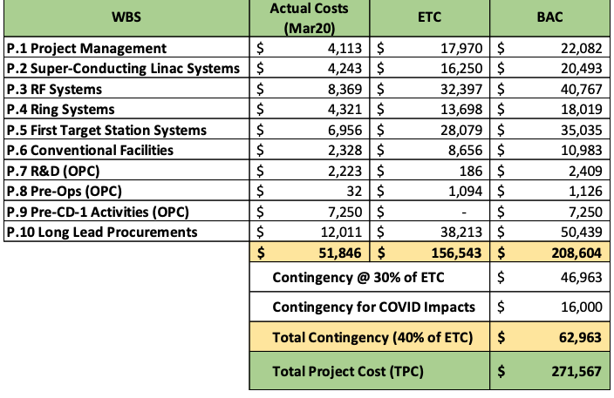
SC7 – Cost and Schedule
D. Hoomes (ORNL), J. Bivens (ORNL)
Findings:
  The project is requesting CD 2/3 approval for a baseline TPC $271.6M.
  The project has already received approval for CD 3A ($10.5M) and for CD 3B ($53.4M).

Slide 49
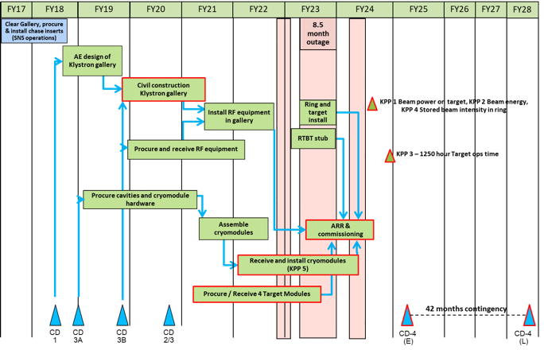
SC7 – Cost and Schedule
D. Hoomes (ORNL), J. Bivens (ORNL)
Findings (continued)
  Cost estimates are documented in the Access Cost Database and were traceable through the P6 Schedule.
  Schedule contains solid logic ties.

Slide 50
SC7 – Cost and Schedule
D. Hoomes (ORNL), J. Bivens (ORNL)
Findings (continued):
  42 months schedule contingency:
  LLP scope tracking schedule well:
    SPI = 0.98
    CPI = 1.02
  The project is using a certified EVMS, last certified December 2019.

Slide 51
SC7 – Cost and Schedule
D. Hoomes (ORNL), J. Bivens (ORNL)
Comments
  Consider revising the Responsibility Assignment Matrix to include ETC.
  COVID-19 potential impact messaging seemed downplayed considering the amount of contingency related. Consider sharpening message in plenary session.
  Consider advertising more prominently that project reporting systems (CPR, VARs, PCRs) have been tested and used for 3A and 3B scope.
  Demonstrate experience from previous SNS projects more prominently and that basis of estimates are based on practice.
  Drill downs of 4 CAMs were performed, covering scope in SCL Systems, RF Systems, Ring Systems, First Target Station Systems, Conventional Facilities, and Long Lead Procurements. CAMs all appeared knowledgeable about scope and supporting documents and have received CAM training.
  Electronic CAM notebook is considered a best practice and all CAMs referenced using it during drill downs.
    Consider adding a direct link to CAM notebook during CAM overview.

Slide 52
SC7 – Cost and Schedule
D. Hoomes (ORNL), J. Bivens (ORNL)
Comments (continued)
  Add a cost and schedule slide discussing approach to planning packages, particularly relating to procurements.
  During CAM drill downs for Target Modules (P5), an opportunity was identified to utilize the front body test article as an on-project first article. This opportunity would result in a cost savings to the project.

Slide 53
SC7 – Cost and Schedule
D. Hoomes (ORNL), J. Bivens (ORNL)
Recommendations:
  Quantify the potential impacts of the Target Module opportunity and any strategies to enhance its probability. Incorporate it into the PPU Risk Analysis prior to the IPR.
  Prior to the CD 2/3 IPR, discuss funding commitment from sponsor, particularly for FY21, and consider adding an FY21 specific risk.
  Recompute project cost and schedule contingency after re-evaluating risk register and/or KPPs.

Slide 54
SC7 – Cost and Schedule
D. Hoomes (ORNL), J. Bivens (ORNL)
Response to Charge Questions:
Cost & Schedule: Are the cost and schedule estimates of sufficient quality to establish a baseline and to support the start of construction? Yes. Is there adequate cost and schedule contingency? Overall, yes, but revisit after re-evaluating risk and/or KPP adjustments. Are the financial systems and staff prepared to properly collect and report project earned value? Yes. Are the cost and schedule risks presented by COVID-19 adequately addressed? Yes, but consider sharpening message.
6) Recommendations: Have past review recommendations been appropriately addressed? Yes.

Slide 55
SC6 – Project Management
D. Kothe (ORNL), L. Price (ORNL), C. Strawbridge (HB-Assoc)
Findings
  3.5-year schedule contingency for an 8-year long project (8 months MC + 22 months operational KPP + 12 months COVID-19)
  TPC of $271.6M, with 40% (of ETC at present) cost contingency ($63M), and 25% of work performed to date
  The draft PEP includes a KPP calling for an operational run of 1250 hours at 1.7 MW (threshold) and 2.0 MW (objective) without target failure.
  The proposed PPU schedule includes a schedule contingency of 22 months between CD-4 early finish and late finish to account for the risk of a problem during this test period.
  The baseline funding plan assumes that SNS operations costs during this period are outside the PPU project, and the PPU cost contingency estimate assumes $250K / month may be required to support a small standing army cost.
  Project Management Systems are proven and mature

Slide 56
SC6 – Project Management
D. Kothe (ORNL), L. Price (ORNL), C. Strawbridge (HB-Assoc)
Findings
  Final design is 83% complete, and will be 92% complete by the CD-2/3 IPR
  JLAB scope is to supply 7 cryomodules to the PPU Project, building on their experience in building the original SNS cryomodules as well as cryomodules for CEBAF, LCLS 2 and FRIB.
  The JLAB team leader functions as a WBS L3 manager as well as a Senior Team Leader in the PPU Management Team. A Memorandum of Understanding between JLAB and ORNL has been signed to govern the relationship.

Slide 57
SC6 – Project Management
D. Kothe (ORNL), L. Price (ORNL), C. Strawbridge (HB-Assoc)
Comments
  KPPs
    The committee believes the KPP that specifies “Target operational time without failure: 1,250 hours at 1.7MW” leads to incorporation of excessive schedule float (22 months) to accommodate unidentified risks. This has ramifications, including extending the time to achieve the design rating of 2MW, operations funding needs, etc.
    The project plan to hold at 1.7MW following the 2024 outage instead of ramping towards 2 MW is optimized to achieve a project KPP and project completion and not aimed at achieving the optimum capability of the machine for science sooner.
    The committee is concerned that the broadly defined operational KPP introduces risk to PPU Project completion.
    Extensive development efforts have gone into the SNS target over the last several years, and all promising improvement technologies have been incorporated into the PPU Target design. Test results have shown clear indication that target lifetime goals can be met. If the motivation for this KPP is to provide more incentive for ORNL to “try harder”, it is misguided because all reasonable actions to improve target performance are already being taken.

Slide 58
SC6 – Project Management
D. Kothe (ORNL), L. Price (ORNL), C. Strawbridge (HB-Assoc)
Comments (continued)
  KPPs
    The committee is not aware of another SC Project that has incorporated an operational goal such as this into the project and believes this could be a bad precedent to introduce an open-ended requirement outside a project’s control in its completion criteria.
    ORNL management, PPU project leadership, the FPD, ORNL Site Office, SC-BES and SC-OPA should engage in free and open discussion on this issue with the objective of finding consensus on realistic and constructive project goals and successful completion criteria.
  CD-2/3 requirements and readiness
    The project checklist for CD-2/3 needs to provide explanatory information for why it is acceptable (and agreed with sponsor) for some items (i.e., final design for a few systems) to be incomplete at this stage.
    The PPU project, FPD and BES should reach agreement that the remaining areas of design effort are minor and that the substantial requirements for CD-3 have been met. This position should be made clear at the IPR.

Slide 59
SC6 – Project Management
D. Kothe (ORNL), L. Price (ORNL), C. Strawbridge (HB-Assoc)
Comments (continued)
  CD-2/3 requirements and readiness
    The project is presenting a plan with a “notional funding profile” that has apparently not been explicitly acknowledged by DOE-BES; past experience has proved that despite low budget numbers early in the cycle, project budget needs have been met or exceeded.
    A more comprehensive plan for TTO (Transition to Operations) should be prepared and documented as soon as possible.
    The SNS science case for the PPU project could be briefly alluded to in the Project Director’s plenary presentation
    One of the plenary presentations should include a list of the reference and background material provided to the CD-2/3 IPR team
    The project team should QA all presentations and documents so that they adhere to standard templates, look-and-feel, and are proofread and free of errors or inconsistencies in content or style

Slide 60
SC6 – Project Management
D. Kothe (ORNL), L. Price (ORNL), C. Strawbridge (HB-Assoc)
Comments (continued)
  Partnerships
    The JLAB team is experienced and functioning well. The work is well underway and the detailed planning to conduct the work is well thought out.
    Communications and relationships between JLAB and PPU management are strong and constructive. The JLAB Lab Director is providing active support to the effort.
    Interface and integration with JLAB going very well
  Management
    Strong, experienced project team with good support from NScD and ORNL
    Highly matrixed staff but working out well
    A new position as Deputy Lab Director for Projects has recently been established in the Office of the Lab Director and the possible interfaces of this role with the project are unclear.
    Project staffing is on plan
    Procurement activity schedule template considered a best practice
    Procurement support and delivery to date has been excellent

Slide 61
SC6 – Project Management
D. Kothe (ORNL), L. Price (ORNL), C. Strawbridge (HB-Assoc)
Recommendations
  Prior to the CD-2/3 IPR, change the 1250 hour / 1.7 MW operational KPP to incorporate an alternative “target acceptance” KPP that appropriately stresses the target to establish project completion.
  Prior to the CD-2/3 IPR, verify, with the DOE sponsor, commitment to the assumed funding profile used to establish the PMB. Ensure presentations to the CD-2/3 IPR are clear with respect to the funding profile commitment and level of risk.
  Prior to the CD-2/3 IPR, include a CD-2/3 requirements checklist document as part of the CD-2/3 IPR evidence and verify with the DOE sponsor that it meets expectations. Include appropriate justification and sponsor support for those requirements that the project proposes to leave incomplete before the IPR and/or ESAAB.
  Prior to the CD-2/3 IPR, create a draft TTO document and vet with SNS Ops and BES.

Slide 62
SC6 – Project Management
D. Kothe (ORNL), L. Price (ORNL), C. Strawbridge (HB-Assoc
Response to Charge Questions:
Scope/Design Maturity: Is the project scope definition sufficiently mature to establish a baseline and a CD-3 approval decision? Do the KPPs adequately define the performance baseline? Not yet. The operational KPP blurs the scope boundary between project and operations. Technical systems are otherwise well defined, mature, and ready. Are system specifications, designs, and interfaces sufficiently mature to support CD-2 and CD-3 approval? Yes. The project team has done an exemplary job in ensuring this maturity.
Technical: Is the technical progress to date sufficient to support the planned procurements and installation? Yes. Are project risks sufficiently identified and managed? Maybe. Certain risks need to be more carefully analyzed for appropriate mitigation responses, e.g., funding profile, target performance, operational KPP delivery.

Slide 63
SC6 – Project Management
D. Kothe (ORNL), L. Price (ORNL), C. Strawbridge (HB-Assoc
Response to Charge Questions:
Management: Is the project being managed for successful execution? Yes. Is the project leadership team fully staffed with people who have sufficient expertise and experience to successfully execute the project and progress to CD-4? Yes.
Recommendations: Have past review recommendations been appropriately addressed? Yes.

