Slide 1
Winter Safety Tips
Naeem Huque

Slide 2
Home Safety
Check smoke and carbon monoxide detectors
Prevent water pipes from freezing
Close interior shut-off valves for outdoor spigots
Let cold water drip from indoor faucets during extreme cold
Ensure proper ventilation
Change furnace filters
Schedule HVAC maintenance annually
Make sure outdoor exhaust vents are clean
Clear ice and snow from roof and driveway
Ensure outdoor lighting is functional
If you feel cold, your pets also feel cold

Slide 3
Home Safety
Have back-up heating in case of power outage
Extra blankets/coats
Wood fireplace
Portable space or kerosene heater (the latter may not be legal in all areas)
Turning on the stove is for heat is not safe
Alcohol will not keep you warm or prevent hypothermia
Feel free to test this in a safe, controlled environment (for science)
Space heaters:
Keep at least 3 feet from drapes
Do not cover, or place on top of furniture
Avoid extension cords, and make sure any cords are not tripping hazards

Slide 4
Car Safety
Do not warm up a car in the garage
Trapped carbon monoxide in a confined space can be fatal
Warming up a car by idling is generally bad for the engine
Test the battery
Power drops as temperature drops
If using all-season tires, ensure the tread is at least 2/32” deep
Ensure tires are properly inflated
Replace wiper blades
Add wiper fluid rated to -30F
Keep gas tank at least half-full

Slide 5
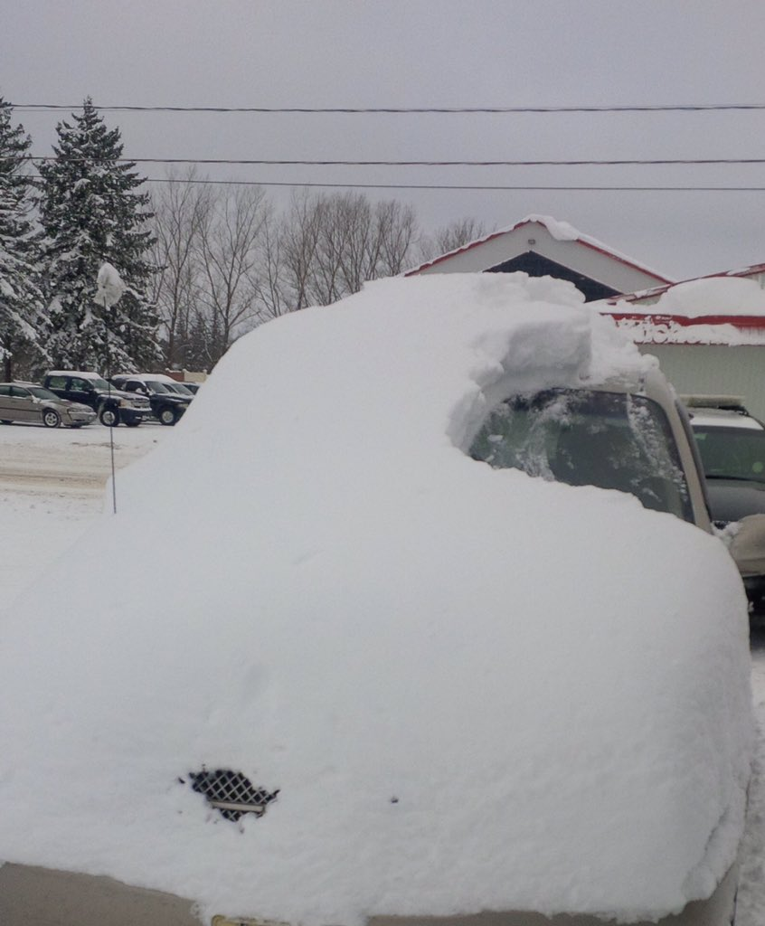
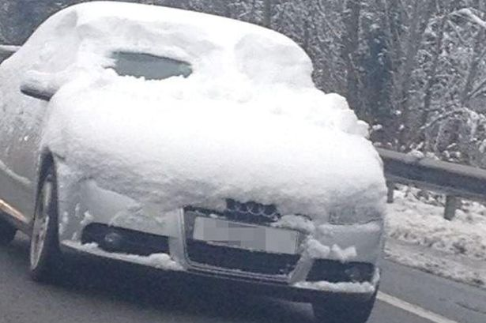
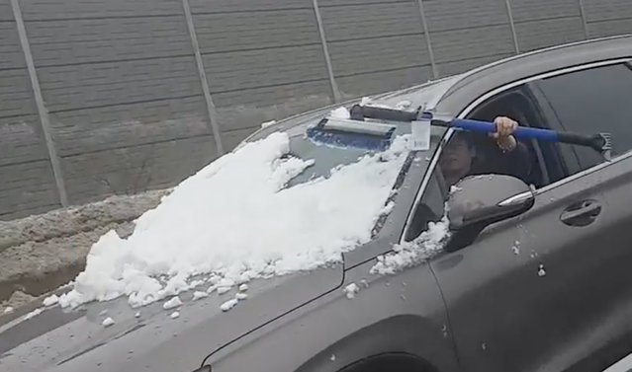
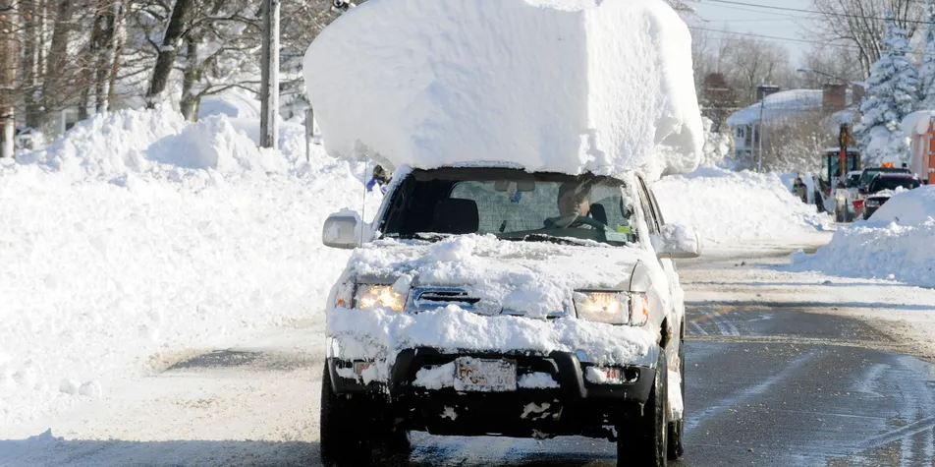
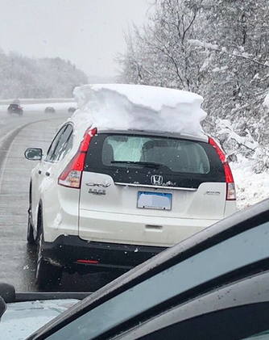
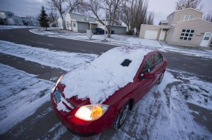
Car Safety
Don’t do this:

