Slide 1
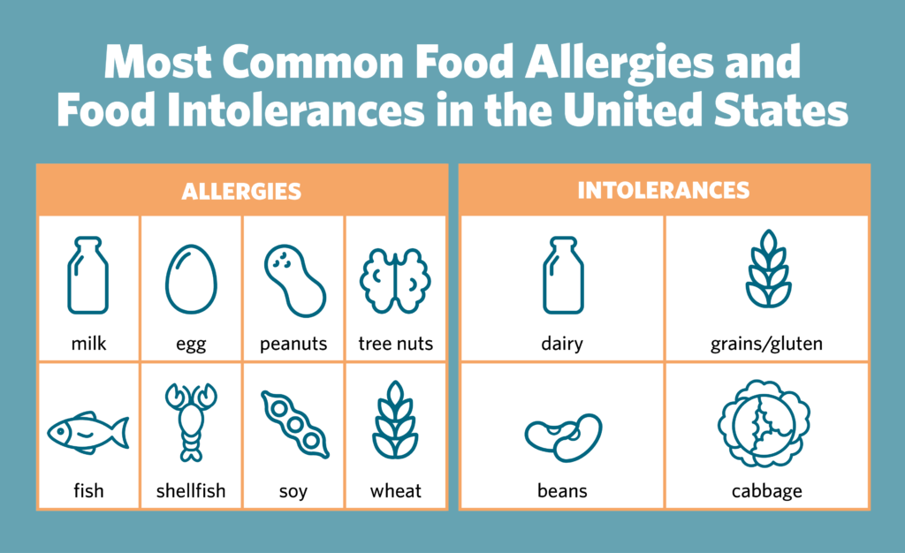
Food allergy vs. food intolerance: What's the difference?

Slide 2
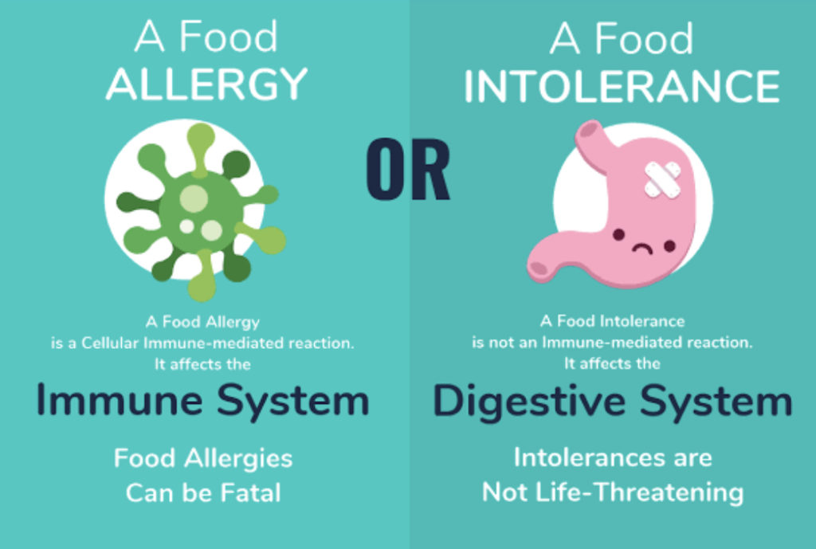
Food allergy vs. food intolerance: What is the difference?
Physical reactions to certain foods are common, but most are caused by a food intolerance rather than a food allergy. A food intolerance can cause some of the same signs and symptoms as a food allergy, so people often confuse the two.
A true food allergy affects the immune system. Even small amounts of the offending food can trigger a range of symptoms, which can be severe or life-threatening.
In contrast, a food intolerance often affects only the digestive system and causes less serious symptoms.
If you have a food intolerance, you may be able to eat small amounts of the offending food without trouble. You may also be able to prevent a reaction.

Slide 3
Causes of food intolerance include:
Absence of an enzyme needed to fully digest a food. Lactose intolerance is a common example.
Irritable bowel syndrome. This chronic condition can cause cramping, constipation and diarrhea.
Sensitivity to food additives. For example, sulfites used to preserve dried fruit, canned goods and wine can trigger asthma attacks in people who are sensitive to food additives.

Slide 4
A Food Intolerance
A Food Allergy
does not involve your immune system – there is no allergic reaction, and it is never life-threatening
symptoms usually begin within a few hours, yet, symptoms can be delayed by up to 48 hours and last for hours or even days, making the offending food especially difficult to pinpoint
only results in symptoms if you eat a substantial amount of the food (unlike an allergy, where just traces can trigger a reaction)
While symptoms of food intolerances vary, they most often involve the digestive system, skin and respiratory system.
can be caused by many different foods
is a reaction by your immune system (your body's defense against infection). Your immune system mistakenly treats proteins found in food as a threat
can trigger allergy symptoms, such as a rash, wheezing and itching, after eating just a small amount of the food (these symptoms usually happen quickly)
is often to particular foods. Common food allergies in adults include fish and shellfish and nut allergies. Common food allergies in children include milk, eggs, fish, peanuts and other nuts
can be life-threatening

Slide 5
While symptoms of food intolerances vary, they most often involve the digestive system, skin and respiratory system.
Food Intolerance Common symptoms include :
Food Allergy Common symptoms include :
Diarrhea
Bloating
Rashes
Headaches
Nausea
Fatigue
Abdominal pain
Runny nose
Reflux
Flushing of the skin
swelling of the tongue, mouth, or face
difficulty breathing
low blood pressure
vomiting
diarrhea
hives
itchy rash
In more severe cases, a food allergy can cause anaphylaxis
Some cases can be fatal

Slide 6
What about celiac disease?
This chronic digestive condition is triggered by eating gluten, a protein found in wheat and other grains. Celiac disease has some features of a true food allergy because it involves the immune system. Symptoms often include gastrointestinal issues as well as those unrelated to the digestive system, such as joint pain and headaches. However, people with celiac disease are not at risk of anaphylaxis.
What about Gluten Intolerance?
Gluten is the general name given to proteins found in wheat, barley, rye and triticale.
Several conditions relate to gluten, including celiac disease, non-celiac gluten sensitivity and wheat allergy (Crohn’s Disease)
Celiac disease involves an immune response, which is why it is classified as an autoimmune disease .

Slide 7
Celiac Disease and Non-Celiac Gluten Sensitivity
Similar Symptoms include:
Both managed with a gluten-free diet
Bloating
Abdominal pain
Diarrhea or constipation
Headaches
Fatigue
Joint pain
Skin rash
Depression or anxiety
Anemia
It involves adhering to a diet free from foods and products that contain gluten, including:
Bread
Pasta
Cereals
Beer
Baked goods
Crackers
Sauces, dressing and gravies, especially soy sauce

Slide 8
Lactose Intolerance
A Caffeine Sensitivity
It is estimated that 65% of the world’s population has trouble digesting lactose
Symptoms Include:
Abdominal pain
Bloating
Diarrhea
Gas
Nausea
Linked to genetics, as well as a decreased ability to metabolize and excrete caffeine
Most adults can safely consume up to 400 mg of caffeine a day without any side effects. This is the amount of caffeine in about four cups of coffee
Symptoms Include:
Rapid heartbeat
Anxiety
Jitters
Insomnia
Nervousness
Restlessness

Slide 9
Salicylates
Amines
These natural chemicals are found in a wide range of foods, including fruits, vegetables, teas, coffee, spices, nuts and honey
Amines are produced by bacteria during food storage and fermentation and found in a wide variety of foods. histamine is most frequently associated with food-related intolerances
Symptoms Include:
Flushing of the skin
Headaches
Hives
Itching
Anxiety
Stomach cramps
Diarrhea
Low blood pressure
Foods To Avoid:
Fermented foods
Cured meats
Dried fruits
Citrus fruits
Avocados
Aged cheeses
Smoked fish
Vinegar
Soured foods like buttermilk
Fermented alcoholic beverages like beer and wine
Aside from being a natural component of many foods, salicylates are often used as a food preservative and may be found in medications
Symptoms Include:
Stuffy nose
Sinus infections
Nasal and sinus polyps
Asthma
Diarrhea
Gut inflammation (colitis)
Hives

Slide 10
FODMAPs
Sulfites
fermentable oligo-, di-, mono-saccharides and polyols
The bacteria breaks down or “ferments”
The osmotic properties, meaning they draw water into the digestive system
Primarily used as preservatives in foods, drinks and some medications
Found naturally in some foods like grapes and aged cheeses
Sulfites are added to foods like dried fruit to delay browning and wine to prevent spoilage
Symptoms Include:
Bloating
Diarrhea
Gas
Abdominal pain
Constipation
Foods To Avoid:
Apples
Soft cheeses
Honey
Milk
Artichokes
Bread
Beans
Lentils
Beer
Symptoms Include:
Hives
Swelling of the skin
Stuffy nose
Hypotension
Flushing
Diarrhea
Wheezing
Coughing
Foods To Avoid:
Dried fruit
Wine
Apple cider
Canned vegetables
Pickled foods
Condiments
Potato chips
Beer
Tea
Baked goods

Slide 11
Other foods and ingredients to which people may be intolerant
Aspartame: an artificial sweetener that is commonly used as a sugar substitute. Although research is conflicting, some studies have reported side effects like depression and irritability in people with a sensitivity
Eggs: Some people have difficulty digesting egg whites but are not allergic to eggs. Egg intolerance is associated with symptoms like diarrhea and abdominal pain
MSG: Monosodium glutamate is used as a flavor-enhancing additive in foods. Some studies have shown that large amounts can cause headache, hives and chest pain
Food colorings: Like Red 40 and Yellow 5 have been shown to cause hypersensitivity reactions in some people. Symptoms include hives, skin swelling and stuffy nose
Yeast: People with a yeast intolerance generally experience less severe symptoms than those with a yeast allergy. Symptoms are typically limited to the digestive system
Sugar alcohols: Often used as zero calorie alternatives to sugar. They can cause major digestive issues in some people, including bloating and diarrhea

Slide 12
Diagnosing Food Allergies
Questions to Ask:
Did the reaction come on quickly, within an hour of eating the food?
Did anyone else get sick?
How much did you eat before the reaction started?
How was the food prepared?
Did you eat anything else at the same time?
Did you take an antihistamine or do something else? Did it help?
Does this always happen when you eat that food?
Keep a food diary to record what you eat and when you get symptoms, and then look for common factors.
Another way to identify problem foods is an elimination diet. You begin by completely eliminating any suspect foods from your diet until you are symptom-free. You then begin to reintroduce the foods, one at a time.

Slide 13
Conclusion
Food intolerances differ from allergies. Most do not trigger the immune system, and their symptoms are usually less severe.
However, they can negatively impact your health and should be taken seriously.
Many people are intolerant or hypersensitive to foods and additives like dairy products, caffeine and gluten.
If you suspect that you may be intolerant to a certain food or food additive, speak to your doctor or dietitian about testing and treatment options.
Although food intolerances are usually less serious than food allergies, they can negatively affect your quality of life.
This is why it’s important to take steps to identify food intolerances in order to prevent unwanted symptoms and health issues.

Slide 14
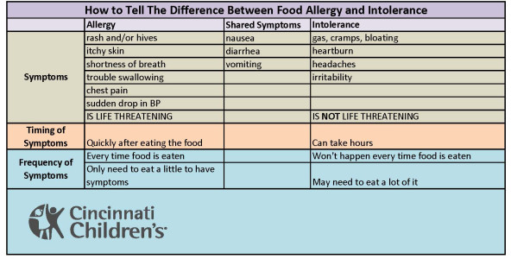
Symptom Comparison Chart

