Slide 1
Testing Results From PPU05
J. Mammosser -on behalf of the SCL Group
M. Doleans. H. Howell, R. Geng, B. Degraff, C. McMahan, Dave. Vandygriff, Dan Vandygriff, R. Afanador, D. Kraft, S. Gold, D. Barnhart, C. Pinion, Dan Vandygriff, Dave Vandygriff, R. Maekawa

Slide 2
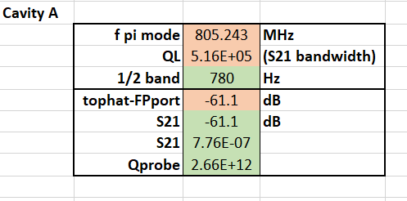
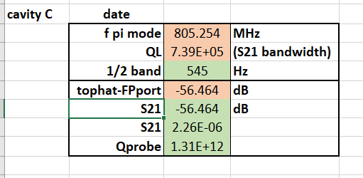
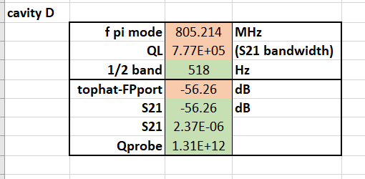
Cold Measurements at 2.1K
Measured at 4.5K

Slide 3
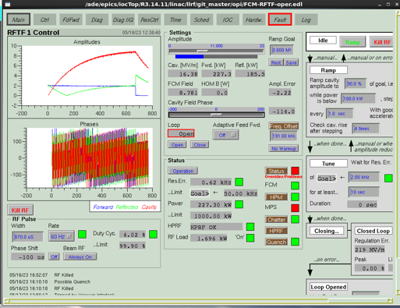
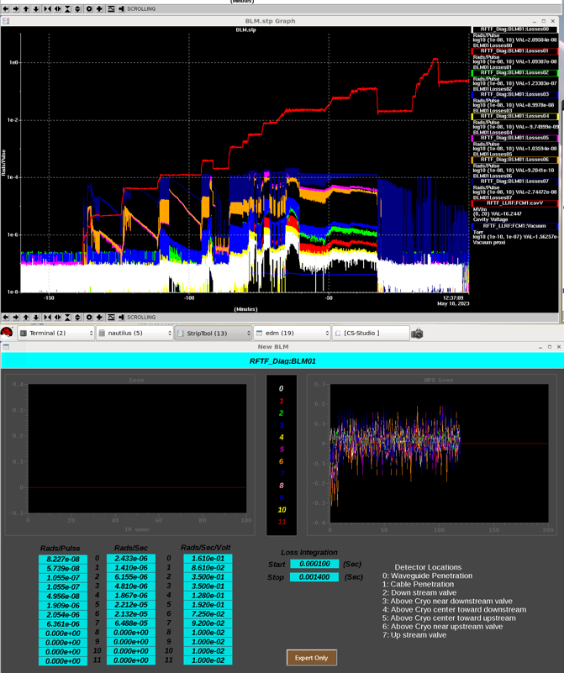
Cavity A – PPU21
No Field emission to admin limit 18MV/m

Slide 4
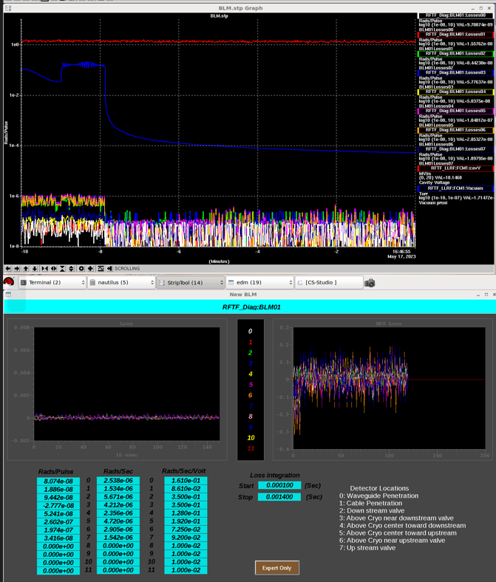
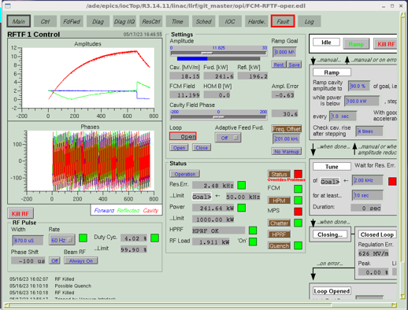
Cavity B – PPU20
No field emission to admin limit 18MV/m

Slide 5
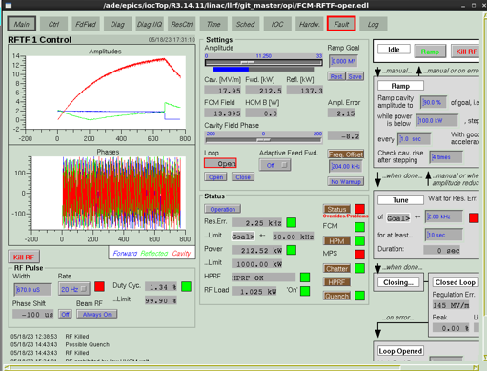
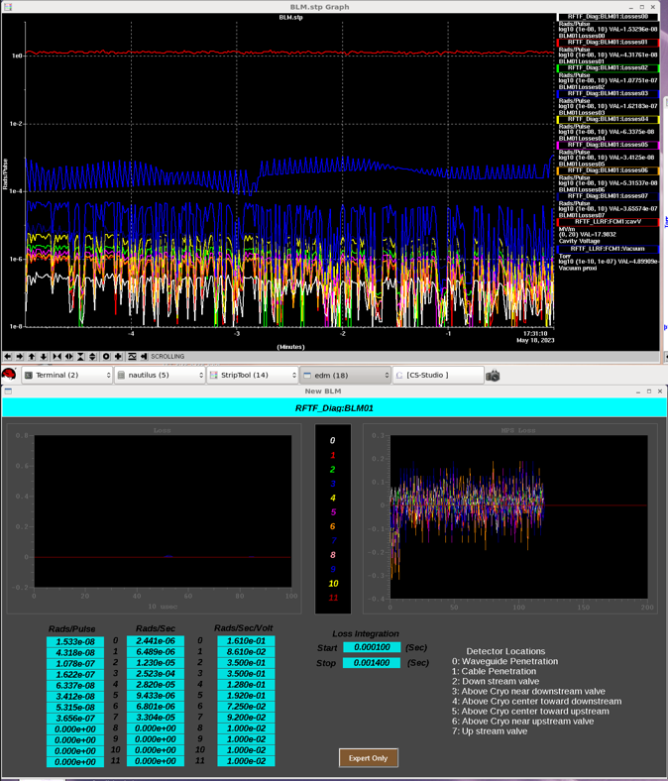
Cavity C – PPU22
No field emission to admin limit 18MV/m

Slide 6
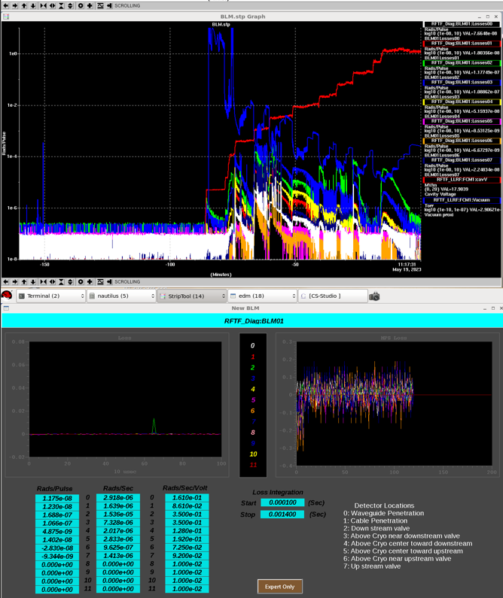
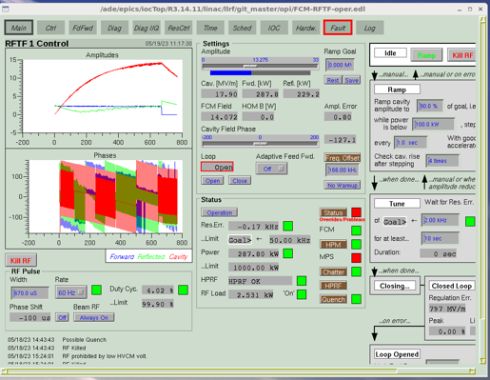
Cavity D – PPU25
No Field emission to admin limit 18MV/m

Slide 7
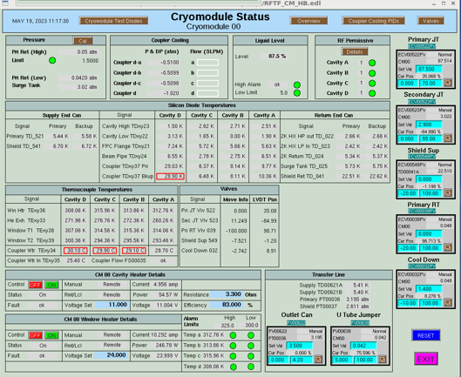
Cryomodule Instrumentation
All Instrumentation was working

Slide 8
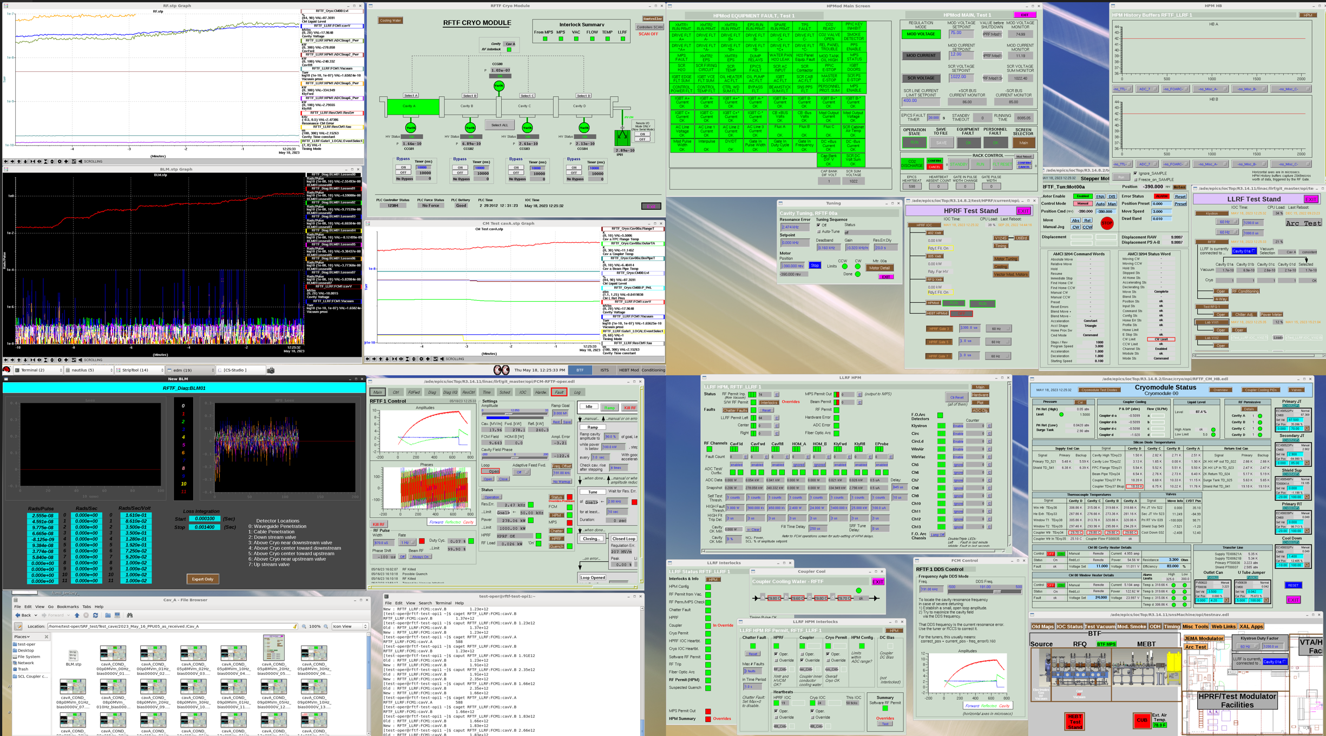
RF Screens Cav-A

Slide 9
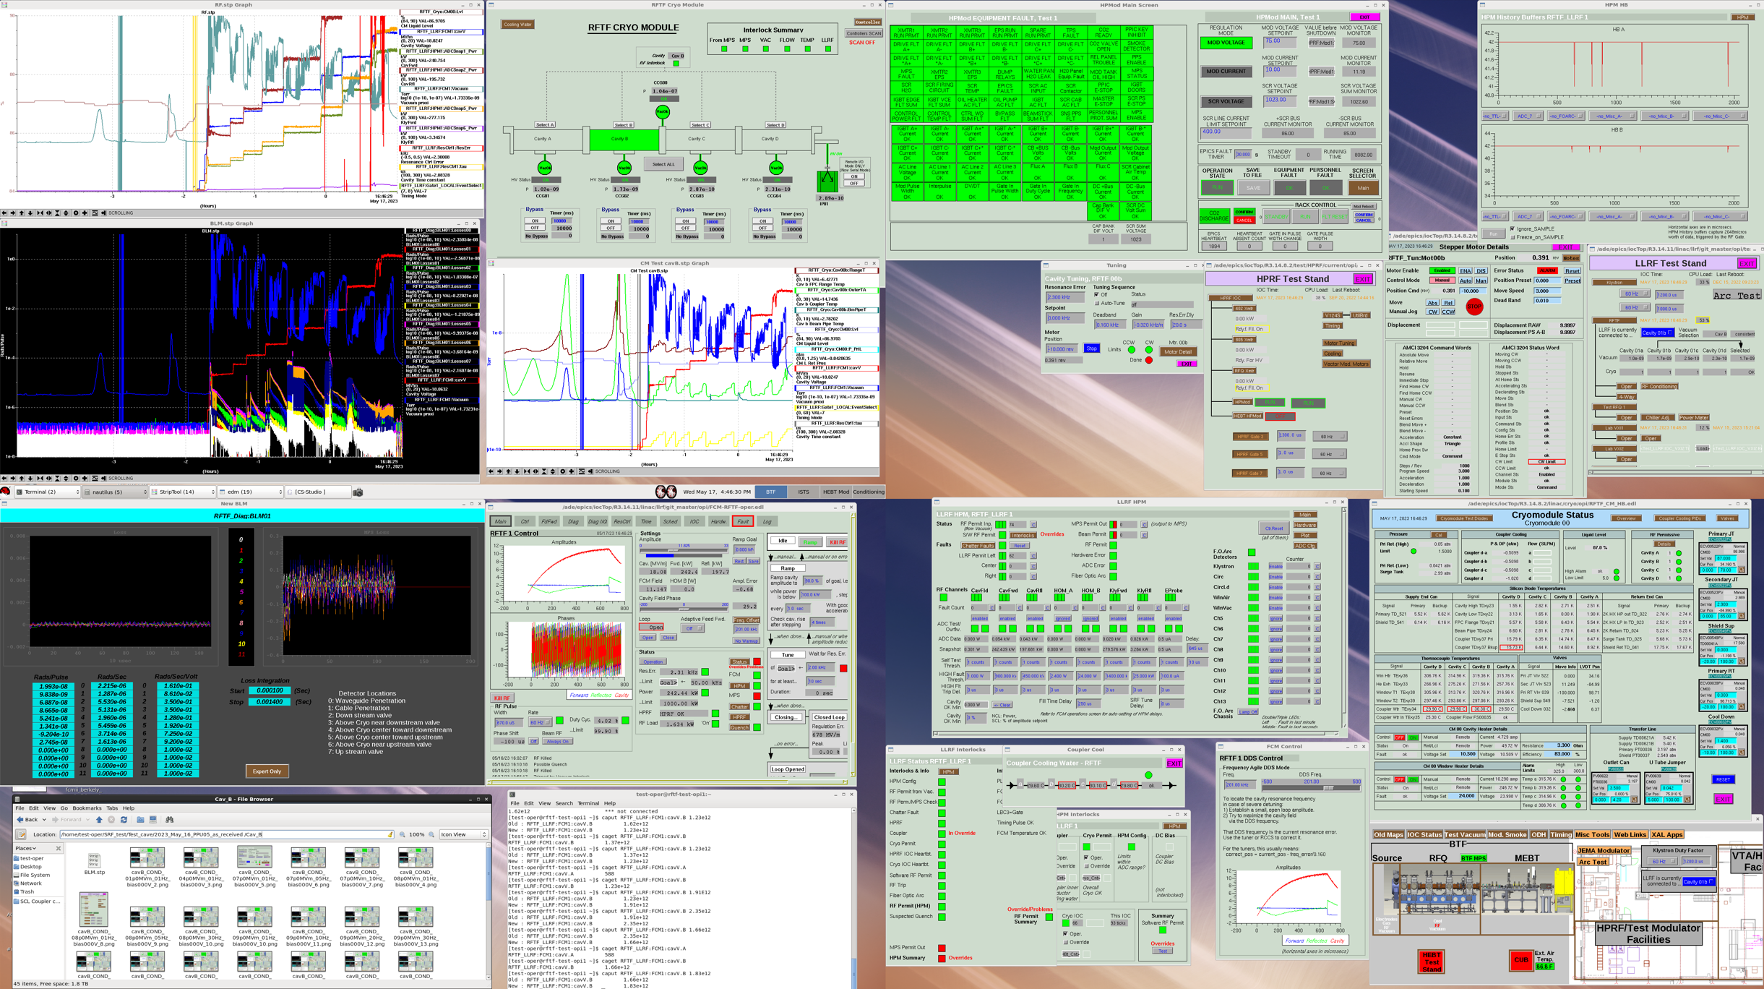
RF Screens -Cav B

Slide 10
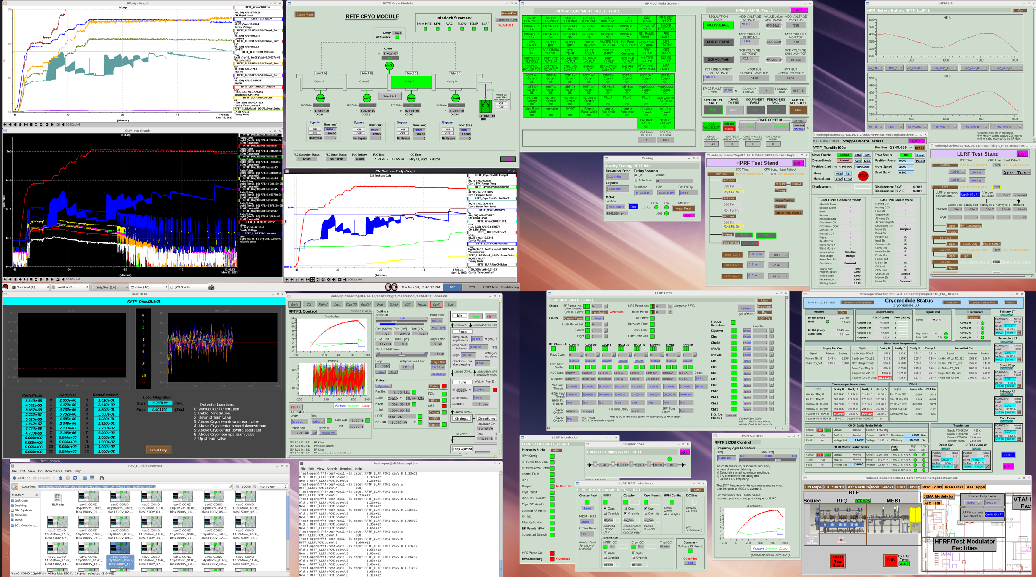
RF Screens – Cav C

Slide 11
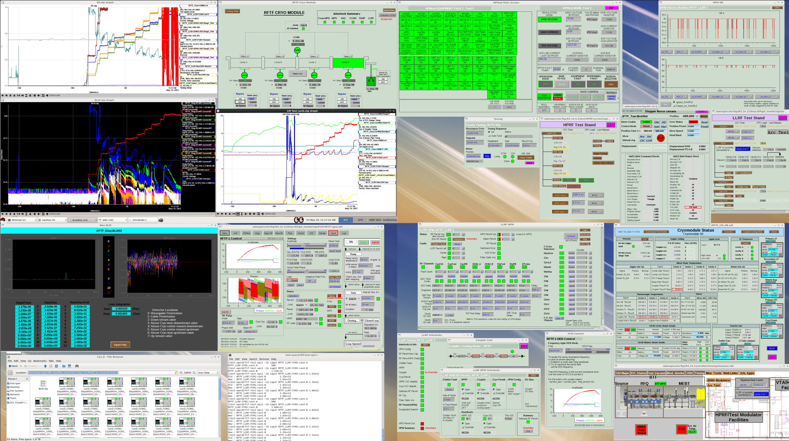
RF Screens - Cav D

Slide 12
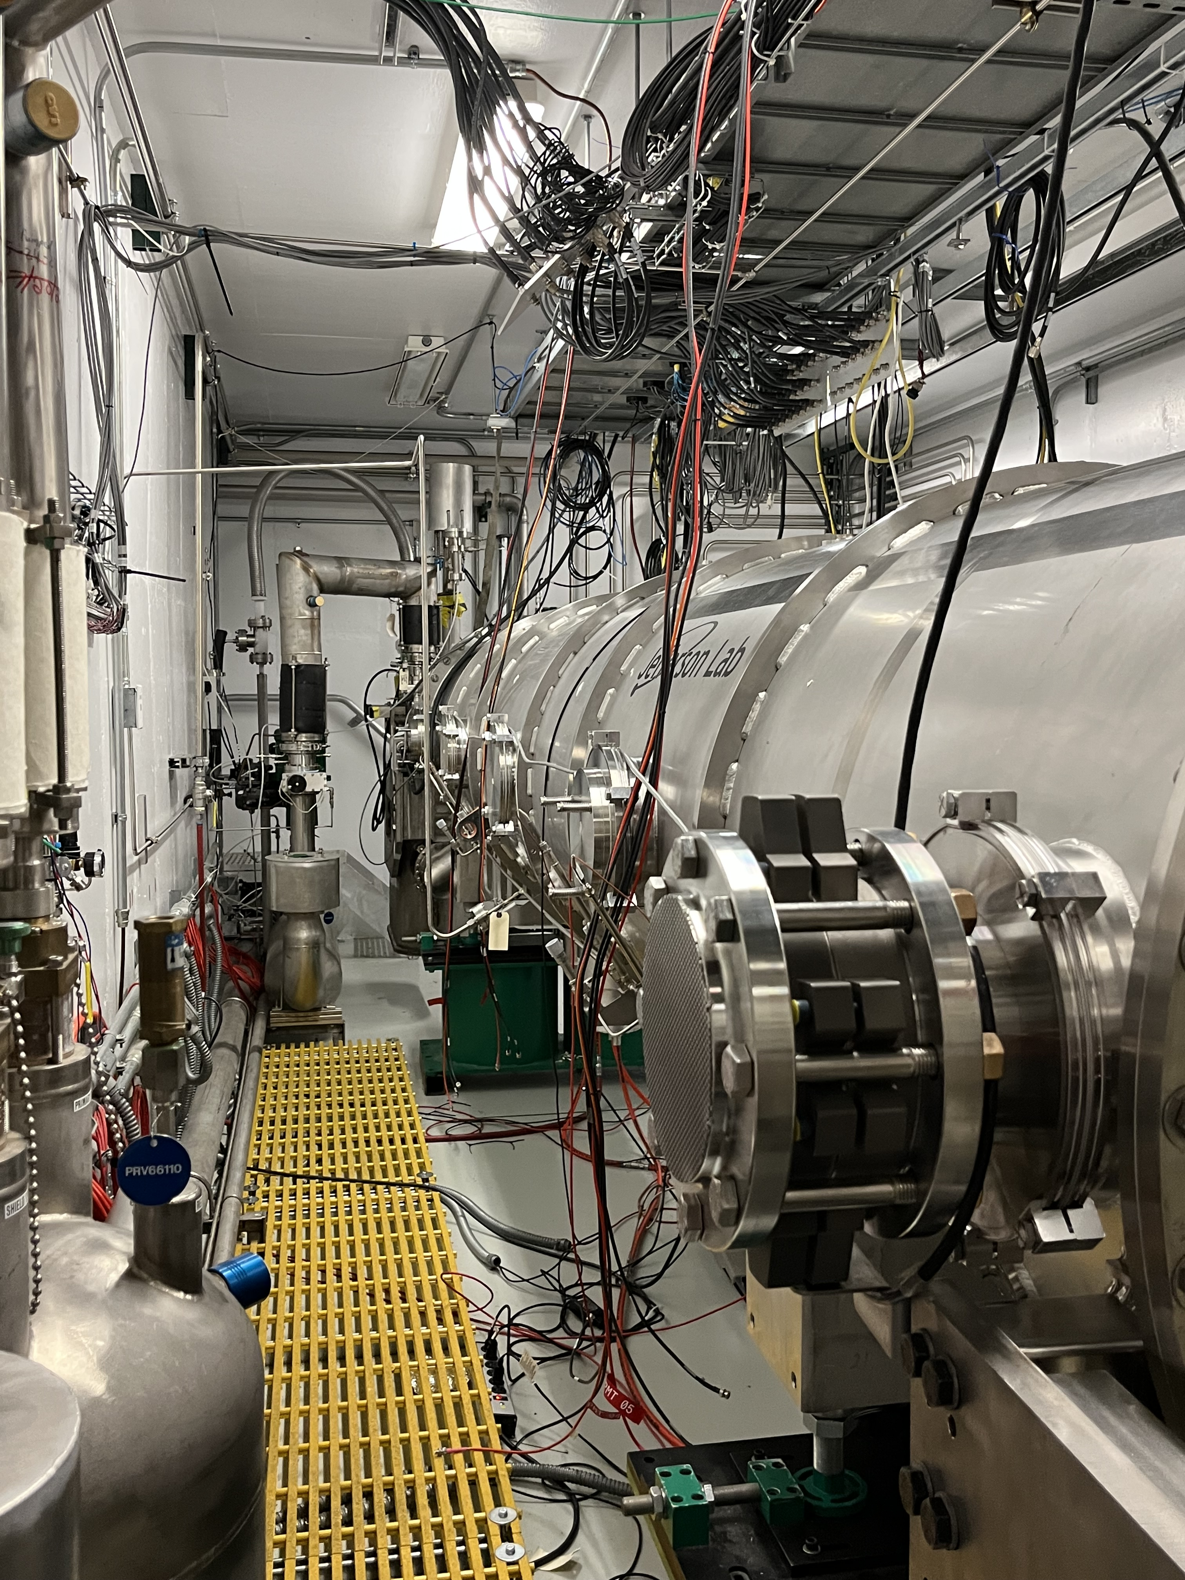
Backside of PPU04

Slide 13
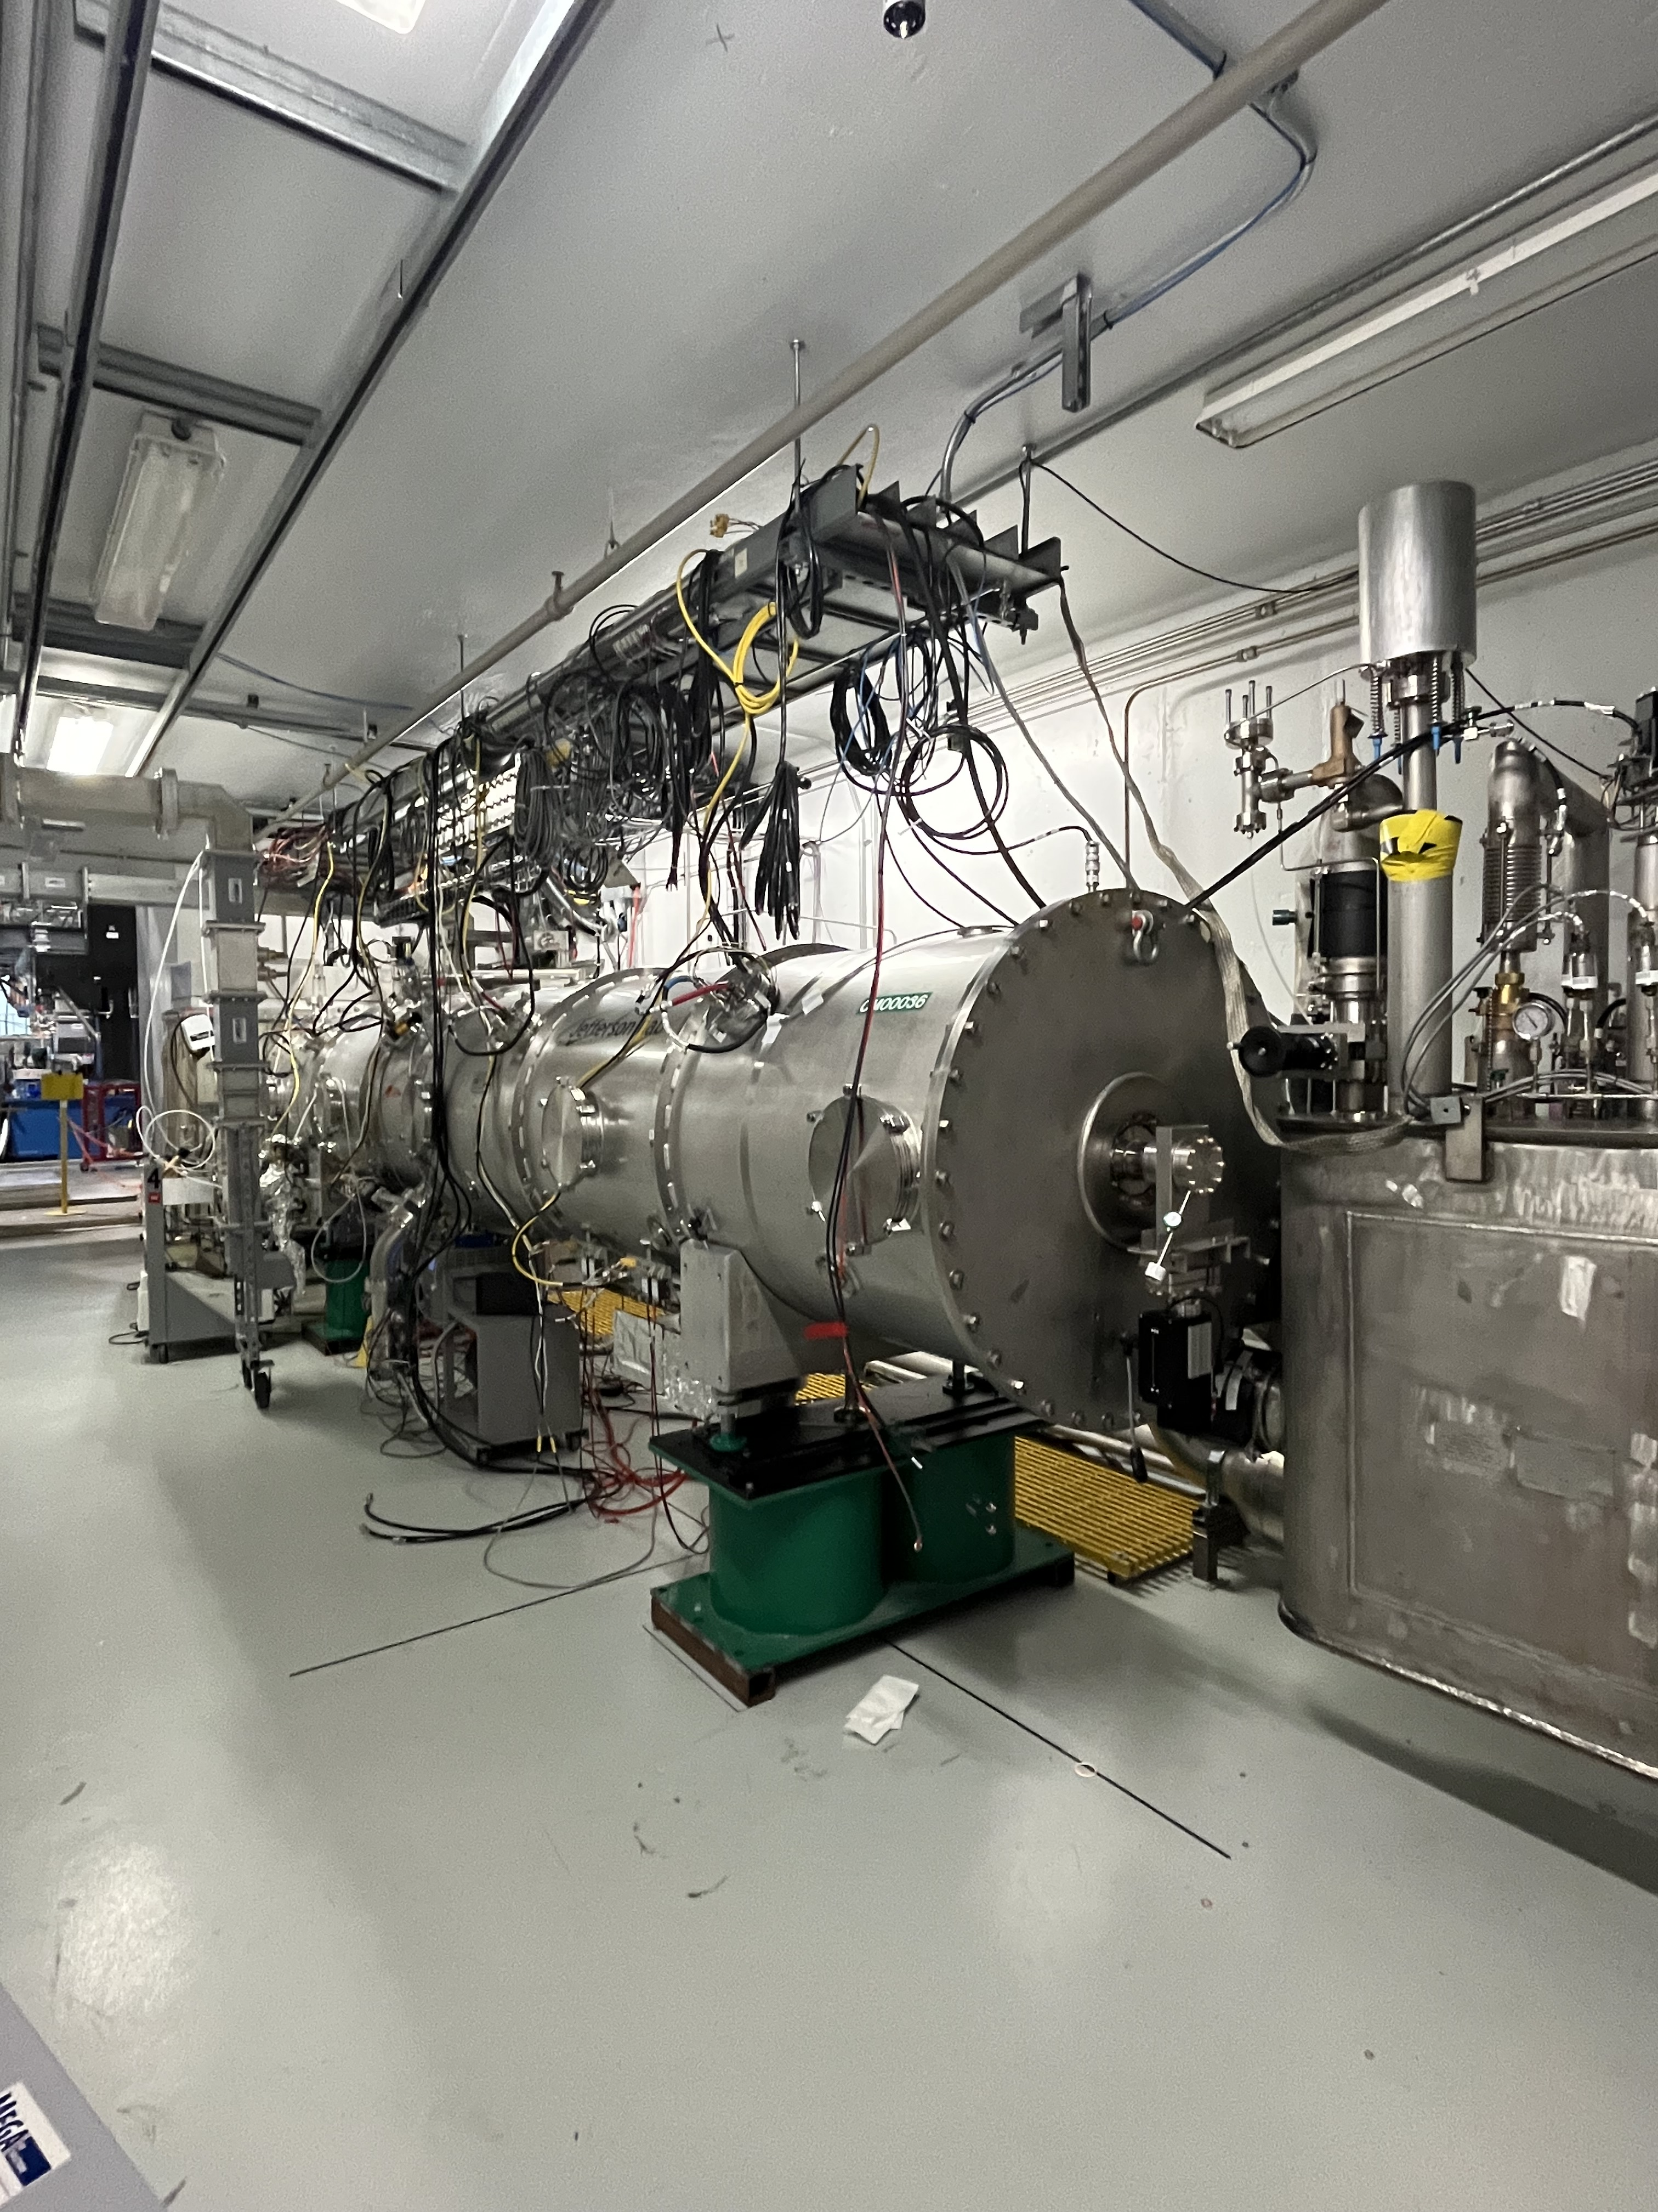
From the back wall

Slide 14
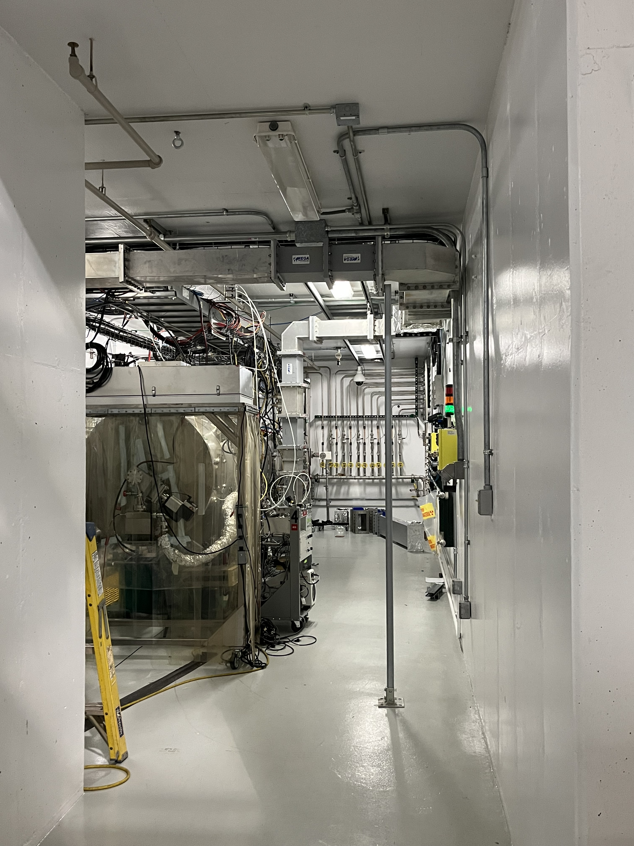
From the door

