Slide 1
Beam test status update
11/17/2016
Ye Tian, SDU
Vincent Sulkosky, UVA

Slide 2
General Update
We don't have beam since last EC meeting. Beam will be delivered on Friday.
The hall changed to controlled access yesterday afternoon, which is one day early than expected. Mark wanted to move all detectors to a smaller angle yesterday, since the schedule changed, wait for next chance.
For SoLID detector, only three shashlyk modules used as trigger.(not include cosmic test)
Added all SoLID modules to scaler.
Changed a NIM crate to solve baseline not stable problem.
Need to check why the cosmic events with signal get less.

Slide 3
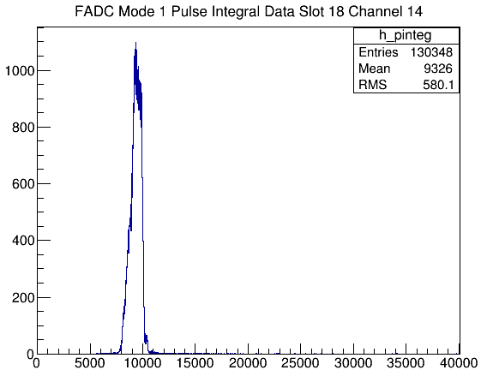
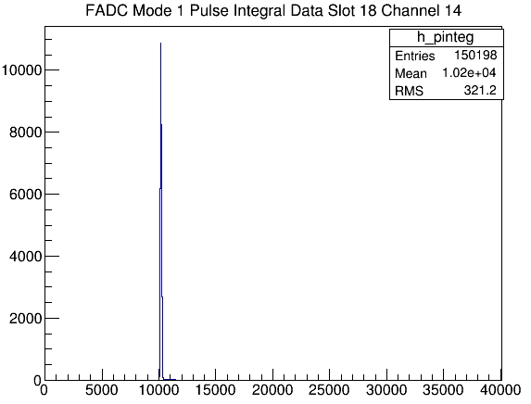

The pedestal difference after replacing to a new NIM crate (Problem solved)

Slide 4
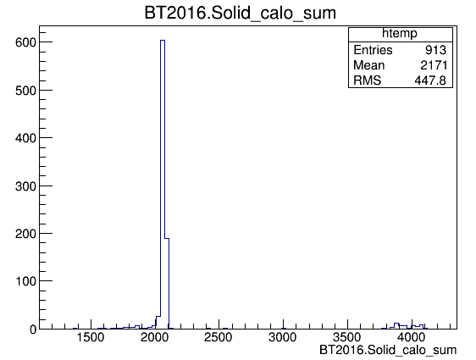
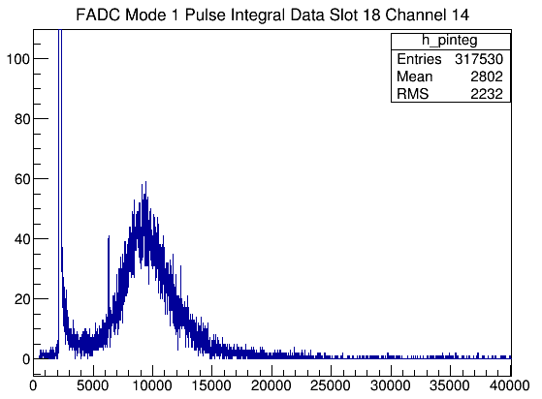
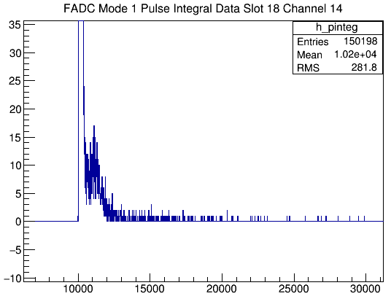
Low signal events after adding FAN-IN/OUT (problem)
Are they really in trigger?

Slide 5
PMT current problem
After I rewrap the preshower detector, the current of two modules get normal, but not the other one. There is still one module' current is positive 7.9 uA checked by picoammeter, comparing previous value 4.9uA(maybe positive).
Even if I use black cloth to cover everywhere, the value never changes, and I also think normal value should be negative. I can't find any unusual noise viewed by oscilloscope.
Vince told me to check it again, I don't have time yesterday and I'm not sure if it's a real problem since the previous result seems OK.

Slide 6
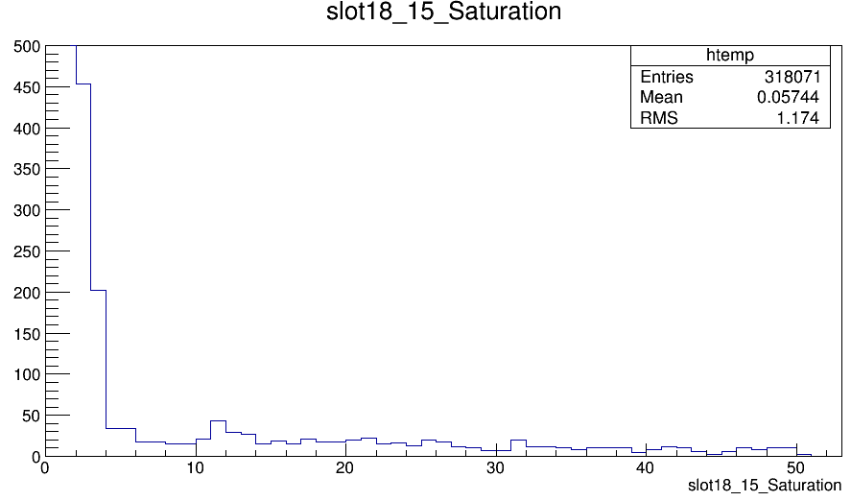
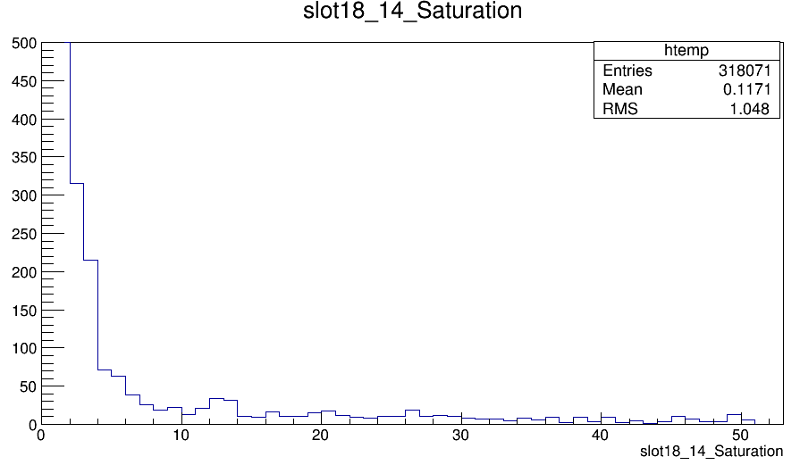
Saturation points

