Slide 1
Beam test status update
12/22/2016
Ye Tian, SDU
Vincent Sulkosky, UVA

Slide 2
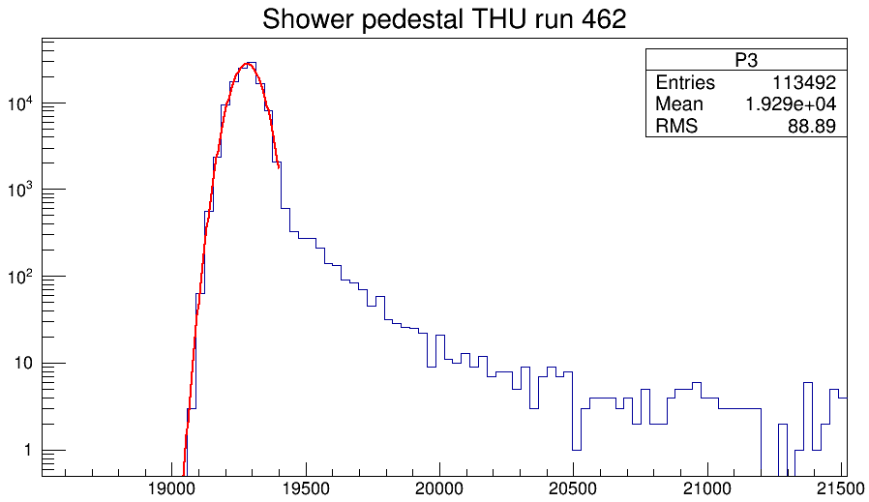
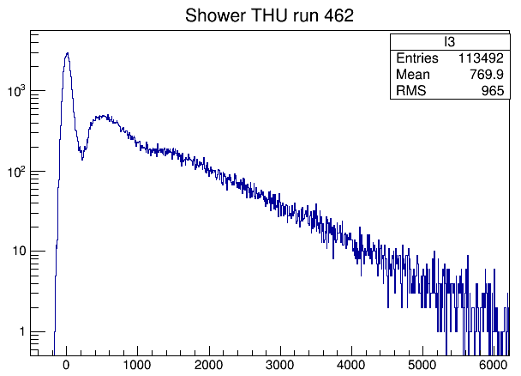
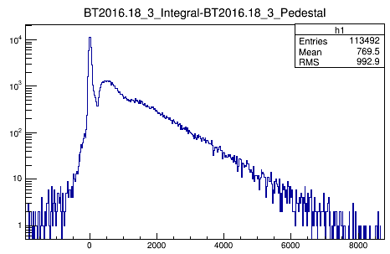
Alteration on dealing with pedestal
Fit the pedestal spectrum that is sum of first 10 points in FADC, get the mean value constant of pedestal spectrum as pedestal, not event by event showed before. (No weird negative peak now.)
Pedestal fit
Subtracted by pedestal mean value
Pedestal fit sigma 50
Subtract pedestal event by event
Pedestal fit sigma 30

Slide 3
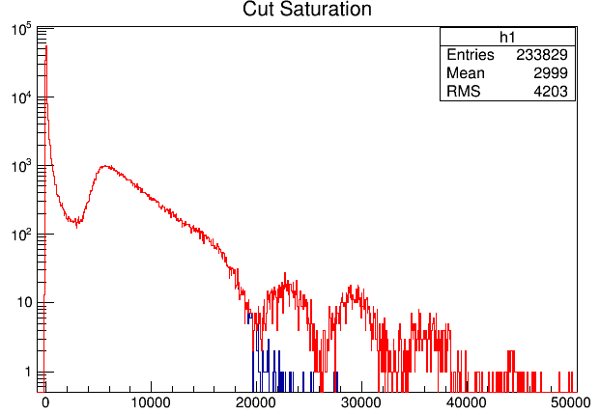
Saturation cut
Run 387, SDU#2. Events with integral above 20000 should be regard as saturation event.

Slide 4
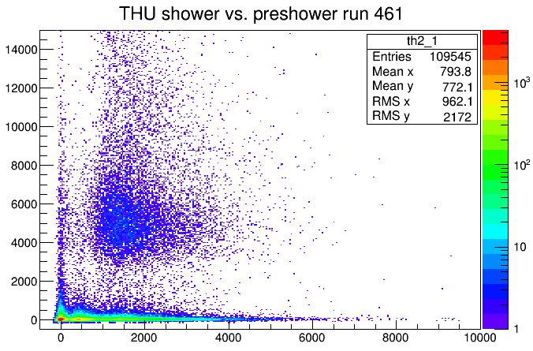
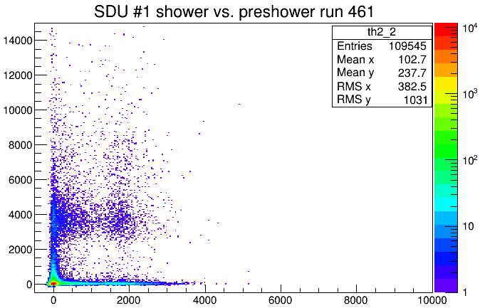
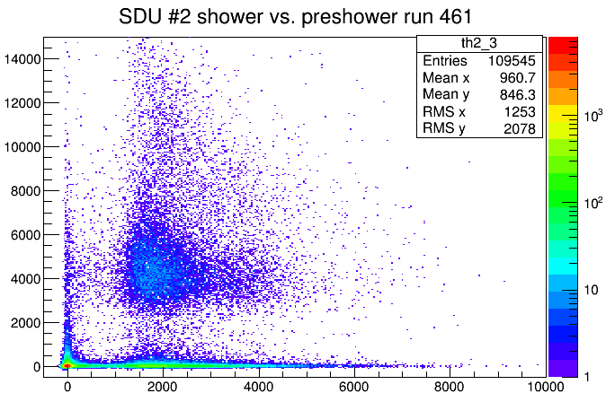
Run 461, lowest HV of test

Slide 5
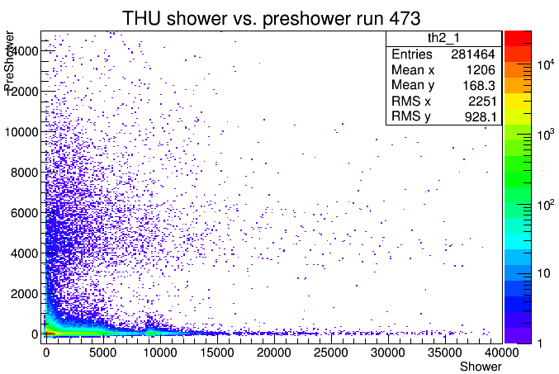
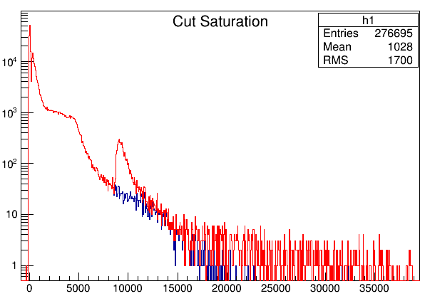
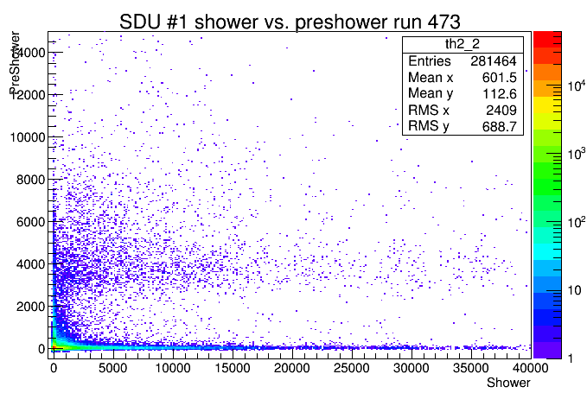
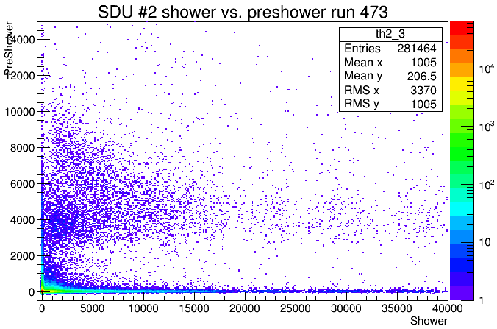
Run 473, highest HV of test

Slide 6
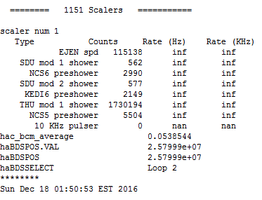
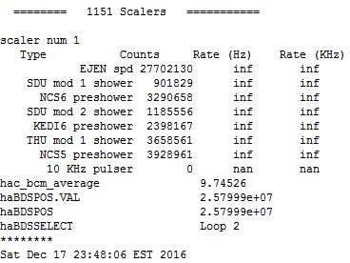
High rate on THU module
Run 465, THU HV: 2420
No beam
10 uA beam, recent data

Slide 7
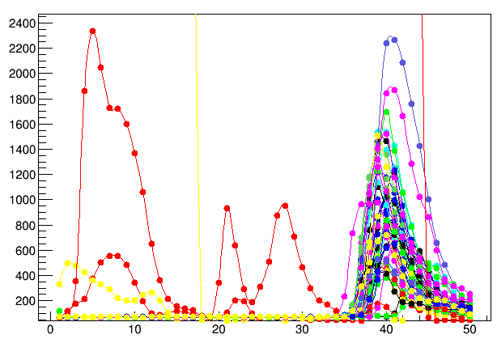
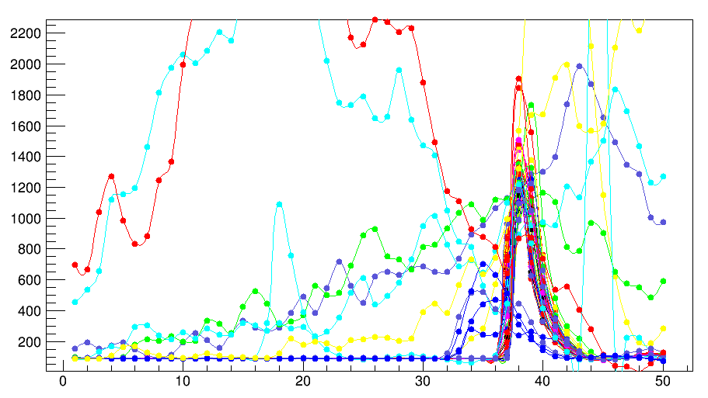
Cosmic run
Time resolution is much better than beam test
We have limited cosmic run using previous electronic now, but it’s OK to take more data in January.
I’m afraid for our detector, trigger time is determined by front scintillator.
SDU #2
THU

Slide 8
Problems
Have no idea on PID just analyse Shashlyk, preshower and FASPD.
The peak in FADC integral spectrum is influenced by threshold, not the detector. How to compare shashlik detectors and monitor radiation damage? Rate could get some ideas, but rate is not stable.
Missing TDC data, need to adjust cable length for future test.

