Slide 1
Three bars test update
Ye Tian
Shandong University
5/11/2017

Slide 2
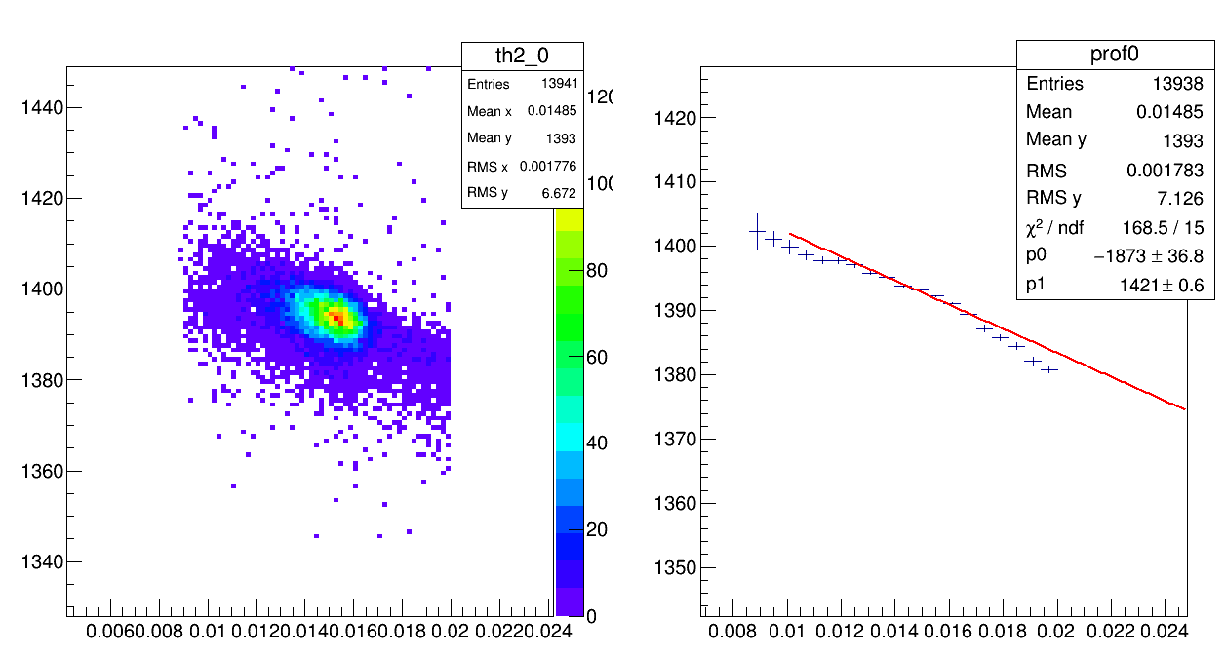
Time walk correction
TDC channel
1/$\sqrt{FADC}$
1/$\sqrt{FADC}$

Slide 3
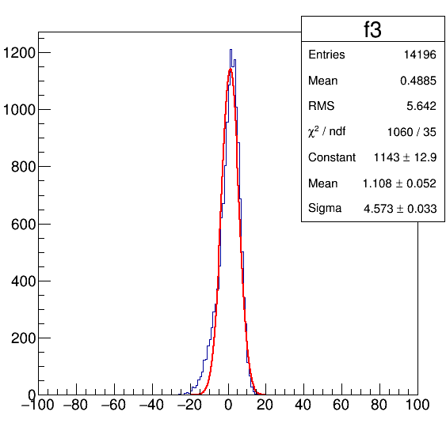
Time walk correction
Processing and cut
Hit position cut
Time walk correction
Low signal and high signal cut
TDC channel

Slide 4
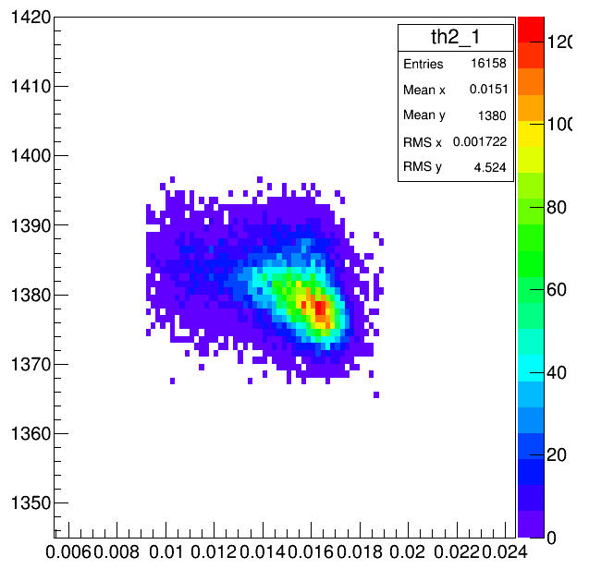
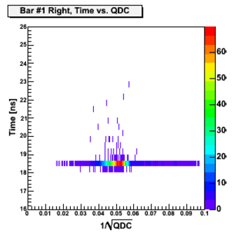
Reference PMT problem
Time distribution of reference bar which is used for trigger is too wide, it should be a constant(time difference between trigger time and trigger PMT).

Slide 5
Time difference between two outputs from Fan in-out of one PMT signal
Problem maybe caused from same reason as previous slide.
Need to check plug-in board.
TDC channel

Slide 6
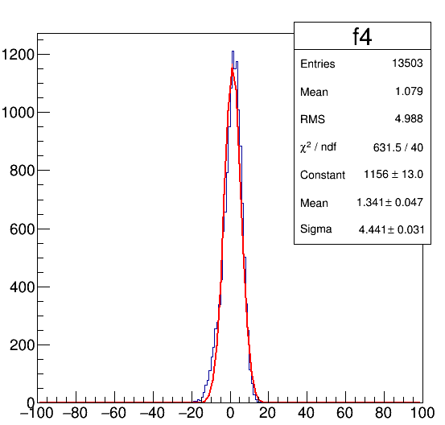
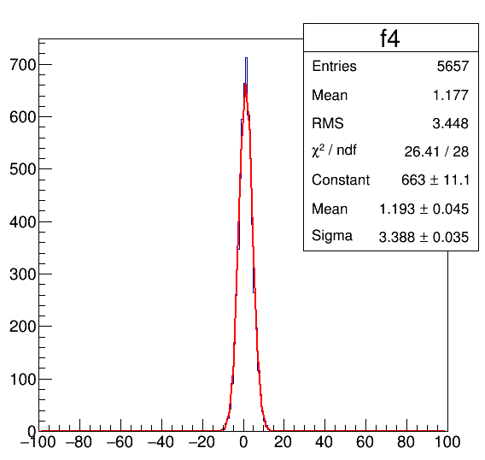
Time resolution with trigger PMT FADC cut
FADC integral channel <6000
FADC integral channel 4000~5000
Time resolution: 4.441* 35ps * $\sqrt{\frac{2}{3}}=126.8ps$
Time resolution: 3.388* 35ps * $\sqrt{\frac{2}{3}}=96.76ps$

Slide 7
Vince’s result
The HV of PMT in run 1484 is 100V larger than 1480
Also the HV of PMT in run 1487 is 100V larger than 1484

