Slide 1
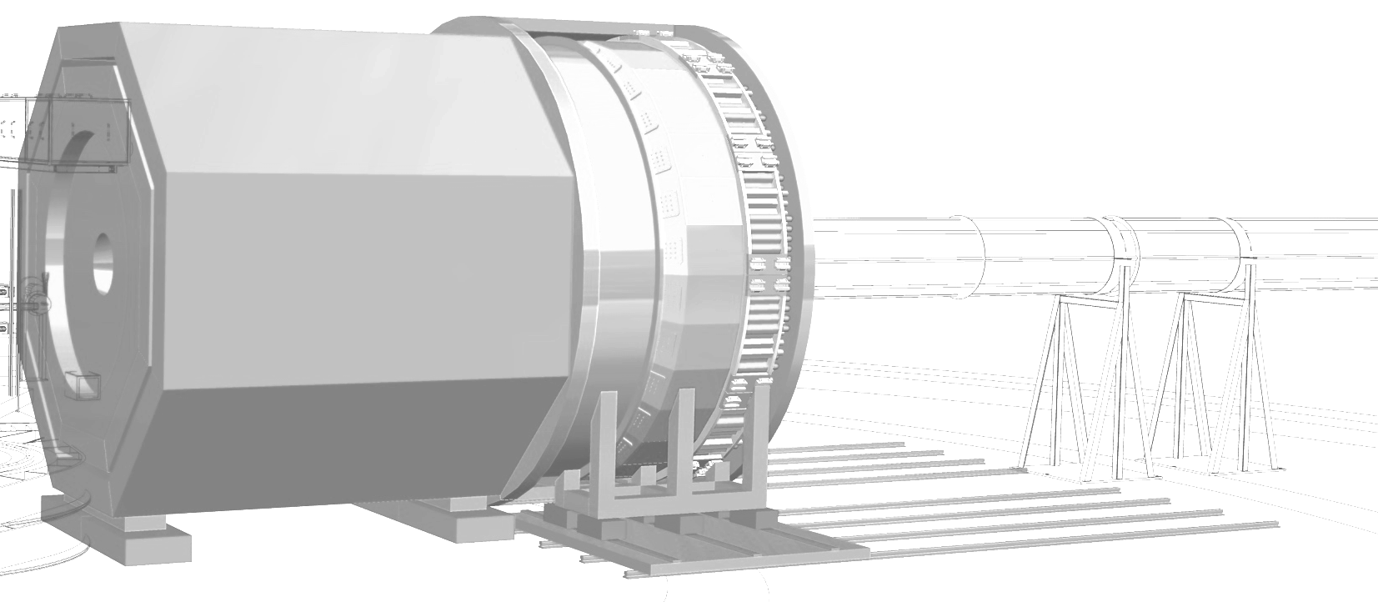
Your Talk Title
Telescopic Cherenkov Device
(OR
Data Acquisition)
Jefferson Lab SoLID Pre-R&D Review
August 7th, 2020
Your Name
working group name
Your affiliation

