Slide 1
First prototype module released from the assembling platform
FENG Cunfeng
2016.01.07

Slide 2
The first prototype module was assembled one week ago. It was took out from the assemble platform today(2016.1.7)

Slide 3
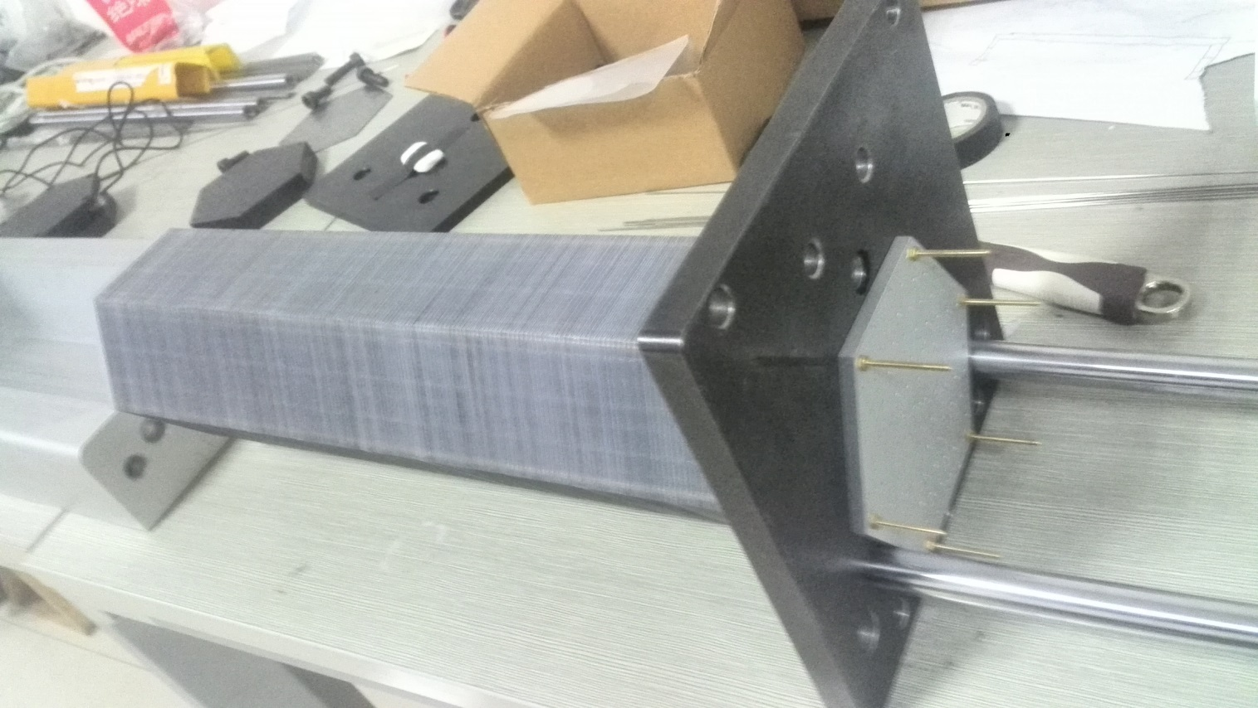
The module was fixed on one support plate at the end side, only one nut for each support bar

Slide 4
The module was hung at the end side. The nut and brass bar can stand the module weight.

Slide 5
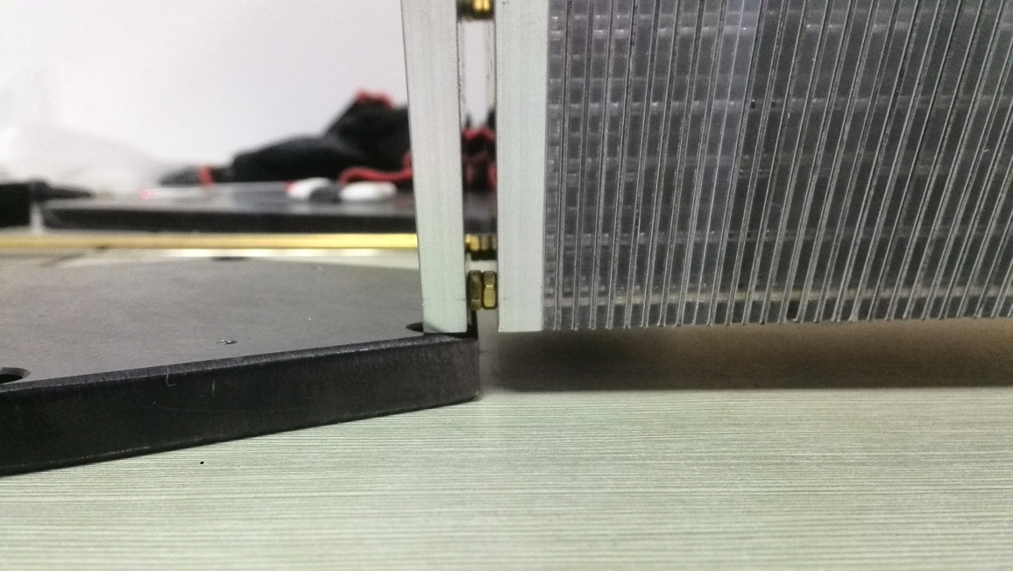
The module was left at two end support status

