Slide 1
New design about Shashlyk calorimeter
Chendi Shen

Slide 2
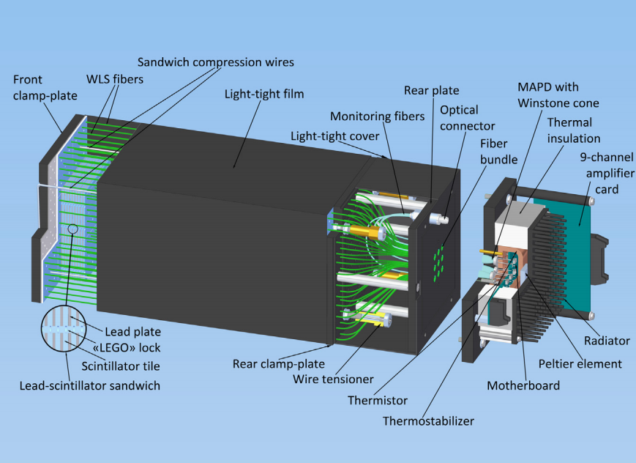
New Design
Two difference
LEGO type lock
Sandwich compression wires & Wire tensioner

Slide 3
