Slide 1
EC Assembling with Assembly Stand of THU
Chendi Shen
1/21/2016
Tsinghua U.

Slide 2
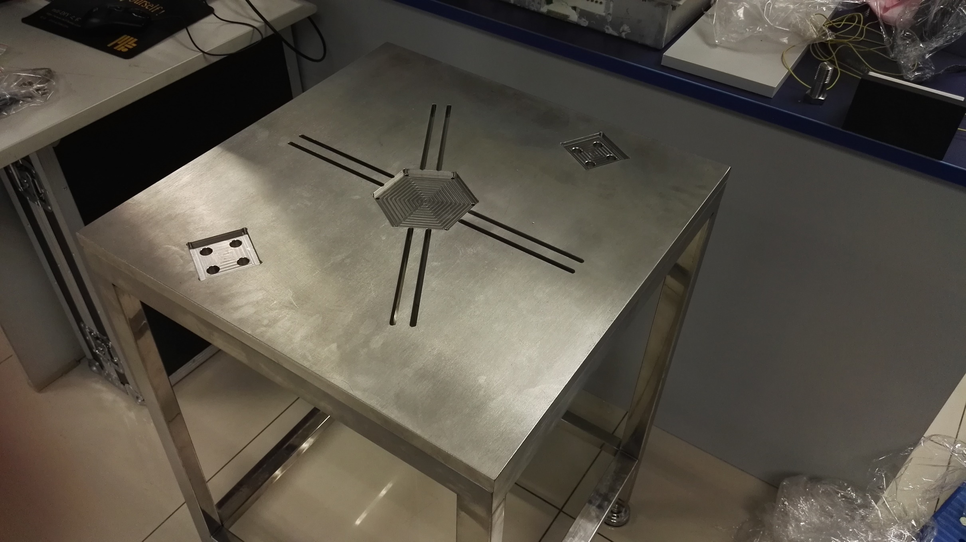
Step1. Bottom of the assembly stand

Slide 3
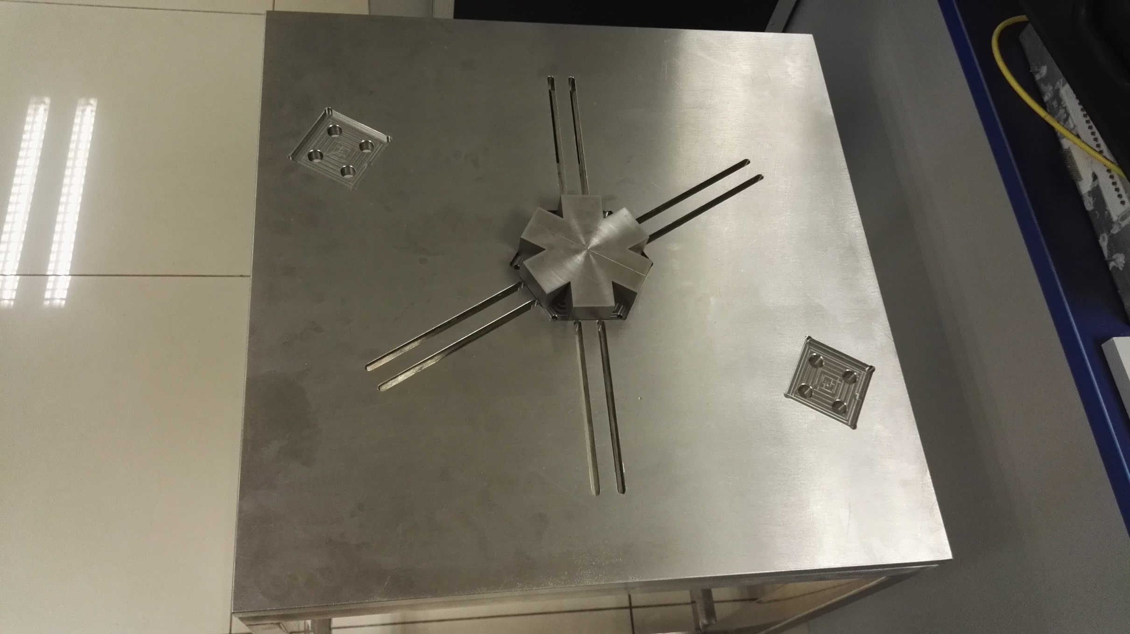
Step2. A bottom piece for supporting the plates

Slide 4
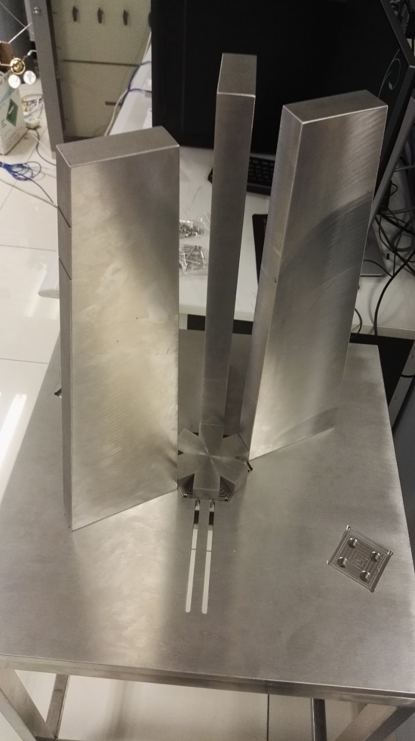
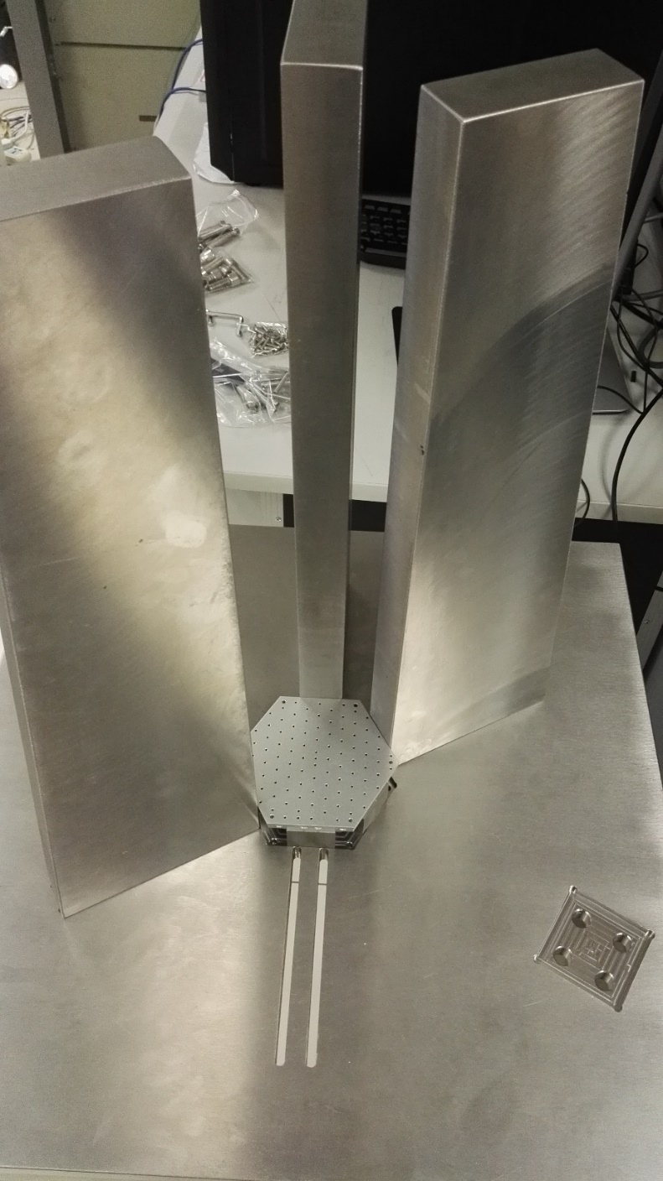
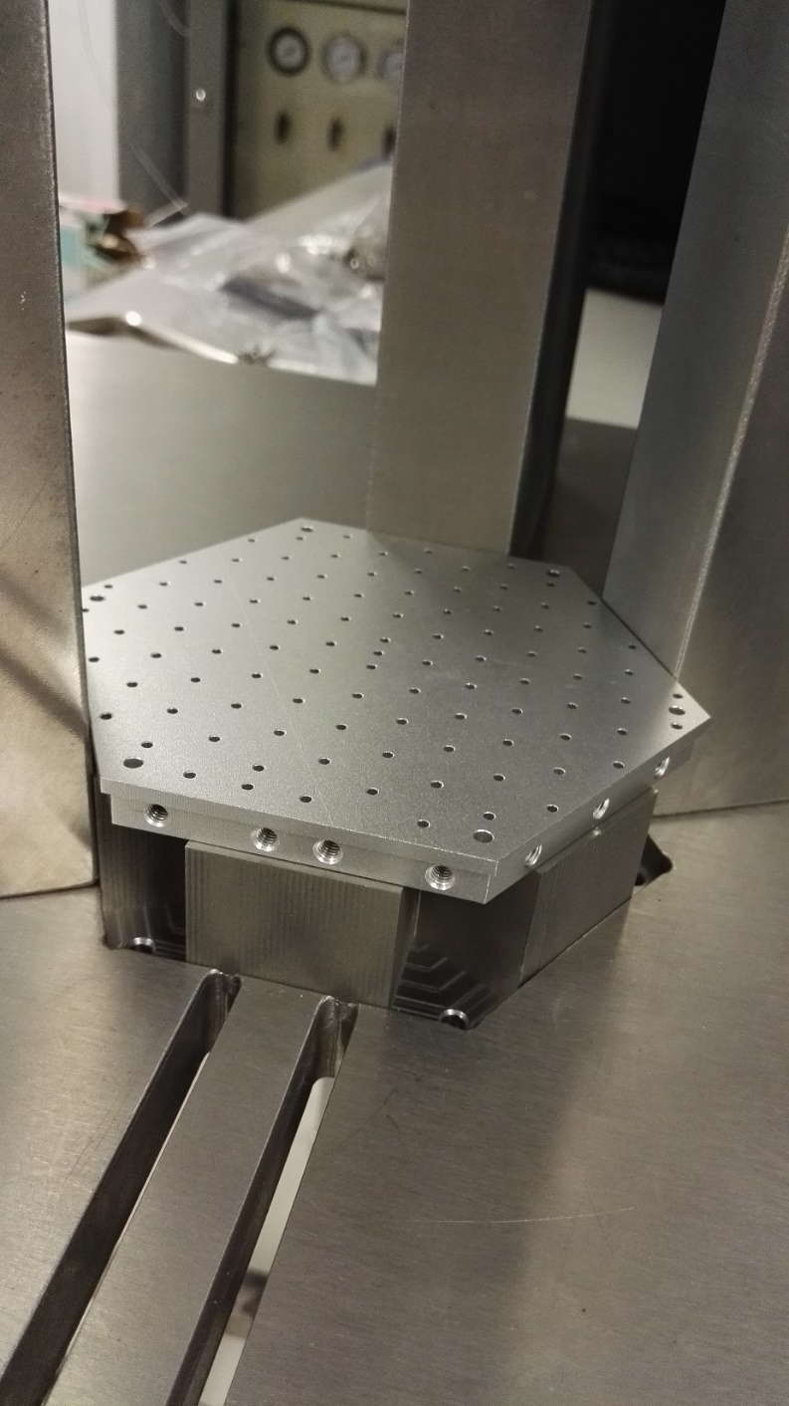
Step4. place the bottom endplate, then start stacking the plates.(1cm,AL)
Step3. 3 posts for positioning

Slide 5
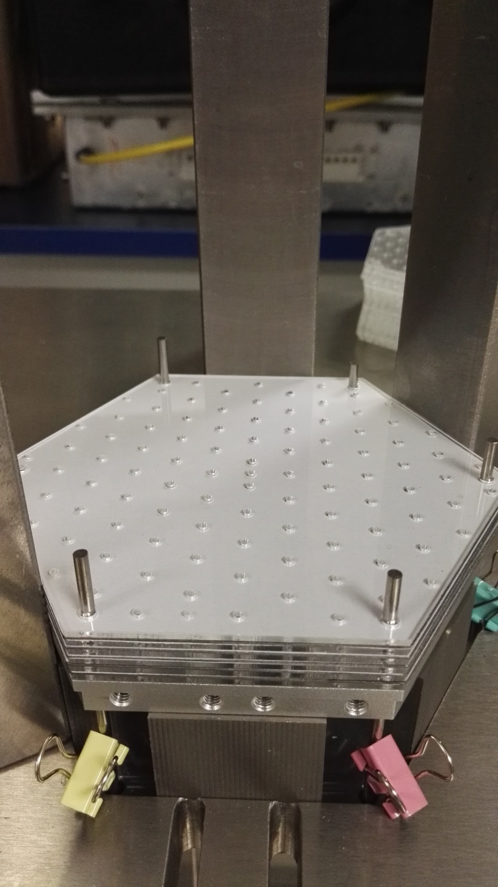
Step5
Six 2.5-mm dia aluminum posts are inserted through pre-drilled holes of the bottom assembly stand and all plates.
Continue stacking all plates. The six poles can be raised to align all plates.

Slide 6
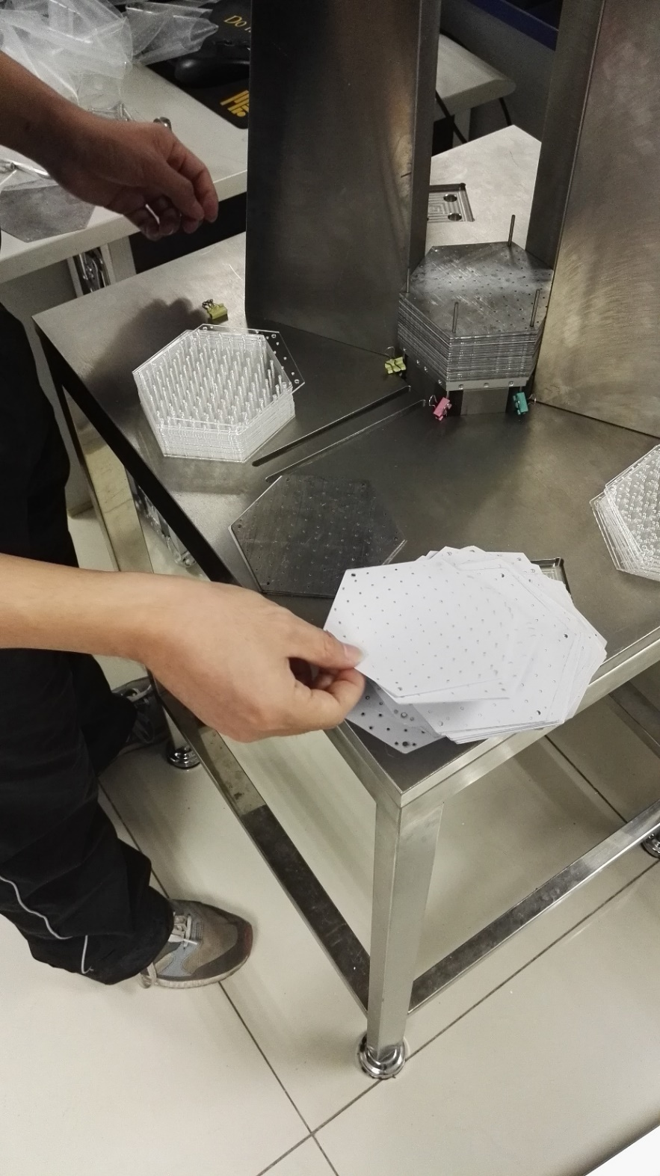
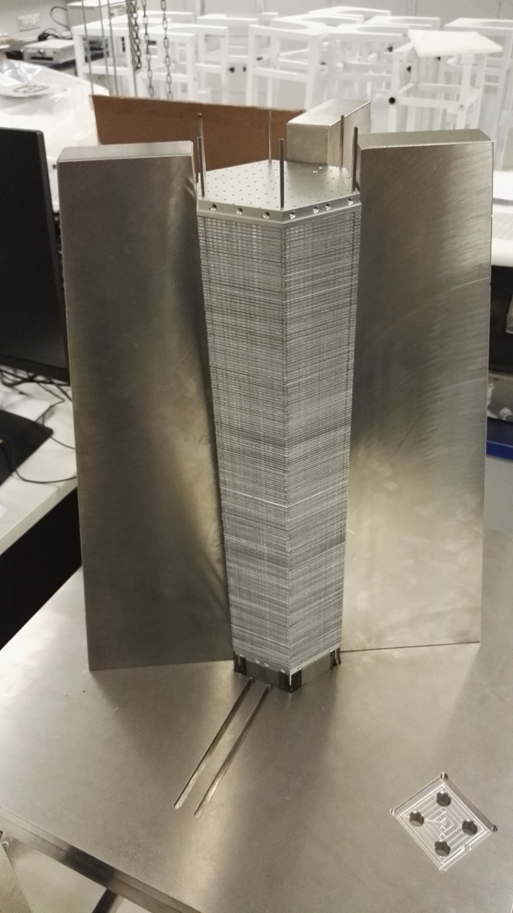
Step6
All 194x lead, 194x scintillator, and 388x paper layers are stacked

Slide 7
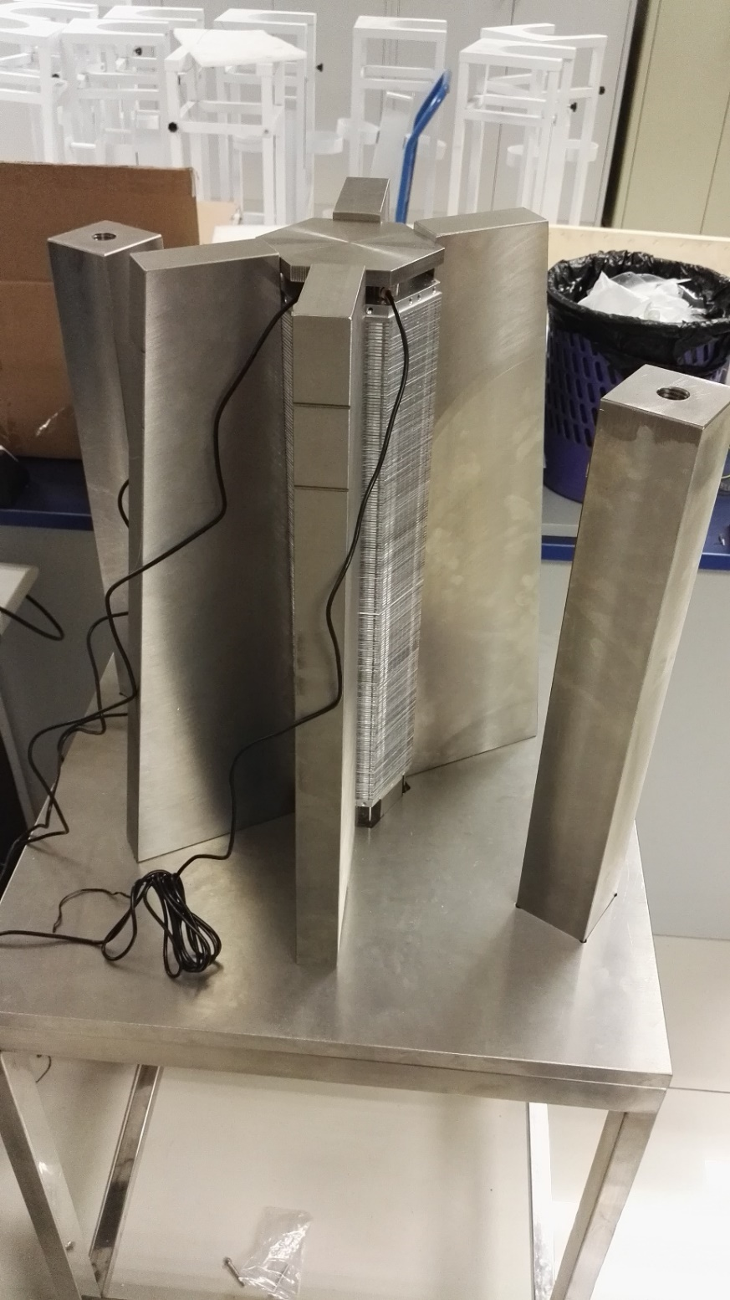
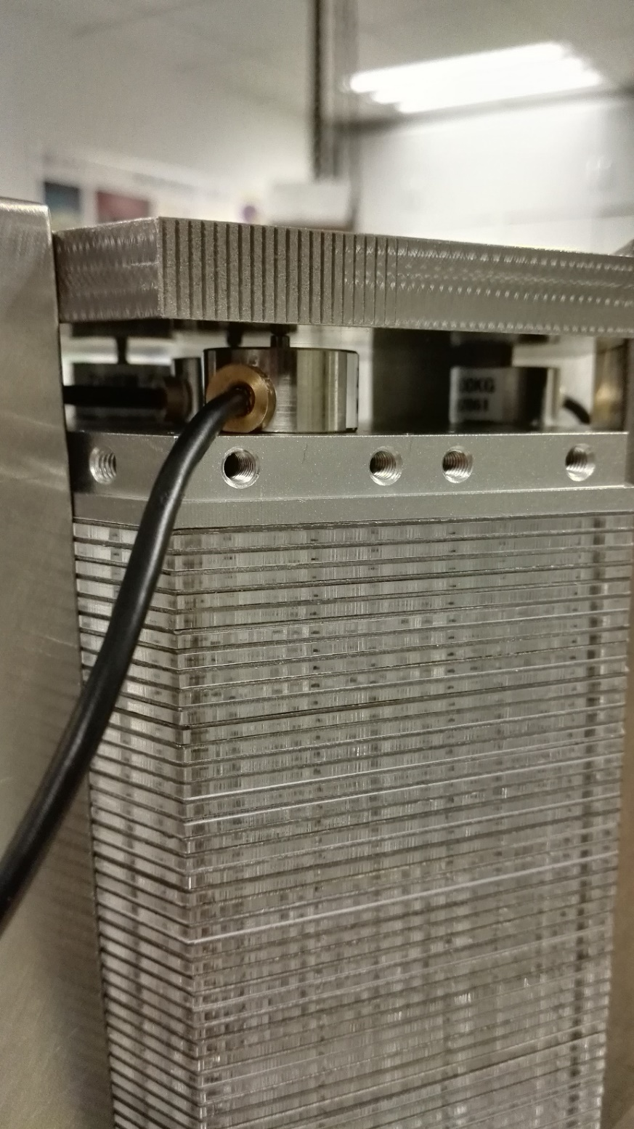
Step7
Add the top end-plate which is identical to the bottom endplate.
Step8
Add the pressure sensor

Slide 8
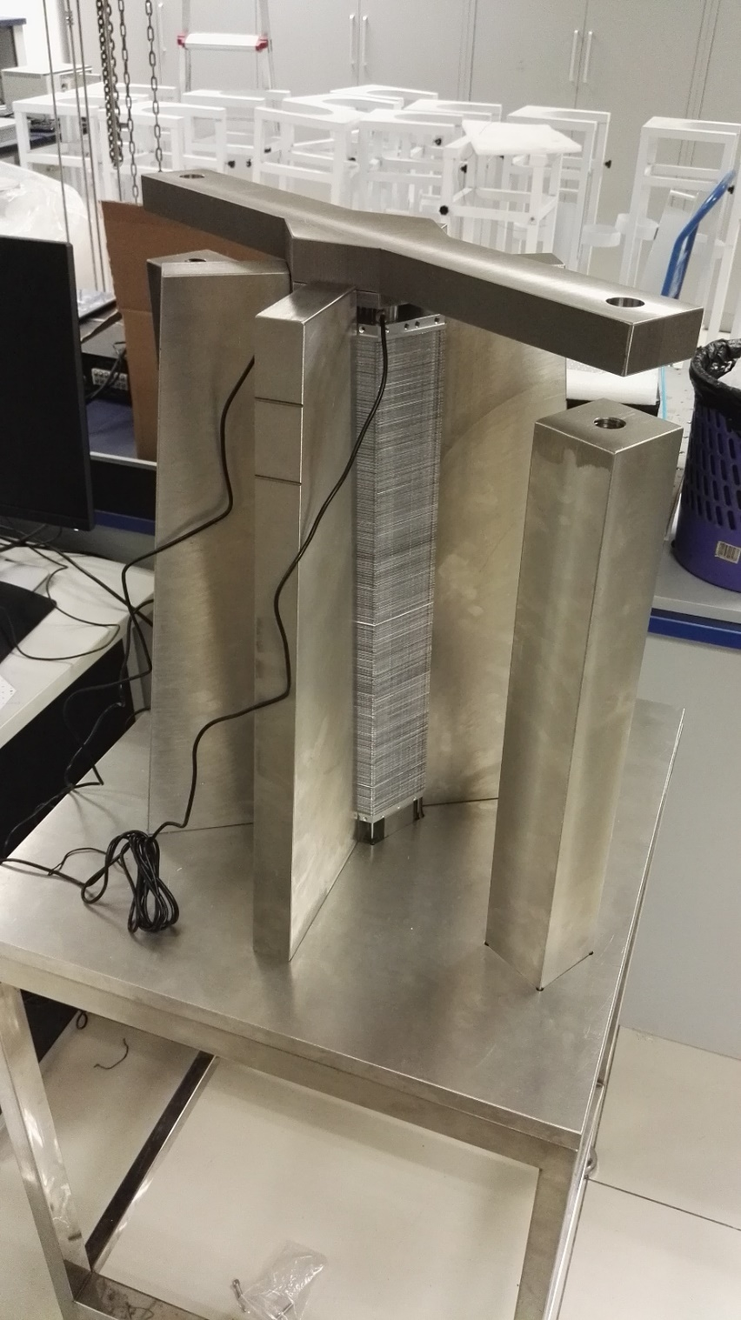
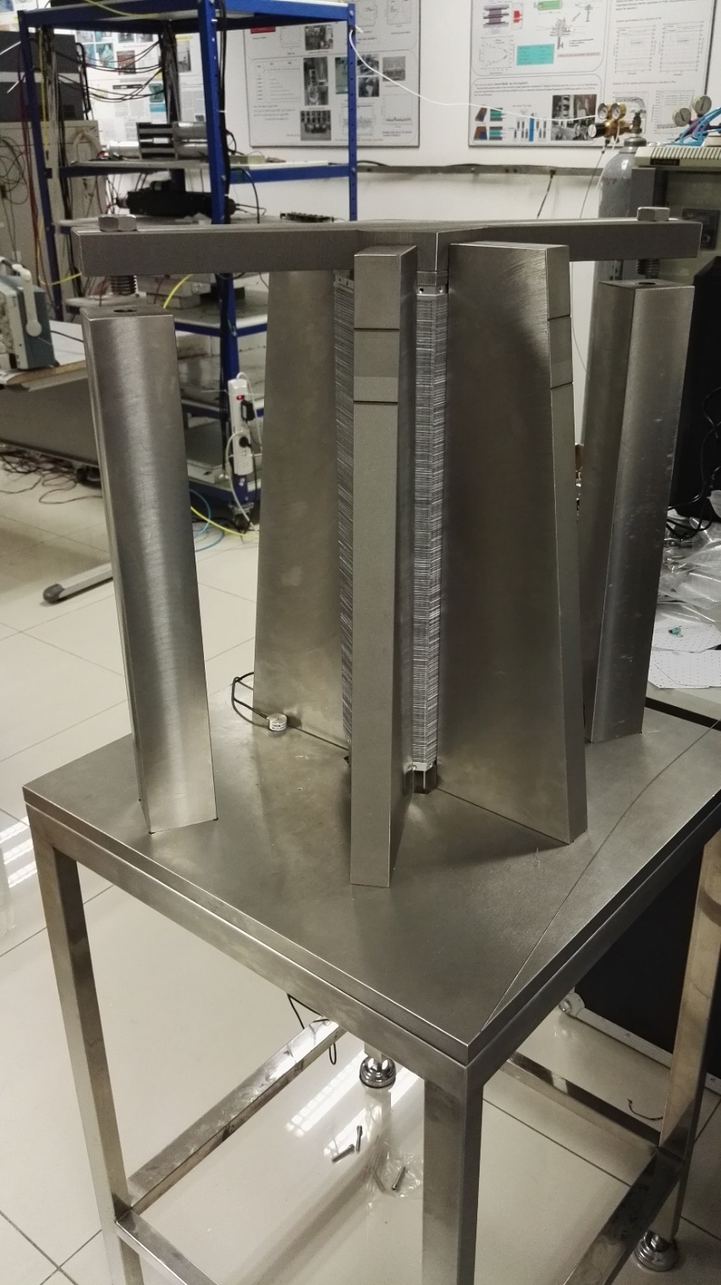
Step9
Now add two supporting ,and a top plate for compressing all layers.

Slide 9
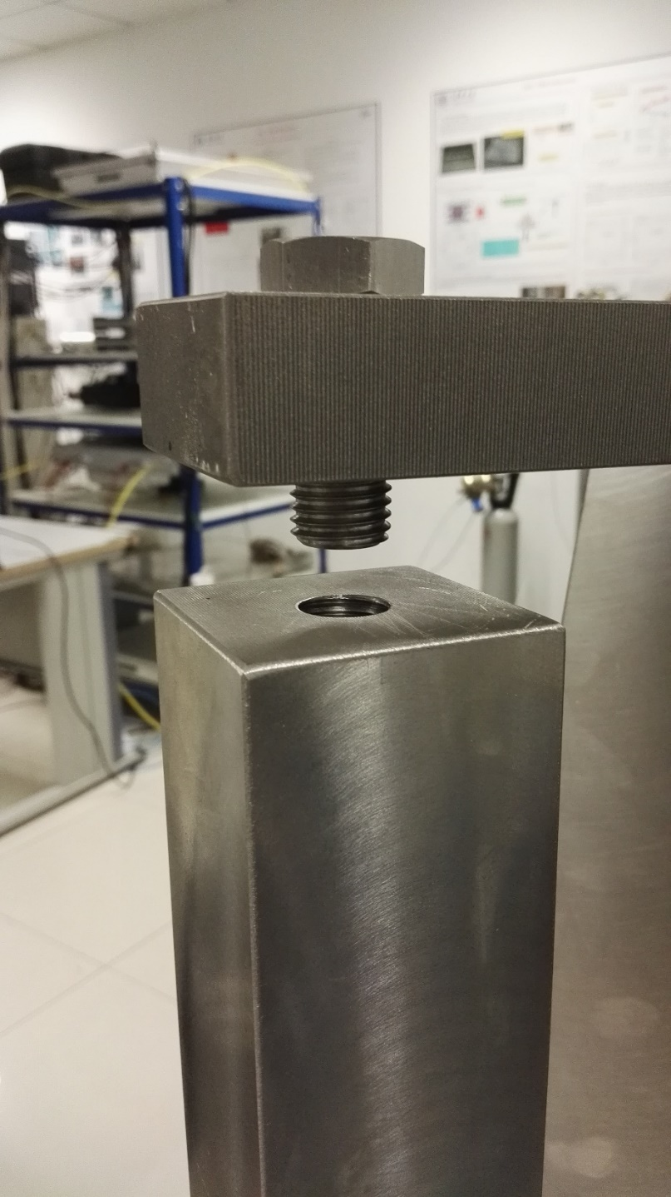
Problem:
The screw is not long enough,tomorrow we will exchange two long one

