Slide 1
Scintillator test results
Cunfeng Feng
Zhongquan Zhang
Ang Li

Slide 2
Structure of the experiment
shelf
Trigger
PMT
Group1
PMT
Group2
PMT
DAQ
PMT
Group3
PMT
Group4
Reference
PMT
Trigger
PMT

Slide 3
Structure of each group
Aluminum plate
lead
The reflectors are changed everyday, sometimes they are print paper, sometimes they are aluminum, sometimes they are Tyvek, sometimes they are nothing.
reflector
scintillator
PMT

Slide 4
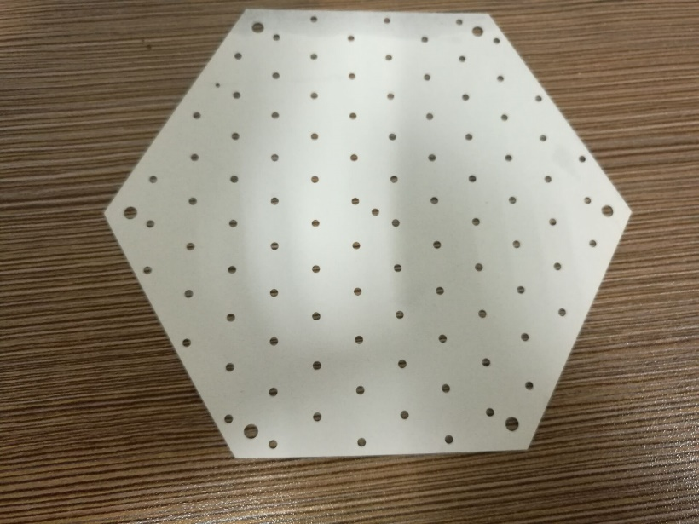
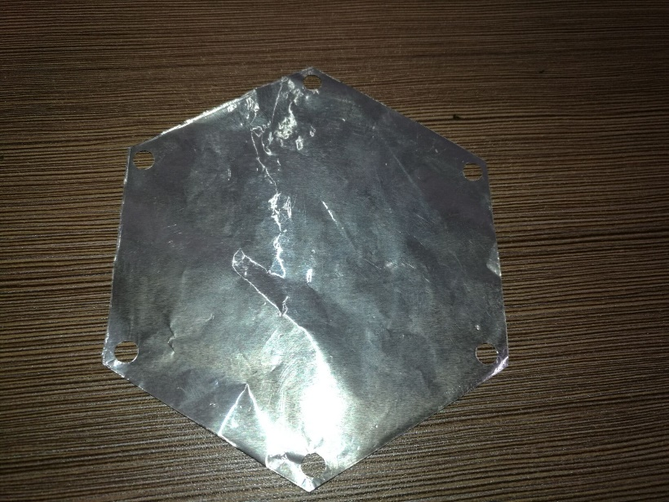
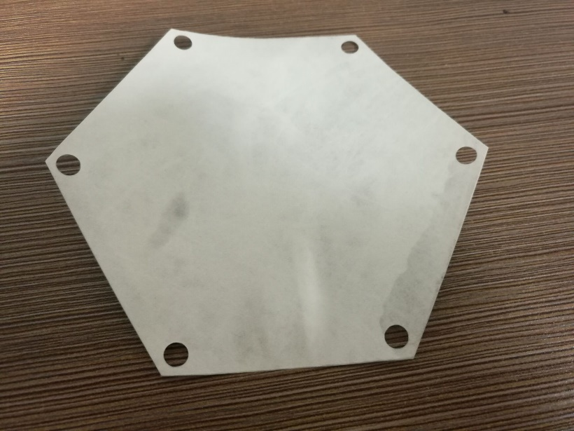
Reflectors

Slide 5
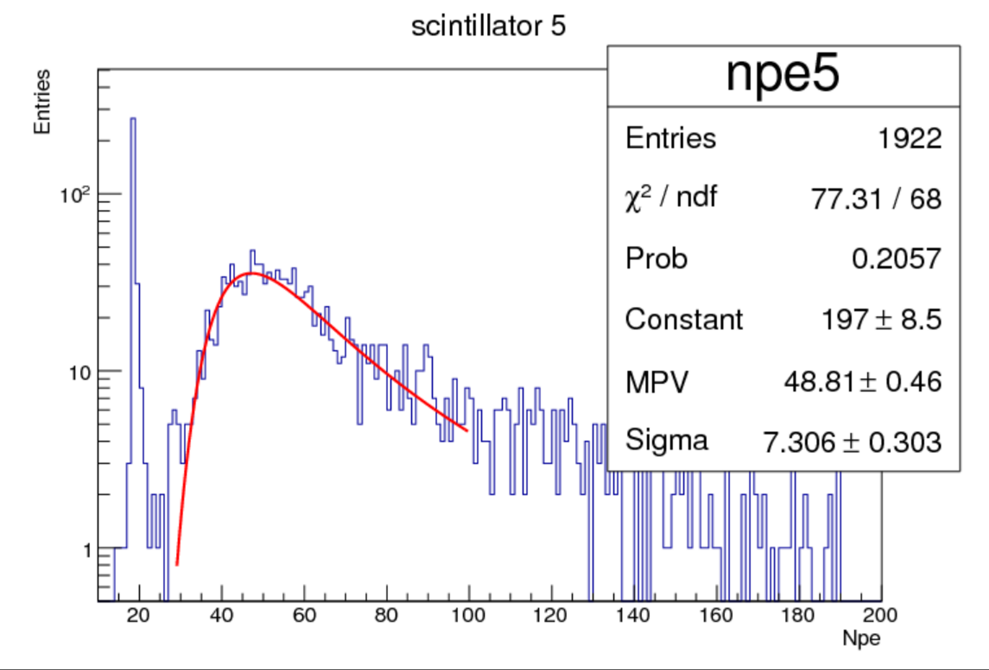
Data of reference
Reference
2016-04-17

Slide 6
Results

Slide 7
Results

Slide 8
Results

Slide 9
Results

Slide 10
Results

