Slide 1
Inserting the fibers
J. Jiao for SDU Group

Slide 2
Method
According to Alessandra’s (ALICE Group) suggestion.
Separate the fibers into 3 groups based on the distance between the inserting hole and center of the end plate.
30
34
32
30.1
44.3
32.9
Positioning hole
5.4
Steel pods inserting hole
46.2
56.5
End Plate

Slide 3
Method
Based on the nearest distance of each groups, the length of fiber between the gland and module is determined
Redundancy：15
Gland：35
Inner: 101(100.2)
(unit：mm)
Middle: 106(105.3)
100
Outer: 111(110.2)
Length of Module: 458
Totle length of fiber:
Inner: 608
Middle: 613
Outer: 618
Thinkness of end plate: 6
32.9
5.4
46.2

Slide 4
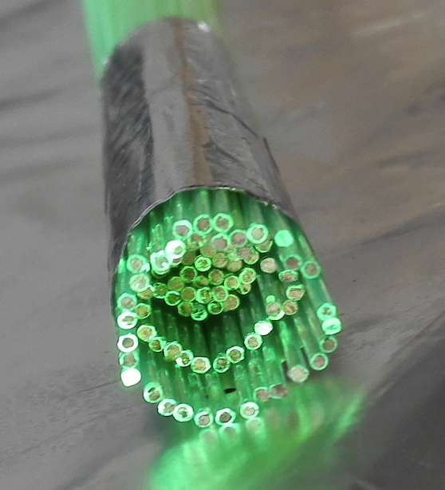
Operation
Cut fibers to specified length
Plate the unbundled end of fibers
Bundle the fibers (from inner group to outer group)
Glue the bundled end
Cut and polish the bundled end of fibers
Unbundled end
Bundled end
Unbundled end

Slide 5
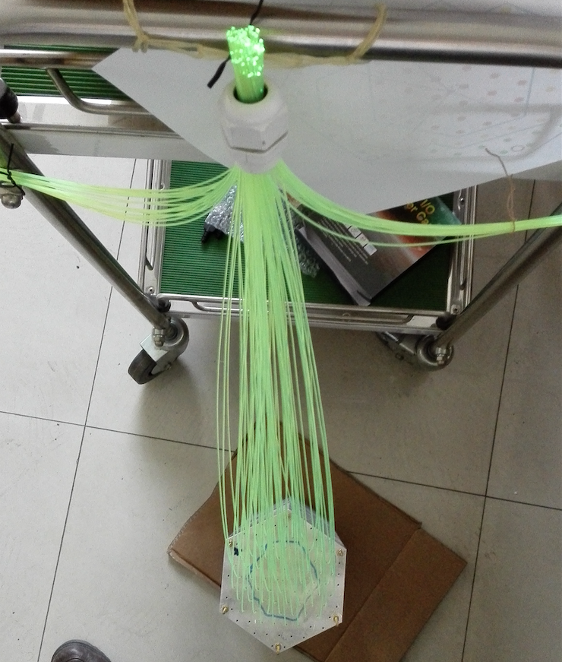
Operation
Hang the fiber bundle with the gland
Separate the outer group fibers into left and right parts, bundle them respectively.
Then do the same thing to the middle group fibers.
Insert fibers into the module (~15cm this time) from inner group to outer group to avoid to tangle the fibers together.
Then push the bundled end of fibers to insert them to the bottom of the module.
Module

Slide 6
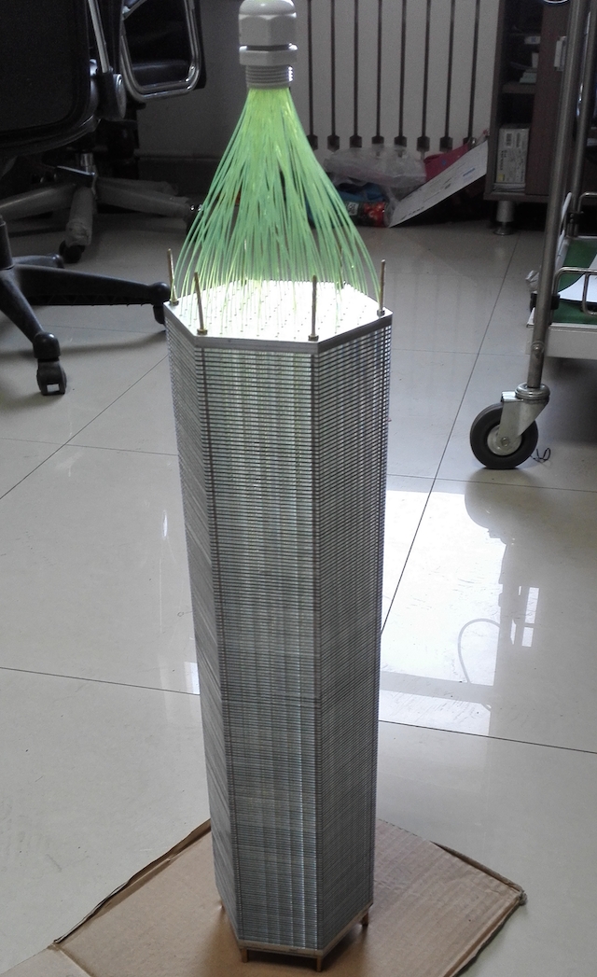
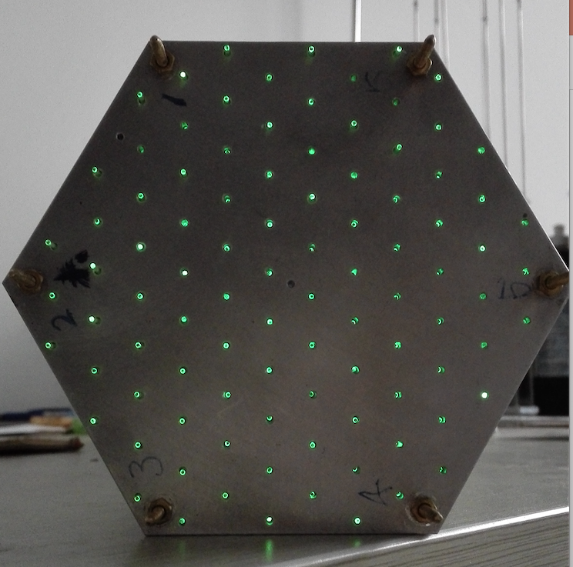
Operation
~45 minutes to insert all the fibers this time
This end

Slide 7
Pros. & Cons.
Thanks!
cap
Pros.:
Only 3 different length of fibers
Simple shaping
Avoid to tangle the fibers together
…
Cons.:
?
Need to be improved:
Use end plate with no holes
Need a cap
provide force to ensure that all the fibers to touch the botteom
End plate

