Slide 1
First shashlyk module test result
Ye Tian
Cunfeng Feng
Jianbin Jiao
Shandong University

Slide 2
Polish fibers in bundle by milling machine
Use a new milling cutter with 1cm diameter.
Better than previous result, need to clean.

Slide 3
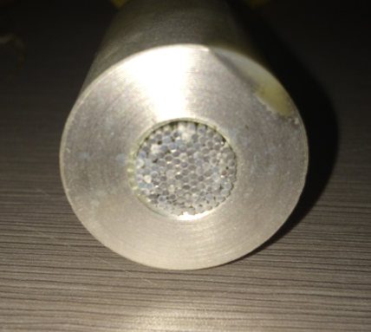
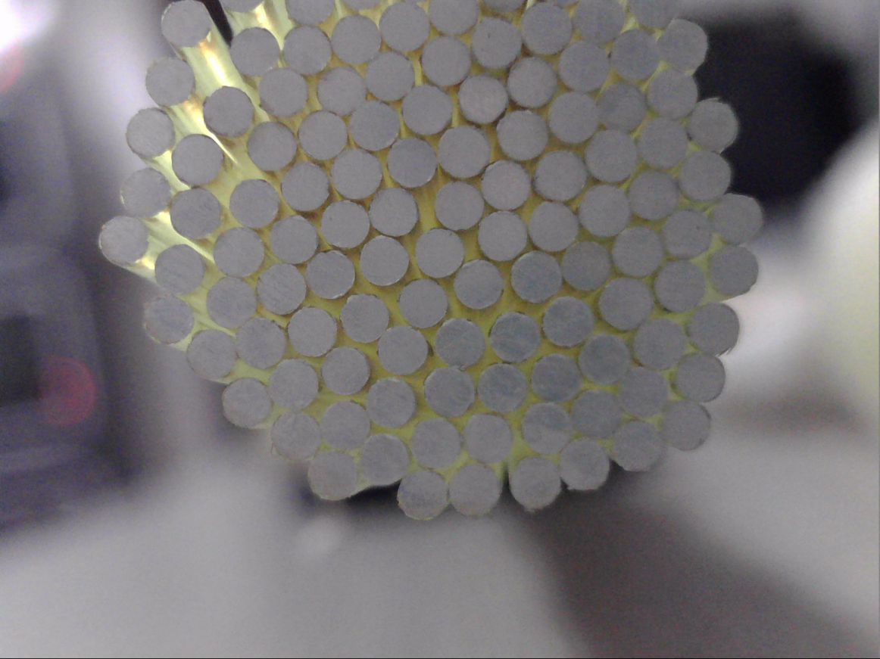
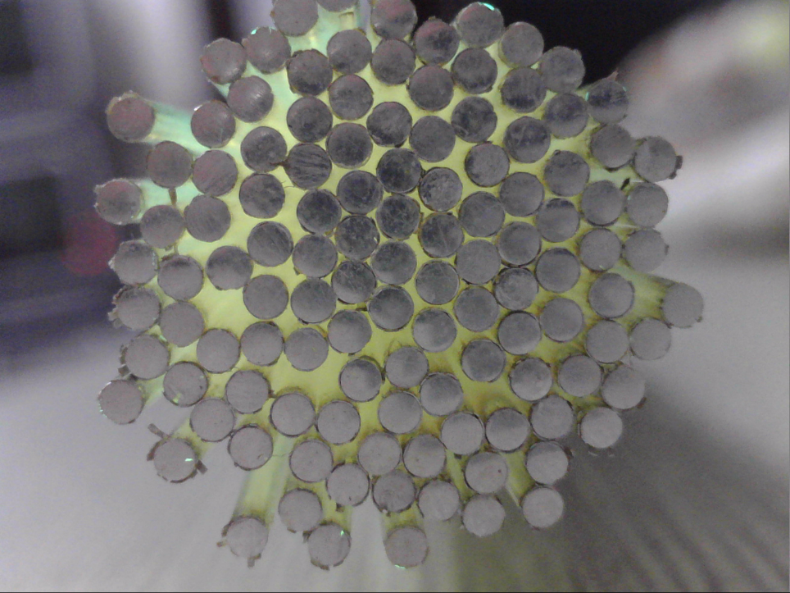
Sputtering plating
We got three bundles with plating, only one bundle could in use now.
Problem: The edge of mirror is easy to shed when insert to module

Slide 4
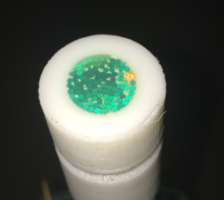
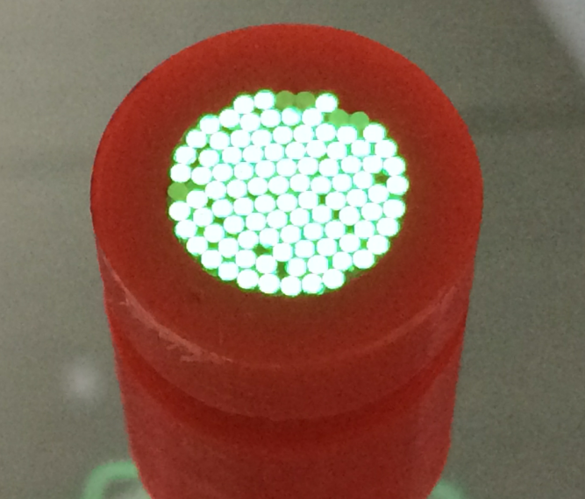
Polish result for glued end
Not good, should improve the usage of glue.

Slide 5
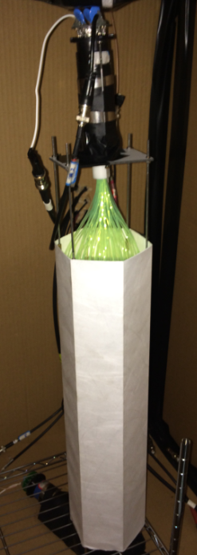
Shashlyk module description
PMT: R11102 (Set the Gain equal to 5*10^6)
Fiber bundle coupled to PMT without optical grease
18cm fiber outside the module which a little longer
New batch scintillator from Kedi company;
Lead get from USA company;
Print paper from SDU.
Fiber end plated with silver mirror
Coved by two layers Tyvek paper for test
Front plate without holes

Slide 6
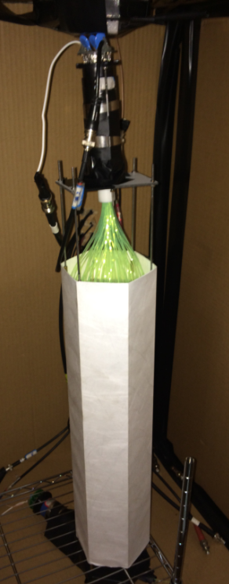
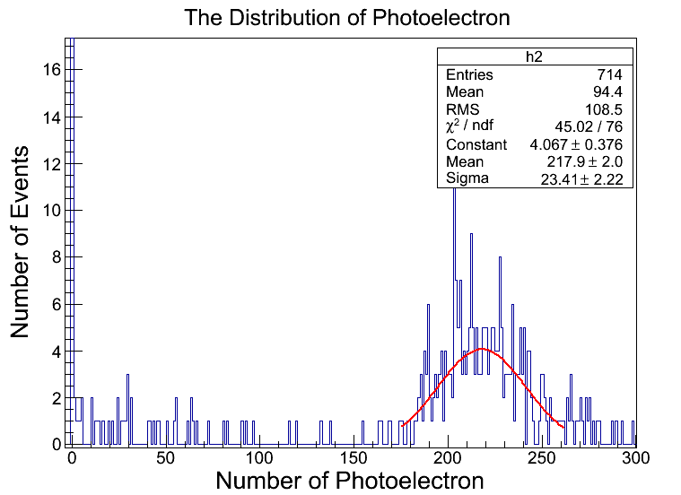
Vertical test result
Triggered by two hexagon preshower scintillator, total height 85cm
Data taken less than 12 hours, too few events.

Slide 7
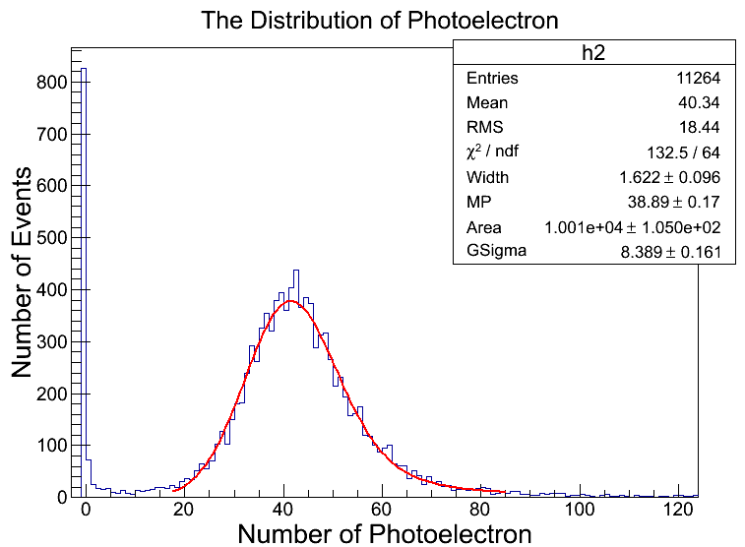
Horizontal result
using two hexagon scintillators as trigger in the middle of shashlyk. It's fitted by convolution of landau and gauss. MP is the gauss peak. Real peak is about 41.5 .

Slide 8
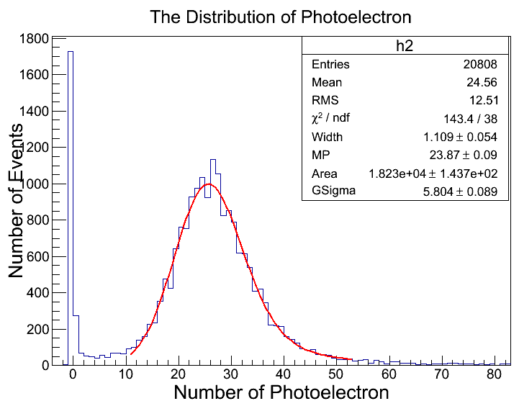
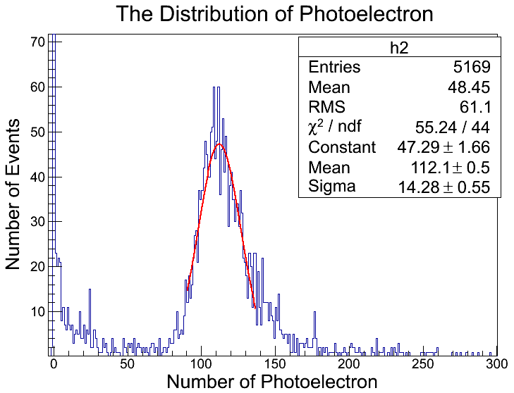
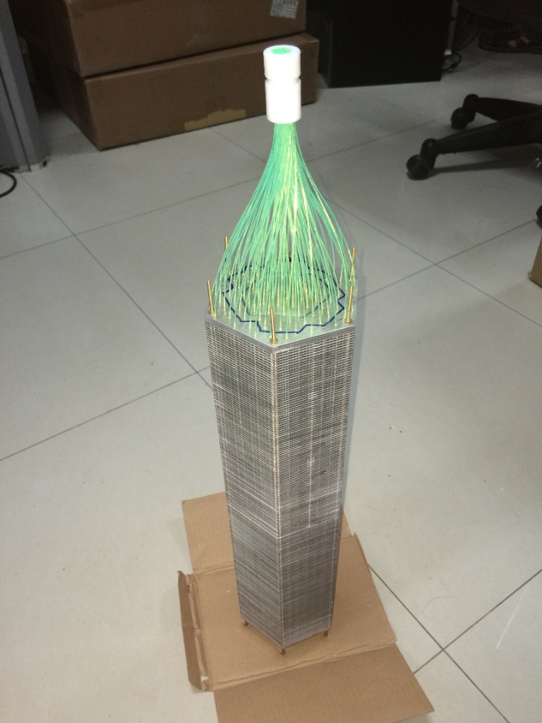
Other module
We also use a previous module for some other test, and the module has no mirror on fiber and use low light yield scintillator comparing with new module.
Peak:25
horizontal
vertical

Slide 9
Result
module | Vertical | Horizontal | Horizontal(without Tyvek)
New | 217.9 | 41.5
Previous | 112.1 | 25 | 19.3
 | 1.94 | 1.66
For previous result, if the new scintillator could improve light yield 40%, and plated mirror end could improve 60%, that should be 224% better, which don’t match.
Other explanation: for my previous 5 layers scintillator test, I didn’t use optical grease, but for Li Ang’s result, 3 layer with optical grease could get the same result.

