Slide 1
First shashlyk module cosmic test result
Chendi Shen
2016.9.8

Slide 2
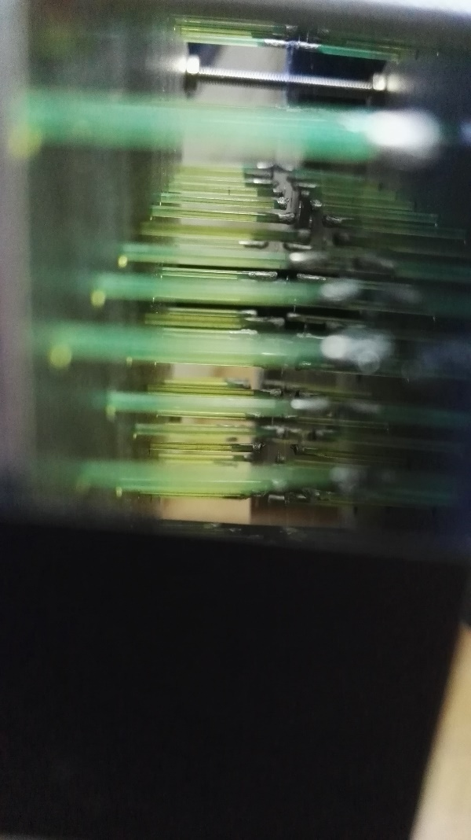
Silver shine 415001 painting
The end of fiber has painted reflective material(silver shine 415001)

Slide 3
Cosmic test
oscilloscope
discriminator
PMT1
PMT2
fan-in/
fan-out
gate
TDC
PMT0
ECal
discriminator
coincidence apparatus
gate
QDC
PMT3

Slide 4
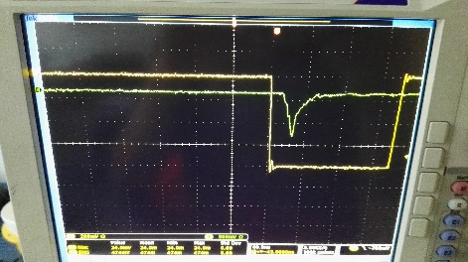
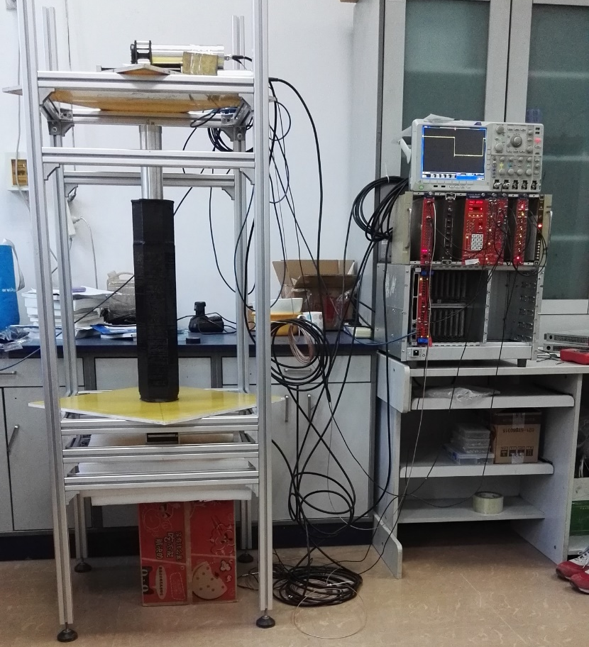
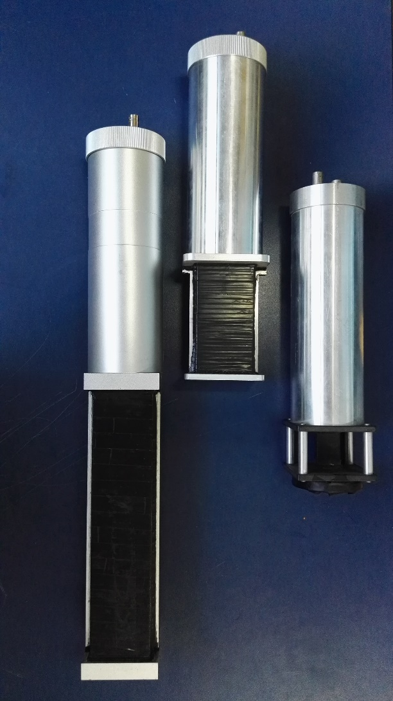
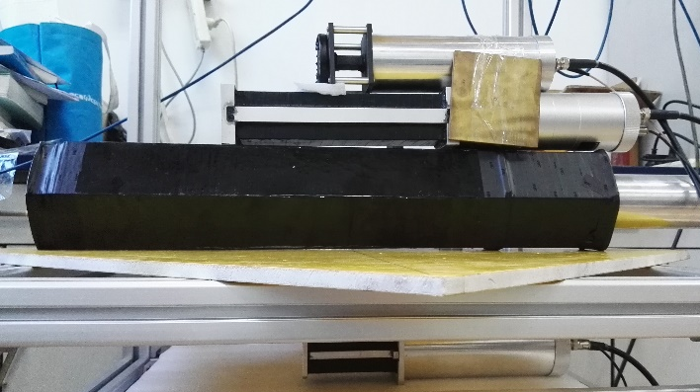
Cosmic test
4cm*2cm*1cm
3CM
25cm*5cm*5cm
10cm*5cm*4cm
ECal
1M
ECal
3CM
23CM

Slide 5
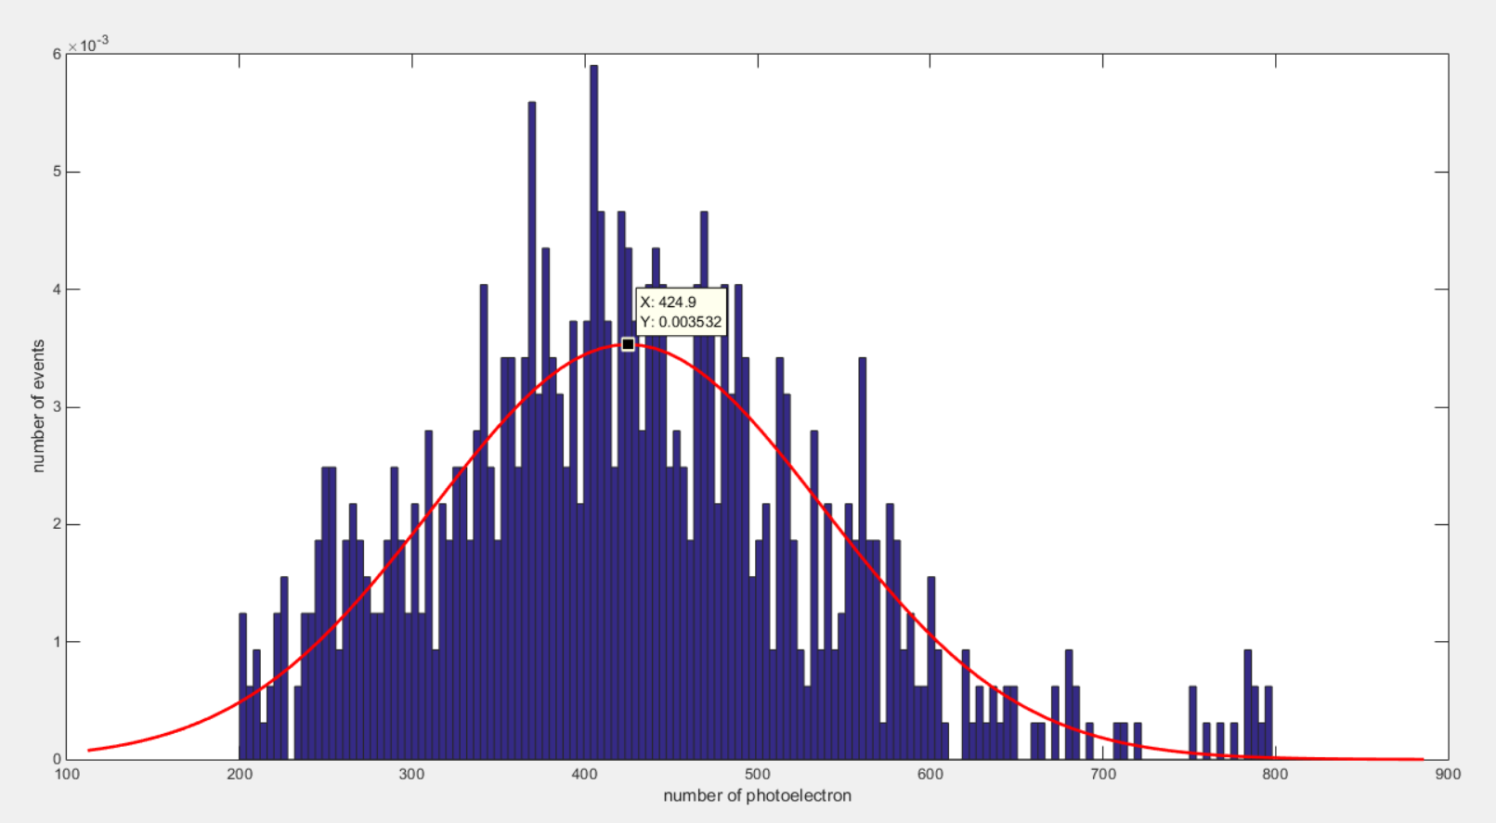
Vertical Test result
Gain of PMT: $2.5×{10}^{6}$
QDC: 0.1pc/channel
Triggered by two scintillators
PMT1
PMT2
PMT0
Peak is 424.9
ECal
PMT3

Slide 6
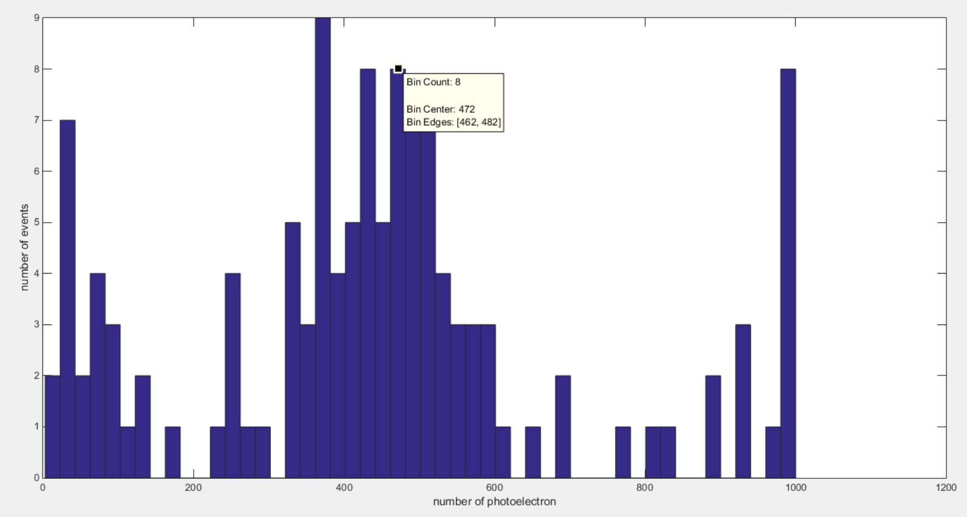
Vertical Test result
Triggered by three scintillators
PMT1
Peak is 472
PMT2
PMT0
ECal
PMT3

Slide 7
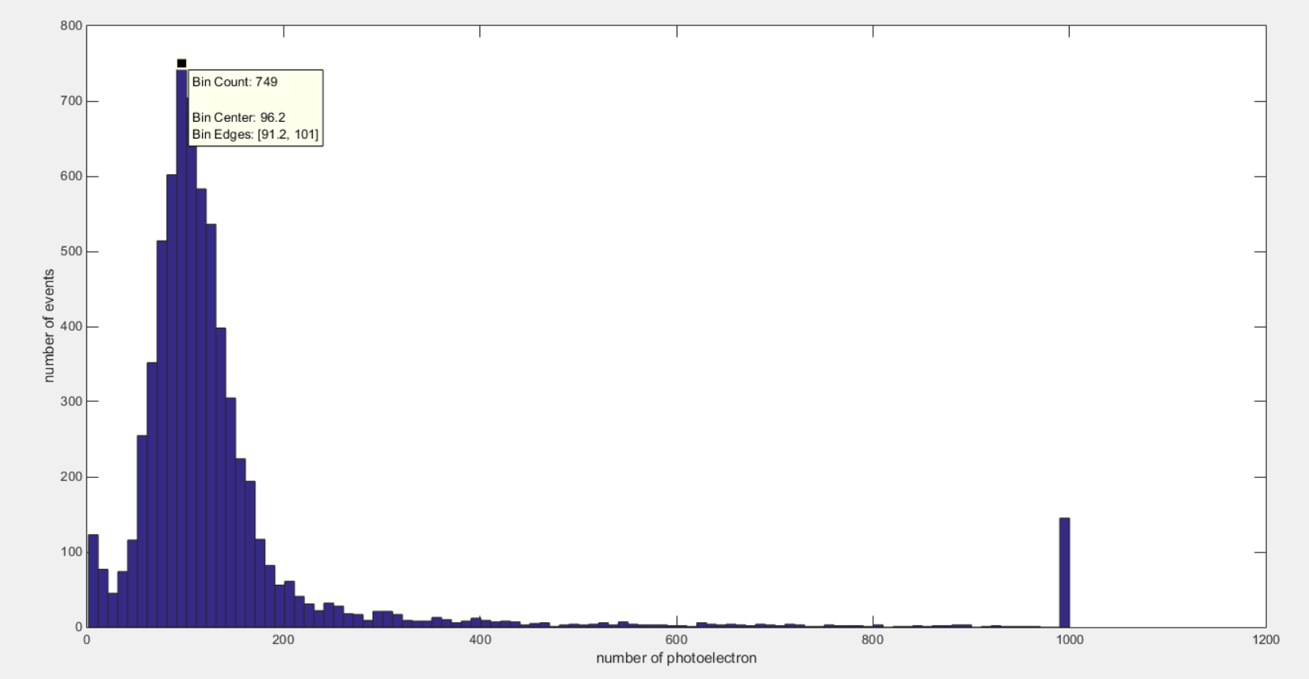
ECal
Horizontal Result
3CM
Triggered by two scintillators
23CM
Peak is 96.2

Slide 8
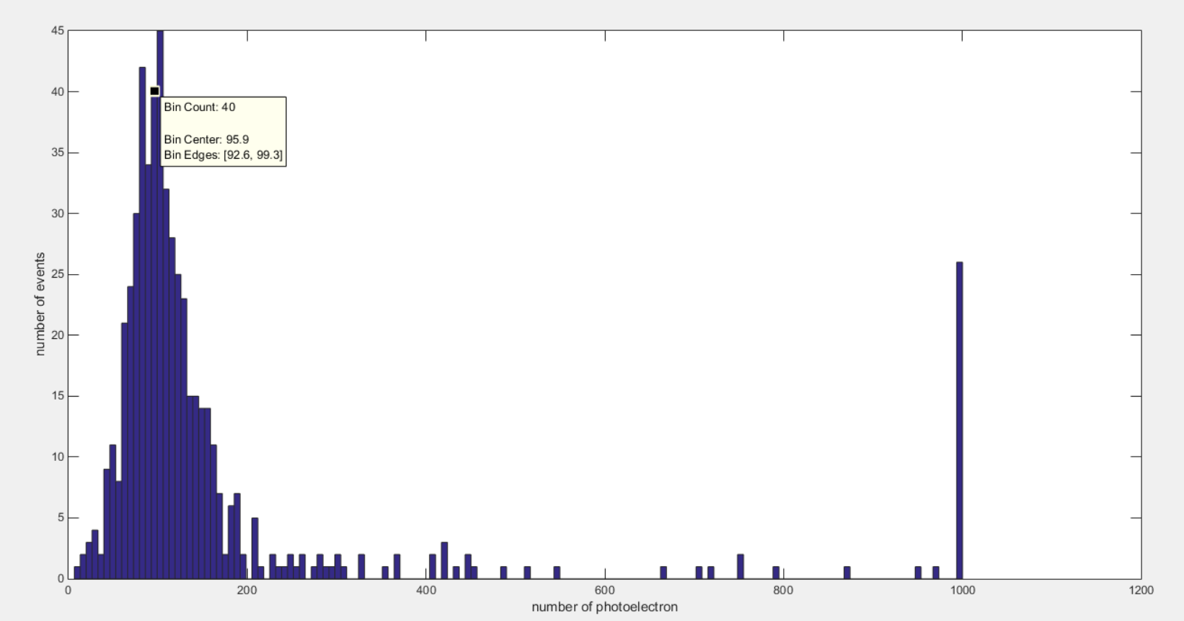
Vertical Test result
ECal
3CM
23CM
Triggered by three scintillators
Peak is 95.9

Slide 9
Thank You ! ! !

