Slide 1
Shashlyk test report update
Ye Tian
Cunfeng Feng
Jianbin Jiao
Shandong University
9-22-2016

Slide 2
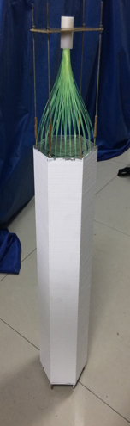
Shashlyk coating
Try to use white glue mixed with TiO2 to get the coating material, and got the idea from Kedi company
We coat module #2 with glue and TiO2 as mixing ratio 10:1 at first, and then coat module #1 with glue, TiO2 and water as ratio 6:1:1.
The quality of first attempt coating(#2) is not as good as the second one(#1).
We got the coating material sample from Kedi company, but that is not enough for one module

Slide 3
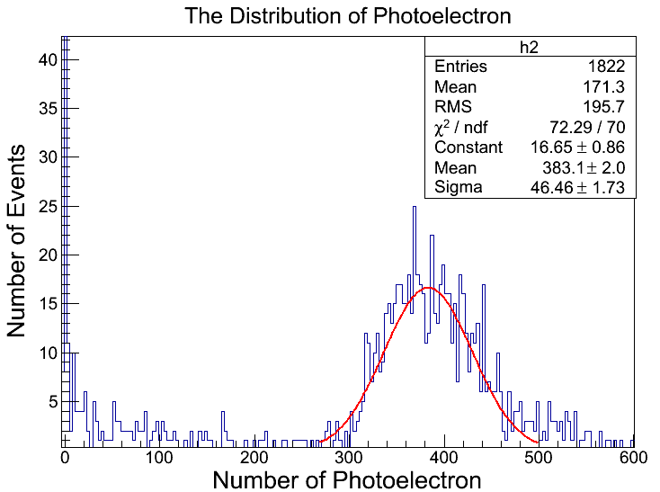
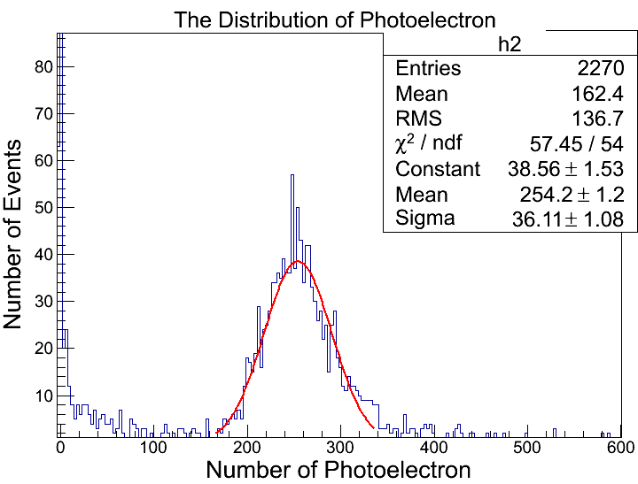
Module with coating test result
#2, photon number mean value is 383, 10% worse comparing with loose tyvek
#1, photon number mean value is 254, 14% better comparing with loose tyvek

Slide 4
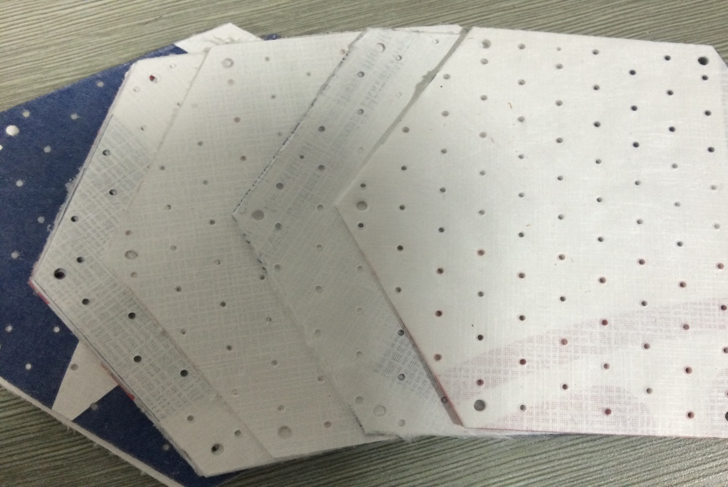
Tyvek sheet from US
Try to test the property
Hole quality not so good
Strange paper, just like cloth, a little non-light tight

Slide 5
Next step
Have built another module #3 with new scintillator and lead from US.
Work on to get one Y11 bundle.
Test the property of Tyvek from US
Compare different coating material

