Slide 1
Beam test status update
11/03/2016
Ye Tian, Vincent Sulkosky

Slide 2
Update
Rearrange the setting of detectors, make three shashlyk module as a cluster.
Add third FADC board, but readout is failed, need to reset address.
Add SUM of preshower and shashlyk to TDC channel, try to add separate module to TDC later
Add SUM of SoLID detectors to scaler
Data taking rate previous is 30, could reach 40 now.

Slide 3
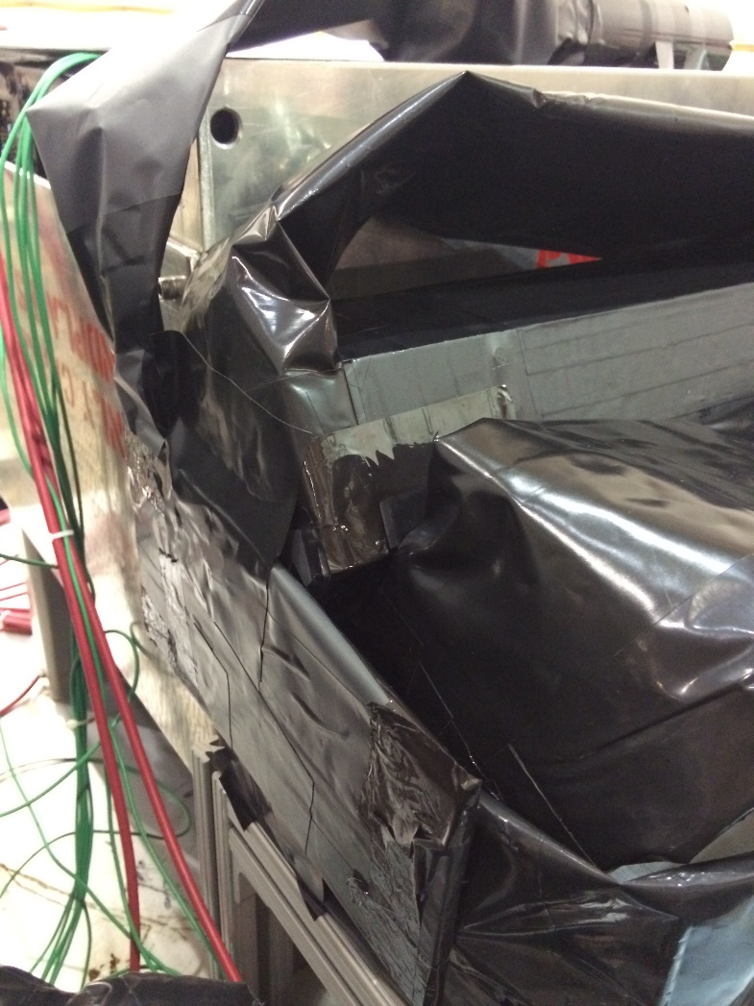
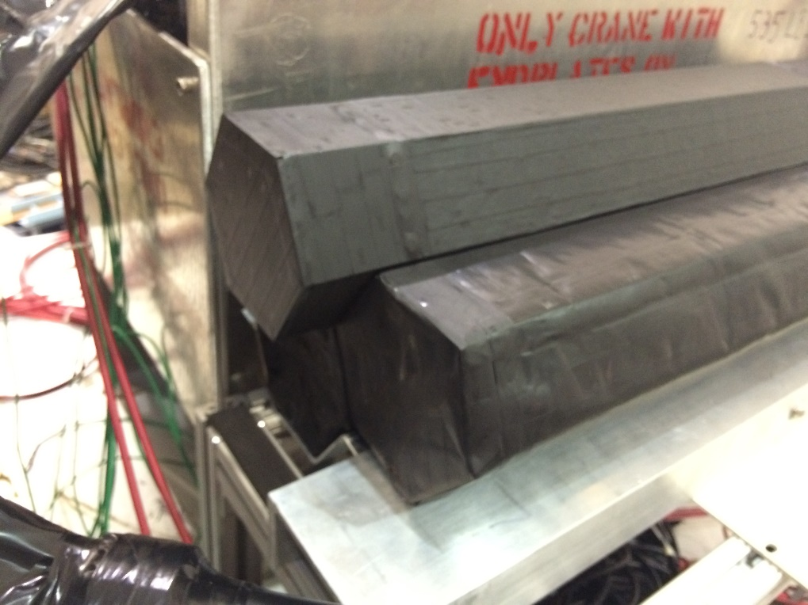
Rearrange the geometry of SoLID detectors

Slide 4
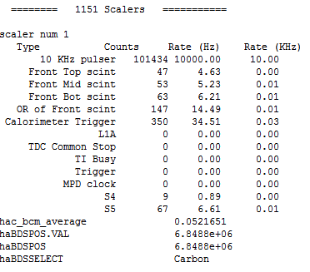
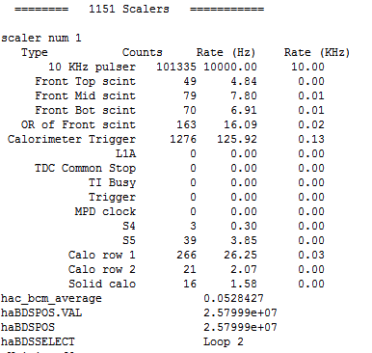
Rate with cosmic after changing geometry
Cosmic rate get higher. Since SoLID calo rate is so low and no other change, why the rate get high? Need to check.

Slide 5
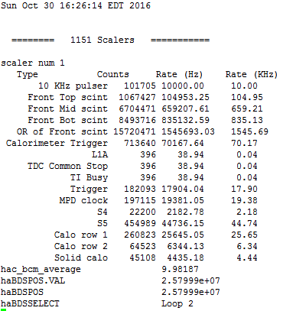
Scaler rate with beam on
Type Counts Rate (Hz) Rate (KHz) 10 KHz pulser 101881 10000.00 10.00 Front Top scint 4094456 401886.12 401.89 Front Mid scint 10800795 1060138.30 1060.14 Front Bot scint 8701107 854046.09 854.05 OR of Front scint 22204054 2179410.69 2179.41 Calorimeter Trigger 1162274 114081.53 114.08 L1A 269 26.40 0.03 TDC Common Stop 269 26.40 0.03 TI Busy 269 26.40 0.03 Trigger 538145 52820.94 52.82 MPD clock 579469 56877.04 56.88 S4 101967 10008.44 10.01 S5 2063590 202549.05 202.55 hac_bcm_average 67.6139 haBDSPOS.VAL 2.57999e+07 haBDSPOS 2.57999e+07 haBDSSELECT Loop 2
Ratio compared with Front scintillator is still around 20, high rate with cosmic may caused by light leak.

Slide 6
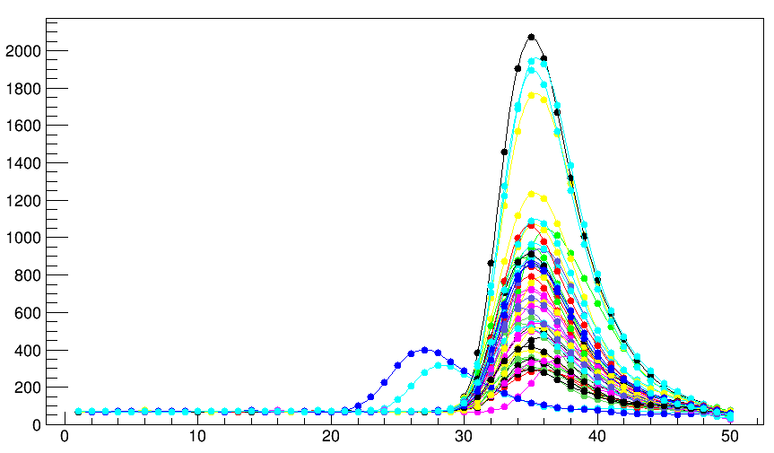
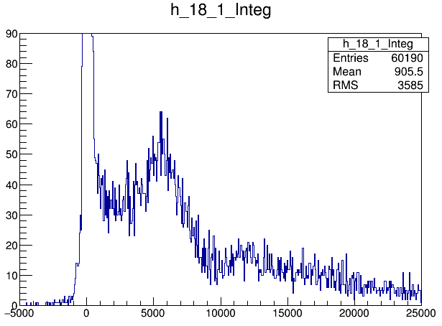
SBS calorimeter
Original wave with signal(selected by Integral cut)
After subtract pedestal

Slide 7
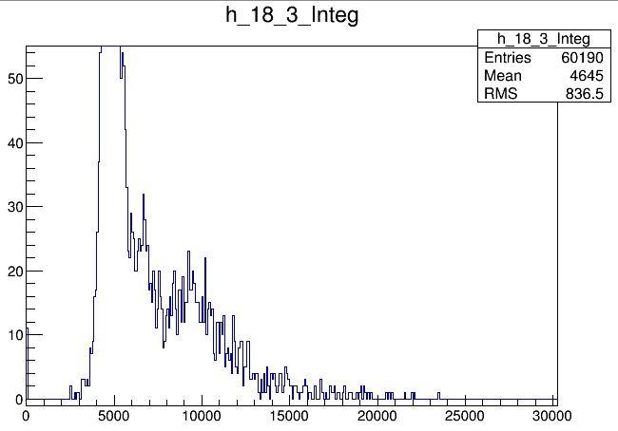
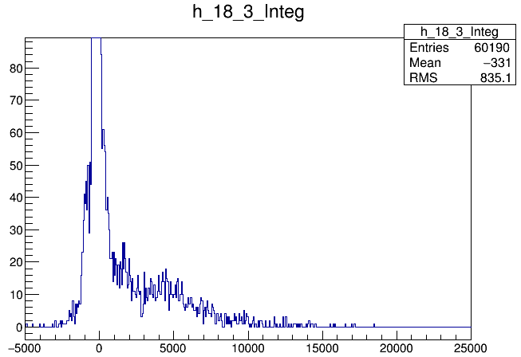
THU module
Integra value(add all points)
Original wave with signal(selected by Integral cut)
After subtract pedestal

Slide 8
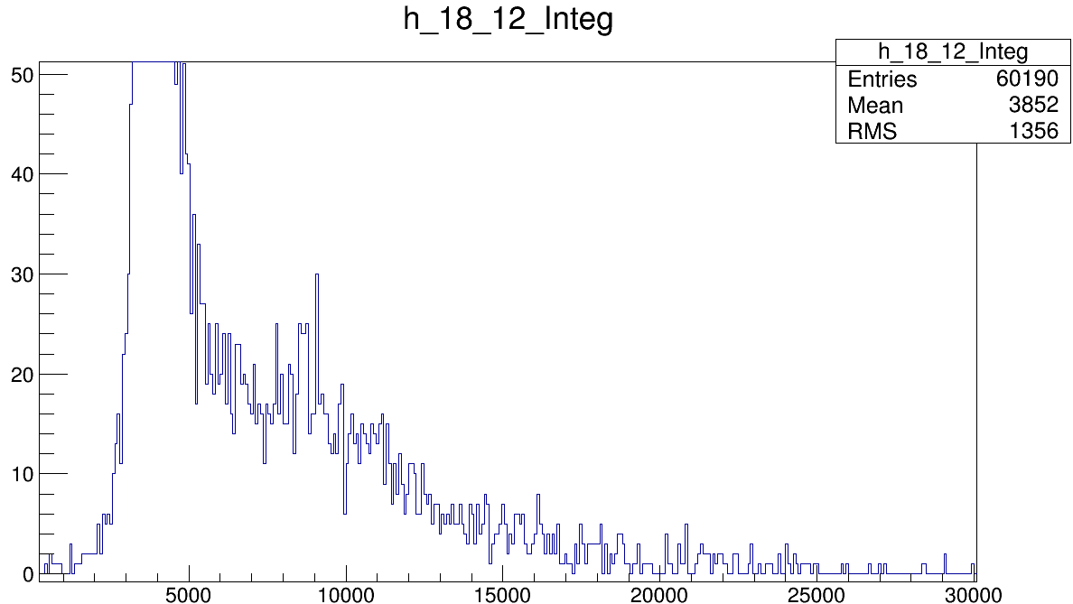
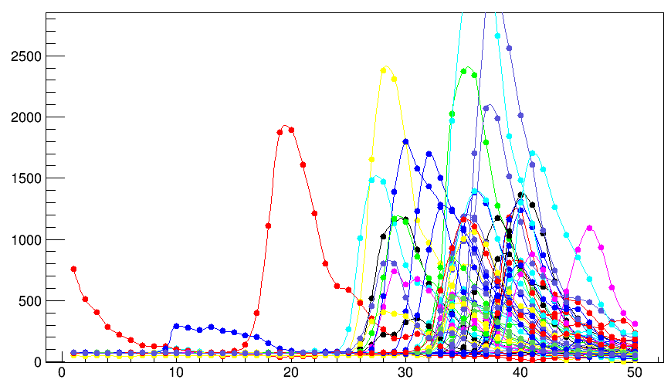
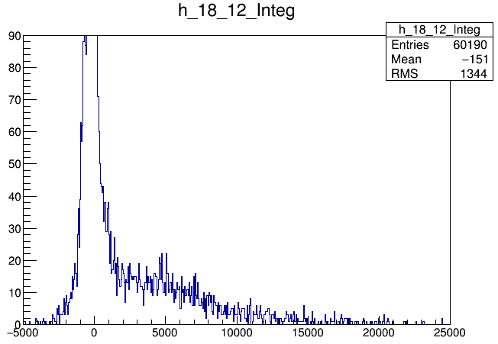
SDU #1
Integra value(add all points)
Original wave with signal(selected by Integral cut)
After subtract pedestal

Slide 9
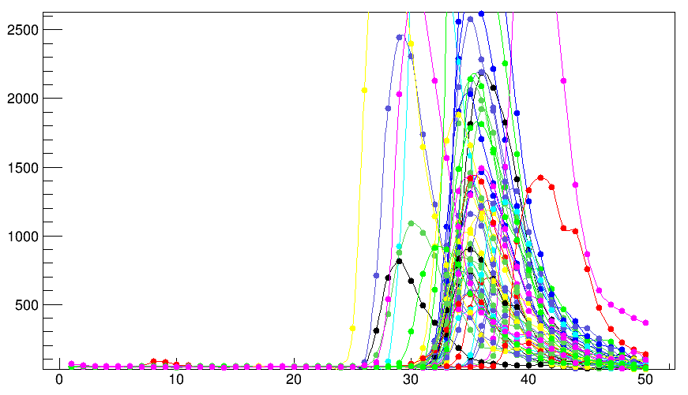
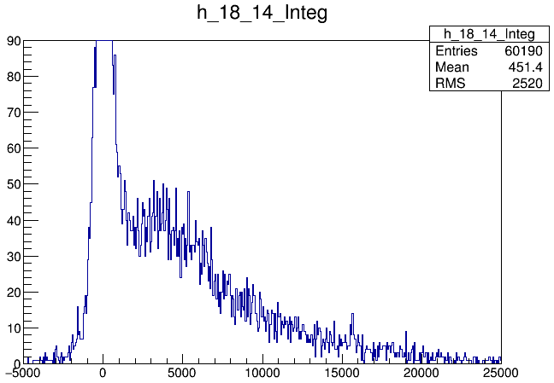
SDU #2
Integra value(add all points)
Original wave with signal(selected by Integral cut)
After subtract pedestal

