Slide 1
Beam test status update
11/10/2016
Ye Tian, SDU
Vincent Sulkosky, UVA

Slide 2
Electronic update
Work still on process, these updates will realize from
The FASPD is removed from SUM of calorimeter
Will remove preshower from trigger too.
Will add one scaler and other modules to get rate information for all preshower and shashlyk detectors. All SoLID detectors signals will input to FADC and scaler, including S4, LASPD and FASPD.
We are not taking any GEM data now, just use high rate to make sure other detector work. The data taking rate could reach 1K with beam now.
Module | FADC | TDC | Scaler
S4_L | √ | √ | √
S4_R | √ | √ | √
LASPD_L | √ | √ | √
LASPD_R | √ | √ | √
FASPD | √ | √ | √
THU | √ |  | √
preshower | √ |  | √
SDU #1 | √ |  | √
SDU #2 | √ |  | √

Slide 3
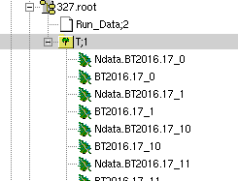
Data readout by HallA analyzer
Now the decoder of TDC and FADC works well using HallA analyzer
HallA analyzer is simple and easy to use
Need help to add more functions, including GEM decoder and also scaler
Need a lot of work to do such as add detector geometry to realize more advanced analysis

Slide 4
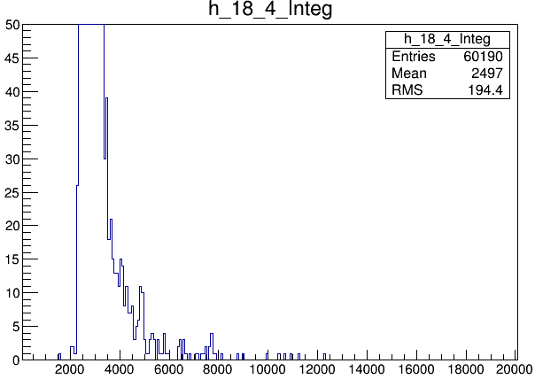
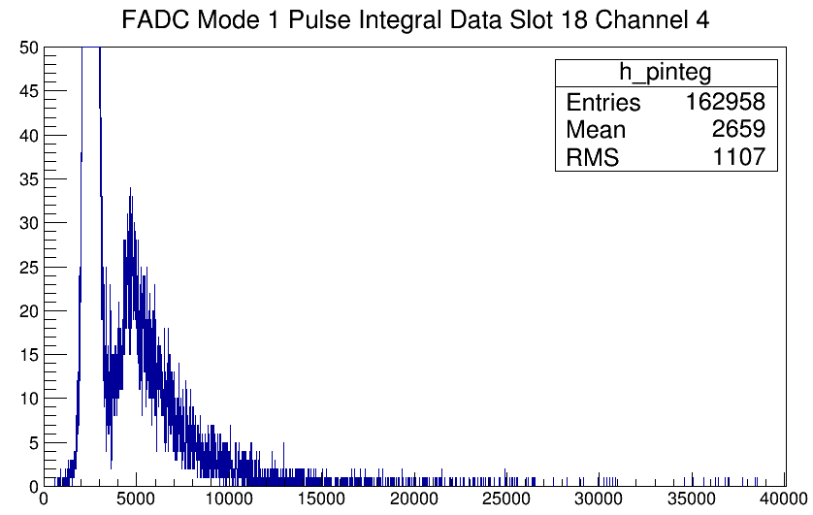
Detector test data after changing HV(BEAM)
Preshower in front of THU module, HV raise from 1600 to 1800

Slide 5
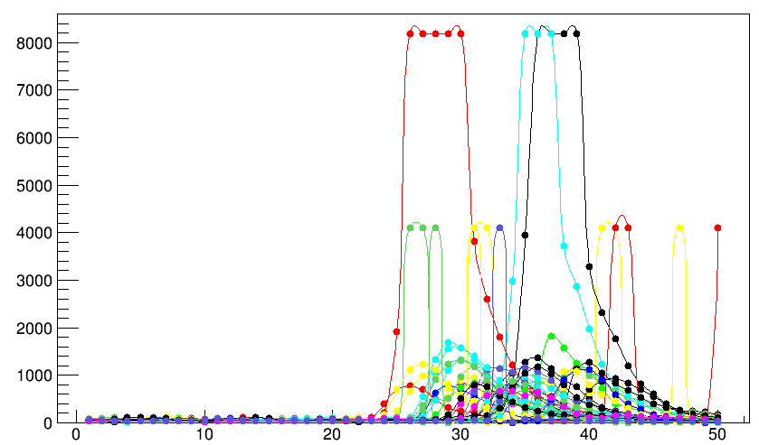
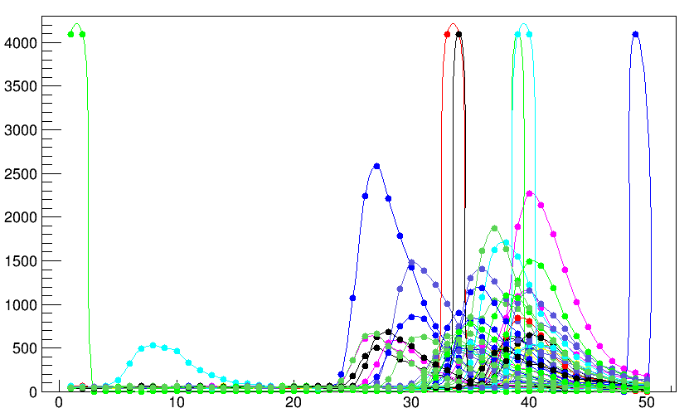
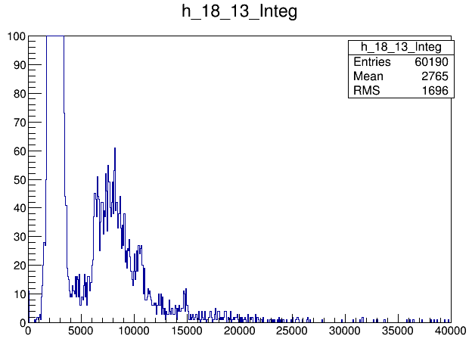
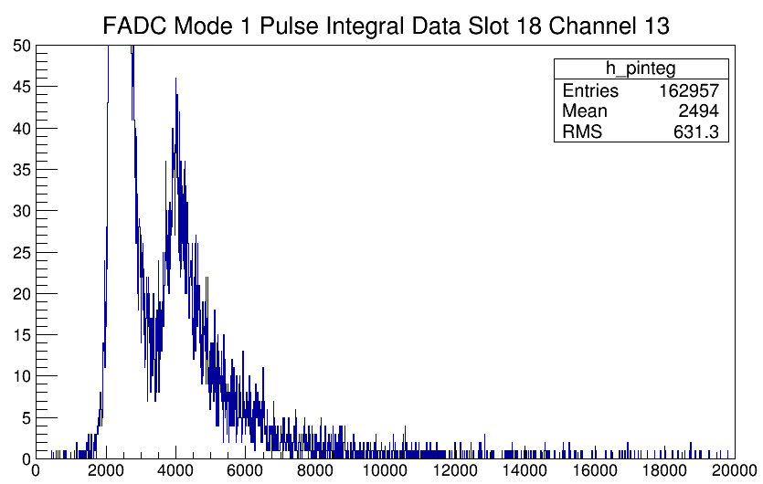
Channel 13, preshower in front of SDU1， decrease from 1600 to 1500

Slide 6
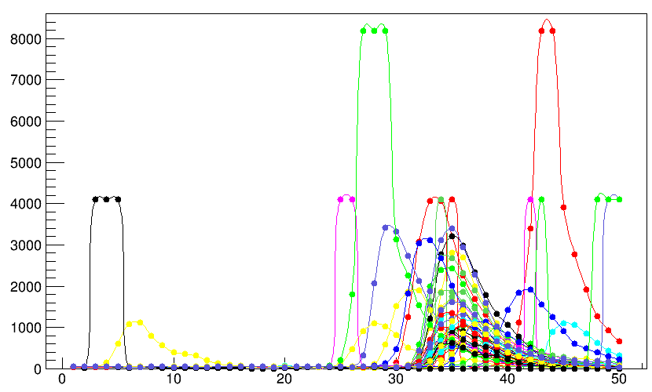
SDU #2 HV decrease from 1320(2.5* 10^6) to 1200(1.5*10^6)

Slide 7
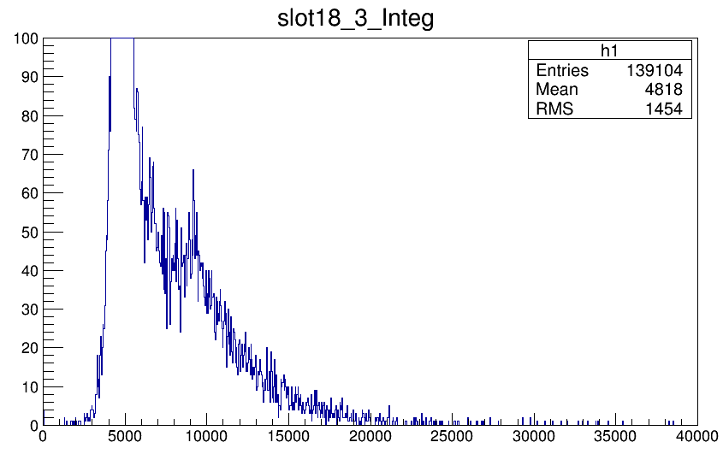
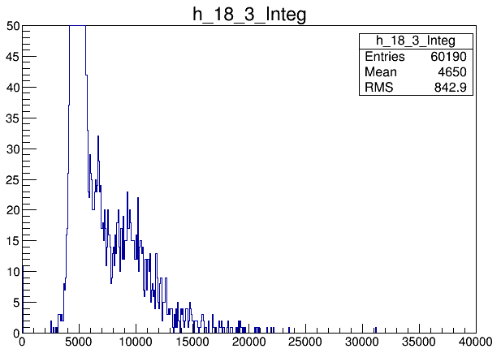
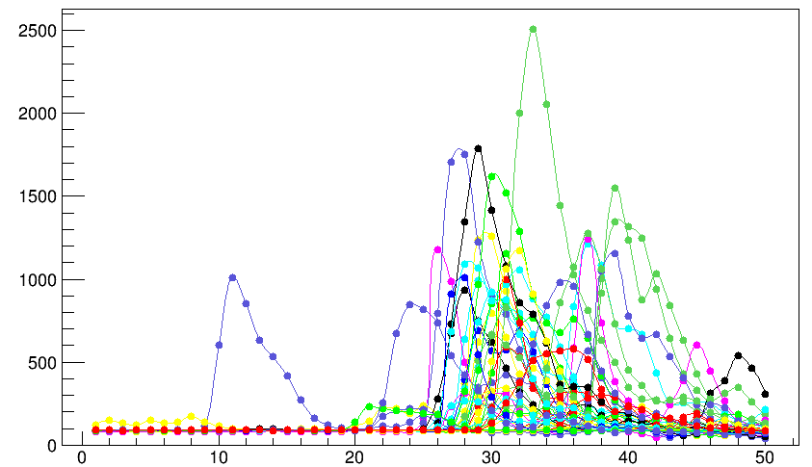
THU module raise from 2000 to 2050

Slide 8
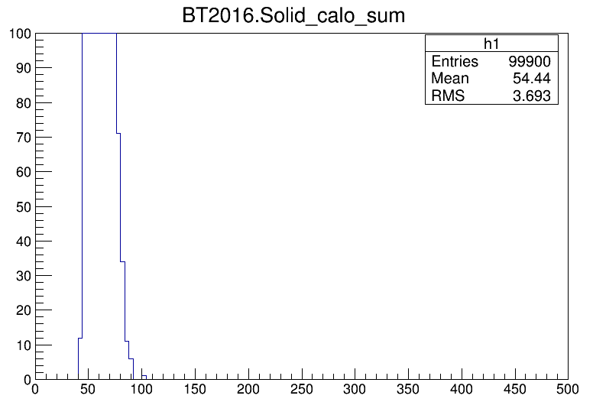
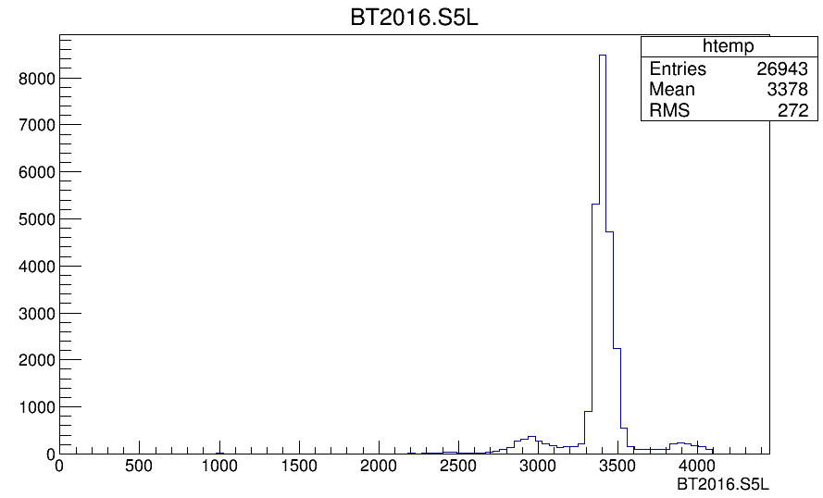
Time information with beam
We don’t have FASPD data because bad cable issue, which is solved now
Now TDC cable issue solved
TDC channel for SoLID sum
TDC channel for LASPD (left)
Time weird, and too many events, need to check.
What’s the peak? Supposing 35ps/channel* 450 channel =16.75 ns, should not the beam structure(4ns)

Slide 9
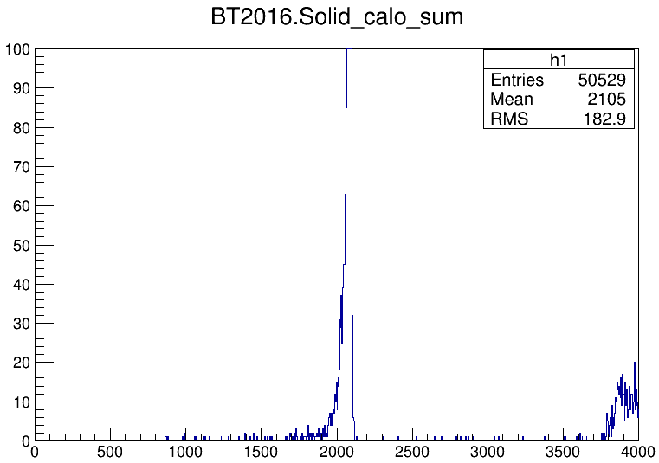
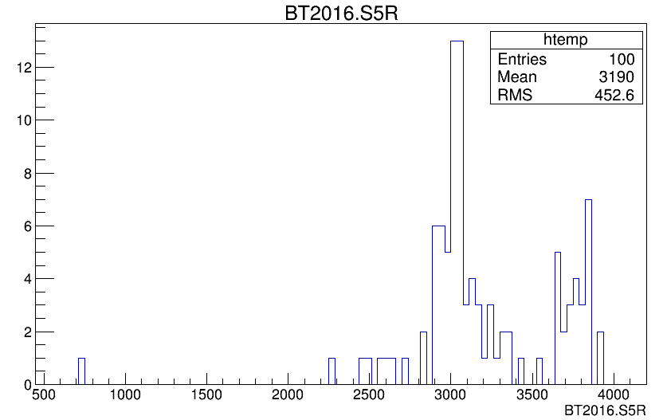
Time information for cosmic ray test
Sum od SoLID detector
LASPD

Slide 10
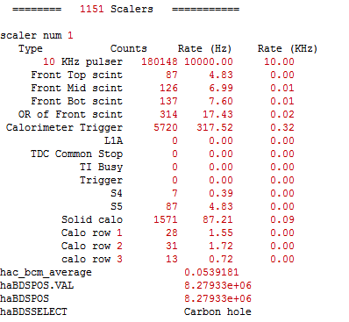
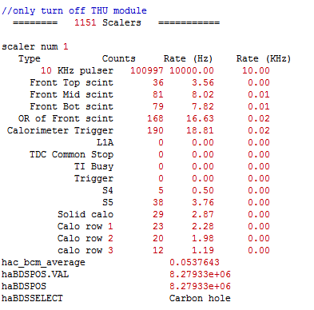
Scaler test with cosmic ray
Normal rate with all HV on
Scaler aate with only THU module off

Slide 11
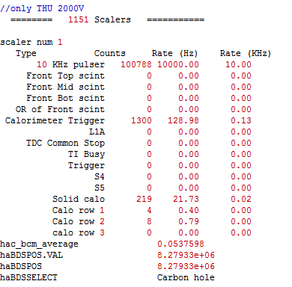
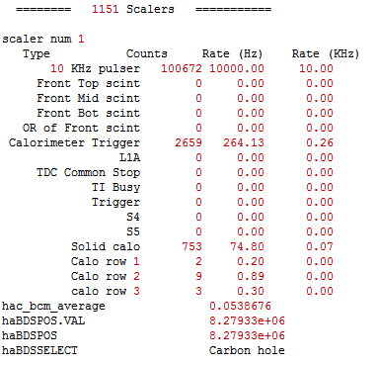
When THU module use HV 2050V, at most events triggered by THU module.
2000V
2050V

Slide 12
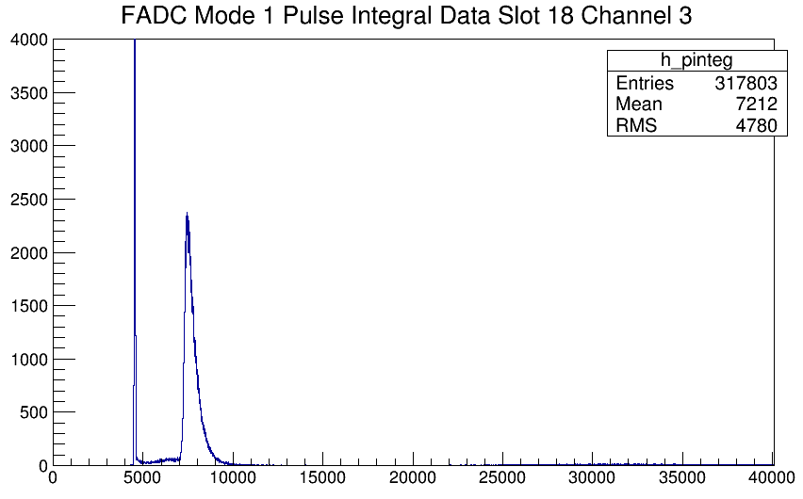
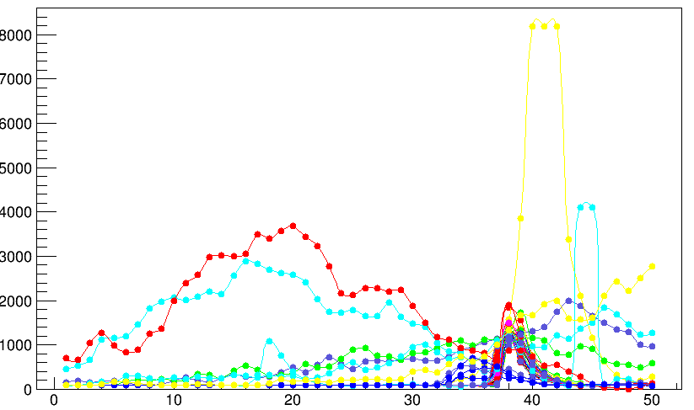
Cosmic ray data
THU module

Slide 13
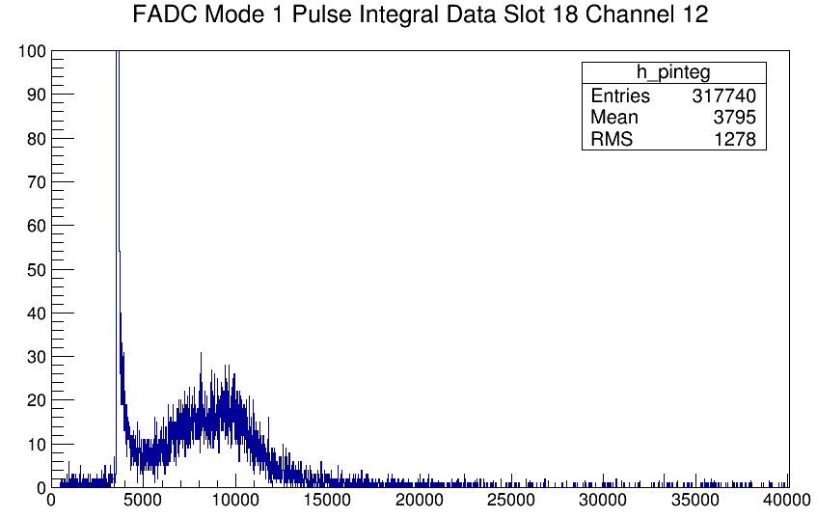
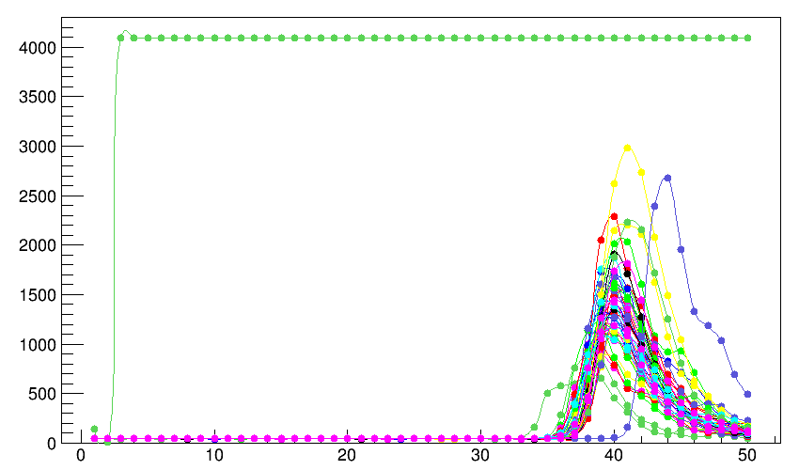
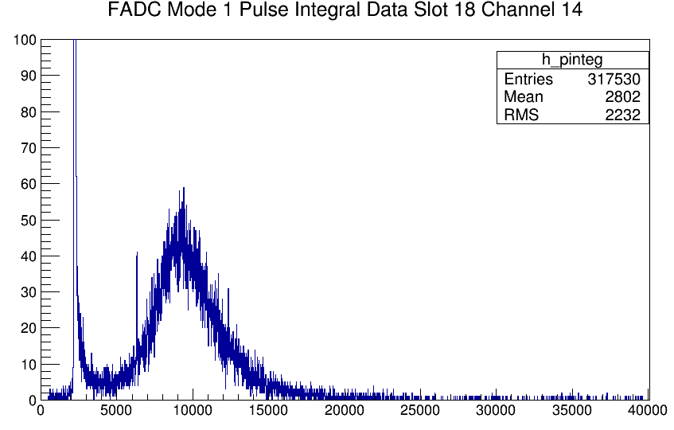
SDU module
SDU #1
SDU #2

Slide 14
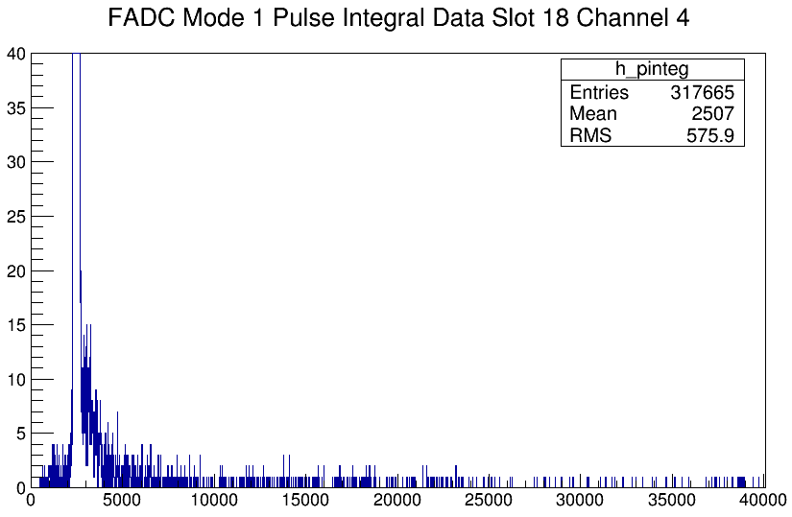
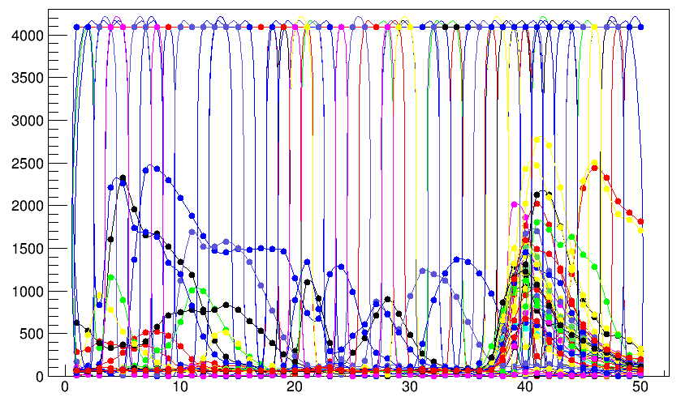
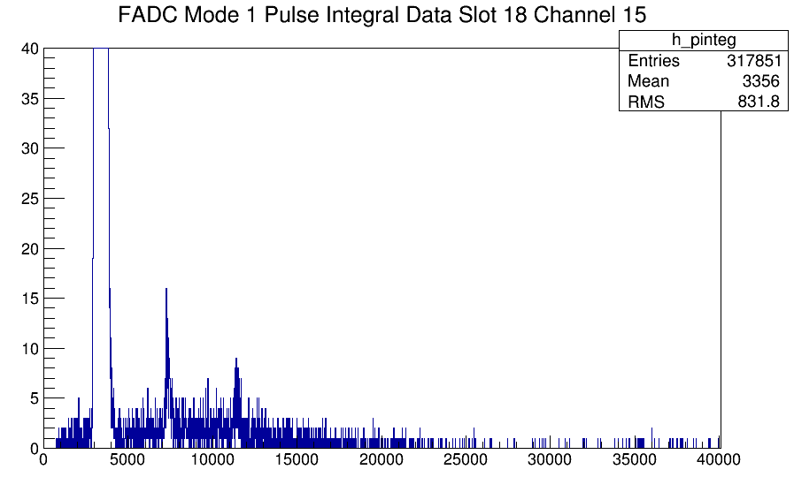
Preshower
Light-leak will result in wider pedestal.

Slide 15
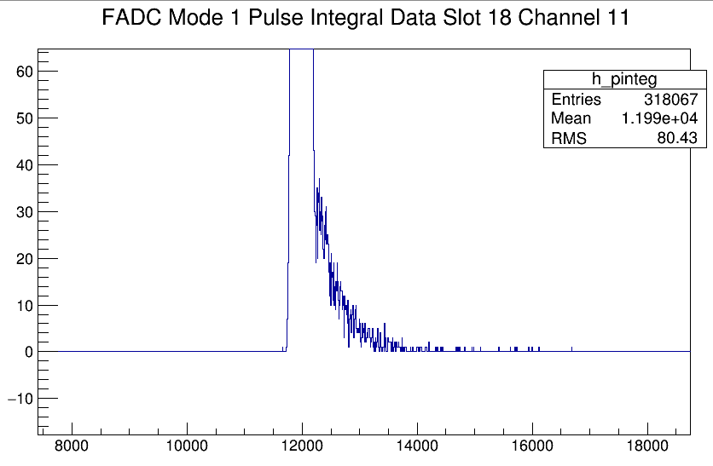
FASPD
After putting the signal into Fan In/Out module, the signal baseline changed. Already changed the offset to make pedestal normal(Need to check).

Slide 16
Light-tight check
Detector | FADC channel | Average current
THU shashlyk | 3 | 9 nA
Preshower NCS5 | 4 | 4.96 uA
FASPD | 11 | 7 nA
SDU #1 | 12 | 1.5 nA
Preshower NCS6 | 13 | 22.4 uA
SDU #2 | 14 | 2 nA
Preshower (KEDI6) | 15 | 5.7 uA
Tested by picoammeter, borrowed from another group.
Three preshowers use bad light-leak material to cover the fiber, and the result get much better(could reach 20 nA) when wrapped by other black cloth. Even so, the rate for both cosmic and beam is still low(trigger threshold is high).
FASPD use same PMT as preshower which is different from shashlik module, but it use black Teflon cloth for wrapping. We now have enough black Taflon to rewrap the preshower.

