Slide 1
Event rate and
Temperature coefficient
Ang Li, Jianbin Jiao, Cunfeng Feng
SDU, Jan. 5th, 2017

Slide 2
PMT noise rate test
Principal of test
PMT
Low threshold discriminator
scaler

Slide 3
The event rate of the PMT in dark ox
PMT Voltage(V) (Gain) | SPE amplitude | Threshold(mV) | rate（/s） | PMT voltage(V) (Gain) |  | Threshold (mV) | rate（/s）
1060 (5.24e+06) | 10.9mV | 5 | 168.8 | 860 (1.0e+06)
 |  | 10 | 44.1 |  |  | 2 | 43.1
 |  | 20 | 6.3 |  |  | 4 | 5.7
 |  | 50 | 2.5 |  |  | 10 | 2.2
 |  | 100 | 0.6 |  |  | 20 | 0.5
960 (2.38e+06) | 5.5mV | 2 | 145.4 | 760 (4.4e+05) Amplify *10 |  | 5 | 3.7
 |  | 5 | 30.7 |  |  | 10 | 3.1
 |  | 10 | 5.5 |  |  | 20 | 2.0
 |  | 25 | 2.2 |  |  | 50 | 0.5
 |  | 50 | 0.5 |  |  | 100 | 0.1

Slide 4
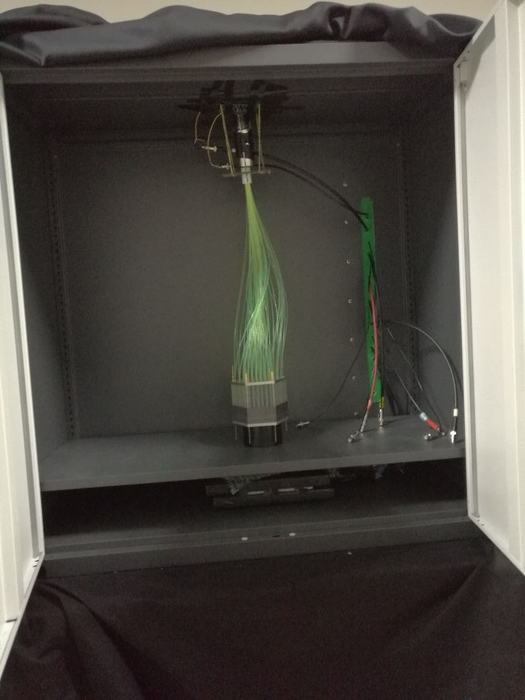
Event rates with one small module
Only tens layers scintillators and leads

Slide 5
The event rates of the small module
Voltage(V) | Threshold(mV) | rate（/s） | voltage | Threshold | rate（/s）
1060 | 5 | 2181.0 | 860
 | 10 | 833.5 |  | 2 | 1000.0
 | 20 | 34.53 |  | 4 | 31.3
 | 50 | 8.0 |  | 10 | 5.2
 | 100 | 2.0 |  | 20 | 1.6
960 | 2 | 2258 | 760 | 5 | 10.8
 | 5 | 662.0 |  | 10 | 7.7
 | 10 | 25.3 |  | 20 | 4.5
 | 25 | 6.1 |  | 50 | 1.6
 | 50 | 1.5 |  | 100 | 0.3

Slide 6
Temperature coefficient
Trigger1
Low threshold discriminator
GATE
scintillator
Trigger2
QDC
delay
Climate box
Temperature range -20 C~85 C

Slide 7
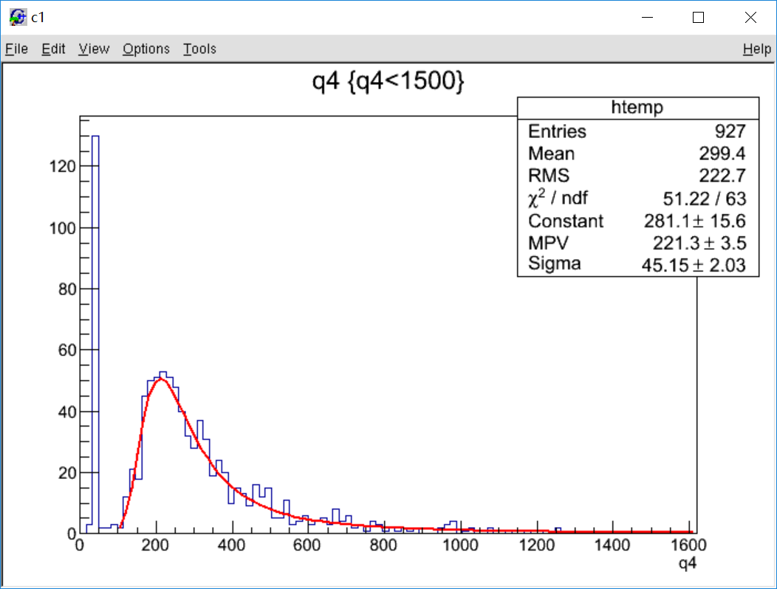
-14.7℃
count
channel

Slide 8
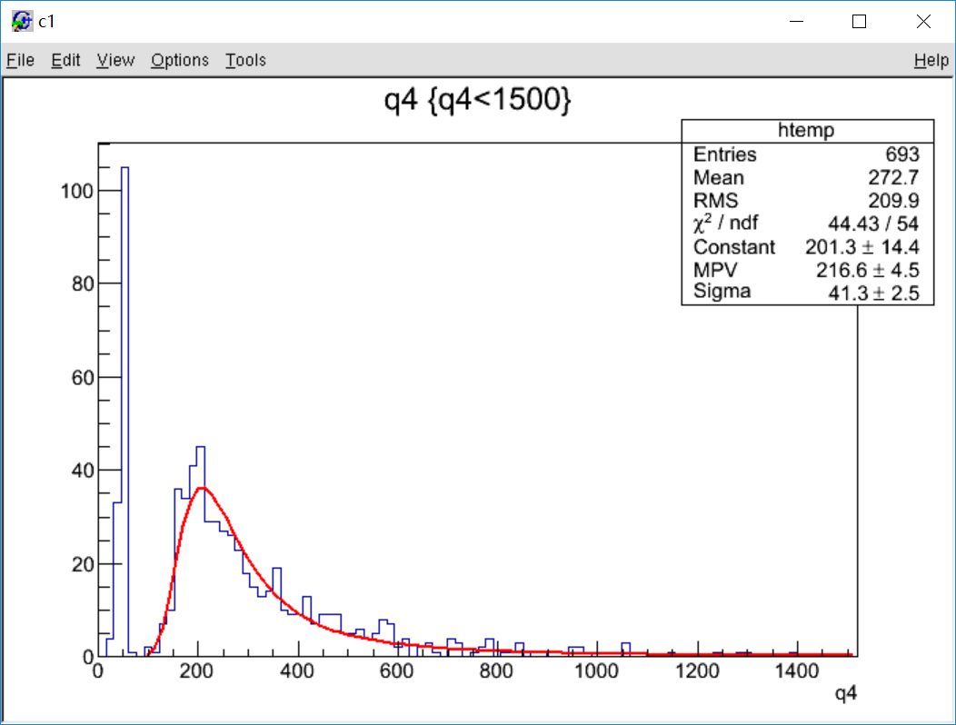
0℃
count
channel

Slide 9
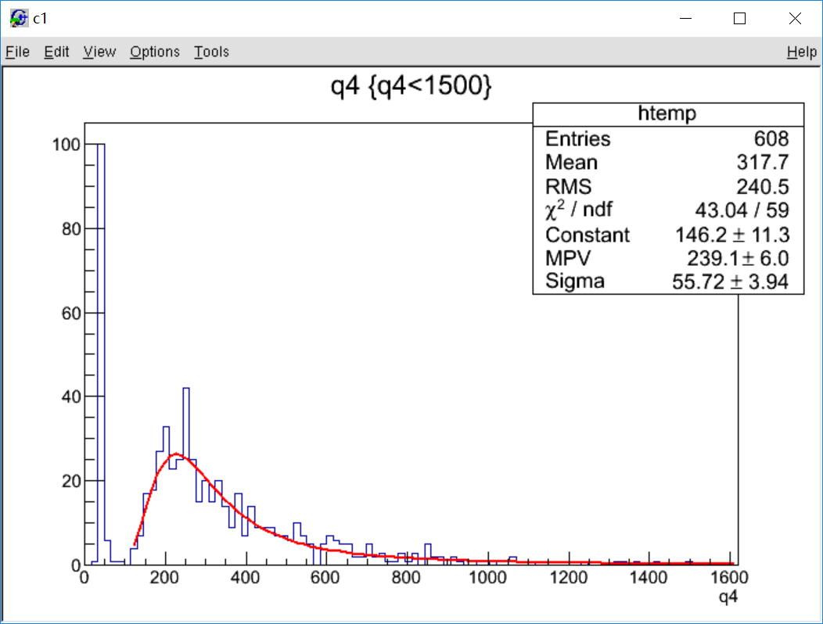
8℃
count
channel

Slide 10
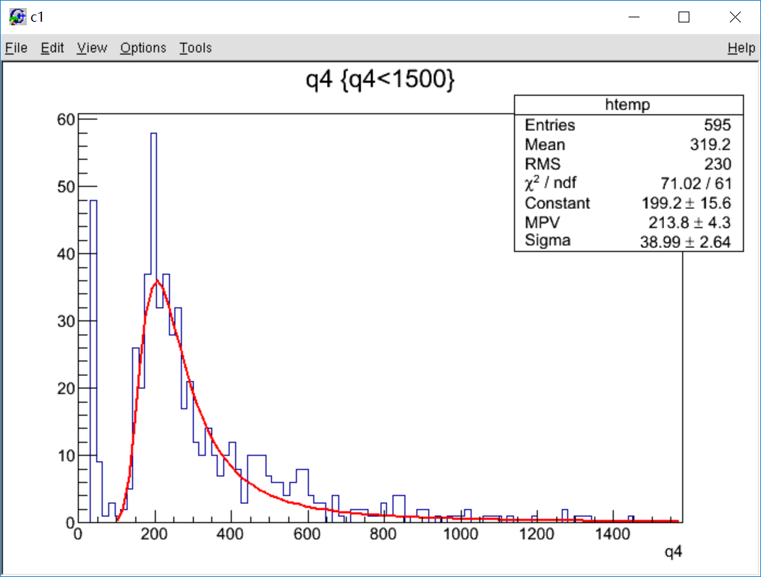
20.7℃
count
channel

Slide 11
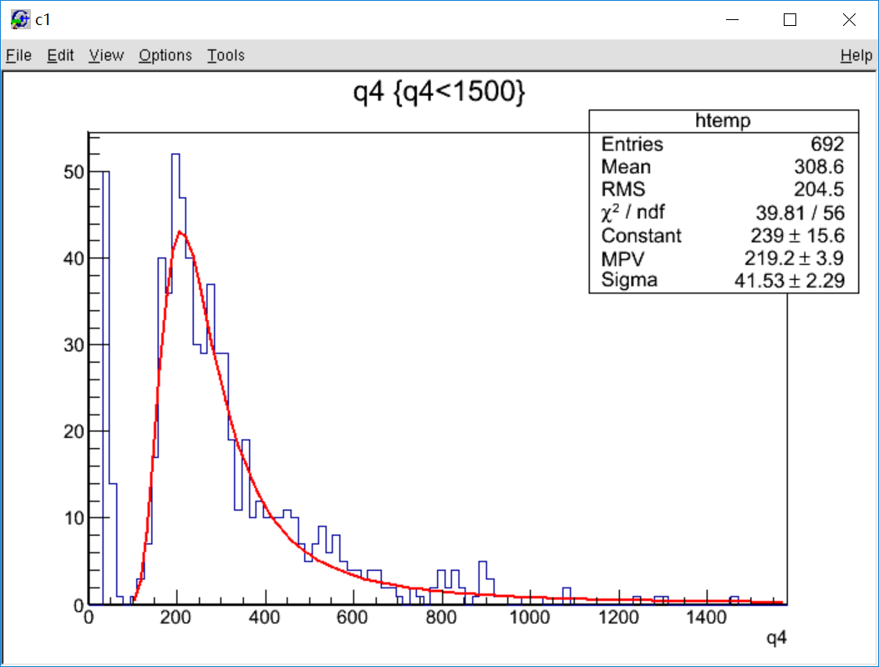
30.2℃
count
channel

Slide 12
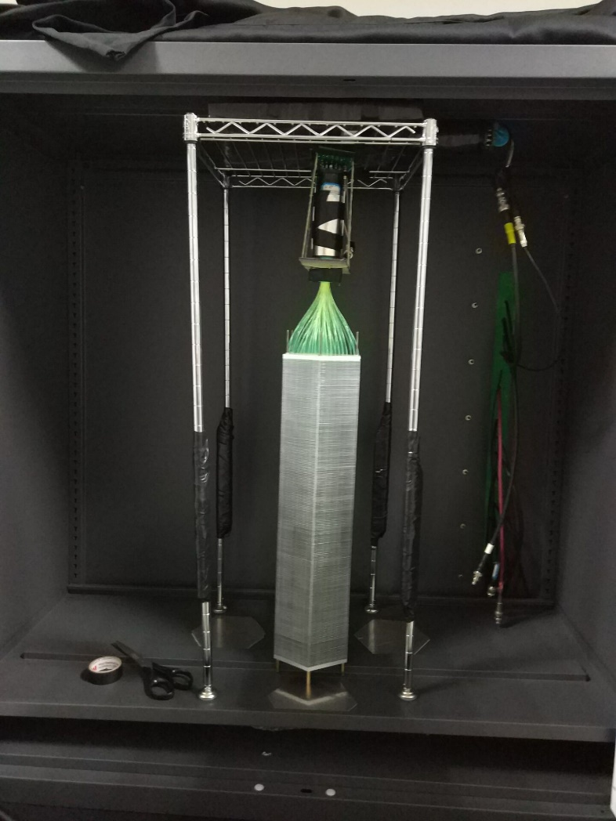
One full module is testing
trigger
trigger

Slide 13
Back up

Slide 14
Voltage | Gain | SPE
1060 | 5.24e+06 | 10.9
960 | 2.38e+06 | 5.5
860 | 1.0e+06 | 2.1
760 | 4.4e+05 | 0.9

