Slide 1
SDU #3 cosmic test result
Ang Li, Jianbin Jiao, Cunfeng Feng
SDU, Jan. 12th, 2017

Slide 2
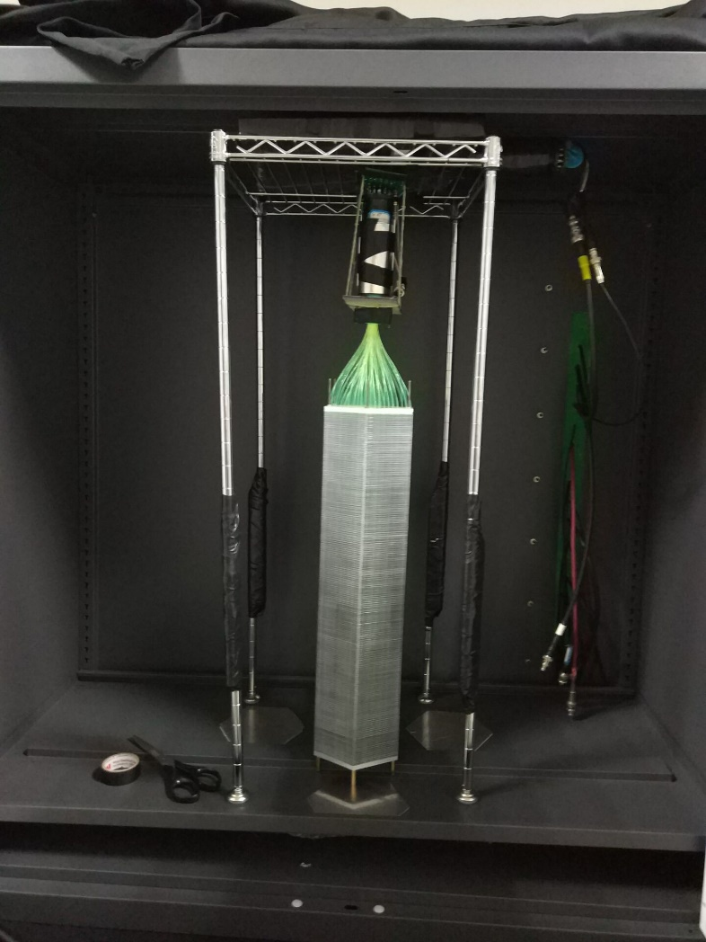
New SDU #3 module
Module No. | WLS fiber | Scintillator | Lead layer | Fiber end | Reflective layer | Front plate | Coating
SDU #3 | Y11 | Kedi(enhanced) | US company | Silver mirror | Print paper | No holes | SiO2+glue(1:1)
Comparing with SDU #2, the improvement is fiber and use more SiO2 ratio.
trigger
trigger

Slide 3
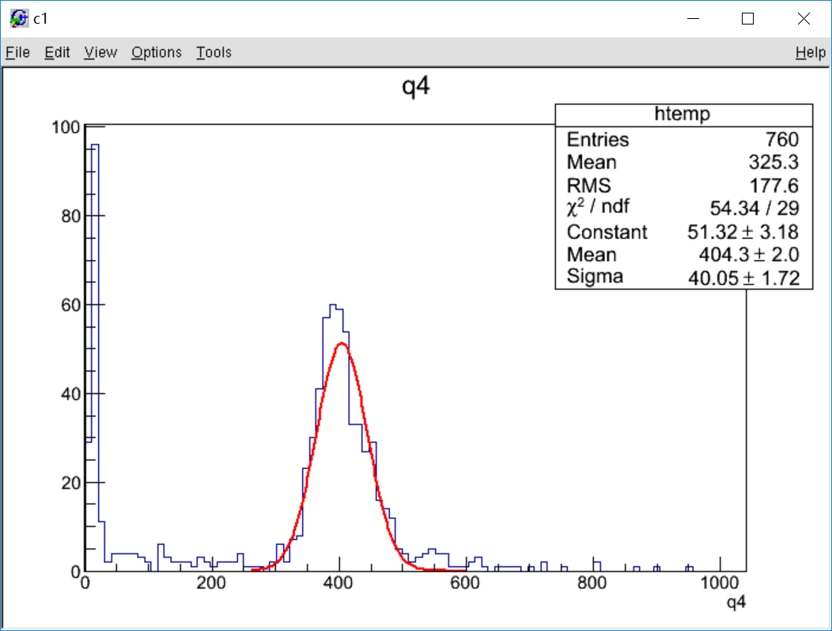
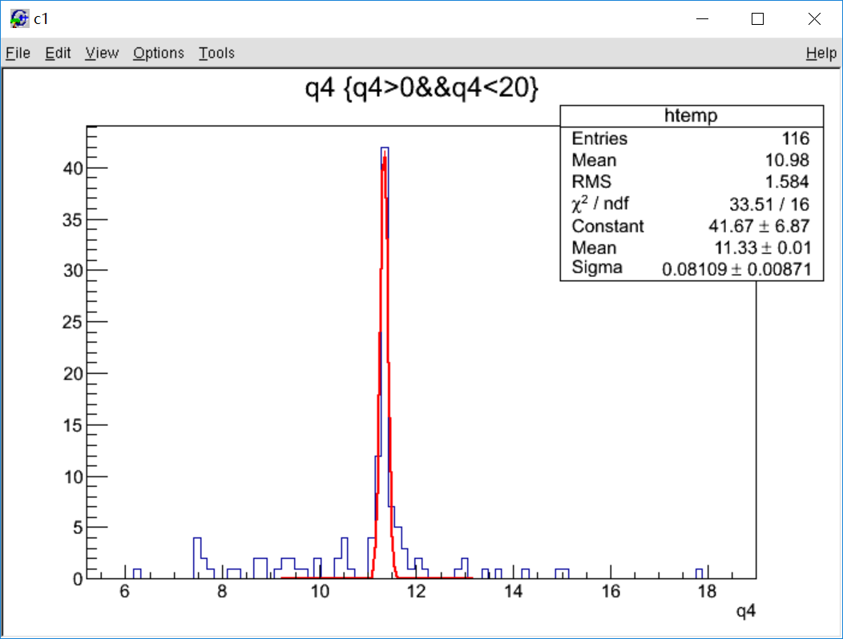
Vertical test result
Signal
Pedestal
count
count
Charge(pC)
Charge(pC)
$\frac{(MPV−Ped)}{e×Gain}=491.3$ photo-electrons (Gain=5*10^6)
For preshower test, Y11 light yield is twice of BCF91. Comparing with SDU #2(426.5), our result is only 15% better. (Maybe SDU #3 mirror quality is bad or maybe fiber test use different scintillator)

Slide 4
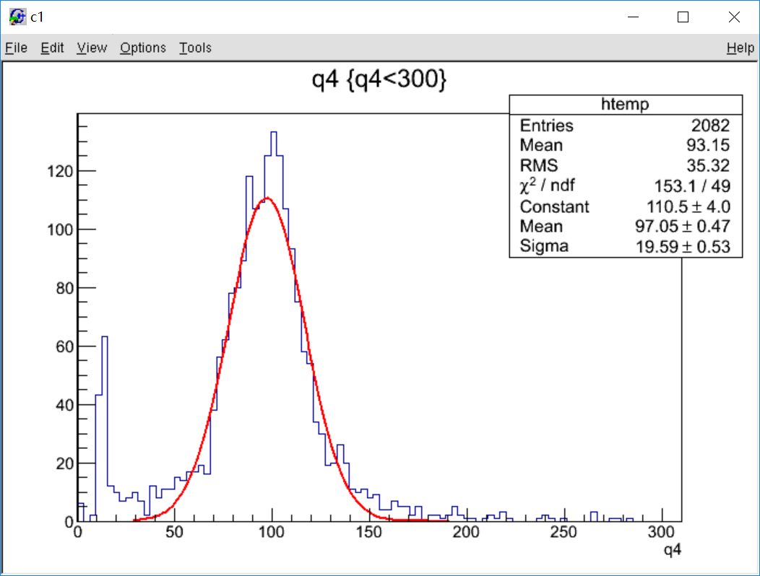
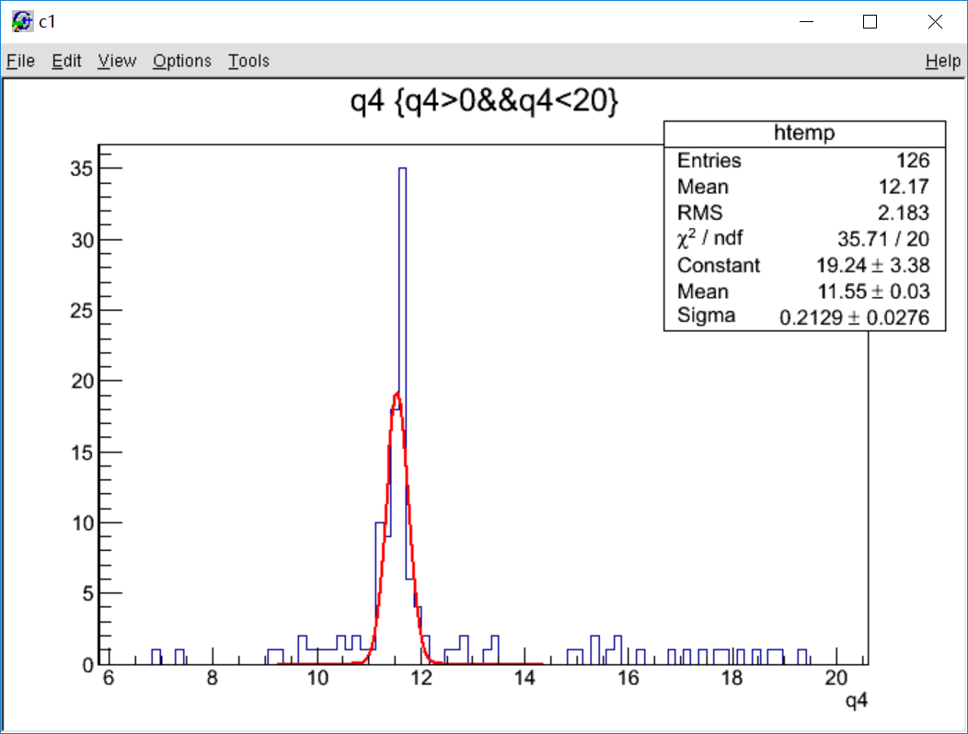
Horizontal test result
Signal
Pedestal
count
count
Charge(pC)
Charge(pC)
$\frac{(MPV−Ped)}{e×Gain}=106.9$ photo-electrons (Gain=5*10^6)

Slide 5
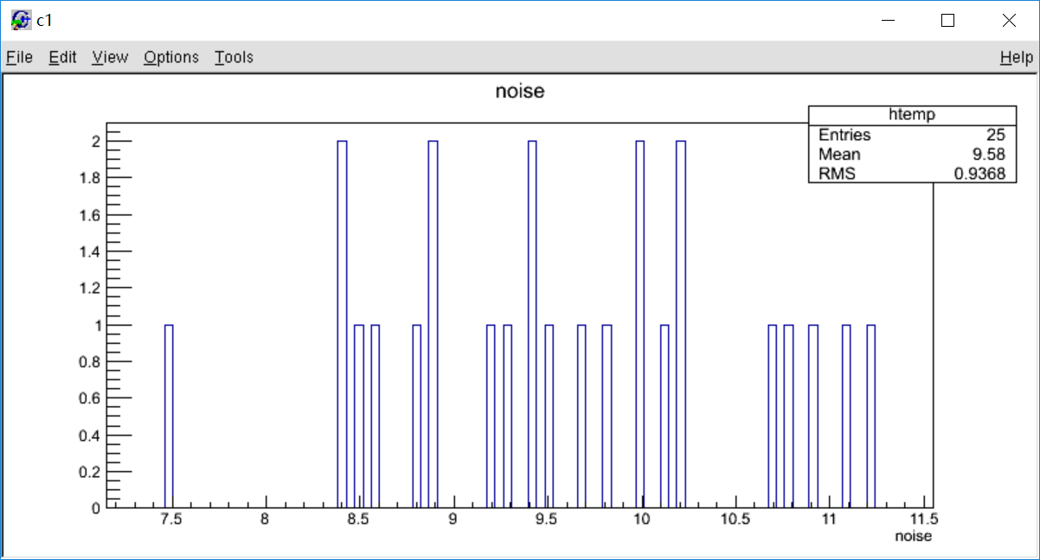
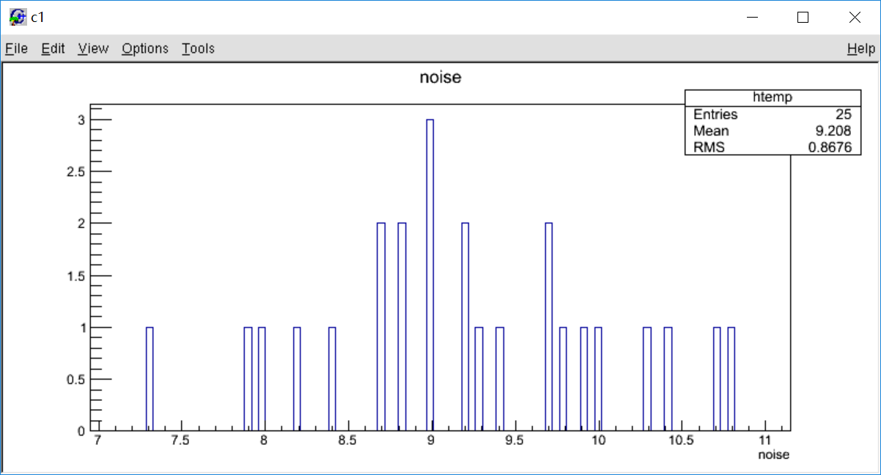
Detector “noise” rate (triggered by itself)
Vertical
Horizontal
count/s
count/s
Threshold 100mV (10 SPE)

Slide 6
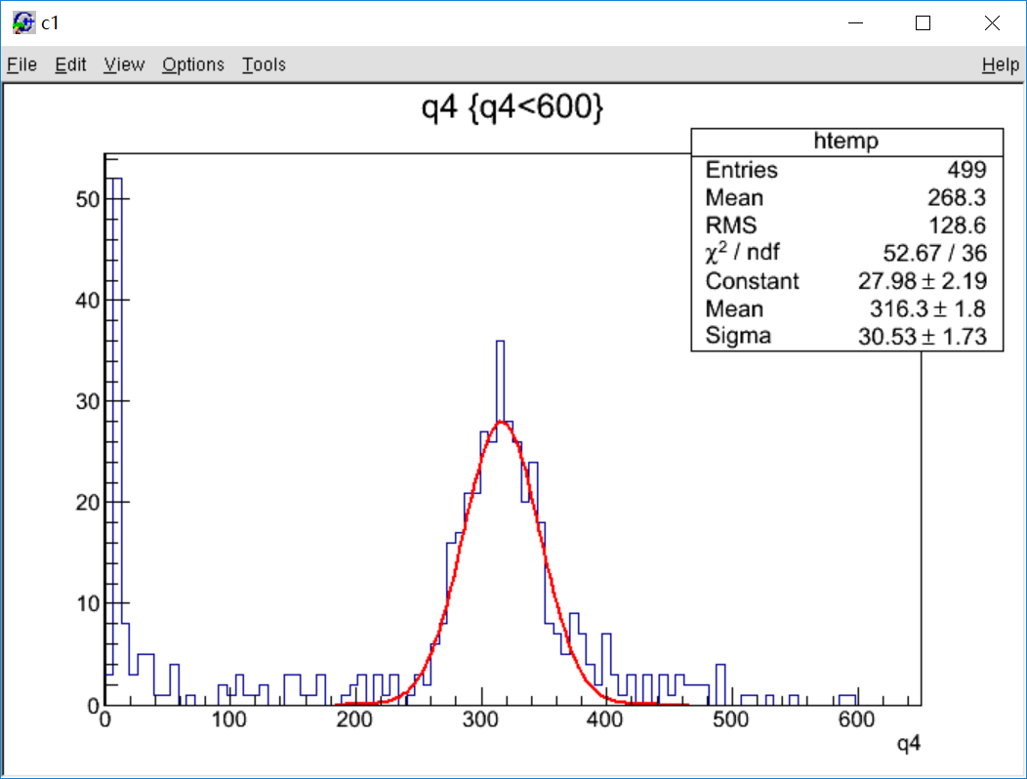
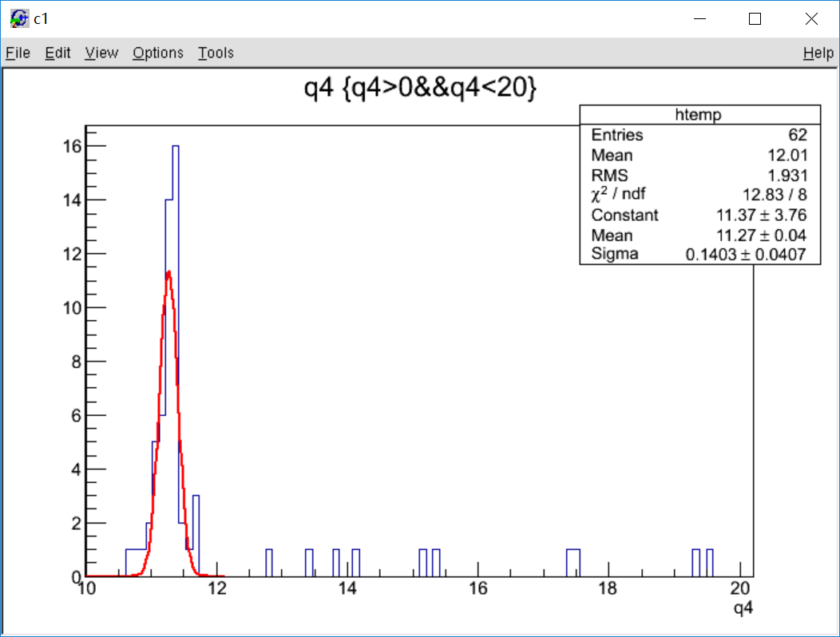
SDU #3 cosmic test without coating
Signal
Pedestal
count
count
charge
charge
$\frac{(MPV−Ped)}{e×Gain}=381.3$ photo-electrons (Gain=5*10^6)
Coating add 29% pthoto-electron.

Slide 7
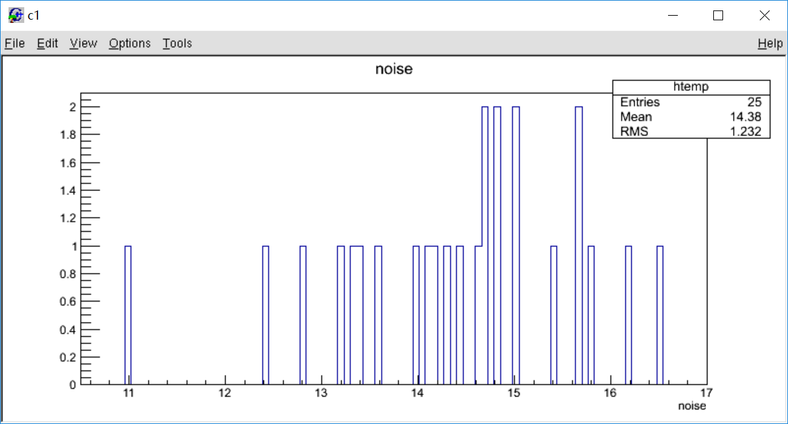
“noise” rate without coating
Rate is higher compared with coating.

