Slide 1
THU module test
Ye Tian
Shandong University
4-20-2017

Slide 2
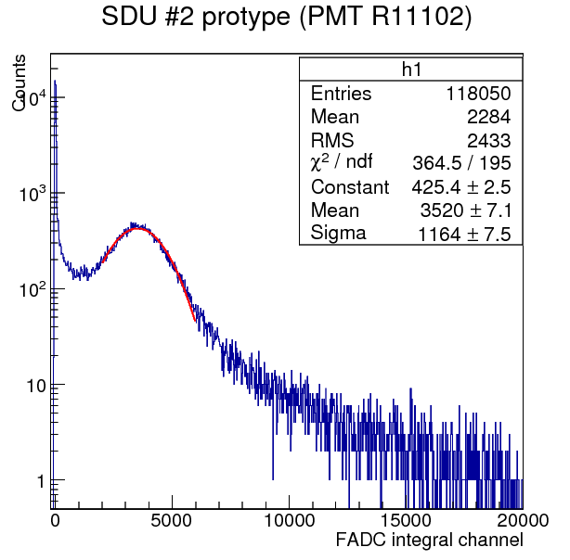
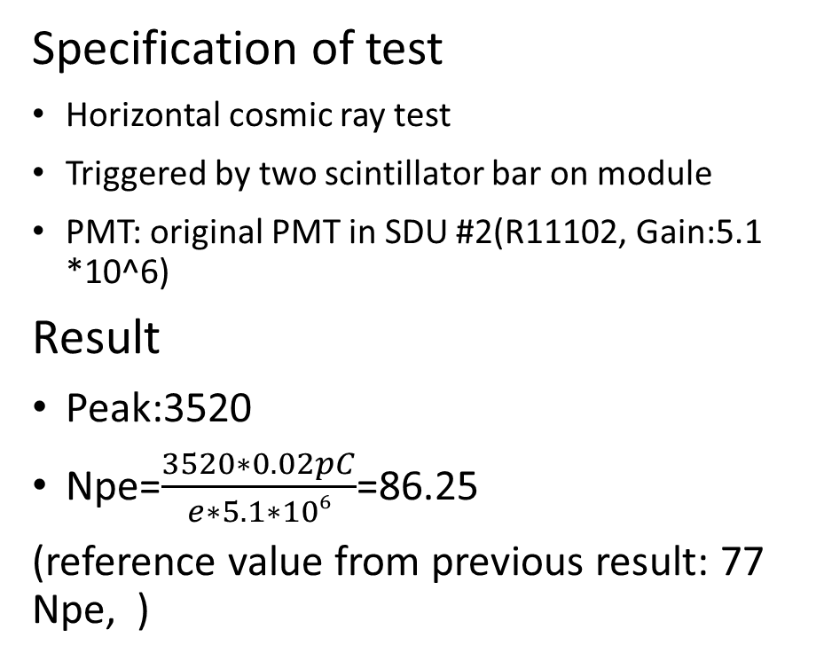
SDU #2 module horizontal cosmic ray test in JLab
Specification of test
Horizontal cosmic ray test
Triggered by two scintillator bar on module
PMT: original PMT in SDU #2(R11102, Gain:5.1 *10^6)
Result
Peak:3520
Npe=$\frac{3520∗0.02pC}{e∗5.1∗106}$=86.25
(reference value from previous result: 77 Npe, )

Slide 3
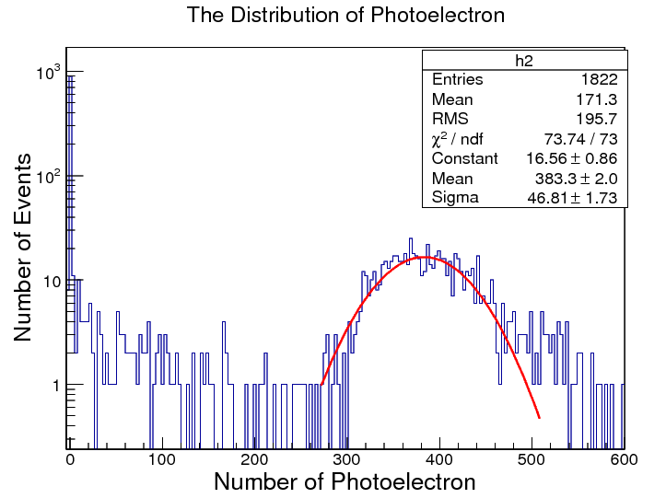

SDU#2 cosmic test result in SDU
Npe: 383
Here is the SDU#2 vertical result with TiO2 coating, the result is covered by Tyvek is(which is better)
I suppose horizontal is 1/5 of vertical result, and get the evaluation value: 77
Difference compared with JLab test
Triggered by two preshower scintillators(average track is shorter than test in JLab)
Attenuation from delay cable: 3% (No delay in JLab test)

Slide 4
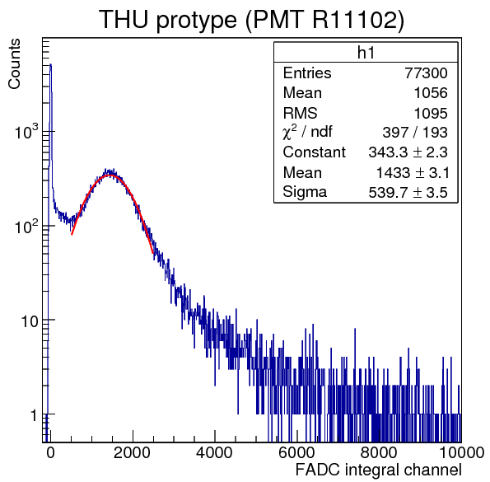
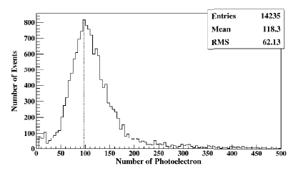

THU module horizontal cosmic ray test(SDU #2 PMT)
Same test method as SDU #2 module
Peak: 1433
Npe=$\frac{1433∗0.02pC}{e∗5.1∗106}=$35.12
(Previous test in THU shows horizontal result nearly 100 Npe)

Slide 5
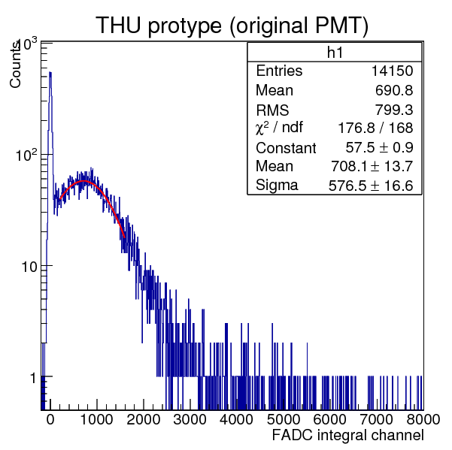
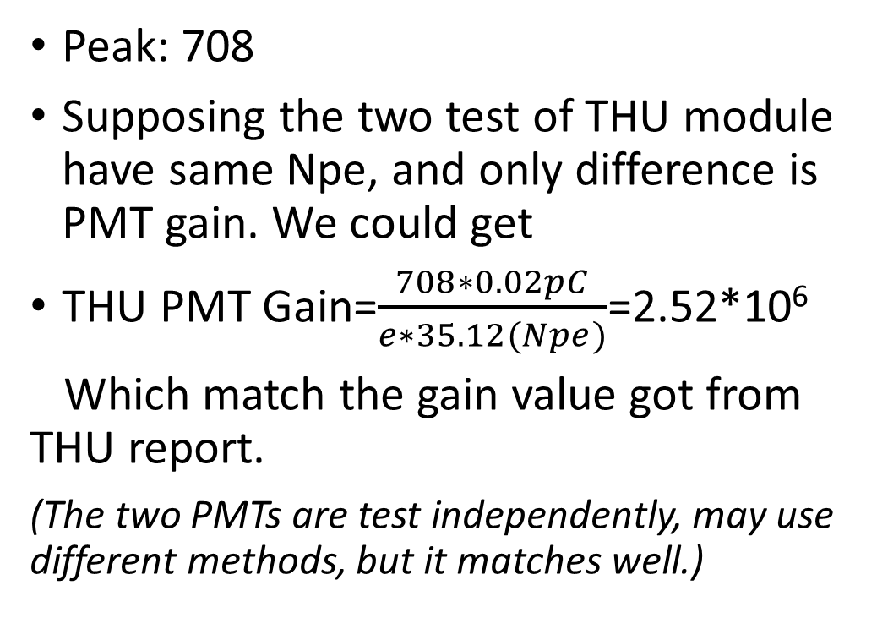
THU module horizontal cosmic ray test(Original PMT)
Peak: 708
Supposing the two test of THU module have same Npe, and only difference is PMT gain. We could get
THU PMT Gain=$\frac{708∗0.02pC}{e∗35.12(Npe)}$=2.52*10⁶
Which match the gain value got from THU report.
(The two PMTs are test independently, may use different methods, but it matches well.)

Slide 6
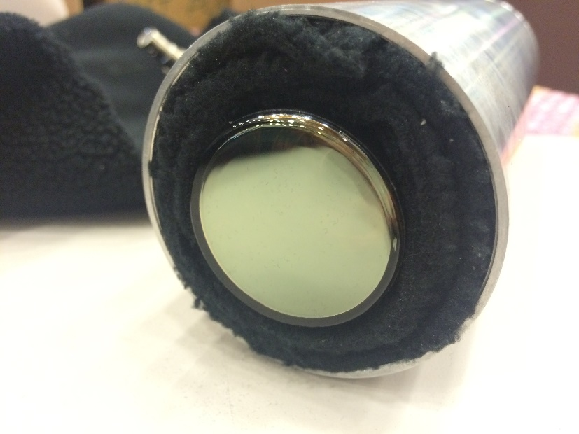
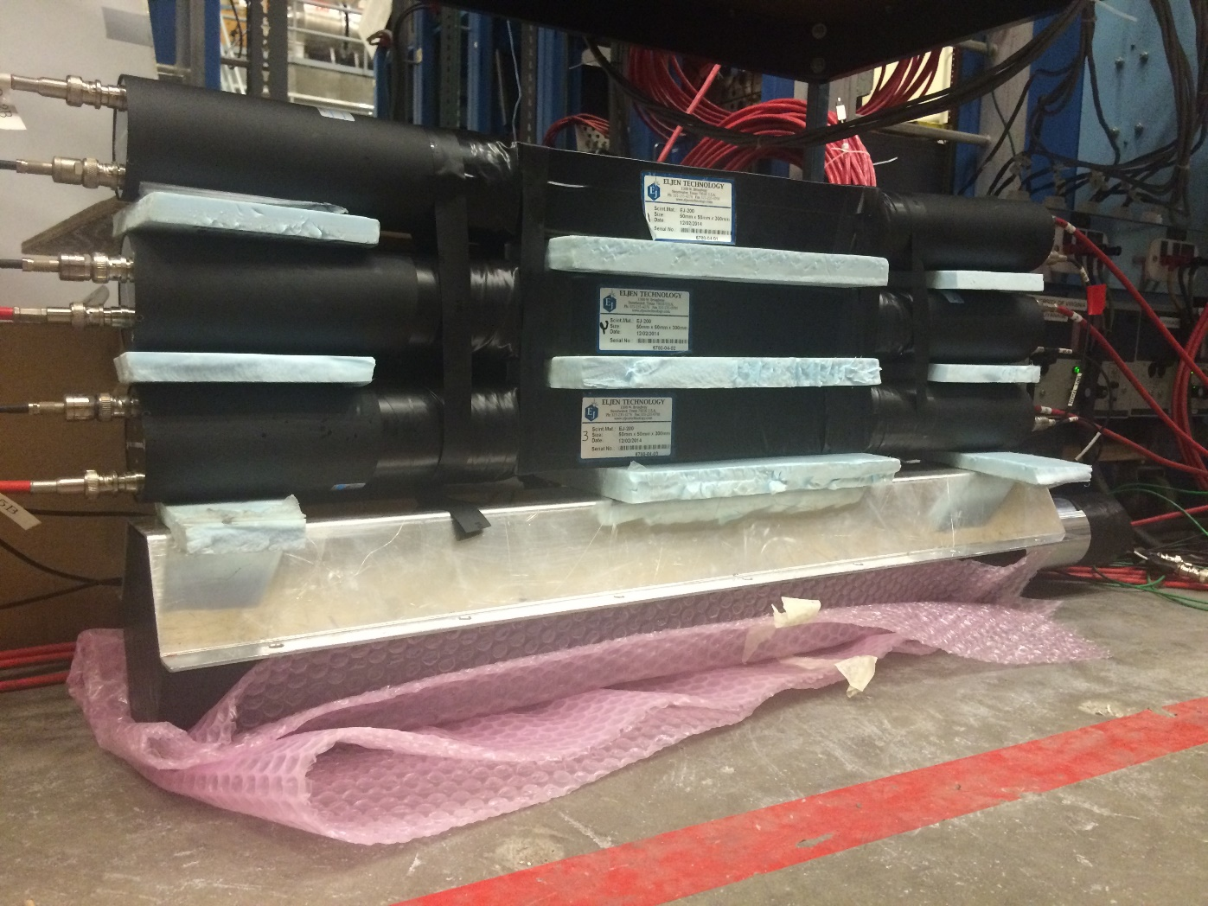
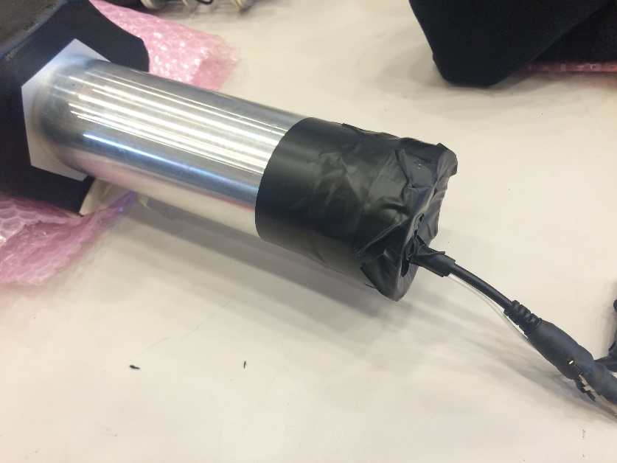
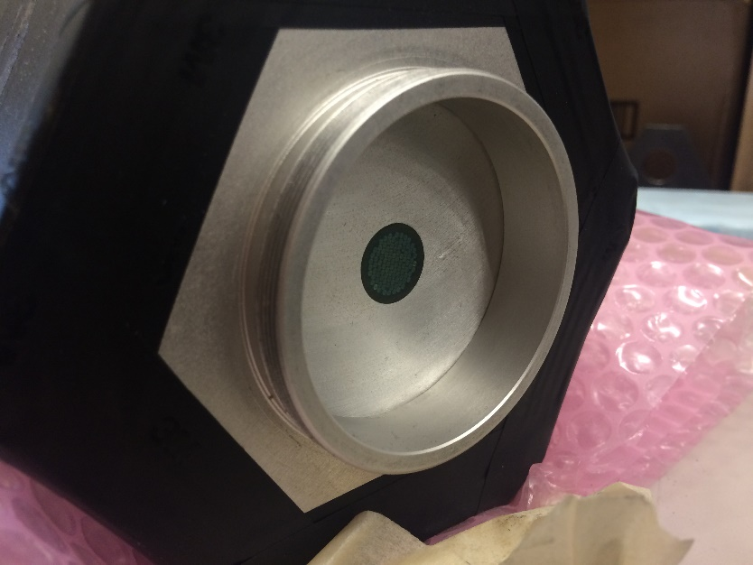
Test setup and THU module

