Slide 1
SPD time resolution test
Ye Tian
Shandong University
6/15/2017

Slide 2
Time resolution of three bar test method
$T=\frac{t0+t3+t2+t5}{4}$ - $\frac{t1+t4}{2}$
The first item is time reconstructed by top and bottom bar, the second item is time got from middle bar. The difference between these two items indicates system time resolution.
Applying assumption $σ_{bar}=\frac{1}{\sqrt{2}}σ_{PMT}$
Since every PMT is identical, scintillator time resolution will be calculated as:
t0
t3
t1
t4
t2
t5
$$σ=\sqrt{\frac{2}{3}}σ_{T}$$
Result: 82ps

Slide 3
FASPD time resolution test
Calculation to get time resolution:
Consider both sides PMT
$T=\frac{t0+t3+t2+t5}{4}$ - $\frac{t1+t4}{2}$
$σ_{m}=sqrt(σ_{T}$²-0.5*$σ_{r}$²)
Only consider one side
$T=\frac{t0+t3+t2+t5}{4}$ - t1 (or t4)
$σ_{1}=sqrt(σ_{T}$²-0.5*$σ_{r}$²)
(same as above)
Where $σ_{r}$= 82ps
15 cm away from narrow side
Wide side
Narrow side
SPD about 55 cm long

Slide 4
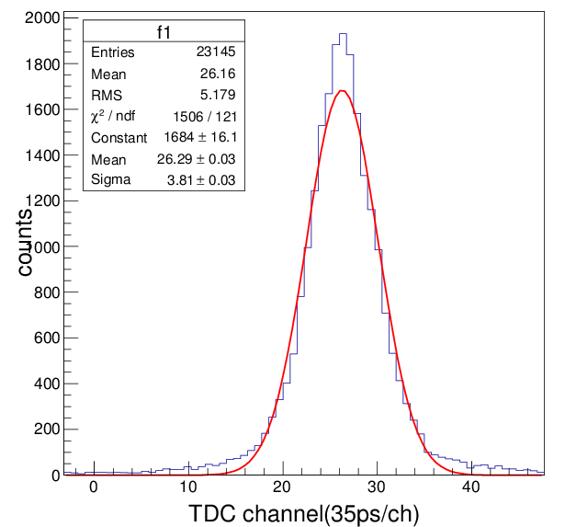
Three bar method for both sides readout
After time walk correction
Add FADC cut
Resolution for T= 110ps Applying formula
SPD time resolution: 93ps

Slide 5
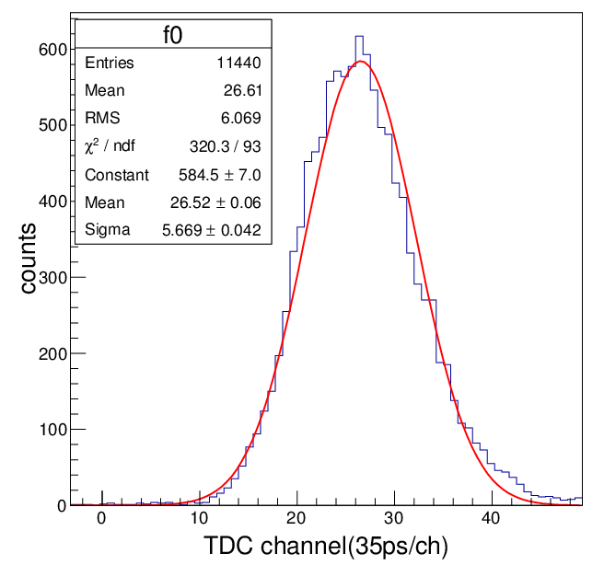
Readout only by one side
Readout by wide side
Readout by narrow side
198ps
184ps

Slide 6
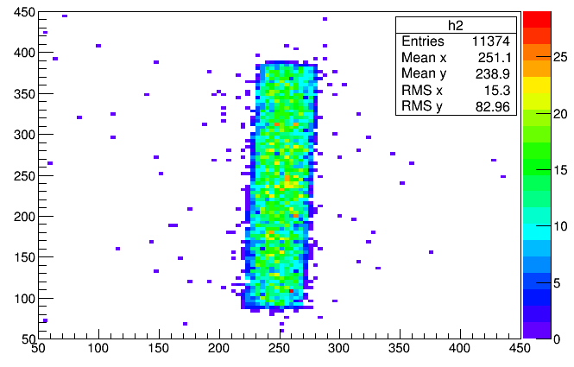
Time resolution with tracking
Hit position on SPD plain(Unit: mm)
Using three layers GEM (5 in total)
Single track efficiency: 25%(all three layers fired)
Get 65000 original events, after all cuts, only 2500 good events left
Cut:
SPD TDC cut
FADC cut
Single track cut
Position related to GEM coordinate

Slide 7
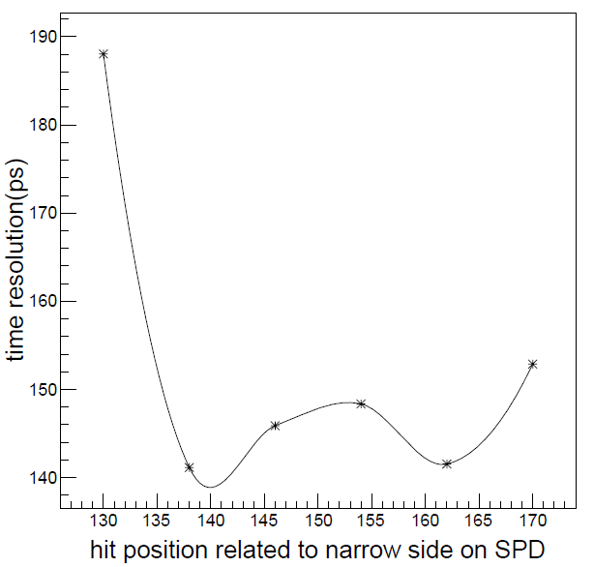
SPD time resolution result with tracking
time resolution readout by wide side
time resolution readout by narrow side

Slide 8
Conclusion
GEM shows good tracking to help get more precious time resolution
The time resolution of narrow side(near) is just a little better than wide side
With tracking both sides could get about 150ps time resolution

Slide 9
Typical SPD time resolution distribution with position cut(low statistics)

