Slide 1
LASPD Time Resolution Test Update
Ye Tian and Jixie Zhang
08/10/2017

Slide 2
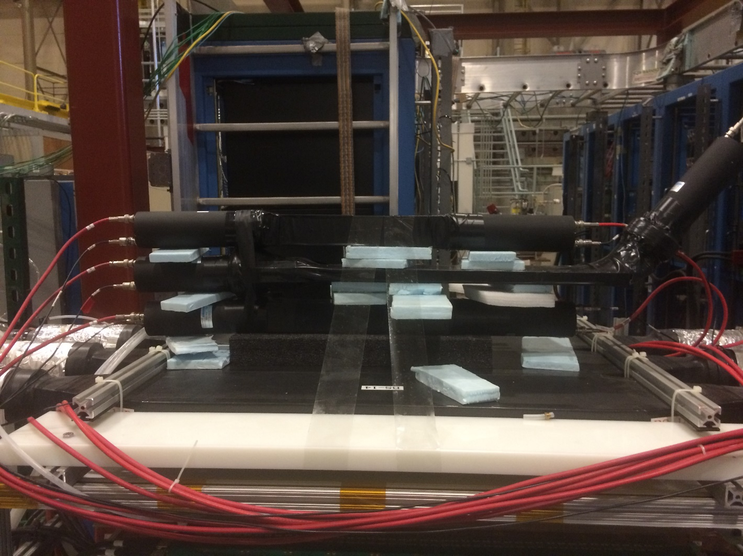
Test Setup
LASPD is set parallel to reference scintillator, and reference bar only cover left side(narrow) of LASPD.
Using the 1st, 4th and 5th layer of GEM, to get better hit position reconstruction on scintillator.
As Jixie’s suggestion, add GEM’s another large paddle scintillator to trigger, try to improve the efficiency of test. But this method rely on the good time resolution of the large scintillator.
Added GEM scintillator

Slide 3
Trigger Logic Sketch
PMT
delay
Left top
&
Rate: 0.5Hz
Right top
&
Left bottom
&
Right bottom
>=1
(OR)
trigger
Left LASPD
&
Right LASPD
&
delay
GEM scintillator
Rate: 5Hz
&
GEM scintillator

Slide 4
Work progress and problems
Cable connection and test are completed, the detector is ready for test
GEM is filled with Nitrogen now, and ready to fill with working gas to test
Some problems in DAQ readout software CODA, Danning is trying to solve the problems(TDC not working now, had confliction with GME readout MPD)
Need enough test time to get full enough statistics

