Slide 1
THU2 cosmic test results (4)
Chendi Shen
2017.9.7

Slide 2
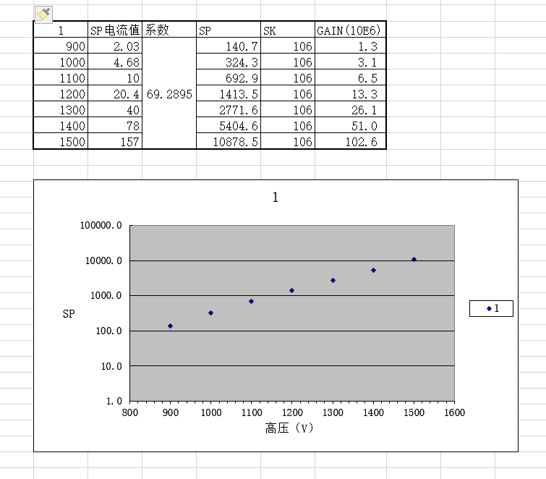
Gain of the PMT
Exponential linear
SP=SP(电流值)*系数
Gain(10E6)=SP/SK

Slide 3
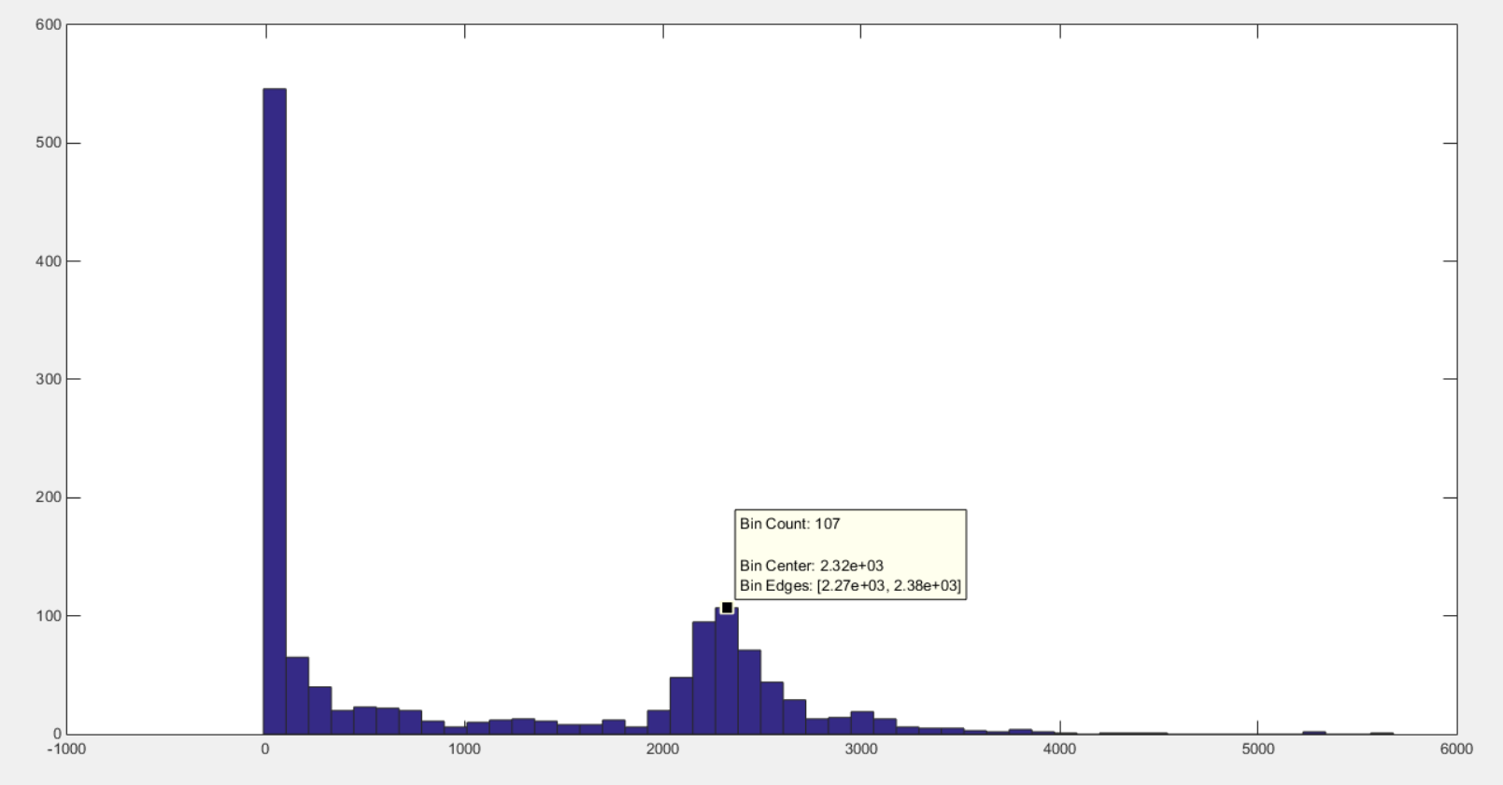
X=2320 (1000V)
Y: number of events
X: Npe*Gain*10⁻⁶
Npe=X/Gain*10⁻⁶=2320/3.1=748

Slide 4
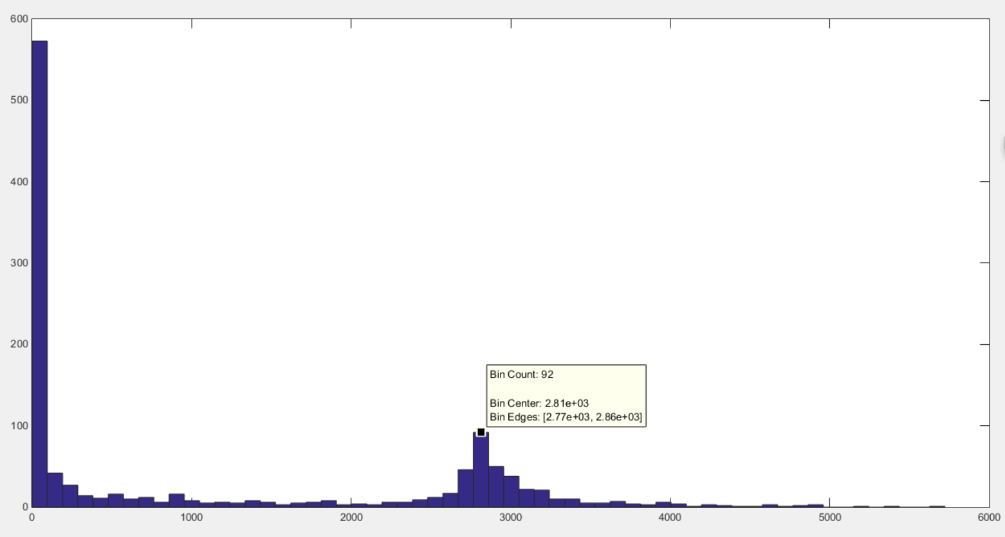
X=2810 (1100V)
Y: number of events
X: Npe*Gain*10⁻⁶
Npe=X/Gain*10⁻⁶=2810/6.5=432

Slide 5
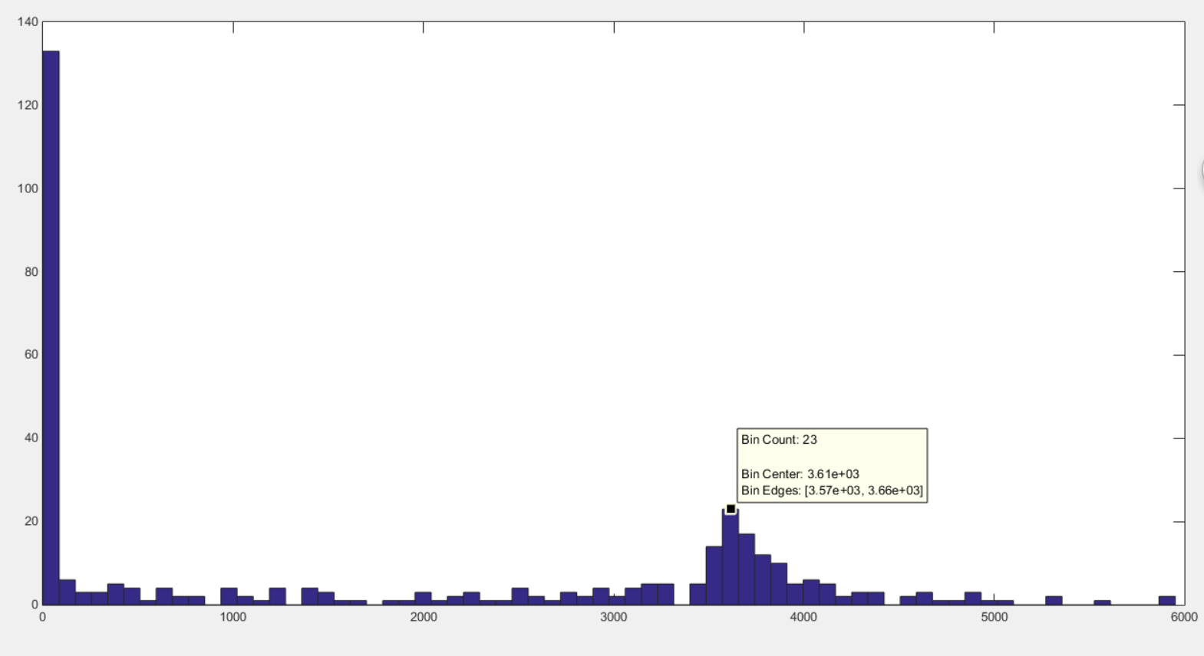
X=3610 (1200V)
Y: number of events
X: Npe*Gain*10⁻⁶
Npe=X/Gain*10⁻⁶=3610/13.3=271

Slide 6
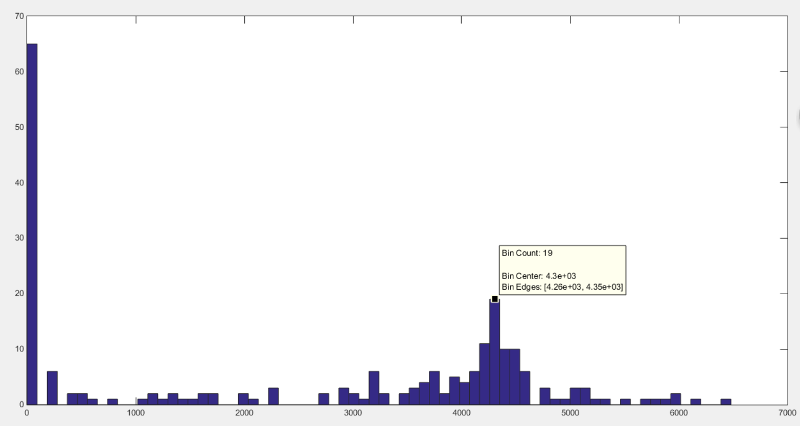
X=4300 (1300V)
Y: number of events
X: Npe*Gain*10⁻⁶
Npe=X/Gain*10⁻⁶=4300/26.1=164

Slide 7
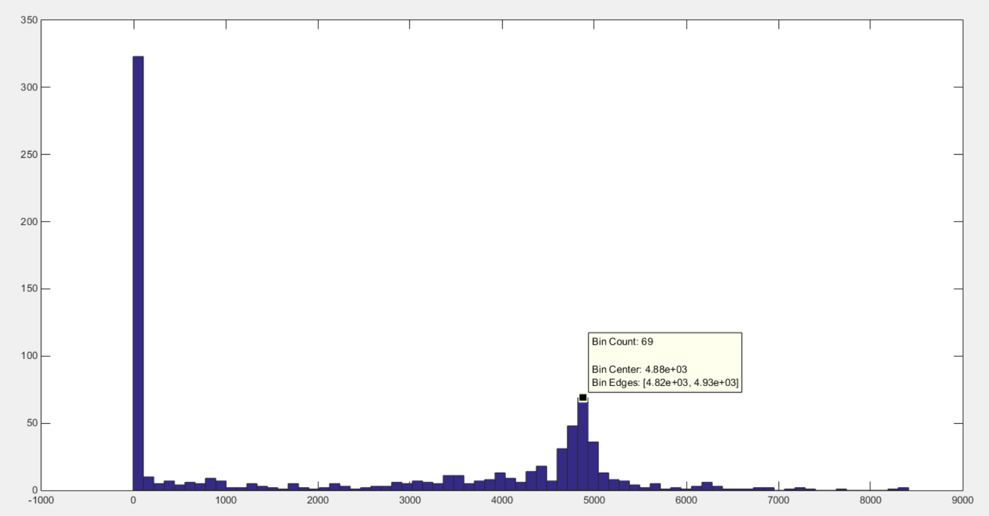
X=4880 (1400V)
Y: number of events
X: Npe*Gain*10⁻⁶
Npe=X/Gain*10⁻⁶=4880/51=96

Slide 9
Why does NPE vary with high voltage? (it is not the real NPE)
?

