Slide 1
THU2 cosmic test results (5)
Chendi Shen
2017.9.14

Slide 2
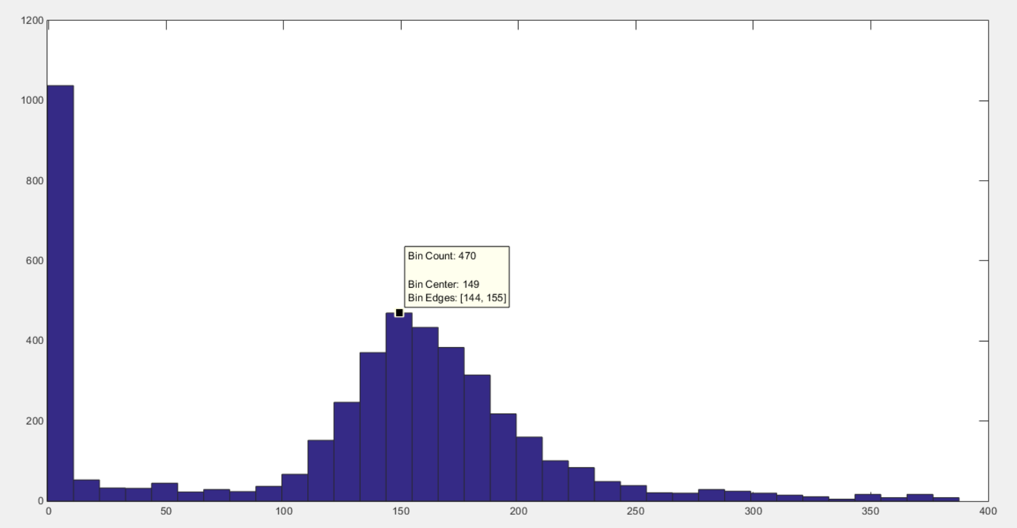
Experiment 01
HV=1100V scintillator for trigger(up: 10cm*5cm*5cm down: 10cm*5cm*5cm)
No attenuator
Npe=[(QDC-ped)*0.1*10⁻¹²]/(1.6*10⁻¹⁹*6.5*10⁶)
Npe=149
Total Number of events 4603
Npe

Slide 3
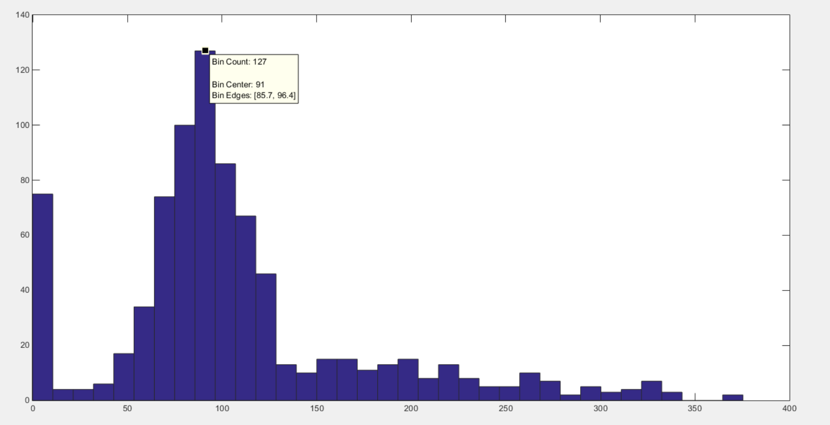
Experiment 02
HV=1100V scintillator for trigger(up: 10cm*5cm*5cm down: 3cm*3cm*3cm)
No attenuator
Npe=[(QDC-ped)*0.1*10⁻¹²]/(1.6*10⁻¹⁹*6.5*10⁶)
Npe=91
Total Number of events 814
Npe

Slide 4
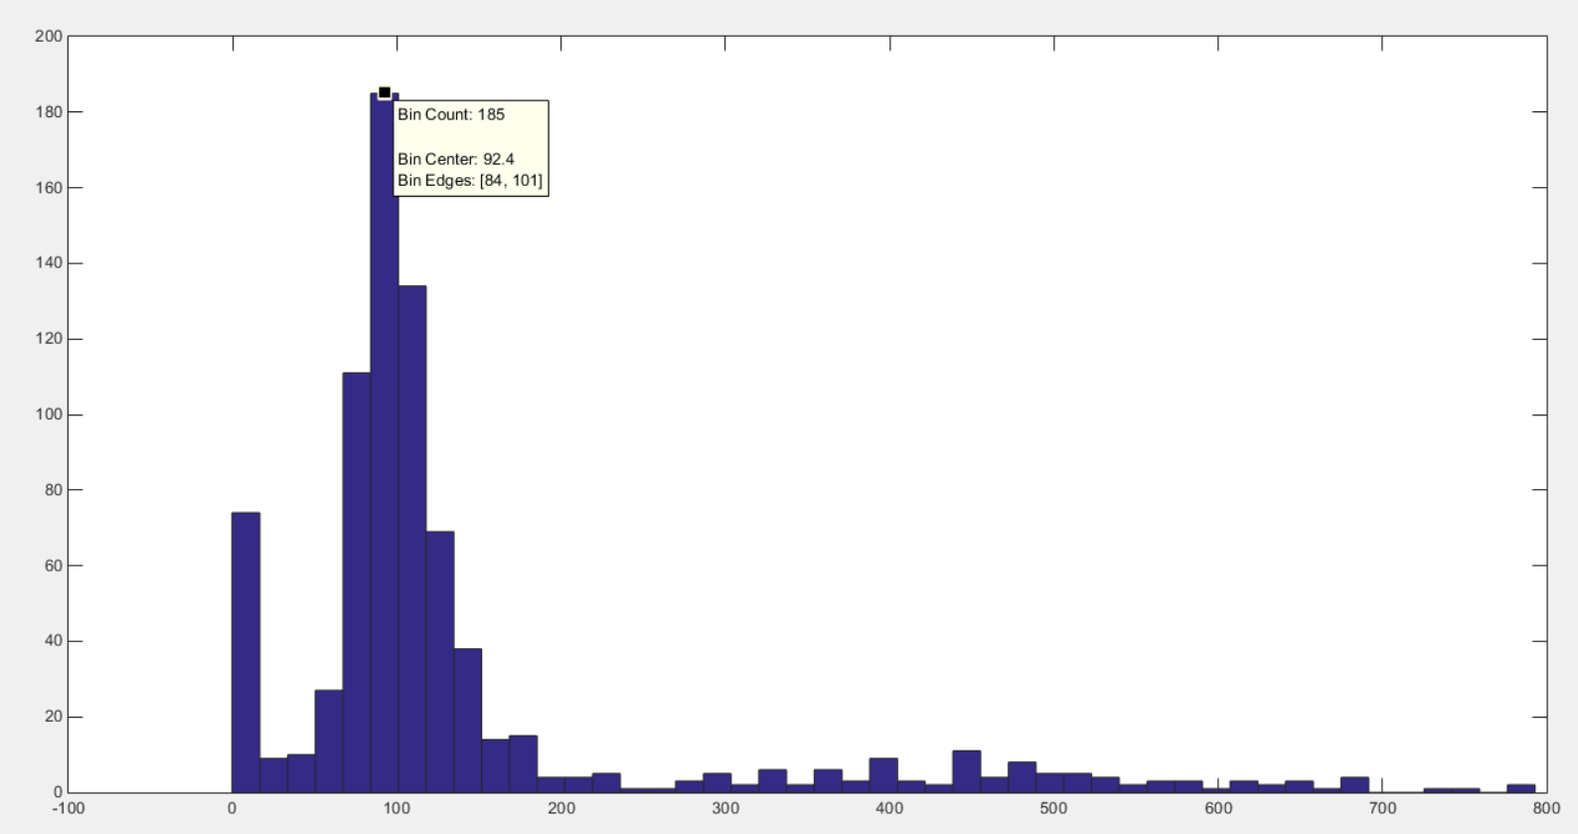
Experiment 03
HV=1000V scintillator for trigger(up: 10cm*5cm*5cm down: 3cm*3cm*3cm)
No attenuator
Npe=[(QDC-ped)*0.1*10⁻¹²]/(1.6*10⁻¹⁹*3.1*10⁶)
Npe=92.4
Total Number of events 805
Npe

Slide 5
Summary
The horizontal yields and the size of scintillator for trigger are correlated.
experiment 01 and 02 get the different Npe under the same HV, so horizontal test can not be used as a reference for vertical test.
experiment 02 and 03 get the same Npe under the different HV, it is normal that Npe does not vary with HV. So we can be sure that the problem of vertical test is due to the signals of vertical test are too large to lead to PMT saturation. The PMT anode current is saturate for vertical test under 1100V – 1500V at least.
Now we are doing
Change the position of the trigger. Observe the changes that Npe varies with the trigger position
Next to do
Back to the vertical test and get the Npe at 900V. This experiment can verify whether the output signal of PMT is saturated at 1000V.
ECal
ECal
ECal

