Slide 1
LASPD time resolution test update
Ye Tian(SDU), Jixie Zhang
09/28/2017

Slide 2
Test setup
LASPD
PMT0(top) and PMT2(bottom)
Trigger bar
0.75”
2”
2”
1.75”
Narrow side
PMT4
Wide side
PMT1
PMT3(top) and PMT5(bottom)

Slide 3
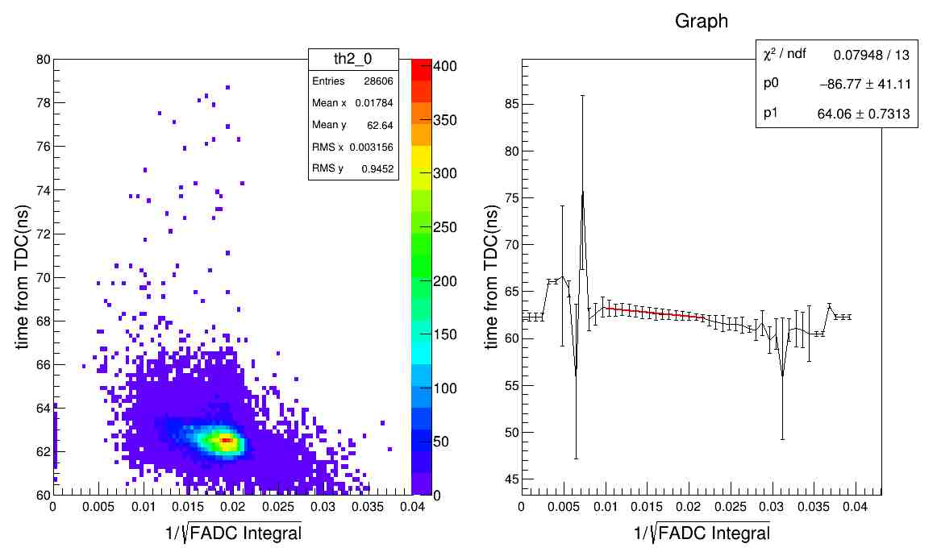
Time walk correction for non-trigger bar

Slide 4
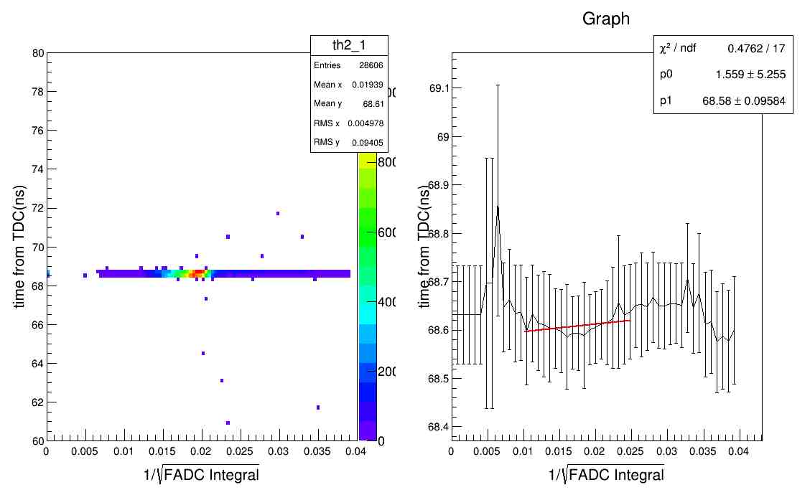

Time vs. 1/$\sqrt{FADC channel}$ for trigger bar(top)
The same method but not work.

Slide 5
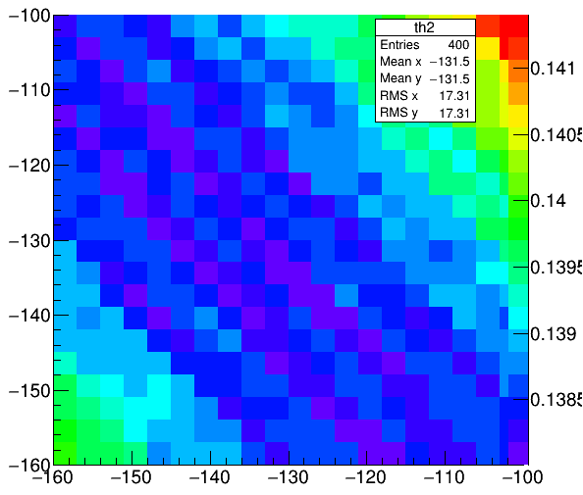
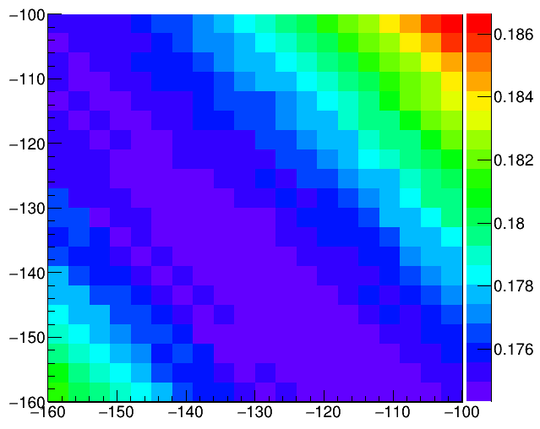
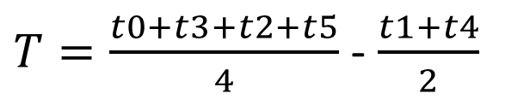
Time walk correction for trigger bar(top)
Time resolution is calculated as
$T=\frac{t0+t3+t2+t5}{4}$ - $\frac{t1+t4}{2}$
X and Y axis are slopes of two PMTs in trigger bar,
time resolution unit: ns
Result without FADC integral signal cut

Slide 6
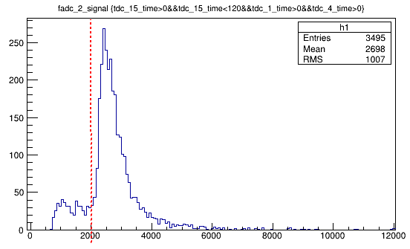
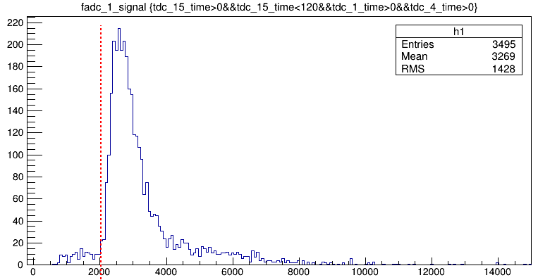
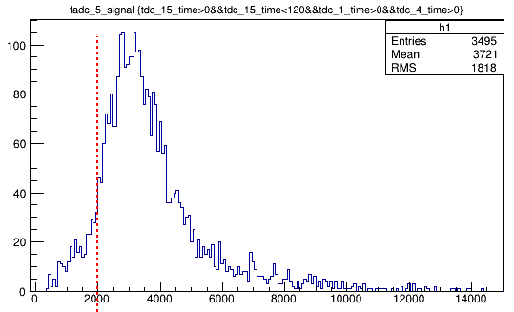
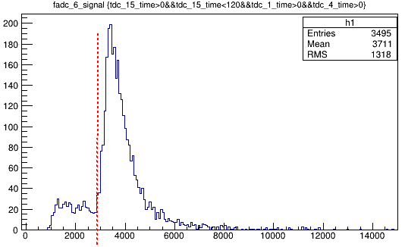
FADC channel Integral cut need all 6 PMTs satisfy the cut
>2000
>2000
>2000
>2800

Slide 7
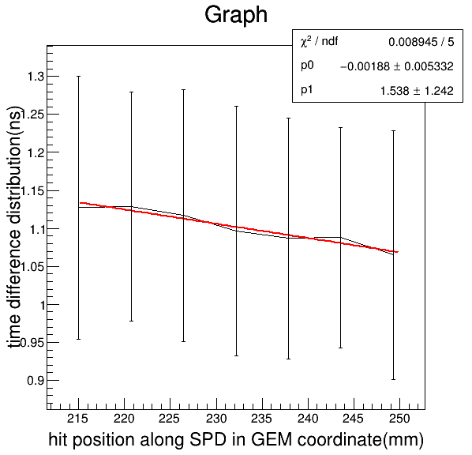
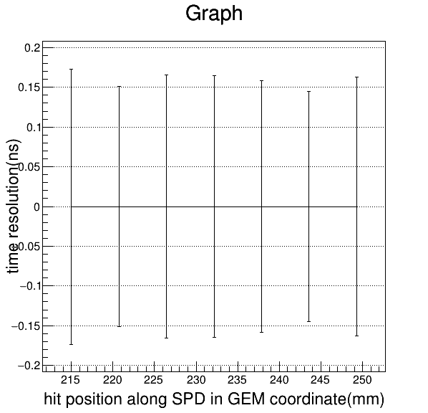
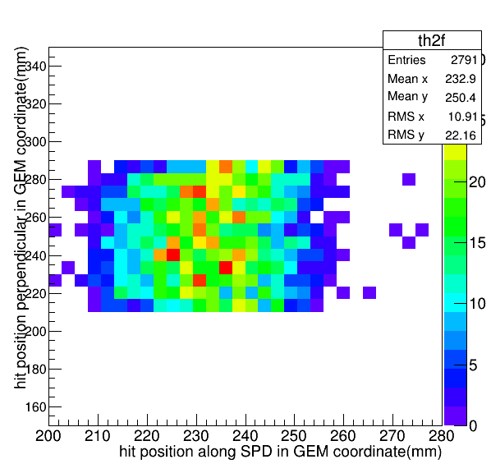
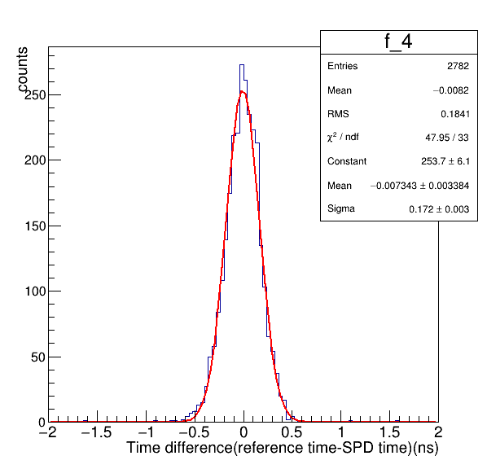

Time resolution of single PMT readout(wide side, right)
$Y=\frac{t0+t3+t2+t5}{4}$ -t1
sigma
Fitting: Y=p0*X+p1
Time resolution after correction
Hit position on SPD

Slide 8
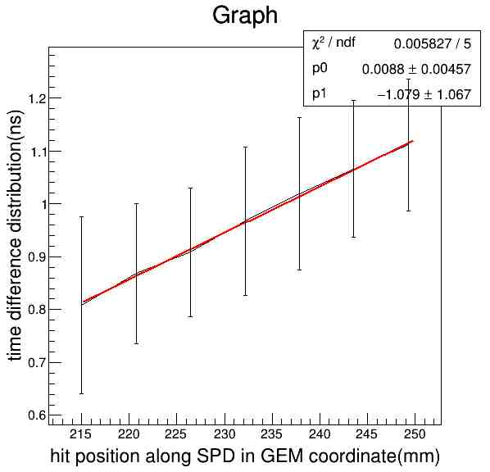
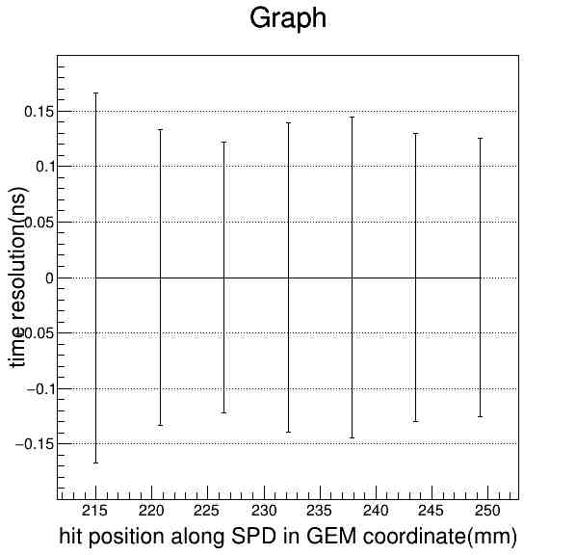
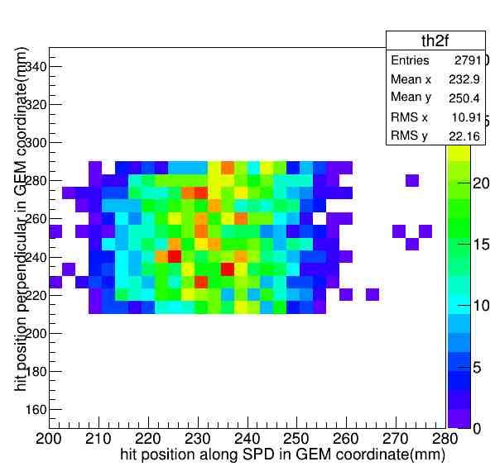
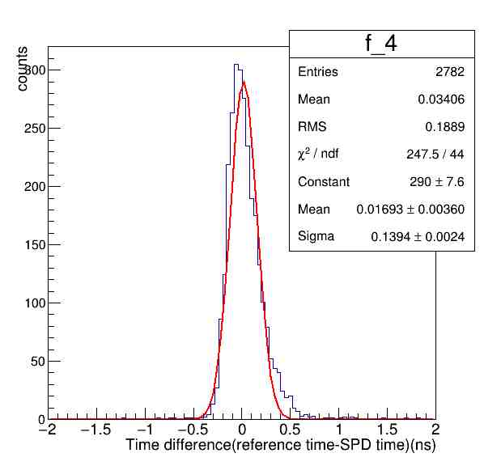

Time resolution of single PMT readout(narrow side, left)
$Y=\frac{t0+t3+t2+t5}{4}$ -t4
8cm in vertical

Slide 9
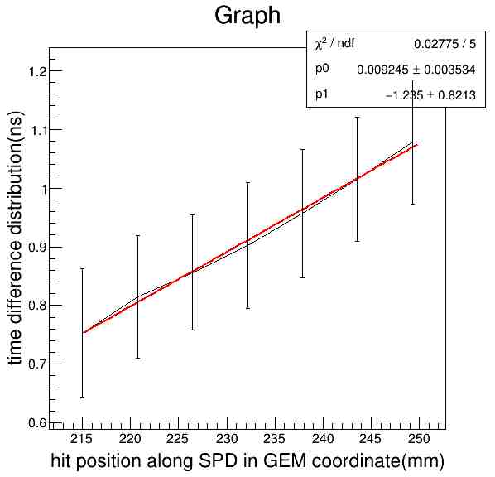
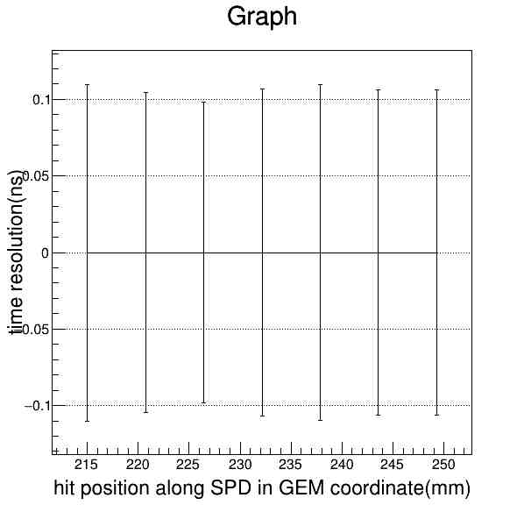
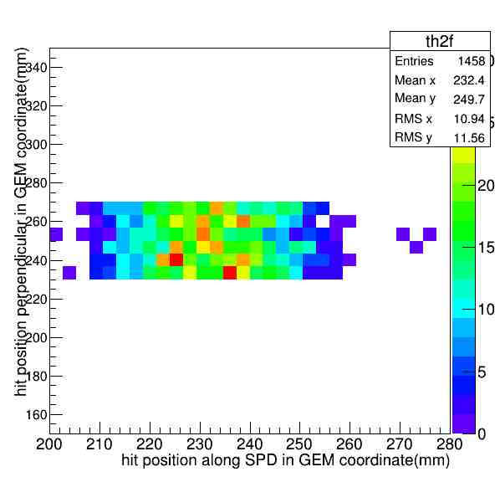
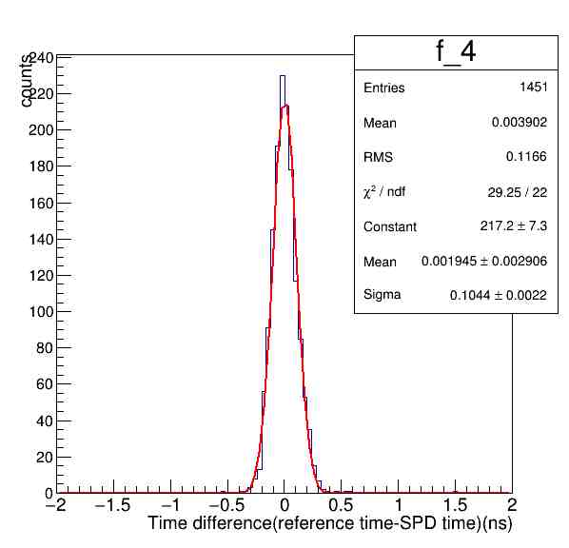

Narrow side(near) add Y direction cut(from 8cm to 4cm)
$Y=\frac{t0+t3+t2+t5}{4}$ -t4
4cm in vertical

Slide 10
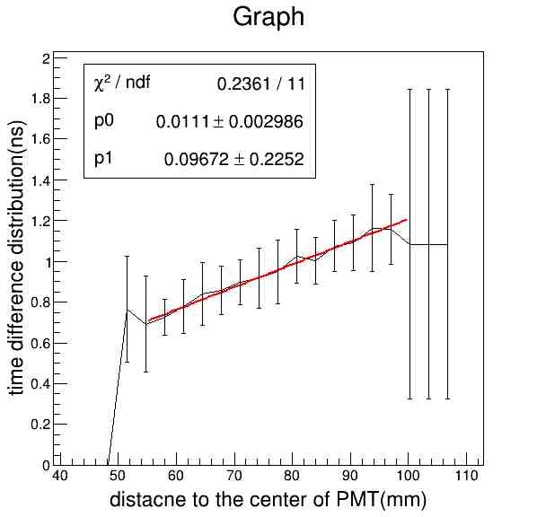
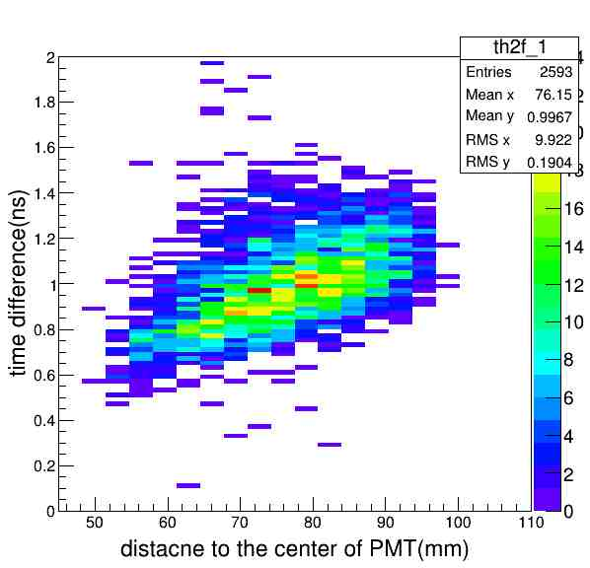
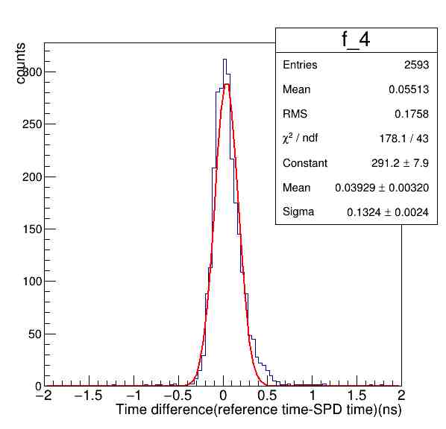
Narrow side(near) consider hit distance to PMT(8cm cut data)
The distance between PMT window and first dynode which is about 3cm is considered in calculation, and the time resolution result is just a little better.

Slide 11
Parallel test setup
LASPD
Trigger bar
Narrow side
PMT4
Wide side
PMT1
PMT3 and PMT5
PMT0 and PMT2

Slide 12
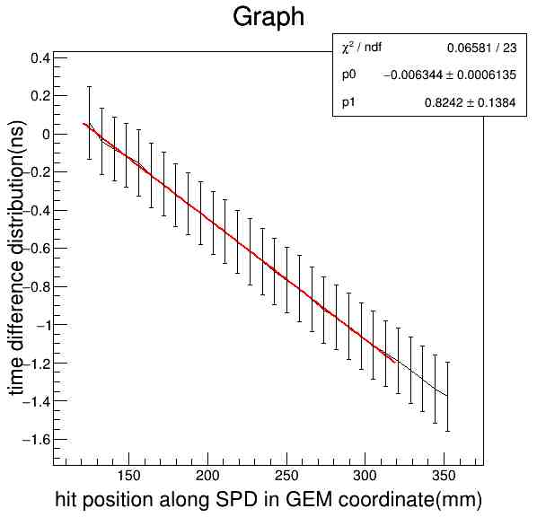
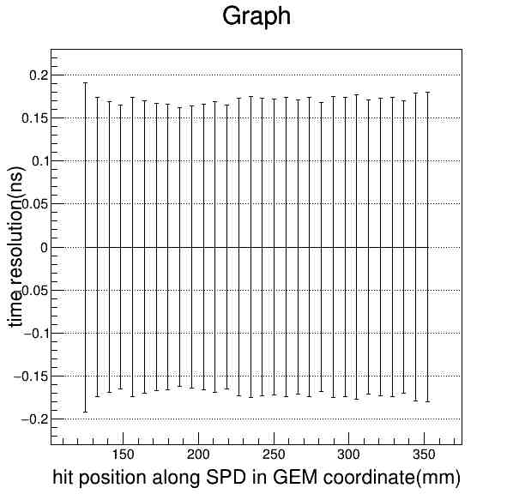
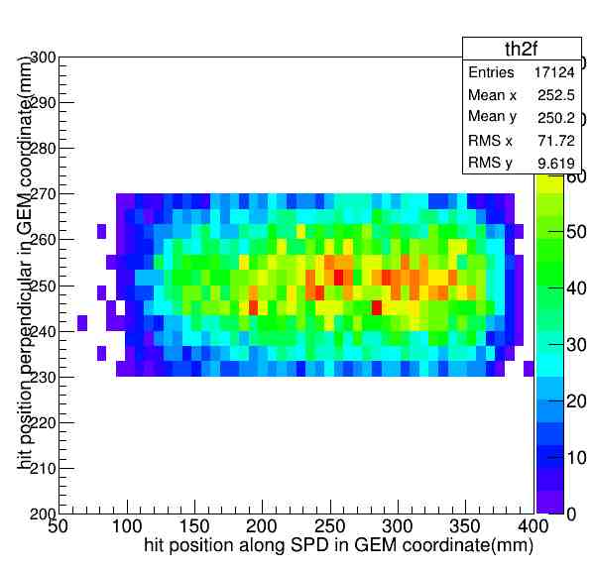
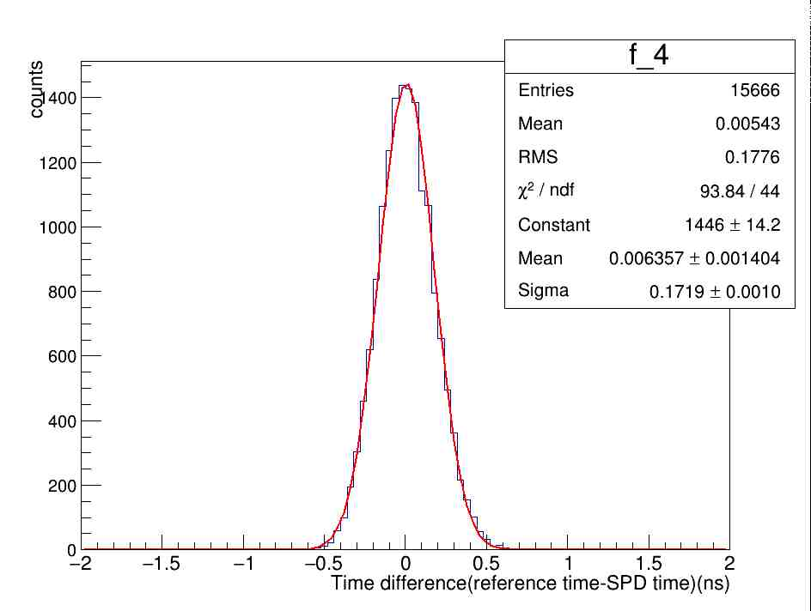
Time resolution of single PMT readout(wide side)

Slide 13
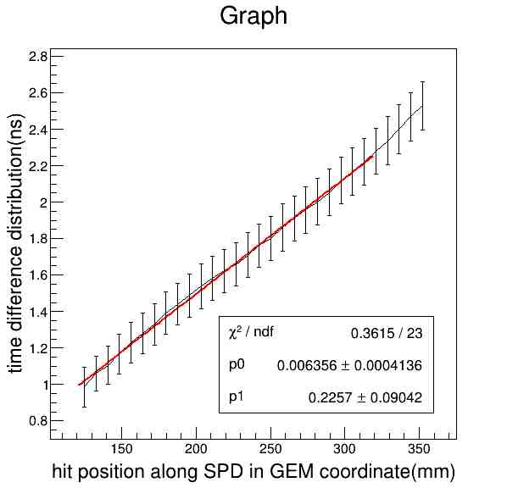
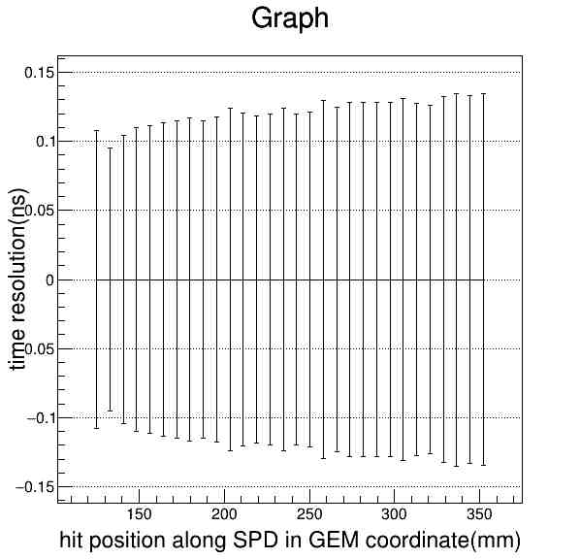
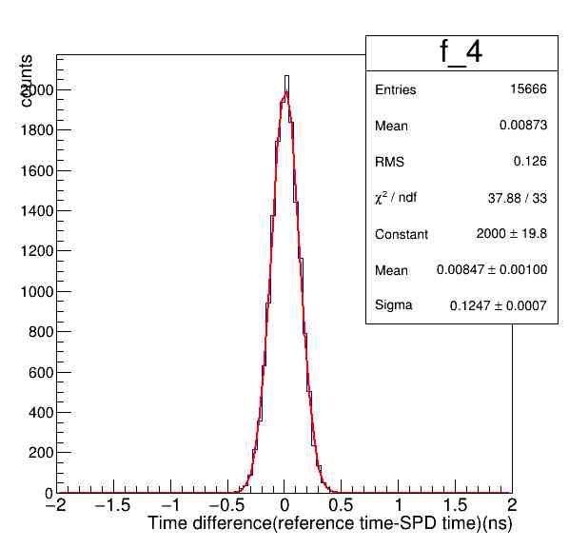
Time resolution of single PMT readout(narrow side)

Slide 14
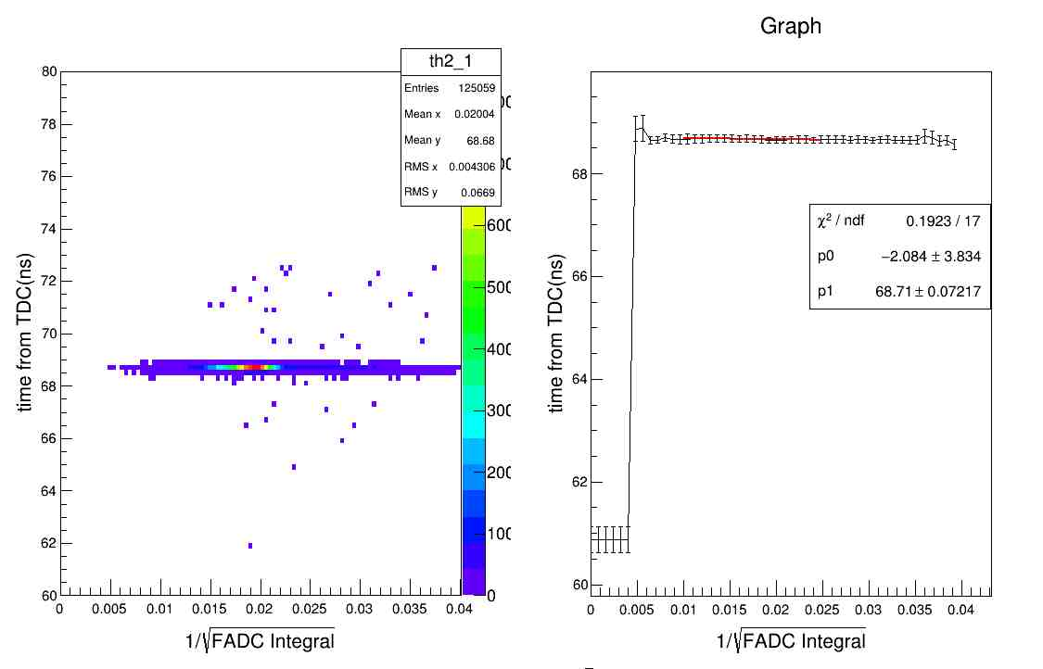
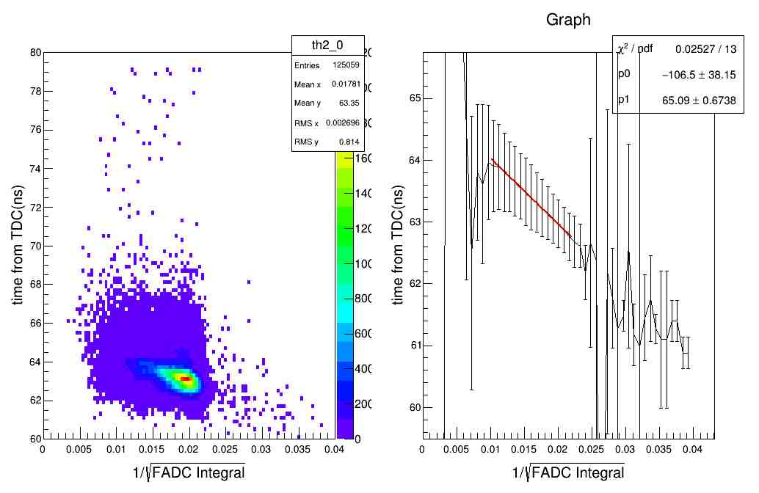
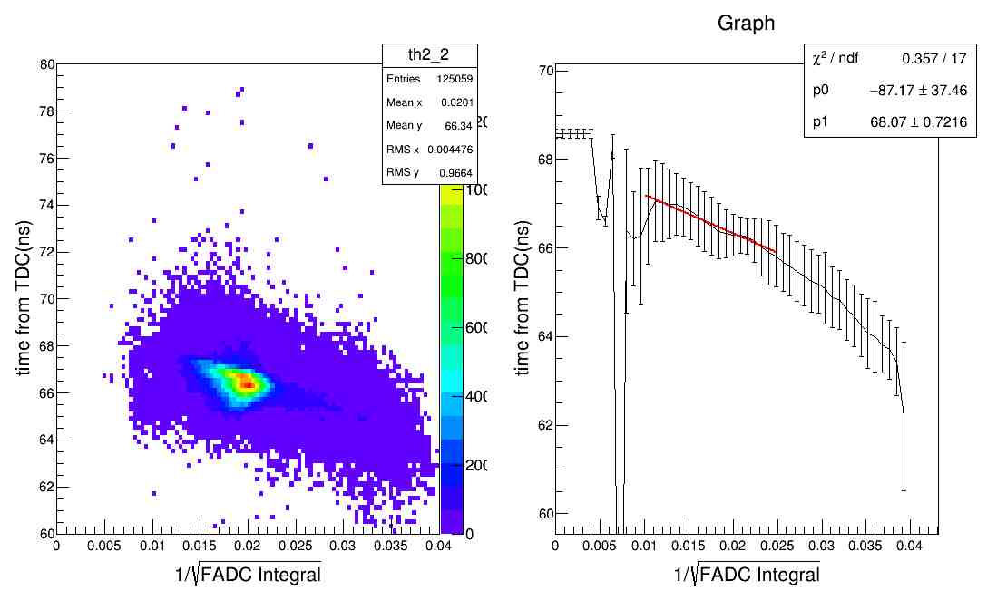
Time walk for PMTs at trigger PMT side
Since the incidence angle of comic ray is small, so the time distribution is narrow.

Slide 15
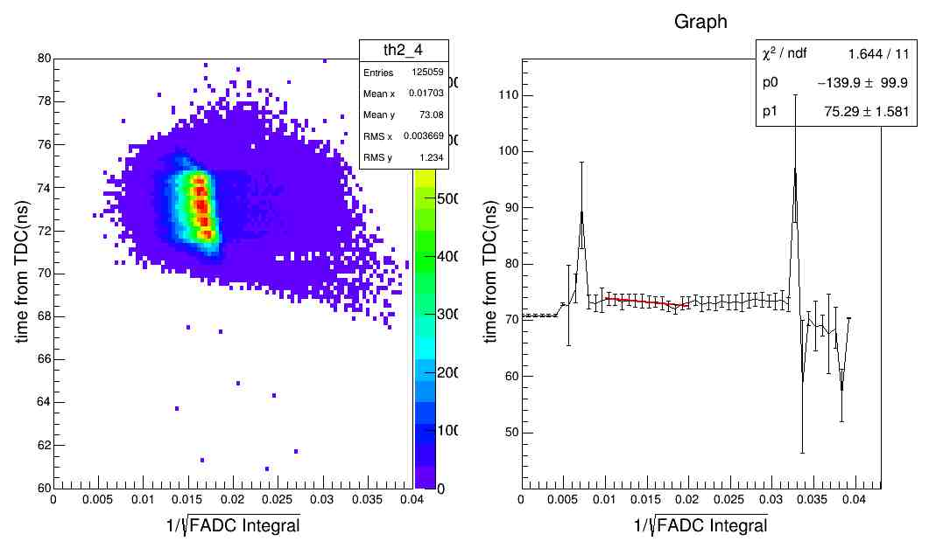
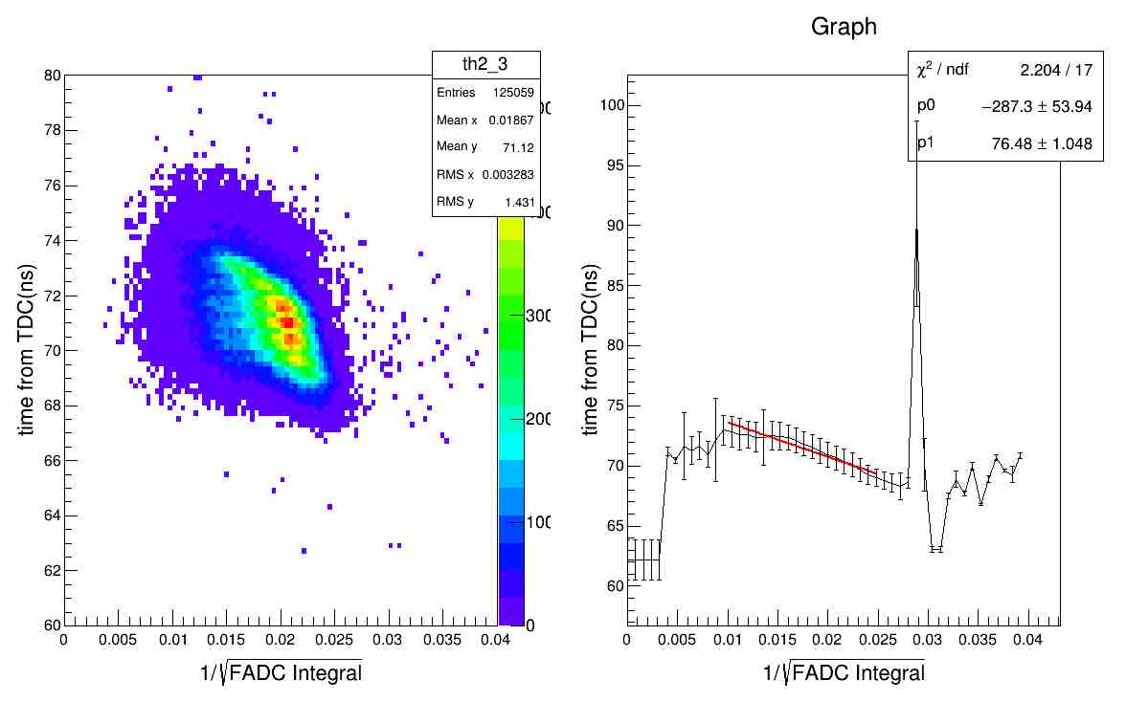
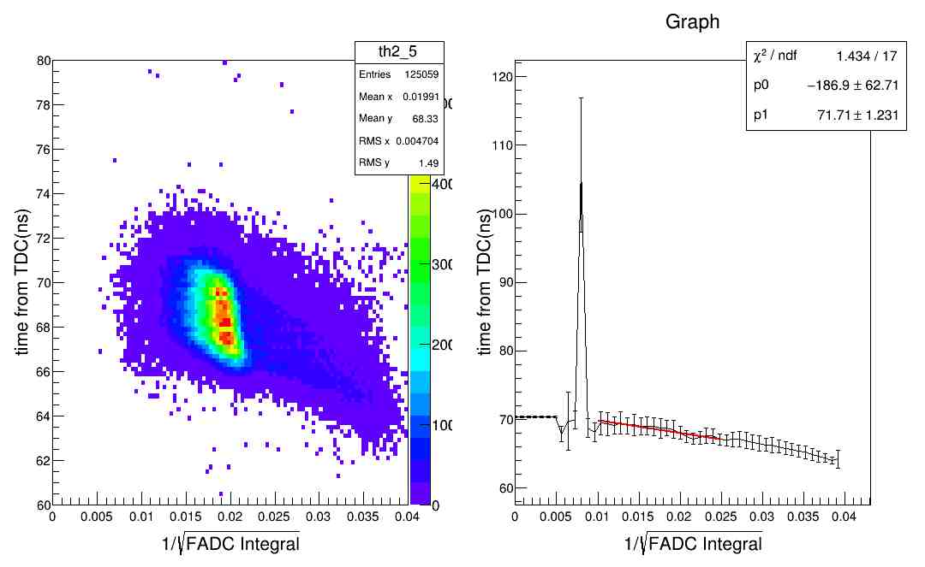
Time walk for PMTs at trigger PMT side
Not like trigger PMT side, the time distribution of these PMTs are hit position related.

Slide 16
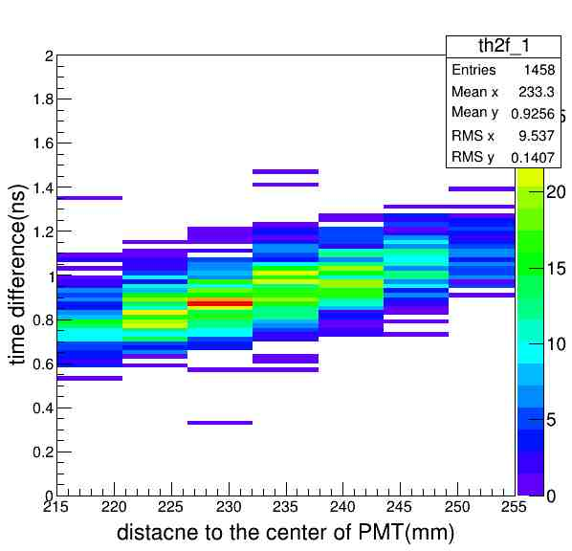
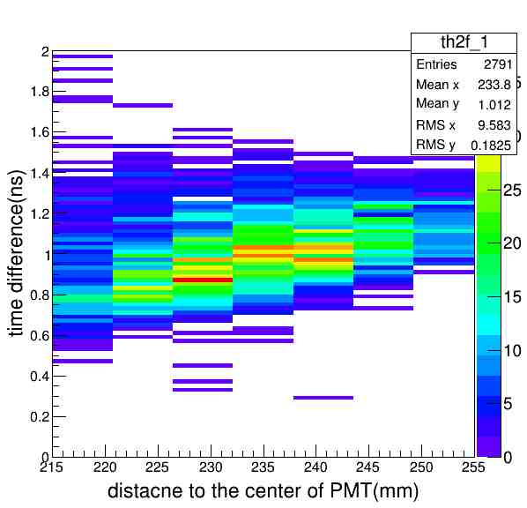
Raw histogram of hit position vs. time difference left: 8cm cut in y direction right: 4cm cut in y direction

