Slide 1
Single photoelectron method introduce
Cunfeng Feng
2017.09.28

Slide 2
CR284 PMT base divider for this test
K | DY1 | DY2 | DY3 | DY4 | DY5 | Dy6 | Dy7 | Dy8 | DY9 | DY10 | P
2 | 1 | 1 | 1 | 1 | 1 | 1 | 1 | 1 | 1 | 1

Slide 3
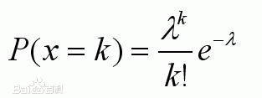
SPE principle
Photoelectron yield follow Poisson distribution
P(k=0)means the possibility of non PE yield
P(1) means the possibility of SPE yield
P(1)/p(0)=λ
If p(1)/p(0)<0.1, i.e. λ<0.1, p(2)<1%

Slide 4
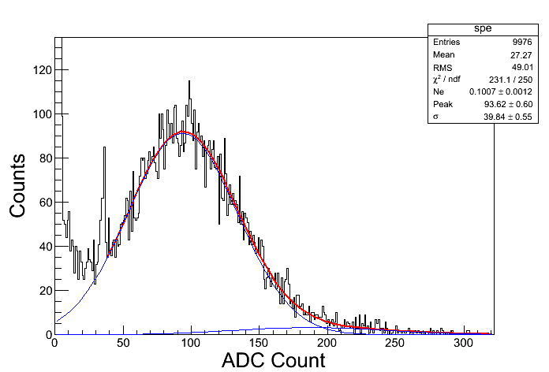
SPE method
Test process:
1, Set the HV=1200V, get big SPE signal to suit our QDC resolution(0.025pC/count) without amplifer.
2, LED is driven by one pulse generator( pulse width 10ns, frequency=10kHz, amplitude adjustable).
3, Another synchronous TTL signal to trigger the QDC and set integral window(80ns).
4, Adjust the driven pulse amplitude, test 100k events, count the event without signal out( around 90k）
5, The bottom left plot s are the output of QDC in log and linear axis. The fist peak count is pedestal, events>90k
6, fit the pedestal peak and second peak with Gauss function. Pedestal peak value has been subtracted in bottom left plot.
7, Then fit the left plot again and get the peak value. Gain(@1200V)=peak*charge-per-count/1.6E-19.

Slide 5
issue
Both THU and SDU PMT is CR284, the performance should be similar.
THU SPE Gain less than SP/SK, SDU larger
Same divider?
To test the SDU PMT also in IHEP.

Slide 6
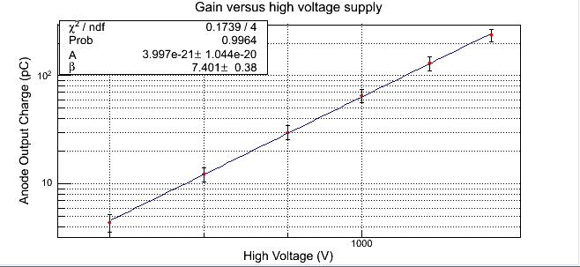
Gain at any voltage
1 fit the parameter A and β of formula G=AV^β:
(1) increase the LED light intensity in order the out big enough at 700V.
(2) measure the charge of PMT output at 1200V, 1100V, 1000V, 900V，800V，700V.
(3) fit the charge~voltage by formula G=AV^β, then acquire A and β value.
2 Gain(@1000V)= (1000/1200)^ β*Gain(@1200V)

