Slide 1
THU2 Cosmic test with SDU PMT （2）
Chendi Shen
2018.1.25

Slide 2
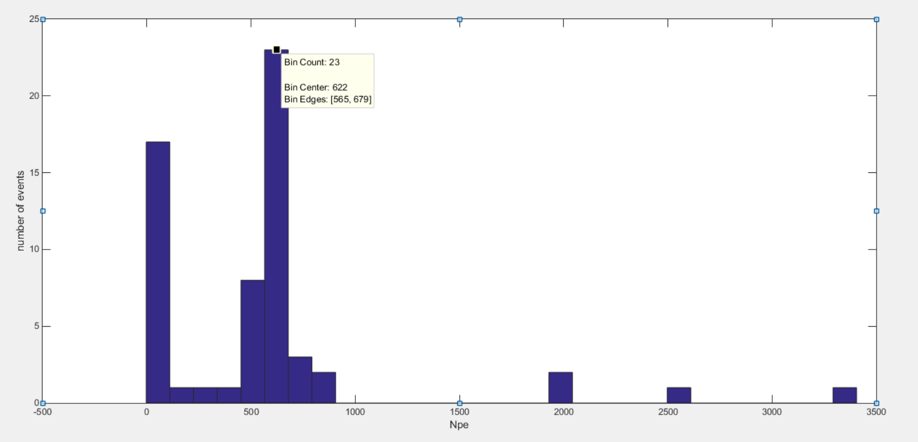
1100V (total number of events: 50)
Npe=622

Slide 3
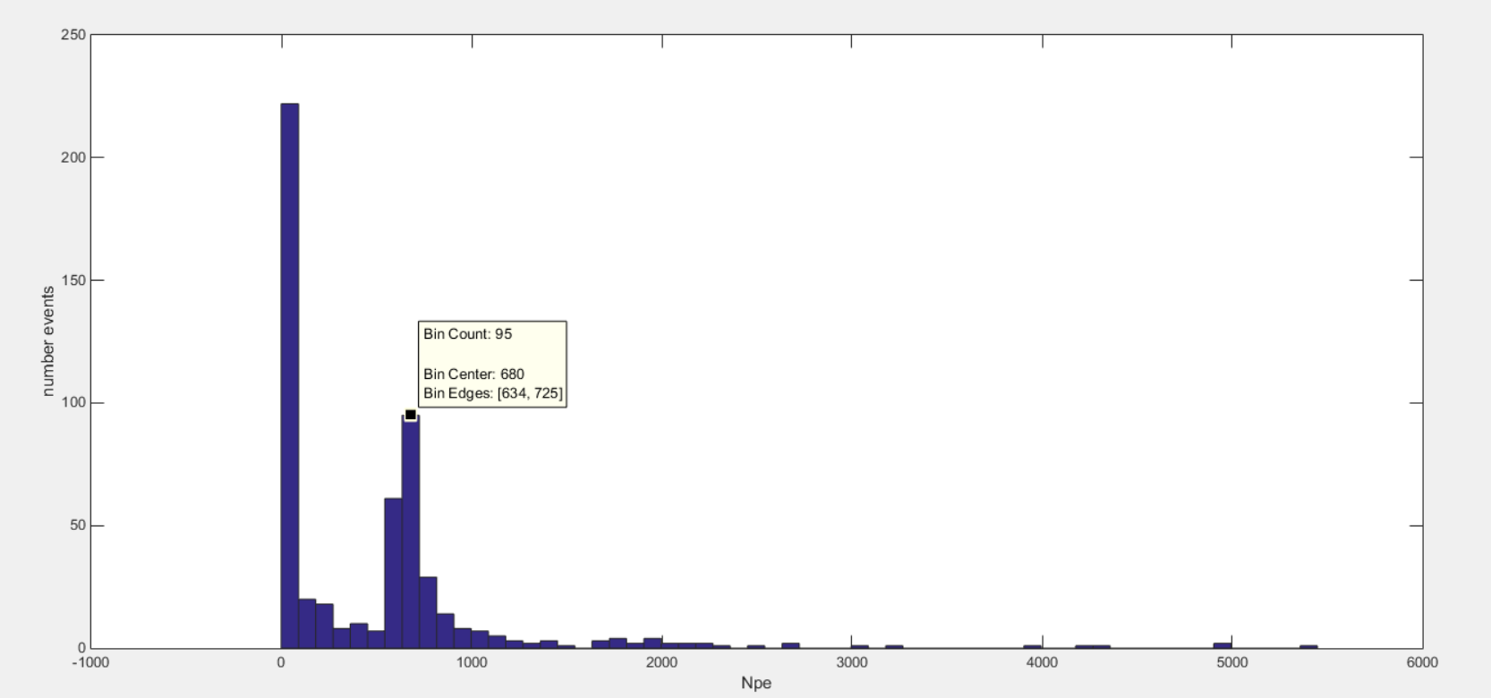
1050V (total number of events: 550) npe=680

Slide 4
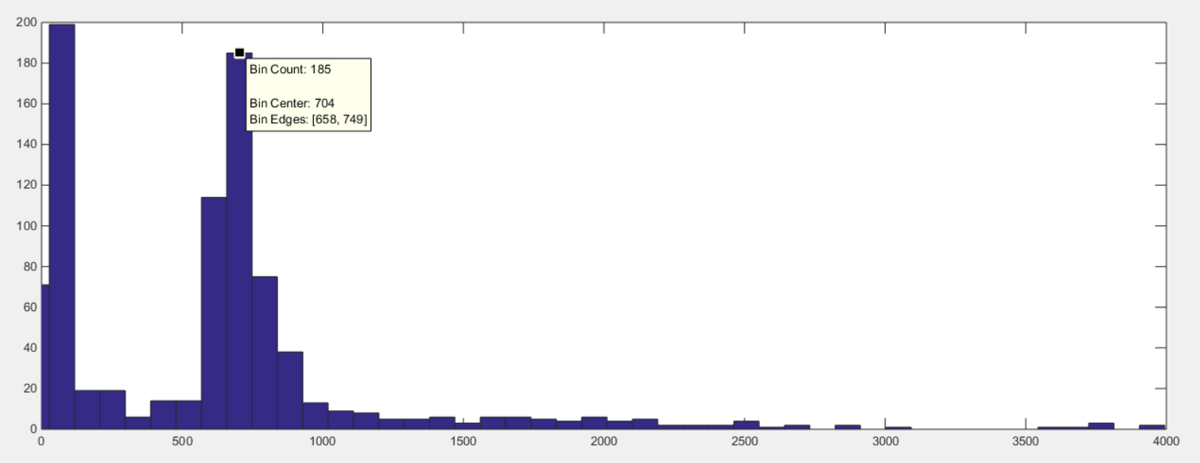
HV=1000 V
Npe=704

Slide 5
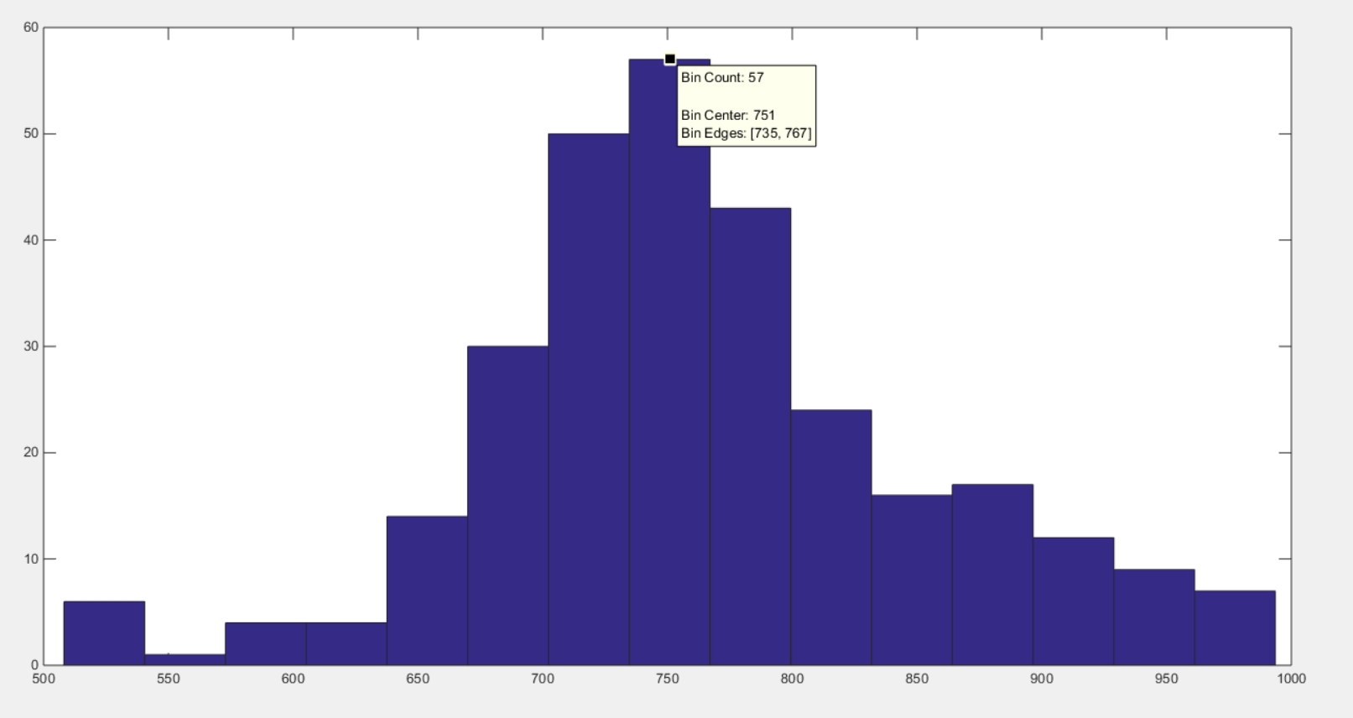
HV=900 V
Npe=751

Slide 6
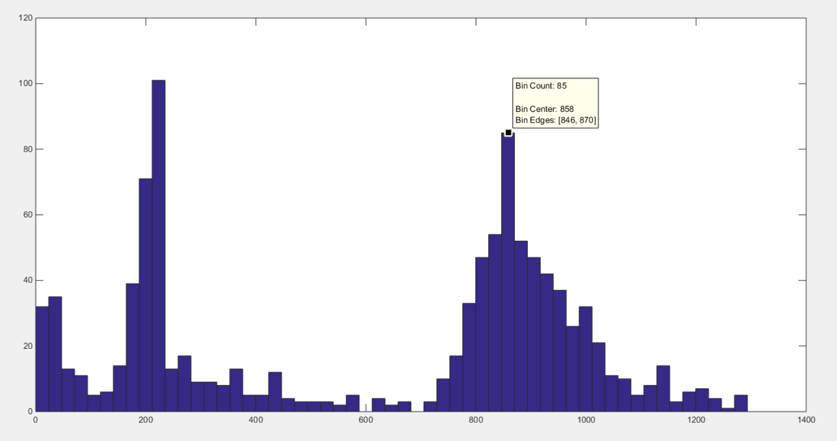
HV=800 V
Npe=858

Slide 7
Gain of PMT
 | THU PMT |  | SDU PMT
HV | hamamatsu | IHEP | SDU
800 |  |  | 0.527*10⁶
900 | 1.3*10⁶ |  | 1.295*10⁶
1000 | 3.1*10⁶ | 2.2*10⁶ | 2.9*10⁶
1050 |  |  | 4.11*10⁶
1100 | 6.5*10⁶ | 4.5*10⁶ | 5.997*10⁶
1200 | 13.3*10⁶ |  | 11.227*10⁶
1300 | 26.1*10⁶

Slide 8
Test results
The SDU PMT is also saturated at 900V
I have test under 700 V, we will calculate the result at 700V.

