Slide 1
fiber reflectivity test
Chendi Shen
2018.6.7

Slide 2
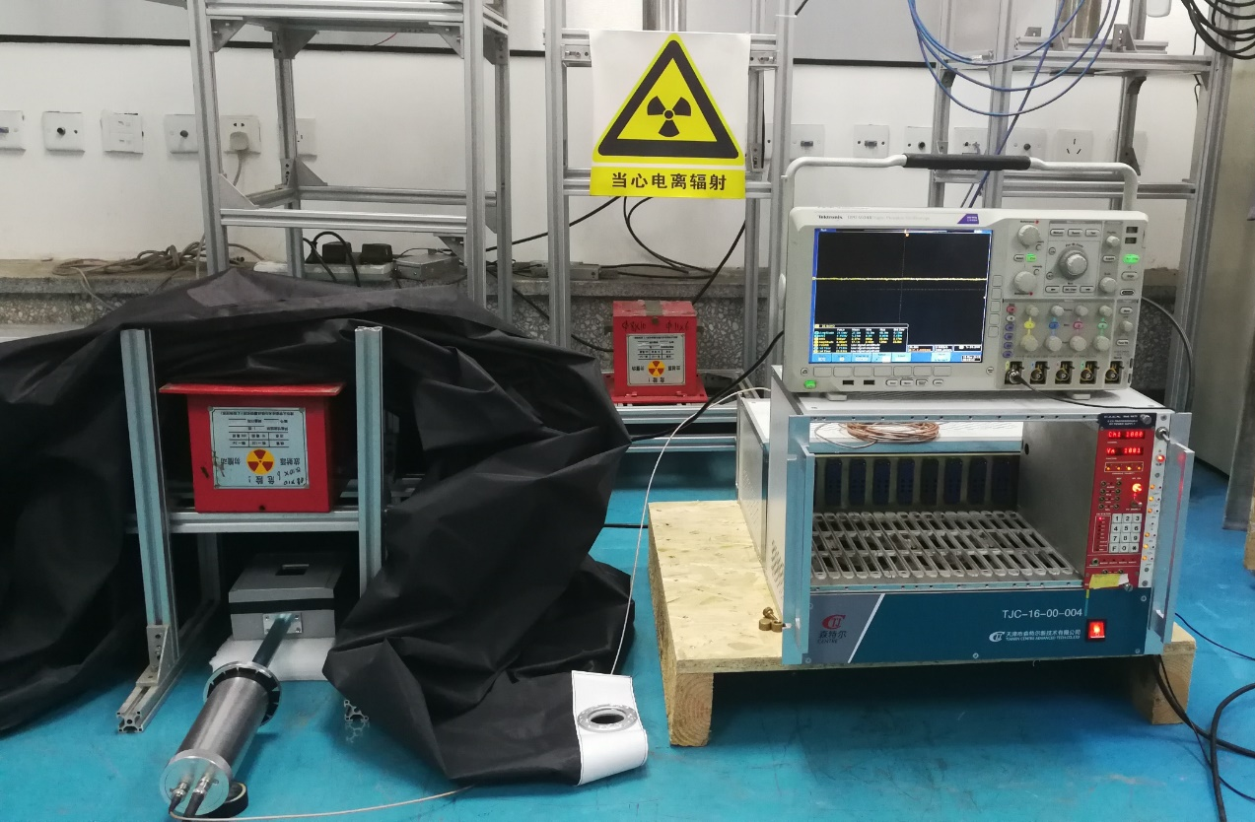
Silver shine 415001
Test setup
r source
16 WLSF
BCF91A
HV
PMT
MPD_Scintillator
6 layers
multimeter
Lead without powderpainting
r source
Test box
Test box

Slide 3
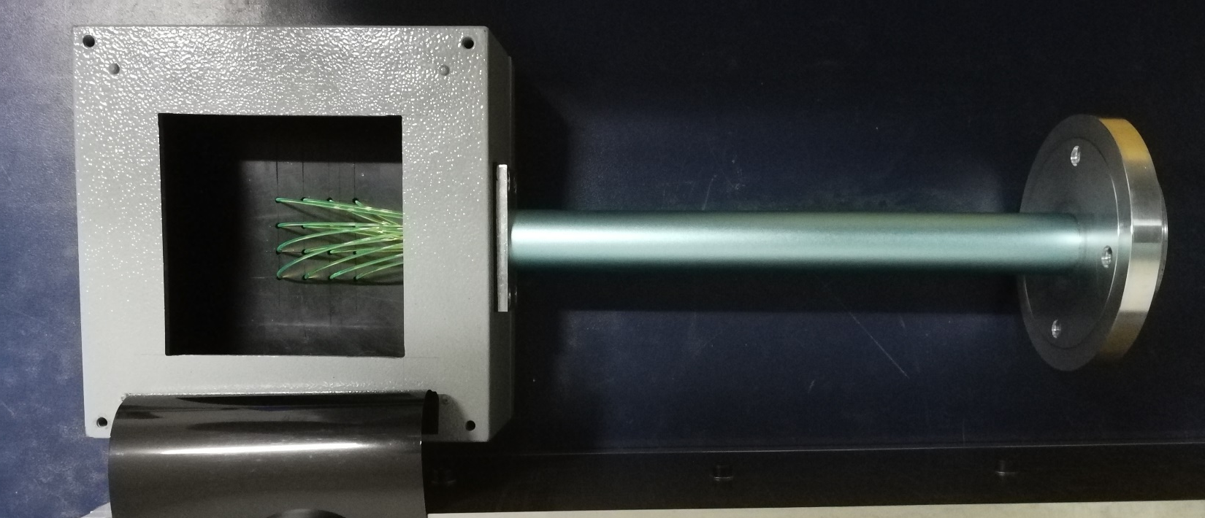
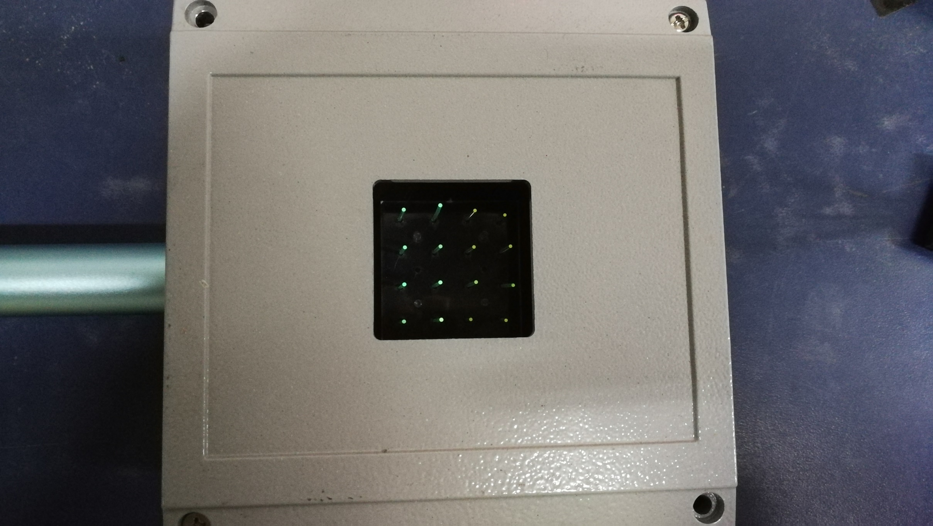
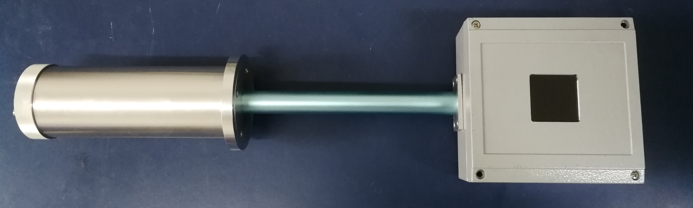
Test box

Slide 4
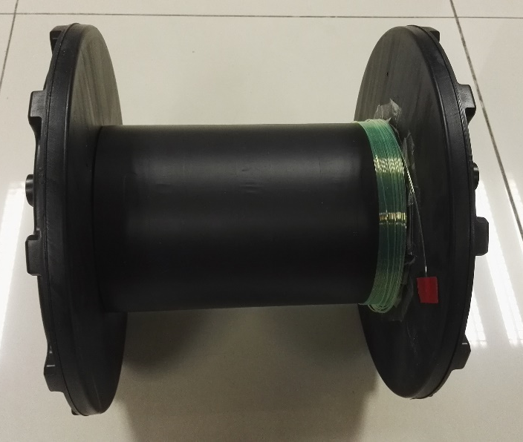
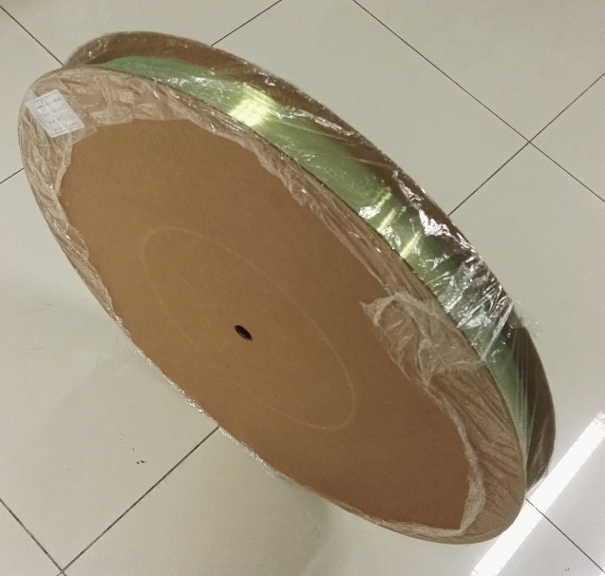
Test result
Previous test results
03/16/2017 Weekly meeting
 | BCF91A Npe | Y11 Npe
No mirror painting | 24 | 25
Silver 415001 | 34 | 33
improvement | 41.67% | 32%
 | BCF91A Voltage (mV)
No mirror painting | 640
Silver 415001 | 890
improvement | 39%
Y11
BCF91A

Slide 5
Next to do
β
Different reflective materials on the end of the fibers.
β
PMT
β
Silver shine or TiO₂
Different reflective materials between lead and scintillator
16 WLSF
Different scintillator
Scintillator
β
Lead
Reflective materials
β
scintillator
scintillator

