Slide 1

The Reflectivity Test of Different Material on Lead Plate Surfaces
Li Yulei
2018-09-27

Slide 2
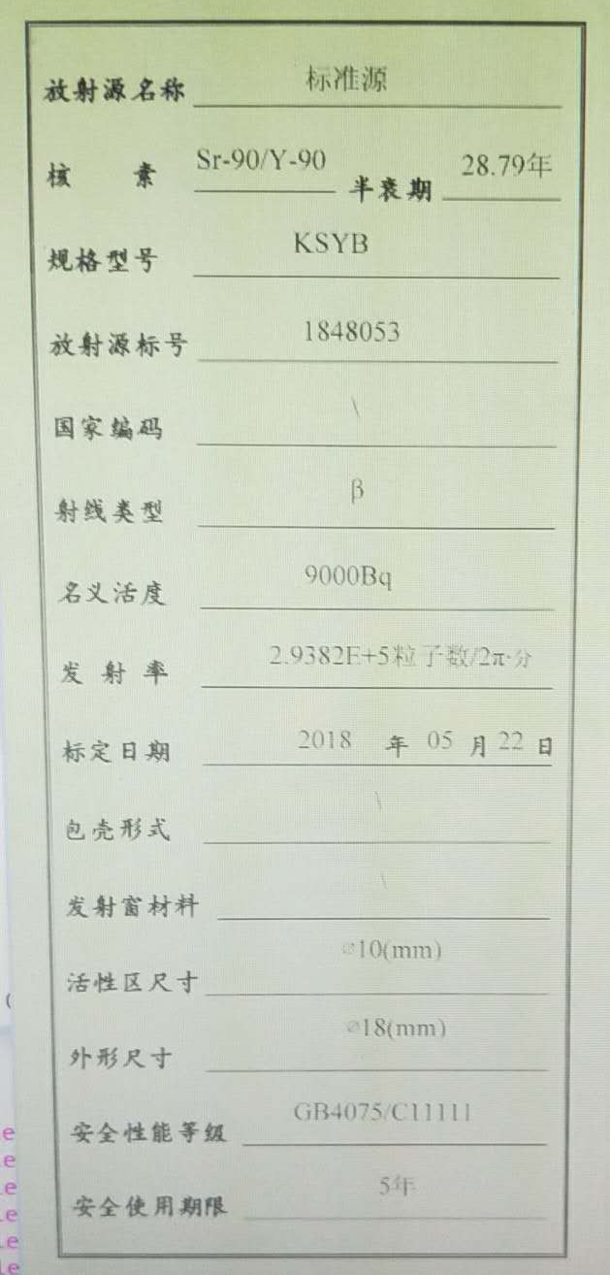

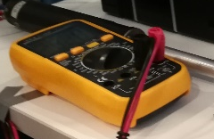
The Structure of Test
Lead
Reflective materials
HV Supply
Sr-90
β
scintillator
16 WLSF
PMT
Dark Box
V

Slide 3
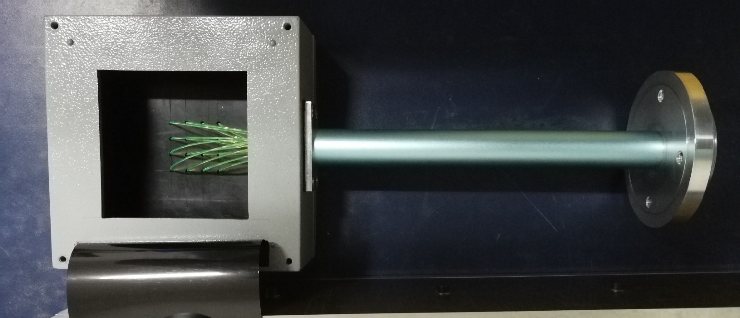
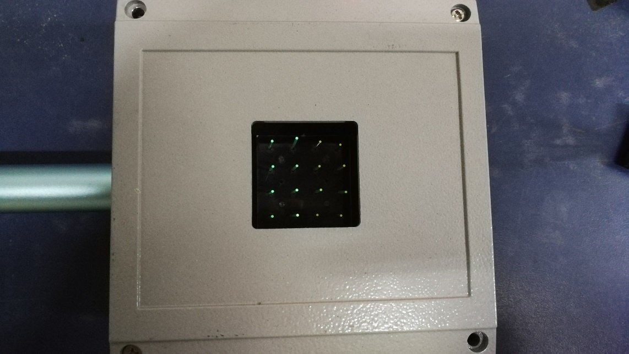
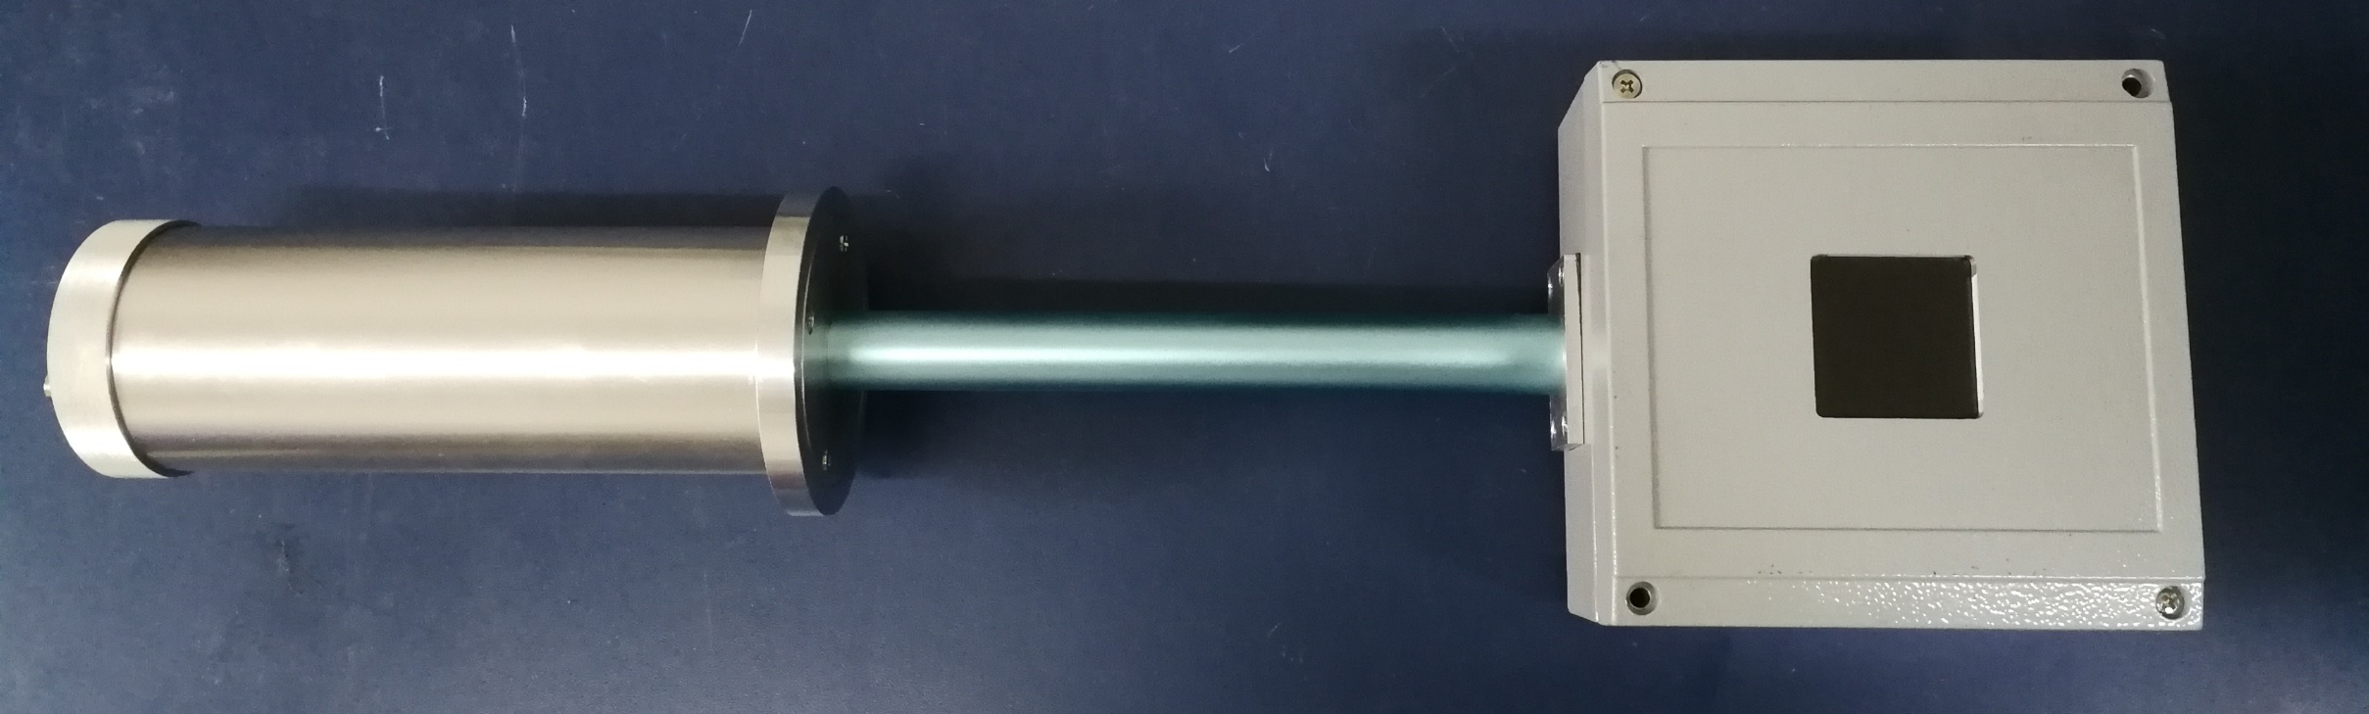
The Photo of Text Box
Dark Box
PMT
Tube

Slide 4
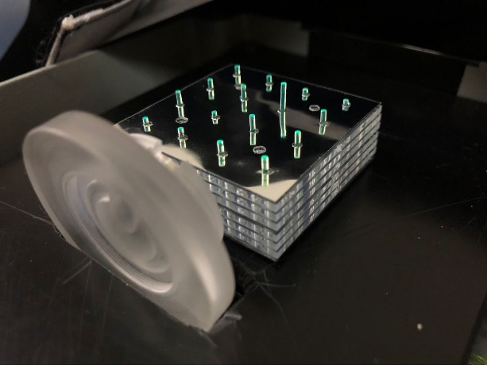
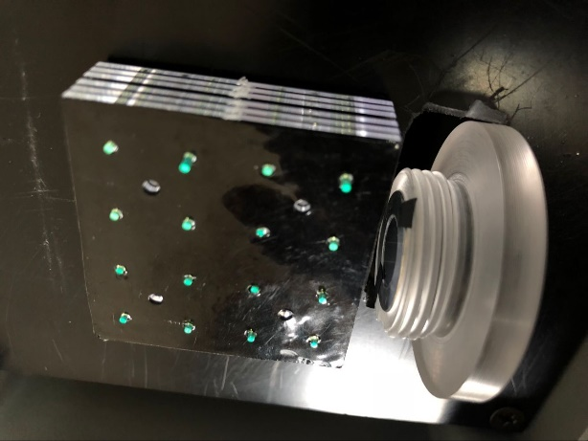
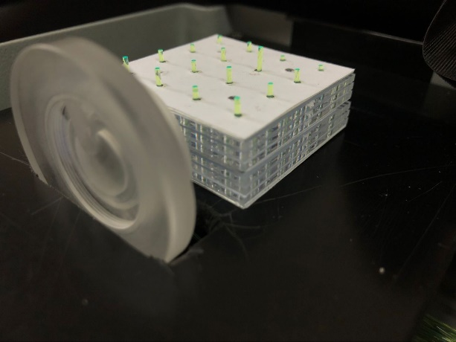
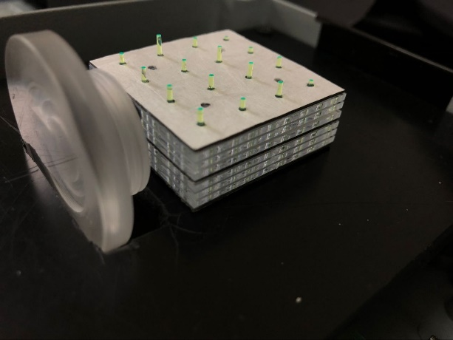
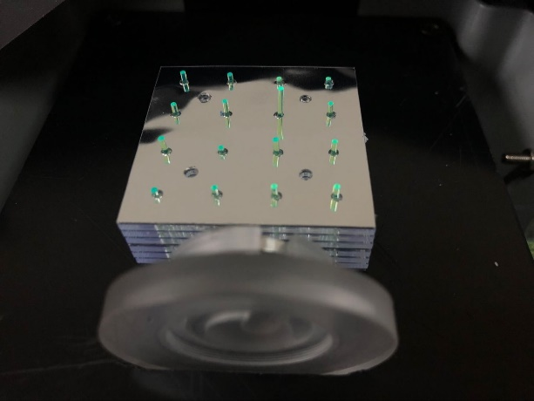
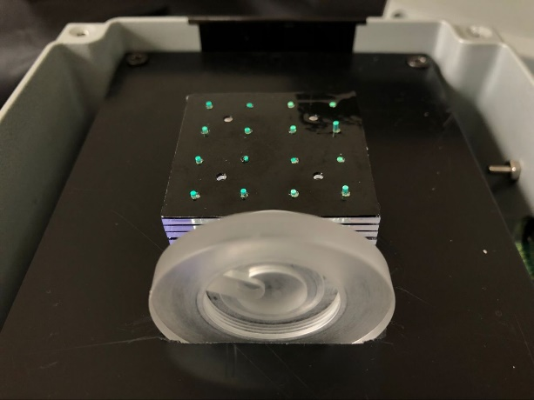
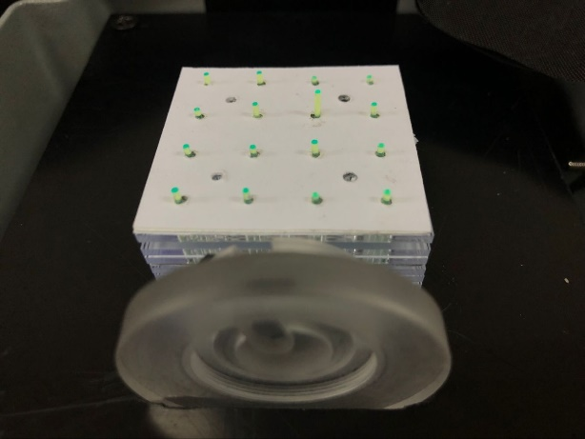
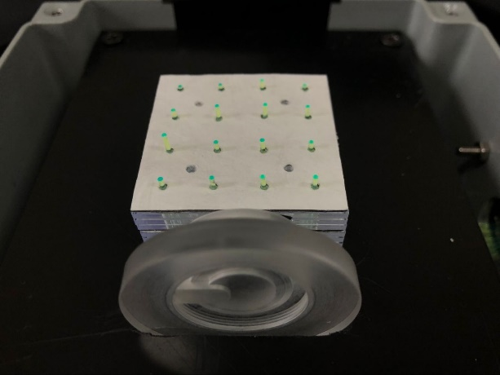
The photo of text with different materials
Sr-90

Slide 5
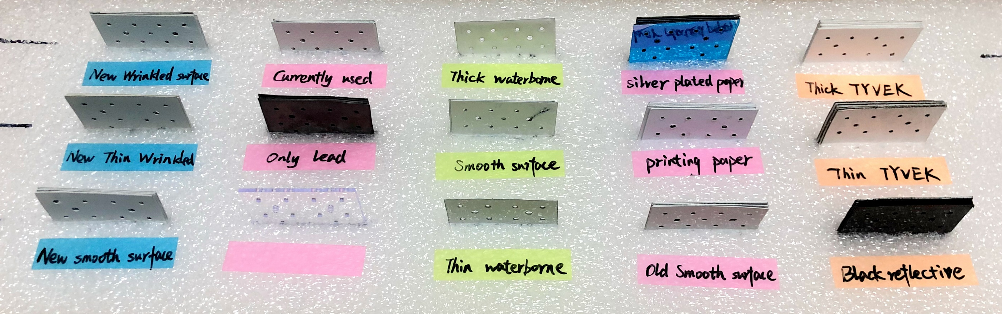
Reflective materials on lead plate from different factory

Slide 6
The Test Datas And Results
Nuclear Instruments and Methods in Physics Research A 584 (2008) 291–303
Material | VoltageU1(V) | Background voltageU2(V) | U1-U2(V) | Reflectivity | Thickness (μm) | Total thickness (mm)
Thick TYVEK | 0.54 | 0.045 | 0.495 | 0.870 | 544.5 | 1.389
Thin TYVEK | 0.5 | 0.045 | 0.455 | 0.800 | 181 | 0.662
New Wrinkled surface | 0.49 | 0.035 | 0.455 | 0.800 | 104 | 0.508
Smooth surface | 0.5 | 0.055 | 0.445 | 0.782 | 62 | 0.424
New smooth surface | 0.45 | 0.035 | 0.415 | 0.730 | 62.5 | 0.425
Print paper | 0.44 | 0.035 | 0.405 | 0.712 | 124 | 0.548
Old smooth surface | 0.45 | 0.045 | 0.405 | 0.712 | 61.5 | 0.423
Currently used | 0.45 | 0.045 | 0.405 | 0.712 | 81.5 | 0.463
Thin wrinkled surface | 0.43 | 0.035 | 0.395 | 0.695 | 70.5 | 0.441
Thin waterborne surface | 0.44 | 0.045 | 0.395 | 0.695 | 61 | 0.422
Thick waterborne surface | 0.43 | 0.035 | 0.395 | 0.695 | 116 | 0.532
Silver plated paper | 0.43 | 0.035 | 0.395 | 0.695 | 145 | 0.59
Only lead | 0.42 | 0.035 | 0.385 | 0.677 | 0 | 0.35
Black reflective surface | 0.42 | 0.045 | 0.375 | 0.659 | 137 | 0.574
Reference
Thickness×
Price×
THU3
THU2 SDU4

Slide 7
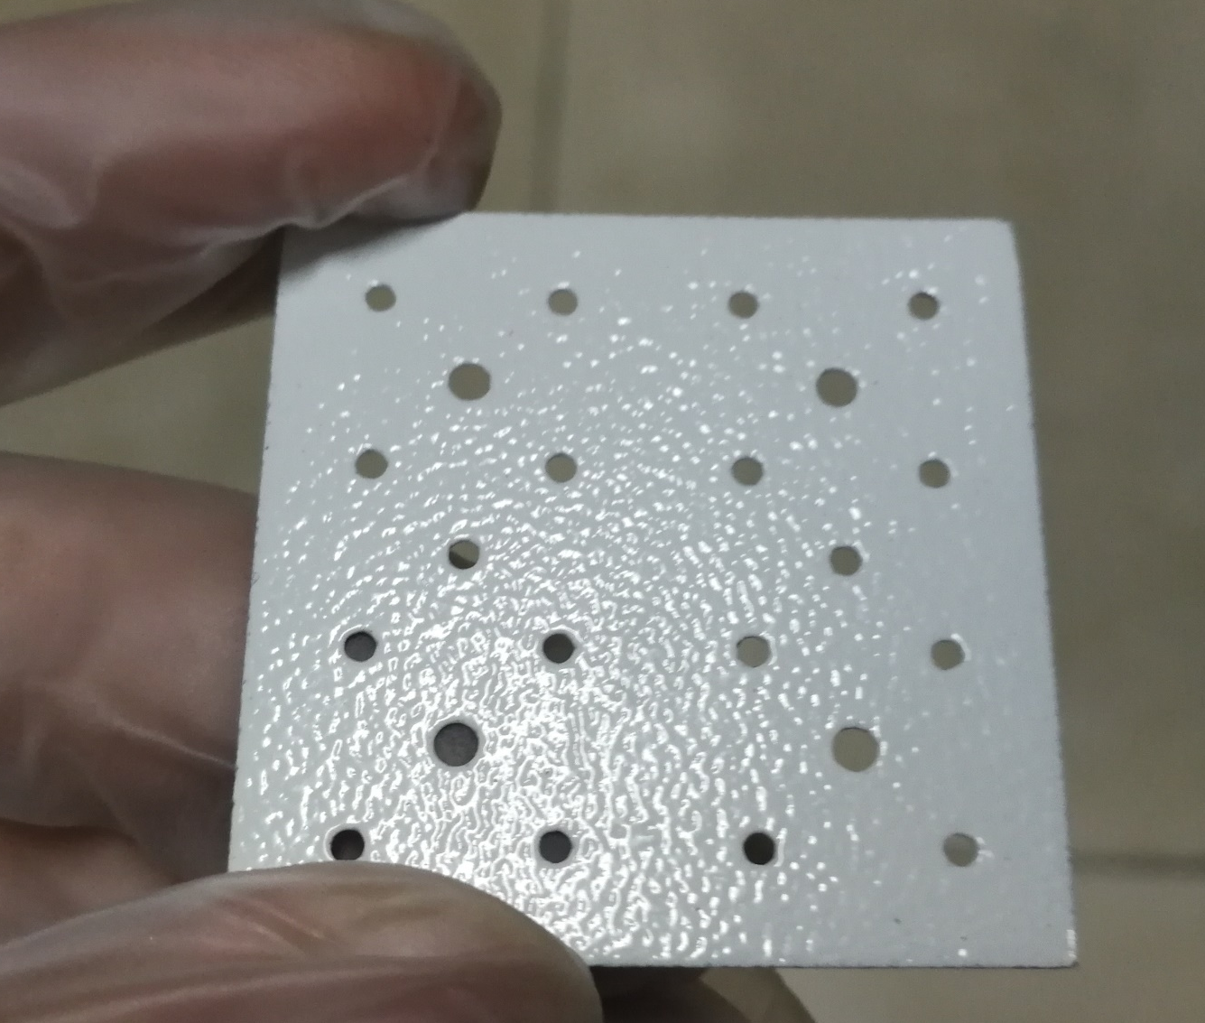
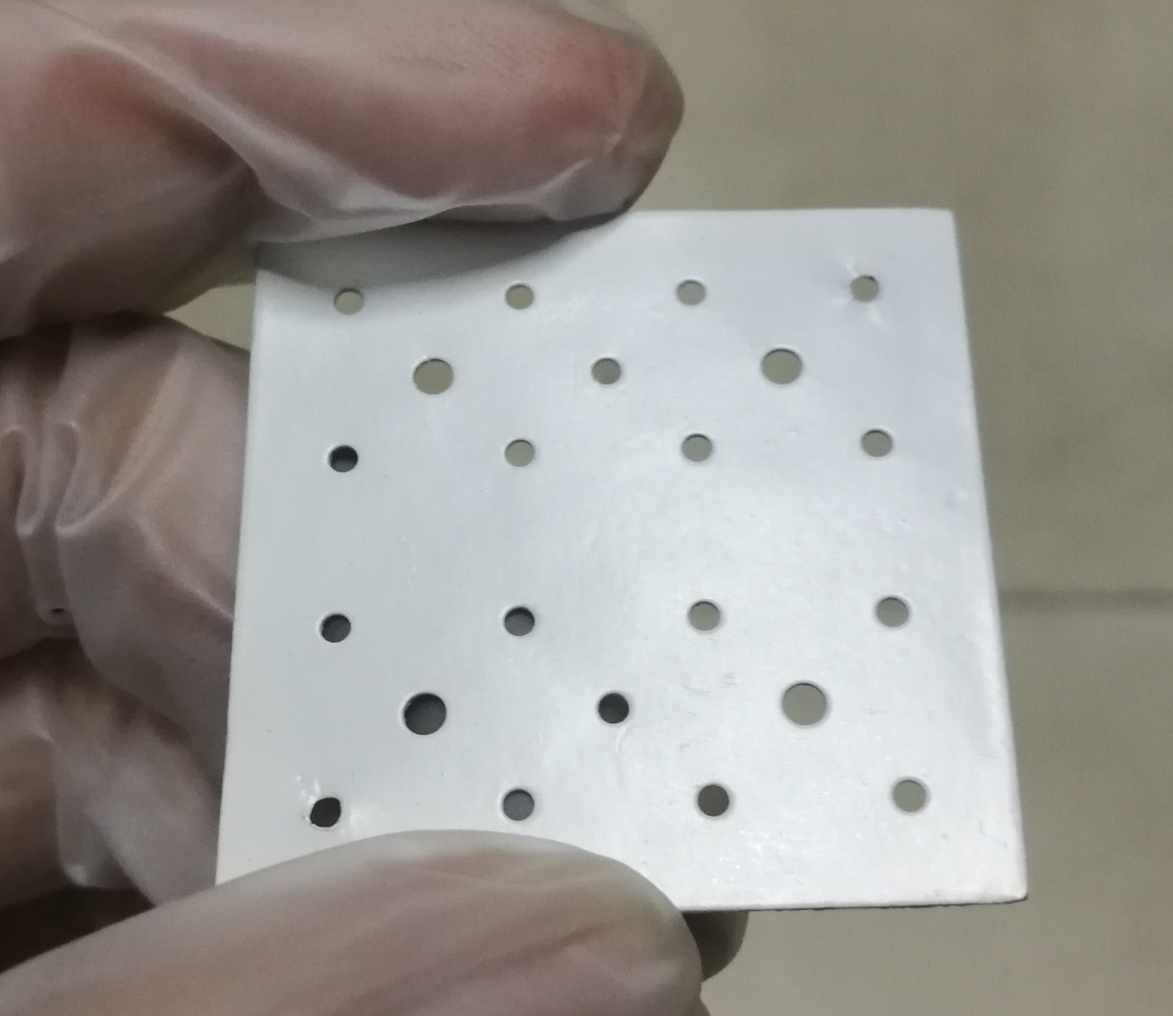
THU2 SDU4
THU3

